Slide 1



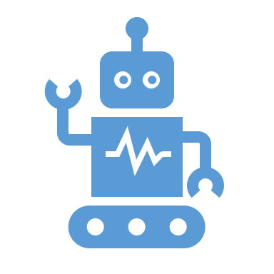

Lesson Learned: operationalization
Reproducible ML training : For debugging and auditability ML training should be reproducible.
Debugging and Diagnosis: Design and implement tools and process to debug, explain and diagnosis individual inference.
Pipeline Integration testing: Apply standard integration testing on end to end pipeline.
Model validation: Validate model quality after each retraining offline before using in production
Model Rollback: Design and implement model rollback procedures.

Slide 2
Technical challenges in operationalization
Pipeline for feature engineering does not match at time of training and inference
Multiple loosely coupled pipelines exist to get data from different sources. Many run in parallel
Pipelines have dependencies. Many dependencies include human intervention.
Jungle of SQL joins
Frameworks: Different framework and languages used e.g. Spark, Sci-kit learn, TensorFlow built using Python, R, Java.
Process : Multiple types of object involved – Code, Algorithm, Data, Trained Model, Metric. Each object type needs different process. Code can be handled thru SDLC and source control process.
Multiple instances: A/B test and ensemble model multiply the complexity
Culture: Data science (research) and production ops have different culture and expertise.

Slide 3
Lesson Learned: operationalization monitoring
Skewness: Design and implement methods to check skewness of data training vs inference.
Staleness : Monitor for model staleness. Alert if model quality is deteriorated.
Model validation: Validate model quality after each retraining offline before using in production

