Slide 1

浙江理工大学信息学院硕士学位论文开题答辩
基于自适应模糊Petri网的无人机自主防碰撞系统研究
Research on UAV Autonomous Collision Avoidance System Based on Adaptive Fuzzy Petri Net
学 生：唐文兵
导 师：丁佐华 教授
专 业：软件工程
2018年11月14日

Slide 2
目录
选题背景和研究意义
国内外研究现状
论文研究主要内容
方案及可行性分析
难点和创新点分析
进度计划安排
参考文献
基于自适应模糊Petri网的无人机自主防碰撞系统研究 1

Slide 3
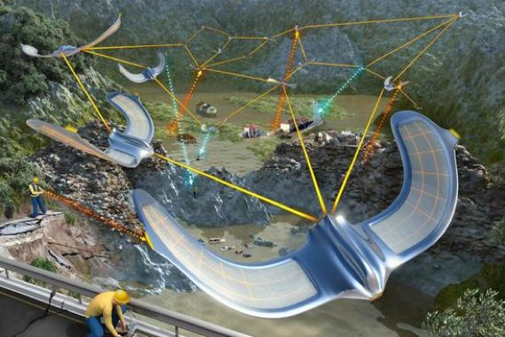
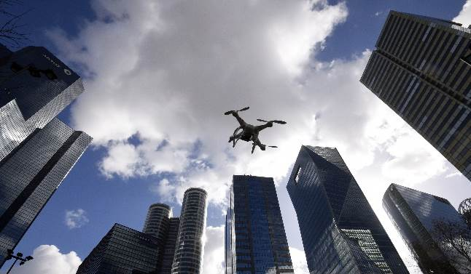

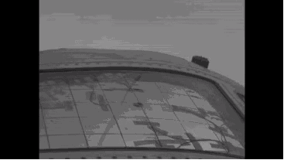
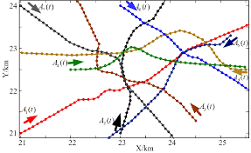
一、选题背景和研究意义(1)
Multi-UAV Cooperation
High-rise building
Formation of UAV
Collision
Conflict
基于自适应模糊Petri网的无人机自主防碰撞系统研究 2

Slide 4
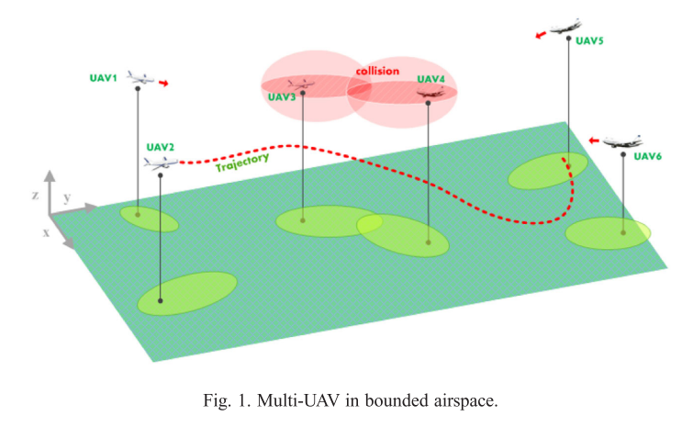
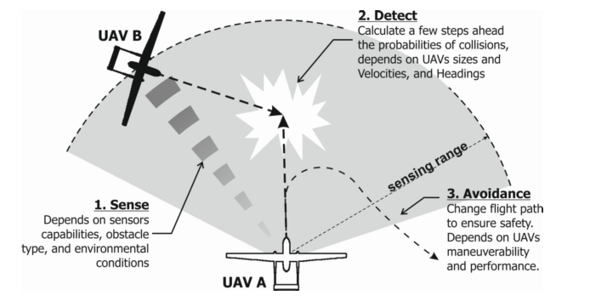
一、选题背景和研究意义(2)
——无人机自主防碰撞系统简介
A conflict is defined as the event in which the Euclidean distance between two agents is less than the minimum desired separation distance. (Albaker and Rahim 2010)
Autonomous Collision Avoidance System (ACAS) for UAVs (Mahjri, Dhraief, and Belghith 2013)
  Ensure the safety, especially to avoid every possible collision.
  Detecting conflicts and mapping all possible avoidance maneuvers automatically.
  Three fundamental functions:
    sensing function
    detection function
    resolution function
基于自适应模糊Petri网的无人机自主防碰撞系统研究 3

Slide 5
二、国内外研究现状(1)
Geometric Method
  geometric approach (Carbone et al. 2006) ( Park, Oh, and Tahk 2008)
  AFP(artificial potential field) approach(朱旭等 2014) (Chen et al. 2016)
Optimization Method
  mixed-integer nonlinear programming (Cafieri and Rey 2017)
  混合整数线性规划（李大东等 2010）
Velocity Obstacle Method
  selective velocity obstacle method ( Jenie et al. 2006)(David 2016)
  cooperative (Jenie, van Kampen, and Remes 2013)
  non-cooperative (Jenie et al. 2014)
MPC(Model Predictive Control)[Monte-Carlo,Markov decision process]
(Jilkov et al 2018) (Zhang, and Fu 2017) (周欢等 2014)
Intelligent Control Method
  fuzzy control(Fu et al. 2014) (Costa and De Oliveira 2012)
  neural network control(Chen et al. 2014)
以上这几个模型都需要精确的数学模型，针对复杂非线性系统控制是不现实的！
However, most of the papers do not consider sources of uncertainty to compute the trajectories, which could be very important in small UAVs.(Alejo et al. 2016)
基于自适应模糊Petri网的无人机自主防碰撞系统研究 4

Slide 6
二、国内外研究现状(2)
模糊逻辑为不确定性知识表示、推理提供了一条途径(但对于MIMO系统，模糊规则将变得非常多）(李德毅等 2004)
PNs have an inherent quality in representing logic in intuitive and visual way. (Li, 2000)
模糊Petri网(Fuzzy Petri Net, FPN) (Chen et al. 1990)
FPN=Fuzzy logic + Petri Nets
自适应模糊Petri网(Adaptive Fuzzy Petri Net, AFPN) (Li and Lara-Rosano 2000)
AFPN=Adaptive(Learning) function + FPN
但现有的研究主要集中在对AFPN的规则表达和参数的确定上，对于动态实时环境下如何确定AFPN的结构仍然没有理论指导。
基于自适应模糊Petri网的无人机自主防碰撞系统研究 5

Slide 7
三、论文研究主要内容
1
设计结构可变的AFPN
实时决策系统应该能动态适应模糊知识的更新。
传统的AFPN的结构是不变的，“自适应”指的是参数的“学习”。
2
选取(设计)用于结构可变AFPN的学习算法
经典的AFPN参数学习算法可能会“陷入”局部极小。
针对动态模糊神经网络(DFNN)、结构可变的模糊神经网络等的结构自适应算法不能直接用到AFPN上。
3
将结构可变的AFPN用于ACAS
结构可变的AFPN适用于无人机自主防碰撞系统。
4
处理不确定性，保证控制过程的实时性
ACAS需要处理诸多不确定性。
ACAS对实时性的苛刻需求。
基于自适应模糊Petri网的无人机自主防碰撞系统研究 6

Slide 8
四、方案及可行性分析(1)
——AFPN结构自适应方案
AFPN training
经典的AFPN构建、学习过程
专家经验
系统日志
Weighted fuzzy production rules
System model
AFPN
拟采用的规则产生(增加)准则和规则剪枝(删除)准则
规则增减准则
系统误差是衡量一个系统泛化能力的主要指标。(伍世虔, 2008)
当系统误差超过某一阈值时，则考虑增加一条新的规则。
规则剪枝准则
灵敏度计算(通过检测各连接权对全局目标函数的敏感度)
最小权值(当连接权小于某个阈值时，考虑删除该连接权)
影响因子(通过计算某个Translation对输出的影响)
基于自适应模糊Petri网的无人机自主防碰撞系统研究 7

Slide 9
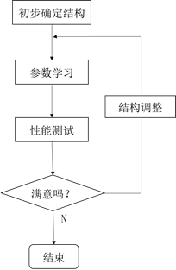
四、方案及可行性分析(2)
——结构自适应AFPN学习算法
动态模糊神经网络学习过程
对于实时控制系统，如果采用类似于DFNN的学习过程，很难满足实时性的要求。(Qiu 2016)
拟采用的结构自适应AFPN学习算法
增量学习
增量学习(Incremental Learning) 能不断地从新样本中学习新的知识，并能保存大部分以前已经学习到的知识。
如自组织增量学习神经网络(Self-Organizing Incremental Neural Network, SOINN) (Shen et al. 2007)
基于自适应模糊Petri网的无人机自主防碰撞系统研究 8

Slide 10
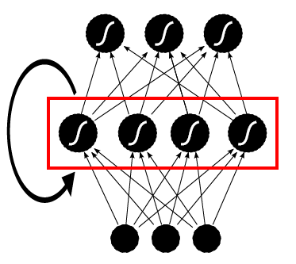
四、方案及可行性分析(3)
——对不确定性的处理
拟开发具有“记忆”能力的AFPN
其他飞行器的意图(方向、速度)不确定
无人机飞行过程中惯性的影响
拟开发具有“记忆”能力的AFPN,综合历史状况对现在的影响并处理不确定性。
上一时刻控制指令(1个place)
环境状态(计划5个place)
运动意图(1个place)
基于自适应模糊Petri网的无人机自主防碰撞系统研究 9

Slide 11
五、创新点和重难点分析
创新点
考虑并处理AFPN的结构不确定性；
考虑将增量学习的思想引入结构自适应的AFPN中；
将结构自适应的AFPN用于处理无人机自主防碰撞问题；
考虑具有“记忆”能力的结构自适应AFPN控制模型。
重难点
对不确定性的处理；
如何实现AFPN结构自适应（关键）；
如何保证严格的实时性；
保证实验安全。
基于自适应模糊Petri网的无人机自主防碰撞系统研究 10

Slide 12
六、进度计划安排
确定主体研究方向
掌握相关理论知识
设计实验方案完成相关实验
整理参考文献撰写毕业论文
2018.11
2019.8
2019.10
2019.4
2019.9
完成模型的建立
确定参数辨识方法
分析实验结果评估模型性能
基于自适应模糊Petri网的无人机自主防碰撞系统研究 11

Slide 13
参考文献（1）
周欢, 魏瑞轩, 崔军辉,等. 面向不确定性环境的多无人机协同防碰撞[J]. 电光与控制, 2014, 21(1):91-96.
魏瑞轩, 许卓凡, 张启瑞,等. 无人机自主防碰撞控制技术新进展[J]. 科技导报, 2017, 35(7):64-68.
刘慧颖, 白存儒, 杨广珺. 无人机自主防撞关键技术与应用分析[J]. 航空工程进展, 2014, 5(2):141-147.
金远先, 李文光, 谢文苗. 基于人工势场法的无人机编队控制[C]// IEEE GNCC. 2014:463-467.
朱旭, 闫茂德, 张昌利,等. 基于改进人工势场的无人机编队防碰撞控制方法[J]. 哈尔滨工程大学学报, 2017, 38(6):961-968.
周绍磊, 祁亚辉, 张文广,等. 考虑内部避碰的无人机编队控制研究[J]. 战术导弹技术, 2016(6):94-98.
李大东, 孙秀霞, 孙彪,等. 基于混合整数线性规划的无人机任务规划[J]. 飞行力学, 2010, 28(5):88-91.
谭雁英, 童明, 张艳宁,等. 基于加权模糊Petri网的无人机自主任务推理决策研究[J]. 西北工业大学学报, 2016, 34(6):951-956.
袁浩川, 叶霖. 基于模糊petri网的无人机动力装置故障诊断研究[C]// 管理科学与工程学会2016年年会. 2016.
伍世虔, 徐军. 动态模糊神经网络[M]. 清华大学出版社, 2008.
李丹婷. 基于RNN模型的工业机器人故障可跟踪预测方法[J]. 计算机与网络, 2018(2).
Albaker B M, Rahim N A. Unmanned aircraft collision detection and resolution: Concept and survey[C]// IEEE Conference on Industrial Electronics and Applications. IEEE, 2010:248-253.
Kuchar J K, Yang L C. A review of conflict detection and resolution modeling methods[J]. IEEE Transactions on Intelligent Transportation Systems , 2000, 1(4):179-189.
Albaker B M, Rahim N A. A survey of collision avoidance approaches for unmanned aerial vehicles[C]// Technical Postgraduates. IEEE, 2010:1-7.
基于自适应模糊Petri网的无人机自主防碰撞系统研究 12

Slide 14
参考文献（2）
Jilkov, Vesselin P.; LEDET, Jeffrey H.; LI, X. Rong. Multiple model method for aircraft conflict detection and resolution in intent and weather uncertainty. IEEE Transactions on Aerospace and Electronic Systems, 2018.
Alejo, David, et al. An efficient method for multi-UAV conflict detection and resolution under uncertainties. In: Robot 2015: Second Iberian Robotics Conference. Springer, Cham, 2016. p. 635-647.
Albaker, B. M., & Rahim, N. A. (2011). A conceptual framework and a review of conflict sensing, detection, awareness and escape maneuvering methods for UAVs. In Aeronautics and Astronautics. InTech.
Park J W, Oh H D, Tahk M J. UAV collision avoidance based on geometric approach[C]// Sice Conference. IEEE, 2008:2122-2126.
Carbone, C., et al. A novel 3D geometric algorithm for aircraft autonomous collision avoidance. In: Decision and Control, 2006 45th IEEE Conference on. IEEE, 2006. p. 1580-1585.
Geser A, Munoz C. A geometric approach to strategic conflict detection and resolution [ATC][C]// Digital Avionics Systems Conference, 2002. Proceedings. the. IEEE, 2002:6B1-1-6B1-11 vol.1.
Goss, Jennifer; Rajvanshi, Rahul; Subbarao, Kamesh. Aircraft conflict detection and resolution using mixed geometric and collision cone approaches. In: AIAA Guidance, Navigation, and Control Conference and Exhibit. 2004. p. 4879.
Khatib O. Real-Time Obstacle Avoidance for Manipulators and Mobile Robots[J]. International Journal of Robotics Research, 1986, 5(1):90-98.
Park M G, Jeon J H, Lee M C. Obstacle avoidance for mobile robots using artificial potential field approach with simulated annealing[C]//Industrial Electronics, 2001. Proceedings. ISIE 2001. IEEE International Symposium on. IEEE, 2001, 3: 1530-1535.
基于自适应模糊Petri网的无人机自主防碰撞系统研究 13

Slide 15
参考文献（3）
Chen Y, Luo G, Mei Y, et al. UAV path planning using artificial potential field method updated by optimal control theory[J]. International Journal of Systems Science, 2016, 47(6): 1407-1420.
Cafieri S, Rey D. Maximizing the number of conflict-free aircraft using mixed-integer nonlinear programming[J]. Computers & Operations Research, 2017, 80:147-158.
Fiorini P, Shiller Z. Motion planning in dynamic environments using velocity obstacles[J]. The International Journal of Robotics Research, 1998, 17(7): 760-772.
Jenie Y I, Kampen E J V, Remes B. Cooperative Autonomous Collision Avoidance System for Unmanned Aerial Vehicle[J]. 2013:387-405.
Jenie Y I, Kampen E J V, Visser C C D, et al. Selective Velocity Obstacle Method for Deconflicting Maneuvers Applied to Unmanned Aerial Vehicles[J]. Journal of Guidance Control & Dynamics, 2015, 38(6):1-6.
Jenie Y I, Van Kampen E J, de Visser C C, et al. Velocity obstacle method for non-cooperative autonomous collision avoidance system for UAVs[C]//AIAA Guidance, Navigation, and Control Conference. 2014: 1472.
Richards A, How J P. Decentralized Model Predictive Control of Cooperating UAVs [J]. 2004, 4(4):4286 - 4291 Vol.4.
Fu C, Olivares-Mendez M A, Suarez-Fernandez R, et al. Monocular Visual-Inertial SLAM-Based Collision Avoidance Strategy for Fail-Safe UAV Using Fuzzy Logic Controllers[J]. Journal of Intelligent & Robotic Systems, 2014, 73(1-4):513-533.
Chen M Q. Flight Conflict Detection and Resolution Based on Neural Network[C]// International Conference on Computational and Information Sciences. IEEE, 2011:860-862.
基于自适应模糊Petri网的无人机自主防碰撞系统研究 14

Slide 16
参考文献（4）
Salt L, Howard D. Self-Adaptive Differential Evolution for Bio-Inspired Neuromorphic Collision Avoidance[J]. 2017.
Zhang Y, Zhang Y, Wen F, et al. A fuzzy Petri net based approach for fault diagnosis in power systems considering temporal constraints[J]. International Journal of Electrical Power & Energy Systems, 2016, 78(6):215-224.
Yeung D S, Ysang E C C. A multilevel weighted fuzzy reasoning algorithm for expert systems[J]. IEEE Transactions on Systems Man and Cybernetics - Part A Systems and Humans, 1998, 28(2):149-158.
Li X, Lara-Rosano F. Adaptive fuzzy petri nets for dynamic knowledge representation and inference[J]. Expert Systems with Applications, 2000, 19(3):235-241.
Li X, Yu W, Lara-Rosano F. Dynamic knowledge inference and learning under adaptive fuzzy Petri net framework[J]. IEEE Transactions on Systems Man & Cybernetics Part C, 2000, 30(4):442-450.
Lundell M, Tang J, Nygard K. Fuzzy petri net for UAV decision making[C]// International Conference on Collaborative Technologies and Systems. IEEE Computer Society, 2005:347-352.
Zhao Z, Zhou R, Chi P. UAV Intelligent Decision Method Based on Fuzzy Reasoning Petri Net[J]. Ordnance Industry Automation, 2015.
Baldoni P D, Yang Y, Kim S Y. Development of Efficient Obstacle Avoidance for a Mobile Robot Using Fuzzy Petri Nets[C]//Information Reuse and Integration (IRI), 2016 IEEE 17th International Conference on. IEEE, 2016: 265-269.
Liu J. Knowledge representation and reasoning for flight control system based on weighted fuzzy Petri nets[C]// International Conference on Computer Science and Education. IEEE, 2010:528-534.
基于自适应模糊Petri网的无人机自主防碰撞系统研究 15

Slide 17
参考文献（5）
Wu S, Er M J. Dynamic fuzzy neural networks-a novel approach to function approximation[J]. IEEE Transactions on Systems, Man, and Cybernetics, Part B (Cybernetics), 2000, 30(2): 358-364.
Carpenter G A, Grossberg S. The ART of adaptive pattern recognition by a self-organizing neural network[J]. Computer, 1988, 21(3): 77-88.
Fahlman S E, Lebiere C. The cascade-correlation learning architecture[C]//Advances in neural information processing systems. 1990: 524-532.
Huanyao Q. The reserch of variable structure fuzzy neural network control system[C]//Online Analysis and Computing Science (ICOACS), IEEE International Conference of. IEEE, 2016: 273-276.
Schlimmer J C, Granger R H. Incremental Learning from Noisy Data.[J]. Machine Learning, 1986, 1(3):317-354.
Furao S , Ogura T , Hasegawa O . An enhanced self-organizing incremental neural network for online unsupervised learning[J]. Neural Networks the Official Journal of the International Neural Network Society, 2007, 20(8):893-903.
Zhou Y, HU HS L. A real-time and fully distributed approach to motion planning for multirobot systems[J]. IEEE Transactions on Systems, Man, and Cybernetics: Systems, 2017.
基于自适应模糊Petri网的无人机自主防碰撞系统研究 16

Slide 18


唐文兵
wenbingtang@hotmail.com
https://kreattang.github.io/

