Slide 1
Guide for working with APIs in DW3000 Arduino Shield
Aug. 2020

Slide 2
Overview
This document is to provide a way of starting a DW3000 Arduino Shield. It includes a PC application to run, an API example to build on an IDE tool. It can be utilized for starting to build an user application on a target micro-controller board.
Because it does not cover each of details, please refer to the reference documents for more details.
Run a DecaRanging PC app for a DW3110 shield on a Nucleo
Build an API example code
Setup an AC6 tools
Connect and debug via OpenOCD and GDB
Run an API example on a target Nucleo board
Test

Slide 3
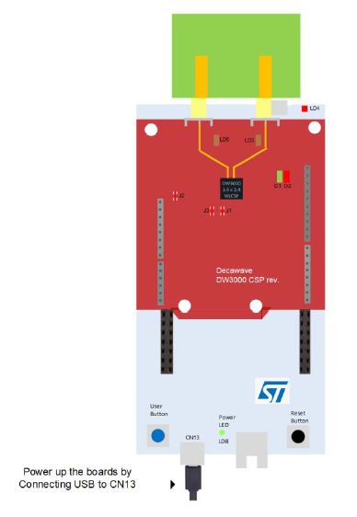
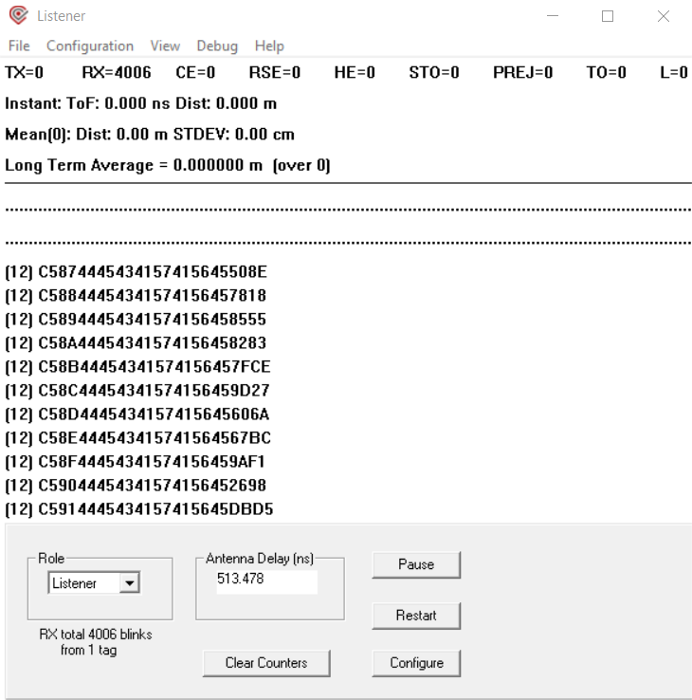
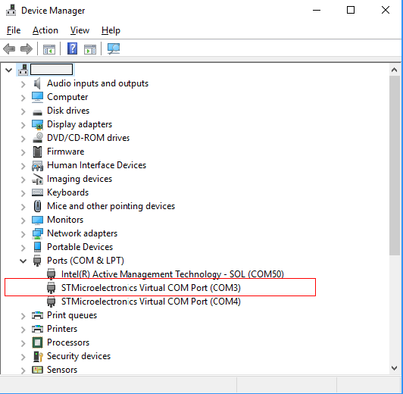
1. Run a DecaRanging PC app for a DW3110 shield on a Nucleo
It is a Windows PC application enables DW3000 capabilities. It can be used for testing with various UWB config and mode. Refer to [1] and [2].
Prepare a MicroUSB data cable
Install STM VCOM driver (https://www.st.com/en/development-tools/stsw-stm32102.html)
Connect to a STM32 Nucleo board (USB port in bottom side)
Execute ‘DecaRanging.exe’ from your Windows PC
a.i
a.ii
b

Slide 4
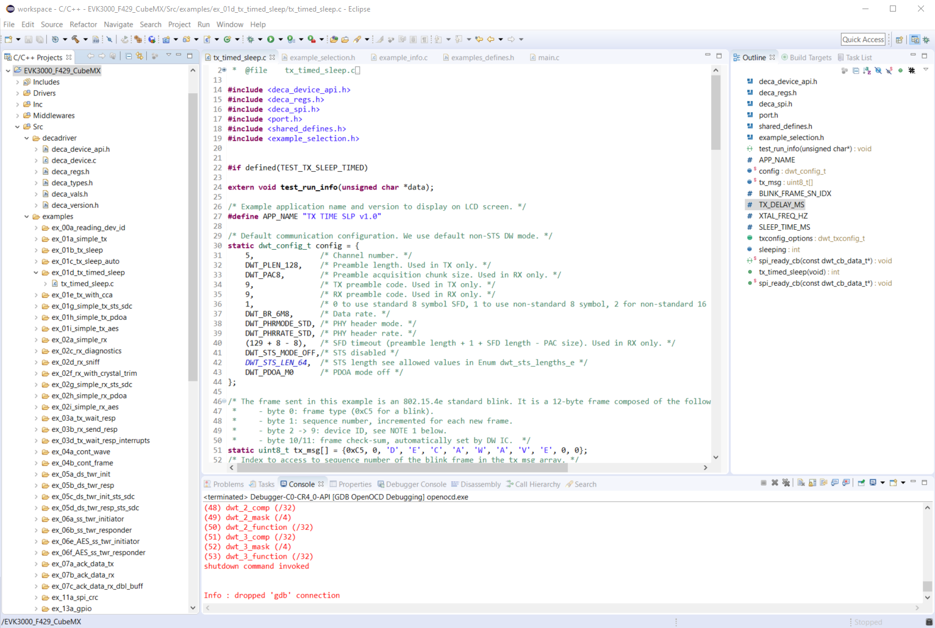
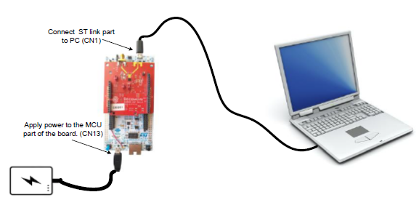
2. Build an API example code (1 of 4)
It provides an API guide to device driver software for exercising features of DW3000 IC though SPI interface. Refer to [3]. This example covers for STM32F429ZI Nucleo.
Setup an AC6 tools
Install a Eclipse-based IDE (System Workbench for STM32)
Prepare another MicroUSB data cable and connect to top USB port in STM32 Nucleo (install a driver if needed)
Install GNU toolchain
Make an empty directory (example, C:/GnuToolsArmForEmbedded) then, install here
GNU Arm Embedded Toolchain
Q2 Update
NOTE: Do not place space, special char in the path of the source code + GNU toolchain folders
STLink Virtual COM Port
Virtual COM Port
a
Both VCOM ports can be recognised from your PC

Slide 5
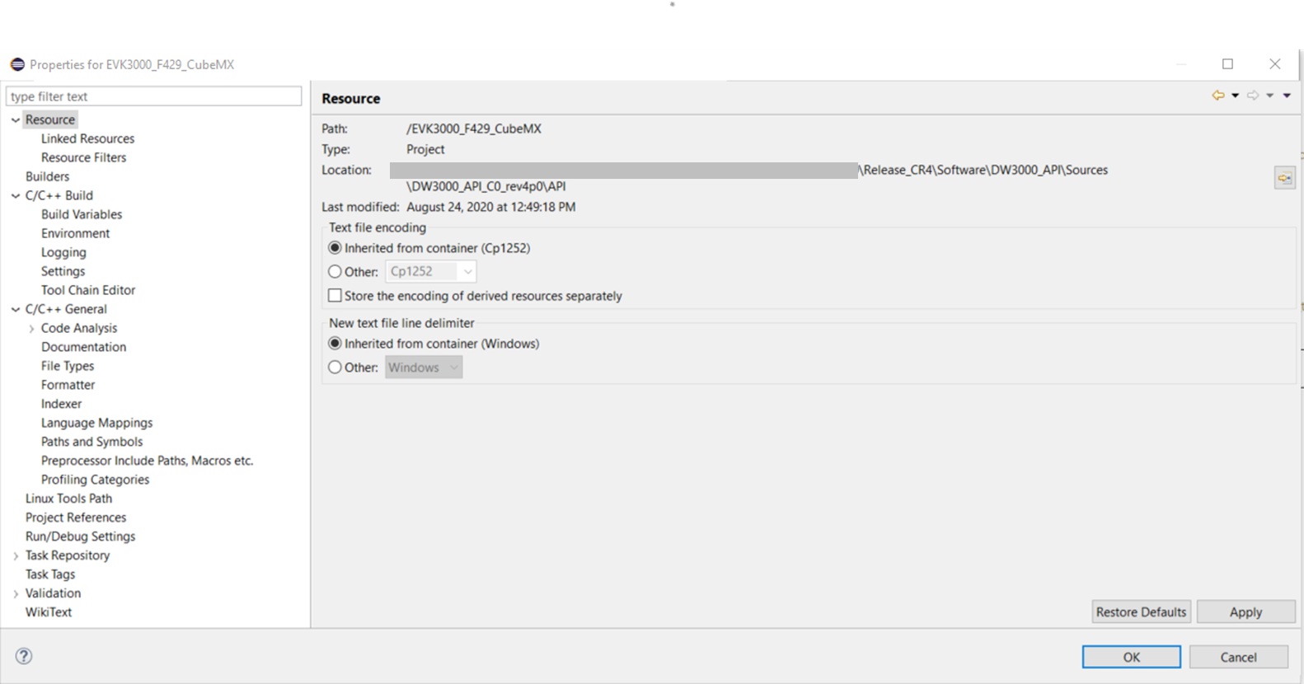
2. Build an API example code (2 of 4)
Place source code where there are no special char and spaces
Import an existing project
Setup IDE for a project: import > General > Existing Projects into Workspace
Select root directory: path in your source code for API (example in the below)
Check ‘NUCLEO_F429.cfg’ file is under the project folder, then Build a project
NUCLEO_F429.cfg
Config for NUCLEO-F429ZI board with a single STM32F429ZITx chip generated by System Workbench for STM32
Example view: property of project

Slide 6
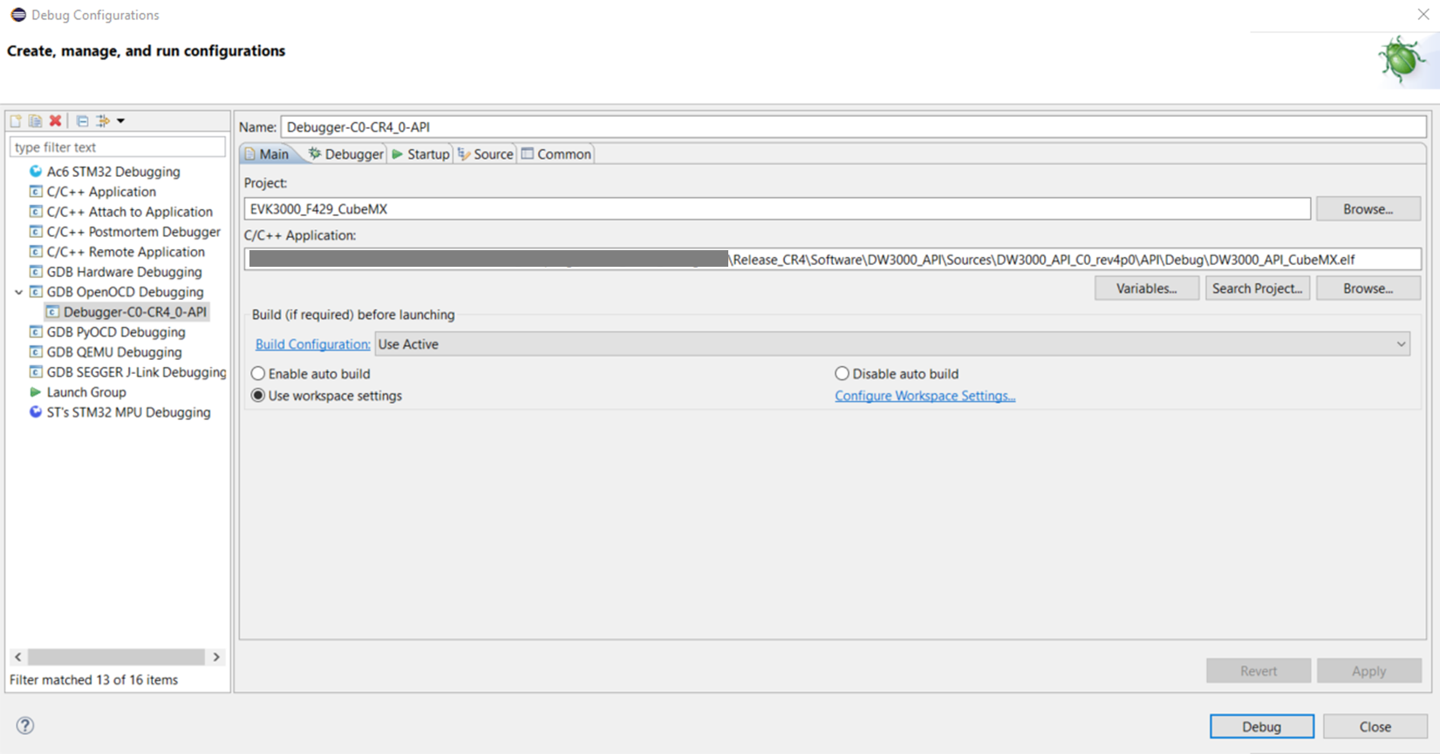
2. Build an API example code (3 of 4)
Create OpenOCD Debugging
Run > Debug Configurations > Create config: double-click GDB OpenOCD Debugging
2
If you don’t have GDB Plug-in, install ‘GNU ARM C/C++ OpenOCD Debugging’
https://gnu-mcu-eclipse.github.io/debug/install/
Make name
Browse your project
Find application file (Debug folder in this project)
3
4
1

Slide 7
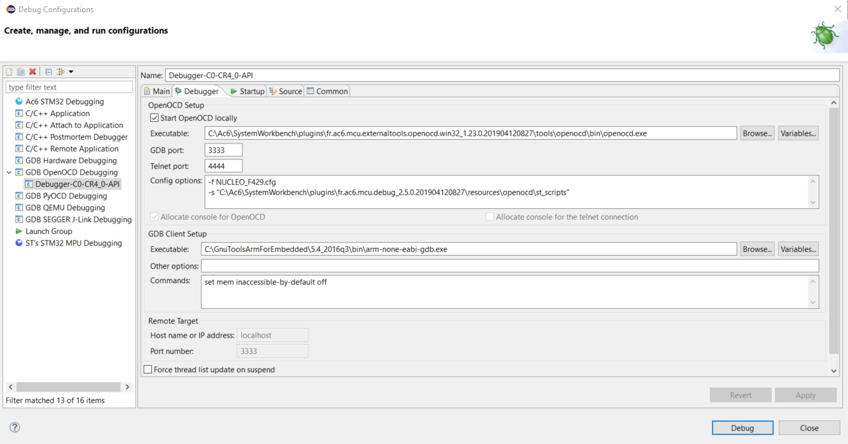
2. Build an API example code (3 of 4)
Setup Debugger
Find OpenOCD executable
C:\Ac6\SystemWorkbench\plugins\fr.ac6.mcu.externaltools.openocd.win32_1.23.0.201904120827\tools\openocd\bin\openocd.exe
Config options
-f NUCLEO_F429.cfg -s "C:\Ac6\SystemWorkbench\plugins\fr.ac6.mcu.debug_2.5.0.201904120827\resources\openocd\st_scripts"
Find GDB executable
C:\GnuToolsArmForEmbedded\5.4_2016q3\bin\arm-none-eabi-gdb.exe
1
2
3

Slide 8
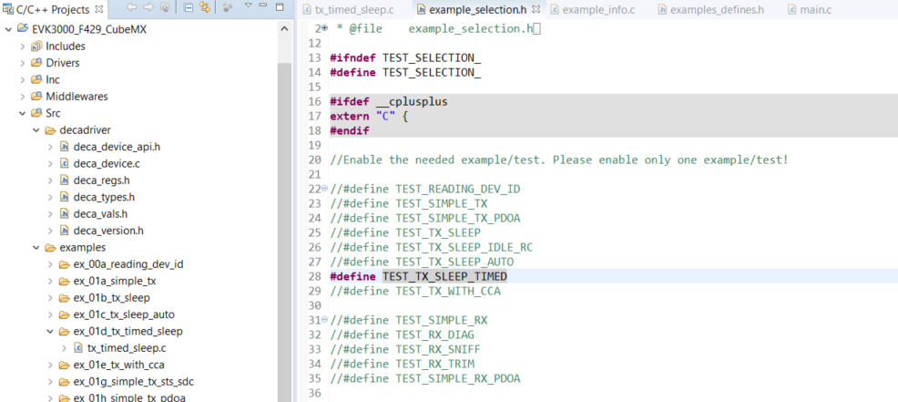
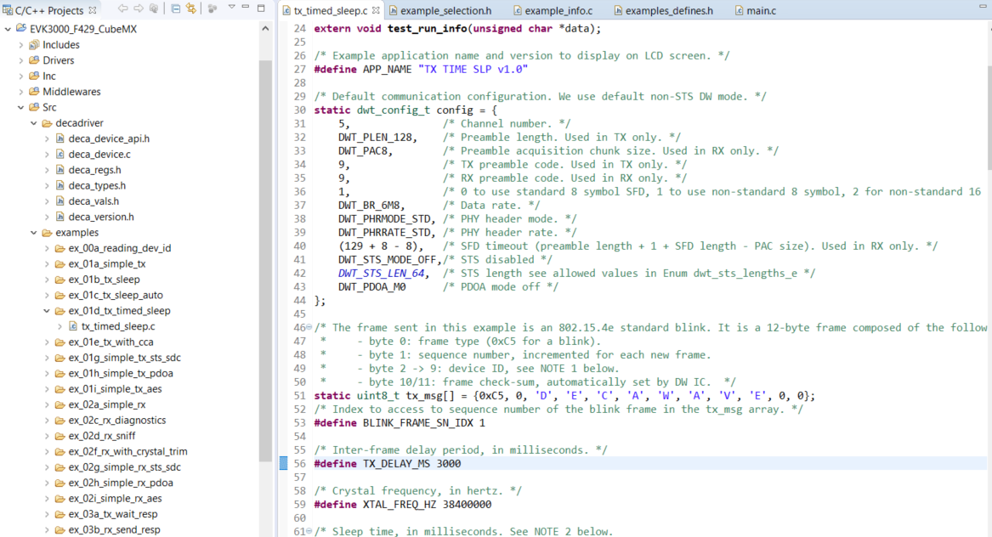
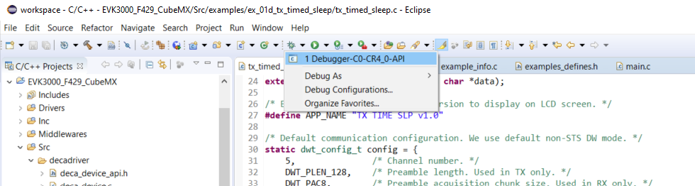
2. Build an API example code (4 of 4)
Build a code and run/debug
1. Select an example: TX_SLEEP_TIMED
2. Modify UWB config and blink interval: tx_timed_sleep.c
3. Run debug: It will build a project and download a firmware to the target

Slide 9
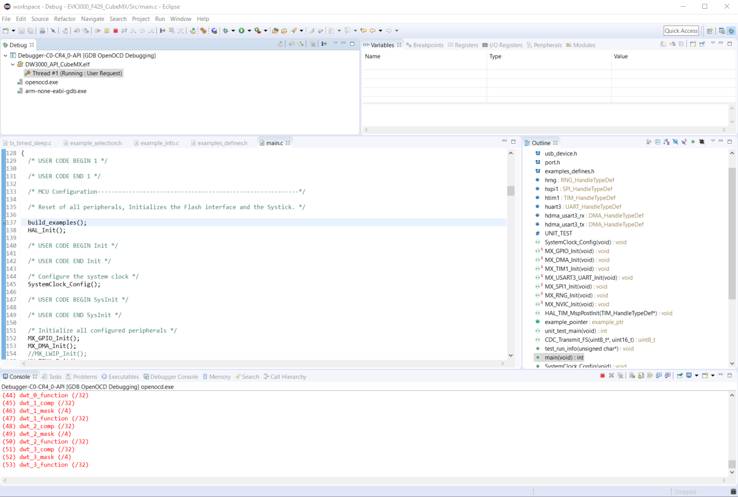

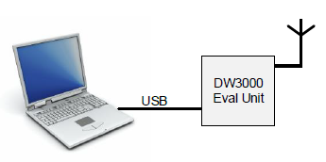
Run & Test
STLink Virtual COM Port
Virtual COM Port
TDoA Blink
Both VCOM ports can be recognised from your PC

Slide 10
Reference
[1] DW3000 Arduino Shield QSG
[2] DecaRanging_PC_User_Guide_DW3000
[3] DW3000 Software API Guide
Source and App
[A] DW3000 API Source
[B] DecaRanging PC app (executable)

