Slide 1

Big Mountain Ski Resort
Kyle Reedy

Slide 2

Problem Identification
What is the best pricing for tickets with the newly installed chair lift. Guidance is needed to come up for new prices and upcoming investments.
Is Big Mountain capitalizing on its features?
The project involves a ticket pricing model that predicts a suggested ticketing price based on the resort’s current variables.
I will Provide insight into what facilities matter most to visitors and which facilities they are most likely to pay for.

Slide 3
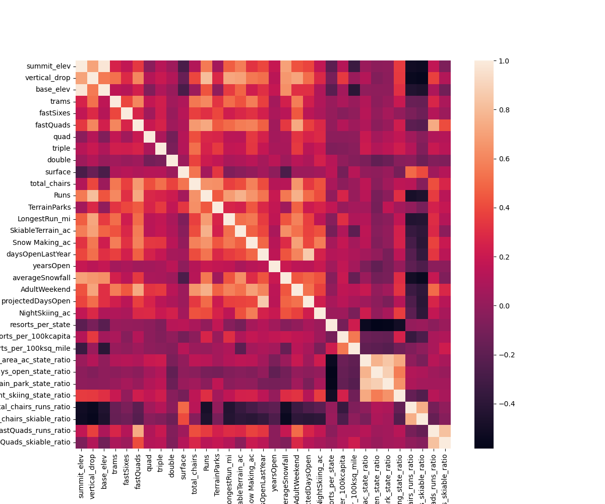
An interesting visual to look at on how each feature correlates with one another.
Problem Identification

Slide 4
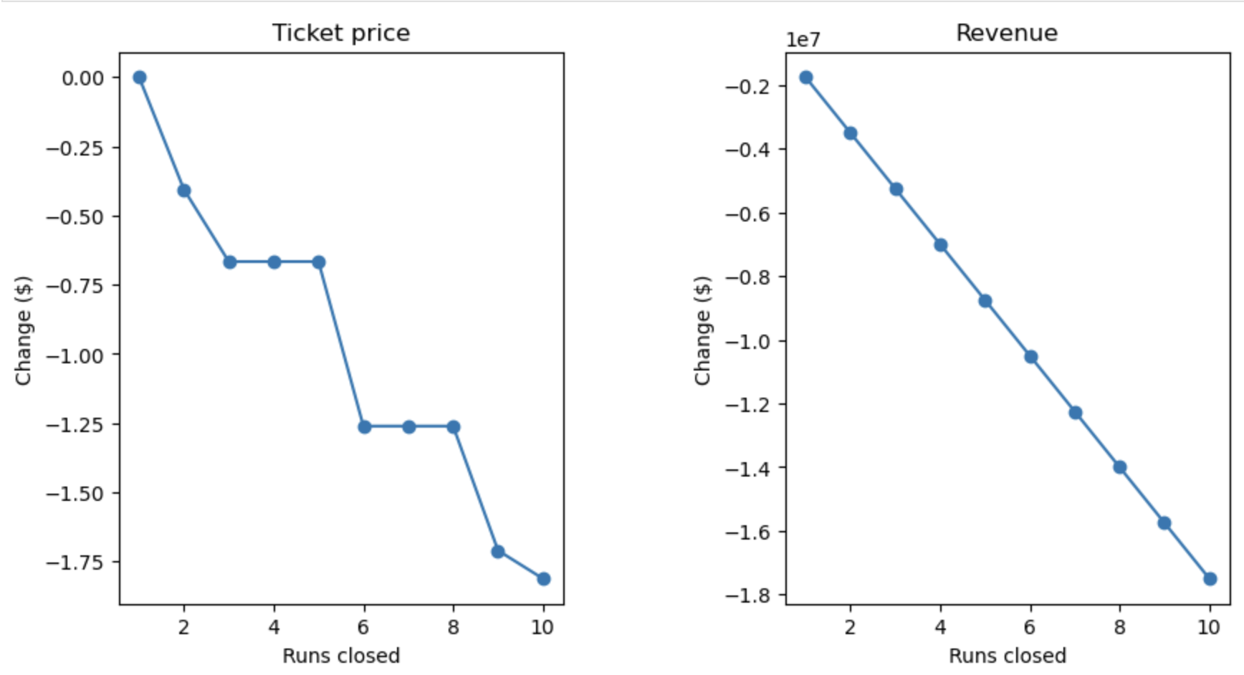
Recommendation and Key Findings
By increasing the vertical drop either with or without snowmaking will provide the opportunity to increase revenues by $15-$18 million, however the increase cost of tickets must be considered.
Other possible recommendations with further discussion:
Closure of least used lifts
More than 5 lift closures will lead to a significant drop in revenue (Figure A)
2. Increase the longest run by 0.2 miles (boasting the longest run) and additional snow making of 4 acres
Ticket Price Change = None
3. Addition of 2 acres of snow making
Slight increase in revenue and ticketing price
Figure A

Slide 5
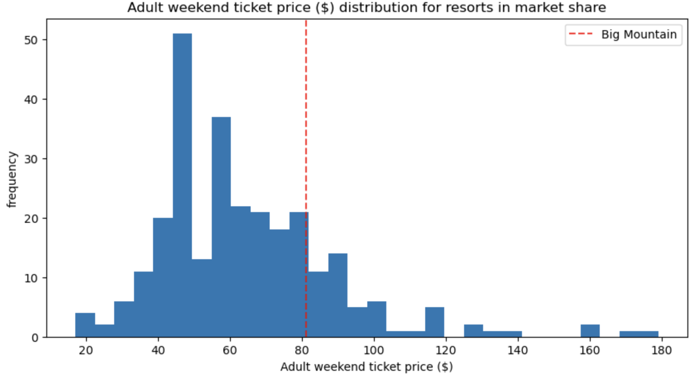
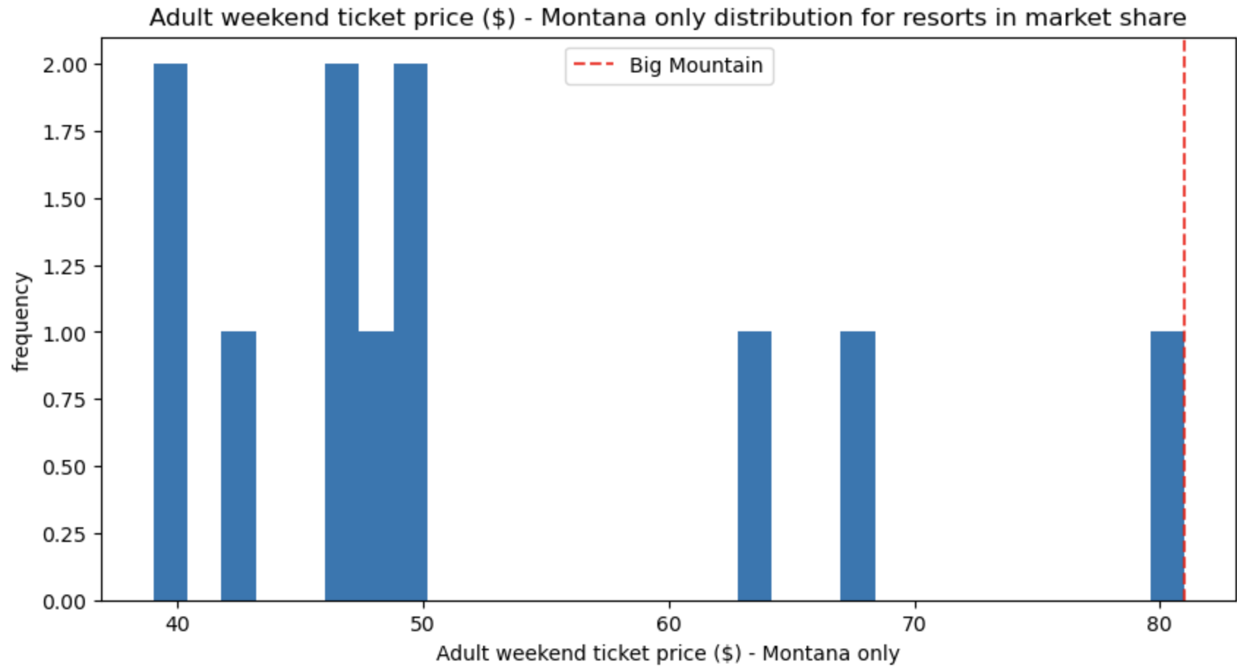
Analyzing Ticket Prices Comparisons
Some charge more than $160 on weekends
Market Comparison
Highest Price in Montana

Slide 6
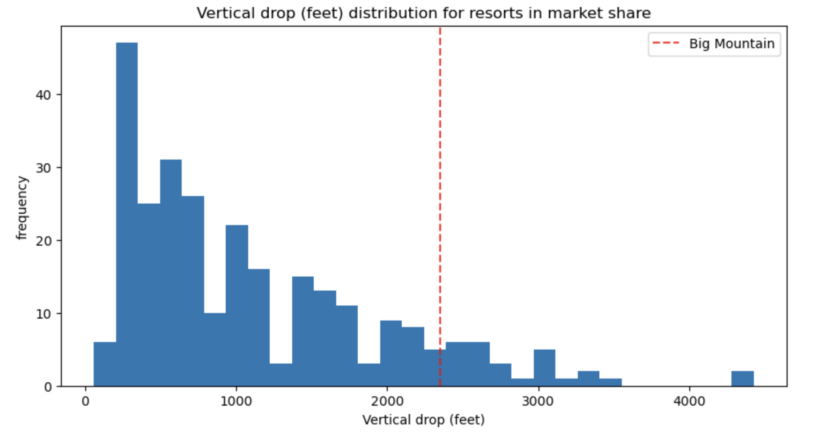
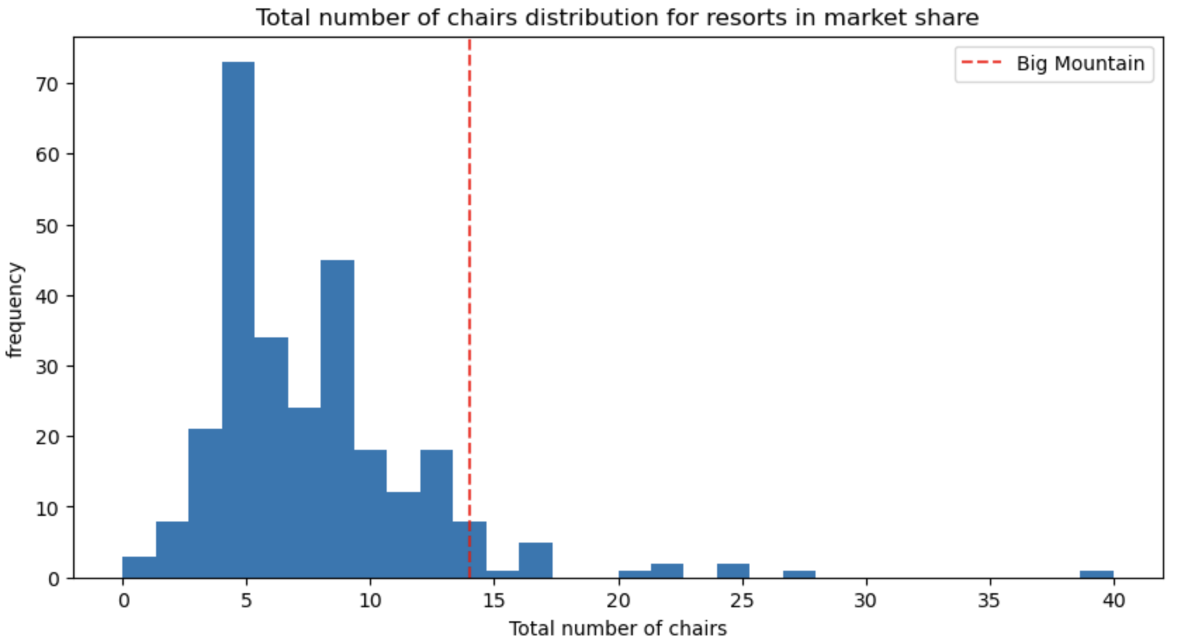
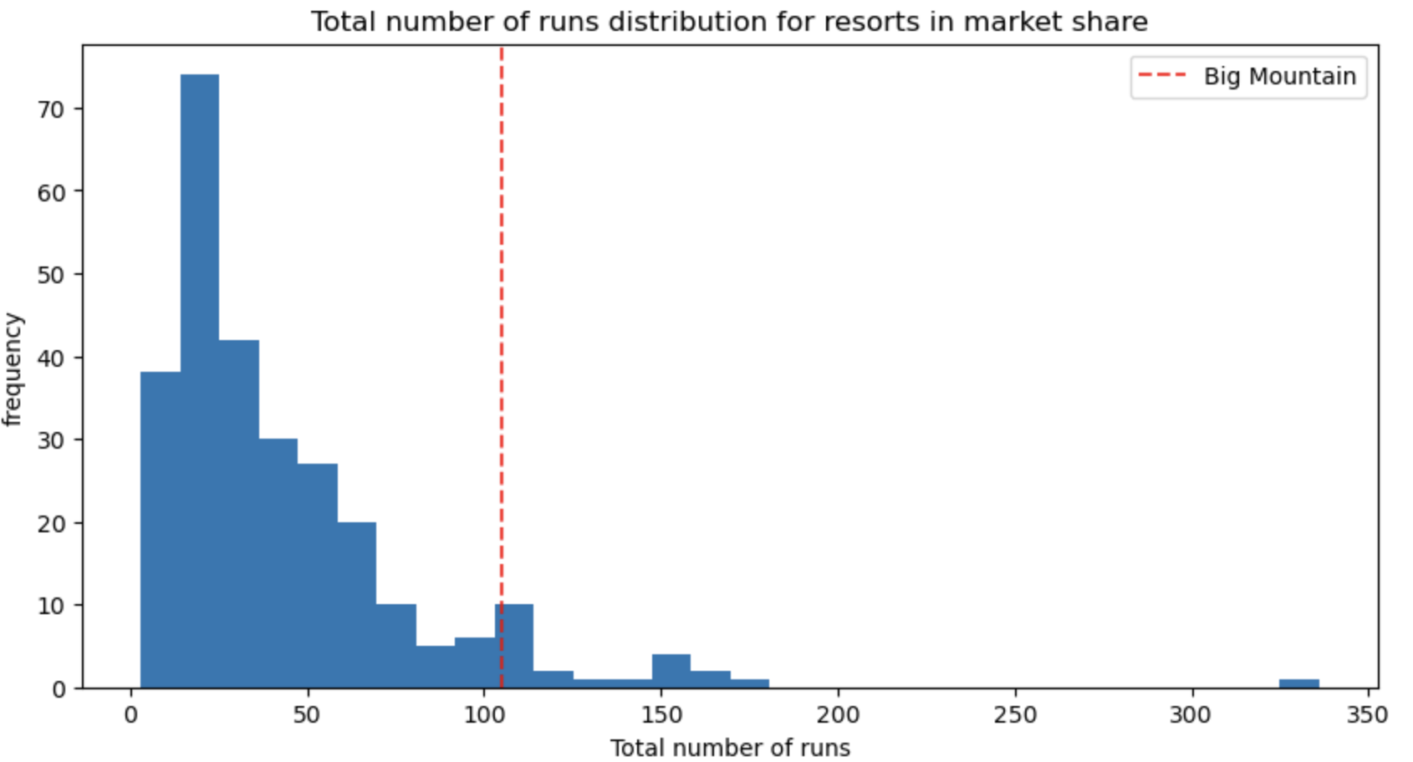
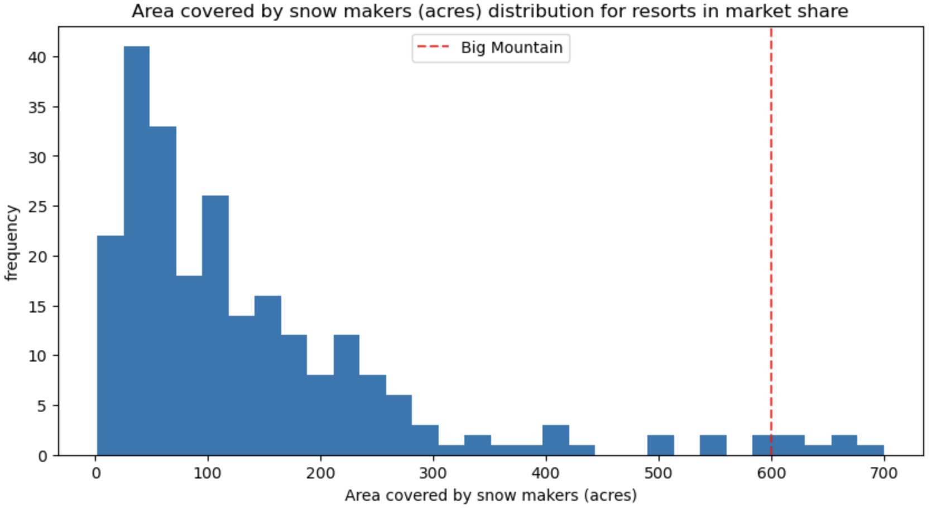
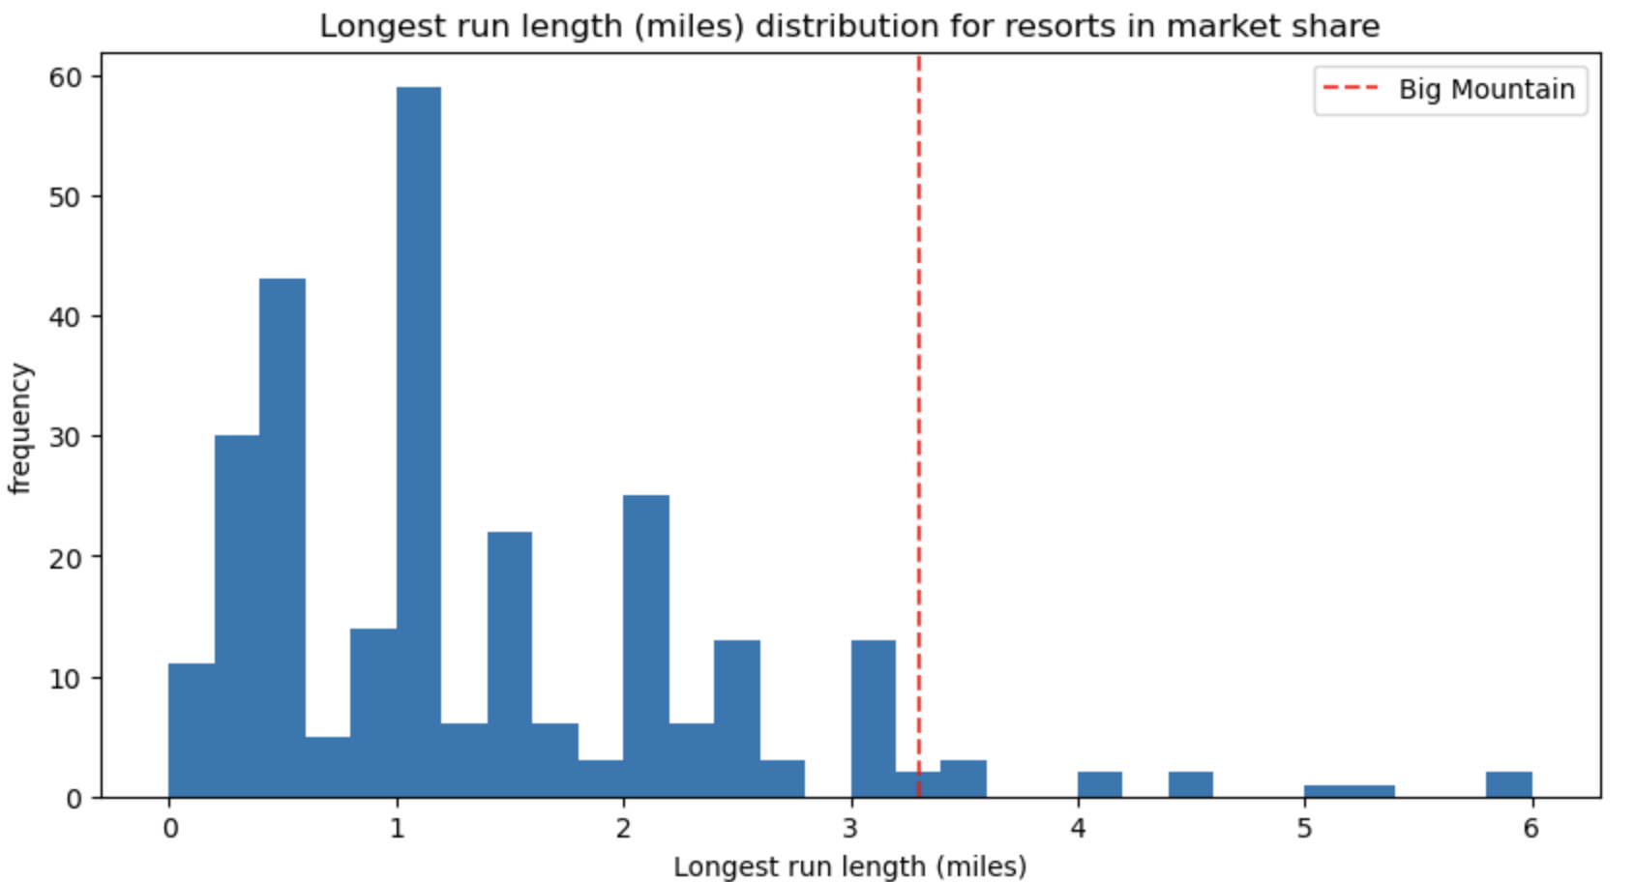
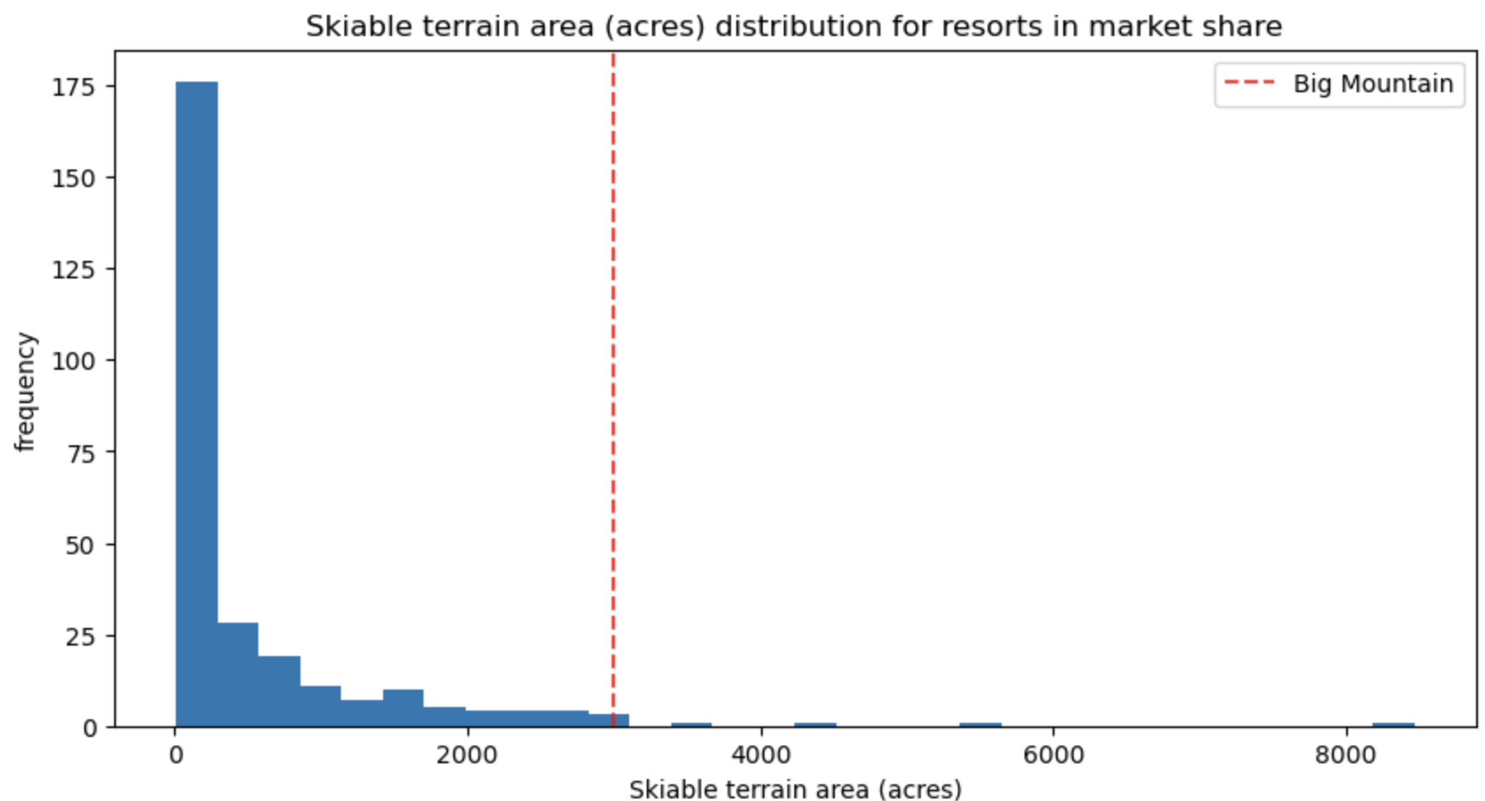
Analysis on Features
Vertical Drop
No. of Chairs
No. of Runs
Snow Makers
Longest Run
Skiable Terrain

Slide 7
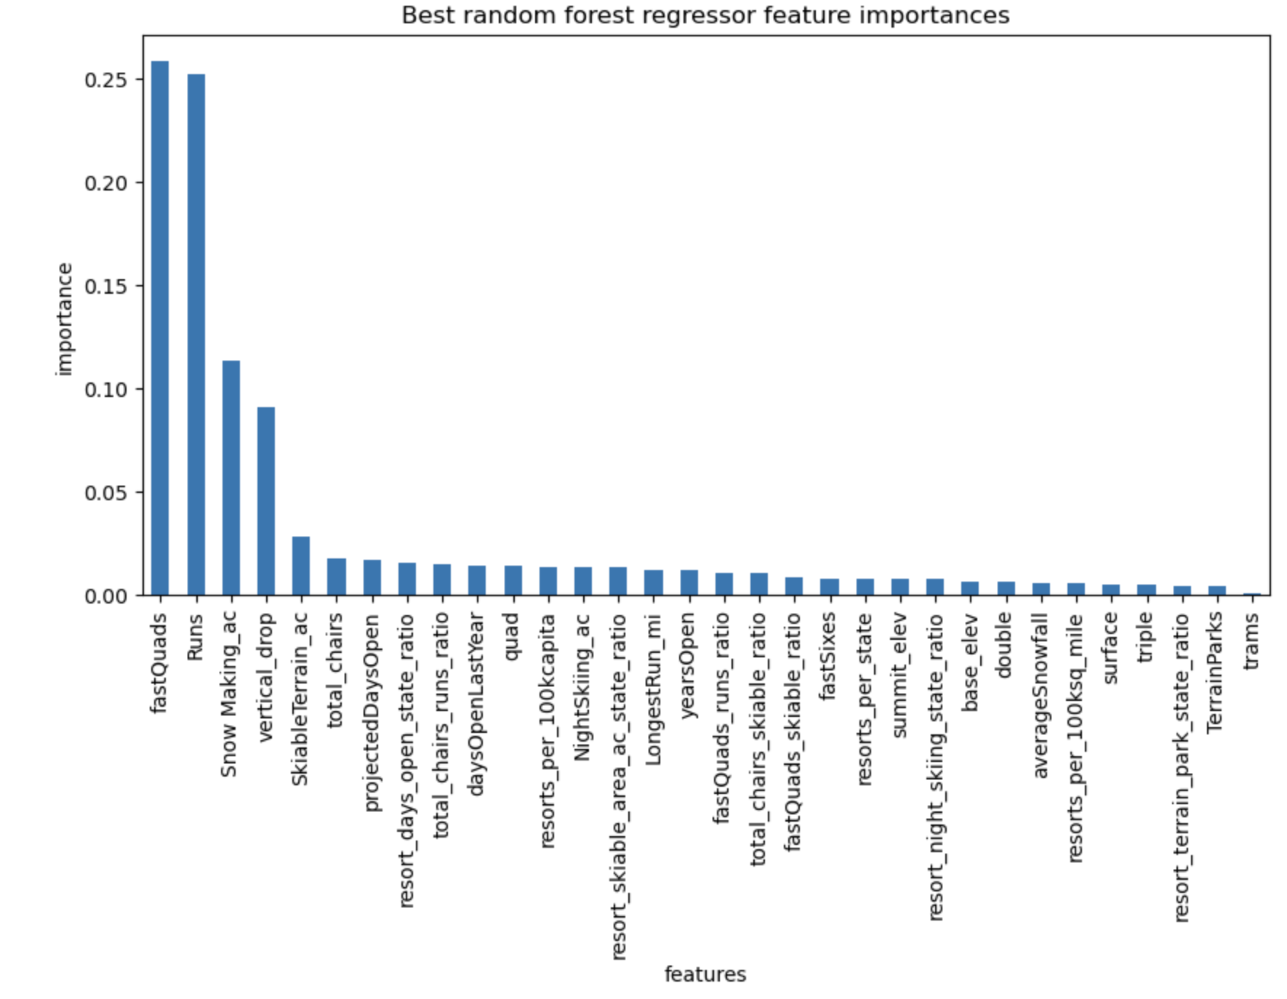
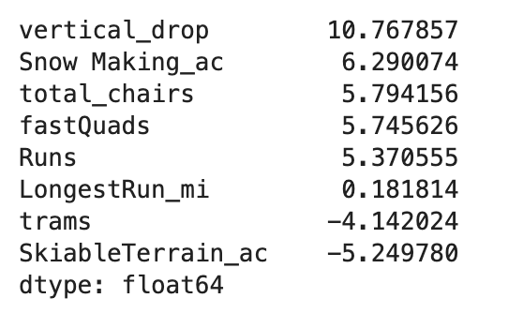
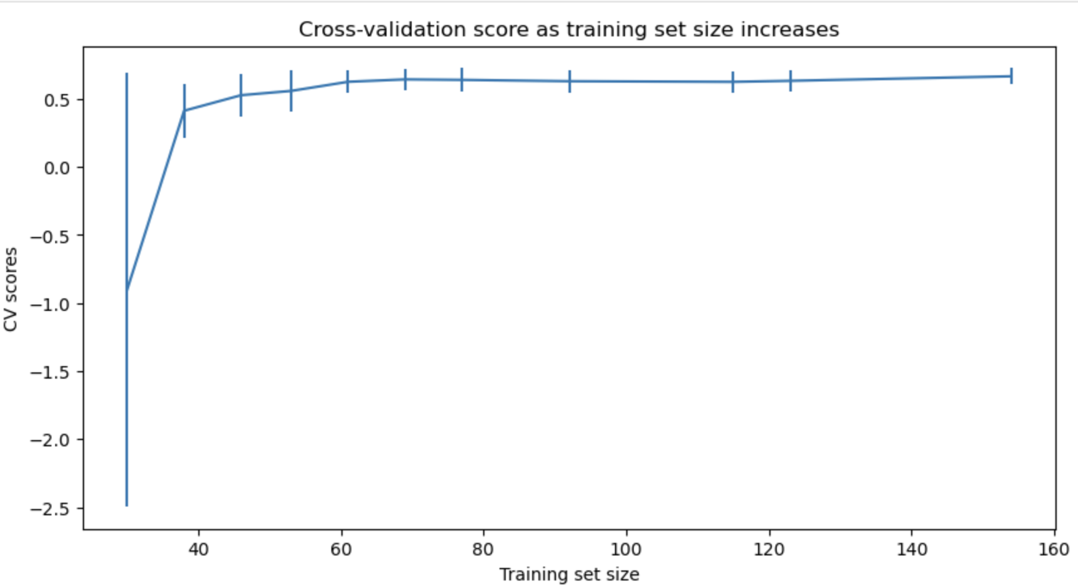
Model Comparisons
Linear Model
VS
Random Forest Model
Is more data needed? = No
Notes:
In the linear model, it shows that the vertical drop is the resorts biggest feature along with some other positives including the number of runs and the snow making equipment as this will help customers not worry about not having snow.

Slide 8
Modeling Results
After modelling the data, the modelled price came out as $95.87 vs. the actual price $81.00
Findings about Pricing
Big Mountain Resort is charging less than what the prediction suggests
Questions for Discussion
Is Big Mountain’s pricing strategy not efficient? Is the resort undercharging?
Are other resorts overpriced?
Should more data be considered for further analysis
Initial installment costs
Operating Costs of new lift, legal costs

Slide 9
Recap
Big Mountain Resort has features that rank amongst the top market share:
Number of Chairs
Snow Making machines/capacity/capability
Number of Runs
Skiable Terrain
Longest Run
Propositions by Importance
Scenario 1 - Increase vertical drop with and without snowmaking
By increasing the vertical drop either with or without snowmaking will provide the opportunity to increase revenues by $15-$18 million, however the increase cost of tickets must be considered.
Scenario 2 - Increase longest run with snowmaking
Scenario 3 - Closure of 4-5 least used runs
Further closures will significantly decrease revenue

