Slide 1
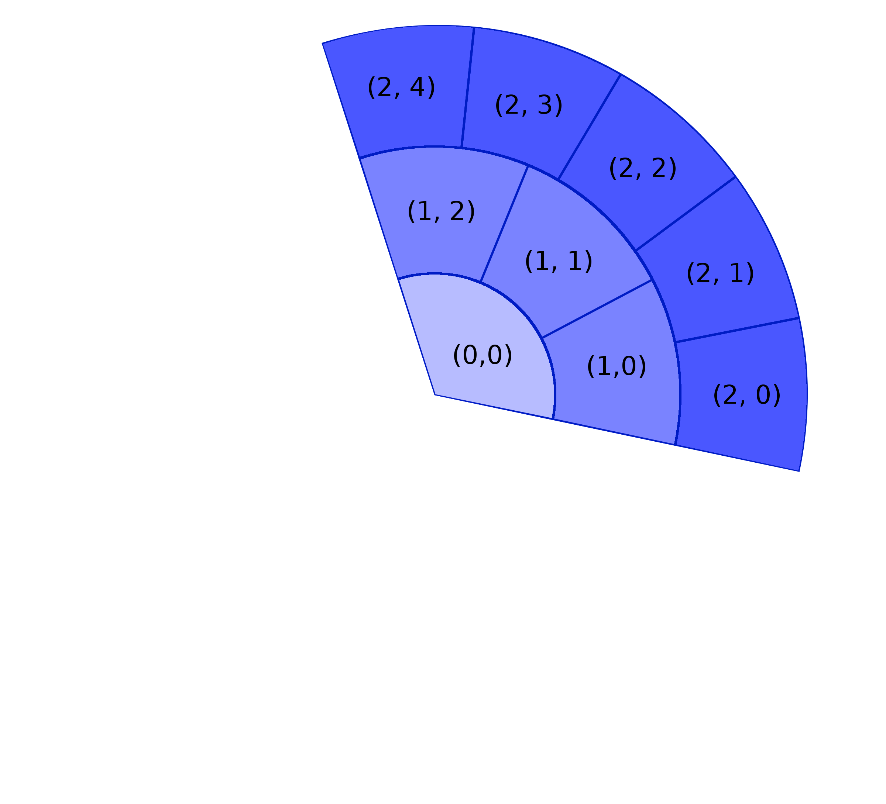
Coordinate | Neighbours Cyclic | Neighbours Non-Cyclic
(0, 0) | (0, 0) (0, 0) (1, 0) (1, 1) (1, 2) | (1, 0) (1, 1) (1, 2)
(1, 0) | (0, 0) (1, 1) (1, 2) (2, 0) (2, 1) | (0, 0) (1, 1) (2, 0) (2, 1)
(1, 1) | (0, 0) (1, 0) (1, 2) (2, 1) (2, 2) (2, 3) | (0, 0) (1, 0) (1, 2) (2, 1) (2, 2) (2, 3)
(2, 3) | (1, 1) (1, 2) (2, 2) (2, 4) | (1, 1) (1, 2) (2, 2) (2, 4)

