Slide 1
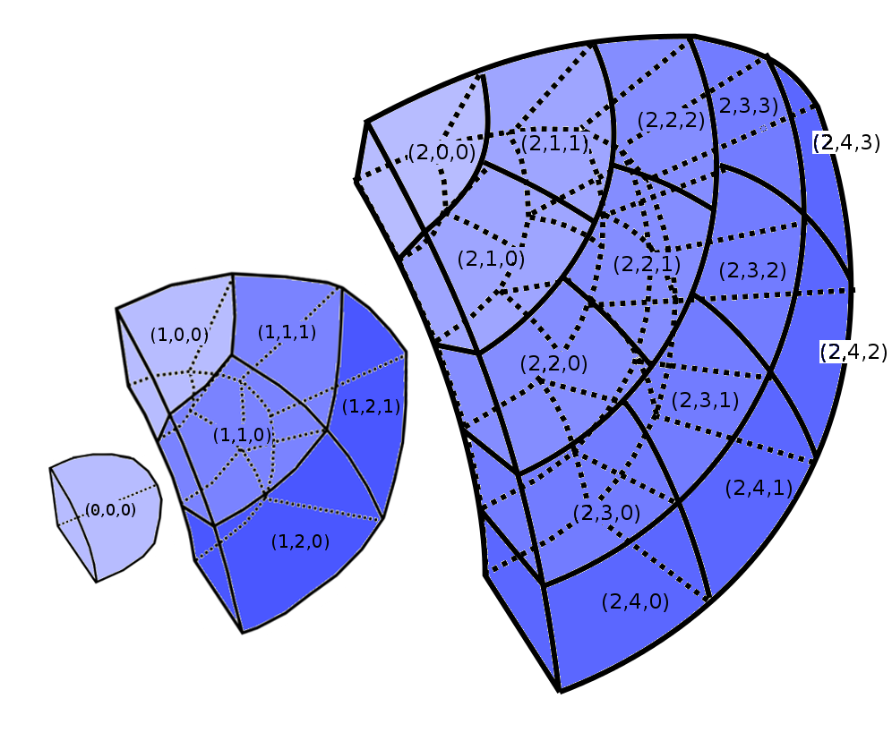
Coordinate | Neighbours Cyclic | Neighbours Non-Cyclic
(0, 0, 0) | (0, 0, 0) (0, 0, 0) (1, 0, 0) (1, 1, 0) (1, 1, 1) (1, 2, 0) (1, 2, 1) | (1, 0, 0) (1, 1, 0) (1, 1, 1) (1, 2, 0) (1, 2, 1)
(1, 0, 0) | (0, 0, 0) (1, 0, 0) (1, 0, 0) (1, 1, 0) (1, 1, 1) (2, 0, 0) (2, 1, 0) (2, 1, 1) | (0, 0, 0) (1, 1, 0) (1, 1, 1) (2, 0, 0) (2, 1, 0) (2, 1, 1)
(1, 1, 0) | (0, 0, 0) (1, 0, 0) (1, 1, 1) (1, 1, 1) (1, 2,0) (2, 1, 0) (2, 2, 0) (2, 2, 1) (2, 3, 0) (2, 3, 1) | (0, 0, 0) (1, 0, 0) (1, 1, 1) (1, 2,0) (2, 1, 0) (2, 2, 0) (2, 2, 1) (2, 3, 0) (2, 3, 1)
(2, 2, 1) | (1, 1, 0) (1, 1, 1) (2, 1, 0) (2, 1, 1) (2, 2, 0) (2, 2, 2) (2, 3, 1) (2, 3, 2) | (1, 1, 0) (1, 1, 1) (2, 1, 0) (2, 1, 1) (2, 2, 0) (2, 2, 2) (2, 3, 1) (2, 3, 2)

