Slide 1
Planning and Executing a Research Project
Sarah M. Kreidler, D.P.T., PH.D.
Deborah H. Glueck, Ph.D.

Slide 2
Overall Learning Objectives
Identify common study designs used in medical imaging research
Form a testable hypothesis from a clinical problem or question
Perform a literature review
List the steps required to plan a research project
Locate funding opportunities on the web
Identify the safeguards for performing ethical human research
List the steps required to submit a grant proposal
List the steps required to execute a research study
List the steps required to publish medical manuscripts

Slide 3
Outline
Finding funding and writing a grant
Writing a protocol
Ethical considerations and working with COMIRB
Running the study
Publishing the results
Break
Group brainstorming for the mentored scholarly activity

Slide 4
Outline
Finding funding and writing a grant
Writing a protocol
Ethical considerations and working with COMIRB
Running the study
Publishing the results
Break
Group brainstorming for the mentored scholarly activity

Slide 5
Funding Basics
Find a funding announcement that is relevant to your scientific field, research goal, and is appropriate to your level of training
Determine the application submission date
Determine the application requirements
Write the grant
Route through the Office of Grants and Contracts
Submit the grant

Slide 6
University funding sources
Department of Radiology
Faculty development grants
Pilot grants
Colorado Clinical and Translational Science Institute (CCTSI)
Colorado Translational Research Imaging Center (CTRIC)
University of Colorado Cancer Center

Slide 7
External funding sources
National Institutes of Health
http://grants.nih.gov/grants/guide/index.html
Radiological Society of North America (RSNA)
ACGME Holman pathway
National societies such as American Cancer Society, Alfred P. Sloan, and many others
http://www.ucdenver.edu/academics/colleges/medicalschool/research/Pages/FundingOpps.aspx
Office of Research Development and Education
http://www.ucdenver.edu/academics/research/AboutUs/ORDE/Pages/orde.aspx

Slide 8
Anatomy of a grant application
Cover letter
Project summary or abstract
Project narrative
References
Facilities and other resources
Biographical sketches and other support
Research plan: specific aims page
Research plan: strategy
Budget

Slide 9
Research Plan: Significance
Explain the importance of the problem or critical barrier to progress in the field that the proposed project addresses.
Explain how the proposed project will improve scientific knowledge, technical capability, and/or clinical practice in one or more broad fields.
Describe how the concepts, methods, technologies, treatments, services, or preventative interventions that drive this field will be changed if the proposed aims are achieved.

Slide 10
Research plan: Innovation
Explain how the application challenges and seeks to shift current research or clinical practice paradigms.
Describe any novel theoretical concepts, approaches or methodologies, instrumentation or intervention(s) to be developed or used, and any advantage over existing methodologies, instrumentation or intervention(s).
Explain any refinements, improvements, or new applications of theoretical concepts, approaches or methodologies, instrumentation or interventions.

Slide 11
Research plan: Approach
Describe the overall strategy, methodology, and analyses to be used to accomplish the specific aims of the project. Unless addressed separately in the Resource Sharing Plan, include how the data will be collected, analyzed, and interpreted as well as any resource sharing plans as appropriate.
Discuss potential problems, alternative strategies, and benchmarks for success anticipated to achieve the aims.
If the project is in the early stages of development, describe any strategy to establish feasibility, and address the management of any high risk aspects of the proposed work.
Point out any procedures, situations, or materials that may be hazardous to personnel and precautions to be exercised. A full discussion on the use of Select Agents should appear in 5.5.11 below.
If research on Human Embryonic Stem Cells (hESCs) is proposed but an approved cell line from the NIH hESC Registry cannot be identified, provide a strong justification for why an appropriate cell line cannot be chosen from the Registry at this time.

Slide 12
Writing tips from NIH
Convey the value of the research in plain language – clear, succinct, and professional
Be comprehensible to both scientists and the public
Relay the potential impact of the research on health
Leave time for proofreading!

Slide 13
Budgeting
Specific budget details depend on the sponsor requirements and research requirements
Common budget items
Personnel and consultants
Equipment
Supplies
Travel
Publishing costs
Indirect costs: facilities, utilities, office supplies, etc.

Slide 14
Submitting the grant
Grants are processed by the Office of Grants and Contracts (OGC) http://www.ucdenver.edu/academics/research/AboutUs/GrantsContractsOffice/Pages/default.aspx
Basic process
Principal investigator creates a Grant Application for sponsored research
PI / department “routes” the application to OGC
OGC reviews the application for policy and legal issues
OGC provides Institutional Endorsement of the application, and returns it to the PI or department
PI or department submits the application to the funding agency

Slide 15
Grant process summary
Find funding announcement
Determine submission deadlines
Write the grant application per the announcement instructions
Route the application to the Office of Grants and Contracts
Submit the application to the funding agency
For questions, contact Patty Nash, PATRICIA.NASH@UCDENVER.EDU

Slide 16
Outline
Finding funding and writing a grant
Writing a protocol
Ethical considerations and working with COMIRB
Running the study
Publishing the results
Break
Group brainstorming for the mentored scholarly activity

Slide 17
Writing an IRB protocol: Background
Hypothesis and specific aims
What are the main goals of the research and what will you test?
Background and significance
What previous work has been done?
Why do I care?
Preliminary studies
What other work have you and your group conducted in this area?

Slide 18
Writing an IRB protocol: Methods
Research Methods
Outcome measures
Population of interest
Study design and research methods
Enrollment and consent process
Randomization scheme (if applicable)
Interventions and treatments
Planned visits and follow-ups
Data collection plan

Slide 19
Writing an IRB protocol: Risks
Description, risks, and justification of procedures and data collection
Details each intervention and procedure used
Describe the risks
State why the procedure is necessary to achieve the study aims
Potential scientific problems
Data safety monitoring plan for research involving more than minimal risk

Slide 20
Writing an IRB protocol: Analysis plan
Call the biostatisticians
For quantitative analysis
Describe the statistical tests for each outcome measure
Provide a justification for the proposed sample size
For qualitative analysis
Describe and justify the qualitative methods used

Slide 21
Writing an IRB protocol: Wrapping it up
Summarize the knowledge to be gained
Provide references
If you get stuck…
Contact the clinical research coordinator
Michelle Carr, MICHELLE.L2.CARR@UCDENVER.EDU
Contact the biostatisticians
Sarah Kreidler, SARAH.KREIDLER@UCDENVER.EDU

Slide 22
Outline
Finding funding and writing a grant
Writing a protocol
Ethical considerations and working with COMIRB
Running the study
Publishing the results
Break
Group brainstorming for the mentored scholarly activity

Slide 23
Ethics in Human Research
Basic Ethical Principles
Respect for Persons
Beneficence
Justice
Applications
Informed consent
Assessment of risk and benefits
Selection of subjects
The phrase “human research participants” is now preferred over “subjects”

Slide 24
Institutional Review Board Basics
The Colorado Multiple Institutional Review Board (COMIRB) is an administrative body established to protect the rights and welfare of human research participants recruited to participate in research activities
http://www.ucdenver.edu/academics/research/AboutUs/comirb/Pages/comirb-home.aspx
Types of submissions
Non-human subject research determination
Exempt review
Expedited review
Full Board review
Submissions for special cases
New researchers must complete CITI/HIPAA training
For questions, contact Michelle Carr, MICHELLE.L2.CARR@UCDENVER.EDU

Slide 25
Quality Improvement vs. Research
Quality improvement (QI): a project designed to improve practice or process within a particular institution or ensure it confirms with expected norms
Does not need to be submitted to COMIRB
Dissemination of information typically within the organization
Research: a project designed to develop or contribute to generalizable knowledge.
Must submit to COMIRB
Published in medical journals, presented at conferences, etc.

Slide 26
IRB Exempt
Minimal Risk
Research on standard educational methods or techniques
Research using surveys, interviews, educational tests or observation of public behavior
Use of data, records, or documents that are already in existence at the time of research application.
Research endorsed by DHHS examining public benefit or service programs
Food taste/quality/consumer acceptance studies

Slide 27
IRB Expedited
Research on drugs or devices for which no IND or IDE from the FDA are required
Blood draws of limited volume and frequency
Collection of biological samples, where the collection methods are minimal risk
Non-invasive procedures to collect data (specifically excludes radiation/X-rays)
Use of data or records, or use of samples collected for purposes other than research
Data collected by photograph, digital image, or digital recording
Use of questionnaires, interviews, psychological tests, or educational tests

Slide 28
IRB Full Board Review
Greater than minimal risk
Involves vulnerable populations (children, pregnant women, prisoners, persons who are challenged in decision making)
Does not meet expedited categories

Slide 29
Outline
Finding funding and writing a grant
Writing a protocol
Ethical considerations and working with COMIRB
Running the study
Publishing the results
Break
Group brainstorming for the mentored scholarly activity

Slide 30
Running the Study
Work with the clinical research coordinator
Follow the IRB-approved protocol
Report adverse events to COMIRB within 5 days or according to the Data Safety and Monitoring Plan
Submit Continuing Review Form to COMIRB annually
For multi-year trials only
Keep research records for a minimum of 5 years after study completion
HIPAA related information a minimum of 7 years

Slide 31
Data Collection Tips
Write a data dictionary describing each field in the database
Use key files to separate PHI from research data
Use redcap.ucdenver.edu to simplify data collection
Add more columns, rather than using complex text fields
Tumor type | Tumor size
High grade glioblastoma | 5x6x9
Low grade astrocytoma | 5 by 7 by 1
Grade | Type | Length | Width | Height
High | Glioblastoma | 5 | 6 | 9
Low | Astrocytoma | 5 | 7 | 1

Slide 32
Summarizing the results
Follow statistical analysis plan in the protocol
Call the biostatisticians if you need help
Make sure your conclusions are supported by the results

Slide 33
Outline
Finding funding and writing a grant
Writing a protocol
Ethical considerations and working with COMIRB
Running the study
Publishing the results
Break
Group brainstorming for the mentored scholarly activity

Slide 34
Publishing Basics
Pick a target journal
Determine coauthorship
Write the manuscript
Obtain coauthor approval
Submit to the journal
Respond to reviewers
Obtain coauthor approval
Repeat until manuscript acceptance

Slide 35
Anatomy of a manuscript
Title page
Acknowledgements and disclosures
Abstract, including key words
Body of the manuscript
References
Tables
Figures

Slide 36
Manuscript body
Introduction
What is the context?
What is the problem and why do I care?
What is the solution we propose?
What is the motivating example?
What did everyone else do?
What is the organizational structure of the paper?

Slide 37
Manuscript body
Methods
Who are the participants?
What instruments were used?
What clinical procedures were used?
How was the statistical analysis performed?
Results
Summarize the important results of the experiment
Tell the story, support with statistical results

Slide 38
Manuscript body
Discussion
Interpret the results in the context of the clinical problem
Describe the limitations of the experiment
Describe how your findings relate to previously reported results
Describe how the work contributes to medical science
Suggest to readers how the work may be used in clinical practice

Slide 39
Communicating with coauthors
Individuals who make an intellectual contribution to the project should be coauthors
Obtain coauthor approval of the work prior to submitting or resubmitting to a journal or meeting
This applies to both abstracts and manuscripts

Slide 40
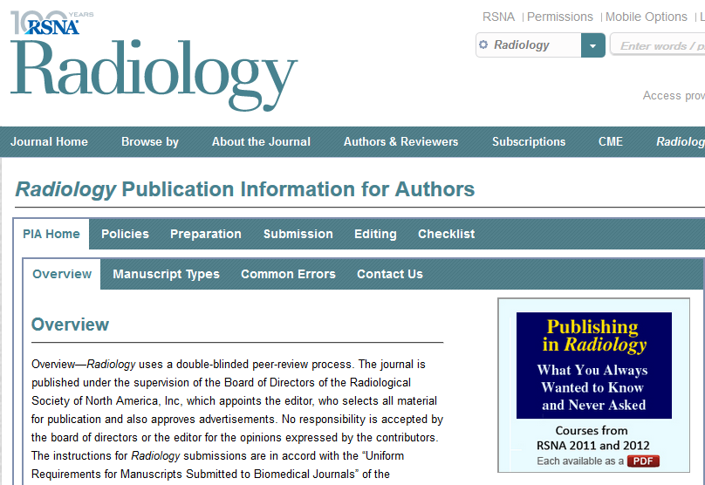
Journal submission
Read the instructions for authors
Note any page, word count or other length restrictions
Format text, tables, and figures
Submit all required documents
The journal will typically assign a manuscript ID for correspondence

Slide 41
Journal response
After review, the journal editor will determine if the manuscript is
Accepted
Rejected
Invited to resubmit with revisions
The corresponding author will receive reviewer comments on the work

Slide 42
Response to Reviewers
The authors must address all comments from the reviewers
Create a separate document including reviewer comments
Respond to each comment
Briefly describe changes made to the manuscript, or
Provide justification as to why no change was made
Obtain coauthor approval for the updated manuscript and response to reviewers document
Resubmit to the journal

Slide 43
A note about rejection
A large proportion of manuscripts are rejected on the first try
A rejection decision does not necessarily indicate that the work is not scientifically useful
Often another journal may be a better venue
Work with your coauthors to determine the best strategy
Sho Kashima: “The pursuit of perfection is nothing without an appetite for failure”

Slide 44
Outline
Finding funding and writing a grant
Writing a protocol
Ethical considerations and working with COMIRB
Running the study
Publishing the results
Break
Group brainstorming for the mentored scholarly activity

Slide 45
Outline
Finding funding and writing a grant
Writing a protocol
Ethical considerations and working with COMIRB
Running the study
Publishing the results
Break
Group brainstorming for the mentored scholarly activity

Slide 46
Mentored Scholarly Activity
Specific Aims
Significance and Innovation
Materials and Methods
Data collection plan
Sample size selection
Analysis plan

Slide 47

Question?

