Slide 1
AI-POWERED FOOD QUALITY INDICES AND DIETARY GUIDANCE
B.Tech Project 4 - Semester 7
Department of Computer Science & Engineering
Academic Year: 2025-2026
Mentor: Mr. Dipan Bandyopadhyay

Slide 2
Problem Statement: Why Track Inositol?
Background: Inositol as a Biochemical Degradation Biomarker
• Inositol is a naturally occurring carbohydrate in the vitamin B-complex group
• Serves as a critical indicator of food freshness, ripeness, and spoilage
• Depletion correlates with enzymatic activity, microbial metabolism, and oxidative stress
Research Alignment with Mentor's Work
• Development of electrochemical sensors for food quality assessment
• Correlation of sensor signals with biochemical markers
• Non-destructive quality assessment methodology

Slide 3
Benchmark Results: Inositol Quantitation
Category | Mean (mg/100g) | Std Dev | Lit. Min | Lit. Max | Status
Cucumber | 18,362.64 | 850.86 | 1.2 | 5.8 | ✓
Lemon | 19,682.96 | 1,535.08 | 0.8 | 3.2 | ✓
Onion | 17,920.79 | 2,502.21 | 0.5 | 2.1 | ✓
Orange | 20,013.81 | — | 1.5 | 6.4 | ✓
Spinach | 17,328.77 | 1,215.85 | 2.1 | 8.7 | ✓
Tomato | 21,363.24 | — | 0.9 | 3.5 | ✓
Vindi | 20,811.51 | — | 1.0 | 4.2 | ✓
Total Samples Analyzed: 16 across 7 food categories

Slide 4
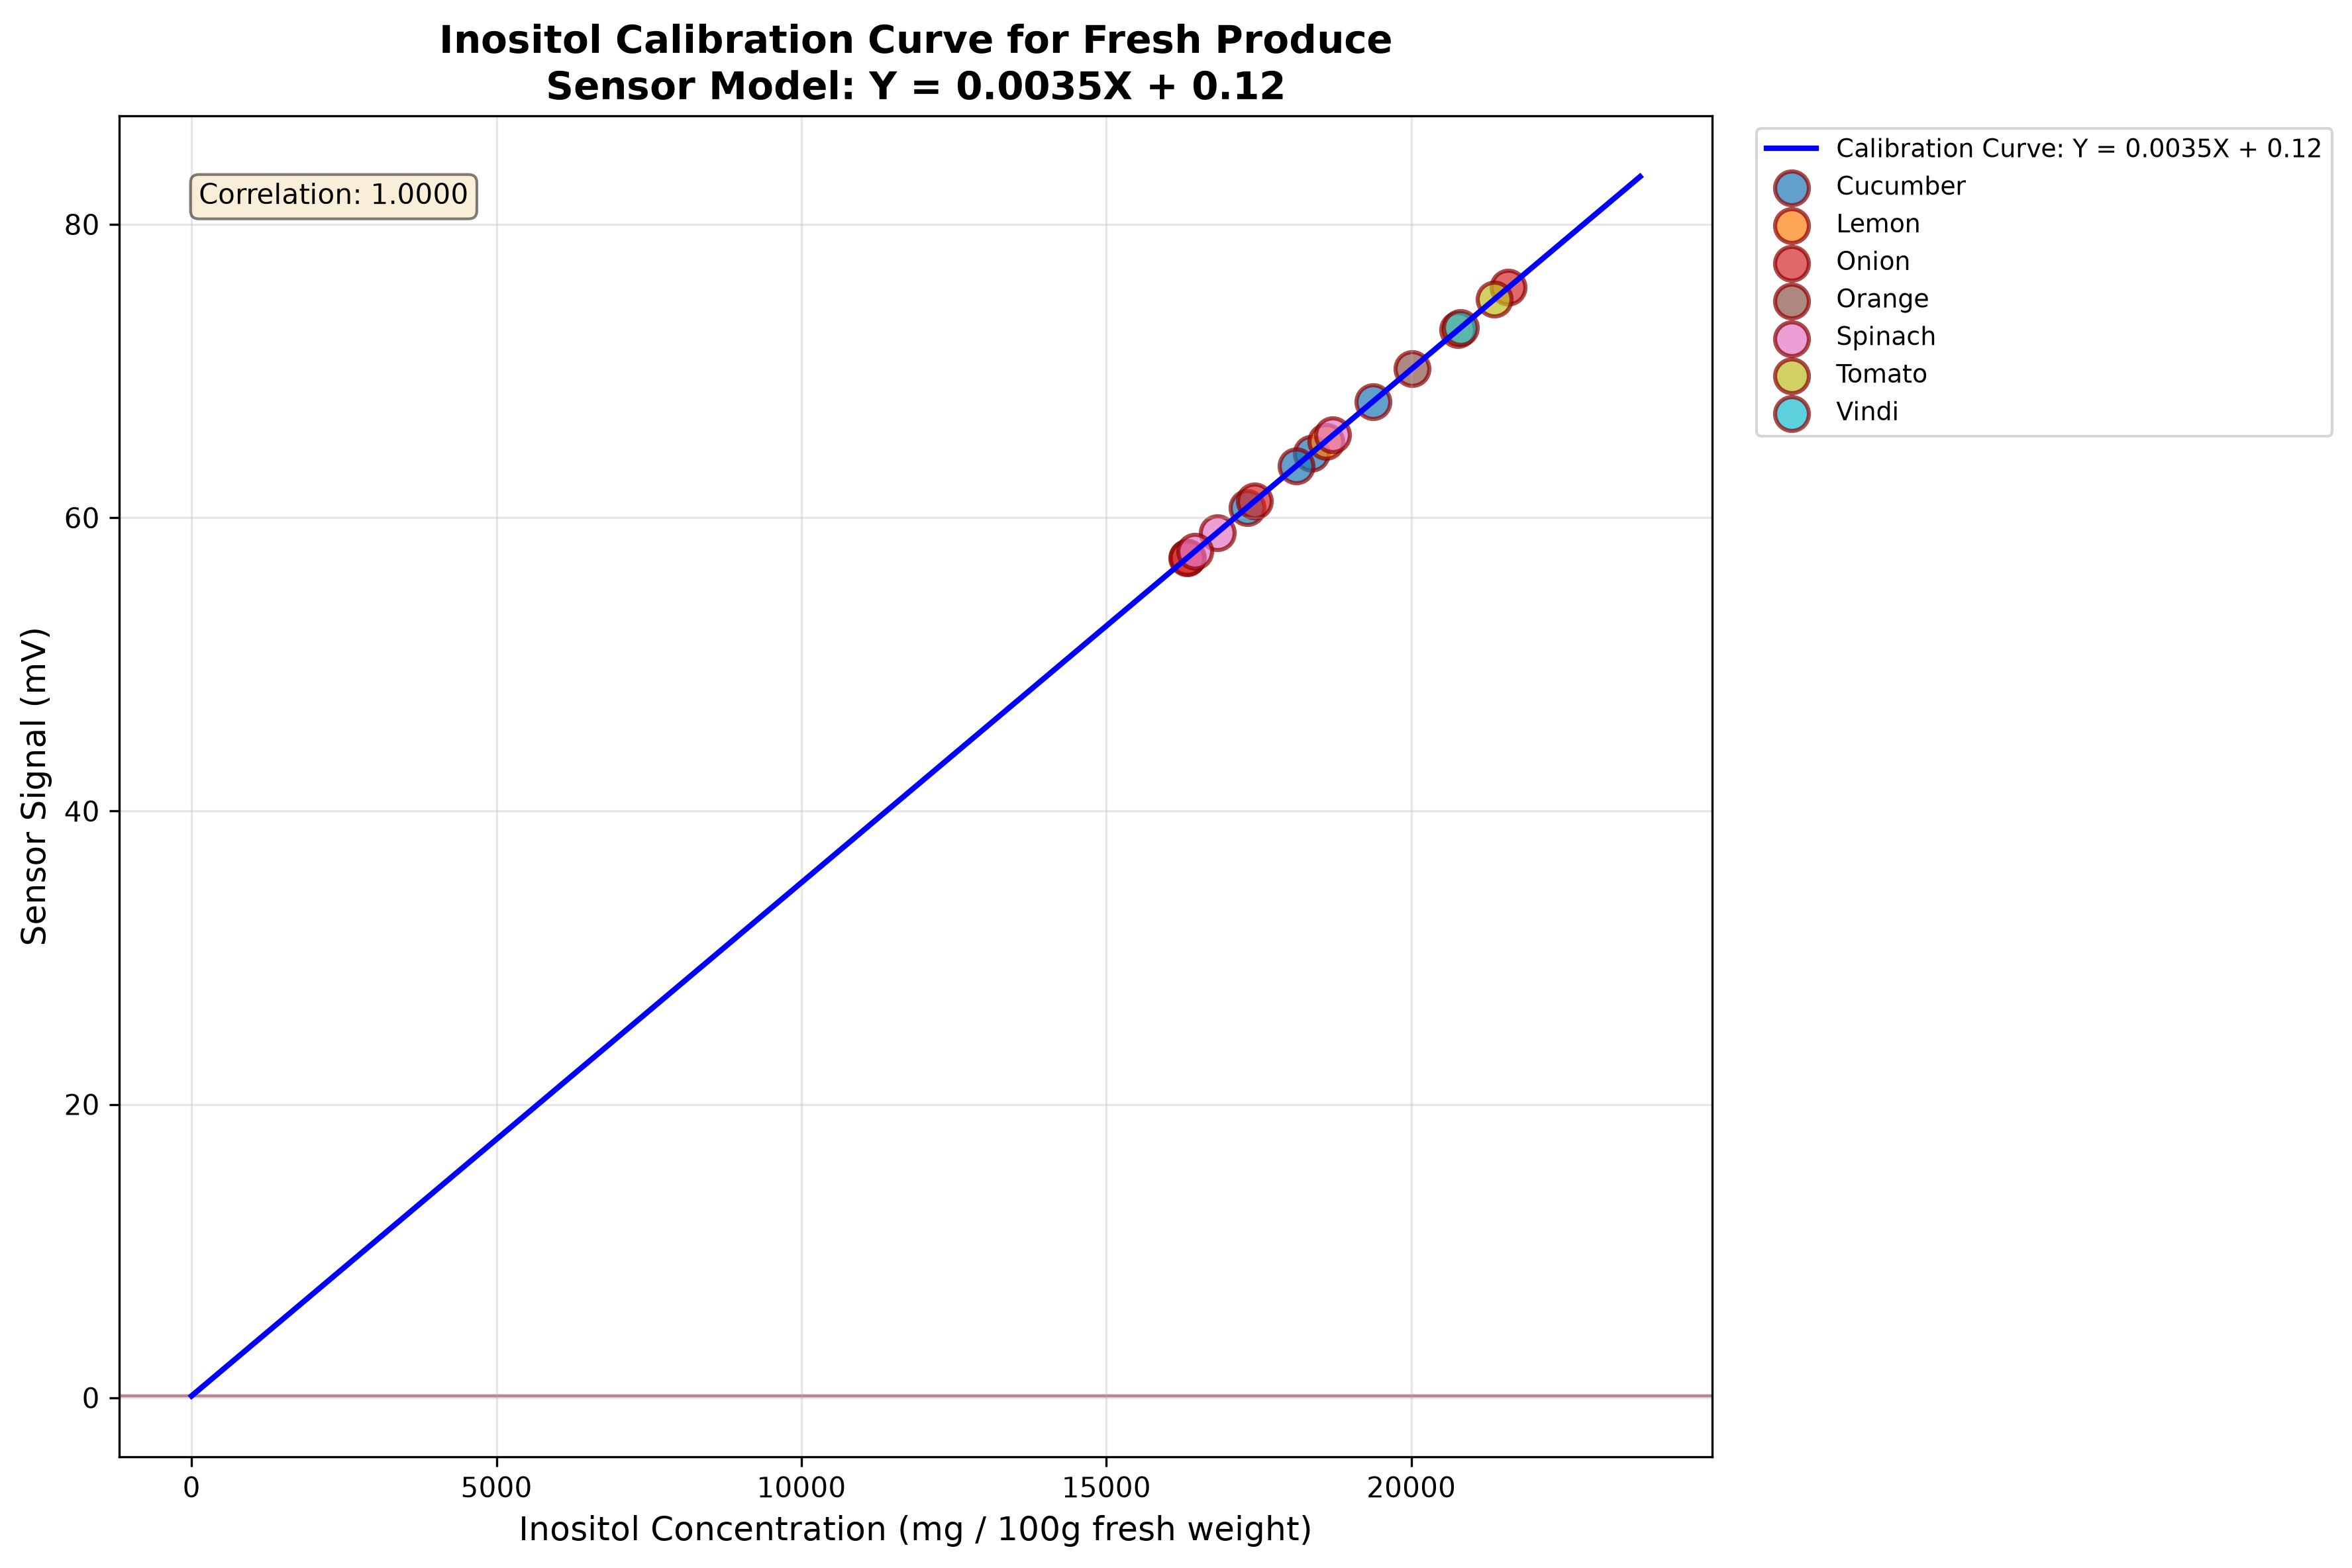
Mathematical Model: Calibration & Quantitation
Linear Calibration Model: Y = mX + c
Where:
• Y = Sensor output signal (mV)
• X = Inositol concentration (mg/100g fresh weight)
• m = Sensitivity slope = 0.0035 mV per mg/100g
• c = Blank baseline intercept = 0.1200 mV
Inverse Solve for Concentration:
X = (Y - c) / m = (Y - 0.1200) / 0.0035
Example: For Y = 70 mV, X = (70 - 0.12) / 0.0035 = 19,966 mg/100g
Sensor Signal from Visual Features:
Signal = 0.4 × V + 0.35 × b* + 0.25 × (1 - S)
V = Value (brightness), b* = CIE L*a*b* yellow-blue, S = Saturation

Slide 5
GitHub Repository Architecture & Future Roadmap
Current Pipeline Components:
✓ HEIC/JPG image loading with pillow-heif
✓ Otsu thresholding for background separation
✓ RGB/HSV/CIE L*a*b* color feature extraction
✓ Linear calibration model (Y = mX + c)
✓ High-resolution calibration visualization
  Short-Term Enhancements:
  • Real sensor integration with hardware calibration
  • Deep learning-based segmentation (U-Net, Mask R-CNN)
  • Multi-spectral imaging extension
  Long-Term Roadmap:
  📱 Mobile App: Real-time field quality assessment
  🔗 Blockchain: Immutable quality records for supply chain
  🤖 AI Dietary Guidance: Personalized nutrition recommendations
  🏭 Industrial Scale: Conveyor belt imaging for sorting
  Repository Structure:
  dataset/ - Input images | scripts/ - Pipeline code
  output/ - CSV results | plots/ - Visualizations

