Slide 1
Super Smash Bros Brawl Database
Team Shine: Ran Chao Zhang, Trevor Krenz, Richard Thai

Slide 2
Problem
One of Nintendo’s greatest title franchises lacks a few key features:
Centralized leaderboards
Social networking
Consistent game information

Slide 3
Solution
SSBB Management System!
It solves all of the problems.
Notes:
What else is there to this?

Slide 4
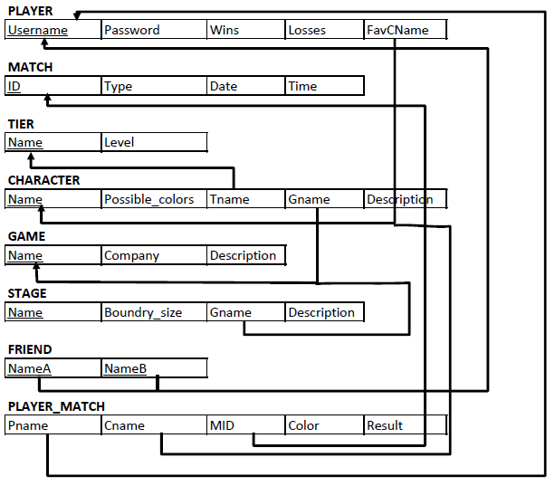
database design
Notes:
Schema, tables, ER?

Slide 5
challenges
stored procedures without a return value
C# language tics
security
Notes:
1) How do you verify a sproc that is supposed to affect a row of data, but returns nothing
2) C# has some peculiarities in terms of handling sprocs
3) Making sure that the final product is not susceptible to SQL injections, and that data is stored securely

Slide 6
lessons learned
choosing a well-documented language
visual studio is excellent for working with GUI applications
SQL and C# work together seamlessly
not all calls can, nor should, be handled by your application
Notes:
Makes all the difference, can find tutorials and examples aplenty from handling SQL to security
Concerning the final point, we had an issue trying to verify games. How do we ensure honesty and efficiency? In the real world, leaderboards are handled by the game’s console sending the data directly so that there is no question of honesty and efficiency is optimal

Slide 7
demo

