Slide 1


Measurement of VBF+VH production fraction for H(126) → ZZ* → 4l
Roberto Covarelli (U. of Rochester)
on behalf of the HZZ group
Higgs PAG meeting – 04 Dec 2012
<number>
R. Covarelli
12/3/12

Slide 2
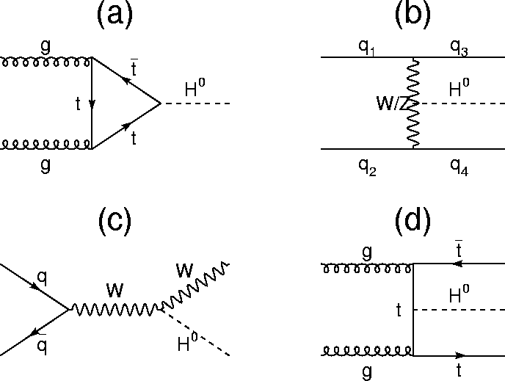
12/3/12
R. Covarelli
<number>
Higgs production and couplings
gluon-gluon fusion (ggF)
Vector-Boson fusion (VBF)
(qq → VH has similar couplings)
Z
Z
cf
cV
Z /
cV
cV
Z
Z
Production mechanism sensitive to Higgs couplings
Standard approach: reconstruct recoil jets for VBF (“VBF tagging”)
Typical WPs have high purity (εgg ~ 2%) but relatively low acceptance (εVBF ~ 35%) → O(1) event for HCP dataset
Still discrimination from untagged events: use pT(ZZ) distribution
126-GeV SM Higgs, @ 8 TeV
σ(ggF) x BR(4l) ~ 3.4 fb
σ(VBF+VH) x BR(4l) ~ 0.4 fb
→ fVBF+VH ~ 12%

Slide 3
<number>
Idea of the measurement
Goal: Measure the fraction of VBF+VH production of ZZ resonances
Today focusing only on already established 126 GeV particle
m(4l) in [106-141] GeV
Plan to pursue the “baseline” mass range ([100, 1600] GeV) for Moriond
Measurement: separate three different kinds of contributions
Signal 1: gg → H, ttH negligible
Signal 2: qqH (VBF), VH (WH + ZH)
Background: qq → ZZ, gg → ZZ, Z+X
Technique: split data in two categories:
“VBF-tagged”: two jets in the event (jet selection → next slide)
“Untagged”: all the rest
Notes:
<number>

Slide 4
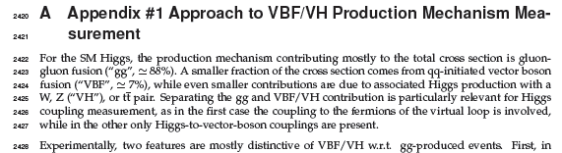
12/3/12
R. Covarelli
<number>
Status of analysis and documentation
VBF+VH measurement at 126 GeV conditionally pre-approved for HCP (asked to check m4l dependences)
Not presented for approval due to a few remaining small issues, addressed in today’s talk
Documentation provided by updating appendix #1 to general document:
CMS AN-12-367

Slide 5
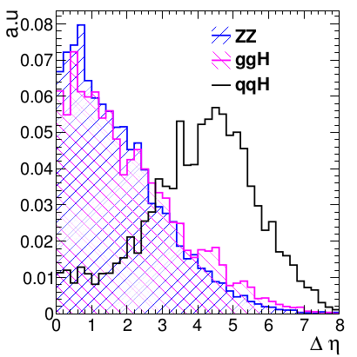
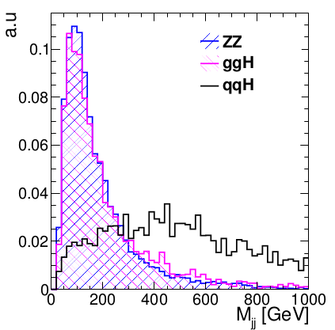
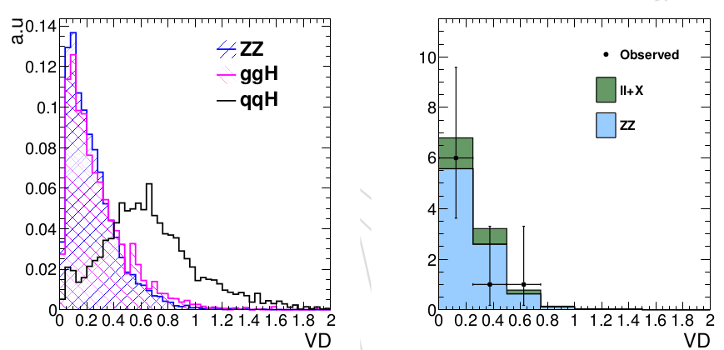
<number>
VBF tagging basics
Exploit jets in the final state to separate VBF
Jets with pT > 30 GeV , η < 4.7, passing loose jet ID and PU jet ID
With this selection, VBF has a di-jet signature in ~50% of the events
mJJ and |Δη| standard discrimination variables
Combined Fisher discriminant optimized to select VBF vs. all other events: Fisher = 0.09407*|Δη| + 0.00041581*mJJ [GeV]
Notes:
<number>

Slide 6

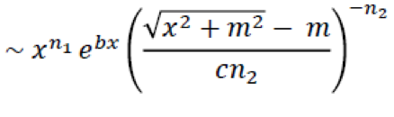
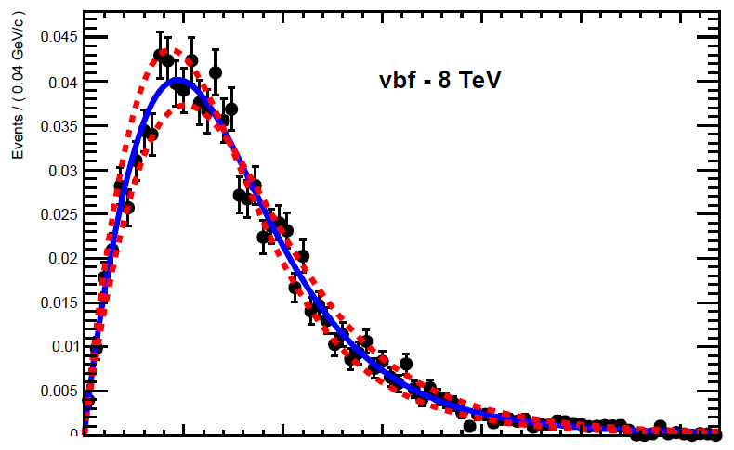
<number>
pT/m4l description
In the untagged category:
Fit pT/m4l distribution with a “modified Tsallis function”
Commonly used to describe pT spectra of charged hadrons, heavy flavor production etc.
pT → pT/m4l to reduce correlations (see next slides)
With analytical description easier to take the (numerous) systematic sources into account: create varied PDFs and do quadratic interpolation
default
+/-1σ bands
Notes:
<number>

Slide 7
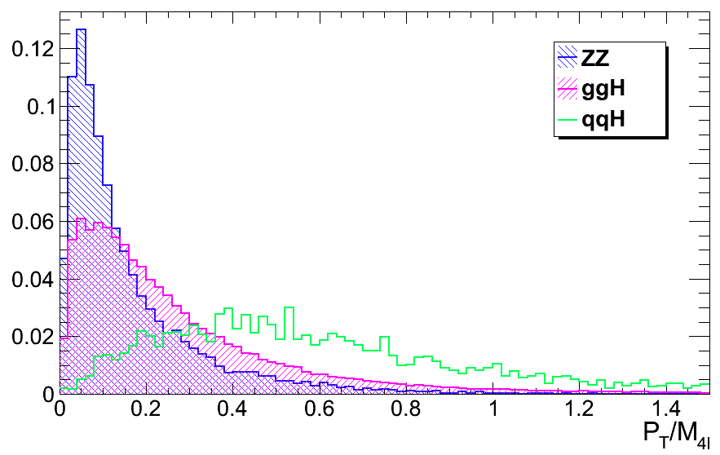
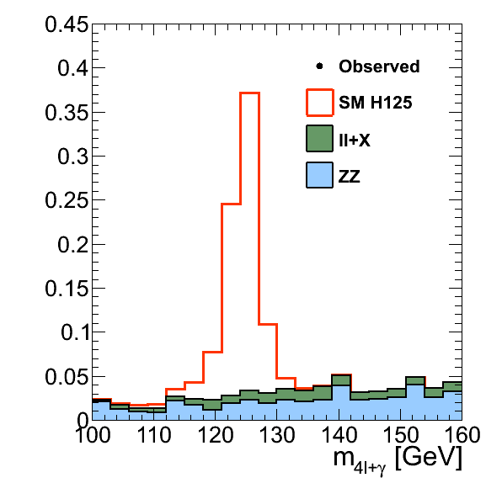
Measurement technique
Fit with a 3D model with two categories using combine
untagged:
Fit P(m4l) x P(KD | m4l) x P(pT/m4l | m4l)
pT/m4l spectrum described by modified Tsallis function
VBF-tagged:
Fit P(m4l) x P(KD | m4l) x P(Fisher | m4l)
Make 2D templates of Fisher vs. m4l
Due to separation of purest category, expect improvements also in total signal significance

Slide 8
12/3/12
R. Covarelli
<number>
VBF-tagged category

Slide 9
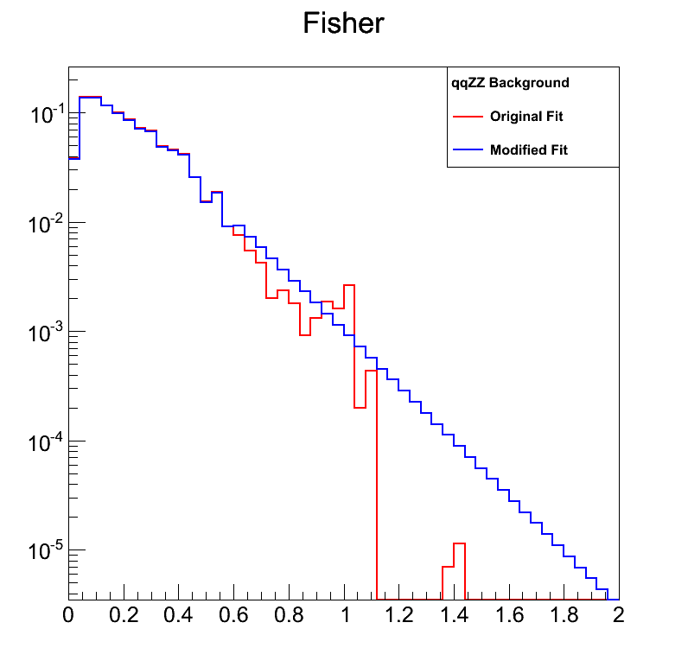
2D Fisher-m4l templates
2D Fisher vs. mass templates calculated for VBF-tagged signal and background
qqH, ggH, qqZZ, Z+X, ZH, WH (and also for sub-dominant ttH and ggZZ)
Combination of 7 and 8 TeV samples
same Fisher for 4e, 4mu, 2e2mu
Tail smoothing method used in case of insufficient statistics
Focused on low mass range
Analytical parameterization of Fisher distribution too complex to formulate taking into account correlation with mass

Slide 10
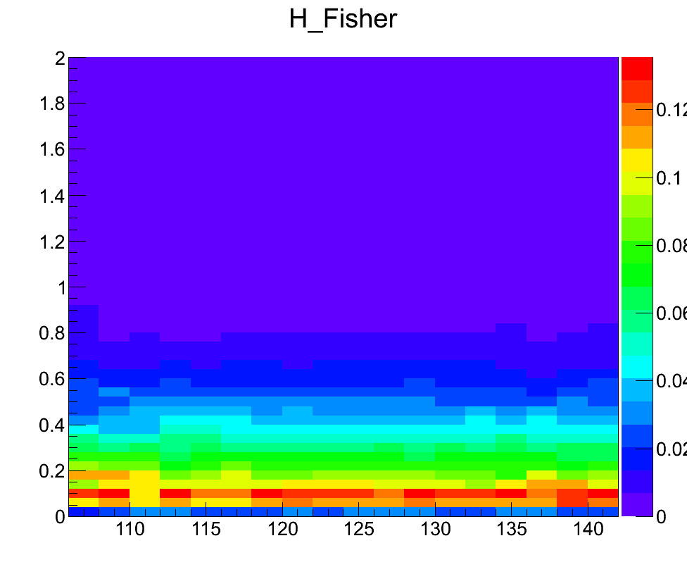
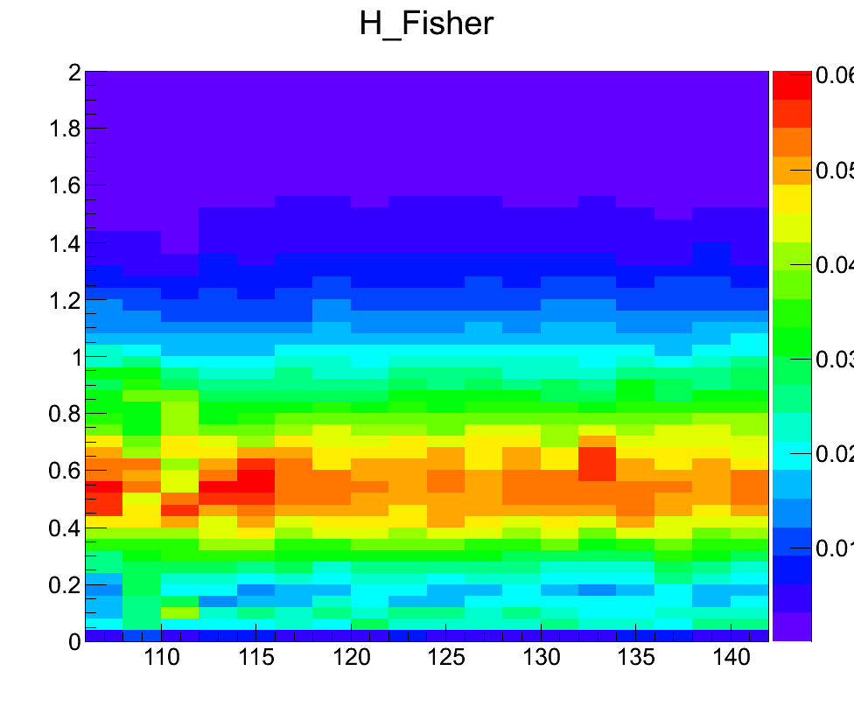
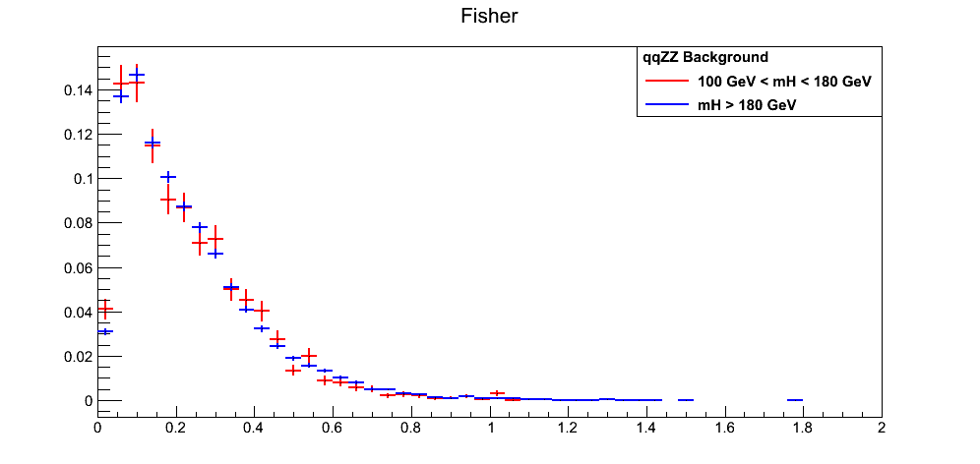
12/3/12
R. Covarelli
<number>
2D Fisher-m4l templates
ggH
VBF
Almost no mass dependence:
For qqZZ, Fisher independent of mass over a very large range → use just one bin in m4l

Slide 11
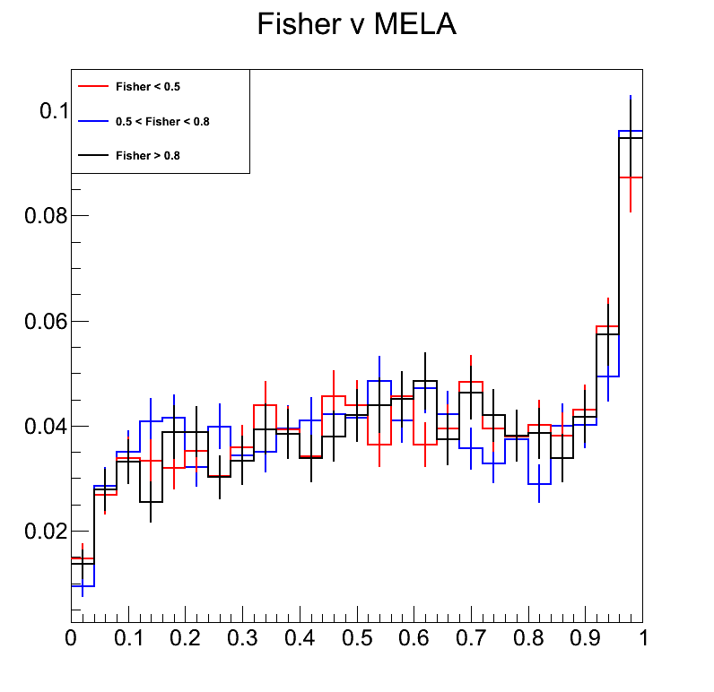
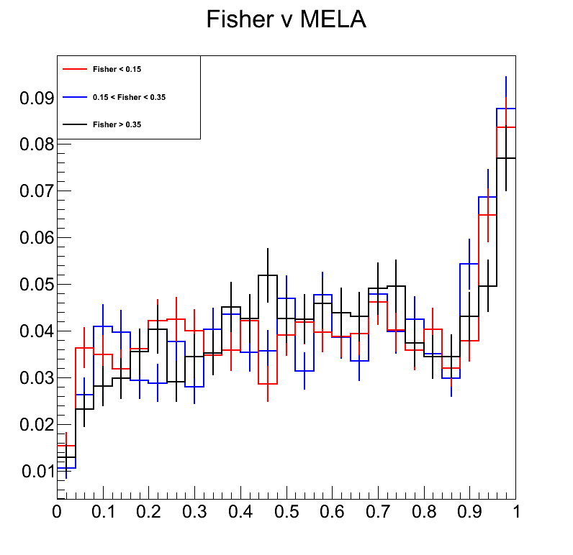
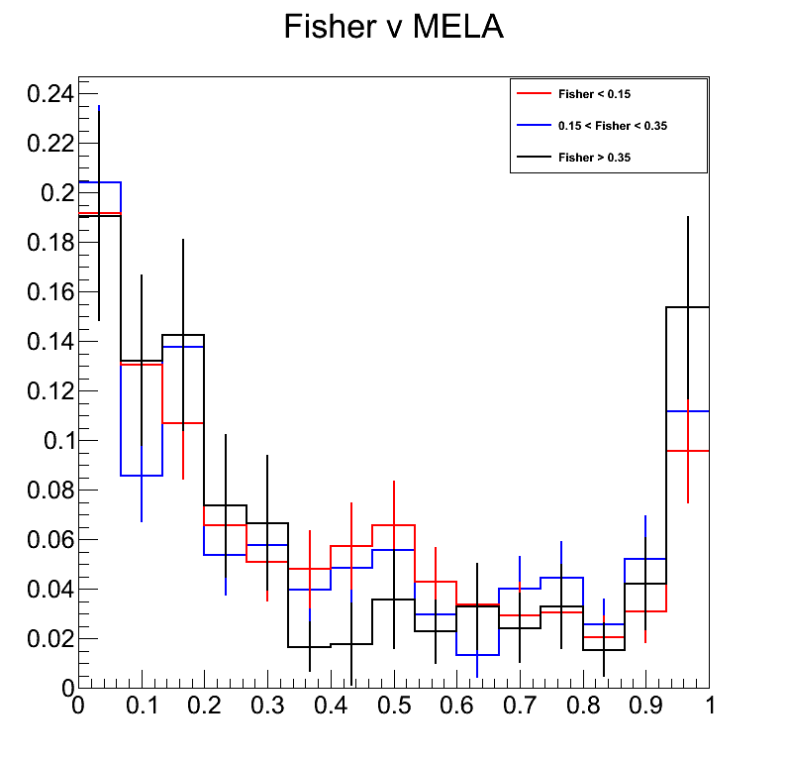
<number>
Fisher-KD correlation
Approach of Fisher-m4l templates requires the two variables to be uncorrelated with the 3rd one (KD)
Verified for all major contribution to the ZZ yield
No effect visible in the available MC statistics (as expected)
VBF 125GeV
VBF 125GeV
ggH 126GeV
qqZZ 106 < m4l < 141 GeV
Notes:
<number>

Slide 12
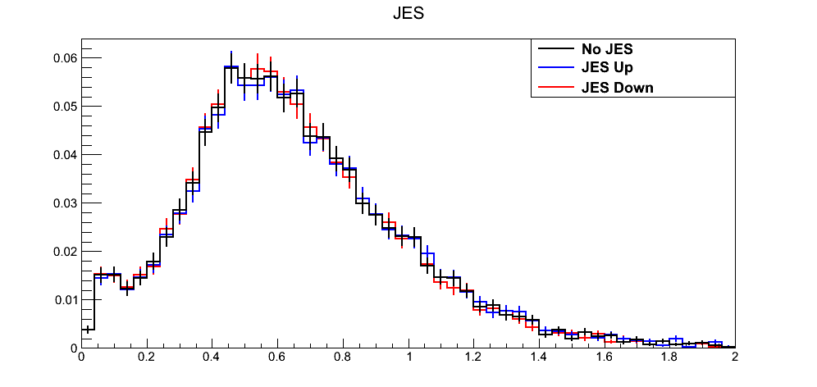
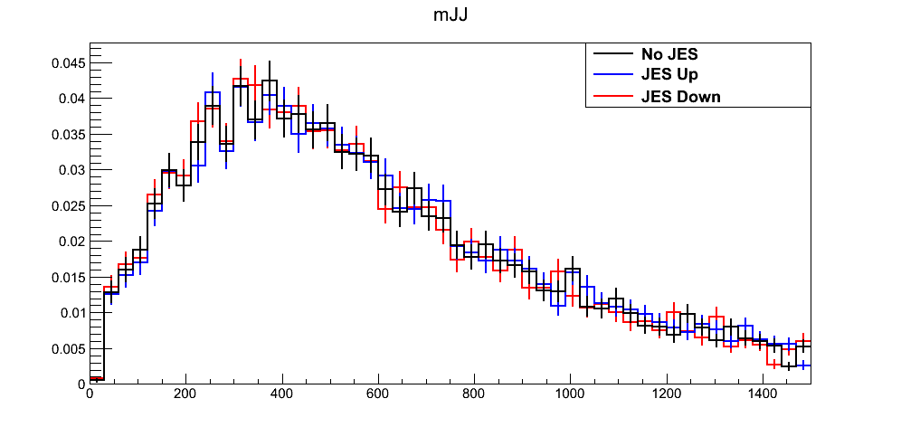
<number>
VBF systematics
Normalization for VBF category from H x-section WG
gluon fusion yield in Njets=2 (~20%)
VBF yield (~10%)
other backgrounds (subleading)
Shape uncertainties
taken into account by building alternative templates
JES uncertainty on Fisher shape (affecting mJJ, leading)
under study for ggH pollution comparing different MC generators https://indico.cern.ch/conferenceDisplay.py?confId=218887
Fisher
mJJ
Notes:
<number>

Slide 13
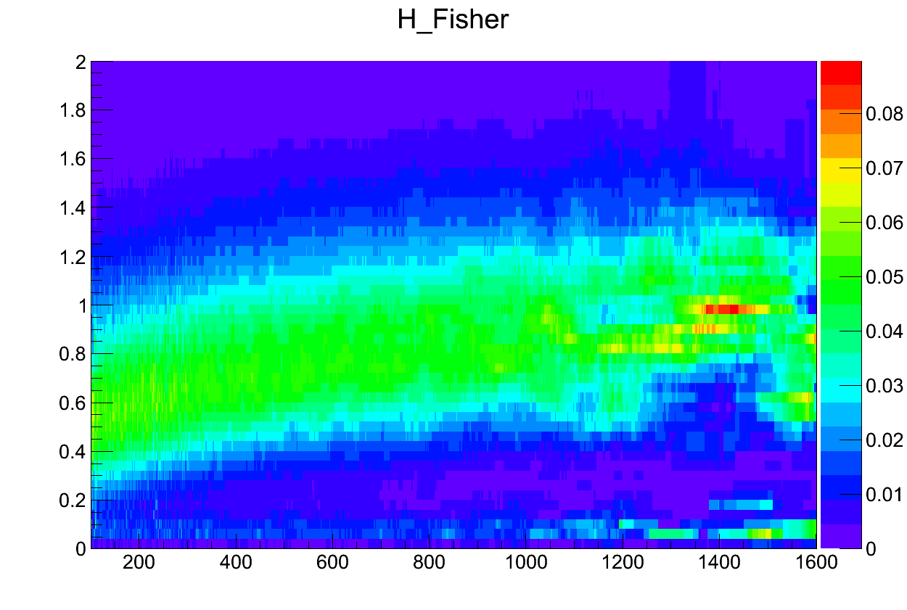
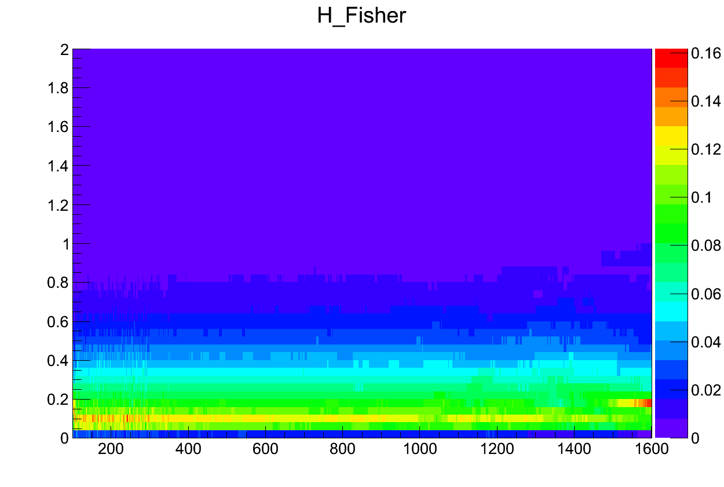
12/3/12
R. Covarelli
<number>
Extension to full range
Accomplished by merging all signal samples
No large correlation observed in any sample except VBF (dependence of jet variables from mass of recoiling H)
Fisher vs m4l
VBF
ggH

Slide 14
12/3/12
R. Covarelli
<number>
Untagged category

Slide 15
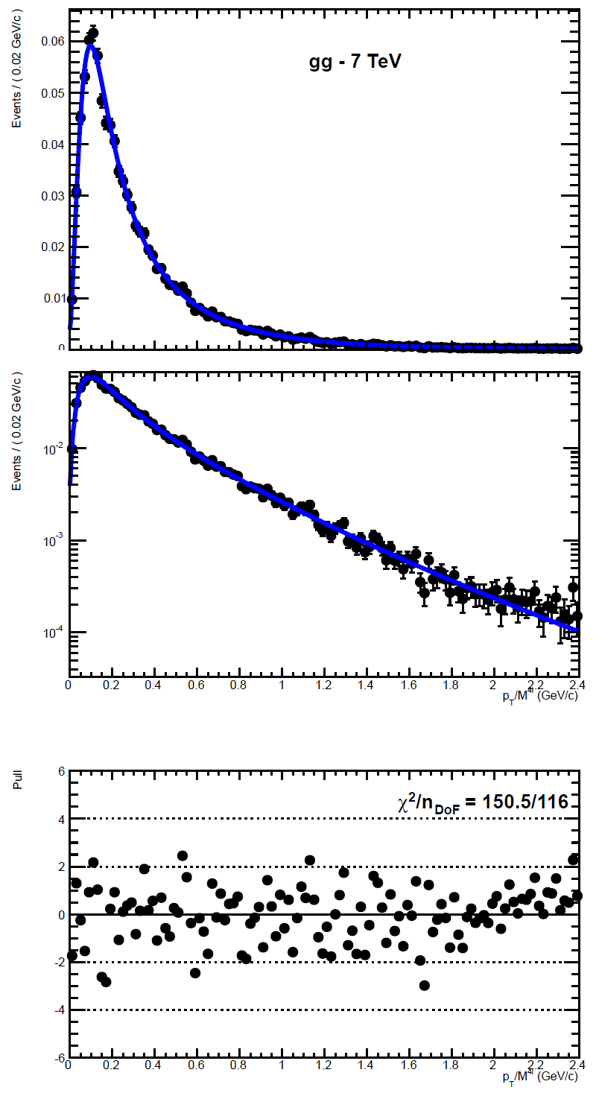
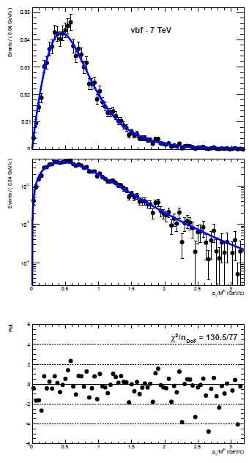
<number>
pT/m4l fits (signal)
with HRes
and finite top-mass
reweighting
ggH
VBF →
All done separately
For 7 and 8 TeV
(merging 4e,4mu, 2e2mu)
WH, ZH fits
also performed (ttH less
important w.r.t. other
signal contributions)
Notes:
<number>

Slide 16
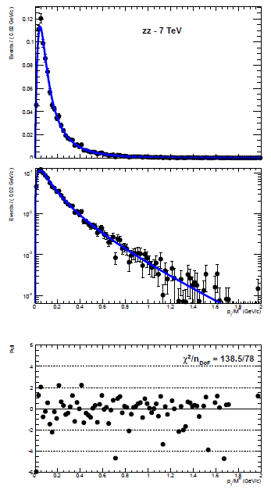
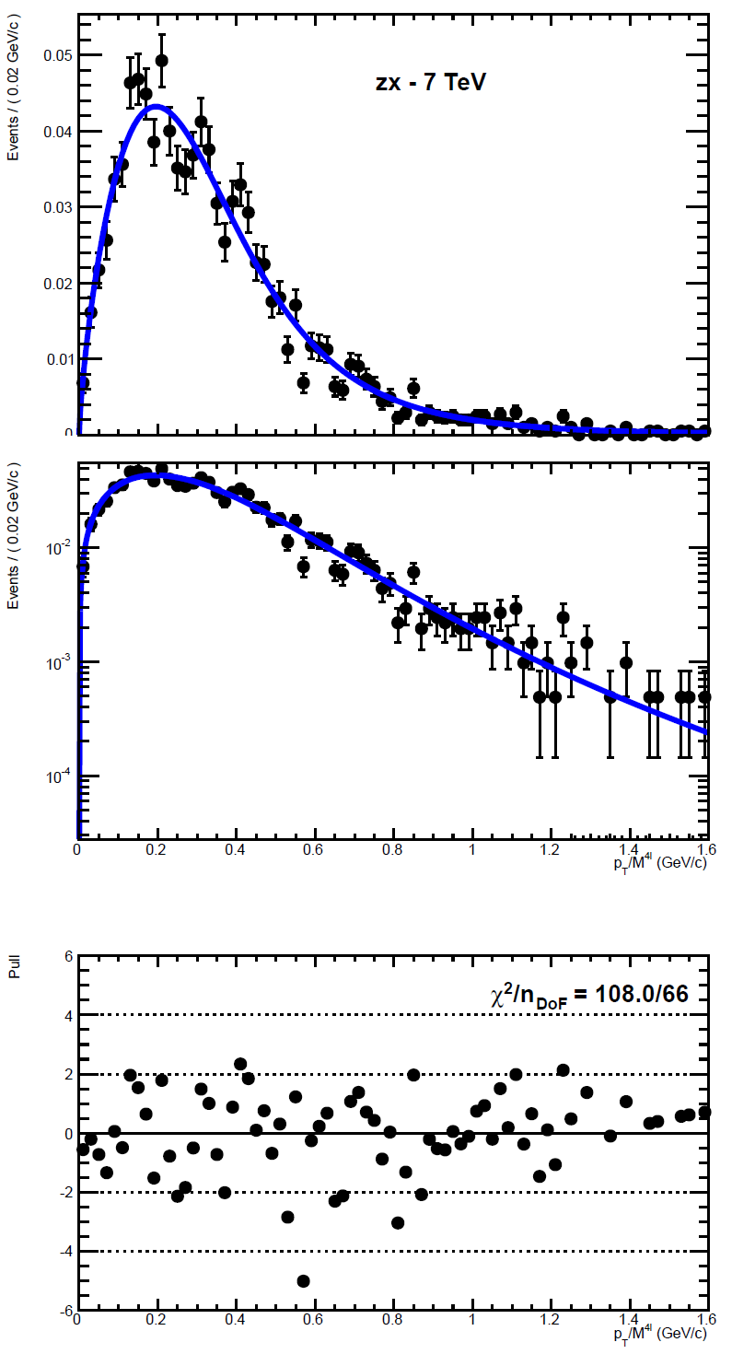
<number>
pT/m4l fits (backgrounds)
qqZZ
Z+X →
From control
regions in data
ggZZ fits
also performed (less
important w.r.t. other
background contributions)
Notes:
<number>

Slide 17
<number>
pT/m4l systematics
ggH signal
Considered: choice of resummation scale (vary resummation, renormalization, and factorization scales simultaneously, as in arXiv: 1203.6321), effect of infinite top-mass approximation (from POWHEG)
VBF signal
Considered: choice of PDFs, variation of renormalization and factorization scale (for variations use recipe in JHEP 1108 (2011) 061)
VH Signal
Spectra not easily available at NLO: using the same as VBF (very similar pT spectrum as verified from MC)
qqZZ Background
Considered: PDFs, scales, data/MC agreement in single-Z EWK measurement (cross-checked at higher masses using the “real” part of the ZZ spectrum, mZZ > 180 GeV)
Z+X Background
Statistical errors from control regions
Notes:
<number>

Slide 18
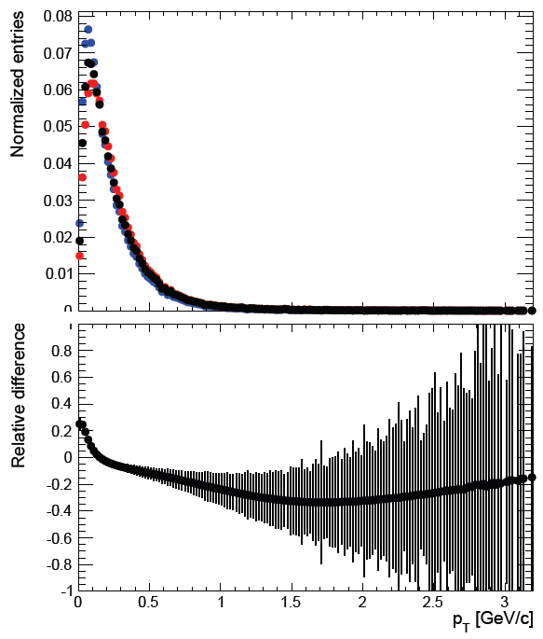
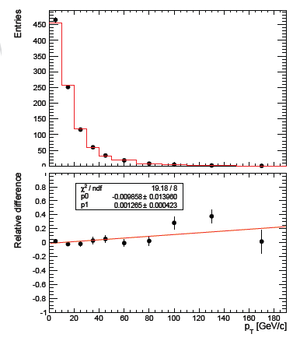
<number>
Examples: systematics on pT/m4l
ggH: resummation qqZZ: data/POWHEG for Z
(EWK-10-010)
μQ = μF/2 = μR/2 = mH/2 (default)
μQ = μF/2 = μR/2 = mH/4
μQ = μF/2 = μR/2 = mH
Data
POWHEG MC
([mH] – [mH/2])/[mH/2]
More included in backup
Notes:
<number>

Slide 19
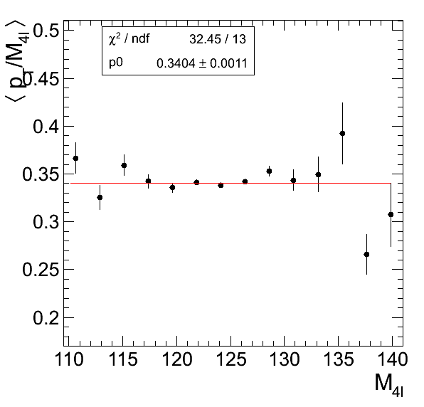
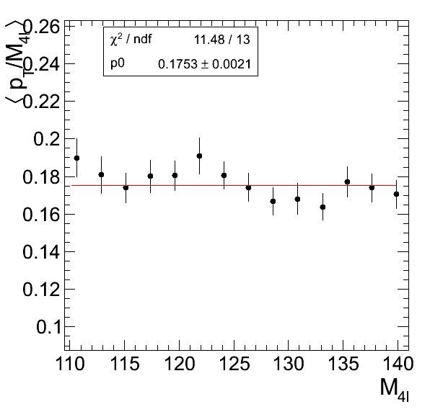
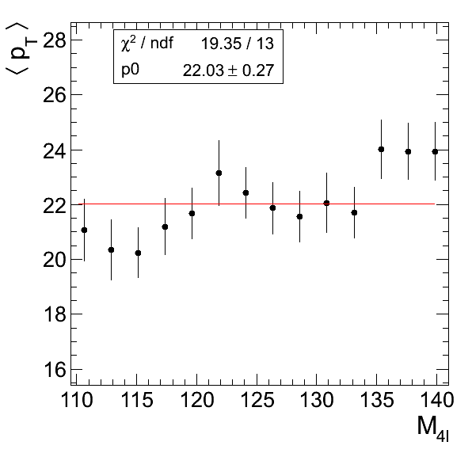
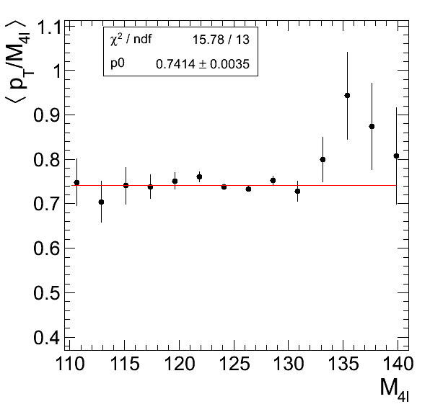
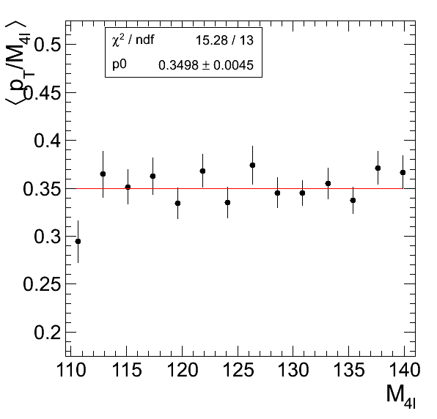
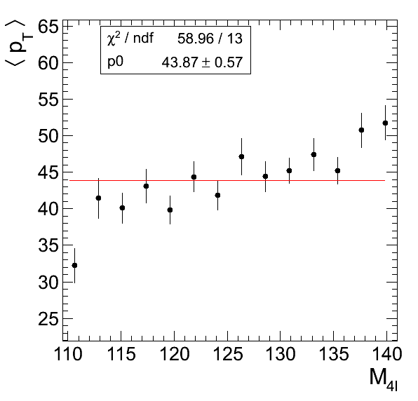
<number>
pT/m4l correlations with m4l
No correlation visible within statistical uncertainties
ggH
qqZZ
if using
simple
pT
qqH
Z+X
Notes:
<number>

Slide 20
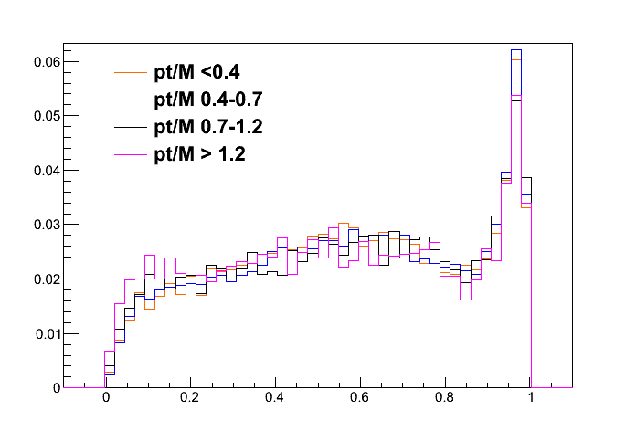
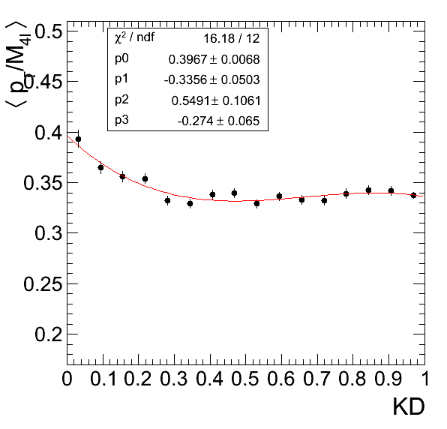
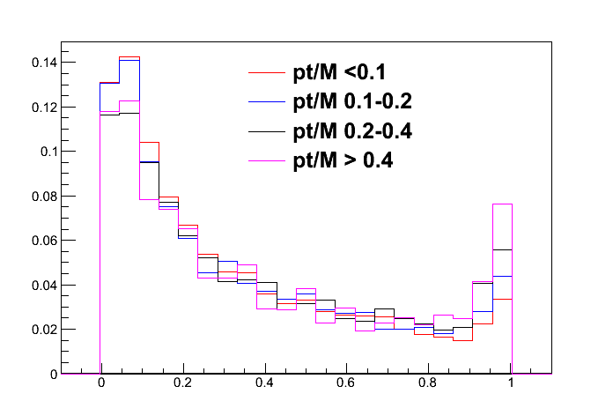
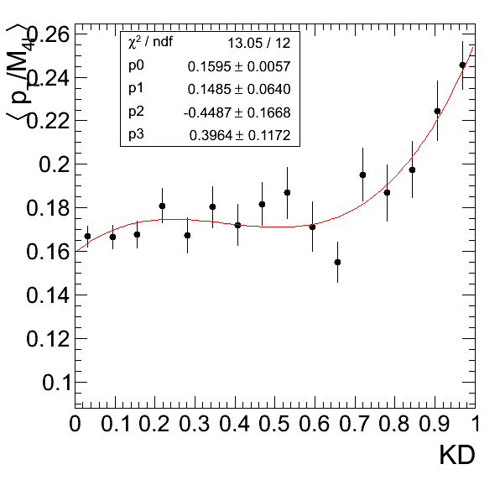
<number>
pT/m4l correlations with KD
At the first order, no correlation expected
MELA variables computed in the H/Z rest frames
A small amount of residual correlation is visible
Impact on significance is of the order of 0.5% (see next slides)
ggH
qqZZ
<number>
Notes:
<number>

Slide 21
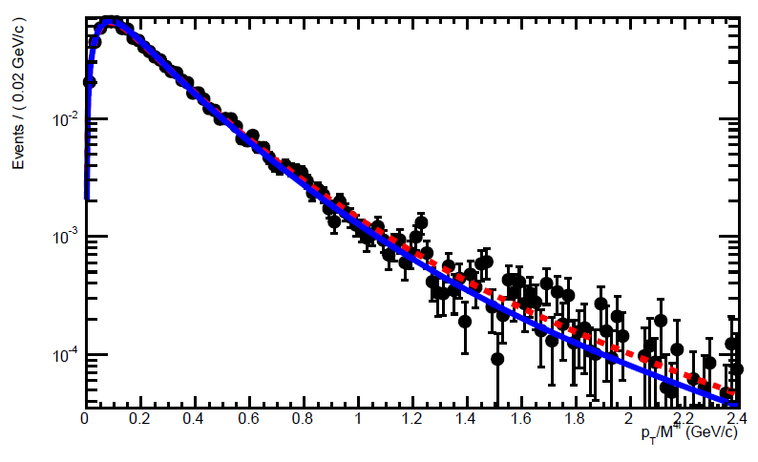

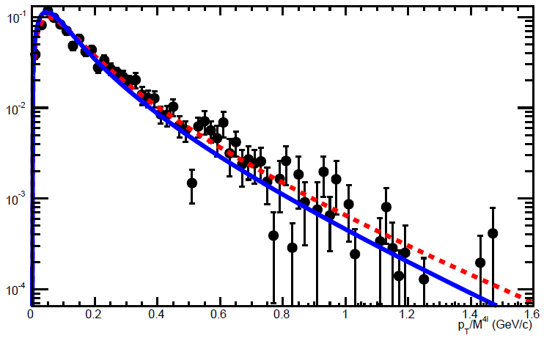

12/3/12
R. Covarelli
<number>
How to take correlations into account
2D templates vs. one other variables
From analytical function: no issues from MC statistics
Default: pT/m4l vs. m4l
Advantage: basically flat in narrow range, can be extended to full range
KD correlation taken into account as additional systematics considering pT/m4l in extreme KD slices
Cross-check: pT/m4l vs. KD
Build 2D templates assuming that, as a function of KD, only the mean of the pT/m4l spectrum varies:
MT (pT/m4l) → MT (α(KD)* pT/m4l)
where α(KD) is the ratio between the value of a flat function and the polynomial fits in previous slide
0 < KD < 1
0 < KD < 0.3
0 < KD < 1
0.7 < KD < 1

Slide 22
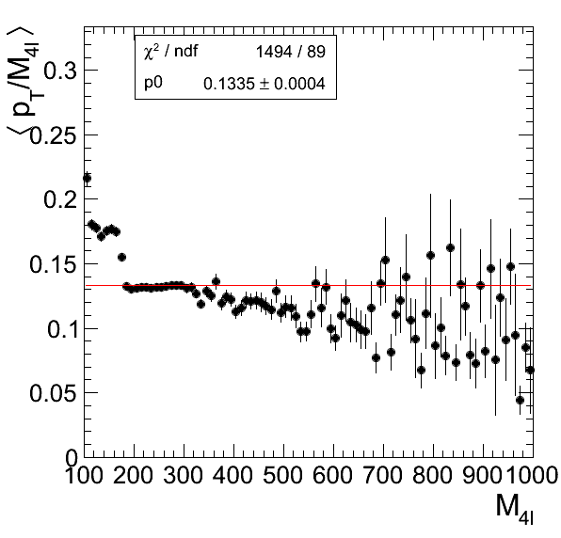
12/3/12
R. Covarelli
<number>
Extension to full range
Easily achieved with current framework
However, flat pT/m4l vs. m4l does not hold anymore
Mass dependence taken into account for all samples by fitting modified-Tsallis parameters as a function of m4l
qqZZ

Slide 23
12/3/12
R. Covarelli
<number>
Combined results

Slide 24
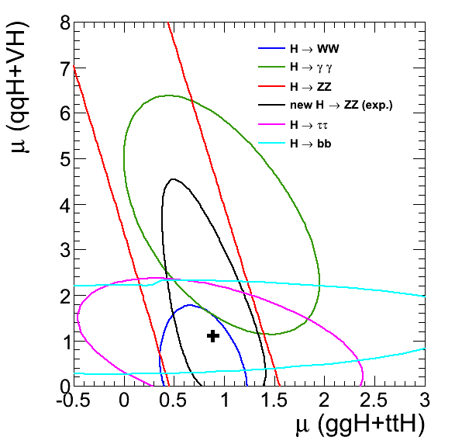
<number>
Expected RV/RF measurement
fVBF+VH = 0.12 ± 0.34
Expected SM 68% CL is overlaid in black in RV/RF plane
We would expect a sensitivity of ~5.5sigma for signal/background separation for HCP dataset
11% improvement
8% from pT/m4l , compatible with improvements seen from KD approaches including pT (nloMELA, BNN, BDT…)
3% from VBF
Notes:
<number>

Slide 25
<number>
Conclusions
Analysis to add the ZZ channel to property measurements
Use 2 exclusive categories in a 3D model fit:
Untagged : fit pT/m4l x m4l x KD
VBF tagged : fit Fisher x m4l x KD
3rd dimension added to baseline fit either by:
Analytical PDFs for pT/m4l (systematics considered by varying PDF and interpolating)
2D templates for Fisher (systematics considered by building alternative shapes)
Expected results with HCP dataset:
fVBF+VH = 0.12 ± 0.34 (important constraint in RV/RF plane)
Total signal significance ~5.5 sigma
Notes:
<number>

Slide 26
<number>
BACKUP
Notes:
<number>

Slide 27
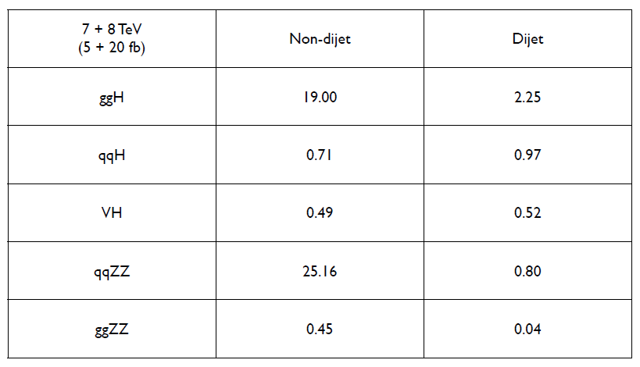
12/3/12
R. Covarelli
<number>
Total expected rates

Slide 28
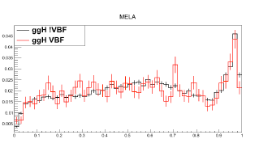

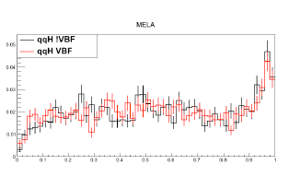

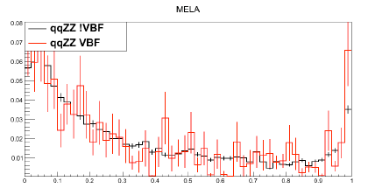

12/3/12
R. Covarelli
<number>
Common Mass-KD template for the 2 categories
OK

Slide 29
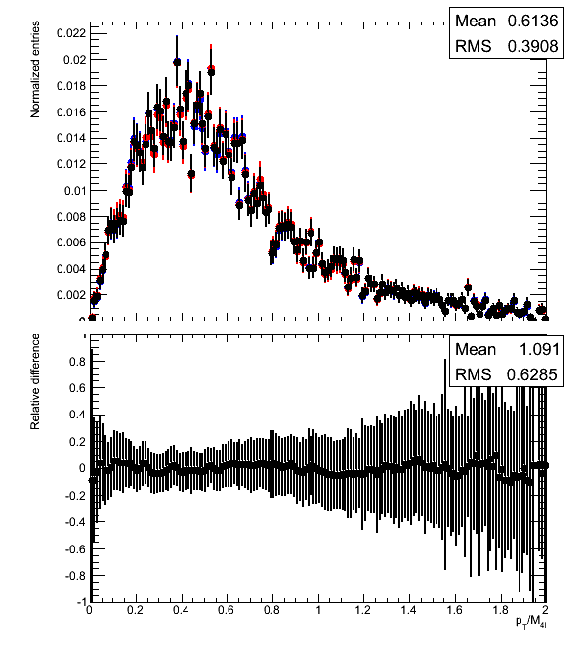
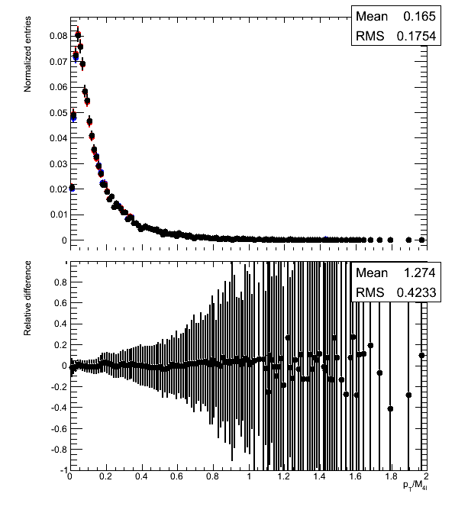
<number>
PDF systematics on Pt/m
PDF
CTEQ
MSTW
NNPDF
CTEQ
MSTW
NNPDF
<number>
Notes:
<number>

Slide 30
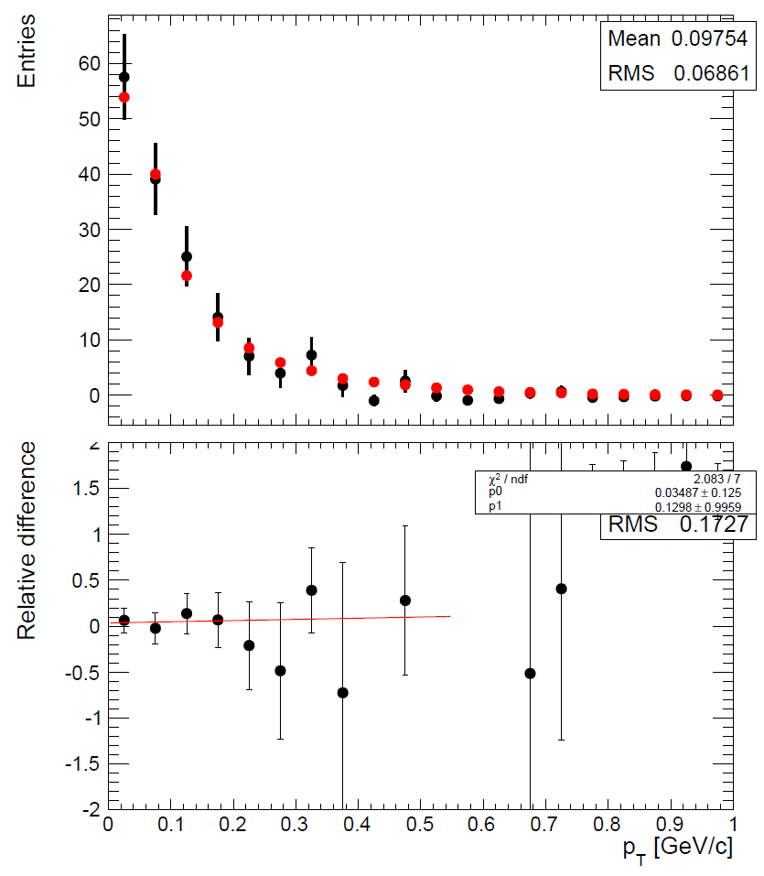
<number>
qqZZ systematics on Pt/m: x-check
Unblinded region
Notes:
<number>

Slide 31
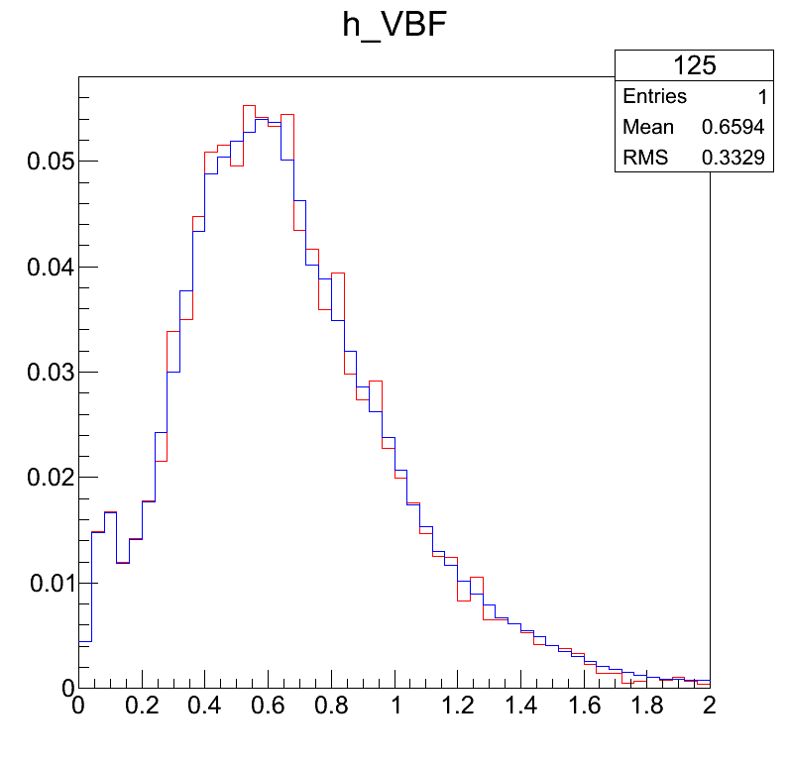
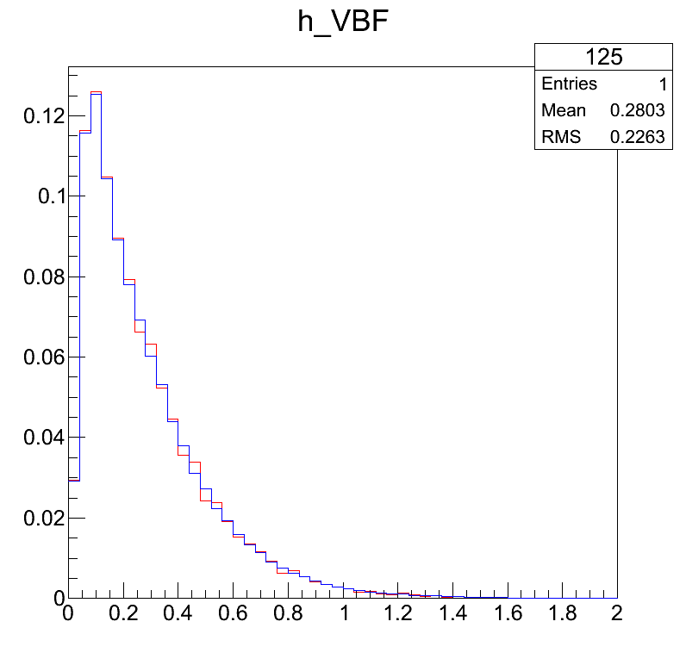
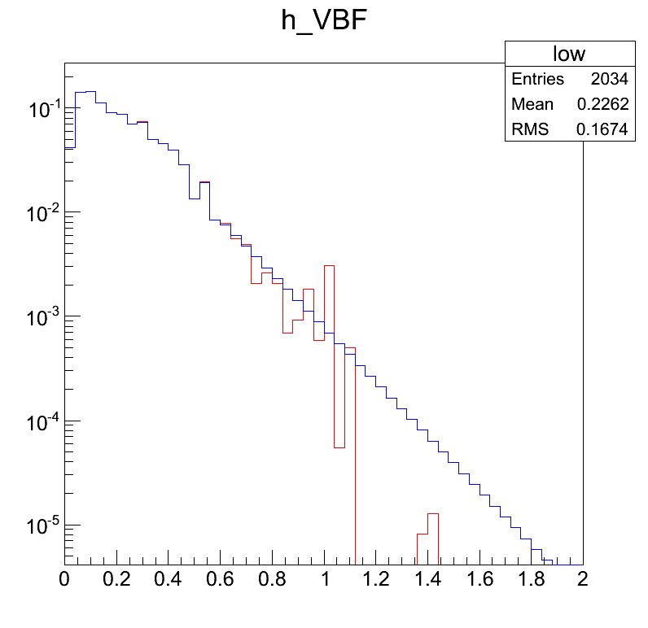
Bias Checks – 125 GeV
VBF
ggH
qqZZ
Red = Original histogram with just normalization
Blue = Histogram after smoothing with normalization

Slide 32






<number>
Fisher Templates
qqH
ggH
ggZZ
qqZZ
Z+Jets
ZH
WH
ttH
Notes:
<number>

Slide 33

<number>
Z+Jets Fisher
VBF
Gluon fusion
Very low statistics (completely negligible
at high mass)
Fit profile with Landau + Gaussian
Fill template with fit
ZZ
Notes:
<number>

Slide 34


<number>
ZH Fisher
VBF
Gluon fusion
No mass dependence visible in the sample
Tail is smoothed with fit
ZZ
Z+X
Notes:
<number>

Slide 35
ggH profiles

Slide 36
qqH profiles

Slide 37
qqZZ profiles

