Slide 1

Studies of the Drell-Yan Process at the LHC
Alexey Svyatkovskiy
Purdue University

Slide 2
Outline
Introduction
  The Standard Model of Particle Physics
  The Drell-Yan Process
  The Compact Muon Solenoid Experiment at the Large Hadron Collider
  Muon Reconstruction
What has been done so far
  The Drell-Yan dσ/dM and d2σ/dMdY Cross Section Measurements
  The Detector Misalignment Effects and the Segment-based Fit
What’s next
  Quantification of PDF Constraints with the Drell-Yan data
  8 TeV analysis
  Finalizing the study of the Segment based fit with APEs

Slide 3
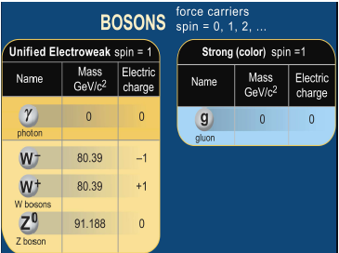
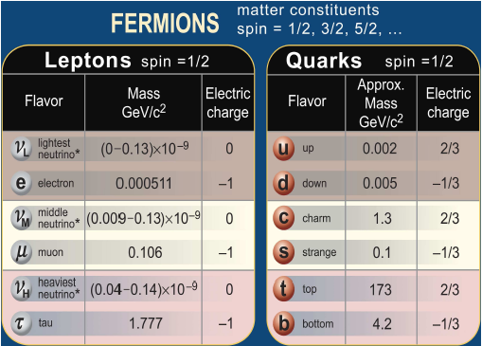
Fundamental Constituents of Matter and Interactions
Despite this striking success, the SM is conceptually incomplete as it does not provide consistent answers to several questions:
large hierarchy in energy scales
presence of dark matter in the universe
origin of many fundamental parameters
3 families

Slide 4
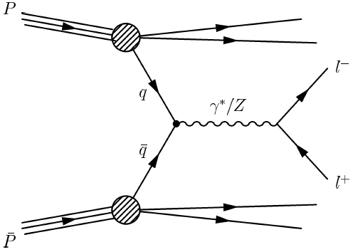

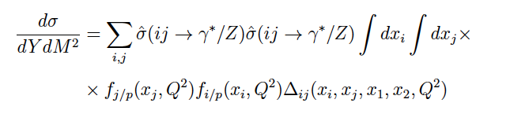
The Drell-Yan process (I)
Low pT interactions:
factored out in PDFs
At leading order, the Drell-Yan process is described by a quark-antiquark
annihilation producing a virtual photon or
a Z-boson, which then decays into two oppositely charged leptons
  3 contributions in the parton cross section (photon, Z exchange and the interference term)
High-pT interaction:
perturbative domain
The double-differential Drell-Yan cross sections in proton-proton collisions is given by:

Slide 5
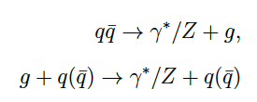
The Drell-Yan process (II)
At the next-to-leading order pQCD, gluon bremsstrahlung and processes with gluons in the initial state contribute
  The size of perturbative corrections depends on the lepton-pair mass and on the overall centre-of-mass energy. At low energies, the correction is generally large and positive, of the order of 50%. In this regime, the (negative) contribution from the quark-gluon scattering terms is quite small
QED radiative corrections are significant in the region right below the Z peak (50-80 GeV), reaching the value of 80%
EWK non-QED radiative corrections are negligibly small in the wide mass range, becoming important at high masses (M > 200 GeV) and large x reaching the value of 10%

Slide 6
Motivation for the Drell-Yan cross section measurement
A lot of valuable predictions can be extracted from the Drell-Yan cross section measurements:
  Tests of scaling of the cross sections with the centre-of-mass energy
  The beam and mass number (A) dependences of the cross sections
  Transverse and invariant mass distributions of Drell-Yan dimuons for the background estimation purposes
  Searching for new physics at the LHC requires a very good understanding of the proton structure. The Drell-Yan process is an ideal microscope for this purpose.
  The measurements of angular distributions and forward-backward asymmetry.

Slide 7
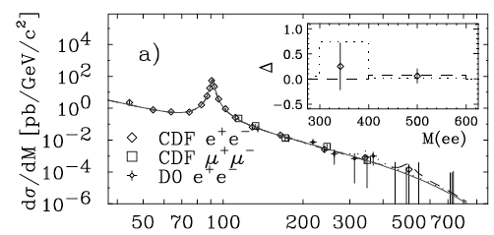
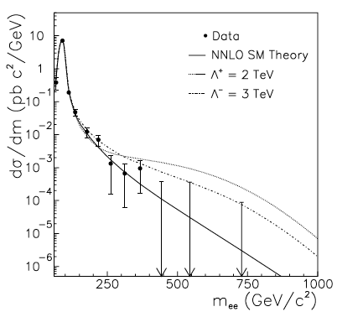
Measurements in the past
The most recent and the most precise dσ/dM and d2σ/dMdY measurements were performed by the CDF and D0
Collaborations
CDF measurement The measurement is dominated by systematic uncertainties at low masses and in the Z peak region, where the total uncertainty is 3-20% at low masses, and 2-8% in the Z peak region. At high masses (M > 120 GeV), the measurement is dominated by statistical uncertainties, where the total uncertainty is 15-100%. The additional overall luminosity error is 3.9%.
D0 measurement The total uncertainty is 22-74% in the 120-400 GeV mass range. No events were observed with the mass M > 400 GeV. In that region (the 3 highest mass bins), the 95% confidence level (CL) upper limits on the cross section were quoted.
CDF, 108 pb-1
D0, 120 pb-1

Slide 8
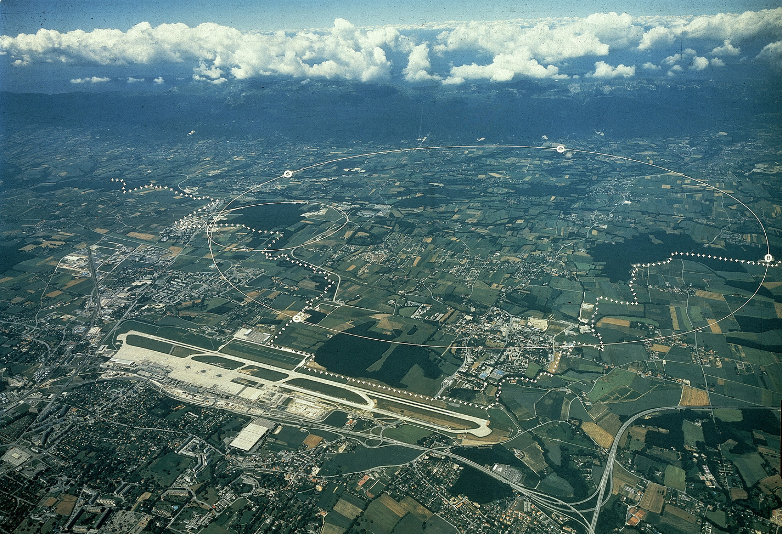
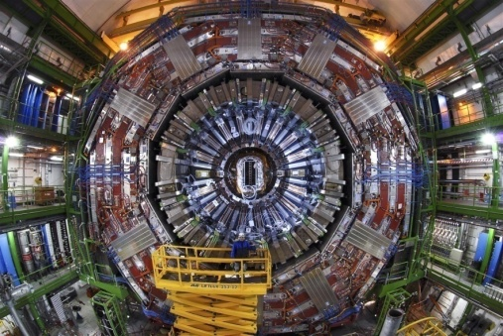
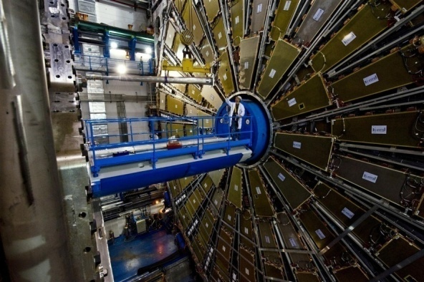
The Large Hadron Collider
CMS
France
France
6 miles
ATLAS
Geneva airport
Operating at a world record energy of 8 TeV
  The world’s most powerful microscope 10-19m
  Time machine 10-12s after the big bang T= 1015K
  Magnets cooled to -271.3°C (1.9 K)
It will reach 13 TeV after a shutdown in 2013
Switzerland
10

Slide 9
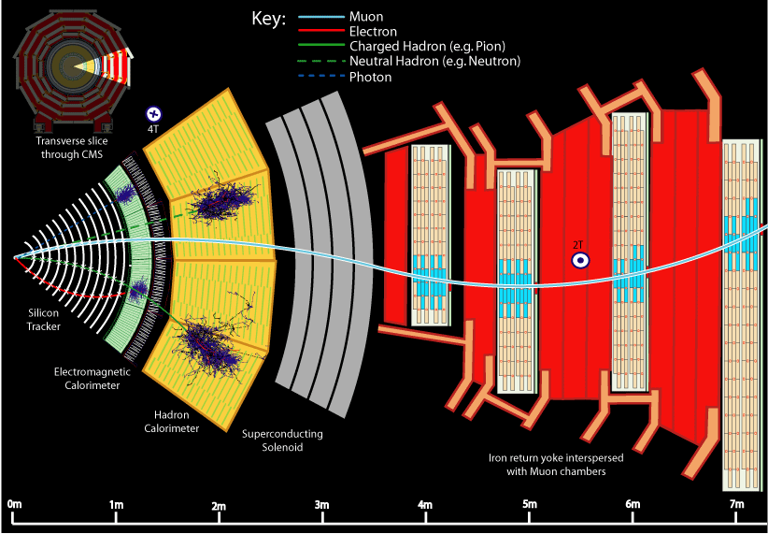

Slide 10
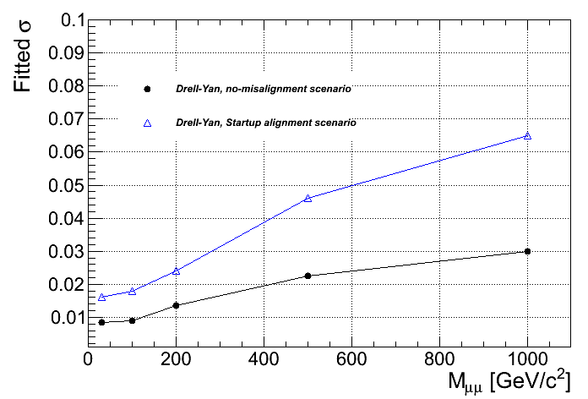
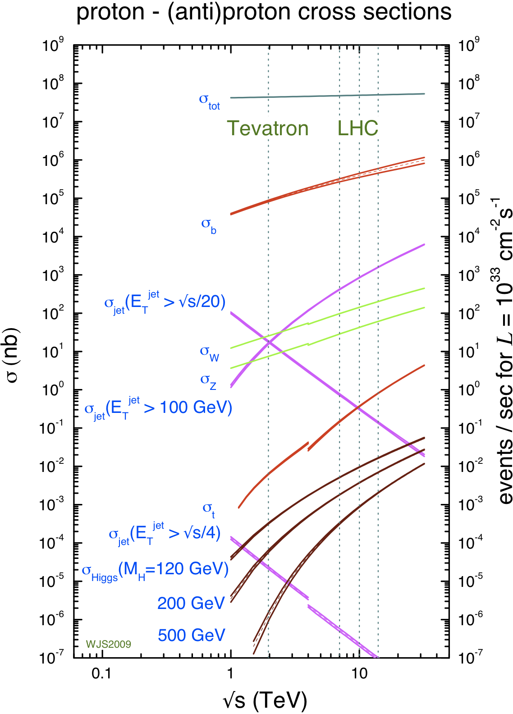
Drell-Yan studies: can we improve with CMS?
Mass resolution
What do we still need:
Perform measurements of Drell-Yan cross sections
sensitive to NNLO (NNNLO?) theoretical predictions.
Provide a precise data-driven Drell-Yan background
estimation for various physics searches beyond
the SM (Z’, Higgs..)
Provide PDF constraints at low x and high Q2 kinematic region
With the LHC and the CMS detector we can satisfy all these needs!

Slide 11
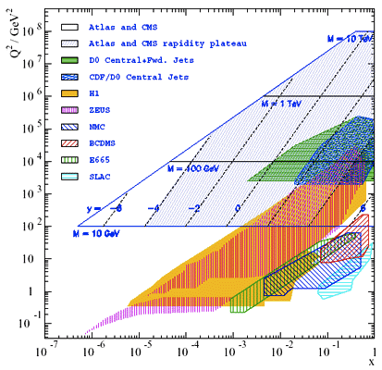
PDF constraints (I)
Parton Distribution Functions are the crucial ingredients for all theoretical calculations of particle production in hadron collisions
  Determined from data (DIS,
  Jets production, Drell-Yan)
  Used for the calculation
  for all physics process at the LHC
In the past, a lot of constraints
were provided by H1/ZEUS,
SLAC, CDF/D0 data
  Only LHC experiments are
  capable to provide small x and
  large Q2 constraints right now
Our group is working on
providing the constraints
for the PDFs of new
generation

Slide 12
PDF constraints (II)
The essential input for a global QCD analysis comes from experimental data.
Ideally, a given PDF set would use as many experimental results as possible to let the experimental data constrain the PDFs in as wide a kinematic range as possible: this approach is used by many theoretical groups, including CTEQ and MSTW, however, the resulting fit quality is worse. An alternative approach is to require an internal consistency between various datasets used in the global fit and the removal of outliers (Alekhin).
The main theoretical inputs to global analyses are the perturbatively calculated hard cross sections, along with the QCD evolution equations which control the scale dependence of the PDFs

Slide 13

PDF constraints (III)
The typical approach adopted by most of the PDFs fitting collaborations consists of setting a functional parameterization which takes into account some handle we have on PDFs behavior; the standard parameterization has a form such as:
There are many sources that contribute to the uncertainty of the global fit. These sources of uncertainty can have theoretical or experimental origins. The experimental uncertainties are related to the data errors as they are extracted from an experiment. The theoretical uncertainties are related to the framework used and the model assumptions made. Several model assumptions are imposed to extract a PDF set. These assumptions are often intended to reduce the parameter space, which is achieved by assuming symmetries and neglecting some phenomena.

Slide 14
Muon reconstruction at CMS
Muon reconstruction strategy at CMS consists of 3 steps
  Local reconstruction
  Reconstruction of hits and segments in the muon chambers
  Track reconstruction in muon spectrometer (standalone)
  Initial (seed) state estimation
  Inside-Out pattern recognition
  Outside-In track reconstruction
  Vertex constraint: extrapolate track to the point of closest approach to the beam line
Track matching and global refit
  Use the parameters of a track reconstructed in muon spectrometer to select a region of interest in the silicon tracker
  Select tracks from silicon tracker in the region of interest
  Track Matching: match tracker tracks to standalone tracks
  Combined (global) fit of track parameters using hits from tracker track and standalone muon track

Slide 15
Track reconstruction in muon spectrometer
Standalone Stage
Seed: segment on an
innermost layer
1. Standalone forward filter:
performs pattern recognition, selects
the best segments and does the
initial track parameter estimates
2. Standalone backward filter:
performs a more precise track parameter
and error estimate, doesn’t modify the
hit pattern when segment granularity is
used (segments rejected on the forward
filter stage do not exist).

Slide 16
Global track reconstruction
Global Stage
Standalone muon
Global muon
Seed: tracker track
innermost state
Extrapolated matched tracker track
4. Global backward filter: does
more precise global track
parameter and error estimate
3. After matching is performed,
global forward filter takes tracker track
rechits and muon segments and performs
the refit. Some segments might be rejected
as outliers

Slide 17

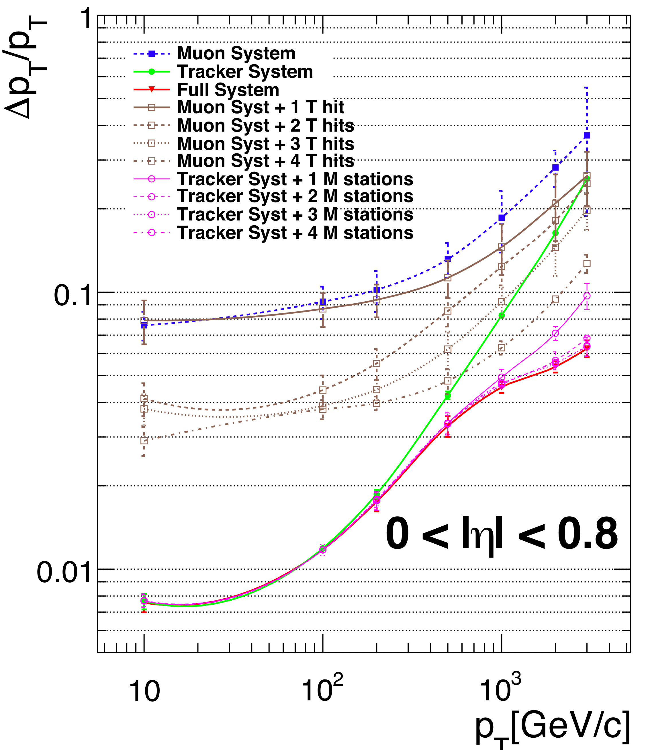
Muon reconstruction performance
The momentum resolution depends on the magnetic field B, the level arm L, the number of measurements and the measurement resolutions
At low and intermediate momenta
(M < 200 GeV), the silicon tracker
dominates the momentum
measurements
At higher energies, the increased
lever arm of the muon chambers
causes the standalone track momentum
to dominate the momentum resolution
Over all energies, the combination of
tracker and standalone tracks (global
tracks) gives the best resolution
In silicon tracker
σrφ ~ 50 μm.
In muon chambers:
σrφ ~ 500 μm.

Slide 18
Drell-Yan analyses
Drell-Yan analyses:
Today, I will present a measurement of the Drell Yan differential cross-section dσ/dM, and the double-differential cross section d2σ/dMd|Y| in pp collisions at 7 TeV using the full 2011 dataset corresponding to an integrated luminosity of 4.5 fb−1 (about 65 M events) recorded at the LHC with the CMS detector.
Muon reconstruction:
I will present the current progress on the segment based fit study and the inclusion of the alignment position errors (APEs)

Slide 19
Drell-Yan analyses: what was done so far
Winter 2011: the Drell-Yan dσ/dM cross-section measurement was performed with 13 mass bins in the mass range 15-600 GeV using 36 pb-1 of data
  Documentation: PAS EWK-10-007, AN 11-013, AN 11-044, AN 11‐011
  Precision: systematics dominated measurement only
  in the peak region
Publication: the result of the DY dσ/dM cross-section measurement with 36 pb-1 was published (JHEP 10 (2011) 007)
Fall 11: the Drell-Yan dσ/dM cross-section measurement was performed with 40 mass bins in the mass range 15-1500 GeV using 1.1 fb-1 of data
  Documentation: PAS EWK-11-020
  Precision: systematics dominated measurement from 15 GeV up
  to 120 GeV
  Winter 2012: the Drell-Yan dσ/dM and d2σ/dMdY cross-section
  measurements with 40 mass bins (6 mass bins and with 24 absolute rapidity bins) in the mass range 15-1500 GeV were performed with the full 2011 dataset (4.5fb-1)
    Documentation: PAS EWK-11-007, AN 12-063
  My contribution: I am one of the main contributors to this analysis, I have contributed tot the various parts of analysis chain, especially the event selection, acceptance-efficiency and background estimation and unfolding steps. For each step, I had to develop dedicated analysis software tools

Slide 20
Analysis procedure
To measure the cross section per bin, we use the following formula:
  σi,j = Nui,j/(Ai,jεi,j Ci,j Lint),
  Note here, that the acceptance correction is
  not applied for 2D measurement, to provide a
  model independent measurement
For 1D measurement, this simplifies to:
  σi = Nui/(Aiεi Ci Lint)
Analysis steps:
1. Selecting Events
2. Subtraction of Backgrounds
3. Momentum scale and resolution correction
4. Acceptance and Efficiency correction using MC
5. Efficiency correction using data-driven methods
6. Correction for FSR effects based on MC
7. Systematic uncertainty estimation
8. Normalized cross section shape calculation
9. Comparison with theoretical predictions
i – mass bin
j – absolute rapidity bin
NU – unfolded, background
subtracted yield
A – acceptance
ε - efficiency
C – efficiency and FSR
correction
Lint – integrated luminosity
40 mass bins
for 1D measurement
6 mass bins
for 2D measurement
24 absolute dimuon rapidity
bins are used for all
mass bins except for
the highest mass bin,
where 12 bins are used

Slide 21
Samples and Event Selection
Full 2011 CMS dataset, containing 4.5 fb-1 of proton collision data is used
Drell-Yan samples are produced with POWHEG MC generator
Trigger selection
  Un-prescaled double muon trigger with no isolation
  requirement on the level of HLT is used (online muon pT > 13,8 GeV)
Candidate Selection
  2 muons with opposite charge
  Select the highest vertex probability muon pair
Kinematic selection
  pT > 14,9 GeV, |η| < 2.4
Muon identification
  Each muon is reconstructed as a “tracker” and “global” muon
  Muon track quality cuts
  Track transverse impact parameter (w.r.t. beam spot) < 0.2 cm
Isolation
  Relative particle-flow Isolation
Di-muon vertex probability and 3D angle to
reject cosmics and muons not coming from
the same collision/process

Slide 22
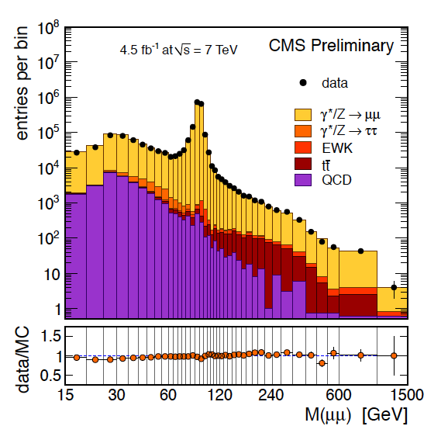
Backgrounds (I)
CMS PAS EWK-11-007
Most important backgrounds
  Low-mass region: QCD multi-jets
  Peak region:
  Drell-Yan → 𝜏+𝜏-,,
  W → l + 𝜈,
  dibosons
  High-mass region:
  top pair production,
  dibosons
All the backgrounds except for QCD
are estimated from MC
The data-driven ABCD method is used
to estimate the QCD background
  Systematics is significantly lower
  compared to MC based estimation
  (1% against 20%)
Same techniques are applied for 2D
measurement
The observed dimuon invariant
mass spectrum in the detector
acceptance for data and MC events.
The signal is normalized to NNLO
Notes:
Backup slide on the ABCD

Slide 23
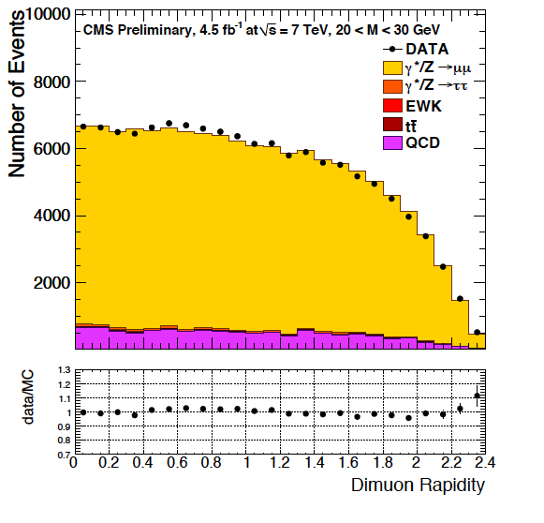
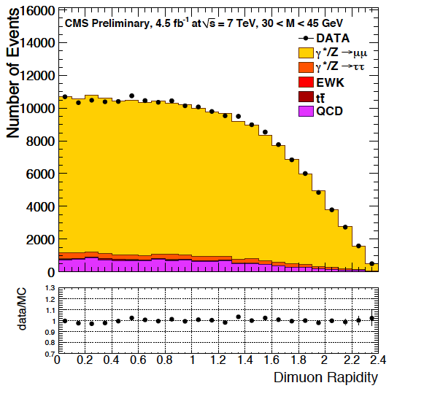
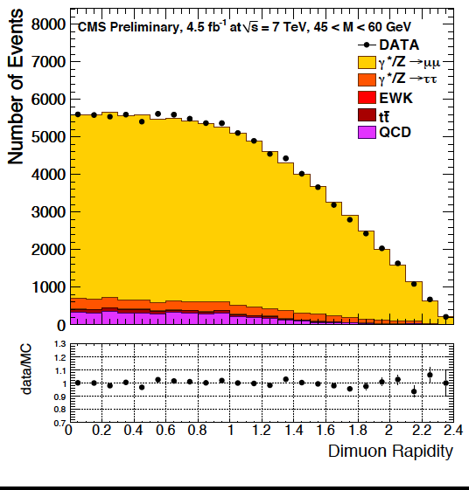
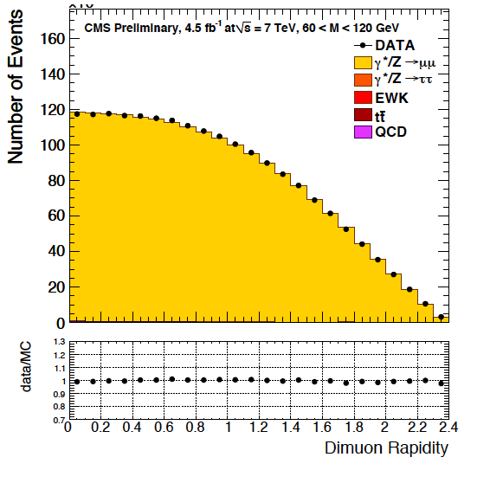
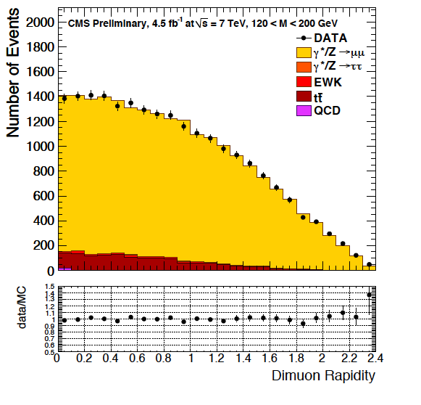
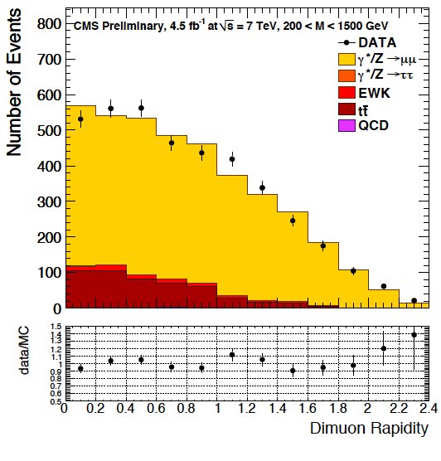
Backgrounds (II)
CMS PAS EWK-11-007
20-30 GeV
30-45 GeV
45-60 GeV
60-120 GeV
120-200 GeV
200-1500 GeV

Slide 24
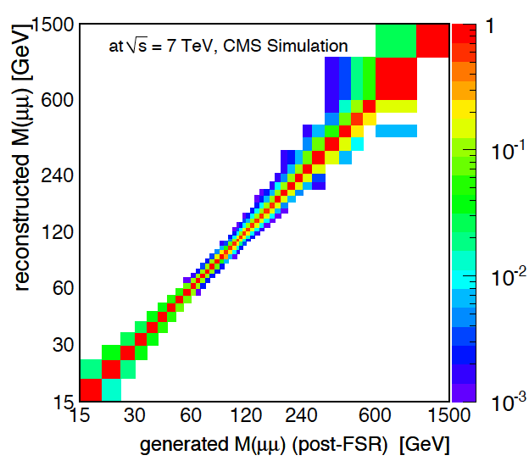
Detector resolution effects (I)
The unfolding procedure corrects the effects of the detector resolution on the mass spectrum
  We use the technique of response
  matrix inversion
Response matrix is produced using
signal MC
  The momentum scale correction,
  taking into account the effects of detector
  misalignment, is applied
Response matrix is nearly diagonal
  Off-diagonal elements located
  adjacent: < 0.1
CMS PAS EWK-11-007
Response matrix

Slide 25
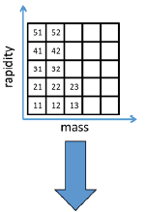
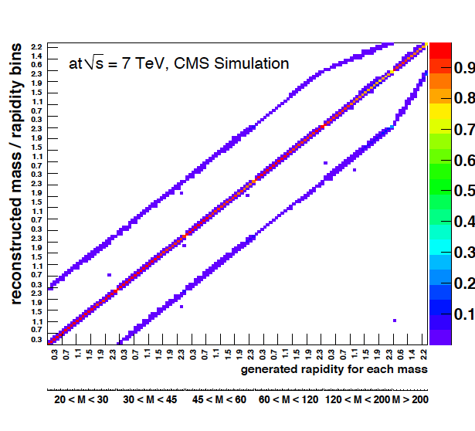

Detector resolution effects (II)
For the 2D measurement, the
conventional unfolding method is used
  Convert the 2D rapidity-mass into a 1D mass
  yield distribution, apply the usual 1D unfolding
  procedure to the flattened spectrum (see previous slide)
The resulting response matrix has a
block-diagonal structure with each
block corresponding to a given mass-rapidity bin. The entries off the main
diagonal are due to migration effects
CMS PAS EWK-11-007
ΔY/Y
4%
0.5%
ΔM/M
5%
0.2%
2%
132x132 unfolding matrix
0.4 1.2 2.4
1%
|Y|
40 120 600
M, GeV

Slide 26

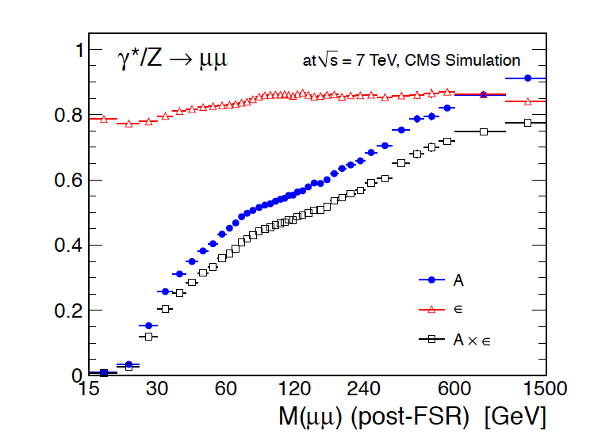
Acceptance and efficiency
NX – number of generated
events, with X:
GEN – initial
ACC – in the acceptance
SEL - (RECO) selected
Acceptance*efficiency is derived from
MC according to:
The acceptance accounts for the muon pT and η cuts, the efficiency
reflects the full selection
Post-FSR muon quantities are used to calculate the di-muon invariant mass
FEWZ NNLO reweighting procedure is
applied to correct for model dependence
Efficiency is almost independent of
invariant mass (0.8-0.9), but the
acceptance is increasing with mass
from very low values (0.007)
to about 0.9
For the 2D measurement, only efficiency
correction is applied
CMS PAS EWK-11-007
Notes:
Backup slide on the acceptance reweighting

Slide 27
Efficiency corrections
The signal efficiency is estimated using MC truth. Data-driven efficiency scale factors are applied to correct for systematic deviations between data and simulation
Single muon efficiencies are estimated using data driven Tag-and-Probe technique
  The Z peak resonance window is used: 2.5 M probes in the data sample
The efficiency correction look-up tables are determined for each individual efficiency as
  ρ = ρ(pT,η) = εData(pT, η)/εMC(pT, η)
  The efficiency corrections are applied per muon and are used to weight the MC events (data is used only to obtain the correction factors)
Notes:
Backup slide on the efficiency corrections

Slide 28
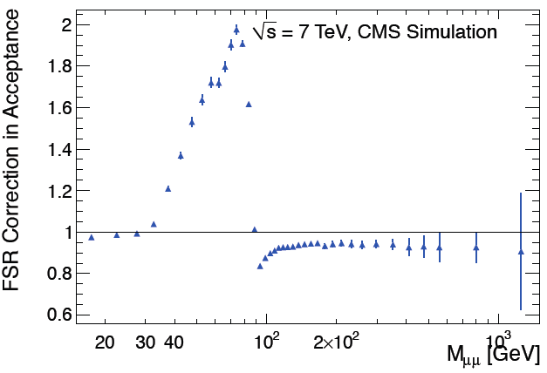
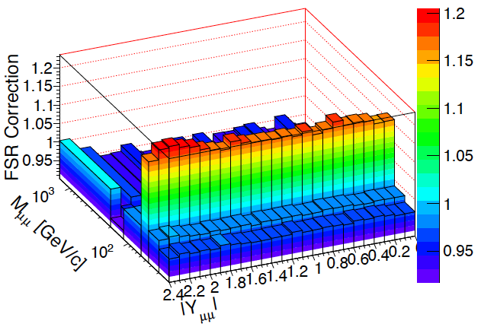
FSR corrections
FSR corrections are determined from simulation
  FSR effects are very well modeled in MC
FSR-correction factors are derived bin-by-bin
Correction is applied in order to compare the measurement to the theoretical calculations which don’t include FSR
CMS PAS EWK-11-007

Slide 29
Systematic uncertainties
Main sources of systematic uncertainties are
  Luminosity: 4 %
  Acceptance (dominated by the uncertainty on PDFs): up to 13 % at low masses, about 1 % at high masses (combined in quadrature)
  Estimation of backgrounds: about 0.5 % at low masses, up to 23 % at high masses
  Efficiency estimation: about 0.5 % at low masses, up to 3.5 % at high masses
  Unfolding and momentum-scale corrections: about 0.5 % at low masses, 28 % in the highest mass bin
The modeling uncertainty on acceptance is dominant at low mass (up to 10%), and the background estimation uncertainty and unfolding and momentum-scale correction uncertainty are dominant at high masses (up to about 25 %)
The luminosity uncertainty cancels out, the PDF uncertainty on acceptance and the pile-up effect in the reconstruction efficiency; the uncertainty on the efficiency estimation are reduced in the cross section ratio

Slide 30

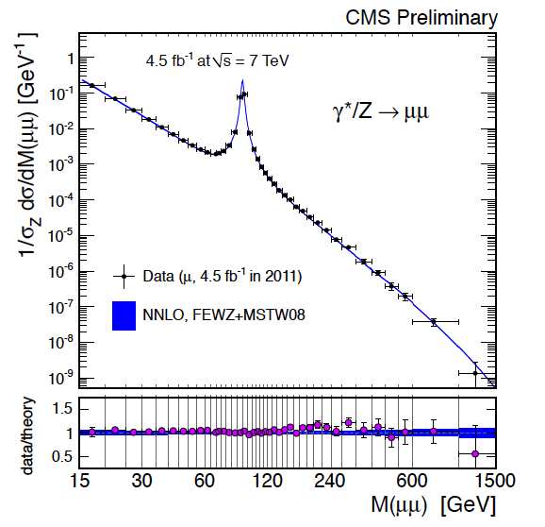
dσ/dM results
Normalized cross-section is calculated as:
  Where ‘norm’ refers to the measurement in the normalization region (Z peak: 60 < M < 120 GeV)
  40 mass bins covering the range from
  15 to 1500 GeV are used
DY dimuon invariant mass spectrum,
normalized to the Z resonance region,
as measured and as predicted by NNLO
calculations, for the full phase space
is shown
  The vertical error bar indicates the
  experimental (statistical and systematic)
  uncertainties summed in quadrature
  with the theory uncertainty resulting
  from the model-dependent kinematic
  distributions inside each bin
Here: i - mass bin index
CMS PAS EWK-11-007

Slide 31

dσ/dMdY results (I)
The first 2D measurement is performed within the detector acceptance, to reduce the model dependence
The result of the double differential cross section measurement is presented as the following ratio per absolute rapidity bin i within the invariant mass slice j:
  j – rapidity index, i –mass index
  Where ‘norm’ refers to the measurement in the normalization region (Z peak: 60 < M < 120 GeV) within |Y| < 2.4
  6 mass bins covering range from 20 to 1500 GeV are used
  24 absolute dimuon rapidity bins within |Y| < 2.4 range are used for all the mass bins except for the highest mass bin, where 12 bins is used

Slide 32
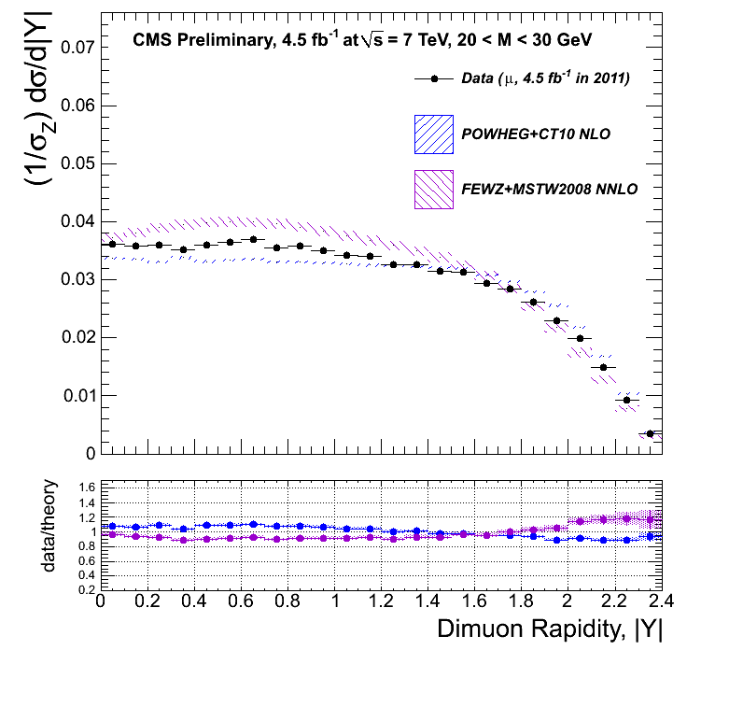
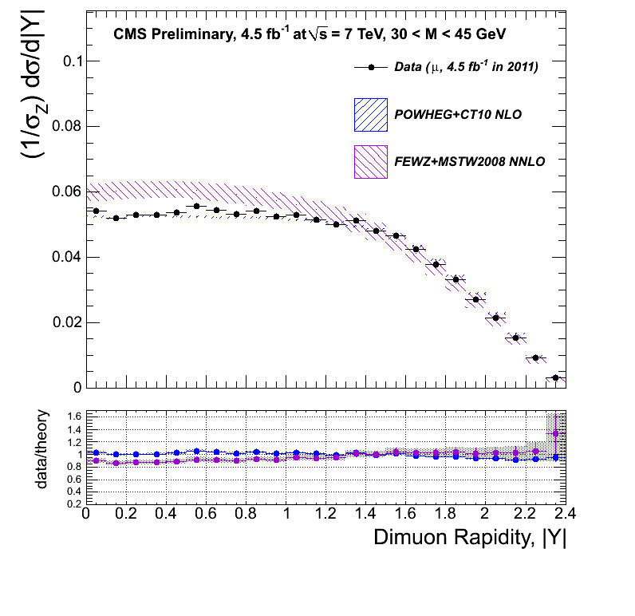
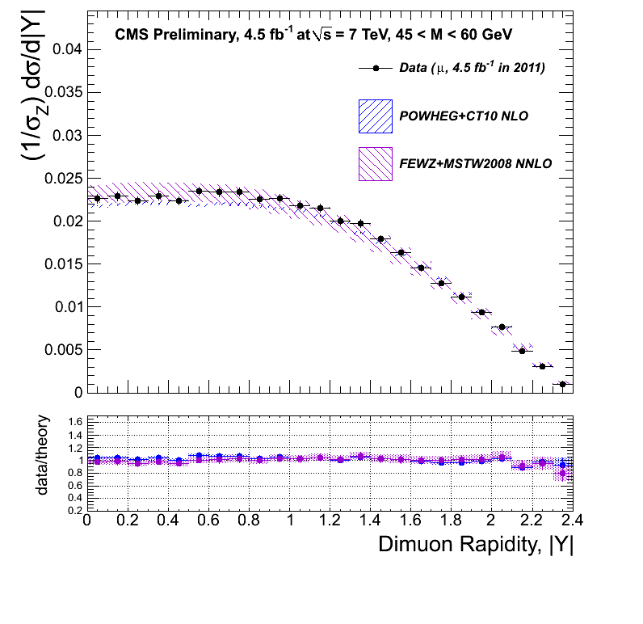
dσ/dMdY results (II)
The following figures show the DY rapidity-invariant mass spectrum in the dimuon channel, normalized to the Z
resonance region, r = (1/σZdσ/dMdY), as measured and as predicted by POWHEG NLO+CT10 PDFs and FEWZ NNLO+MSTW2008NNLO PDFs calculations
Within the detector acceptance
CMS PAS EWK-11-007
20-30 GeV
30-45 GeV
45-60 GeV

Slide 33
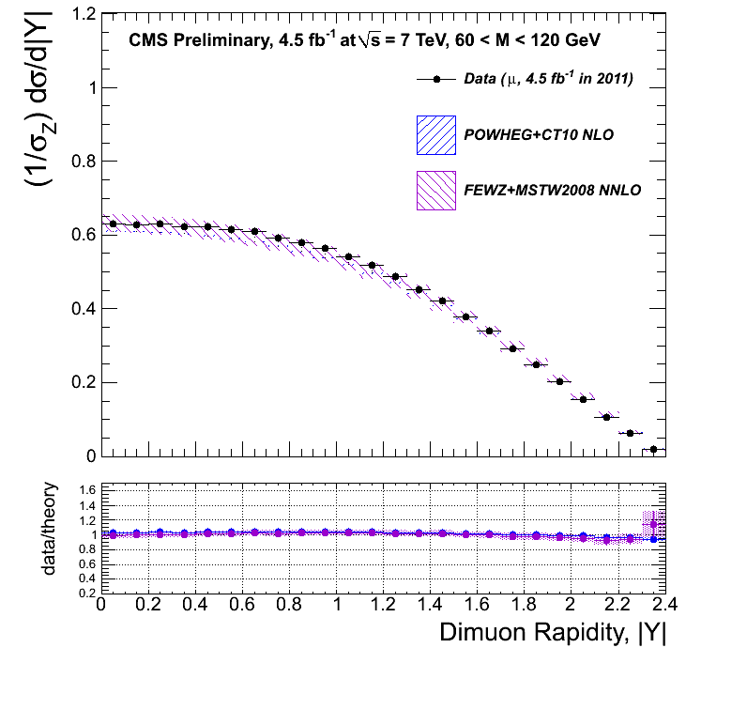
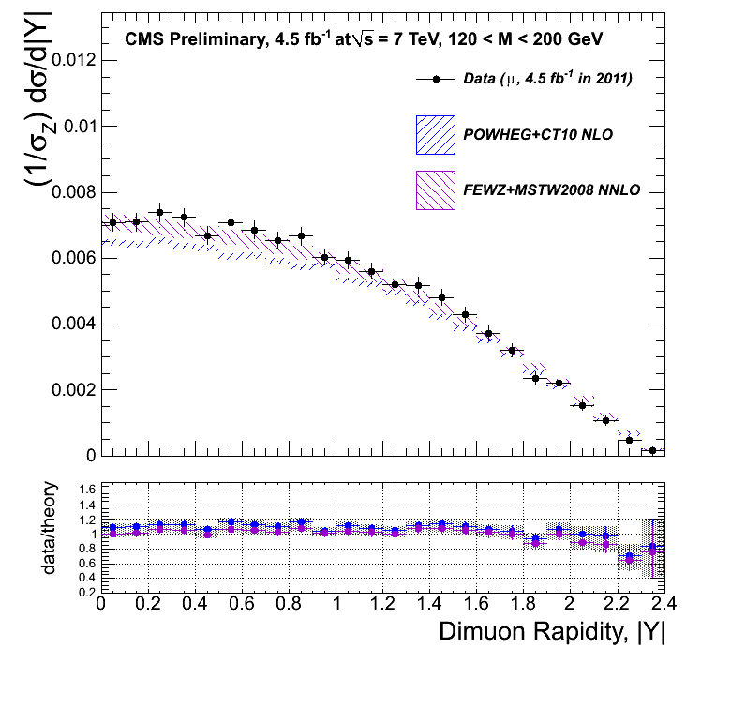
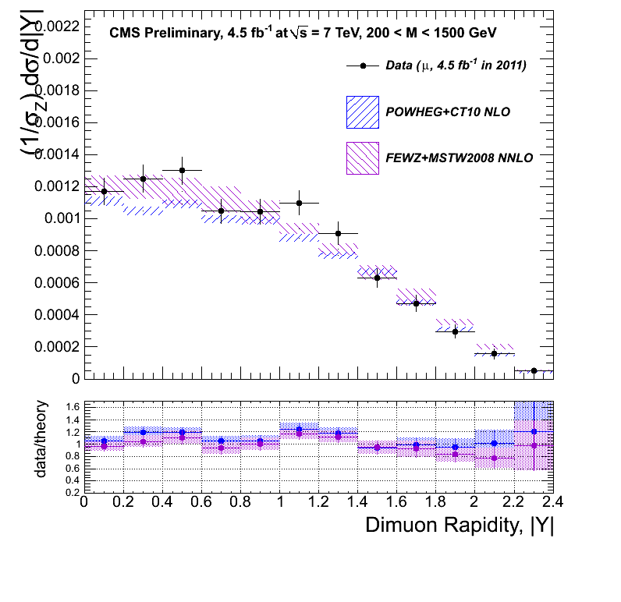
dσ/dMdY results (III)
Within the detector acceptance
CMS PAS EWK-11-007
60-120 GeV
120-200 GeV
200-1500 GeV
Good agreement observed for most mass bins except the lowest mass bin
Low mass region is very sensitive to the PDF uncertainties

Slide 34
Muon reconstruction: what was done so far
I will explain an alternative approach in the global muon reconstruction, which uses the segments in the standalone (StA) backward filter
  Recently this has became the default approach
The effect of changing the granularity of the StA backward filter to segments was understood
  Tests with various misalignment scenarios in the wide energy range were performed (including MC, START and artificial misalignments)
  Switched to the fully segment based fit with zero APEs in the standard CMS software in Fall11
My contribution to this study is following
  I provided the code allowing to switch to the segment based granularity and coordinated the efforts of others in the initial stage of the studies
  I studied the effect of switching to the segment based for various detector misalignment scenarios and APEs in the wide energy range and performed the validation of its inclusion in the standard CMS software

Slide 35
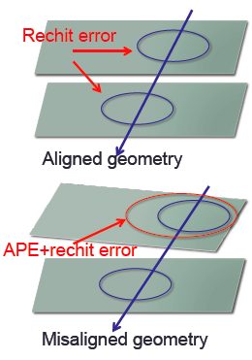
APEs the introduction (I)
What are APEs?
  The alignment position error (APE) characterizes the measurement uncertainty of each detector layer due to misalignment effects
  APEs form 6x6 symmetric matrix of
  covariance with components corresponding
  to shift and rotation uncertainties
The APE is combined with the spatial
resolution of the detector giving the total
error of hit positioning as
a quadrature
The APEs might have direct impact on:
  Pattern recognition
  Performance/efficiency of muon reconstruction
  Momentum resolution
  Global track quality

Slide 36
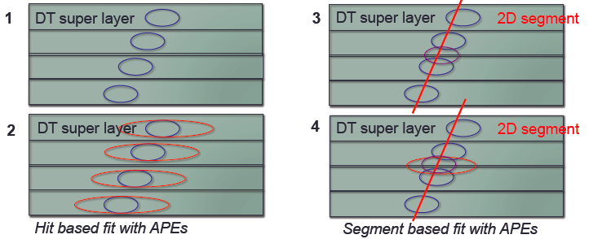
APEs the introduction (II)
How are APEs implemented in CMSSW?
  APEs are extracted from the data and are stored in the database. The database is updated frequently, as the detector misalignment itself and the APEs are dependent on the data taking period
  APEs are included in to the hit position error
Why do we need segment based fit?
  APEs are assigned per chamber – correlated errors

Slide 37
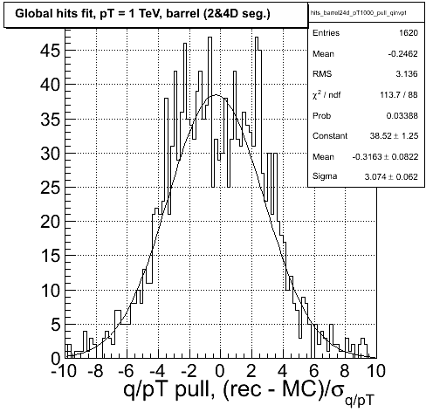
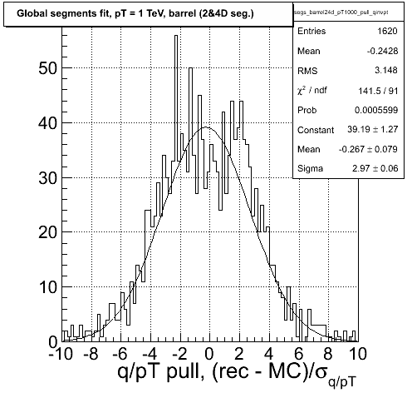
Comparison of the hit based to the segment based fit
Hit based fit with APEs set to zero
Segment based fit with APEs set to zero
Sigma: 3.074
+/- 0.062
Mean: -0.3163
+/- 0.0822
Underflow: 18
Overflow: 17
Sigma: 2.97
+/- 0.06
Mean: -0.267
+/- 0.079
Underflow: 16
Overflow: 10
Effect of the segment based granularity: overall positive effect on the pulls
The sigma of the Gaussian fit to q/pT pull is closer to 1 by 3-5 %, less entries in overflows. Large positive effect on the eta pulls. No statistically significant difference in the endcaps.

Slide 38
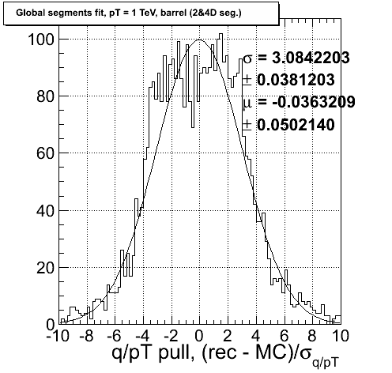
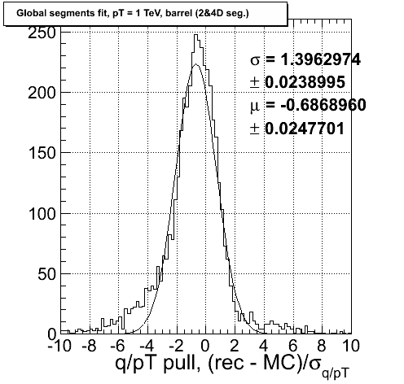
Comparison of the fits with zero and non-zero APEs
Segment based fit APEs set to zero
Segment based fit with non-zero APEs
Effect of switching to non-zero APEs (with the segment base fit)
Over 50% reduction of sigma of the Gaussian fit. However, a significant bias in the mean position, and non-Gaussian tails are introduced – still to be investigated.

Slide 39
Future plans
Drell-Yan analyses:
First of all, we are planning to use the results of the double- differential cross section measurement for PDF quantification
  Cooperating with NNPDF collaboration
In 2012, the CMS detector will collect up to 15 fb-1 of the proton collision data at 8 TeV. It is planned to analyze this data and to use this for the PDF quantification as well as studies of the scaling of the cross sections with energy and other physics studies
Muon reconstruction:
Finish study of the segment based fits with non-zero APEs. Investigate the RMS increase in resolution distributions, and significant deviations from zero in mean pulls.
Set up the code to accept the rotational APEs

Slide 40
Plans: 7 TeV Drell-Yan analysis
Finalize the analysis note and the PAS on the 7 TeV Drell-Yan analysis (CMS AN-12-063, PAS-EWK-11-007) and prepare for a publication in a referred journal
My main contribution is on (Summer2012-Fall2012)
  Background estimation using e-mu method. Understanding weather MC based or data-driven approach gives better estimation.
  Efficiency correction
  Systematic uncertainties on unfolding, efficiency correction, trigger matching algorithm
  Theory expectation
  Understanding the difference between measurement and theory expectation

Slide 41
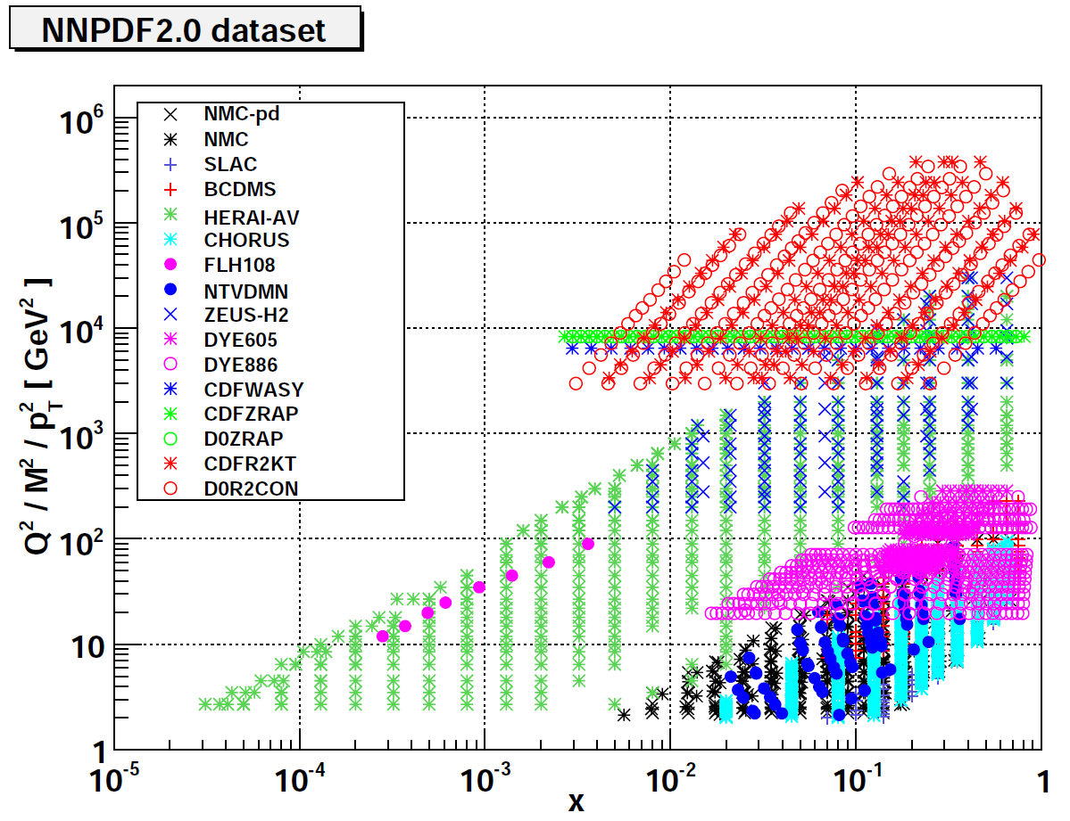
Plans: quantification of PDF constraints with the CMS data
There are various PDF parameterizations available nowadays.
  The most widely used are: MSTW, CTEQ and NNPDF.
  They differ by data categories used for the constraints, the PDF parameterization (ansatz), the assumptions made on the physics behind the parameterization and the uncertainty estimation.
  Current PDF uncertainties on the cross section are 3-5% increasing at smaller x. In the region accessible by LHC experiment, these PDF sets are not well constrained, and the uncertainties go up to 10%
DY fixed target experiments are a core ingredient in the current PDF fits
Collider DY experiments are
destined to play a major role
partially substituting fix target results
CMS/ATLAS can cover x ranges
from 10-4-10-5 to almost 1
  LHCb can reach down to 10-6
Fall 2012-Winter 2013: an analysis note and
a publication on the PDF constraints with
the Drell-Yan data

Slide 42
Plans: 8 TeV Drell-Yan analysis
Fall 2012-Winter 2013: Repeat the dσ/dM, and the d2σ/dMd|Y| measurements with 8 TeV data collected during the 2012
Understand the scaling of the cross sections with energy
Take advantage of the larger statistics in the region of high masses
Impact on the PDF constraints
I plan to contribute to almost all the steps of the analysis chain.
Deliver an analysis note and possibly a publication on the 8 TeV analysis

Slide 43
Plans: segment based fits
Summer 2012-Fall 2012: analysis note on the segment based fit study
Understand the significant deviations from zero in mean pulls with non-zero APEs and asymmetric tails
Understand the effect of inclusion of the APEs corresponding to the rotational misalignments
My contribution: my goal is to validate the effect of the segment based fit with non-zero APEs on the global muon reconstruction and to improve it. Modify the current software to accept the rotational APEs.

Slide 44
Backup

Slide 45
Electroweak Interactions and QED
QED: the electromagnetic interaction acts on all the charged particles and is mediated by photons. It has infinite range. Within the Standard Model, it is described by a gauge theory based on the abelian gauge group U(1)em, the quantum electrodynamics (QED).
Electroweak theory: The weak interaction acts on all the particles (both quarks and leptons) and is mediated by the W and Z bosons. Within the Standard Model a unified electro-weak theory is considered which is described by a gauge theory based on the Yang-Mills model with the non-abelian gauge group SU(2)L x U(1)Y, the Cartesian product of the weak isospin group SU(2)L and U(1)Y.
As a result of the spontaneous symmetry breaking of SU(2)L x U(1)Y gauge symmetry to the U(1)em symmetry an extra scalar (Higgs) field is added to the theory. As a result of the Yukawa interactions with the Higgs boson fermions acquire mass

Slide 46
Quantum Chromodynamics
QCD: The strong interaction acts on all the colored particles (quarks and gluons) and is mediated by gluons. It is described by a gauge theory based on the Yang-Mills model with the non-abelian gauge group SU(3)c - the quantum chromodynamics (QCD).

Slide 47
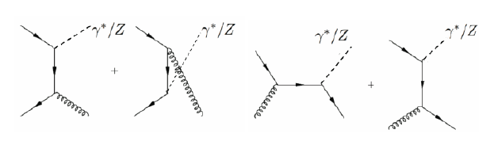

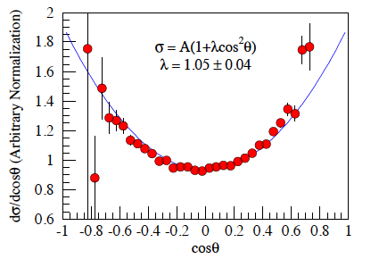
The Drell-Yan process (III)
Leading order annihilation (interference of photon and Z exchange) and Compton scattering diagrams for the production of Z bosons are leading to forward-backward asymmetry
Considering the quark anti-quark partonic initial state only:
Fermilab, E866/NuSea
The forward-backward asymmetry

Slide 48
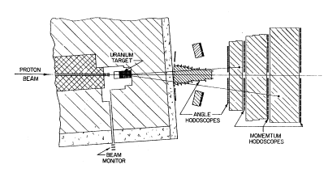
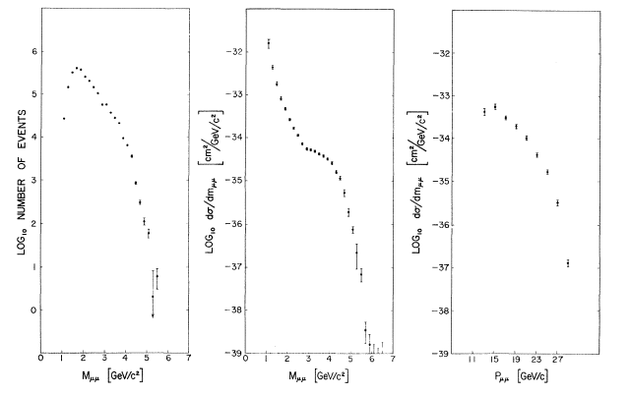
Measurements in the past (II)
The first Drell-Yan cross section measurement was performed by the group of L. Lederman at Brookhaven’s AGS (Phys. Rev. Lett. 25 (1970) 1523)
It was a fixed target experiment with a 29 GeV proton beam and an Uranium target
Mass resolution of the apparatus was 15 % at 2 GeV and 8 % at 5 GeV.
300 million events were recorded!
Dimuon mass spectra
As a result muon pairs were
observed in the range
1 - 6.7 GeV
An overall uncertainty of 60%
was assigned
to the absolute cross section

Slide 49

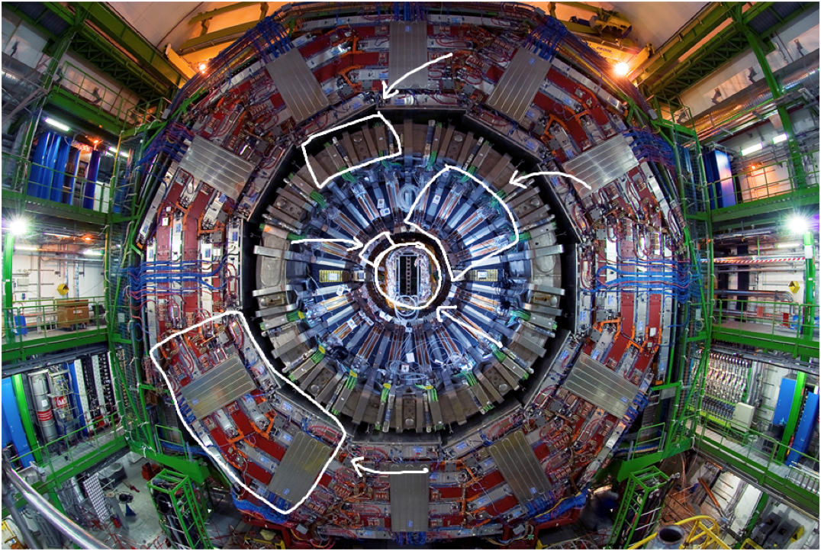

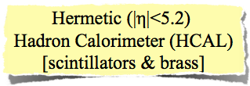


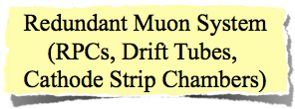

Slide 50
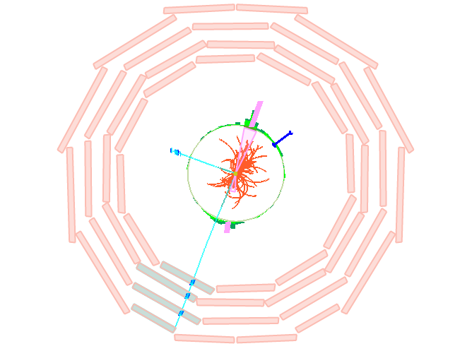

Typical Drell-Yan Event at CMS
Global Muon1: pT = 64.7,
η = -0.757, φ = -1.987
Global Muon2: pT = 24.5,
η = -2.271, φ = 2.833
Mμμ = 61 GeV

Slide 51



Local reconstruction
CSC
Local reconstruction is performed
separately in CSC, RPC and DT
CSC local reconstruction
  φ-coordinate is measured by strips
  r-coordinate is measured by wires
  2D points are fit in 6 layers to get
  3D segments
RPC local reconstruction
  φ-coordinate is measured by double gap
  chambers
  Extract up to 6 2D points in the barrel and
  4 2D pointes in the endcap
DT local reconstruction
  Hit position with respect to the wire is determined in the
  drift cell
  1D hit is extracted with left-right ambiguity
  R-φ and r-θ projections are reconstructed independently
  to extract the 2D segment (left-right ambiguity is
  resolved by choosing the best χ2 candidate)
  The two projections are combined together in the
  3D segment
RPC chamber
DT chamber

Slide 52


Data samples
Data samples
JSONs
Only LSs having the DoubleMu6 or Mu13_Mu8 unprescaled (depending on the run range) were used for the measurement

Slide 53



Slide 54
Binning for 1D measurement
Use the same normalization region (60 < M < 120 GeV)
40 bins proposed for 2011 analysis:15, 20, 25, 30, 35, 40, 45, 50, 55, 60, 64, 68, 72, 76, 81, 86, 91, 96, 101, 106, 110, 115, 120, 126, 133, 141, 150, 160, 171, 185, 200, 220, 243, 273, 320, 380, 440, 510, 600, 1000, 1500
Notes:
Important: attention was paid to stat vs syst comparison -> more prominent point

Slide 55


QCD background estimation
We use the ABCD method to estimate the QCD background in a data driven way
  Uses muon isolation, muon
  pair sign (SS,OS) as variables
  Correction factors are applied for
  each bin to remove the
  contaminations from other processes
Due to a lack of statistics in the QCD MC samples after all the selection cuts, we rely on the
data-driven QCD estimates
  More reliable tham MC estimate
  Better systematics compared
  to 1.1fb-1
  data driven estimate by 0.7%
Blue: QCD
Red: DY
OS
A
C
SS
B
D
Muon Isolation
Notes:
Show by how much the QCD background estimation improved compared to last year!

Slide 56


Effects on acceptance (motivation for reweighting)
The POWHEG MC does not properly describe the low mass region as it is based on NLO. An additional acceptance correction has to be applied to take NNLO effects into account
FEWZ+MSTW2008NNLO
POWHEG+CT10NLO
FEWZ+MSTW2008NNLO
FEWZ+MSTW2008NLO
Higher order effects: the difference
between NLO and NNLO is sizable at
low mass
The effect due to the difference in PDF
set used in theory and MC changes
the resulting effect

Slide 57



Acceptance cut optimization
At lower masses, phase space available for muons
are right at the edge of our cuts
With full 2011 dataset the problem with limited acceptance in the low
mass region is less emphasized
  Lower muon pT thresholds are used
  1.1 fb-1 measurement: 0.0033 +- 0.0001
  4.5 fb-1 measurement: 0.0067 +- 0.0001
The size of the correction for NNLO effects
is significantly smaller
Cuts have changed from
pT > 31,7 GeV to
pT > 14,9 GeV
15 < M < 20 GeV
keep
Large acceptance gains
at low masses
FEWZ correction
Notes:
Current -> 4.5

Slide 58



Acceptance reweighting
To perform the cross-section measurement at the NNLO, we use the acceptance reweighting technique with FEWZ and POWHEG Z boson
kinematics rapidity-transverse momentum maps
The acceptance correction factors (weights) are determined in the bins of dimuon PT-Y as:
  Dimuon PT binning used is: 0,20,40,60,80,100,200 GeV
  Dimuon rapidity binning used is: -5,-3,-1.5,0,1.5,3,5
20 < M < 30 GeV

Slide 59


Testing the unfolding procedure in 2D
A set of tests was performed to validate and justify the conventional unfolding procedure in 2D
Closure test: the response matrix
was calculated from MC truth, and
applied to MC truth
Toy MC test: generate the Toy MC
using random Gaussian distribution

Slide 60
Efficiency
With the double muon trigger, the per event trigger efficiency can be parameterized with per muon trigger efficiencies as:
The main contribution to the systematic error on the
efficiency is coming from the correction map
  Estimated by varying the probe muon pT-eta binning of the correction map
  Due to larger statistics, we have got up to 0.3% reduction of systematics compared to 1.1 fb-1 measurement
The efficiencies as a function of probe muon pT and eta can be found in the backup

Slide 61


Efficiency estimation
We employed various PDFs in the
simultaneous fit:
  Voigtian+Exponential
  (default option, used in the past analyses)
  2 Voigtians+Exponential
  2 Voigtians+Quadratic Chebyshev polynomial
  2 Voigtians+Exponential or
  Quadratic Chebyshev dependent on pT
  The proposed hypothesis uses the switch in probe muon pT:
  2 Voigts + [Exponential (pT < 20 GeV) or
  Quadratic Chebyshev (pT > 20 GeV)]
  Provides the best fits and less fit failures
  We checked if there is a bias due to
  the muon pT cut on the tag muon

Slide 62




Trigger efficiency
For the HLT_Mu13_Mu8, the legs are different, the asymmetry is taken into account by the new factorization ansatz
Mu8 leg
Mu8 leg
Mu13 leg
Mu13 leg

Slide 63




RECO+ID, ISO efficiency
RECO+ID
ISO
ISO
RECO+ID
Notes:
Do we need this here or in backup?

Slide 64



Efficiency correction for 2D measurement
The efficiency correction is evaluated
in the bins of dimuon rapidity in variant mass
RECO+ID
ISO
TRIG

Slide 65


New physics searches in the dilepton channel
Various new physics searches are performed in dimuon channel
  Z′ and Kaluza-Klein Graviton models
Drell-Yan study can provide a data-driven estimate for the irreducible Drell-Yan background and therefore increase the sensitivity of these searches
Notes:
Instead of using the MC one can estimate with the data prediction

