Slide 1
PSM TECHNICAL ROUND
MLS Data Feed Operations: Pipeline Health & Implementation Insights
Executive briefing on Sample Data 1 (feed onboarding workflow) and Sample Data 2 (MLS feed implementation assets)
Analysis of 403 onboarding requests across 201 MLSs · 565 feed assets across 325 MLSs

Slide 2
01 — What These Datasets Track
Both datasets describe MLS listing-data feed operations for a real-estate technology platform (IDX / Back Office / VOW).
SAMPLE DATA 1 — Feed Onboarding Pipeline
SAMPLE DATA 2 — Feed Implementation Inventory
Tracks individual broker/MLS feed activation requests end-to-end.
Column B (MLS): which MLS the feed is being activated against.
Columns Q–X: semi-sequential stage timestamps —
New → Ready for Compliance → Pending Broker/CWS/MLS →
Provisioning → Approved Complete.
Also captures: feed status, agreement channel (eSign, Trestle,
Spark, MLS Grid, broker-initiated), access level (IDX / Back
Office / VOW), DLM owner, state, and compliance artifacts.
403 requests · 201 unique MLSs · mostly IDX+Back Office pairs
Tracks MLS-level data-feed assets and how they were set up.
Asset Name: the MLS providing listing data.
Feed Type: implementation / contracting method —
Hard Copy, Electronic Trestle/Grid, CWS-initiated,
or Member-initiated (with/without portal).
Feed Product: IDX, Back Office, or VOW feed.
Days Opened (Average): how long the feed ticket/asset
remained open — a proxy for implementation friction.
565 assets · 325 unique MLSs · median 17 days open

Slide 3
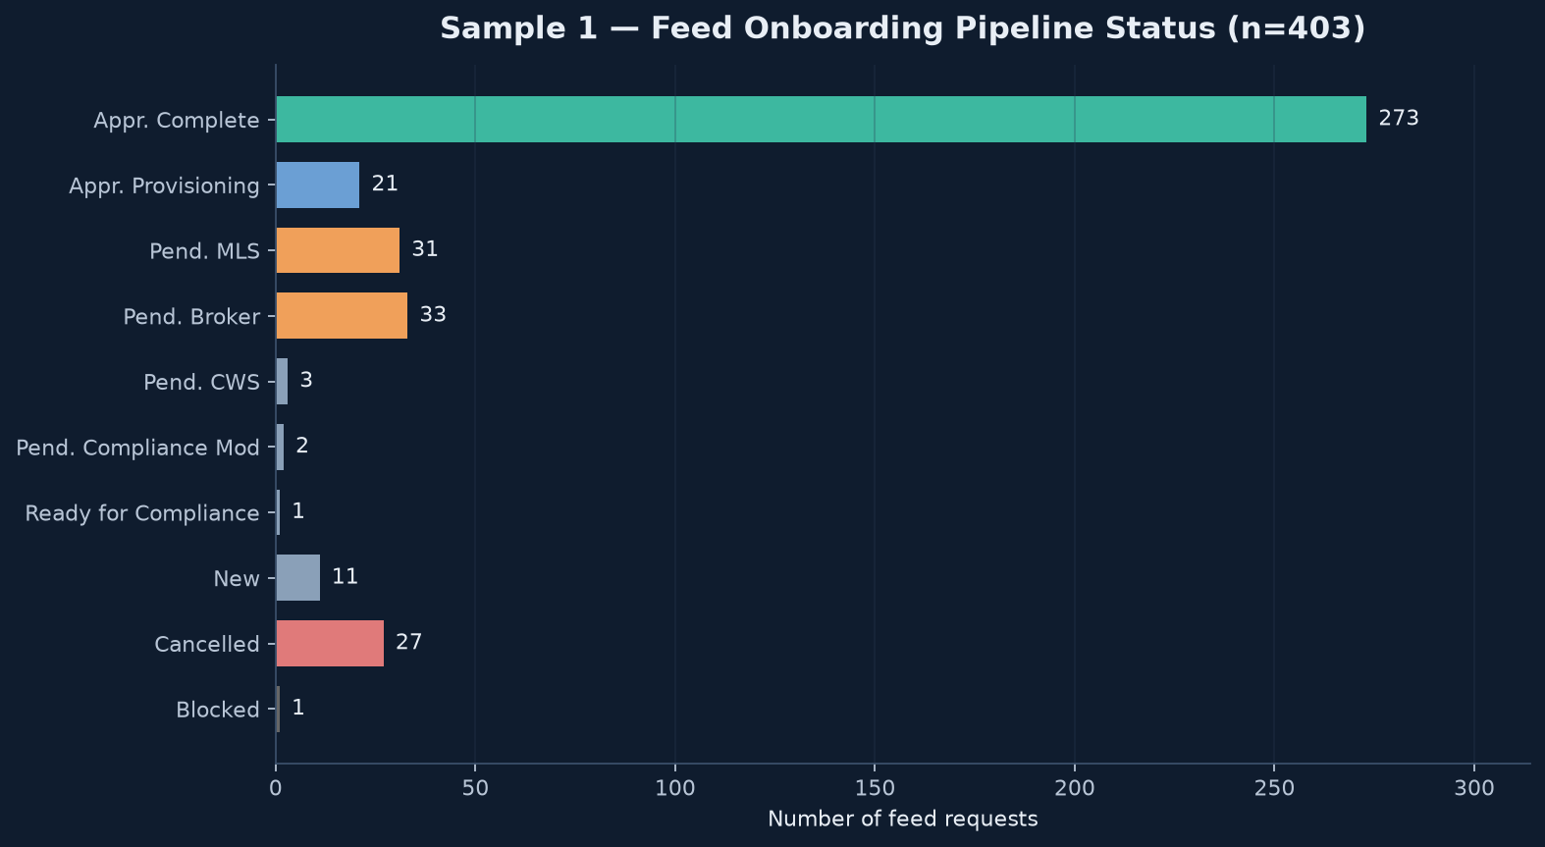
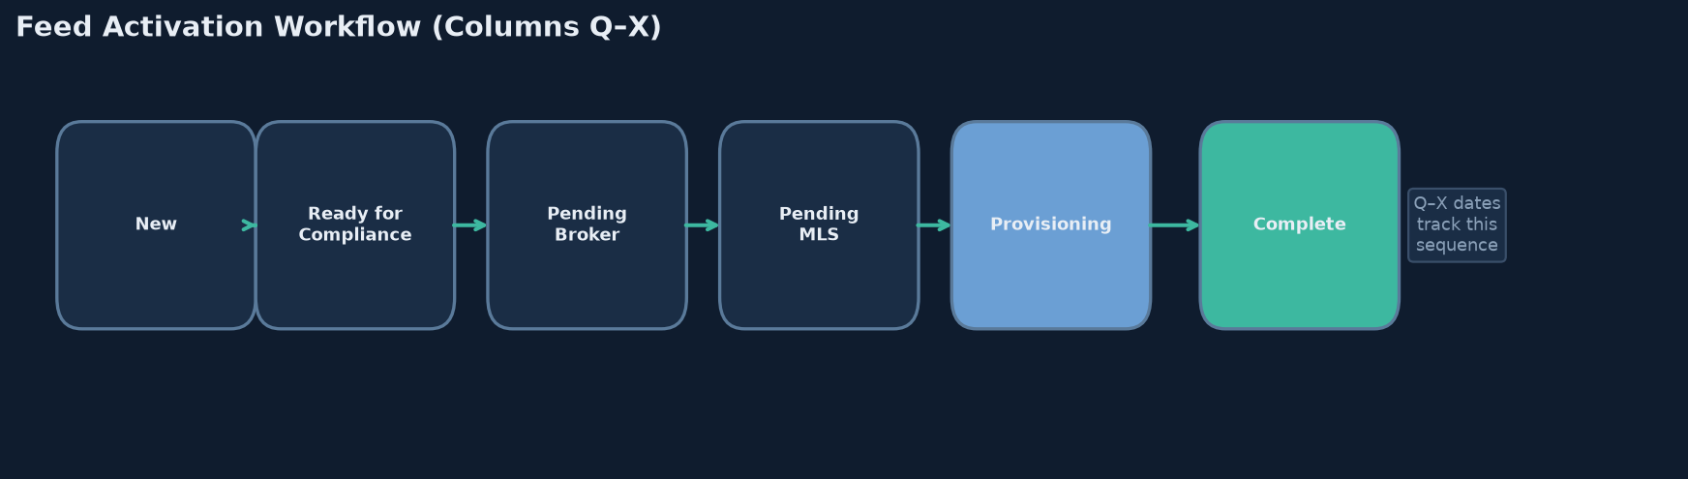
02 — Sample 1: Pipeline Health
67.7%
98 days
102
6.7%
Approved–Complete
Median New→Complete
Still in-flight
Cancelled
Key read
Two-thirds of requests finish, but the typical journey takes ~3 months. Roughly 1 in 4 requests are still open or cancelled — a material operational backlog concentrated in broker and MLS approval waits.

Slide 4
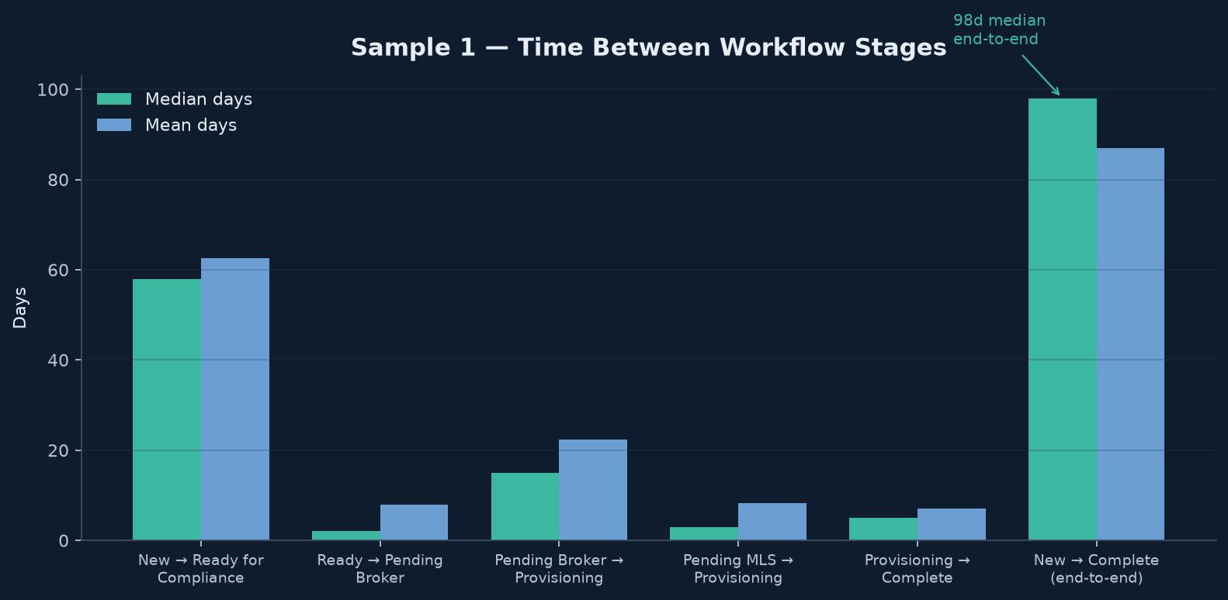
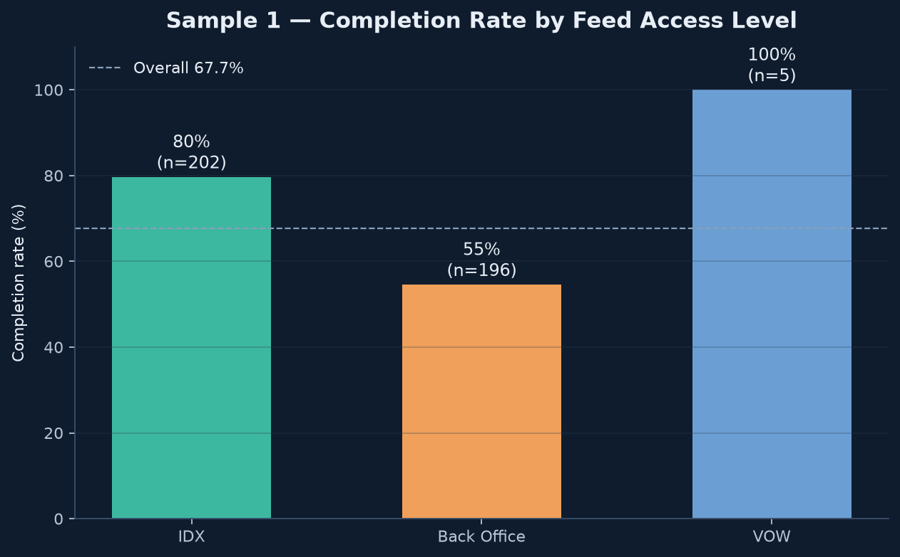
03 — Sample 1: Where Time Is Lost
Executive insights
1. Front-loaded delay: New → Ready for Compliance alone is ~58 median days — the largest single stage gap. Compliance readiness is the primary cycle-time driver.
2. Broker approval is the live bottleneck: Pending–Broker waits ~14 median days to provisioning (vs ~3 days from Pending–MLS). 33 broker-pending + 31 MLS-pending items dominate the open queue.
3. Back Office underperforms IDX: 55% vs 80% completion. Nearly every MLS is requested as an IDX+Back Office pair (195 of 200 pairs) — Back Office drag pulls down overall activation success.

Slide 5
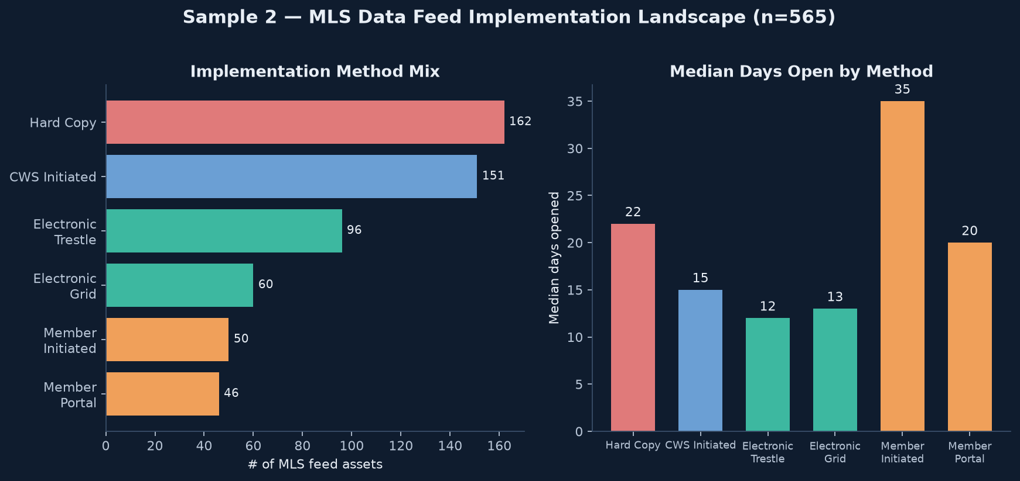
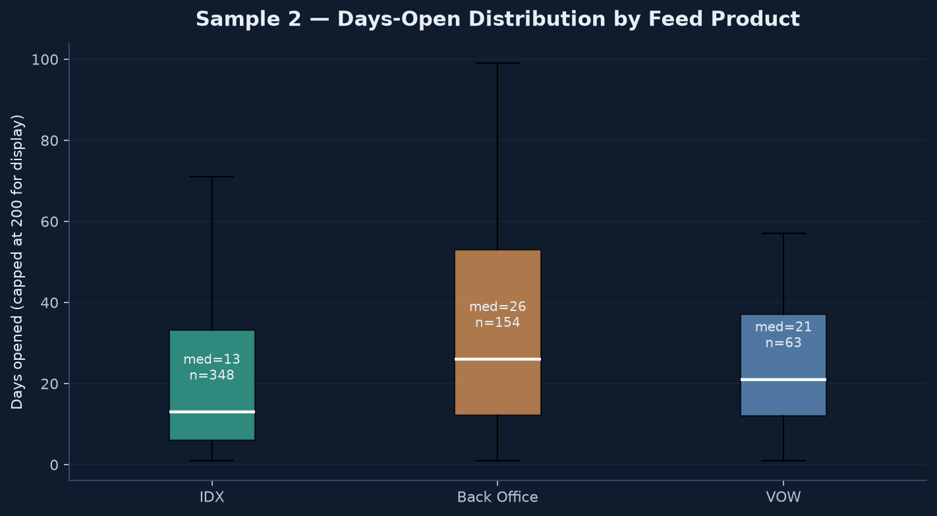
04 — Sample 2: Implementation Landscape
Executive insights
1. Electronic channels are faster: Trestle/Grid median ~12–13 days open vs Hard Copy ~22 days and Member-Initiated ~26–38 days. Paper and member-driven setups create outsized friction.
2. Back Office feeds stay open longer (median 26d) than IDX (13d) — consistent with Sample 1’s lower Back Office completion. VOW is smaller volume but can have long-tail outliers.
3. Hard Copy still ~29% of assets — a clear modernization opportunity to shift volume toward electronic Trestle/Grid agreements.

Slide 6
05 — How the Two Datasets Relate
Same domain, different grain
Sample 1 is the transactional workflow for activating a broker’s feed against an MLS (request → approvals → live). Sample 2 is the MLS asset catalog describing how each MLS feed connection was contractually/technically implemented and how long that setup stayed open. ~140 MLS names overlap — Sample 1 requests run on top of Sample 2’s MLS feed infrastructure.
Shared entities
Complementary metrics
Reinforcing signal
MLS / Asset Name is the join key.
Both classify feeds as IDX, Back Office, or VOW.
Agreement channels align: Trestle, MLS Grid, CWS, and member/broker-initiated appear in both.
S1 measures stage-level cycle time for each request (Q–X dates).
S2 measures days-open for the underlying MLS feed implementation.
Together: infrastructure friction (S2) + request workflow friction (S1).
Electronic methods win in both: Trestle/Grid show higher S1 completion and lower S2 days-open.
Back Office is harder in both datasets — lower completion (S1) and longer open times (S2).

Slide 7
06 — Executive Takeaways & Actions
01
Compress compliance intake
The New → Ready-for-Compliance gap (~58 median days) dominates cycle time. Standardize packet requirements and auto-validate display URL / rules / logo artifacts before a ticket enters the queue.
02
Attack the broker-approval queue
Pending–Broker is the largest live backlog and a slower gate than MLS approval. Add broker SLAs, reminders, and self-serve approval (BAM/PAM/dashboard) to cut the ~14-day median wait.
03
Fix Back Office specifically
Back Office completes at 55% vs IDX at 80%, and stays open nearly 2× as long in Sample 2. Treat Back Office as a separate product workstream — not a twin of IDX.
04
Migrate off Hard Copy
~29% of Sample 2 assets still use Hard Copy (median 22d open vs ~13d electronic). Prioritize Trestle/Grid conversion for high-volume MLSs to reduce implementation friction upstream of onboarding.

