Slide 1
Outlay.ai
Put AI compute on a budget.
Market & product strategy
Krethikram Gowrisankar · Founder
outlay-ai.com
Notes:
One-line frame: AI spend is the fastest-growing line item nobody can explain. We make it attributed, forecastable, and governable.

Slide 2
THE SHIFT
AI spend is exploding — and moving to consumption.
88% of US enterprises are raising AI budgets · 62% by ≥10%
CONSUMPTION, NOT SEATS
• AI scales by tokens/compute, not users — per-seat can't price it.
INFERENCE > TRAINING
• Production usage overtook training — recurring cost, not one-time.
CODE-GEN IS THE BREAKOUT
• ~$4B, ~28% of enterprise LLM use; Claude ~42% dev share.
Notes:
Sources: Wharton/GBK 2025; Menlo Ventures 2025. The bill is big, growing, and now consumption-shaped — which is exactly what breaks visibility and seats.

Slide 3
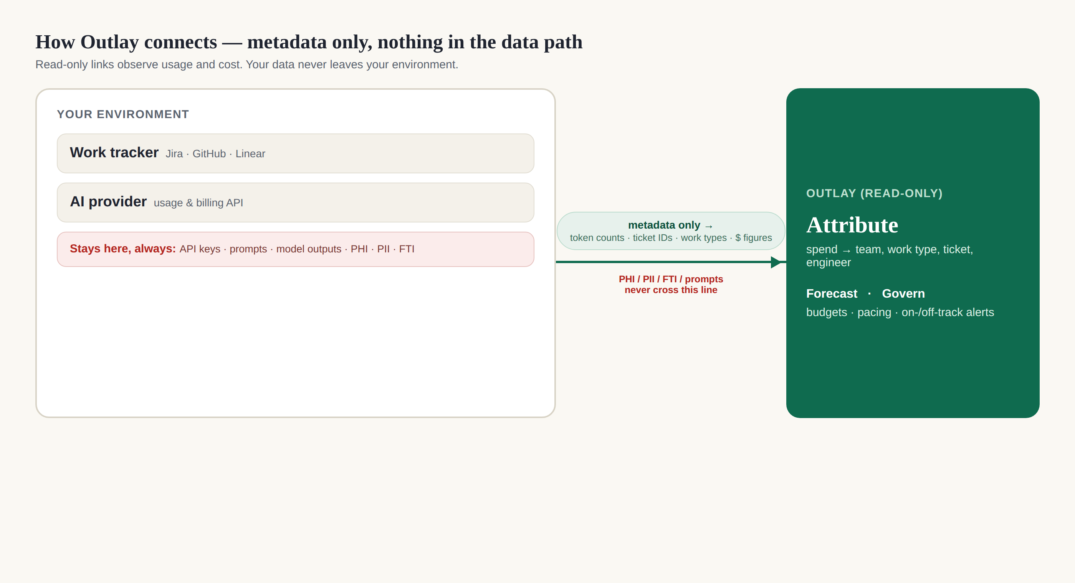
THE PROBLEM
Consumption AI spend is opaque, multi-vendor, and unattributed.
• Provider bills are aggregated at the account level — no team, ticket, or cost-center metadata.
• Spend is spread across OpenAI, Anthropic, Bedrock, Azure, Cursor, Copilot — no unified view.
• Finance can't map a credit to a workload; 78% of IT leaders saw surprise AI charges.
• Nobody can answer the question that matters: “What is AI costing us per team / feature / output?”
Notes:
This is the gap. The question finance actually asks has no answer today. Sources: Flexera, Datadog, Vantage.

Slide 4
THE CATEGORY IS HERE
From niche to near-universal in 24 months.
98% of organizations now manage AI spend — up from 31% in 2024
The fastest cost-discipline adoption the FinOps survey has ever recorded.
Managing AI spend is the #1 FinOps priority for the next 12 months, and AI cost management is the #1 skill gap (58%).
Notes:
FinOps Foundation State of FinOps 2026 (n=1,192). There is now a budget line and an owner to sell to — the market arrived.

Slide 5
WHAT OUTLAY IS
The work-attribution + forecast + governance layer — not a dashboard.
1 · ATTRIBUTE
• AI spend → the ticket, feature, engineer, and program — via the work-tracker join.
• The question finance actually asks; hard to copy.
2 · FORECAST
• Back-tested on the customer's OWN delivered work (leave-one-out).
• Their data, measured error — the trust unlock.
3 · GOVERN
• Program budgets, real-time pacing, on-/off-track rating.
• Turns a report into a system of record you act on.
Notes:
All three are built. The strategic move is positioning: sell the join + honest forecast + governance, not commodity 'visibility'. Read-only, BYOK, metadata-only.

Slide 6
WHY IT'S DEFENSIBLE
Three layers compete; none owns ours.
VISIBILITY DASHBOARDS
• Vantage · CloudZero · Finout · Datadog
• Attribute at team/project — not the work-item join; crowded.
LLM GATEWAYS
• LiteLLM · Portkey · OpenRouter · TrueFoundry
• In-path cost cuts + budgets — opposite of our read-only posture.
CLOUD OPTIMIZERS
• ProsperOps (Flexera) · Zesty · nOps
• Reserve cloud GPUs you run — not the model-API layer; no work data.
Our moat: work-item attribution · own-data forecast · metadata-only / read-only · budget governance
Notes:
We don't fight on 'visibility' or token price. The tracker join + honest forecast + read-only posture are what they don't lead with.

Slide 7
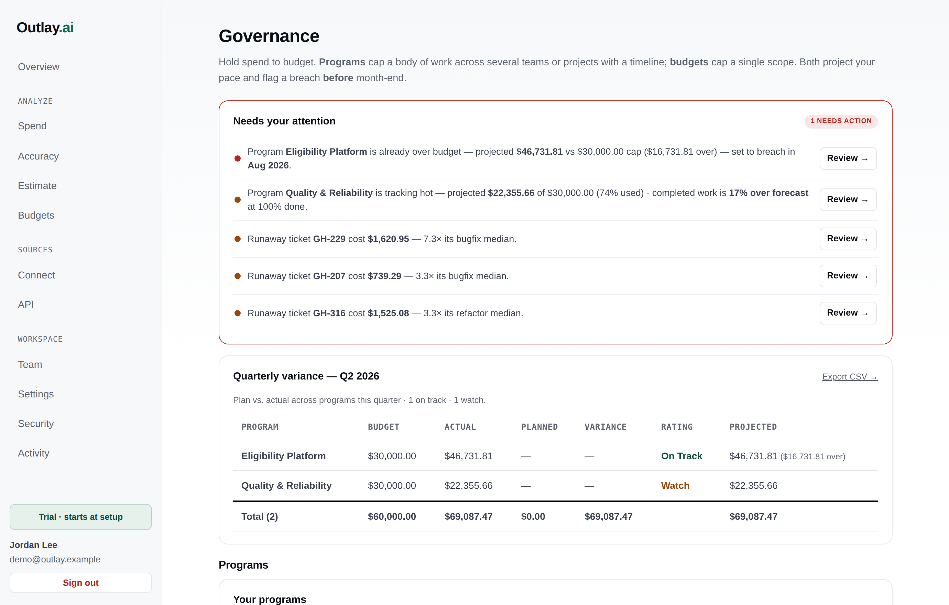
THE PRODUCT TODAY
Built and demoing — governance on real-shaped data.
Notes:
Proof it exists and works: program budgets, breach projections, earned-value ratings, the quarterly variance table. Live on sample data; verified with a real gov pilot motion (Maryland).

Slide 8
THE WEDGE
Land the hardest, highest-value layer first.
BEACHHEAD ICP
• Eng-heavy software / AI-native companies
• 250–5,000 employees
• >$250–500k/yr AI spend, consumption-based, multi-provider, unowned
• Buyer: platform/eng lead + VP Finance/FinOps
WHY HERE
• The attribution gap is worst — and our tracker join only fires here
• Budgets growing 50–100%/yr → urgency + a buyer with money
• Reachable founder-led; no 12-month procurement
• Gov/Maryland = parallel high-ACV lighthouse + compliance moat, NOT the roadmap driver
Notes:
Differentiation and pain peak in the same place. Run gov in parallel for ACV + the SOC2/StateRAMP moat, but software-eng is the velocity/PMF beachhead. ~70/30.

Slide 9
THE ENGINE
One data asset, reused three ways.
A · MORE SPEND LAYERS
• Land eng consumption (hardest)
• → seats (sales/mktg/support/legal)
• → company-wide AI cost system of record
B · MORE VALUE
• Attribution → chargeback
• → enforcement
• → commitment optimization (the prize)
C · MORE SEGMENTS
• Software → enterprise
• → financial services
• → regulated / gov (metadata-only wedge)
Every step reuses the attributed data, adds a buyer or spend layer, raises ACV, deepens lock-in
Notes:
Expand the DATA before the features — own the attributed spend so the high-$ commitment optimizer launches from a defensible data advantage.

Slide 10
THE PRIZE · ALREADY SHIPPED
Commitment & procurement optimization.
• AI is priced like cloud: on-demand vs committed-discount vs provisioned. Most companies over- or under-commit.
• Getting it right needs forecasting + attribution — exactly our core data. The highest-$ FinOps lever (cloud analog: 30–60% savings).
• Built it: recommend the commit, size it against forfeit risk, pace it, export a vendor negotiation pack — live in-product.
• Our work-attributed steadiness signal beats an infra-only optimizer — the moat applied to procurement.
Built before Flexera (ProsperOps + FinOps-for-AI) stitched the model-API layer — from data they don't have
Notes:
The high-$ expansion is no longer a plan — it's shipped (engine + CLI + console: recommender, provisioned break-even, pacing, negotiation pack, advisory caching/batch). Spec: docs/spec-commitment-optimization.md.

Slide 11
MARKET SIZE (US, MODELED)
$35–70B governable pool → $1–3B revenue TAM.
SPEND UNDER MANAGEMENT
• US governable AI spend pool
• ≈ $35–70B in 2026
• growing ~50–100%/yr → $100B+
OUTLAY REVENUE TAM
• at a 2–5% software take-rate
• ≈ $1.0–3.0B
• serviceable (ICP) ≈ $0.3–0.9B
CORE VS INCREMENTAL
• Core (attribute+forecast+budget): ~60–70%
• Incremental (chargeback, enforcement, commitment opt): ~30–40% & rising
Demand-side (what companies pay to use AI), not hyperscaler capex. Ranges, not point estimates.
Notes:
Modeled bottoms-up + top-down (market-analysis §5). Capex ($400B+) is the supply-side backdrop, not our pool. Core is the wedge and most of the TAM; incremental features expand the wallet.

Slide 12
WHY NOW
Govern the AI spend before it scales.
The category just inflected, the spend is exploding, and the winning layer (work-attribution) is uncontested. The cheapest time to build the governance layer is now.
THE PLAN
• N
• N
• D
• L
Notes:
Close: the data asset compounds — more spend under management = more lock-in. The high-$ expansion is already built, ahead of schedule. Ask / next step per the audience.

