Slide 1
Outlay.ai
Put AI compute on a budget.
Prepared for Maryland Health Connection
Krethikram Gowrisankar · Founder, Outlay
June 26, 2026 · outlay-ai.com
Notes:
Cover. Open with a sentence of context, not the deck: who you are and that this is built
specifically for Maryland Health Connection. Then advance to the About slide for a 30-second intro
before the pitch.

Slide 2
ABOUT
Krethikram Gowrisankar
KG
Founder, Outlay · ex-Amazon (Senior PM, Tech)
• Senior PM (Tech) at Amazon — led Smart TDR, an autonomous docking system scaled to ~50% of the middle-mile network in 12 months: 1M+ automated cycles, zero safety incidents.
• Delivered $40M+ annual savings and owned $50M+ annual investment / $100M+ NPV programs — cost governance and capital allocation at scale.
• Repeat 0→1 builder across hardware, software, and operations; filed a provisional patent and cold-pitched Amazon leadership into a full-time PM role.
• B.S. Computer Science, UW–Madison — built Outlay to bring that same financial rigor to AI/LLM spend.
San Francisco, CA
krethikram@gmail.com · outlay-ai.com
Notes:
About me — 30-45 seconds. The throughline to land: "I spent years at Amazon owning
safety-critical autonomous systems and the financial models behind them — $40M+ saved, $100M+ NPV
programs. Outlay brings that same cost-governance rigor to AI spend." Establishes you're credible on
BOTH scale/safety (matters to a gov buyer) and financial discipline (matters to the CFO).

Slide 3
OUTLAY · FOR MARYLAND HEALTH CONNECTION
AI spend, mapped to the work
that drove it — and held to budget.
A read-only, metadata-only governance layer for the AI behind Maryland Health Connection.
Attribute · Forecast · Govern
Outlay.ai · Demo · June 26, 2026 · Krethikram Gowrisankar
Notes:
OPEN HERE. The one rule for this room: lead with the architecture, not the features.
This is a state health exchange — their first instinct is "what data does this touch?" Win that in
the first five minutes (slide 4) and the rest lands. Room: CIO (Koshanam)=technical fit,
Compliance (Brennan)=the gate, CFO (Armiger)=budget value. Speak to all three.

Slide 4
THE MOMENT
Maryland is operationalizing its 2025 AI Enablement Strategy.
Right after “is it safe?” comes the question every CFO and CIO asks:
“What is the AI costing us — per program — and is it on budget?”
Today that answer lives in invoices and spreadsheets, after the money is spent. Outlay answers it continuously, attributed to the work.
Notes:
Talking track: "Maryland's standing up its AI strategy this winter. The cost-and-governance
question always lands right after the safety question — and right now it's answered in arrears, in
invoices. We make it continuous and attributed." Keep it short; this is the setup for slide 4.

Slide 5
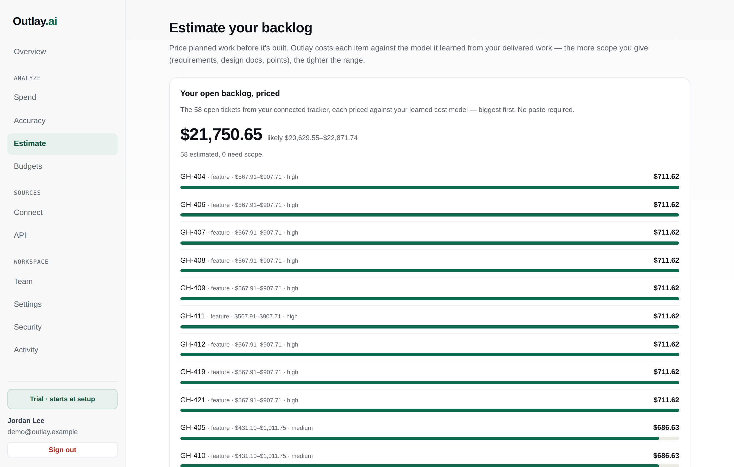
WHAT OUTLAY DOES
Three things, from data you already have.
• Attribute — every AI dollar mapped to a team, work type, ticket, and engineer.
• Forecast — what planned work will cost, back-tested on your own delivered work.
• Govern — budgets per program, real-time pacing, and on-/off-track alerts.
Read-only links — no agents, nothing in the request path.
Notes:
Talking track: "From two read-only connections — your tracker and your AI provider's billing
API — Outlay does attribution, forecasting, and governance. No agents, nothing inline." Don't dwell;
the architecture slide next is where you slow down.

Slide 6
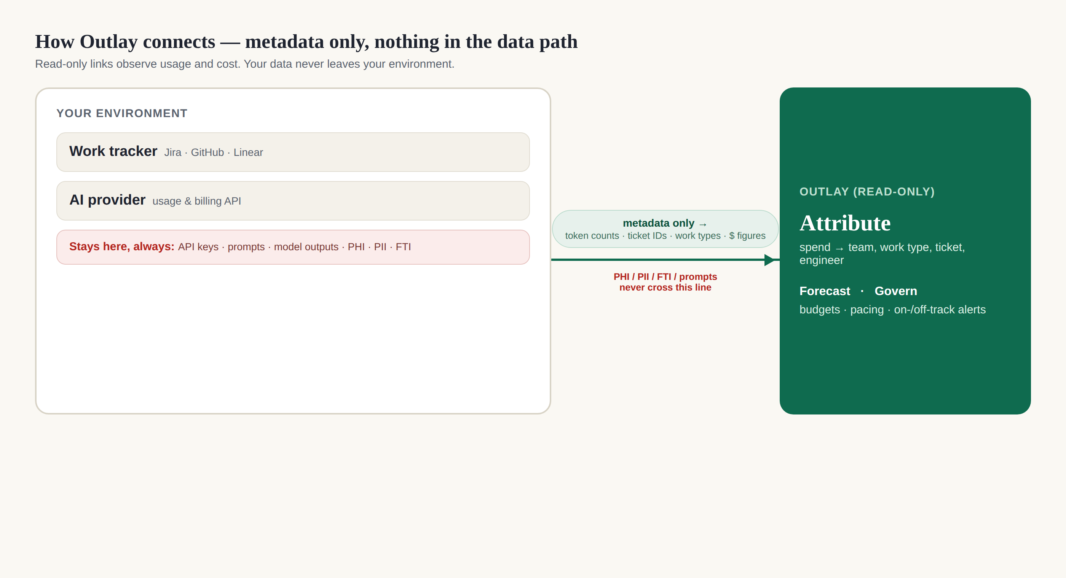
WHY THIS IS SAFE FOR A HEALTH EXCHANGE
We never see PHI, PII, or FTI — by design.
• Metadata-only — token counts, ticket IDs, work types, dollar figures. Never prompts or outputs.
• Bring-your-own-key — your API keys stay in your environment.
• Read-only — never a proxy or gateway in any data path.
• Out of MARS-E / IRS 1075 / HIPAA data scope — what stops most vendors at the door.
Notes:
THE slide. Slow down. "Everything I'll show runs on metadata only — token counts, ticket
IDs, dollars. Never prompts, outputs, PHI, PII, or FTI. Your keys stay with you; we're read-only,
never in a data path. So none of the data MARS-E, IRS 1075, or HIPAA govern reaches us — the
integration is outside that boundary."
OBJECTION — "Do you ever see PHI/member data?": "No, by design. Metadata only. Prompts and keys
never leave your environment." Name MARS-E / ARC-AMPE / 1075 yourself — it signals you know their world.

Slide 7
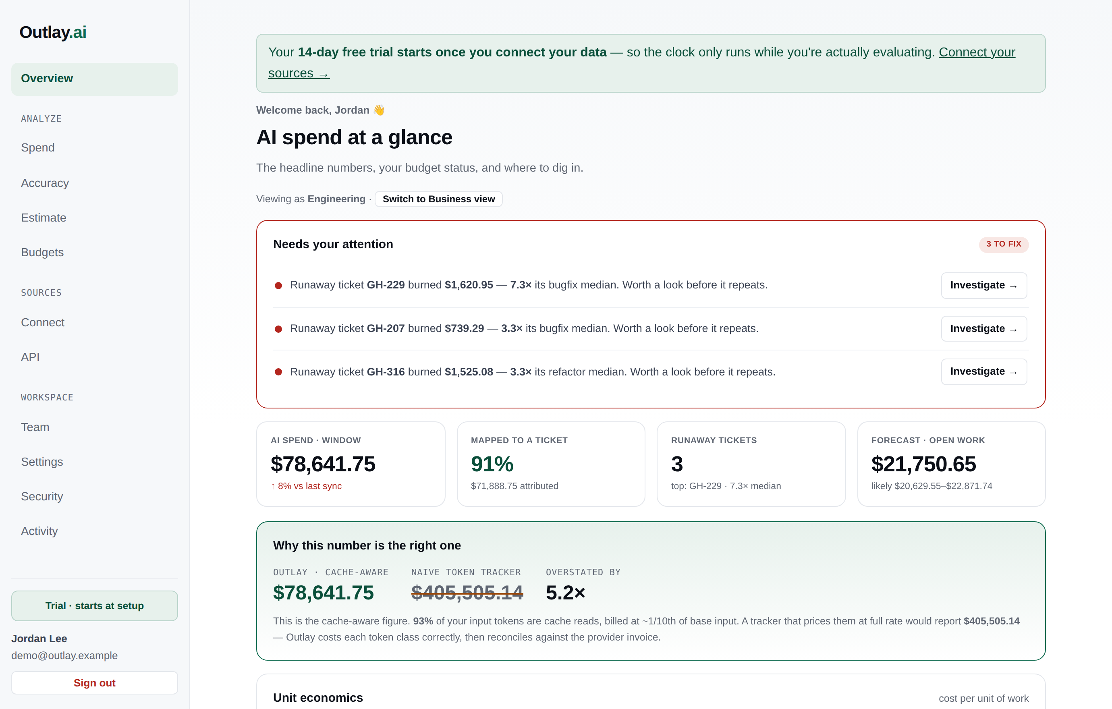
LIVE
Let's look at the product.
On sample data shaped like a real engineering program — the same screens you'd see on day one of a pilot.
Notes:
SETUP (do before the call): signed into a demo-flagged account on app.outlay-ai.com with
SAMPLE DATA loaded; "business" persona (or "eng" if technical); ~110% zoom; notifications off.
Smoke it first: python scripts/preflight.py --base https://app.outlay-ai.com, then click every page once.
Backup: localhost — CONSOLE_SECRET=… DEMO_ACCOUNT_EMAILS="*" python -m console.server.

Slide 8
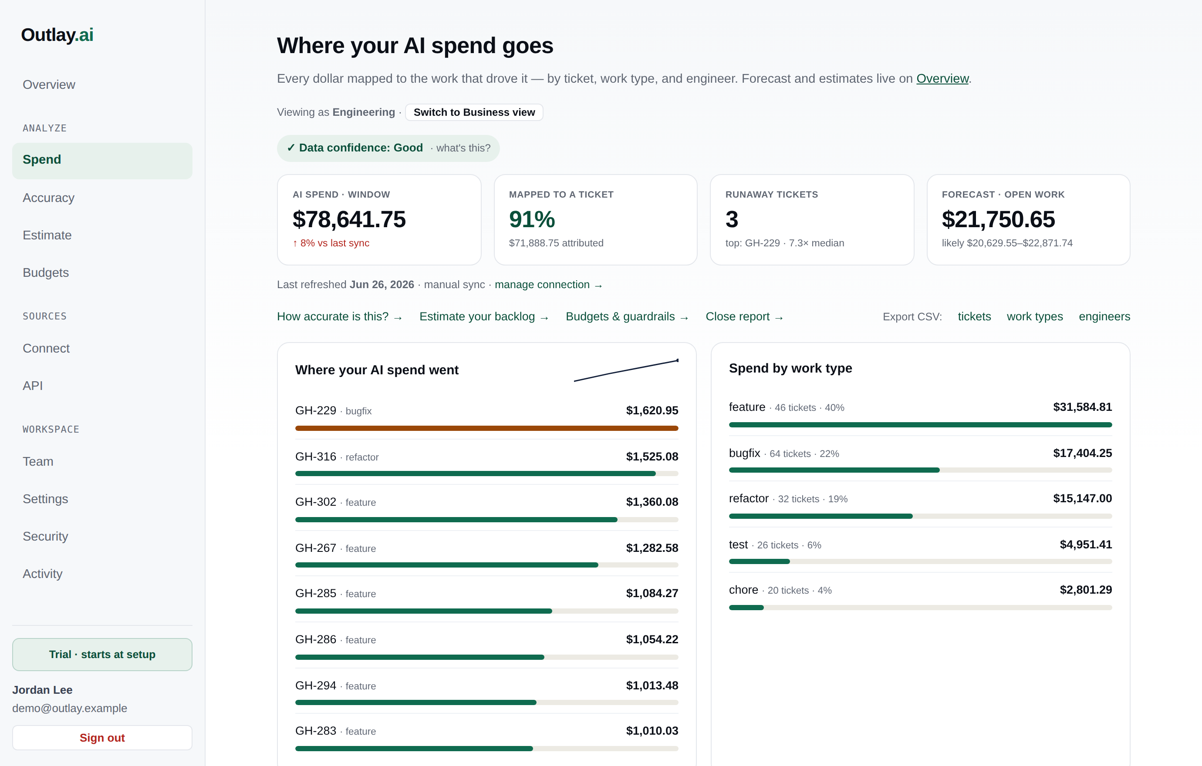
DEMO · ATTRIBUTION
Every dollar, on the roadmap.
• By team & cost center, work type, ticket, and engineer.
• Ticket coverage shown honestly — and how to lift it.
• FOCUS-aligned CSV export for finance.
Notes:
Click path: open Spend (/app/outlay). Scroll the attribution (team / work type / ticket /
engineer). Then point at the COVERAGE line: "We're honest about it — this is the share of spend that
maps to a specific work item, and exactly how to lift it. We never inflate the number." Mention the
FOCUS CSV export ("the artifact your finance team loads").

Slide 9
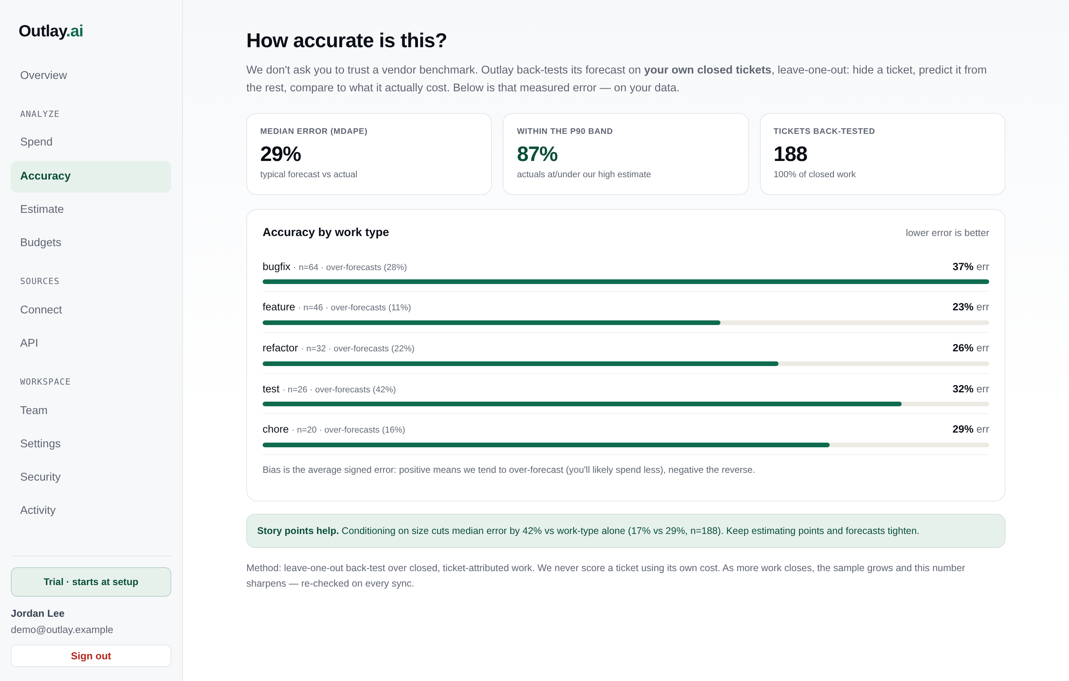
DEMO · ACCURACY (THE HONESTY LAYER)
We don't ask you to trust a vendor benchmark.
• Back-tested on your own closed tickets (leave-one-out).
• Median error, within-P90, and sample size — never hidden.
• Per-work-type accuracy with over/under bias.
Notes:
THE TRUST MOMENT — this is what separates you from a dashboard. Open Accuracy
(/app/outlay/accuracy). "The #1 question is 'can I trust the forecast?' We don't answer with a vendor
benchmark — we back-test on YOUR closed tickets, leave-one-out, and show the measured error, sample
size never hidden." Let a compliance/finance person sit with this; candor is the sell.

Slide 10
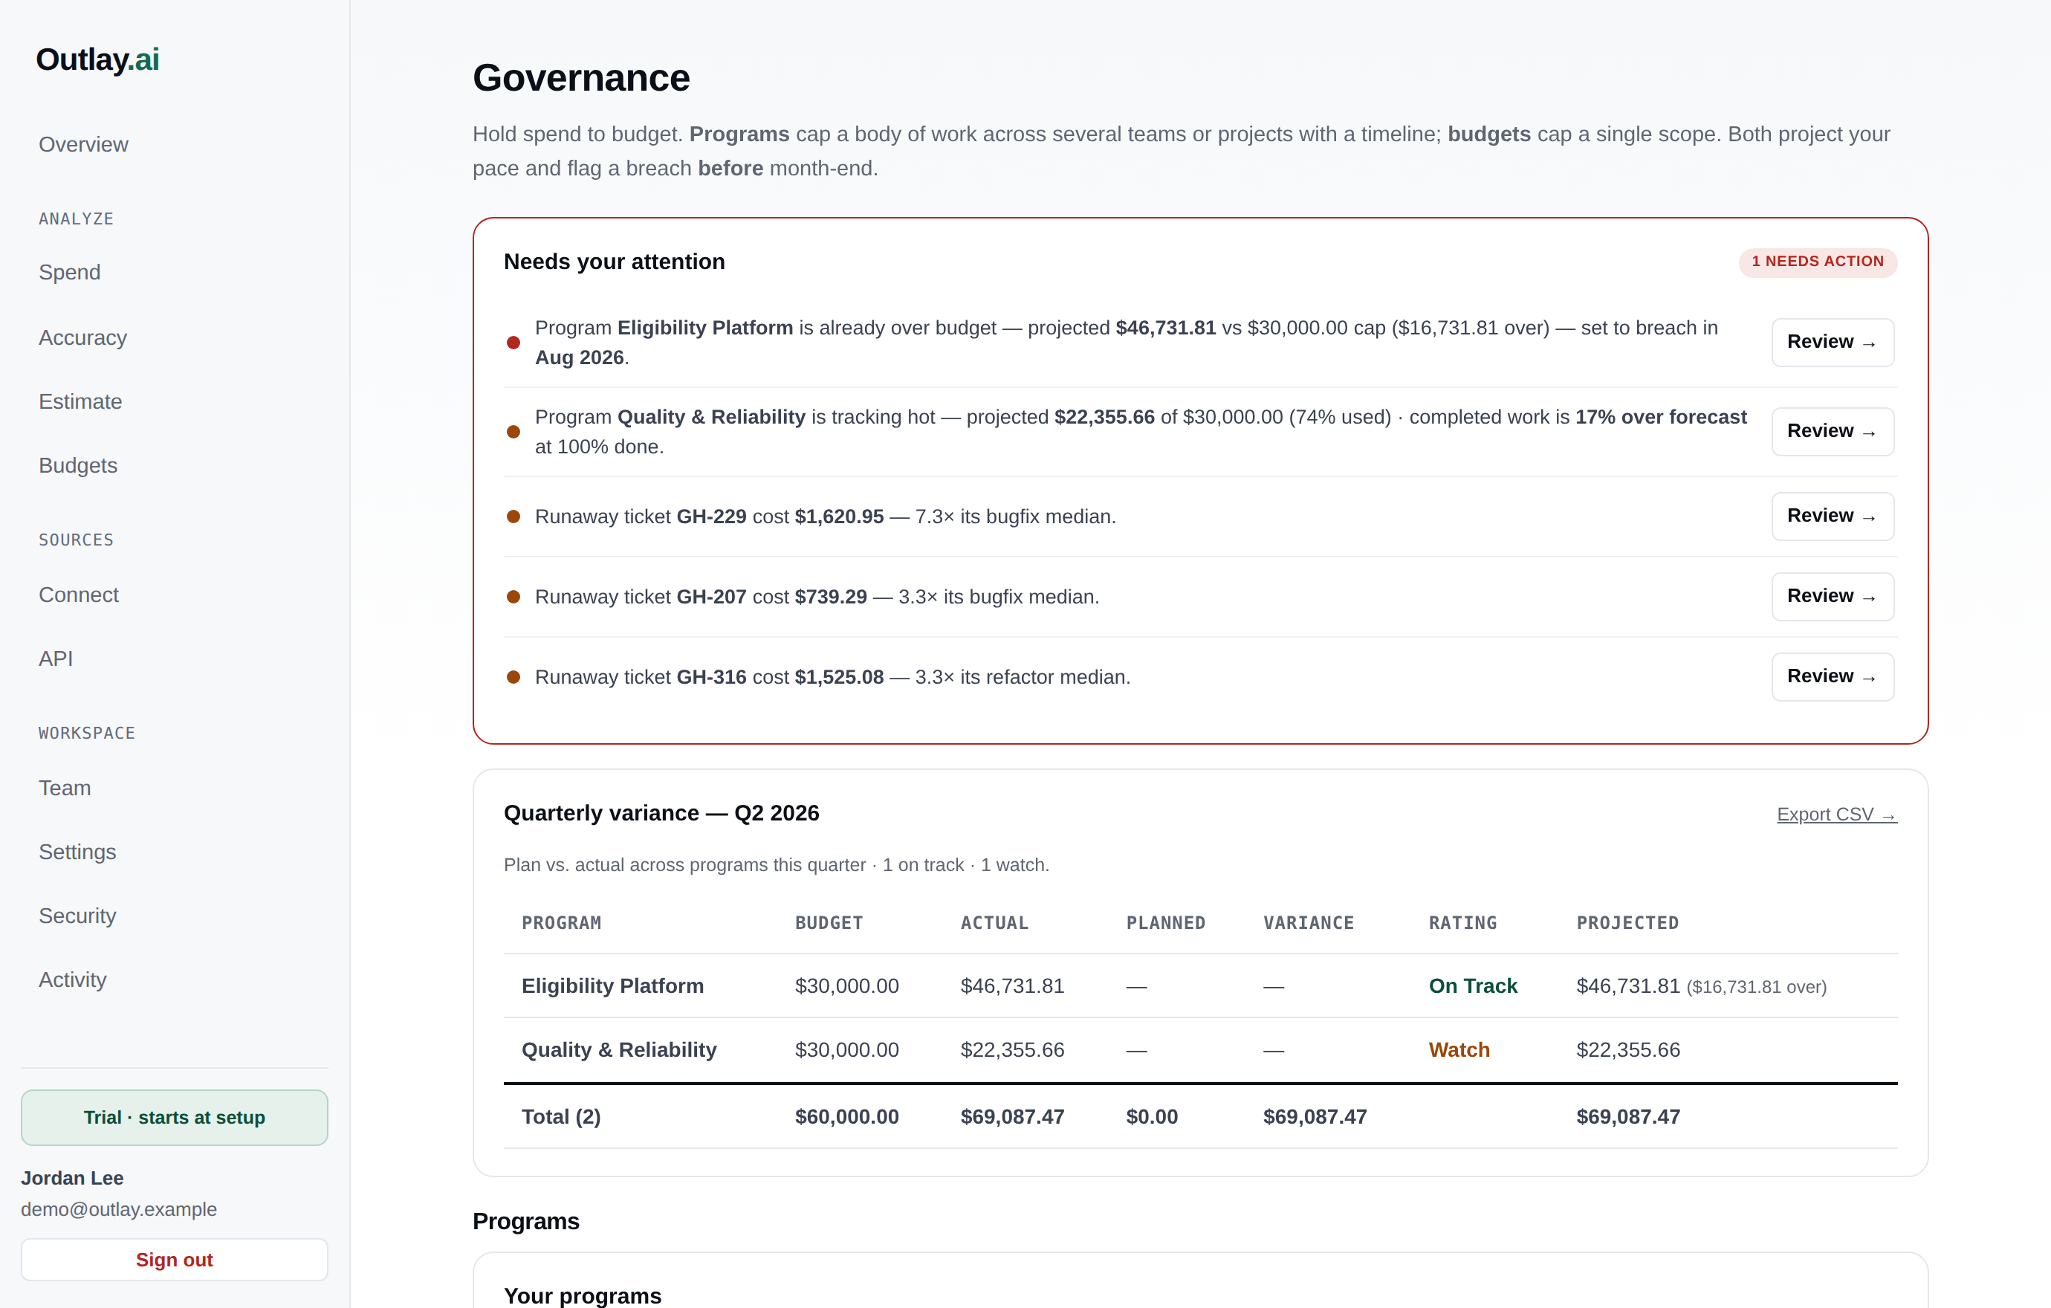
DEMO · GOVERNANCE
Put AI compute on a budget — per program.
• Program budgets across teams, projects, and work types.
• Real-time pacing → the projected breach date.
• On-/off-track earned-value rating; alerts to your SIEM.
Notes:
The CFO segment. Open Budgets/Governance (/app/outlay/budgets, /app/outlay/governance).
"Set a budget per program. We pace it in real time, project the breach date, and rate it on-track /
watch / off-track from forecast vs actual on completed work — and it reaches you proactively:
digest, close pack, Slack, webhook to your SIEM."

Slide 11
SECURITY & COMPLIANCE POSTURE
Straight talk on where we are.
IN PLACE TODAY
• SSO (OIDC) + SCIM provisioning
• Phishing-resistant MFA (passkeys)
• RBAC · audit log → SIEM export
• Retention + self-serve erasure
• Encryption at rest + KMS hook
• IR plan · WCAG 2.1 AA · CI security scan
ON THE ROADMAP (HONEST)
• SOC 2 Type II — in progress
• Annual penetration test — scheduled
• StateRAMP / GovRAMP — roadmap
• FedRAMP cloud + FIPS crypto — deal-gated
• Metadata-only keeps most of these out of scope for the data we touch.
Notes:
OBJECTION HANDLING — keep these cold:
• "SOC 2 / StateRAMP / FedRAMP?" → "SOC 2 Type II in progress, StateRAMP on the roadmap. I'll be
straight — not there yet. What makes a pilot work NOW is the architecture: read-only + metadata-only
puts us outside the data scope those frameworks govern. Happy to share our SOC 2 timeline + NIST
800-53 mapping today."
• "MARS-E / ARC-AMPE / 1075?" → "Those govern systems that receive member data/FTI. We receive none,
so we're outside that boundary. For controls that apply to any vendor — access, audit, encryption,
IR — we have them."
• "Where are you hosted?" → "Today Fly.io. For a gov engagement that advances, the path is a re-host
to AWS GovCloud / Azure Government — which also gives FIPS-validated crypto + US residency. Gated on
a real deal; metadata-only lets us pilot before it."
NEVER say "HIPAA compliant" or claim a cert you don't hold. Candor wins with a compliance officer.

Slide 12
FIT FOR MHBE
Two ways this earns its place now.
THE AI-GOVERNANCE LAYER
• Be the cost-attribution + budget-guardrail layer as you stand up the 2025 AI strategy.
• Governance-first — matched to how your program is being built.
• Day-one value with no instrumentation: read-only connections.
VENDOR & ENHANCEMENT SPEND
• As Deloitte / J29 enhancement work adopts AI coding agents, see cost per project.
• The earned-value view a public agency needs to justify IT spend.
• Attributes the $12.7M “MHC enhancements” work to the tickets behind it.
Notes:
Tie it to THEIR world. The $12.7M "MHC enhancements" line + the Deloitte/J29 contracts are
the natural first surface — AI-assisted dev cost per project, which a public agency must justify.

Slide 13
THE ASK
A two-week, read-only pilot — zero data-handling risk.
• Scoped to your development / vendor AI usage, not any production PHI system.
• Metadata-only and read-only — nothing for the security review to clear on data flow.
• You walk away with a real number: attribution coverage + a measured forecast accuracy on your work.
Free during the pilot · we share our SOC 2 timeline and NIST 800-53 control mapping up front.
Notes:
Don't leave without a next step. Say it plainly (above). Then pin: a follow-up with Scott
Brennan on the architecture + control mapping, and identify the dev/vendor data sources for the pilot.
OBJECTION — "What does a pilot require from us?" → "A read-only token to a work tracker and your AI
usage/billing API, scoped to dev/vendor. No installs, no production access, nothing inline."
OBJECTION — "Cost?" → "Pilot is free. Platform pricing we set with early customers — but prove the
number first." Leave-behind = the one-pager on the next slide's content.

Slide 14
WHY NOW
Govern the AI spend before it scales.
The cheapest time to put AI on a budget is at the start of the curve — which is exactly where Maryland is.
Krethikram Gowrisankar · krethikram@gmail.com · outlay-ai.com
Notes:
Close, then go to the ask (slide 11) and agree the next step. Backup slides follow for Q&A.

Slide 15
BACKUP · OBJECTION HANDLING
Do you ever see PHI / member data / prompts?
No — by design. Metadata only: token counts, ticket IDs, work types, dollars. Prompts, outputs, and API keys never leave your environment.
SOC 2 / StateRAMP / FedRAMP authorized?
SOC 2 Type II in progress; StateRAMP on the roadmap. Not there yet — and the architecture is what makes a pilot work now (outside the data scope those govern).
MARS-E / ARC-AMPE / IRS 1075?
Those govern systems that receive member data/FTI. We receive none, so we're outside that boundary. Vendor-applicable controls (access/audit/encryption/IR) we have.
Where are you hosted?
Fly.io today. A gov engagement that advances → re-host to AWS GovCloud / Azure Gov (FIPS crypto + US residency). Gated on a real deal; metadata-only lets us pilot first.
What does a pilot require from us?
A read-only token to a tracker + your AI usage/billing API, scoped to dev/vendor. No installs, no production access, nothing inline. Two weeks.
Cost?
Pilot is free. Platform pricing set with early customers — prove the number first.
Notes:
Flip here if Q&A goes deep on compliance. Never overclaim — 'in progress / roadmap / out of scope by design'.

Slide 16
BACKUP · SECURITY & CONTROL SUMMARY
Architecture removes the heaviest scope; operational controls are in place; attestations are the roadmap.
HAVE & CAN EVIDENCE
• Metadata-only / BYOK / read-only — no PHI/PII/FTI
• SSO (OIDC) + SCIM
• MFA incl. phishing-resistant passkeys (AAL2/3)
• RBAC · audit log + SIEM export (/api/v1/audit)
• Session controls: idle/absolute/epoch revocation
• Retention + self-serve erasure
• Encryption at rest + pluggable KMS hook
• IR plan (MD-SOC 1-hr) + incident webhook
• WCAG 2.1 AA + automated a11y & security CI scans
ROADMAP / EXTERNAL / FUNDED
• SOC 2 Type II — in progress (highest leverage)
• Annual third-party penetration test
• Monthly vulnerability-scan program + patch SLA
• StateRAMP / GovRAMP (Ready → Authorized)
• FedRAMP-authorized cloud (AWS GovCloud / Azure Gov)
• FIPS 140-validated crypto (IRS 1075)
• 3PAO assessment vs NIST 800-53 Rev 5
Notes:
Mirrors docs/prospect-maryland-health-connection.md (the requirements→readiness matrix) and docs/soc2-stateramp-sequencing.md.

