Slide 1
YaFSM Generator by Jörg Kreuzberger

Slide 2
Goals
Open Source FSM Generator for C++ and Java
Generation of Code
Free Generation of State visualisation
(Non-Free) Graphical Editor Frontend

Slide 3
Design Goals
Hierachical State Engine without Memory
Trigger with parameter
Conditional state transitions
State enter and exit actions
State transtition actions
State self transitions without state exit/enter
Timers, Events, Attributes

Slide 4
Generator input
Simple XML file as input for generator
XSD definition
Graphical Editor for XML file
<root>
<definitions>
<action name="onEnterRun" param=""/>
<action name="onExitRun" param=""/>
<trigger name="run" param=""/>
<trigger name="end" param=""/>
</definitions>
<fsm>
<state name="stop" type="entry"/>
<state name="run" enter="onEnterRun()" exit="onExitRun()">
<state name="stopping" type="entry"/>
<state name="running"/>
<transition trigger="run" begin="stopping" end="running" condition=""/>
<transition trigger="end" begin="running" end="stopping" condition=""/>
</state>
<transition trigger="run" begin="stop" end="run" condition=""/>
<transition trigger="end" begin="run" end="stop"/>
</fsm>
</root>

Slide 5
Generator
Perl Script to generate C++ classes
Code templates for C++ classes for Timer and Events
Planed: Java generator for C++ and Java

Slide 6
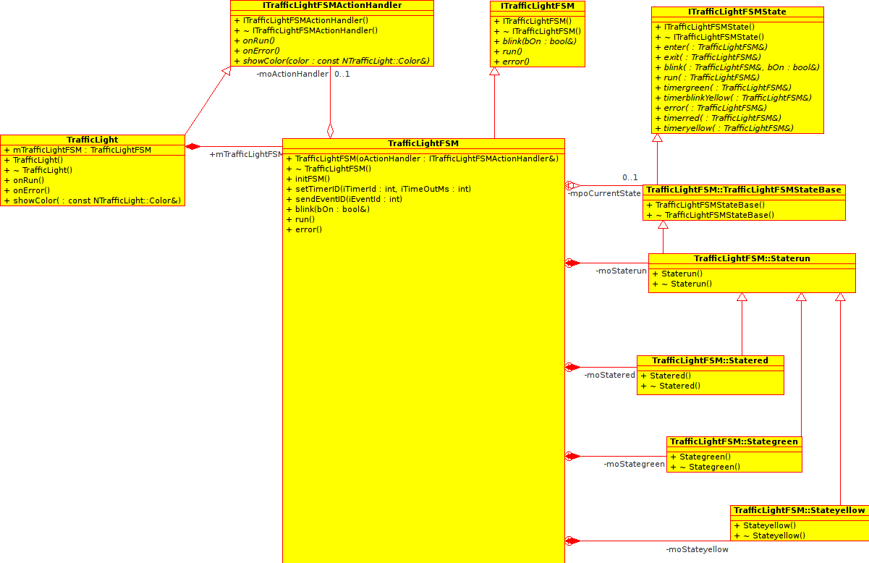
Code Generator
Based on ”Design Patterns” from
  Gamma, Erich; Richard Helm, Ralph Johnson, John M. Vlissides (1995).

Slide 7
Visualisation
Generation of GraphViz dot input files
Transformation of dot files to SVG with dot
Generation of text description files
OCFDFsmViewer as tool to parse description files and link SVG files

Slide 8
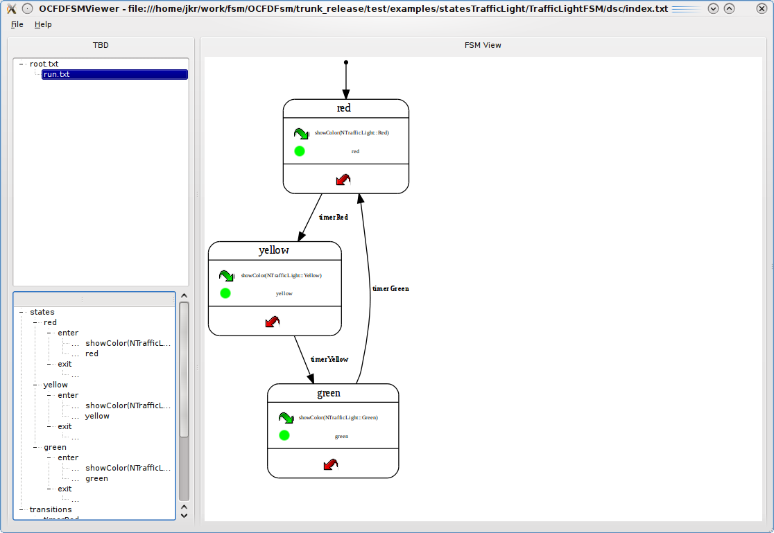
OCFDFsmViewer

Slide 9
End

