Slide 1
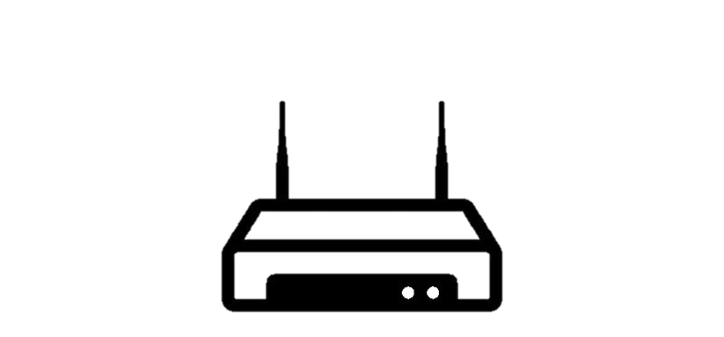
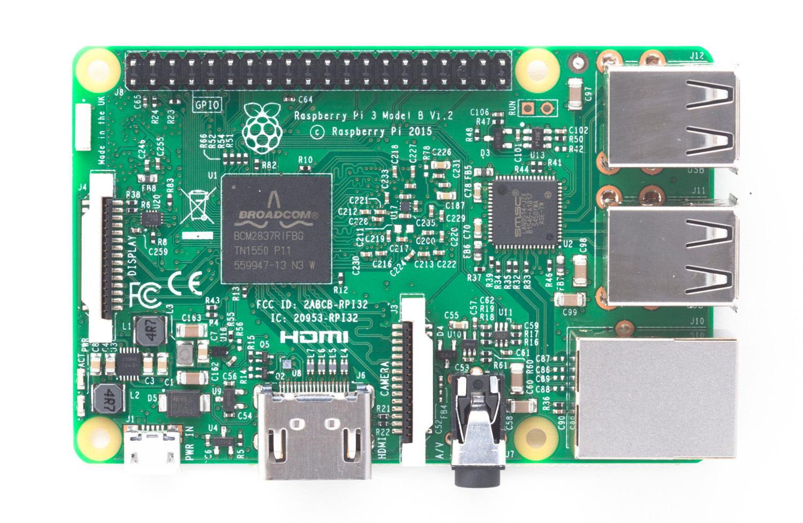





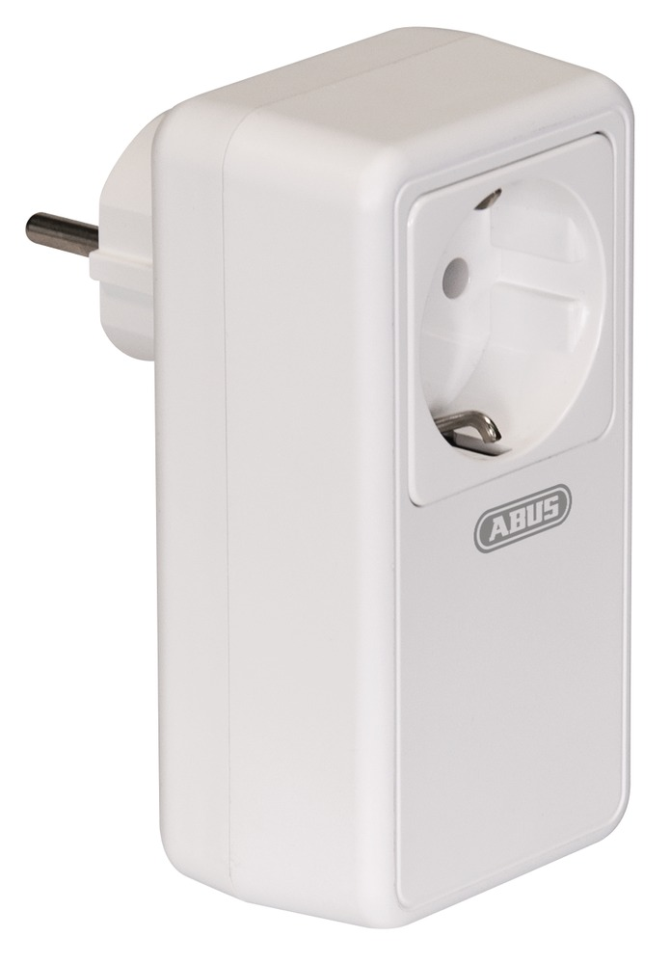
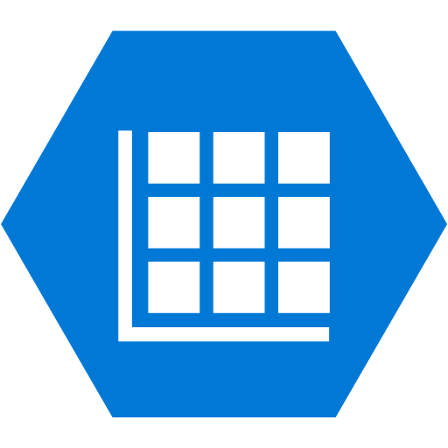

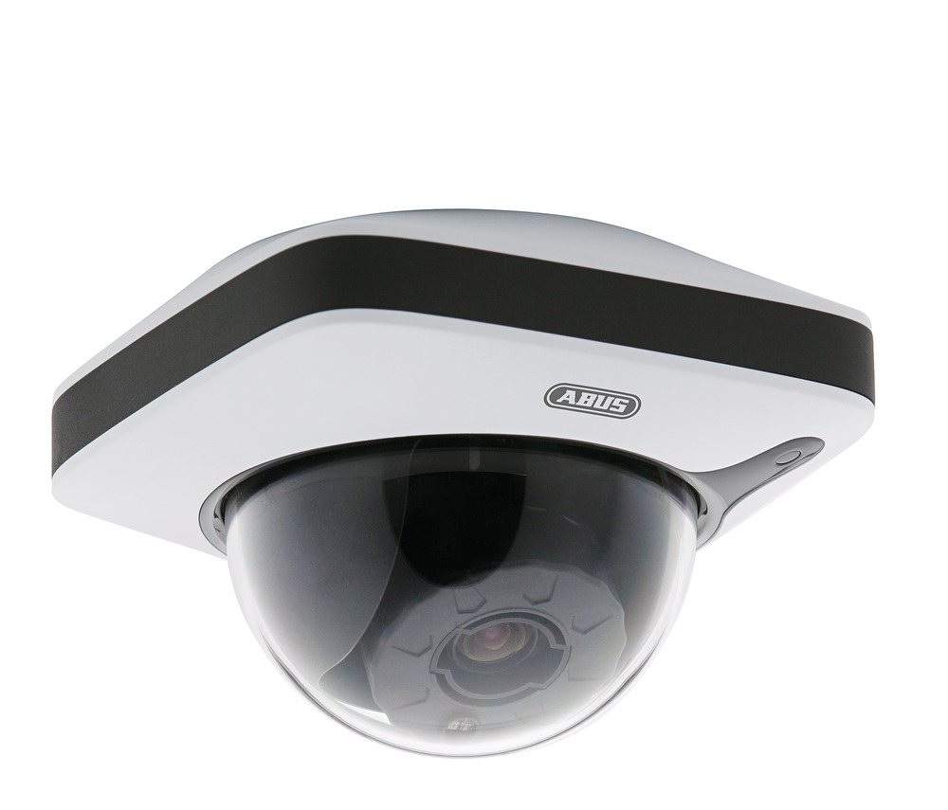
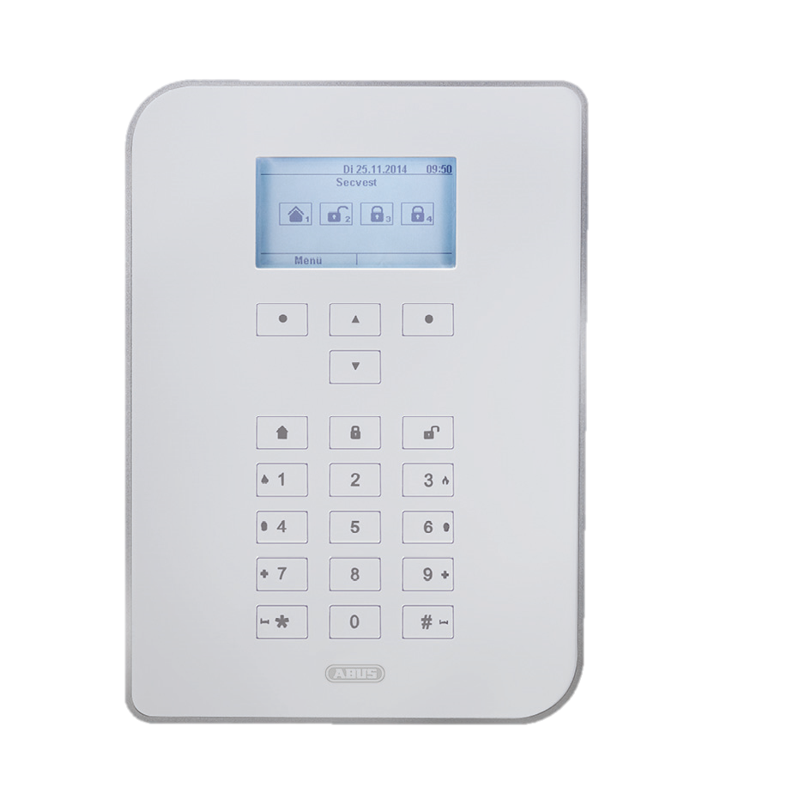
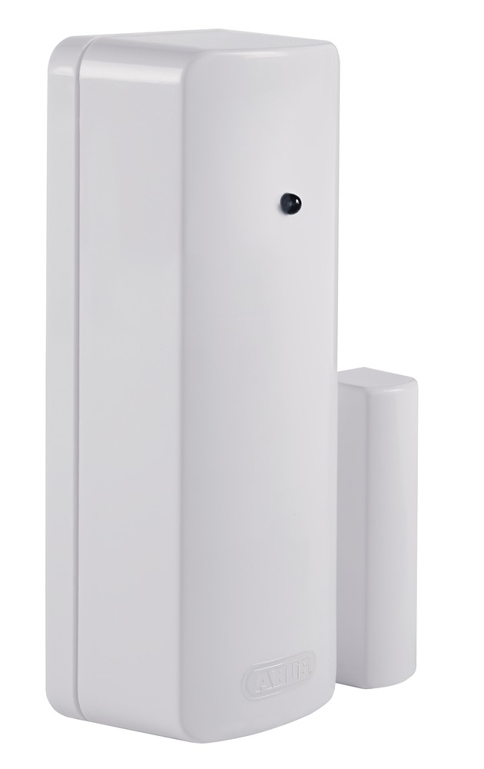
IoT Homesecurity – Architecture overview
LAN
Azure Cloud
Internet
Azure Storage Tables
(Device DB, Customer DB,
Telemetry)
Azure AD B2C
mqtt
Azure IoT Hub
Azure Functions
IoTHs
Gateway
Internet Router
Router has dynamic public IP
(Using dyndns, no-ip.org, etc.)
Azure App Service
Web Portal (https)
API (https)
Phone and
Tablet Apps,
Browsers
Wireless connection
(868MHz protocol)
IP connection
AC Power Switch
ABUS IP Camera
ABUS Alarm panel
Window Sensor

