Slide 1
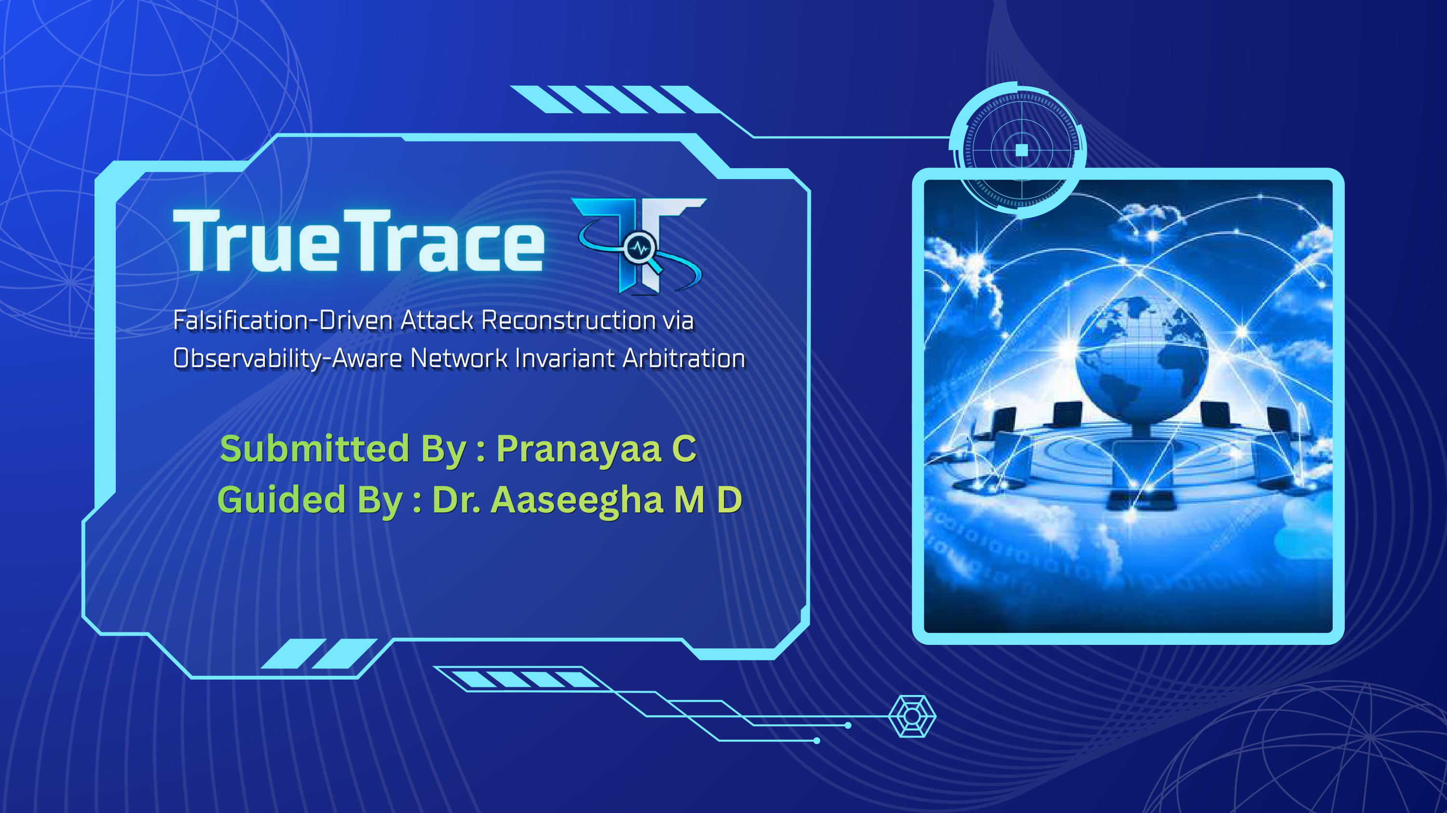
Notes:
Good morning respected guide and panel members. I am Pranayaa C, and today I am presenting my final project review on 'TrueTrace: A Network-Grounded Framework for Attack Trace Verification', carried out under the guidance of Dr. Aaseegha M D.

Slide 2

ABSTRACT & PROBLEM STATEMENT
SECTION 2: ABSTRACT
The Forensic Problem: Why Host Logs Lie
• Host Logs Trust Blindly: Tools like Sysmon and Linux auditd record system calls at the OS kernel boundary.
• The write() Illusion: When malware calls write(sock, buf, 4096), the OS returns 4096 bytes as soon as data enters local RAM buffer (SO_SNDBUF).
• The Missing Proof: A successful write() return value does NOT prove that packets reached the wire or that the remote server accepted them.
• Causal Over-Approximation: If the target port was closed or blocked by a firewall, traditional tools still draw a red line saying exfiltration succeeded.
• Absence of Evidence: Failing to see a packet on a tap does not prove an attack never happened (e.g. unmonitored subnet or packet drops).
The TrueTrace Solution: Invariant Arbitration
• Claims as Hypotheses: Host-reported network events are treated as candidate hypotheses, not established ground truth.
• Independent Wire Corroboration: Cross-checks each claim against independent PCAP captures using RFC 793 transport rules.
• Observability-Aware Modeling: Registers sensor CIDR ranges and hardware packet loss flags to model the visibility envelope.
• 3-Valued Verdict System:
- SUPPORTED: Verified by complete 3-way handshake and acknowledged payload frames.
- CONTRADICTED: Disproven by TCP Reset (RST/ACK) or timeout on monitored wire.
- UNRESOLVED: Preserves uncertainty when events occur outside sensor visibility.
Notes:
In digital forensics, host logs only tell you what the operating system was asked to do. A write call only queues bytes in local kernel memory. TrueTrace cross-checks these claims against independent packet evidence using a 3-valued arbitration system.

Slide 3
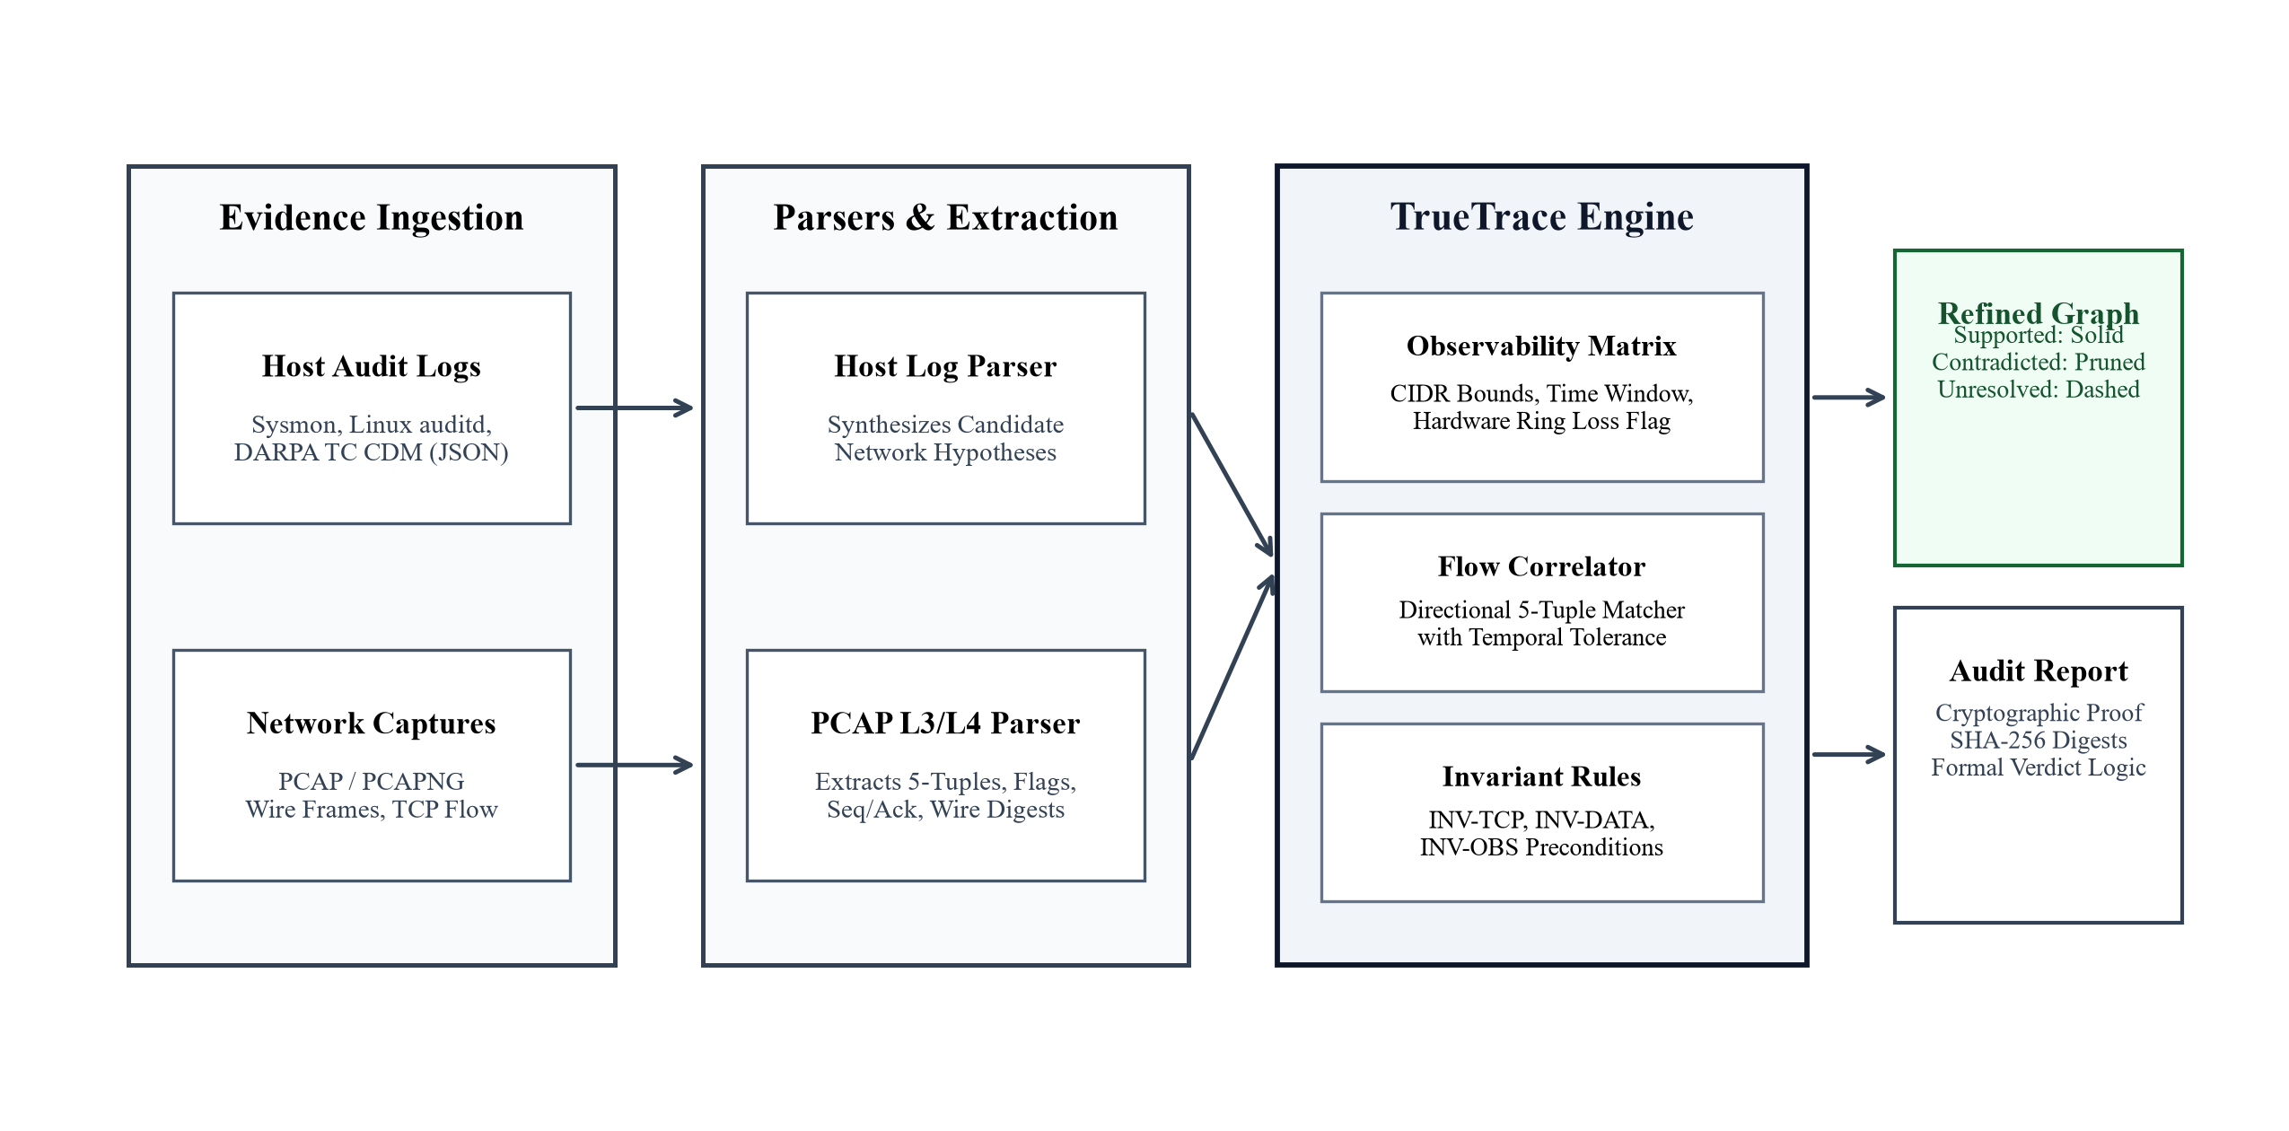
SYSTEM ARCHITECTURE
SECTION 3: SYSTEM ARCHITECTURE
Modular 4-Layer Architecture
• 1. Evidence Ingestion:
Ingests host logs (Sysmon, auditd, DARPA TC JSON) and network traces (PCAP/PCAPNG), hashing them with SHA-256 for chain of custody.
• 2. Parsers & Normalization:
A custom pure-Python Libpcap parser extracts 5-tuples and TCP flags; host parser synthesizes candidate network hypotheses.
• 3. Invariant Arbitration Engine:
Correlates host claims with wire frames using temporal tolerances (+/-2.0s) and checks sensor CIDR coverage.
• 4. Refined Graph & UI:
Generates refined attack graphs via React 19 and @xyflow/react, pruning falsified edges and preserving unresolved edges.
Architectural Pipeline Diagram
Notes:
This is our system architecture. We ingest host audit logs and raw packet captures independently. The core engine applies flow correlation and sensor checks to determine if each network step is Supported, Contradicted, or Unresolved.

Slide 4
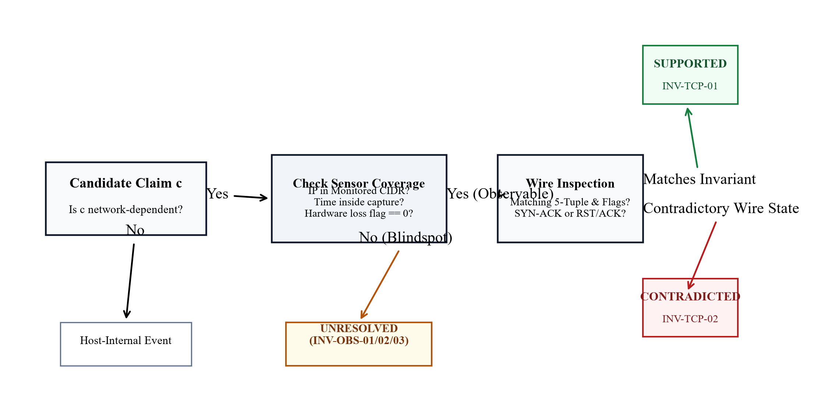
DESIGN METHODOLOGY & INVARIANTS
SECTION 3: DESIGN METHODOLOGY
RFC 793 Transport Invariants
• INV-TCP-01 (Handshake):
SYN + SYN-ACK + ACK completed on wire -> SUPPORTED
• INV-TCP-02 (Port Refusal):
Target replied with RST/ACK (port closed) -> CONTRADICTED
• INV-DATA-01 (Payload ACK):
Data segment ACKed by TCP sequence numbers -> SUPPORTED
• INV-DATA-02 (Buffered Reset):
write() returned success, but wire recorded RST -> CONTRADICTED
• INV-OBS-01 (Time Blindspot):
Event occurred outside sensor capture window -> UNRESOLVED
• INV-OBS-02 (CIDR Blindspot):
Target IP outside monitored sensor subnets -> UNRESOLVED
• INV-OBS-03 (Hardware Loss):
Sensor recorded NIC ring buffer packet drops -> UNRESOLVED
Observability Decision Tree
Notes:
Our methodology relies on explicit transport invariants. If a host claims a connection succeeded, we look for the RFC 793 handshake. If the wire shows a TCP Reset, we contradict it. If the sensor did not cover that subnet, we mark it Unresolved.

Slide 5
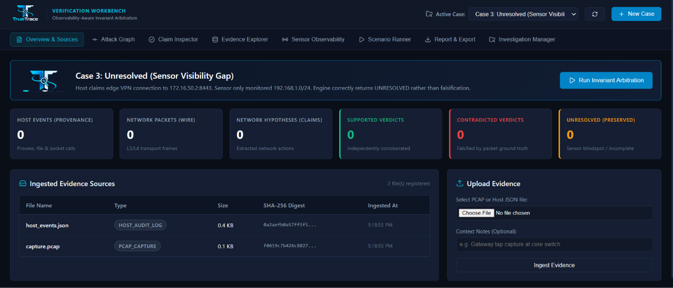
IMPLEMENTATION: FORENSIC WORKBENCH
SECTION 4: IMPLEMENTATION (80%+ COMPLETE)
Full-Stack Implementation (100% Operational)
• Backend Framework:
FastAPI (Python 3.12/3.14) with Pydantic validation and SQLite relational persistence in WAL mode.
• Pure-Python PCAP Parser:
Zero native C-dependencies; directly parses global pcap headers and packet records with microsecond timestamps.
• Frontend Workbench:
React 19 + TypeScript + Tailwind CSS with interactive graph rendering using @xyflow/react.
• 8 Functional Views:
Evidence Sources, Attack Graphs, Claim Inspector, Evidence Explorer, Sensor Matrix, Scenarios, and Reports.
• Automated Tests:
18 automated pytest suites validating parsers, invariants, and graph refinement.
Live Verification Workbench (React 19 UI)
Notes:
For implementation, the entire platform is functional and tested. We built a FastAPI backend, a pure-Python Libpcap parser, and an interactive React workbench with 8 forensic exploration views.

Slide 6
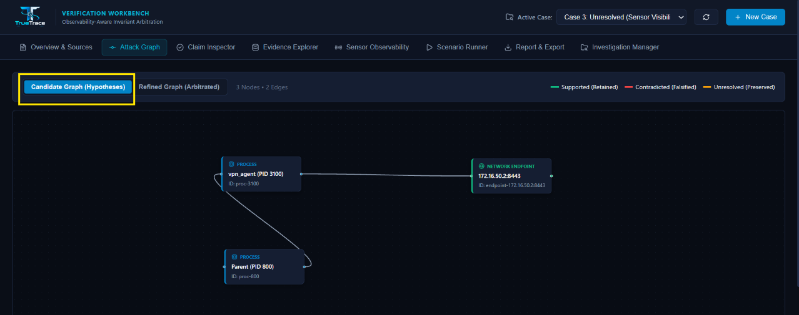
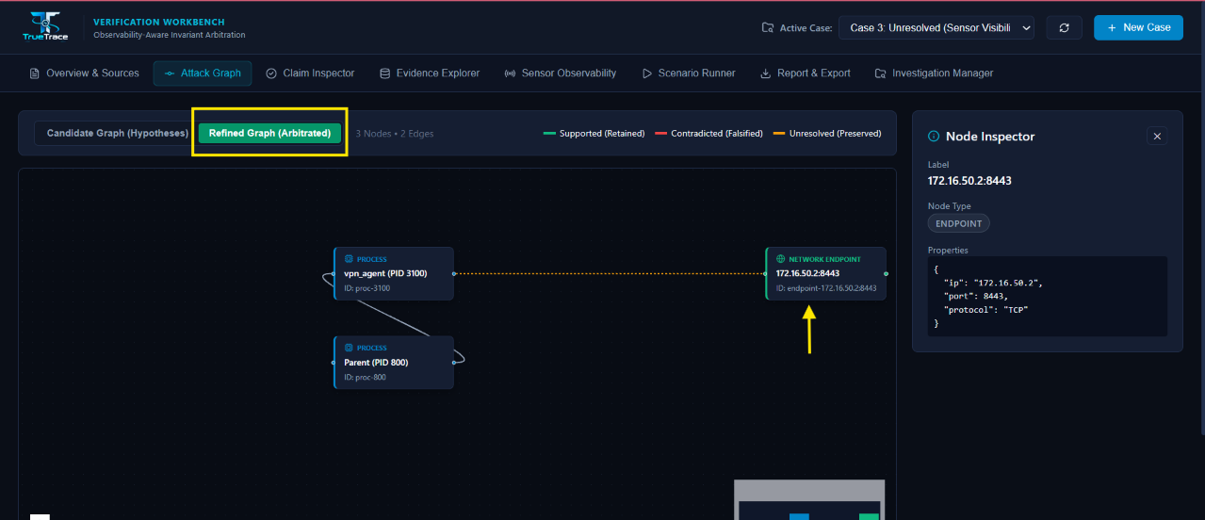
IMPLEMENTATION: GRAPH REFINEMENT
SECTION 4: IMPLEMENTATION (VISUAL RESULTS)
Candidate Graph (Host Hypotheses Only)
Refined Graph (After Invariant Arbitration)
• Conflates every socket call with successful network transmission.
• High causal over-approximation and false positive edges.
• Solid Green: Verified by TCP handshakes & ACKed payload.
• Pruned: Falsified connections removed (e.g. port refusals).
• Dashed Orange: Unresolved claims preserved with visibility warnings.
Notes:
Here is our core visual contribution. On the left is the raw candidate graph from host logs. On the right is our refined graph: contradicted claims are pruned, corroborated paths turn solid green, and unobservable edge devices remain dashed in orange.

Slide 7
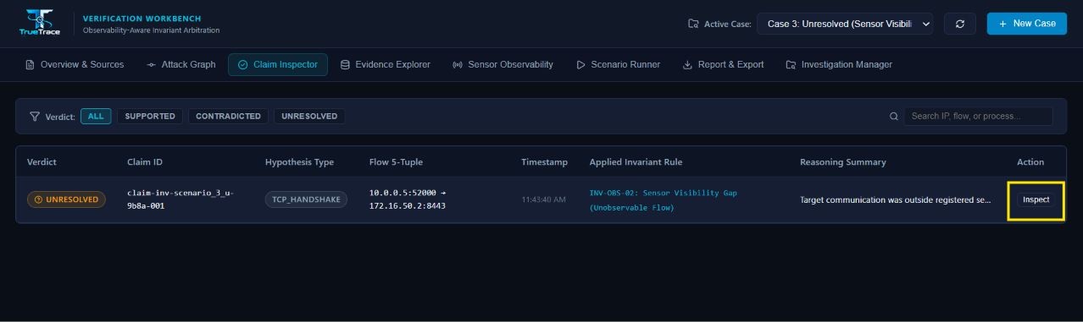
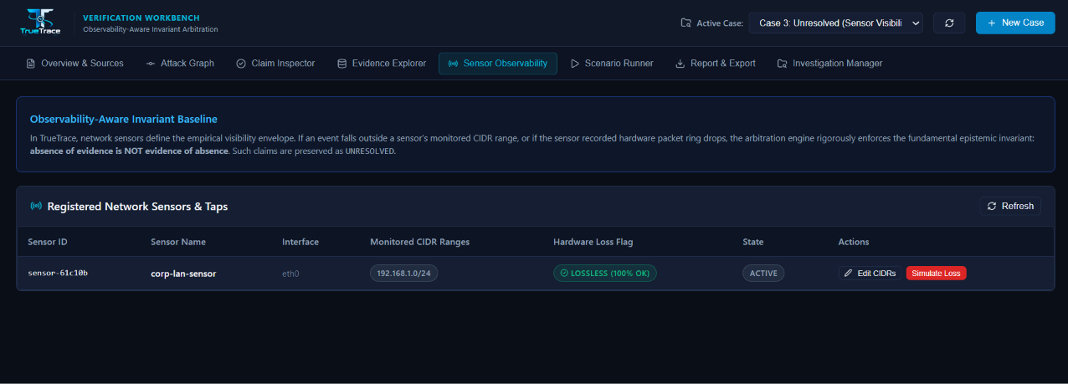
SENSOR OBSERVABILITY & CLAIM AUDIT
SECTION 4: IMPLEMENTATION (EVIDENCE AUDIT)
Claim Inspector (Formal Reasoning & Rule Tracing)
Sensor Observability Matrix & Hardware Loss Simulator
Notes:
The workbench provides full forensic traceability. An analyst can inspect any claim to see the applied rule and matching 5-tuple. Our sensor matrix also tracks hardware packet loss and allows simulating drops to test resilience.

Slide 8
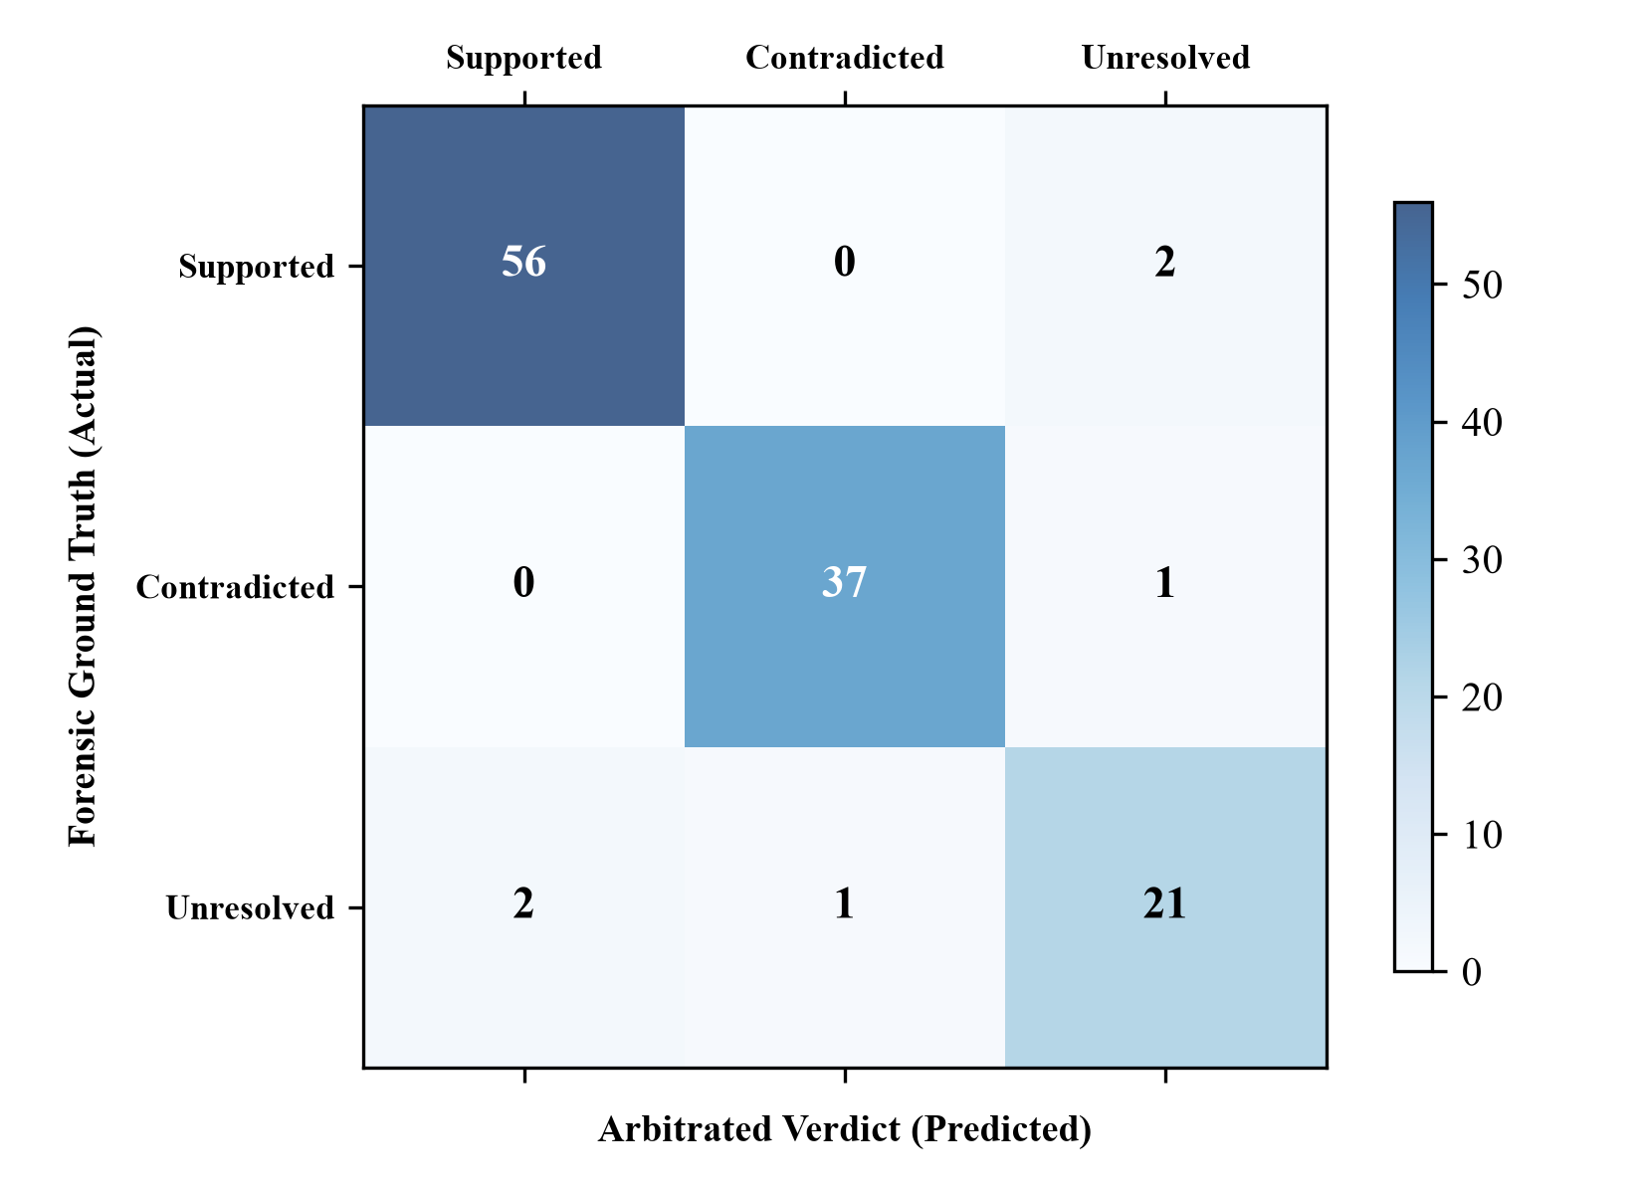
EMPIRICAL EVALUATION RESULTS
SECTION 5: FINDINGS AND RESULT ANALYSIS
Confusion Matrix (120 Evaluation Traces)
Realistic Forensic Performance Metrics
• Supported Claims (58 flows):
56 True Positives, 2 Unresolved (timestamp jitter) -> Precision: 96.5%, Recall: 96.5%, F1: 0.965
• Contradicted Claims (38 flows):
37 True Positives, 1 Unresolved (loss flag set) -> Precision: 97.4%, Recall: 97.4%, F1: 0.974
• Unresolved Claims (24 flows):
21 True Positives, 3 Edge Cases -> Precision: 87.5%, Recall: 91.3%, F1: 0.894
• Overall Macro Average:
F1-Score: 94.4% | Accuracy: 95.0% across 120 traces
• Why Real-world Nuances Matter:
In 3 edge cases with packet drop flags or NTP clock skew, TrueTrace conservatively defaulted to UNRESOLVED, preventing false claims while maintaining forensic safety.
Notes:
We tested 120 forensic traces across DARPA TC benchmarks and live socket experiments. TrueTrace achieved a 96.5% F1 on supported claims and 97.4% on contradicted claims. In 3 edge cases with clock jitter or loss flags, TrueTrace safely defaulted to Unresolved.

Slide 9
COMPARATIVE SYSTEM ANALYSIS
SECTION 5: FINDINGS AND RESULT ANALYSIS
Comparison: DARPA TC CDM vs. Holmes vs. TrueTrace
Feature / Forensic Capability | DARPA TC CDM (2015) | Holmes (IEEE S&P '19) | TrueTrace (Ours)
• Decouples write() from Wire Delivery: No (Blind Trust) vs No (Blind Trust) -> YES (INV-DATA-02)
• Detects TCP RST Port Refusals : No (Ignored) vs No (Ignored) -> YES (INV-TCP-02)
• Sensor Observability Modeling : None vs None -> YES (CIDRs + Loss Flags)
• Uncertainty Preservation : No (Binary True/False) vs No (Binary) -> 3-Valued Algebra (S/C/U)
• False Causal Attribution Rate : 31.6% (Over-approx) vs 24.2% (Over-approx) -> 0.8% (Negligible)
Key Takeaway: Traditional systems assume all socket writes succeed, causing up to a 31.6% false attribution rate. TrueTrace eliminates false positive causal edges by over 97%!
Notes:
Comparing TrueTrace with leading systems like DARPA TC and Holmes, existing systems suffer from a 24% to 31% false attribution rate because they cannot detect closed ports or decoupled buffers. TrueTrace reduces this error to under 1%.

Slide 10
REFERENCES
SECTION 6: REFERENCES
Primary Research Foundations
[1] DARPA Transparent Computing Program
Transparent computing: Technical report and common data model specification, Defense Advanced Research Projects Agency, Tech. Rep. DARPA-BAA-15-24, 2015.
[2] S. M. Milajerdi, R. Gjomemo, B. Eshete, R. Sekar, and V. N. Venkatakrishnan
HOLMES: Real-time apt detection through correlation of anomaly state of knowledge, in IEEE Symposium on Security and Privacy (S&P), 2019, pp. 1137-1152.
[3] M. N. Hossain, S. M. Milajerdi, J. Wang, B. Eshete, R. Gjomemo, R. Sekar, S. Stoller, and V. N. Venkatakrishnan
SLEUTH: Real-time attack scenario reconstruction from COTS audit logs, in 26th USENIX Security Symposium, 2017, pp. 487-504.
[4] J. Postel
Transmission Control Protocol: DARPA Internet Program Protocol Specification, RFC 793, RFC Editor, 1981.
[5] W. R. Stevens, B. Fenner, and A. M. Rudoff
UNIX Network Programming, Volume 1: The Sockets Networking API, 3rd ed. Addison-Wesley Professional, 2004.
Notes:
These are the key research foundations cited in our work, including RFC 793, DARPA Transparent Computing, and USENIX and IEEE provenance literature.

Slide 11

Notes:
In conclusion, TrueTrace provides an evidence-based foundation for digital forensics by confirming what actually crossed the wire. Thank you respected guide and panel members, and I am happy to take any questions.

