Slide 1
ANALYSIS OF GROWTH OF SPECIFIC STRATEGY IN THE POOL OF STRATEGIES.
Authors:
Komal Gujarathi
Snehal More
TE Computer, Cummins College of Engineering For Women,pune.

Slide 2
Human Interactions
Rescue operations, NGO efforts, Defence forces.
Security of female employees, Terrorism.
Traffic indiscipline,
Match fixing /doping in sports
Leads to the common beliefs-
In kaliyug , the cooperation is expected to vanish.
Grand parents view - “Cooperation seen in olden days is not seen these days”.

Slide 3
Quantitative cross check
This study attempts to quantitatively cross check these common beliefs.
Our approach gains the motivation from the Axelrod’s tournament held in 1980’s.
Robert Axelrod asked for the different strategies and allowed them to compete with each other based on Prisoners Dilemma.
We borrow 3 representative strategies (Cooperator, Defector, Tit for Tat) in our model to represent individuals in social interactions.

Slide 4
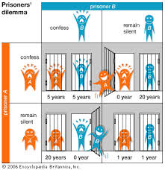
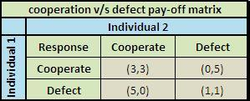
Prisoners Dilemma pay off matrix

Slide 5
Our simulation
Iterated Prisoners Dilemma (IPD).
Cases considered-
Invasion of strategy into others
A small group of one strategy into other
Equal population of all three strategies.

Slide 6
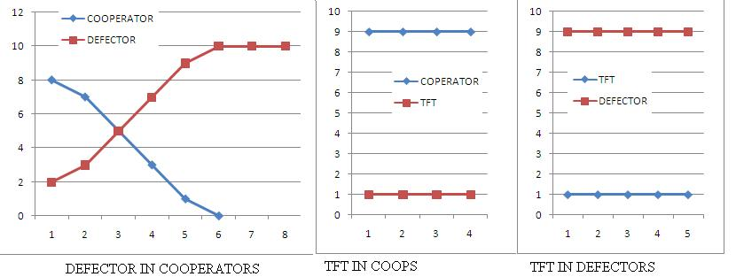
Invasion of a strategy into others
Fatal to cooperators
TFT unaffected

Slide 7
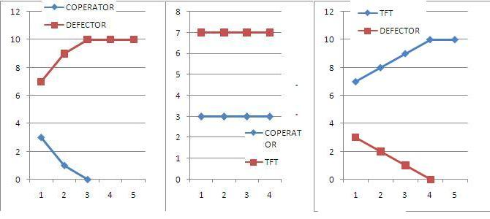
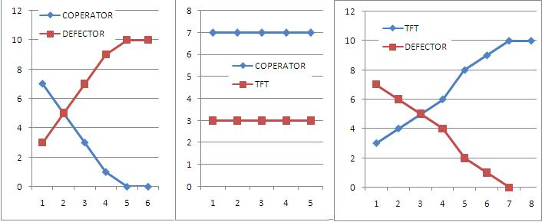
A small group of a single strategy into other dominant strategy

Slide 8
A small group of a single strategy into other dominant strategy
Minimum mass of TFT can dominate defectors.
Co-operators and defectors remains unchanged.

Slide 9
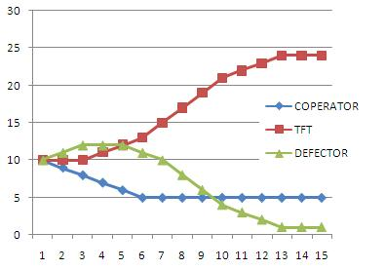
Equal population of all three strategies
Initial increase in defectors and reduction in co-operators.
At a critical point defectors start vanishing and cooperators remain constant.

Slide 10
Conclusions:
A group of cooperators suffer badly due to invasion of even a single defector.
Tit for Tat approach cannot suffer from even a big group of defectors.
Tit for Tat doesn’t try to win over any one.
Tit for Tat approach and cooperating approach help each other to coexist.
Cooperation (Visionaries ) has good hope of existence with Tit for Tats (Law and order).

Slide 11
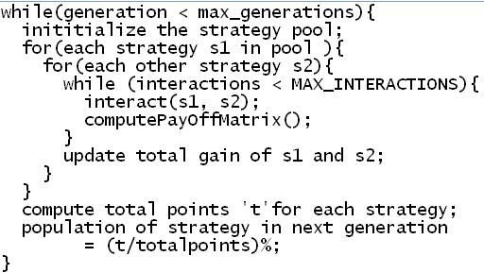
Algorithm

Slide 12
THANK YOU…..

