Slide 1
SMARTEx
Invest Smart
By:
Komal Gujarathi
Lakshmi Kanth Sandra

Slide 2
PURPOSE
To enable smart investment in the FOREX market.
advent of globalisation and increasing foreign trade across the world there is a tremendous growth in the foreign exchange market
Some traders use Technical analysis and others use fundamental analysis for FOREX trading purpose. Many apps like XE currency exist
overwhelms the novel retail user. Reading multiple charts, comparing them and analysing them necessitates both knowledge and time from the user
Provide simple yet scientifically sound and appealing app

Slide 3
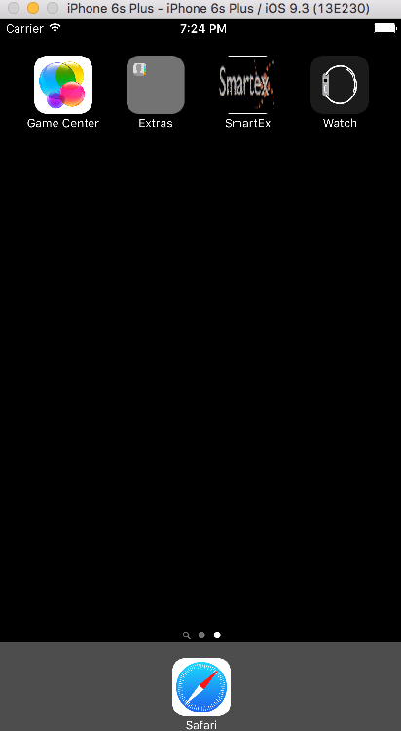
User Perspective

Slide 4


Slide 5
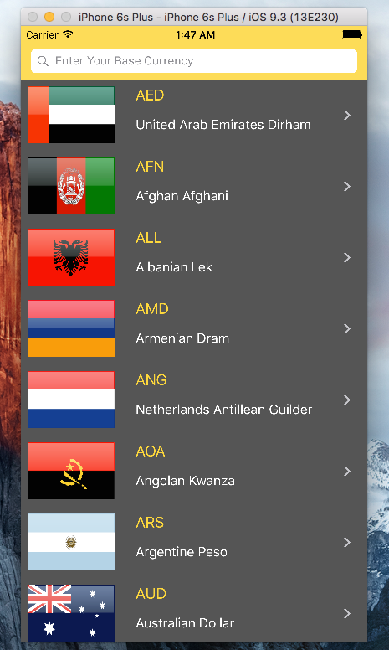

Slide 6
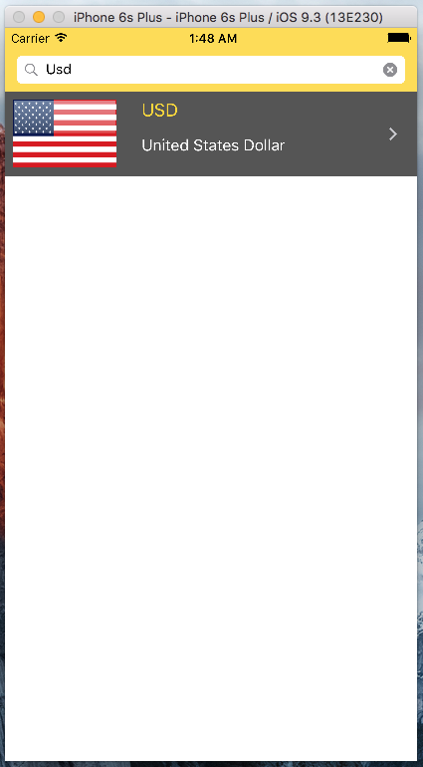

Slide 7
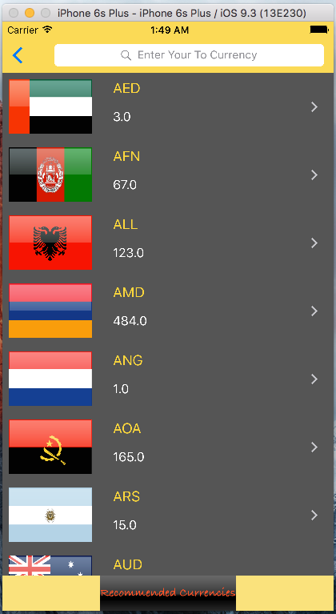

Slide 8
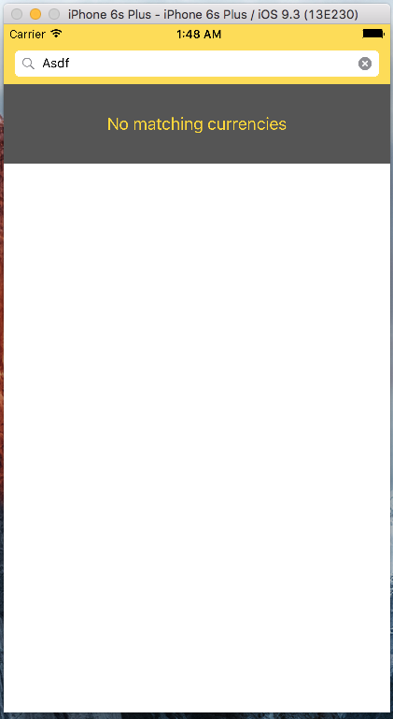

Slide 9
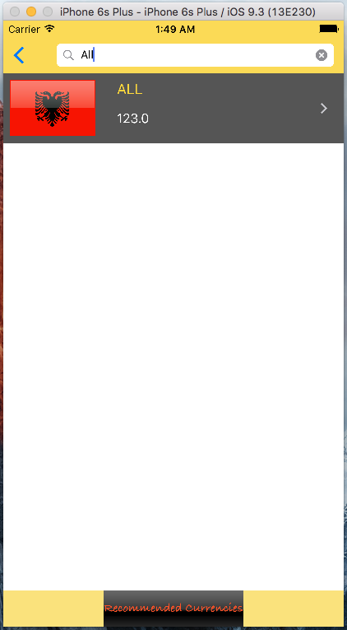

Slide 10
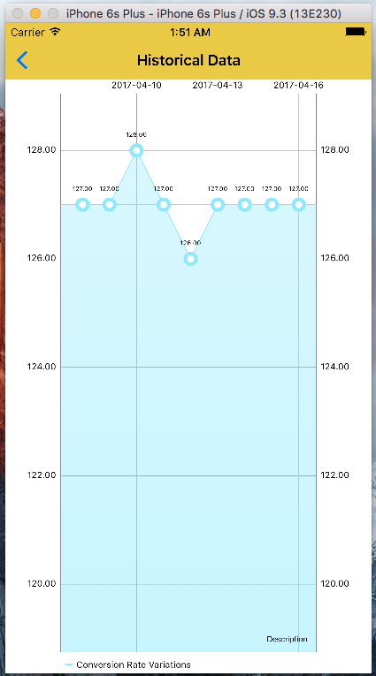

Slide 12
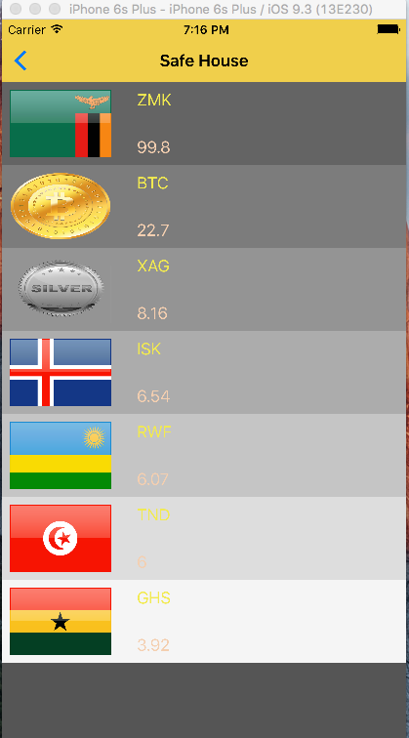

Slide 13
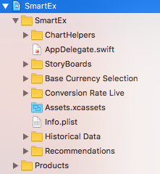
Deep Peek Packages

Slide 14
Package Structure
Data Variable class
API.swift
Store class
Cell class
Controller class

Slide 15
MVC architecture
Historical Data View Controller
Historical Data
Historical Data Store
Historical Data API
Charts
Line chart
Navigation Bar

Slide 16
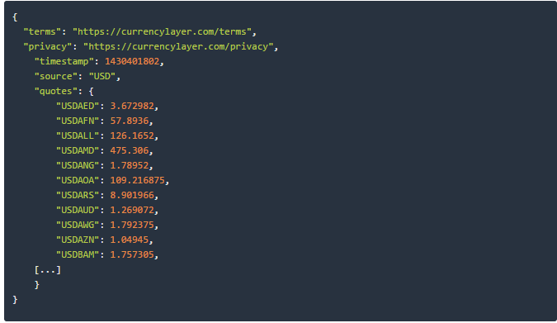
API used

Slide 17
Implementation Details
Dependency Inversion Principle
Single responsibility Principle

Slide 18
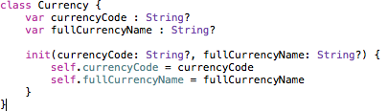

Slide 19
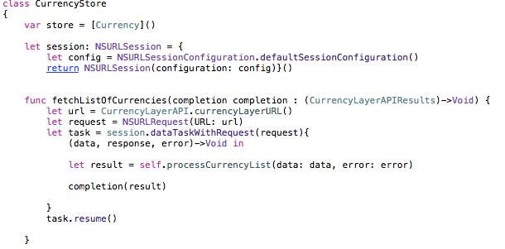

Slide 20
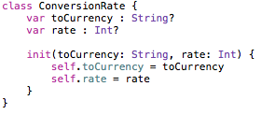
Data.swift
Low level data variables are segregated in to a custom class so that they can be easily extendable in future. The following snippets shows one of the data variable classes.

Slide 21
API.swift
has a struct which contains API key and URLs of the respective package as private data to prevent any untoward data corruption.
The struct segregates the base URL, API key and Query parameters. This ensures easy extension in the future.
A static function in each API.swift file to generate the needed URL. This function is being accessed by the store class. The function returns an url.
A function to query data from the API server in JSON format. This function returns an enum type to consider the possibility that the result of the query might be successful or yield various types of errors.

Slide 22
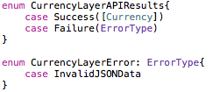
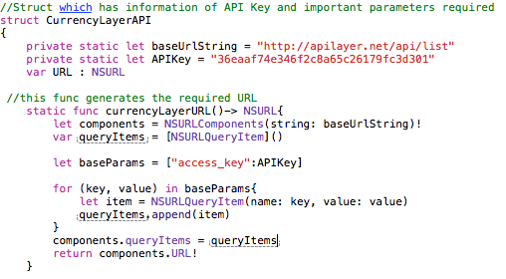

Slide 23
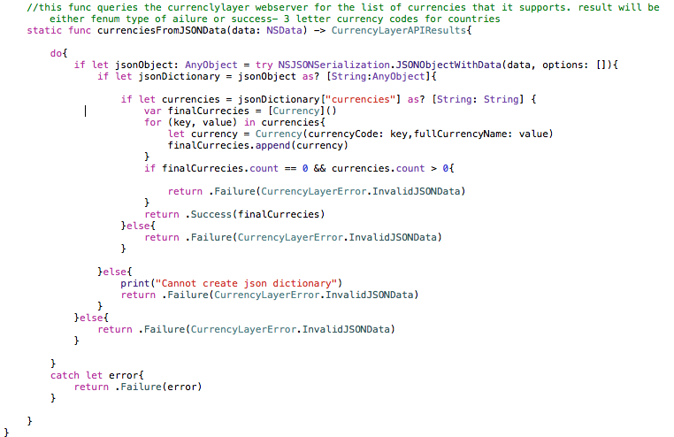

Slide 24
Store.swift
composes the data class
Has an interface function for the controller to call. This function internally uses the API.siwft for calling URL function and the Queryfunction
A new session with default configuration is created by the store class using the NSURLSessionConfiguration.defaultsessionConfiguration(). This session is used by the above interface function to fire a query through session.dataTaskWIthRequest().

Slide 25
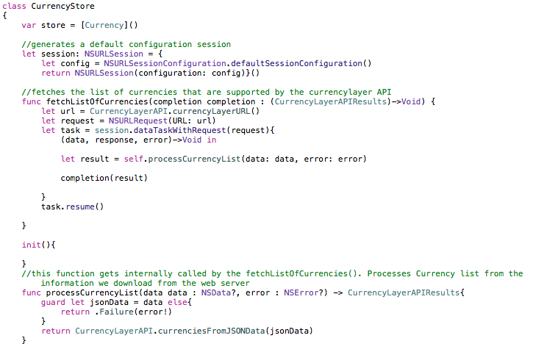

Slide 26
Controller.swift
There are 5 controllers in the SMARTEx viz.
BaseCurrencySelector
ConversionTableVIewController
HistoricaldataViewController
RecommendationTableViewController
Navigation Controller

Slide 27
Base Currency Selector
UIViewController
UISearchDelegate
BaseCurrencySelector
UITableVIewDataSource
UITableVIewDelegate

Slide 28
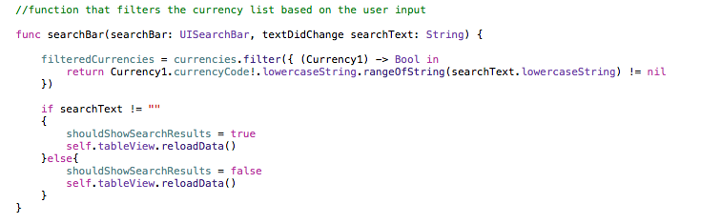
UISearchBar

Slide 29
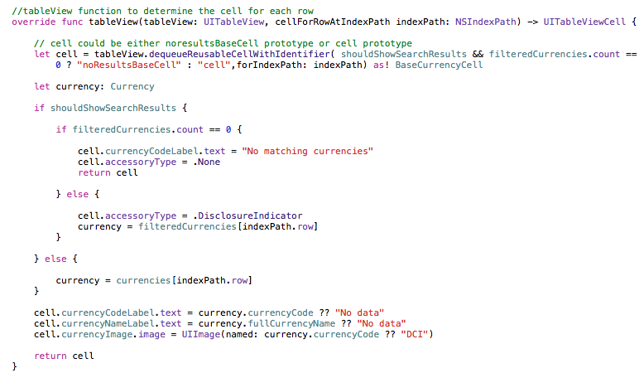
Generating UITableViewCell Content

Slide 30
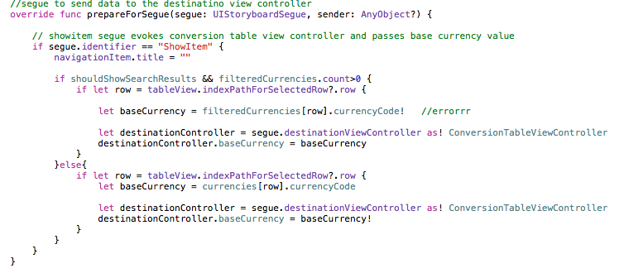
Segue Based Transition

Slide 31
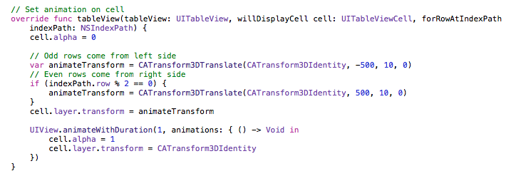
Animating UITableViewCells

Slide 32
ConversionViewTableController
UIViewController
UISearchDelegate
BaseCurrencySelector
UITableVIewDataSource
UITableVIewDelegate

Slide 33
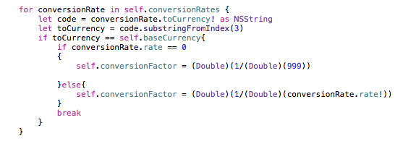
API only provides exchange rate with USD as base currency. Hence Exchange rate made as a computed property. Conversion factor.

Slide 34
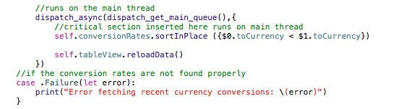
Thread Synchronisation

Slide 35
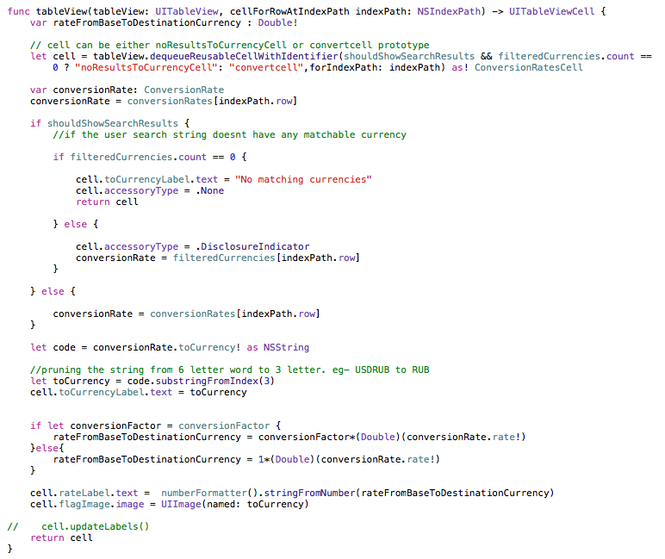

Slide 36
HistoricalDataViewController
Queries the server for the past 30 days exchange rate and plots the chart, et al.
UIViewController
Charts
Historical Data View Controller

Slide 37
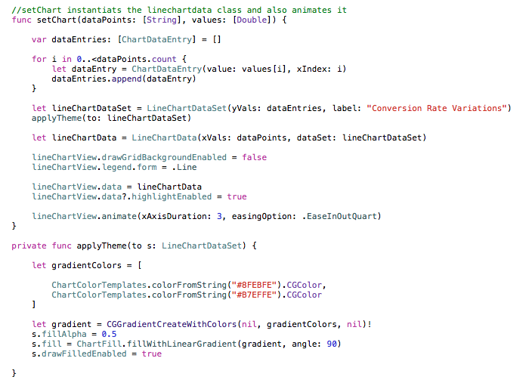

Slide 38
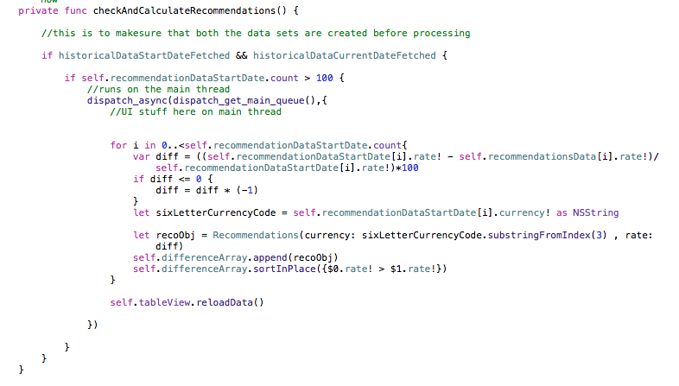
RecommendationsTableViewController
Major functionality of this controller is to analyse the safe currencies which are relatively risk free to invest and display those currencies on the tableview

Slide 39
Navigation Controller

Slide 40
Demo

Slide 41
Utopia
Interface commerce transactions
Reinforcing the quantitative metric with data analytics based fundamental analysis

Slide 42


Slide 43


