Slide 1

Mathematical model of ‘comparative development of social health of communities’ using Prisoner’s Dilemma
Presented under the topic:
Computational Biology
Author:
Miss Komal Gujarathi
TE Computer, Cummins College of Engineering For Women,pune.

Slide 2
Social issues
Barter System used in early times.
Rescue operations in Uttarakhand by some NGO’s.
Educational institutes for learning.
Development of Indian society over the other developed countries.
Security of the female employees and thus the disturbance created in the society as a whole.

Slide 3
Background
Our approach gains the motivation from the Axelrod’s tournament held in 1980’s.
Robert Axelrod asked for the different strategies and allowed them to compete with each other based on Prisoners Dilemma.
We borrow 3 representative strategies (Cooperator, Defector, Tit for Tat) in our model to represent individuals in social interactions.

Slide 4
Purpose of paper
Paper tries to model the interactions in the community into the three representative strategies namely cooperate, defect, tit-for-tat.
After each interaction, the society as a whole is given certain points.
Paper tries to relatively compare the development of the social health of the communities (represented by the points to the society here) using the Prisoners Dilemma(PD).

Slide 5
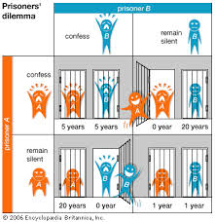
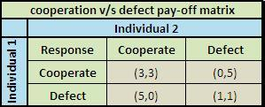

Prisoners Dilemma pay off matrix

Slide 6
Our simulation
Iterated Prisoners Dilemma (IPD).
Cases considered-
Community consisting of individuals following same strategy
Community consisting of individuals following the strategy in a prescribed proportion

Slide 7
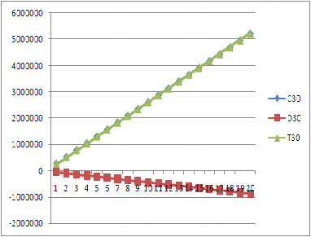
Community consisting of individuals following same strategy
Evolution of co-operation beneficial to society
Effects of defection fatal to society

Slide 8
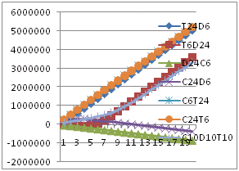
Community consisting of individuals following the strategy in a prescribed proportion

Slide 9
Conclusions:
There is the good chance for the society to prosper if the community is completely made up of the individuals showing cooperative and faithful attitude towards each other.
Even a critical minimum number of defectors in a community is able to badly affect the social development of the large group of cooperators.
Community has a good chance to develop if there exists the minimum amount of law and order in the society.
There is a good chance for the social development of a community having minimum law and order among the visionaries.

Slide 10
Scalabile
The same model can be extended to the family, city, state, and even the nation. Thus it follows the theme ‘Technology for masses’.
It can also be used to solve the major social issues mentioned early.

Slide 11
Limitations:
Every community may not always have the individuals following the same strategy all the times in any situation.
This initial model simulates the idealized social development just within the boundaries of isolated three strategies. But the idea can be further extended.

Slide 12
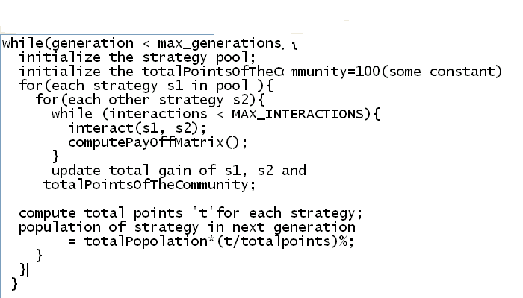
Algorithm

Slide 13
THANK YOU…..

