Slide 1
Beyond Local Convolution
Vision Transformers and Gabor Priors for Interpretable Uterine Cancer Histopathology
Krushna Sanjay Sharma
M.S. Computer Science · Northeastern University
krushnasharma24@gmail.com
ViT-B/16
GaborResNet
Grad-CAM

Slide 2
Problem Statement
UCEC histopathology classification with deep learning
🔬
Uterine Corpus Endometrial Carcinoma (UCEC) is the 6th most common cancer in women worldwide.
🖼
Whole Slide Images (WSIs) are gigapixel — manual pathology review is slow and variable.
🧠
Standard CNNs use sliding kernels with small receptive fields — miss long-range tissue structure.
⚠
Prior work (v1): ViT collapsed to 27.35% accuracy due to catastrophic forgetting.
⚠
Prior work (v1): CNN AUROC = 1.000 — patient-level data leakage inflated metrics.
✅
This work: Fixes both problems with progressive unfreezing and strict patient-level splitting.

Slide 3
Dataset: CPTAC-UCEC
168,531 patches · 224×224px · 20× magnification
168,531
72.7%
27.3%
70 / 15 / 15
Total Patches
Cancerous
Normal
Train / Val / Test
📁
Source: Cancer Imaging Archive — CPTAC-UCEC collection.
🔪
Tiles extracted via OpenSlide with Otsu tissue masking (≥60% tissue coverage).
⚖
Strict patient-ID stratified split — no slide from the same patient in train and test.
🎨
Augmentations: ±30° rotation, H/V flips, color jitter to prevent stain memorization.
📐
Normalized with ImageNet μ = (0.485, 0.456, 0.406), σ = (0.229, 0.224, 0.225).

Slide 4
Four Architectures Evaluated
Consistent two-phase transfer learning across all models
ViT-B/16
ResNet-34
DenseNet-121
GaborResNet
Progressive Unfreezing 12 encoder blocks ~86M parameters
Two-phase Transfer Residual skip connections ~21M parameters
Two-phase Transfer Dense block connections ~7M parameters
Frozen Gabor conv1 64 orientation kernels ~21M parameters
All models optimized with Adam · AMP (float16) · ReduceLROnPlateau · BCE Loss

Slide 5
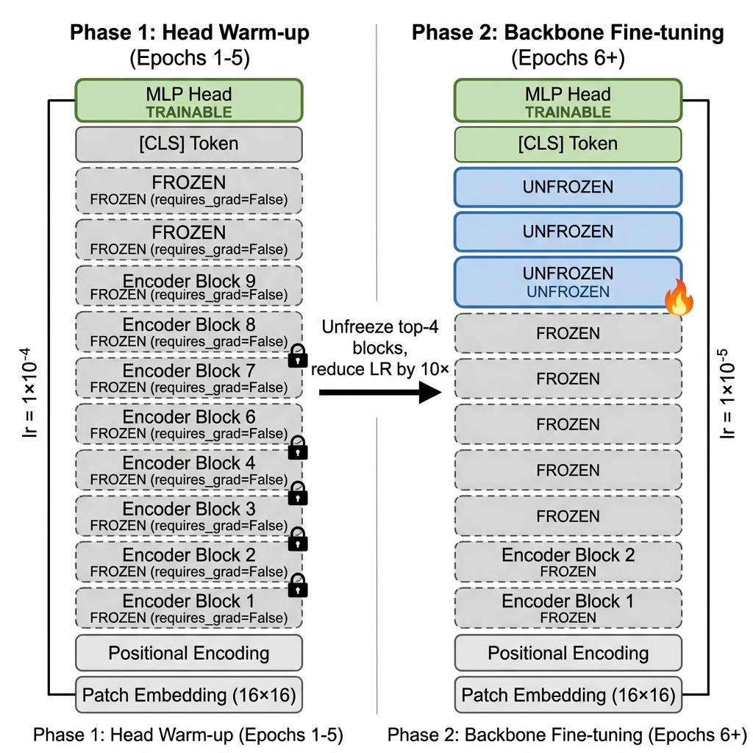
Model 1: Progressive Transfer ViT-B/16
Two-phase unfreezing prevents catastrophic forgetting
📌
Phase 1: Only MLP head trained lr = 1×10⁻⁴, 5 epochs
🔓
Phase 2: Top-4 encoder blocks unfrozen lr = 1×10⁻⁵
📈
v1 ViT: 27.35% → v2 ViT: 96.40% +69% recovery
🧮
MHSA: Attention(Q,K,V) = softmax(QKᵀ/√dₖ)V

Slide 6
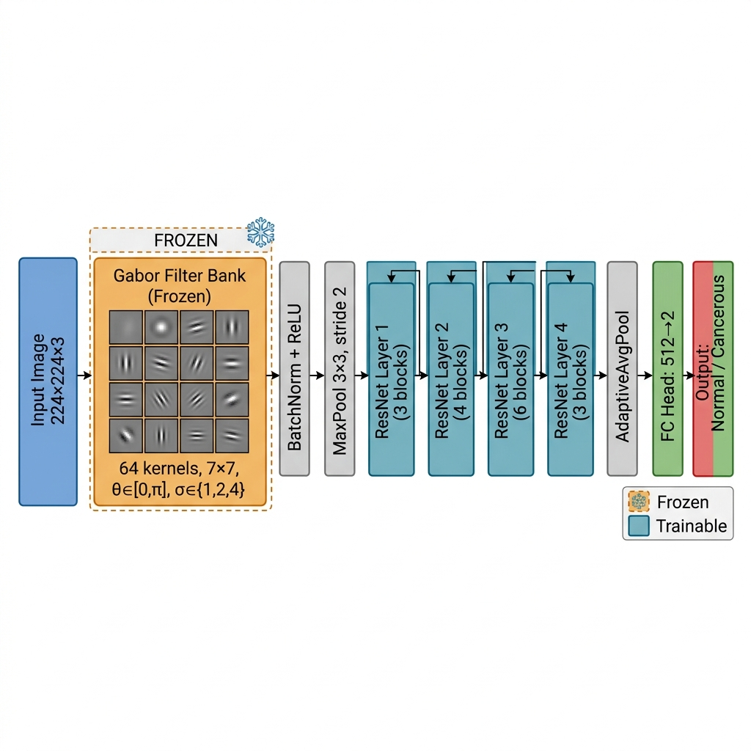
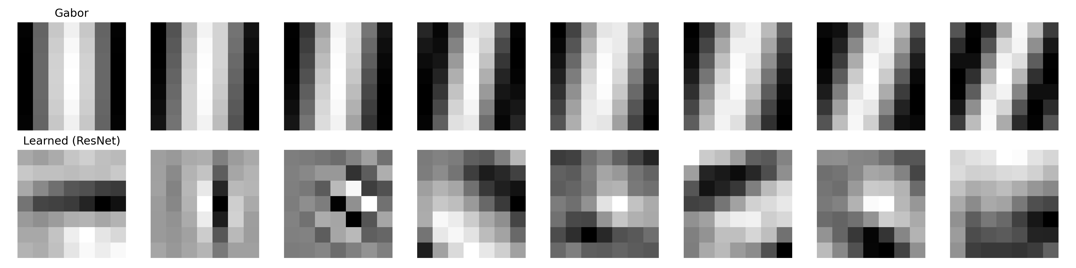
Model 4: Texture-Guided GaborResNet
Biologically-inspired Gabor priors replace random conv1 initialization
Gabor kernels (top) vs learned ResNet filters (bottom)

Slide 7
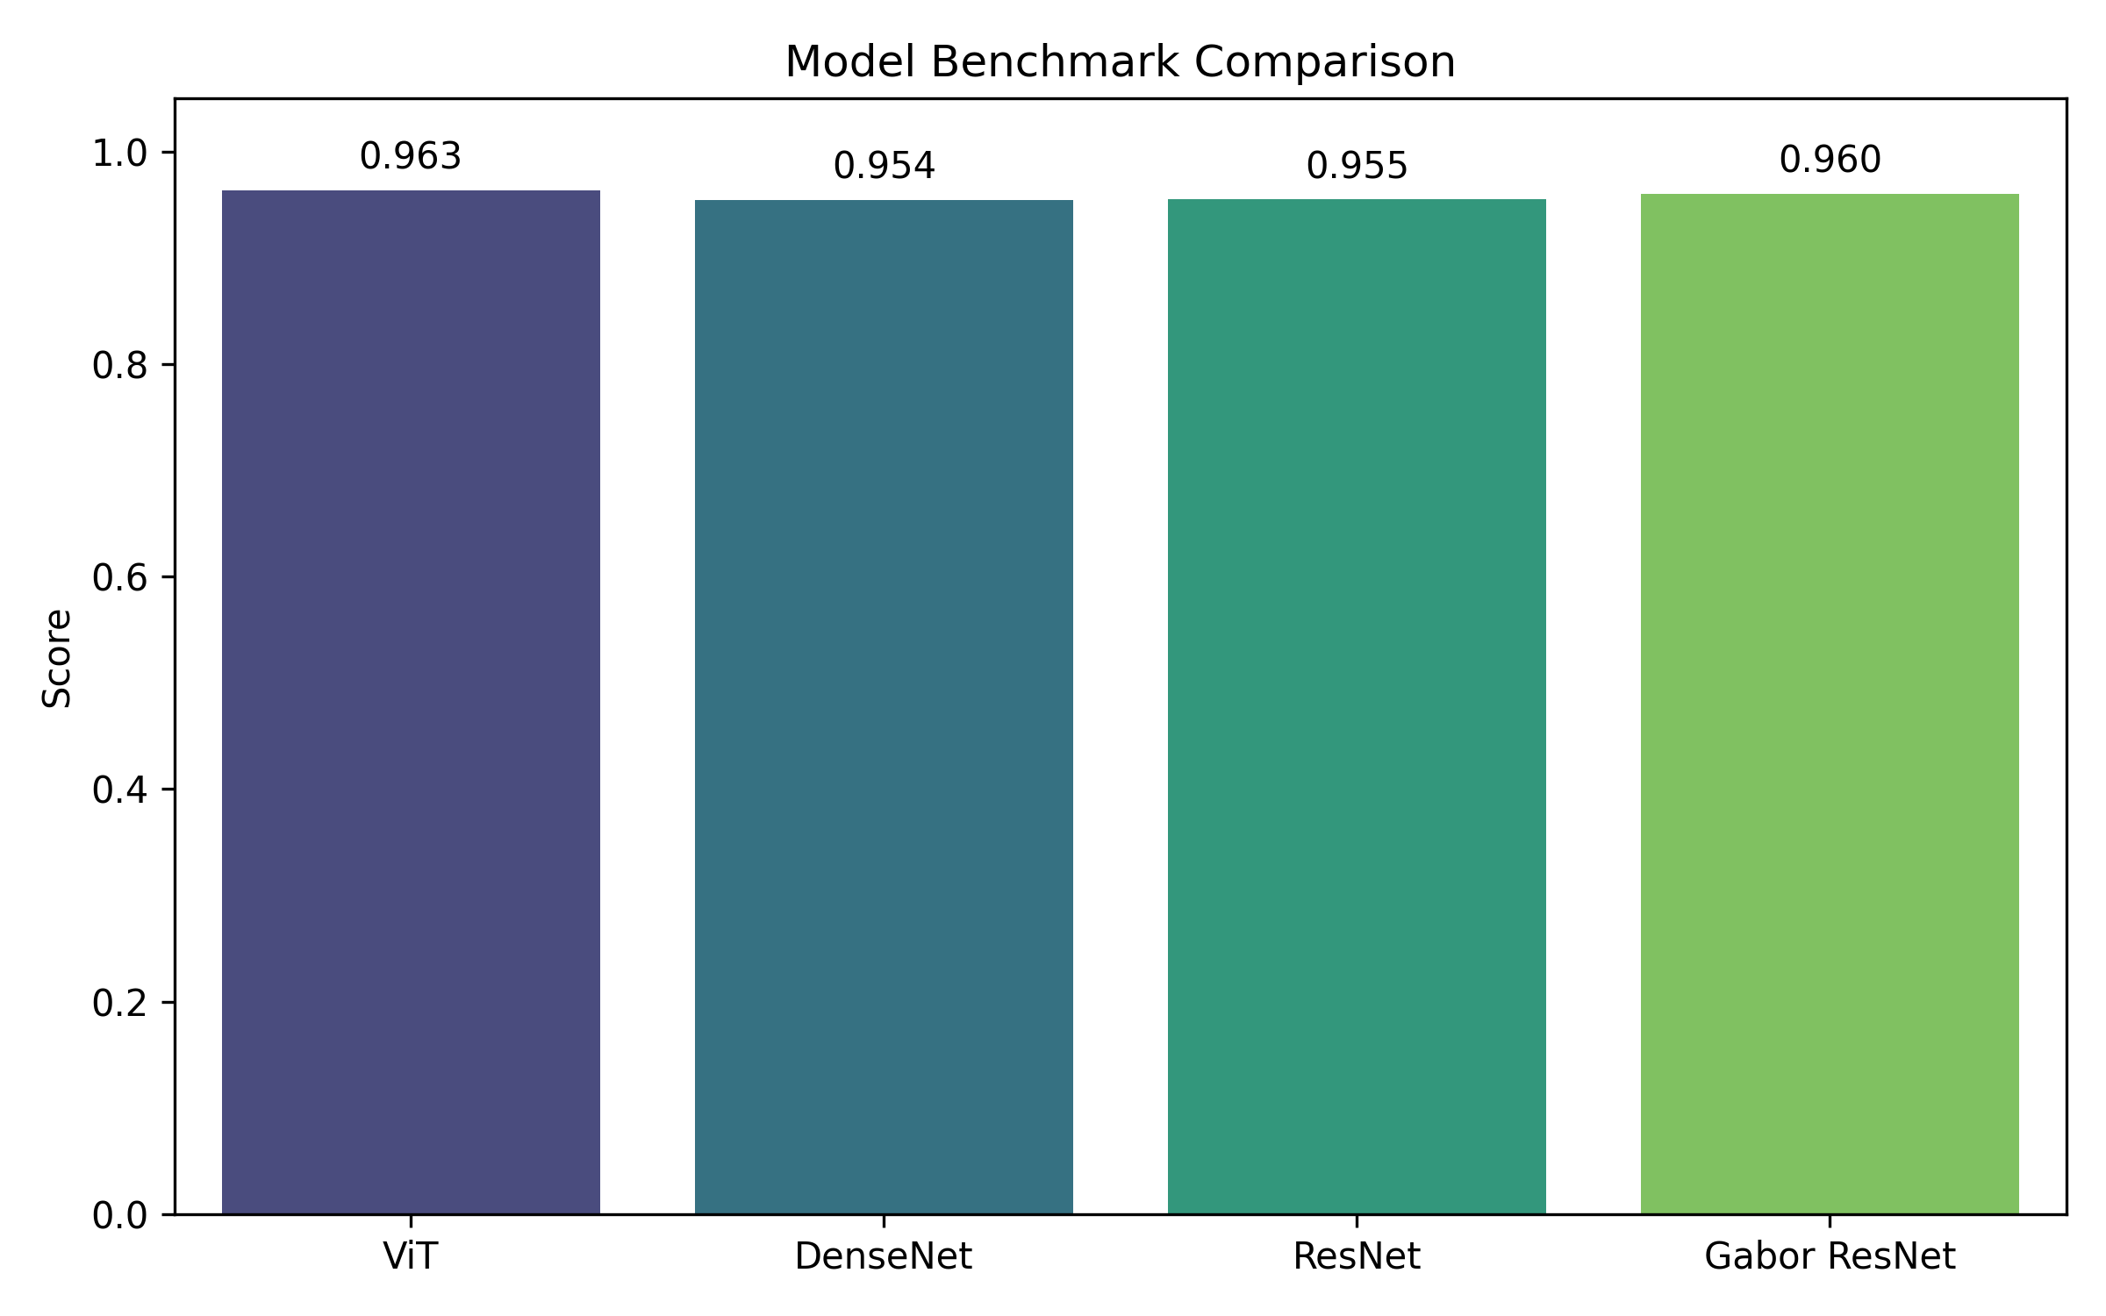
Quantitative Results
Evaluated on 25,280 holdout test patches — patient-level stratified split
Model
Accuracy
F1 Score
AUROC
Params
DenseNet-121
95.44%
0.9669
0.9886
~7M
ResNet-34
95.65%
0.9697
0.9907
~21M
GaborResNet ★
96.08%
0.9730
0.9918
~21M
ViT-B/16 ★
96.40%
0.9759
0.9931
~86M
★
GaborResNet: same params as ResNet-34, +1.64% Recall
★
ViT: highest across all metrics; 4× param cost
📉
DenseNet underperforms deeper ResNet — harder optimization

Slide 8
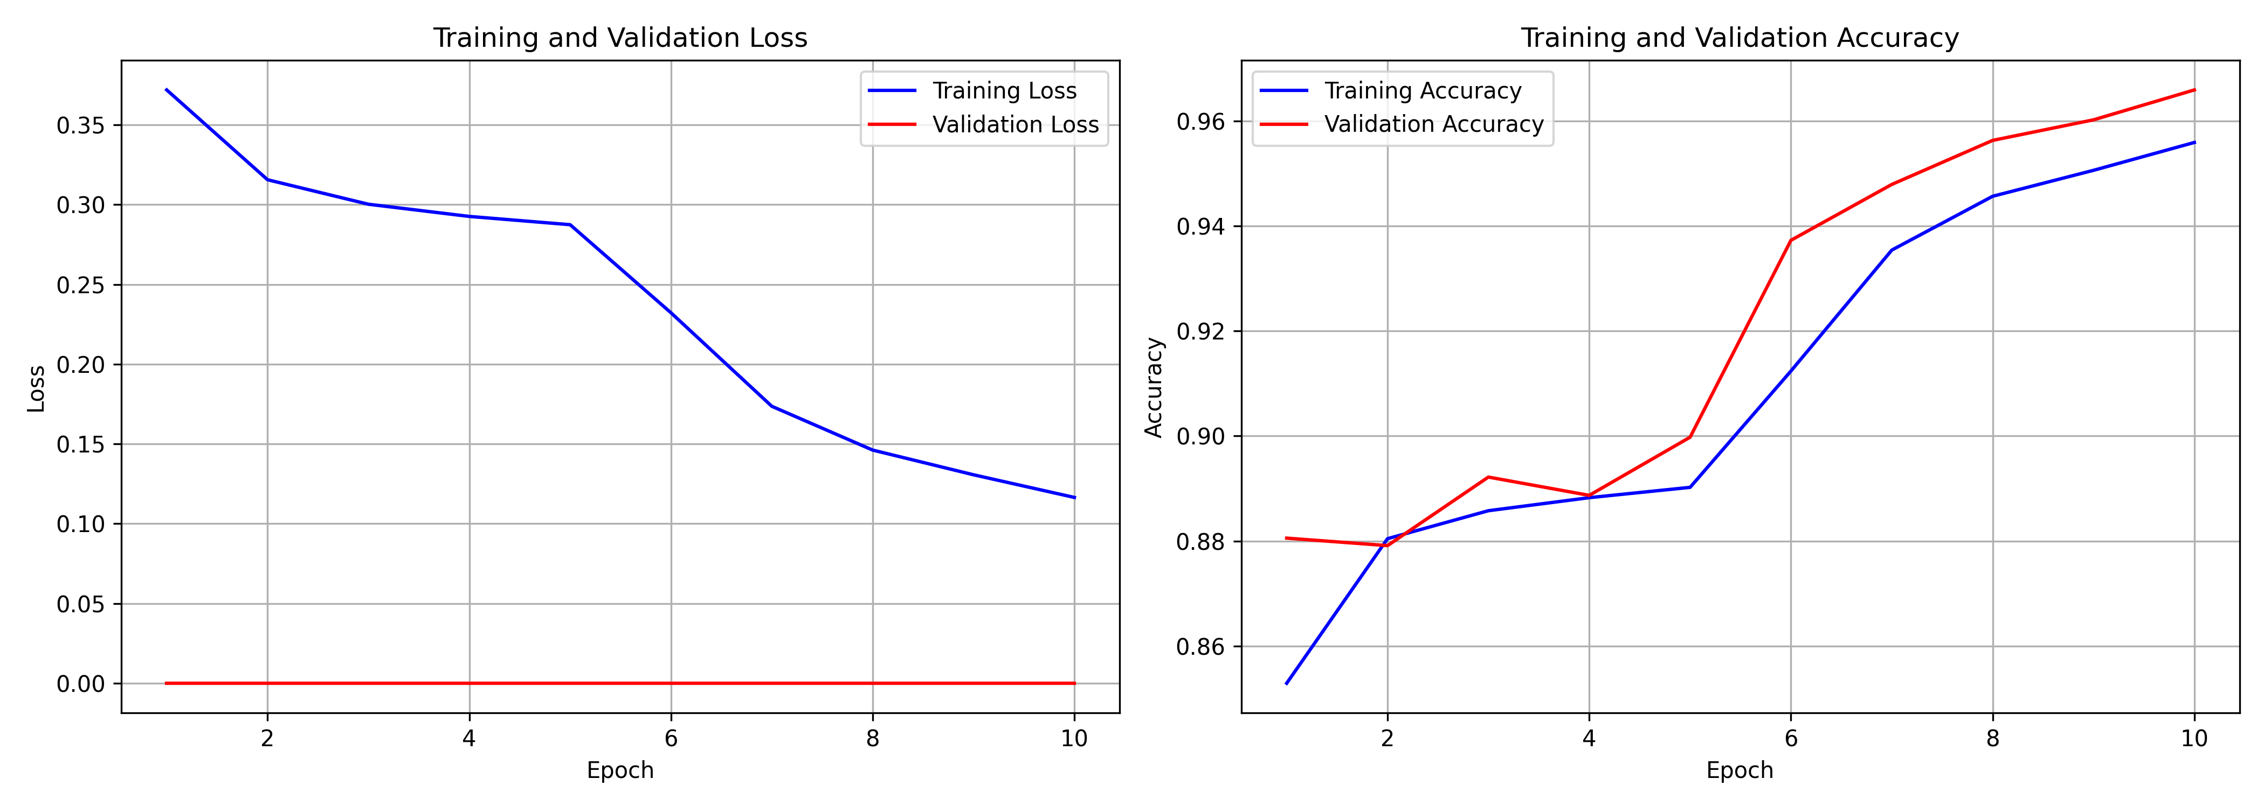
The ViT Recovery: 27% → 96.40%
The training protocol — not the architecture — was the bottleneck
v1 ViT
v2 ViT (Ours)
• All 12 encoder blocks + head updated simultaneously • Head gradients >> backbone gradients • W_Q, W_K, W_V overwritten before useful repr. form • Model collapses → 27.35% (random baseline)
• Phase 1: ONLY head trained — backbone frozen • Stable gradient signal established first • Phase 2: Backbone gradients at lr×0.1 — gentle • Result: 96.40% ✅ AUROC 0.9931 ✅
→
🔑
Key insight: progressive unfreezing decouples two incompatible learning objectives
📐
Less than 1% of parameters updated in Phase 1
📈
+69.05% accuracy gain vs v1
ViT learning curves — Phase 1→2 transition visible at epoch 5

Slide 9
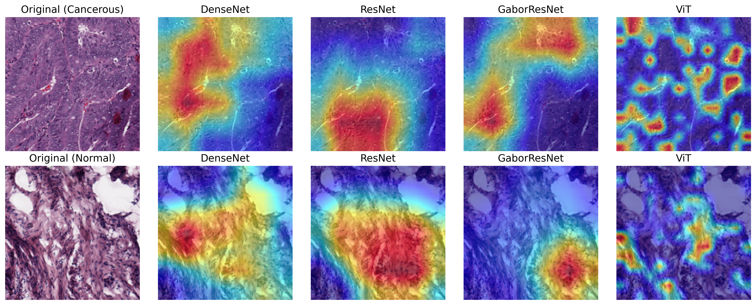
Grad-CAM: Attentional Strategies
Identical patches — deterministic seed-locked comparison across all models
CNNs (DenseNet / ResNet / GaborResNet)
Vision Transformer (ViT-B/16)
• Activate broad contiguous boundaries • False-positive noise on normal tissue edges
• Multi-focal sparse activation on nuclear anomalies • Correctly suppresses normal tissue heat

Slide 10
Conclusion & Future Work
Key Findings
✅
ViT-B/16 achieves 96.40% accuracy and AUROC 0.9931 — best across all architectures.
✅
Progressive unfreezing recovers ViT from 27.35% collapse — protocol, not architecture, was the issue.
✅
GaborResNet improves Recall +1.64% at zero parameter cost — Gabor priors detect diffuse nuclear atypia.
✅
Grad-CAM confirms ViT uses multi-focal global attention vs CNN single-boundary focus.
Future Work
🔭
Swin Transformer — hierarchical attention at O(N) cost for gigapixel WSI.
🔭
Multiple Instance Learning (MIL) — slide-level prognosis from patch aggregation.
🔭
Extend Gabor prior beyond conv1 into deeper residual blocks.
github.com/krhash/computer-vision/tree/main/6-uterine-cancer-detection

