Slide 1

<Reuse-Oriented Software Engineering Model>

Slide 2
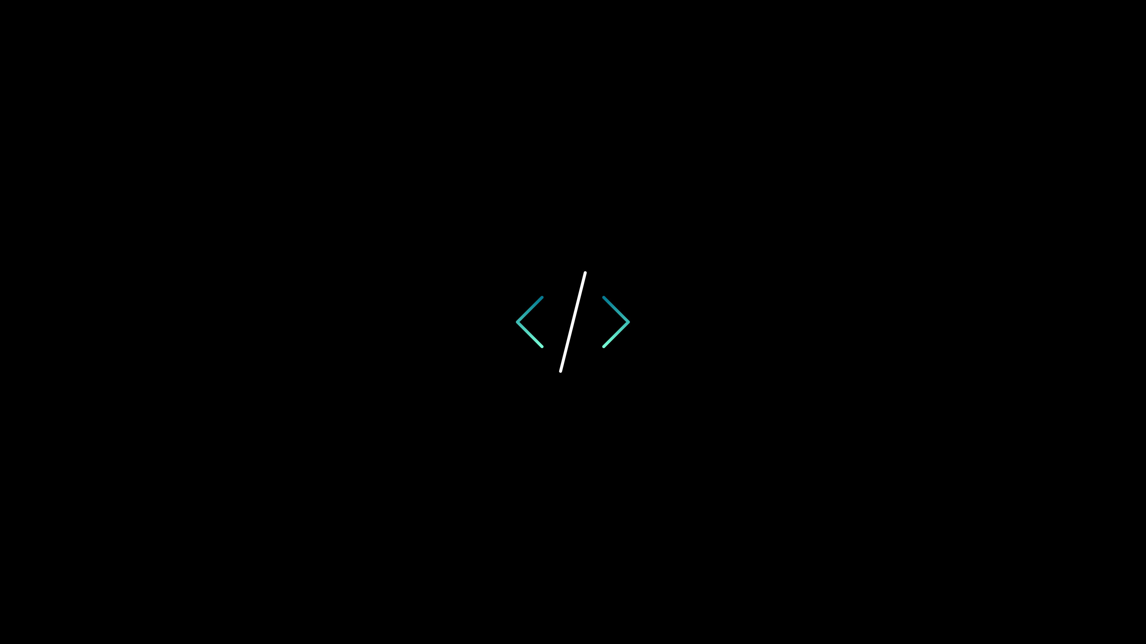
<Reuse-Oriented Software>
What is this?
Benefits And Harms
Current Approaches

Slide 3
Reuse-Oriented Software nedir? "Reuse has gained significant importance in all engineering branches. This enables more production in less time and more efficient work. The reusability of software is defined as the use of requirements, designs, test cases, etc. in the production of new software."
<WHAT İS REUSE-ORİENTED SOFTWARE?>
The benefits of software reuse:
The harms of software reuse:
Saving time
Cost Savings
Quality and Reliability
Standardization
Resource Efficiency
Compatibility Issues
Maintenance Challenges
Data Privacy and Security Concerns
Code Complexity
Lack of Adequate Documentation
Language and Platform Limitations
Ownership and Licensing Issues

Slide 4
Time Savings: Reusing previously developed and tested components or libraries allows for faster completion of new projects. This contributes to speeding up the software development process.
Cost Savings: Reusable software components or code segments reduce the need to start from scratch for each new software development, resulting in cost savings.
Quality and Reliability: Reusability enables the use of previously tested and matured components in new projects, leading to more reliable and high-quality software.
Standardization: Reusability encourages the standardization of the software development process, ensuring greater consistency and compatibility between projects.
Resource Efficiency: It allows software development teams to use their resources more efficiently. Reusable code or components can be used repeatedly in different parts of the software.
<The benefits of software reuse>

Slide 5
<The Harms of software reuse>
Compatibility Issues: A reused component or library may not fit seamlessly into a new project, requiring additional effort, leading to time and resource overhead.
Maintenance Challenges: Maintaining reusable software to keep it up-to-date and secure for each project can be complex.
Data Privacy and Security Concerns: Reused components may contain sensitive data or security vulnerabilities, potentially leading to privacy and security issues.
Code Complexity: Reusability can sometimes increase code complexity, as the needs of different projects may vary, resulting in a more intricate multi-purpose component.
Lack of Adequate Documentation: Insufficient or missing documentation related to reusable components can make their correct usage challenging.
Language and Platform Limitations: Reusability may be tied to a specific programming language or platform, limiting portability and cross-platform use.
Ownership and Licensing Issues: Ownership rights and licenses for reusable components can be complex, potentially leading to legal and ownership complications for the project.

Slide 6
<Current Approaches>
All current approaches in software engineering aim to increase software reuse. When we look at the history of reuse, the first noticeable form of reuse was at the function level. This is the simplest technique of software reuse. However, this type of software reuse is not very productive because it heavily depends on the knowledge of engineers.
The next stage in software reuse is libraries. Libraries can provide users with a kind of interface, making software reuse more convenient. However, the configurability of libraries is low, and applications developed using libraries tend to be heavily dependent on them.
Frameworks, also known as skeletons, are one step ahead in terms of software reuse. Unlike libraries, frameworks involve the concept of the inversion of control. When using libraries, the programmer maintains control, but in frameworks, the situation is different. The framework user makes a request, and the framework, through various mechanisms and events, triggers these requests internally.

Slide 7
EXAMPLE
In the context of object-oriented programming, let's consider an example where 'Class-2' inherits the properties of 'Class-1'. This means that 'Class-2' can make use of all the properties of 'Class-1'. However, this approach also has the potential for introducing errors and inflexibility. Any changes made in 'Class-1' will directly affect 'Class-2', which can lead to unintended consequences. This issue is commonly encountered in object-oriented frameworks and is known as the 'fragile base class problem'.
After the emergence of object-oriented programming, component-oriented approaches began to find their place in the literature, leading to the development of component-based frameworks. Component technology holds significant importance for software reuse. Components have defined interfaces, which not only describe the services provided or offered by the components but also have the capability to accommodate various requirements such as performance, timing, quality of service (QoS), and more.
The most important point here is the use of composition, not inheritance, for reuse. As known, inheritance is fixed at compile time. However, composition can be altered at runtime. This way, component-based frameworks can achieve a much higher degree of flexibility compared to object-oriented frameworks.
Component Oriented

Slide 8
In today's world, where people increasingly expect everything to be personalized, meeting their demands in a timely and cost-effective manner is only possible through software product line approaches that promote the reusability of all software assets.
İnsanların git gide her şeyin kişiye özel olmasını bekledikleri günümüzde, istekleri zamanında ve az maliyetli olarak karşılamak ancak tüm yazılım varlıklarının yeniden kullanılabilirliğini savunan yazılım ürün hattı yaklaşımları ile mümkün olabilecektir.
Teşekkür ederim..

