Slide 1
PEN AND PAINT
PRESENTED TO:
DR. GULSHAN GOYAL
PRESENTED BY :
KRITI AGGARWAL
CO19335
CSE, 1ST YEAR

Slide 2
INDEX
|
INTRODUCTION AND CONCEPT
|
TECHNOLOGIES USED
|
MODULES & FEATURES
|
WORKING PROTOTYPE
|
|
FEASIBILITY & COMPETITION
SCOPE FOR FUTURE DEVELOPMENT
CONCLUSION
|
TARGET AUDIENCE

Slide 3
WHAT IS PEN AND PAINT ?
PEN AND PAINT is a program that allows you to write on the screen by detecting and following the motion of the blue coloured object with the help of opencv.

Slide 4
CONCEPT
This program is made to meet the current needs of people who do not want to buy expensive touchscreen laptops or other accessories.
It allows you to enjoy working on laptop and gives the feel of traditional drawing using pen and paper .
It is simple and easy because it just requires a blue object and the program to be able to draw without touching the screen or the mouse.

Slide 5
TARGET AUDIENCE
STUDENTS & TEACHERS | BEGINNER - ARTISTS | MOUTH & FOOT ARTISTS
Teachers can use this program as a virtual whiteboard to draw diagram and solve equations etc. For subjects like math where writing the equations and jotting down the symbols is very crucial this program can be a life saver for both teachers and students. | It can be used by be beginner artists to practice drawing on pictures without expensive drawing tabs. Also it is a paperless solution for practice doodling and idea drawing. | It can be a motivating factor and a platform for people with special needs since it can be easily used by people without having to move the mouse because of the color object motion recognition feature .

Slide 6
TECHNOLOGIES USED
Python 3.8.3 (32 bits )
OpenCV 4.4.0
NumPy 1.19.0
Printy 2.1.1

Slide 7
WORKING
This program identifies the blue color objects through computer vision.
It then finds the finds the object with largest contour and marks a circle around it.
As soon as the user presses ‘c’ it starts to draw on the screen by following the motion of the circled object.
The program also allows the users to open image of their choice and save their result at any point of time.

Slide 8
BLOCK DIAGRAM
RUN THE PROGRAM.
CHOOSE BETWEEN IMAGE OR BLANK SCREEN (THE DEFAULT WINDOW).
CONTINUE OR STOP WRITING BY PRSSING THE “C” AND ‘W’ RESPECTIVELY .THIS HELPS TO DRAW TO AT BREAKS
AFTER OPENING, USER CAN DRAW AS WELL ERASE STUFF AS PER REQUIREMENT AND PROGRAM FEATURES .
CHOOSE BETWEEN 3 DIFFERENT BRUSH SIZES AND 4 COLOURS.
CLOSE THE PROGRAM BY PRESSING ‘Q’ .THE WINDOW GETS DESTROYED AS SOON AS YOU PRESS Q .
SAVE YOUR WORK AT ANY POINT OF TIME BY PRESSING ‘S’

Slide 9
FEATURES
COMMON | DIFFERENT
FOUR DIFFERENT COLOUR OPTIONS. A SEPERATE PAINT SCREEN FROM THE WEBCAM WINDOW ERASER CLEAN ALL QUIT PROGRAM BY PRESSING ‘q’ | DIFFERENT BACKROUND OF USERS CHOICE FOR THE PAINT WINDOW. 3 DIFFERENT BRUSH SIZE OPTION TO SAVE AT ANY POINT OF TIME IN DESIRED FORMAT STOP AND CONTINUE THE WRITING BY PRESSING ‘w’ AND ‘c’

Slide 10
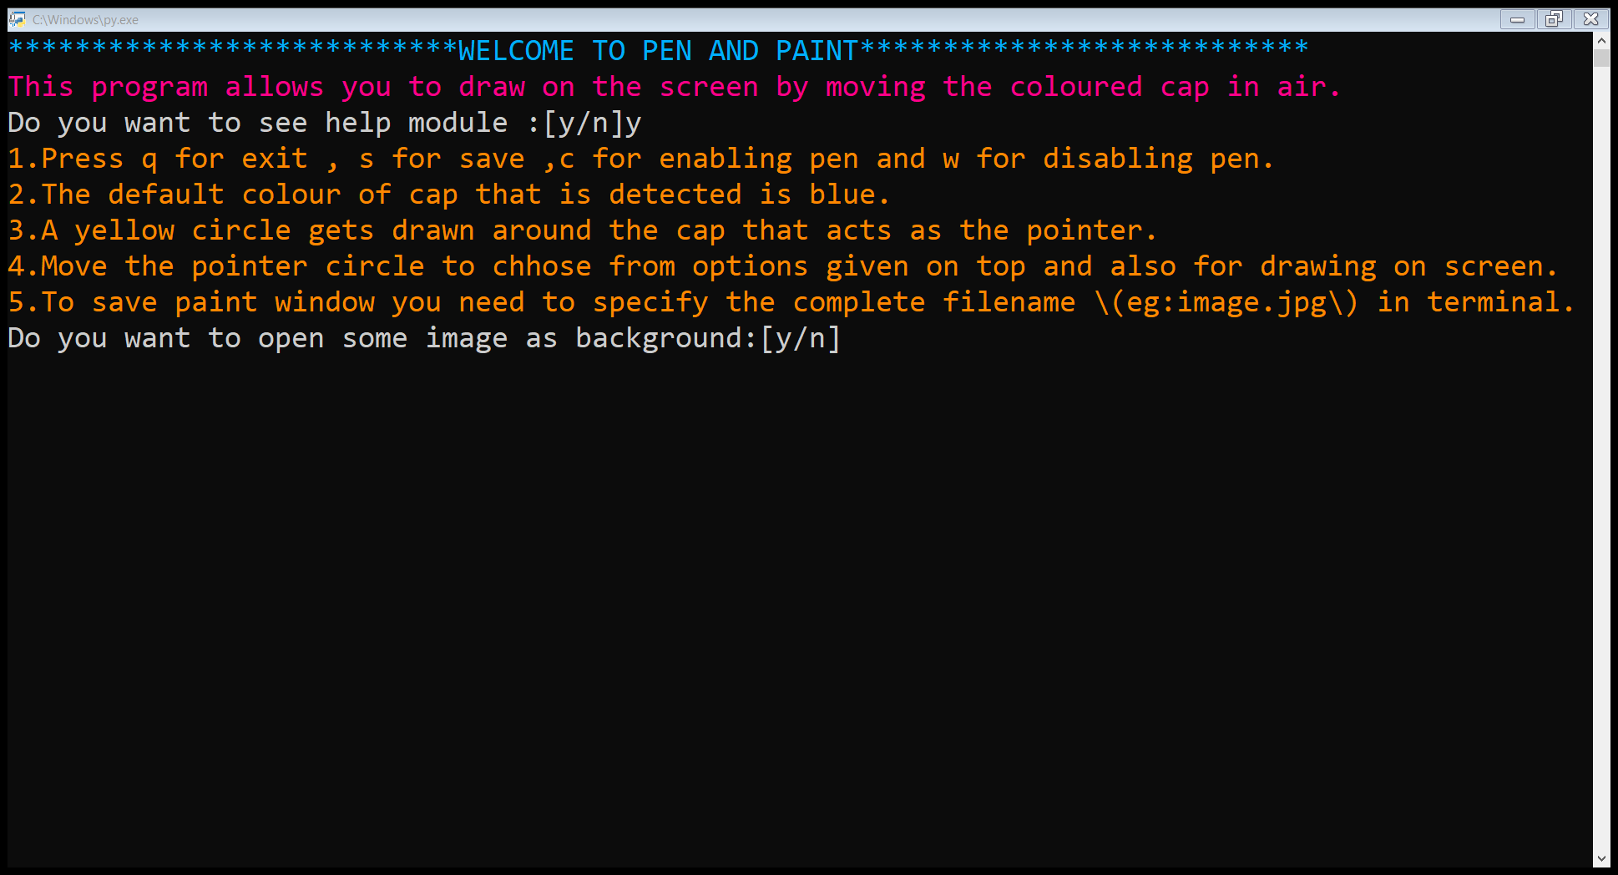
THE TERMINAL

Slide 11
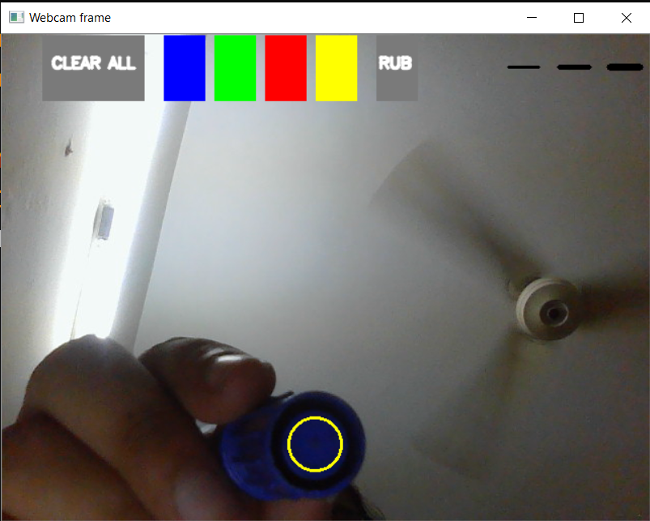
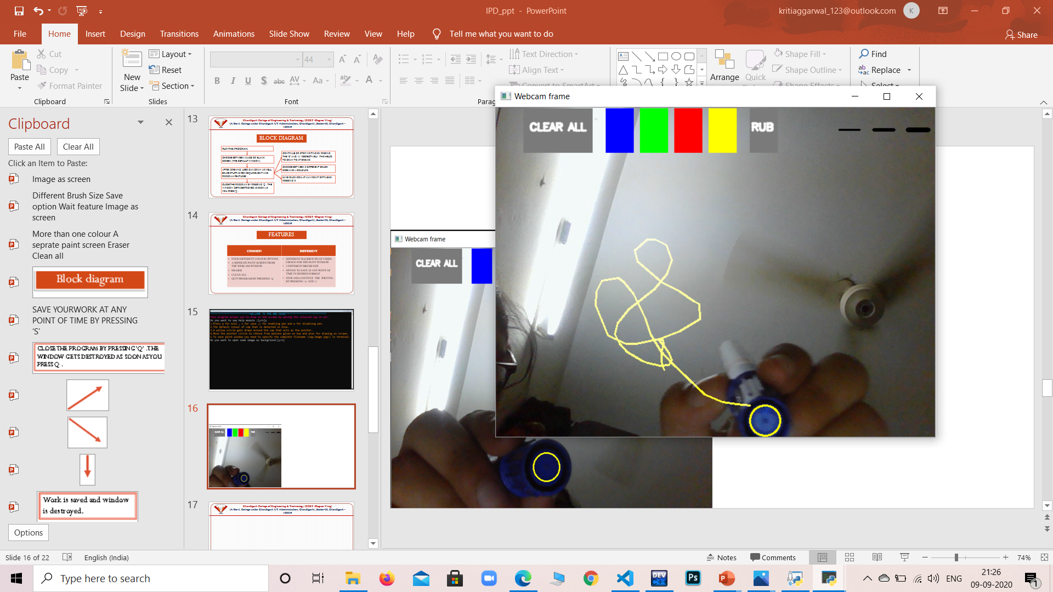
WEB CAM FRAME
The object detection
Drawing along with object

Slide 12
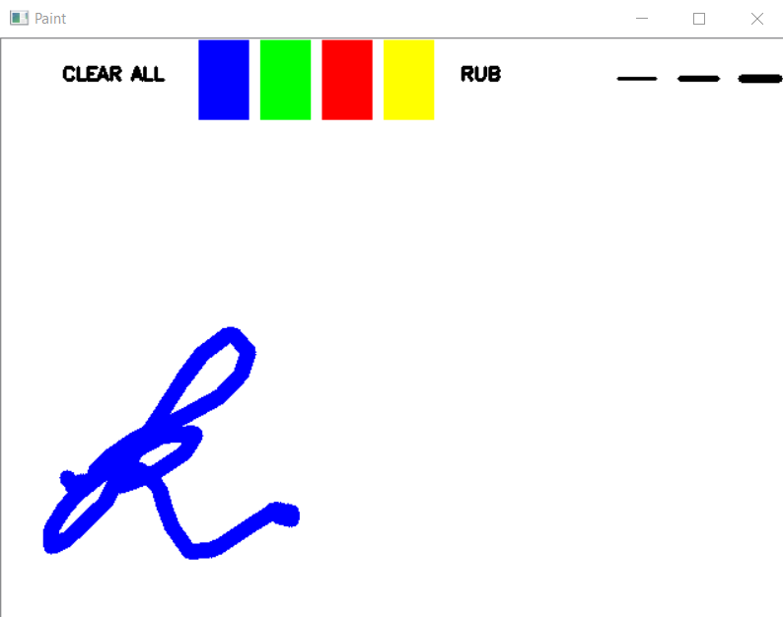
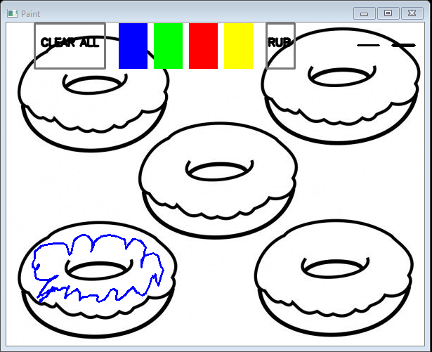
THE PAINT WINDOW
DEFAULT BACKGROUND
IMAGE AS BACKGROUND

Slide 13
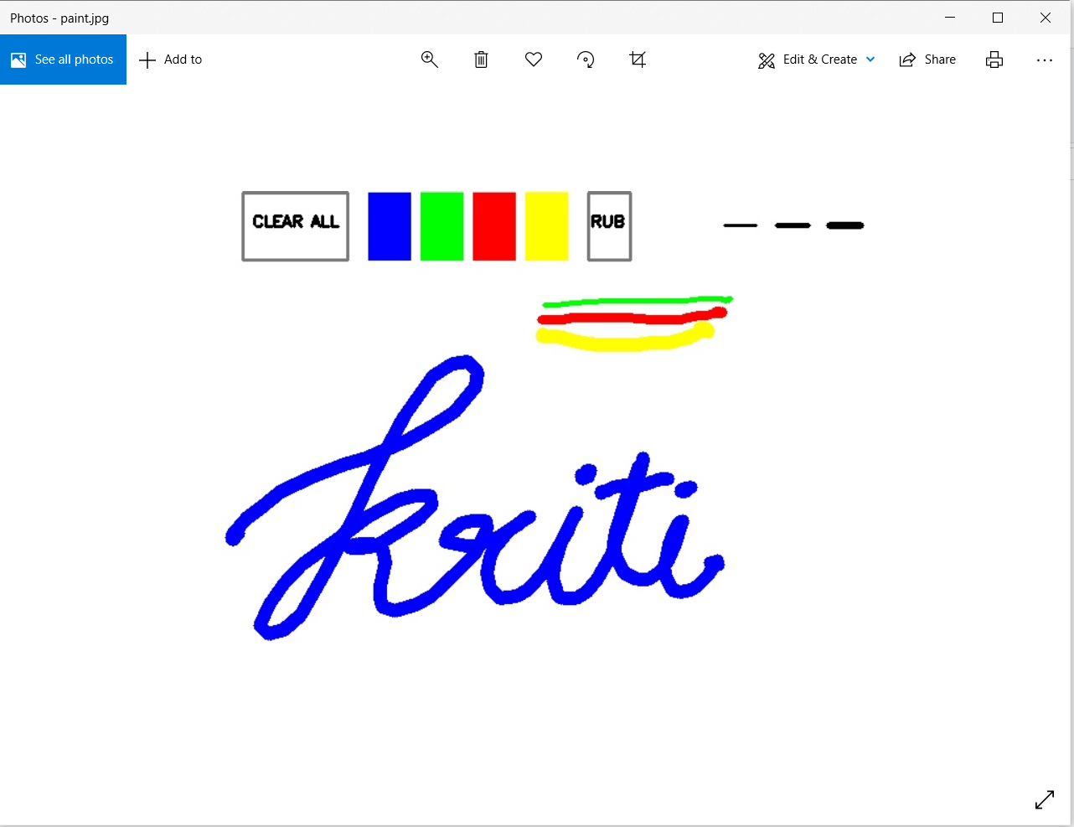
SAVED IMAGE

Slide 14
FEASIBILITY
ECONOMIC | TECHNICAL
THE PROJECT IS ECONOMICALLY FEASIBLE AS IT DOES NOT CONTAIN MUCH COMPLICATIONS AND CAN BE USED BY VARIOUS EDUCATIONAL INSTITUTES FOR BENEFIT OF STUDENTS OR BY LEARNING ARTISTS WITHOUT PROCURING MUCH COST. | BUILT USING PYTHON AND IT’S LIBRARIES LIKE OPENCV, NUMPY AND PRINTY , THIS PROGRAM IS EASY TO UNDERSTAND AND MODIFY. THE ADVANCED LIBRARY OF PYTHON MAKES IT POSSIBLE TO INTEGRATE COMPUTER VISION,MAKING IT TECHICALLY FEASIBLE.

Slide 15
SCOPE FOR FUTURE GROWTH
Python is an easy to learn language and there is no end to enhancements one can do in their program.
This project can be easily integrated into the online learning platforms as it eliminates the disadvantage of not having blackboard and touch screen laptops/computers.
Due to its flexibility there is a lot freedom for modifying to match the institutional requirements.

Slide 16
FUTURE GROWTH STRATEGY
WEB
APP
MORE FEATURES
We can move this on to web platforms to allow everybody to access it without having to install python or its libraries.
We can convert this into an application that allows user to work in offline mode and share online .
Using more advanced concepts and libraries we can add more drawing options, improve the look and feel.

Slide 17
CONCLUSION
THE PROJECT PEN AND PAINT IS TRULY COMPATIBLE TO FUFILL THE DEMANDS OF INDIVIDUALS AND THE NEEDS OF ONLINE TEACHING PLATFORMS. THIS PROJECT CAN BE USED TO TRANFORM THE TRADITIONAL PAINTING APPLICATIONS INTO A MUCH ADVANCED COMUTER VISION APPLICATION THAT CAN MEET THE NEEDS OF TOUCHSCREEN ON A NON-TOUCH SCREEN PLATFORM WITHOUT ANY ADDITIONAL EXPENSE.

Slide 18
REFERENCES
https://www.youtube.com/watch?v=N81PCpADwKQ
Links for downloading :
https://www.python.org/downloads/windows
https://code.visualstudio.com/docs/?dv=win
https://pypi.org/project/printy/
https://opencv.org/
https://numpy.org/doc/stable/

Slide 19
THANK YOU

