Slide 1
UNIT VI: TRANSACTION AND CONCURRENCY
Syllabus:
Introduction to Transaction Processing, Transaction and System Concepts, Desirable Properties of Transactions, Characterizing Schedules based on Recoverability, Characterizing Schedules based on Serializability. Introduction to Concurrency Control, Two Phase Locking Techniques, Concurrency Control on Timestamp Ordering, Validation Concurrency Control Techniques, Granularity of Data items and Multiple Granularity Locking, Recovery Concepts, Recovery Techniques Based on Deferred and Immediate Update, Shadow Paging.

Slide 2
TRANSACTION
Definition:
A transaction can be defined as an action or series of actions that is carried out by a single user or application program to perform operations for accessing the contents of the database.

Slide 3
TRANSACTION
The operations can include retrieval (Read), insertion (Write), deletion (Write), and modification (Write).
A transaction must be either completed or aborted.
It can either be embedded within an application program or can be specified interactively via a high-level query language such as PL/SQL.
Its execution preserves the consistency of the database.
Each transaction should access shared data without interfering the other transactions.
Whenever a transaction successfully completes its execution; its effect should be permanent.
A transaction is a sequence of READ and WRITE actions that are grouped together to from a database access.

Slide 4
TRANSACTION
Basic database access operations:
OPERATIONS | DESCRIPTIONS
Retrieve | To retrieve data stored in a database.
Insert | To store new data in database.
Delete | To delete existing data from database.
Update | To modify existing data in database.
Commit | To save the work done permanently.
Rollback | To undo the work done.

Slide 5
TRANSACTION
Transaction that changes the contents of the database must alter the database from one consistent state to another.
A consistent database state is one in which all data integrity constraints are satisfied.
To ensure database consistency, every transaction must begin with the database in a known consistent state.

Slide 6
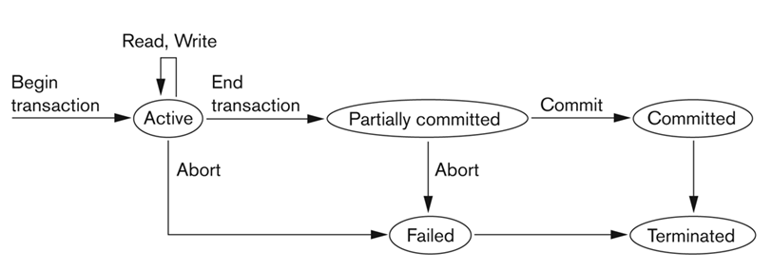
Transaction Execution and Problems
A transaction which successfully completes its execution is said to have been committed. Otherwise, the transaction is aborted.
Thus, if a committed transaction performs any update operation on the database, its effect must be reflected on the database even if there is a failure.

Slide 7
TRANSACTION
STATE | DESCRIPTION
Active state | A transaction goes into an active state immediately after it starts execution, where it can issue READ and WRITE operations.
Partially committed | When the transaction ends, it moves to the partially committed state.
Aborted | When the normal execution can no longer be performed. Failed or aborted transactions may be restarted later, either automatically or after being resubmitted by the user as new transactions.
Committed | After successful completion of transaction. A transaction is said to be in a committed state if it has partially committed and it can be ensured that it will never be aborted.

Slide 8
Transaction Execution with SQL
Transaction support is provided by two SQL statements namely COMMIT and ROLLBACK.
Transaction sequence is initiated by a user or an application program.
It must continue through all succeeding SQL statements until one of the following four events occur:
A COMMIT statement is reached, in which case all changes are permanently recorded within the database.
The COMMIT statement automatically ends the SQL transaction.
The COMMIT operations indicates successful end-of-transaction.

Slide 9
Transaction Execution with SQL (Cont…)
A ROLLBACK statement is reached, in which case all the changes are aborted and the database is rolled back to its previous consistent state.
The ROLLBACK operation indicates unsuccessful end-of-
transaction.
The end of a program is successfully reached, in which case all changes are permanently recorded within the database. This action is equivalent to COMMIT.
The program is abnormally terminated, in which case the changes made in the database are aborted and the database is rolled back to its previous consistent state. This action is equivalent to ROLLBACK.

Slide 10
TRANSACTION PROPERTIES
A transaction must have the four properties, called ACID properties (also called ACIDITY of a transaction), to ensure that a database remains stable state after the transaction is executed:
Atomicity.
Consistency.
Isolation.
Durability.

Slide 11
TRANSACTION PROPERTIES
1. Atomicity:
Atomicity refers to the guarantee that either all of the tasks of a transaction are performed or none of them are.
Database modifications must follow an all or nothing rule.
Each transaction is said to be atomic if when one part of the transaction fails, the entire transaction fails.

Slide 12
TRANSACTION PROPERTIES
2. Consistency:
The consistency property ensures that the database remains in a consistent state (reliable) before the start of the transaction and after the transaction is over (whether successful or not).
3. Isolation:
Isolation refers to that other operations cannot access or see the data in an intermediate state during a transaction.
Each transaction is unaware of another transactions executing concurrently in the system. (Concurrency Control)

Slide 13
TRANSACTION PROCESSING
4. Durability:
Once a transaction has committed its changes, these changes must never get lost due to subsequent (system) failures. (Recovery)

Slide 14
TRANSACTION LOG (JOURNAL)
DBMSs maintain a transaction record of every change made to the database into a log (also called journal).
Log is a record of all transactions and the corresponding changes to the database.
The information stored in the log is used by the DBMS for a recovery.
The DBMS automatically update the transaction log while executing transactions that modify the database.
The transaction log stores before-and-after data about the database.
The beginning and the ending of the transaction are also recorded in the transaction log.

Slide 15
TRANSACTION LOG (JOURNAL)
For each transaction, the following data is recorded on the log:
A start-of-transaction marker.
The transaction identifier which could include who and where information.
The record identifiers which include the identifiers for the record occurrences.
The operation(s) performed on the records (insert, delete, modify).
The previous value(s) of the modified data.
The updated value(s) of the modified record(s).
A commit transaction marker if the transaction is committed, otherwise an abort or rollback transaction marker.

Slide 16
CONCURRENCY CONTROL
Concurrency control is the process of managing simultaneous execution of transactions in a multiprocessing database system without interfere with one another.
DBMS allows many transactions to access the same database at the same time without interfering with each other.
The primary goal of concurrency is to ensure the atomicity of the execution of transactions in a multi-user database environment.
Concurrency controls mechanisms attempt to interleave (parallel) READ and WRITE operations of multiple transactions so that the interleaved execution produces results that are identical to the results of a serial schedule execution.

Slide 17
CONCURRENCY CONTROL
Need for Concurrency Control:
When transactions are executed in an uncontrolled manner, several problems can occur.
Lost updates.
Dirty read (or uncommitted data).
Unrepeatable read (or inconsistent retrievals).

Slide 18
CONCURRENCY CONTROL
1. Lost Update Problem :
A lost update problem occurs when two transactions that access the same database items that makes the value of database item incorrect.
Example: If transactions T1 and T2 both read a record and then update it, the effects of the first update will be overwritten by the second update.
Transaction- T1 | Time | TransactionT2
----- | t0 | ----
Read X | t1 | ----
---- | t2 | Read X
Update X | t3 | ----
---- | t4 | Update X
---- | t5 | ----

Slide 19
CONCURRENCY CONTROL
1. Lost Update Problem :
T1 | Time | T2
----- | t0 | ----
Read X | t1 | ----
---- | t2 | Read X
Update X | t3 | ----
---- | t4 | Update X
---- | t5 | ----
At time t1 , Transactions-T1 reads value of X.
At time t2 , Transactions-T2 reads value of X.
At time t3, Transactions-T1 writes value of X on the basis of the value seen at time t1.
At time t4, Transactions – T2 writes value of X on the basis of the value seen at time t2.
5. Update of Transactions-T1 is lost at time t4, because Transactions-T2 overwrites it without looking at its current value.
6. Such type of problem is referred as the Update Lost Problem.

Slide 20
CONCURRENCY CONTROL
2. Dirty Read Problem:
A dirty read problem occurs when one transaction updates a database item and then that transaction fails for some reason.
The updated database item is accessed by another transaction before it is changed back to the original value.
Example: A transaction T2 updates a record, which is read by the transaction T1.
Then T2 aborts and T2 now has values which have never formed part of the stable database.
T1 | Time | T2
---- | t0 | ----
---- | t1 | Update X
Read X | t2 | ----
---- | t3 | Rollback
---- | t4 | ----

Slide 21
CONCURRENCY CONTROL
2. Dirty Read Problem:
At time t1 , Transactions-T2 writes value of X.
At time t2 , Transactions-T1 reads value of X.
At time t3 , Transactions -T2 rollbacks.
Transaction-T1 now has value which has never become part of the stable database.
Such type of problem is referred as the Dirty Read.
T1 | Time | T2
---- | t0 | ----
---- | t1 | Update X
Read X | t2 | ----
---- | t3 | Rollback
---- | t4 | ----

Slide 22
CONCURRENCY CONTROL
Inconsistent Retrievals Problem:
Inconsistent retrievals (un-repeatable read) occurs when a transaction calculates some summary function over a set of data while other transactions are updating the data.
The problem is that the transaction might read some data before they are changed and after they are changed, thereby yielding inconsistent results.
In an un-repeatable read, the transaction T1 reads a record and then does some other processing during which the transaction T2 updates the record.
Now, if T1 rereads the record, the new value will be inconsistent with the previous value.

Slide 23
Account-1 Balance = 200 , Account-2 Balance = 250, Account-3 Balance = 150
Transaction- T1 | Time | Transaction- T2
----- | t0 | ----
Read Balance of Acc-1 sum ← 200 Read Balance of Acc-2 | t1 | ----
Sum ← Sum + 250 = 450 | t2 | ----
---- | t3 | Read Balance of Acc-3
---- | t4 | Update Balance of Acc-3 150 → 150 - 50 → 100
---- | t5 | Read Balance of Acc-1
---- | t6 | Update Balance of Acc-1 200 → 200 + 50 → 250
---- Read Balance of Acc-3 | t7 | COMMIT
Sum ← Sum + 100 = 550 | t8 | ----

Slide 24
CONCURRENCY CONTROL
Inconsistent Retrievals Problem:
Transaction-T1 is summing all balances; while, Transaction-T2 is transferring an amount 50 from Account-3 to Account-1.
Here, the result produced by Transaction-T1 is 550,which is incorrect.
If this result is written in database, database will be in inconsistent state, as actual sum is 600.
Here, Transaction-T1 has seen an inconsistent state of database, and has performed inconsistent analysis.

Slide 25
CONCURRENCY CONTROL
PERMUTABLE ACTIONS:
An action is a unit of transaction that is indivisible from the DBMS's perspective.
All the actions are named as read-page and write-page.
The actions are independent of side-effects and do not produce side-effects.
A pair of actions is permutable if every execution of A, followed by B has the same result as the execution of B followed by A, on the same granule.
For the actions read and write we have:
Read-Read: Permutable.
Read-write: Not permutable, since the result is different depending on whether read is first or write is first.
Write-Write: Not permutable, as the second write always nullifies the effects of the first write.

Slide 26
SCHEDULES

Slide 27
SCHEDULES
Definition:
When transactions are executing concurrently in an interleaved fashion, then the order of execution of operations from the various transactions is known as a Schedule or History.
Schedules that facilitate recovery when failure occur.

Slide 28
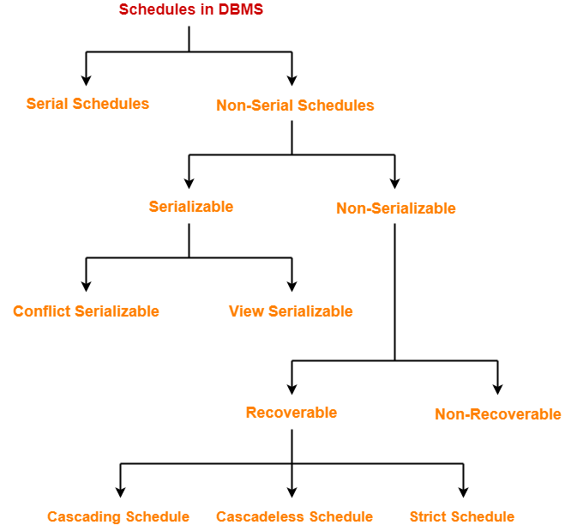
Types of Schedules

Slide 29
SERIAL SCHEDULES
Serial Schedules-
In serial schedules, All the transactions execute serially one after the other.
When one transaction executes, no other transaction is allowed to execute.
Characteristics-
Serial schedules are always-
Consistent
Recoverable
Cascadeless
Strict

Slide 30
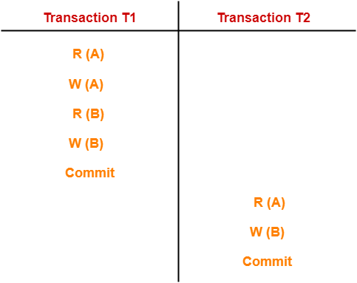
SERIAL SCHEDULES
Serial Schedules-
In this schedule,
There are two transactions T1 and T2 executing serially one after the other.
Transaction T1 executes first.
After T1 completes its execution, transaction T2 executes.
So, this schedule is an example of a Serial Schedule.

Slide 31
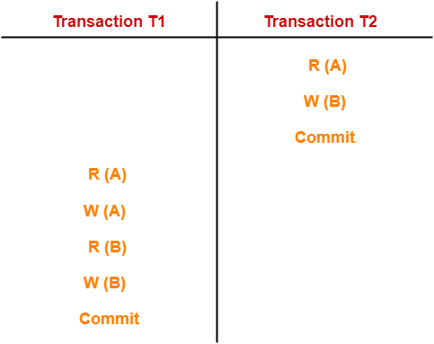
SERIAL SCHEDULES
Serial Schedules-
In this schedule,
There are two transactions T1 and T2 executing serially one after the other.
Transaction T2 executes first.
After T2 completes its execution, transaction T1 executes.
So, this schedule is an example of a Serial Schedule.

Slide 32
NON SERIAL SCHEDULES
In non-serial schedules,
Multiple transactions execute concurrently.
Operations of all the transactions are inter leaved or mixed with each other.
Characteristics-
Non-serial schedules are NOT always-
Consistent
Recoverable
Cascadeless
Strict

Slide 33
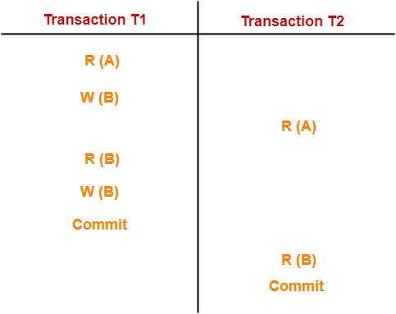
NON SERIAL SCHEDULES
In this schedule,
There are two transactions T1 and T2 executing concurrently.
The operations of T1 and T2 are interleaved.
So, this schedule is an example of a Non-Serial Schedule.

Slide 34
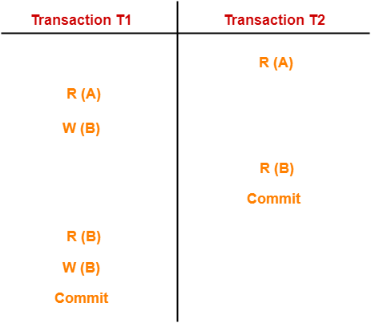
NON SERIAL SCHEDULES
In this schedule,
There are two transactions T1 and T2 executing concurrently.
The operations of T1 and T2 are interleaved.
So, this schedule is an example of a Non-Serial Schedule.

Slide 35
SCHEDULES

Slide 36
Serializability in DBMS

Slide 37
Serializability
Some Non-Serial schedules may lead to inconsistency of the database.
Serializability is a concept that helps to identify which Non-Serial schedules are correct and will maintain the consistency of the database.

Slide 38
Serializable Schedules
Non-Serial schedule of ‘n’ transactions is equivalent to some serial schedule of ‘n’ transactions, then it is called as a serializable schedule.
Characteristics-
Serializable schedules behave exactly same as serial schedules.
Thus, serializable schedules are always-
Consistent
Recoverable
Cascadeless
Strict

Slide 39
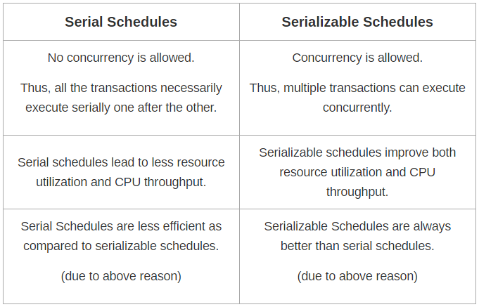
Serial Schedules Vs Serializable Schedules

Slide 40
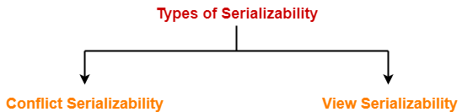
Types Serializability
Serializability is mainly of two types-

Slide 41
Conflict Serializability

Slide 42
Conflict Serializability
Definition:
If a given Non-Serial schedule can be converted into a serial schedule by swapping its Non-Conflicting operations, then it is called as a Conflict Serializable Schedule.

Slide 43
Conflict Serializability
Conflict Operations:
Two operations are called as conflicting operations if all the following
conditions hold true for them-
Both the operations belong to different transactions.
Both the operations are on the same data item.
At least one of the two operations is a write operation.

Slide 44
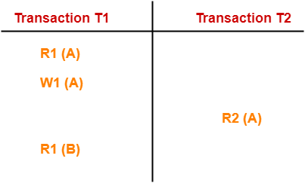
Conflict Serializability
Conflict Operations:
In this schedule,
W1(A) and R2(A) are called as conflicting operations.
This is because all the above conditions hold true for them.

Slide 45
TESTING FOR CONFLICT SERIALIZABILITY
Precedence Graph can be used to test a schedule for Conflict Serializability.
Precedence Graph is directed graph G= (N, E) that consist of a set of nodes N = {T₁, T₂, ….T_{n}} and a directed edges E = {e₁, e₂,…e₃}.
Each edge e_{i} in the graph is of the form (T_{j}→T_{k}), where T_{j} is the starting node of the edge e_{i} and of the edge e_{i}. T_{k} is the ending node
An edge is created if one of the operations in T_{j} appears in the schedule before some conflicting operation in T_{k}.

Slide 46
TESTING FOR CONFLICT SERIALIZABILITY
For each transaction T_{i} participating in schedule S, create a node labeled Ti in the precedence graph.
For each case in S where T_{j} executes a Read(X) after T_{i} executes a Write(X), create an edge (T_{i} → T_{j}) in the precedence graph.
For each case in S where T_{j} executes a Write(X) after T_{i} executes a Read(X), create an edge (T_{i} → T_{j}) in the precedence graph.
For each case in S where T_{j} executes a Write(X) after T_{i} executes a Write(X), create an edge (T_{i} → T_{j}) in the precedence graph.
The schedule S is serializable if and only if the precedence graph has no cycles.

Slide 47
TESTING FOR CONFLICT SERIALIZABILITY
SCHEDULE C
T1 | T2
Read(X)
X:=X-N
 | Read(X)
 | X:=X+M
Write(X)
Read(Y)
 | Write(X)
Y:=Y+N
Write(Y)
T1
T2

Slide 48
TESTING FOR CONFLICT SERIALIZABILITY
SCHEDULE C
T1 | T2
Read(X)
X:=X-N
 | Read(X)
 | X:=X+M
Write(X)
Read(Y)
 | Write(X)
Y:=Y+N
Write(Y)
T1
T2

Slide 49
TESTING FOR CONFLICT SERIALIZABILITY
SCHEDULE C
T1 | T2
Read(X)
X:=X-N
 | Read(X)
 | X:=X+M
Write(X)
Read(Y)
 | Write(X)
Y:=Y+N
Write(Y)
T1
T2
Graph has Cycle. So Schedule C is Not Serializable Schedule.

Slide 50
TESTING FOR CONFLICT SERIALIZABILITY
SCHEDULE D
T1
T2
T1 | T2
Read(X)
X:=X-N
Write(X)
 | Read(X)
 | X:=X+M
 | Write(X)
Read(Y)
Y:=Y+N
Write(Y)

Slide 51
TESTING FOR CONFLICT SERIALIZABILITY
SCHEDULE D
T1
T2
T1 | T2
Read(X)
X:=X-N
Write(X)
 | Read(X)
 | X:=X+M
 | Write(X)
Read(Y)
Y:=Y+N
Write(Y)

Slide 52
TESTING FOR CONFLICT SERIALIZABILITY
SCHEDULE D
T1
T2
T1 | T2
Read(X)
X:=X-N
Write(X)
 | Read(X)
 | X:=X+M
 | Write(X)
Read(Y)
Y:=Y+N
Write(Y)

Slide 53
TESTING FOR CONFLICT SERIALIZABILITY
SCHEDULE D
T1
T2
T1 | T2
Read(X)
X:=X-N
Write(X)
 | Read(X)
 | X:=X+M
 | Write(X)
Read(Y)
Y:=Y+N
Write(Y)
Graph has no Cycle. So Schedule D is Serializable Schedule.

Slide 54
TESTING FOR CONFLICT SERIALIZABILITY
PRACTICE PROBLEMS BASED ON CONFLICT SERIALIZABILITY-
Problem-01: Check whether the given schedule S is conflict serializable or not-
S : R₁(A) , R₂(A) , R₁(B) , R₂(B) , R₃(B) , W₁(A) , W₂(B)

Slide 55
TESTING FOR CONFLICT SERIALIZABILITY
PRACTICE PROBLEMS BASED ON CONFLICT SERIALIZABILITY-
Problem-01: Check whether the given schedule S is conflict serializable or not-
S : R₁(A) , R₂(A) , R₁(B) , R₂(B) , R₃(B) , W₁(A) , W₂(B)
T1 | T2 | T3
R1(A)
 | R2(A)
R1(B)
 | R2(B)
 |  | R3(B)
W1(A)
 | W3(B)

Slide 56
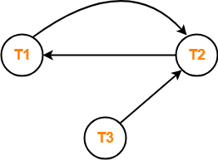
TESTING FOR CONFLICT SERIALIZABILITY
T1 | T2 | T3
R1(A)
 | R2(A)
R1(B)
 | R2(B)
 |  | R3(B)
W1(A)
 | W3(B)
List all the conflicting operations
R2(A) , W1(A) (T2 → T1)
R1(B) , W2(B) (T1 → T2)
R3(B) , W2(B) (T3 → T2)
Draw the precedence graph-
Clearly, there exists a cycle in the precedence graph.
Therefore, the given schedule S is not conflict serializable.

Slide 57
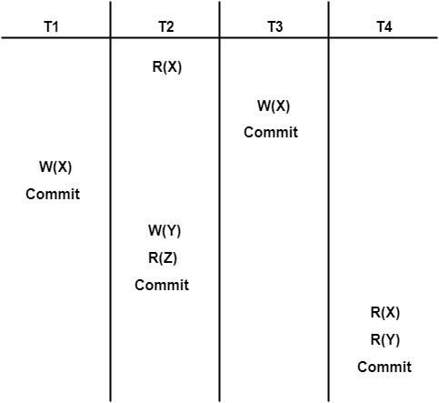
TESTING FOR CONFLICT SERIALIZABILITY
PRACTICE PROBLEMS BASED ON CONFLICT SERIALIZABILITY-
Problem-02: Check whether the given schedule S is conflict serializable and recoverable or not-

Slide 58
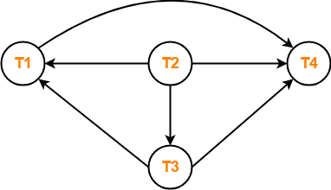
TESTING FOR CONFLICT SERIALIZABILITY
List all the conflicting operations and determine the dependency between the transactions-
R₂(X) , W₃(X) (T₂ → T₃)
R₂(X) , W₁(X) (T₂ → T₁)
W₃(X) , W₁(X) (T₃ → T₁)
W₃(X) , R₄(X) (T₃ → T₄)
W₁(X) , R₄(X) (T₁ → T₄)
W₂(Y) , R₄(Y) (T₂ → T₄)
Clearly, there exists no cycle in the precedence graph.
Therefore, the given schedule S is conflict serializable.
Draw the precedence graph-

Slide 59
CONFLICT SERIALIZABILITY
CONFLICT EQUIVALENCE:
Schedule C
Re-order
Schedule C
Schedule A
T1 | T2
Read(X)
X:=X-N
Write(X)
Read(Y)
Y:=Y+N
Write(Y)
 | Read(X)
 | X:=X+M
 | Write(X)
T1 | T2
Read(X)
X:=X-N
 | Read(X)
 | X:=X+M
Write(X)
Read(Y)
 | Write(X)
Y:=Y+N
Write(Y)
T1 | T2
Read(X)
X:=X-N
Write(X)
Read(Y)
Y:=Y+N
Write(Y)
 | Read(X)
 | X:=X+M
 | Write(X)

Slide 60
CONFLICT SERIALIZABILITY
CONFLICT EQUIVALENCE:
SCHEDULE D
Re-Order SCHEDULE
SCHEDULE A
T1 | T2
Read(X)
X:=X-N
Write(X)
Read(Y)
Y:=Y+N
Write(Y)
 | Read(X)
 | X:=X+M
 | Write(X)
T1 | T2
Read(X)
X:=X-N
Write(X)
 | Read(X)
 | X:=X+M
 | Write(X)
Read(Y)
Y:=Y+N
Write(Y)
T1 | T2
Read(X)
X:=X-N
Write(X)
Read(Y)
Y:=Y+N
Write(Y)
 | Read(X)
 | X:=X+M
 | Write(X)

Slide 61
View Serializability

Slide 62
View Serializability
Definition:
If a given schedule is found to be view equivalent to some serial schedule, then it is called as a view serializable schedule.

Slide 63
View Serializability
View Equivalent Schedules-
Schedules S1 and S2 are called view equivalent if the following three conditions hold true for them-
Condition-01:
For each data item X, if transaction T_{i} reads X from the database initially in schedule S1, then in schedule S2 also, T_{i} must perform the initial read of X from the database.
Condition-02:
If transaction T_{i} reads a data item that has been updated by the transaction T_{j} in schedule S1, then in schedule S2 also, transaction T_{i} must read the same data item that has been updated by the transaction T_{j.}

Slide 64
View Serializability
View Equivalent Schedules-
Condition-03:
For each data item X, if X has been updated at last by transaction T_{i} in schedule S1, then in schedule S2 also, X must be updated at last by transaction T_{i}.

Slide 65
View Serializability
Checking Whether a Schedule is View Serializable Or Not-
Method-01:
Check whether the given schedule is conflict serializable or not.
If the given schedule is conflict serializable, then it is surely view serializable. Stop and report your answer.
If the given schedule is not conflict serializable, then it may or may not be view serializable.
All conflict serializable schedules are view serializable.
All view serializable schedules may or may not be conflict serializable.

Slide 66
View Serializability
Checking Whether a Schedule is View Serializable Or Not-
Method-02:
Check if there exists any blind write operation.
(Writing without reading is called as a blind write).
If there does not exist any blind write, then the schedule is surely not view serializable. Stop and report your answer.
If there exists any blind write, then the schedule may or may not be view serializable.
No blind write means not a view serializable schedule.

Slide 67
View Serializability
Checking Whether a Schedule is View Serializable Or Not-
Method-03:
In this method, try finding a view equivalent serial schedule.
Then, draw a graph using those dependencies.
If there exists no cycle in the graph, then the schedule is view serializable otherwise not.

Slide 68
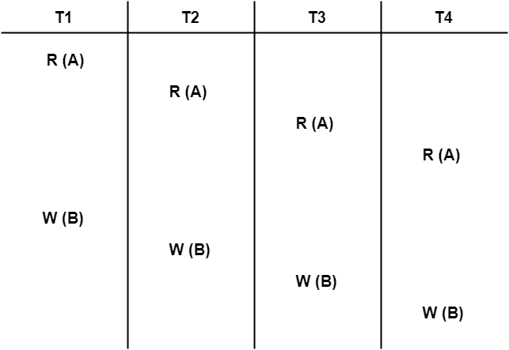
View Serializability
Checking Whether a Schedule is View Serializable Or Not-
Problem-01:

Slide 69
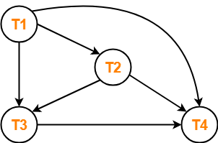
View Serializability
Checking Whether a Schedule is View Serializable Or Not
If a schedule is conflict serializable, then it is surely view serializable.
List all the conflicting operations and determine the dependency between the transactions-
W1(B) , W2(B) (T1 → T2)
W1(B) , W3(B) (T1 → T3)
W1(B) , W4(B) (T1 → T4)
W2(B) , W3(B) (T2 → T3)
W2(B) , W4(B) (T2 → T4)
W3(B) , W4(B) (T3 → T4)
Draw the precedence graph-
Clearly, there exists no cycle in the precedence graph.
Therefore, the given schedule S is conflict serializable.
Thus, we conclude that the given schedule is also view serializable.

Slide 70
Recoverable Schedules

Slide 71
Recoverability in DBMS
A schedule is the order in which the operations of multiple transactions appear for execution.
Non-serial schedules may be serializable or non-serializable.
Non-Serializable Schedules
A non-serial schedule which is not serializable is called as a non-serializable schedule.
Characteristics-
may or may not be consistent
may or may not be recoverable

Slide 72
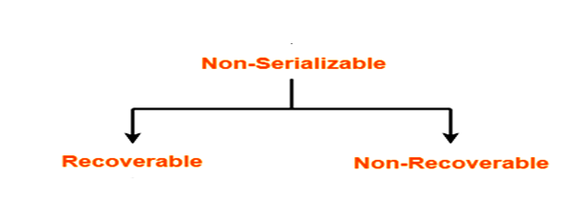

Slide 73
Recoverable Schedule
If in a schedule,
A transaction performs a dirty read operation from an uncommitted transaction.
And its commit operation is delayed till the uncommitted transaction either commits or roll backs
Then such a schedule is known as a Recoverable Schedule.

Slide 74
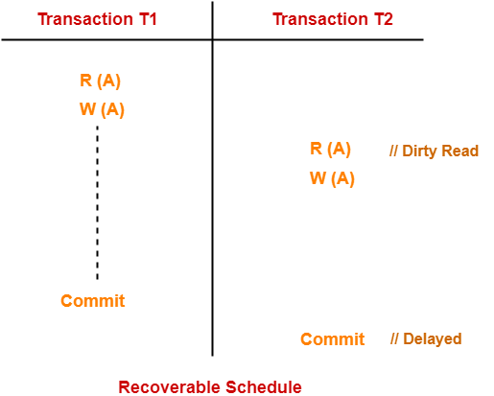
Recoverable Schedule
Here,
T2 performs a dirty read operation.
The commit operation of T2 is delayed till T1 commits or roll backs.
T1 commits later.
T2 is now allowed to commit.
In case, T1 would have failed, T2 has a chance to recover by rolling back.

Slide 75
Non -Recoverable Schedule
If in a schedule,
A transaction performs a dirty read operation from an uncommitted transaction
And commits before the transaction from which it has read the value then such a schedule is known as an Non - Recoverable Schedule.

Slide 76
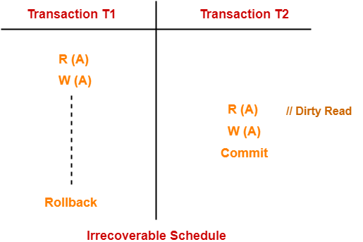
Non -Recoverable Schedule
Here,
T2 performs a dirty read operation.
T2 commits before T1.
T1 fails later and roll backs.
The value that T2 read now stands to be incorrect.
T2 can not recover since it has already committed.

Slide 77
Recoverable Vs Non-Recoverable

Slide 78
Recoverable Problems
Checking Whether a Schedule is Recoverable or Irrecoverable-
Method-01:
Check whether the given schedule is conflict serializable or not.
If the given schedule is conflict serializable, then it is surely recoverable. Stop and report your answer.
If the given schedule is not conflict serializable, then it may or may not be recoverable. Go and check using other methods.
All conflict serializable schedules are recoverable.
All recoverable schedules may or may not be conflict serializable.

Slide 79
Recoverable Problems
Checking Whether a Schedule is Recoverable or Irrecoverable-
Method-02:
Check if there exists any dirty read operation.
(Reading from an uncommitted transaction is called as a dirty read)
If there does not exist any dirty read operation, then the schedule is surely recoverable. Stop and report your answer.
If there exists any dirty read operation, then the schedule may or may not be recoverable.

Slide 80
SCHEDULES BASED ON RECOVERY
SCHEDULE B
The Schedule B is Not Recoverable.
T2 reads item X from T1.
T2 commits before T1 commits.
T1 Aborts after T2 Commits.
The value of X that T2 read is no longer valid.
T2 must be Aborted after its Committed.
Leading to schedule that is not recoverable.
T1 | T2
Read(X)
Write(X)
 | Read(X)
Read(Y)
 | Write(X)
 | Commit
Abort
Note: For the schedule to be recoverable, the T2 Commit operation in Schedule B must be postponed until T1 Commits.

Slide 81
SCHEDULES BASED ON RECOVERY
SCHEDULE C
The Schedule C is Recoverable.
T2 reads item X from T1.
T2 commits after T1 commits.
T1 | T2
Read(X)
Write(X)
 | Read(X)
Read(Y)
 | Write(X)
Write(Y)
Commit
 | Commit

Slide 82
SCHEDULES BASED ON RECOVERY
SCHEDULE D
The Schedule D is Recoverable.
T2 reads item X from T1.
T1 Aborts instead of Committing, Then T2 Should also Abort.
Because the value of X it read is no longer valid
T1 | T2
Read(X)
Write(X)
 | Read(X)
Read(Y)
 | Write(X)
Write(Y)
Abort
 | Abort

Slide 83
RECOVERABLE SCHEDULES

Slide 84
RECOVERABLE SCHEDULES
If in a schedule,
A transaction performs a dirty read operation from an uncommitted transaction
And its commit operation is delayed till the uncommitted transaction either commits or roll backs
then such a schedule is called as a Recoverable Schedule.

Slide 85
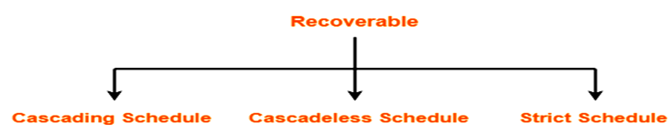
RECOVERABLE SCHEDULES

Slide 86
Types of Recoverable Schedules
I. Cascading Schedule-
If in a schedule,
failure of one transaction causes several other dependent transactions to rollback or abort, then such a schedule is called as a Cascading Schedule or Cascading Rollback or Cascading Abort.
It simply leads to the wastage of CPU time.

Slide 87
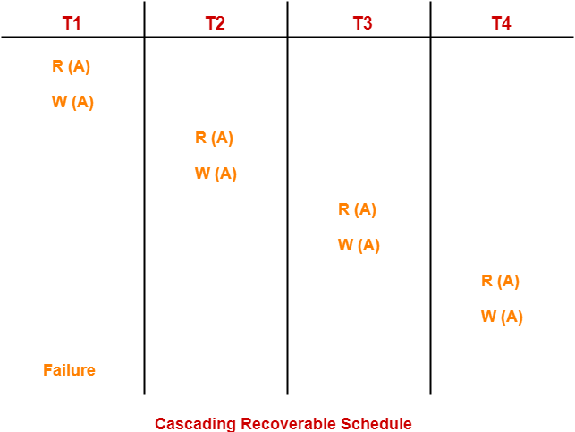
Types of Recoverable Schedules
I. Cascading Schedule-
Hère,
Transaction T2 dépends on transaction T1.
Transaction T3 dépends on transaction T2.
Transaction T4 dépends on transaction T3.
In this schedule,
The failure of transaction T1 causes the transaction T2 to rollback.
The rollback of transaction T2 causes the transaction T3 to rollback.
The rollback of transaction T3 causes the transaction T4 to rollback.
Such a rollback is called as a Cascading Rollback.

Slide 88
Types of Recoverable Schedules
II. Cascadeless Schedule-
If in a schedule,
“A transaction is not allowed to read a data item until the last transaction that has written it is committed or aborted, then such a schedule is called As a Cascadeless Schedule.”
In other words,
“Cascadeless schedule allows only committed read operations.”
Therefore, it avoids cascading roll back and thus saves CPU time.

Slide 89
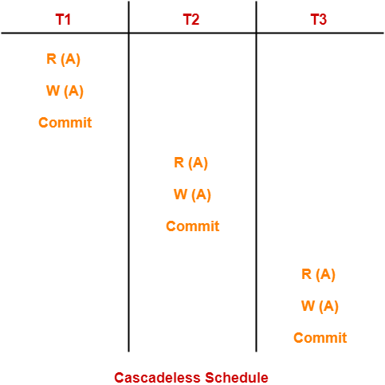
Types of Recoverable Schedules
II. Cascadeless Schedule-
Cascadeless schedule allows only committed read operations.
However, it allows uncommitted write operations.

Slide 90
Types of Recoverable Schedules
III. Strict Schedule-
If in a schedule,
“A transaction is neither allowed to read nor write a data item until the last transaction that has written it is committed or aborted, then such a schedule is called as a Strict Schedule.”
In other words,
“Strict schedule allows only committed read and write operations.”
Strict schedule implements more restrictions than Cascadeless schedule.

Slide 91
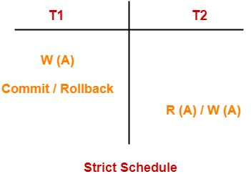
Types of Recoverable Schedules
III. Strict Schedule-
Here,
Strict schedules are more strict than Cascadeless schedules.
All strict schedules are Cascadeless schedules.
All Cascadeless schedules are not strict schedules.

Slide 92
CONCURRENCY CONTROL
Concurrency control techniques that are used to ensure the non-interference or Isolation property of concurrently executing transactions.
There are three methods for concurrency control. They are as Follows:
Locking Methods
Time-stamp Methods
Optimistic Methods

Slide 93
CONCURRENCY CONTROL
Locking Methods of Concurrency Control:
"A lock is a variable, associated with the data item, which controls the access of that data item.”
Locking is the most widely used form of the concurrency control mechanism.
Locks are further divided into three fields:
Lock Granularity
Lock Types
Deadlocks

Slide 94
CONCURRENCY CONTROL
Lock Granularity:
A database is a collection of named data items.
The size of the data item chosen as the unit of protection by a concurrency control program is called GRANULARITY.
Locking can take place at the following level :
Database level locking.
Table level locking.
Page level locking.
Row (Tuple) level locking.
Attributes (fields) level locking.

Slide 95
CONCURRENCY CONTROL
Lock Types:
The DBMS mainly uses following types of locking techniques.
Binary Locking
Shared / Exclusive Locking
Two - Phase Locking (2PL)

Slide 96
CONCURRENCY CONTROL
BINARY LOCKS

Slide 97
CONCURRENCY CONTROL
BINARY LOCKS:
A binary lock can have two states or values:
Locked state - (1)
2) Unlocked state - (0)
If the value of the lock on X is 1, then the item X cannot be accessed by a other operation.
If the value of the lock on X is 0, the item can be accessed by other operation.
The current state of the lock associated with item X is LOCK(X).
Two operations, lock_item and unlock_item, are used with binary locking.

Slide 98
CONCURRENCY CONTROL
BINARY LOCKS (Cont…):
Lock_item(X):
A transaction requests an item.
If LOCK(X) = 1, then transaction has to wait.
If LOCK(X) = 0, it is set to 1 and the transaction is allowed to access item X.

Slide 99
CONCURRENCY CONTROL
BINARY LOCKS (Cont…):
Unlock_item (X):
Sets LOCK(X) to 0 (unlocks) so that X may be accessed by other transactions. ( LOCK(X)←0 )
A binary lock enforces mutual exclusion on the data item ; i.e., at a time only one transaction can hold a lock.

Slide 100
CONCURRENCY CONTROL
BINARY LOCKS RULES (Cont…):
A transaction T must issue the operation lock_item(X) before any read_item(X) or write_item(X) operations are performed in T.

Slide 101
CONCURRENCY CONTROL
BINARY LOCKS RULES (Cont…):
A transaction T must issue the operation unlock_item(X) after all read_item(X) and write_item(X) operations are completed in T.

Slide 102
CONCURRENCY CONTROL
BINARY LOCKS RULES (Cont…):
A transaction T will not issue a lock_item(X) operation if it already holds the lock on item X.

Slide 103
CONCURRENCY CONTROL
BINARY LOCKS RULES (Cont…):
A transaction T will not issue an unlock_item(X) operation unless it already holds the lock on item X.

Slide 104
CONCURRENCY CONTROL
BINARY LOCKS RULES (Cont…):
A transaction T must issue the operation lock_item(X) before any read_item(X) or write_item(X) operations are performed in T.
A transaction T must issue the operation unlock_item(X) after all read_item(X) and write_item(X) operations are completed in T.
A transaction T will not issue a lock_item(X) operation if it already holds the lock on item X.
A transaction T will not issue an unlock_item(X) operation unless it already holds the lock on item X.

Slide 105
Shared / Exclusive Locking

Slide 106
CONCURRENCY CONTROL
Shared / Exclusive Locking:
Binary locking scheme allows at most one transaction can hold a lock on a given time.
We should allow several transaction to access the same data item X if they all access X for reading purposes only.
If a transaction is to write a data item X, it must have exclusive access to X.
For this purpose, a different type of lock called multiple-mode lock is used.
This scheme is called shared/exclusive lock.

Slide 107
CONCURRENCY CONTROL
Shared / Exclusive Locking:
There are three locking operations:
1. Read_lock(X) 2. Write_lock(X) 3.Unlock(X)
A lock associated with an data item X, LOCK(X)
Has three states – 1) read-locked state
2) write-locked state
3) unlocked state.

Slide 108
CONCURRENCY CONTROL
Shared / Exclusive Locking:
A read-locked item is also called share-locked because other transactions are allowed to read the item.
A write-locked item is called exclusive –locked because a single transaction exclusively holds the lock on the item.

Slide 109
CONCURRENCY CONTROL
Shared / Exclusive Locking:
Shared Lock:
These locks are referred as read locks, and denoted by 'S'.
If a transaction T has obtained Shared-lock on data item X, then T can read X, but cannot write X.
Multiple Shared lock can be placed simultaneously on a data item.

Slide 110
CONCURRENCY CONTROL
Shared / Exclusive Locking (Cont…):
Exclusive lock:
These Locks are referred as Write locks, and denoted by 'X'.
If a transaction T has obtained Exclusive lock on data item X, then T can be read as well as write X.
Only one Exclusive lock can be placed on a data item at a time.
This means multiple transactions does not modify the same data simultaneously.

Slide 111
CONCURRENCY CONTROL
Shared / Exclusive Rules:
A transaction T must issue the operation read_lock(X) or write_lock(X) before any read_item(X) opeartion is performed in T.

Slide 112
CONCURRENCY CONTROL
Shared / Exclusive Rules:
A transaction T must issue the operation write_lock(X) before any write_item(X) operation is performed in T.

Slide 113
CONCURRENCY CONTROL
Shared / Exclusive Rules:
A transaction T must issue the operation unlock(X) after all read_item(X) and write_item(X) operations are completed in T.

Slide 114
CONCURRENCY CONTROL
Shared / Exclusive Rules:
A transaction will not issue a read_lock(X) operation if it already holds a read_lock(shared) or a write_lock (exclusive) on item X.

Slide 115
CONCURRENCY CONTROL
Shared / Exclusive Rules:
A transaction will not issue a write_lock(X) operation if it already holds a read_lock(shared) or a write_lock (exclusive) on item X.

Slide 116
CONCURRENCY CONTROL
Shared / Exclusive Rules:
A transaction will not issue a unlock(X) operation unless it already holds a read_lock(shared) or a write_lock (exclusive) on item X.

Slide 117
CONCURRENCY CONTROL
Shared / Exclusive Locking (Cont…):
T1: | Lock-X(B)
 | Read(B)
 | B:=B-50
 | Write(B)
 | Unlock(B)
 | Lock-X(A)
 | Read(A)
 | A:=A+50
 | Write(A)
 | Unlock(A)

Slide 118
CONCURRENCY CONTROL
Shared / Exclusive Locking (Cont…):
T2: | Lock-S(A)
 | Read(A)
 | Unlock(A)
 | Lock-S(B)
 | Read(B)
 | Unlock(B)
 | Display(A+B)

Slide 119
CONCURRENCY CONTROL
Shared / Exclusive Rules:
A transaction T must issue the operation read_lock(X) or write_lock(X) before any read_item(X) opeartion is performed in T.
A transaction T must issue the operation write_lock(X) before any write_item(X) opearation is performed in T.
A transaction T must issue the operation unlock(X) after all read_item(X) and write_item(X) operations are completed in T.
A transaction will not issue a read_lock(X) operation if it already holds a read (shared) lock or a write (exclusive) lock on item X.
A transaction will not issue a write_lock(X) operation if it already holds a read (shared) lock or a write (exclusive) lock on item X.

Slide 120
CONCURRENCY CONTROL
Two-Phase Locking (2PL)

Slide 121
CONCURRENCY CONTROL
Two-Phase Locking (2PL):
Two-phase locking (2PL) is a method of controlling concurrent processing in which all locking operations precede the first unlocking operation.
Thus, a transaction is said to follow the two-phase locking protocol if all locking operations (read_Lock, write_Lock) precede the first unlock operation in the transaction.
Two-phase locking is the standard protocol used to defines how transactions acquire and hand over locks.

Slide 122
CONCURRENCY CONTROL
Two-Phase Locking (2PL): (Cont…)
This protocol requires that each transaction issue lock and unlock requests in two phases.
Growing Phase: In this phase, a transaction may obtain locks, but may not release any lock.
Shrinking Phase: In this phase, a transaction may release locks, but may not obtain any new locks.
Initially, a transaction is in the growing phase. The transaction acquires locks as needed.
Once the transaction releases a lock, it enters in the shrinking phase, and it cannot issue more lock request.

Slide 123
CONCURRENCY CONTROL
Two-Phase Locking (2PL): (Cont…)
T3 | Lock-X(B)
 | Read(B)
 | B:=B-50
 | Write(B)
 | Lock-X(A)
 | Read(A)
 | A:=A+50
 | Write(A)
 | Unlock(B)
 | Unlock(A)

Slide 124
CONCURRENCY CONTROL
Two-Phase Locking (2PL): (Cont…)
T1 | T2
Raed_lock(Y) | Read_lock(X)
Read_item(Y) | Read_item(X)
Unlock(Y) | Unlock(X)
Write_lock(X) | Write_lock(Y)
Read_item(X) | Read_item(Y)
X:X+Y | Y:=X+Y
Write_item(X) | Write_item(Y)
Unlock(X) | Unlock(Y)
Not obey two phase locking

Slide 125
CONCURRENCY CONTROL
Two-Phase Locking (2PL): (Cont…)
T1 | T2
Raed_lock(Y) | Read_lock(X)
Read_item(Y) | Read_item(X)
Write_lock(X) | Write_lock(Y)
Unlock(Y) | Unlock(X)
Read_item(X) | Read_item(Y)
X:X+Y | Y:=X+Y
Write_item(X) | Write_item(Y)
Unlock(X) | Unlock(Y)
Obey two phase locking

Slide 126
CONCURRENCY CONTROL
Two-Phase Locking (2PL): (Cont…)
Time | Transaction | Remarks
t0 | Lock - X (A) | Acquière Exclusive lock on A.
t1 | Read A | read original value of A
t2 | A = A - 100 | subtract 100 from A
t3 | Write A | write new value of A
t4 | Lock - X (B) | Acquière Exclusive lock on B.
t5 | Read B | read original value of B
t6 | B = B + 100 | add 100 to B
t7 | Write B | write new value of B
t8 | Unlock (A) | release lock on A
t9 | Unock (B) | release lock on B

Slide 127
CONCURRENCY CONTROL
Two-Phase Locking (2PL): (Cont…)
Advantages:
The two-phase locking ensures conflict serializability.
Disadvantages:
Two-phase locking does not ensure freedom from deadlock.
Cascading Roll-backing may occur under two-phase locking.

Slide 128
CONCURRENCY CONTROL
Strict Two-Phase Locking (2PL):
Strict two-phase locking method used in concurrent systems.
Strict Two-Phase is most used in real-world implementation.
Rules of Strict 2PL:
If a transaction T wants to read/write an object, it must request a shared/exclusive lock on the object.
All exclusive locks held by transaction T are released when T commits.

Slide 129
CONCURRENCY CONTROL
Strict Two-Phase Locking (2PL):
A Transaction T does not release any of its Exclusive Lock until it Commits or Aborts.
Hence, no other transaction can read or write an item that is written by T unless T has committed.

Slide 130
CONCURRENCY CONTROL
Strict Two-Phase Locking (2PL):
T1 | T2
Lock-S(A)
Read(A)
 | Lock-S(A)
 | Read(A)
 | Loc-X(B)
 | Read(B)
 | Write(B)
 | Commit
Lock-X(C)
Read(C)
Write(C)
Commit
Strict Two-phase locking prevents transaction from reading uncommitted data, overwriting uncommitted data and unrepeatable reads.
Strict 2PL prevents Cascading Rollbacks.
Strict 2PL does not guarantee a Deadlock Free Schedule.

Slide 131
CONCURRENCY CONTROL
Rigorous Two-Phase Locking (2PL):
This protocol that all locks be held until the transactions commits.

Slide 132
CONCURRENCY CONTROL
DEADLOCKS :
Definition:
“A System is in deadlock state if there exists a set of transactions such that every transaction in the set is waiting for another transaction in the set.”
“There exists a set of transactions {T0, T1, T2,….Tn} such that T0 is waiting for a data item that T2 holds and T2 waiting for a data item that T3 holds…. Tn is waiting for data item that T0 holds. In such situation, none of the transaction can make progress”

Slide 133
CONCURRENCY CONTROL
DEADLOCKS :
Here T1 is holding an Exclusive lock on B and t2 is requesting a Shared lock on B, T2 is waiting for T1 to unlock B.
Similarly, T2 is holding Shared lock on A, T1 is requesting an Exclusive lock on A, T1 is waiting for T2 to unlock A.
In this situation neither of transaction can proceed with normal execution.
This situation is called DEADLOCK.
T1 | T2
Lock-X(B)
Read(B)
B:=B-50
Write(B)
 | Lock-X(A)
 | Read(A)
 | Lock-S(B)
Lock-X(A)

Slide 134
CONCURRENCY CONTROL
DEADLOCKS :
There are two principle methods for dealing with deadlock problem
Deadlock Prevention: This approach ensures that the system will never enter in deadlock state.
Deadlock Detection and Recovery: This approach tries to recover from Deadlock if system enters in deadlock state.

Slide 135
CONCURRENCY CONTROL
DEADLOCK DETECTION & PREVENTION:
Deadlock Prevention:
Deadlock prevention technique avoids the conditions that lead to deadlocking.
It requires that every transaction lock all data items it needs in advance.
In other words, a transaction requesting a new lock is aborted if there is the possibility that a deadlock can occur.

Slide 136
CONCURRENCY CONTROL
Deadlock Prevention:
There are two approaches for deadlock prevention:
Approach:1
This ensures that no cyclic wait can occur by ordering the request for locks.
It requires that every transaction lock all data items it needs in advance.
It is required that, either all data items should be locked in one step, or none should be locked.
Disadvantages of this approach:
It is hard to predict before the transaction begins, What data items need to be locked.
Data item utilization may be very low, because many of the data items may be locked but unused for a long time.

Slide 137
CONCURRENCY CONTROL
Deadlock Prevention:
Approach:2
Deadlock prevention is to use preemption and transaction rollbacks.
In preemption when a transaction T2 request a lock that transaction T1 holds.
The lock granted to T1 may be preempted by rolling back T1, and granting of lock to T2.
To control preemption, a unique timestamp is assigned to each transaction.
The system uses timestamp to decide whether a transaction wait or roll back.

Slide 138
CONCURRENCY CONTROL
Deadlock Prevention:
Two different deadlock prevention schemes using timestamp are:
Wait Die.
Wound Wait.

Slide 139
CONCURRENCY CONTROL
Deadlock Prevention:
Wait Die:
The Wait-Die scheme is non-preemption technique.
When Transaction T_{i} request a data item held by T_{j}, T_{i} is allowed to wait only if it has a timestamp smaller than T_{j}.
Otherwise, T_{i} is rolled back (Die)
EXAMPLE:
Consider three transactions T1, T2, T3 with timestamps 5, 10, 15 respectively.
If T1 request a data item held by T2, Then T1 will wait.
If T3 request data item held by T2, then T2 will be Rolled Back.

Slide 140
CONCURRENCY CONTROL
Deadlock Prevention:
Wound Wait:
The Wound Wait scheme is preemption technique.
When Transaction T_{i} request a data item held by T_{j}, T_{i} is allowed to wait only if it has a timestamp greater than T_{j}.
Otherwise, T_{i} is rolled back (Die)
EXAMPLE:
Consider three transactions T1, T2, T3 with timestamps 5, 10, 15 respectively.
If T1 request a data item held by T2, Then T2 will be Rolled Back.
If T3 request data item held by T2, then T3 will wait.

Slide 141
CONCURRENCY CONTROL
DEADLOCK DETECTION & PREVENTION:
Deadlock detection:
This technique allows deadlock to occur, but then, it detects it and solves it.
Here, a database is periodically checked for deadlocks.
If a deadlock is detected, one of the transactions, involved in deadlock cycle, is aborted. other transaction continue their execution.
An aborted transaction is rolled back and restarted.

Slide 142
DATABASE RECOVERY TECHNIQUES

Slide 143
DATABASE RECOVERY TECHNIQUES
Database Failure:
We cannot guarantee a failure-free transaction every time. There are several types of failures that affect database processing.
Some failures may affect the disk storage, while some may only affect the data items of the database residing in the main memory.

Slide 144
TYPES FAILURE

Slide 145
Types of Failure
Failures are generally classified as Transaction, System, and Media Failures.
There are several possible reasons for a transaction to fail in the middle of execution.
A Computer Failure (System Crash):
A hardware, software, or network error occurs in the computer system during transaction execution.
Hardware crashes are usually Media Failure
Example: Main Memory Failure.

Slide 146
Types of Failure
2. A Transaction or System error:
Some operation in the transaction may cause it to fail, such as integer overflow or divide by zero.
Transaction Failure may also occur because of erroneous parameter values or because of a logical programming error.

Slide 147
Types of Failure
Disk Failure:
Some disk blocks may lose their data because of a read or write malfunction or because of a read/write head crash.
This may happen during a read or a write operation of the transaction.

Slide 148
Types of Failure
Physical Problem and Catastrophes:
This refers to an endless list of problems that includes power failure or air-conditioning failure, fire, theft, sabotage, overwriting disks or tapes by mistake, and mounting of a wrong tape by the operator.

Slide 149
Types of Failure
Failure of types 1 and 2 are more common.
Whenever a failure of type 1 and 2 occurs, the system must keep sufficient information to recover from the failure.
Disk Failure and Catastrophic Failure are do not happen frequently.
If they occur, recovery is a major task.

Slide 150
DATABASE RECOVERY TECHNIQUES

Slide 151
Types of Failure
Recovery from transaction failure means that the database is restored to the most recent consistent state just before the time of failure.
Wide portion of the database due to catastrophic failure, the recovery method restores past copy of the database and reconstructs a more current state by redoing the operations up to the time of failure.

Slide 152
Types of Failure
When the database is not physically damaged, the recovery system is to reverse any changes that caused the inconsistency by undoing some operations.
It may also redo some operation in order to restore a consistent state of the database.

Slide 153
Types of Failure
There are many different approaches to recover a database: Manual reprocessing, a variety of automated recovery techniques.
1. Manual Reprocessing
The database is periodically backed up and all transactions applied since the last save are recorded.
If the system crashes, the latest database save is restored and all of the transactions are re-applied (by users) to bring the database back up to the point just before the crash.
Limitations: 1) Time required to reapply transactions.
2)Transactions might have other (physical) potential failures.
3) Reapplying concurrent transactions is not straight forward.

Slide 154
Types of Failure
Automated Recovery:
There are several types of automated recovery techniques including: deferred update and immediate update, shadow paging, etc.
A transaction can be in one of the following states:
  Active - When the transaction just begins
  Partially Committed - After the last operation has completed (but before the commit point is reached)
  Failed - Normal operation is prevented.
  Aborted - Transaction is rolled back.
  Committed - Transaction completes all operations and moved the database to the next consistent state

Slide 155
Types of Failure
Automated Recovery: (Cont…)
Each transaction writes the following information to the log:
  Start(T) - the fact that transaction T has started.
  Write(T, X, old_value, new_value) - The Transaction T has written to item X with the new_value. old_value is also maintained.
  Read(T, X) - The Transaction T has read data item X
  Either
  Commit(T) - Transaction T committed, or
  Abort(T) - transaction T was aborted

Slide 156
Types of Failure
Automated Recovery: (Cont…)
Checkpoint:
A recovery point in the logs where all current transactions have terminated and all updates have been written to disk. Consists of 4 steps:
  Cease accepting new transactions
  Allow all unfinished transactions to complete (commit or abort)
  Write all pending changes to disk and to logs
  Resume accepting new transactions
In many environments, it is possible to take checkpoints each 15 minutes or half hour, etc.
Recovery must then only be done from the time of the last checkpoint.

Slide 157
Types of Failure
1. DEFERRED UPDATE RECOVERY:
Also called NO-UNDO/REDO
During a transaction, only record the changes to data items in the log.
When the transaction commits, update the data items on disk.
Two main rules:
  A transaction cannot change any items in the database until it commits.
  A transaction may not commit until the entire write operations are successfully recorded in the log.
  This means that we must check the log is actually written to disk.

Slide 158
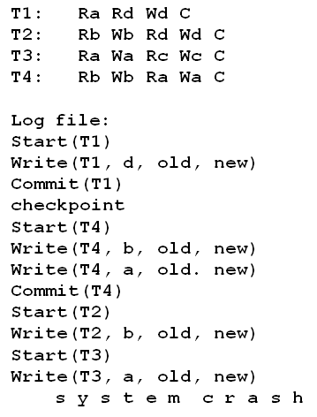
Types of Failure
DEFERRED UPDATE RECOVERY: (Cont…)
Since T1 and T4 committed, their changes were written to disk.
However, T2 and T3 did not commit, hence their changes were not written to disk.
T2 and T3 are ignored because they did not reach their commit points.
T4 is redone because its commit point is after the last system checkpoint.

Slide 159
Types of Failure
1. DEFERRED UPDATE RECOVERY: (Cont…)
Advantages:
  Recovery is made easier:
  Any transaction that reached the commit point (from the log) has its writes applied to the database. All other transactions are ignored.
  Cascading rollback does not occur because no other transaction sees the work of another until it is committed.
Disadvantages:
  Concurrency is limited: Must employ Strict 2PL which limits concurrency.

Slide 160
Types of Failure
IMMEDIATE UPDATE RECOVERY
A Transaction issues an update command, the database can be updated immediately, without any need to wait for the transaction to reach its commit point.
An update operation must still be recorded in the log (on disk) before it is applied to the database – using the write ahead logging protocol.
So that we can recover in case of failure.

Slide 161
Types of Failure
IMMEDIATE UPDATE RECOVERY
Immediate Update allows the write operations to the database as the transaction is executing.
Writes are still saved in the log before being applied to the database - a Write-Ahead Log (WAL)
Maintain two logs:
  REDO log: A record of each new data item in the database.
UNDO log: A record of each updated data item (old values).

Slide 162
Types of Failure
IMMEDIATE UPDATE RECOVERY: (Cont…)
Two rules:
  Transaction T may not update the database until all UNDO entries have been written to the UNDO log.
  Transaction T is not allowed to commit until all REDO and UNDO log entries are written (forced-written to disk).

Slide 163
Types of Failure
IMMEDIATE UPDATE RECOVERY: (Cont…)
To Recover:
  Begin at the end of the log and read backwards to the last
  checkpoint Create two lists:
  C - transactions that have committed (Committed Transaction)
  NC - transactions that did not commit (Active Transaction)
  Undo all the write operations of the Active transactions from the log, using UNDO procedure.
  Redo the write operations of the Committed Transactions from the log using REDO procedure.

Slide 164
IMMEDIATE UPDATE RECOVERY: (Cont…)
Since T1, T2, T3 and T4 changes were written to disk.
However, T1 and T4 are committed.
T2 and T3 are not committed.
T2 and T3 are in Active Transaction List and T4 is in Committed Transaction.
T2 and T3 are Undone from the log using UNDO procedure.
T4 is redone because its commit point is after the last system checkpoint using REDO procedure.

Slide 165
Types of Failure
IMMEDIATE UPDATE RECOVERY: (Cont…)
Advantages:
  Immediate update allows higher concurrency because transactions write continuously to the database rather than waiting until the commit point.
Disadvantages:
  Can lead to cascading rollbacks - time consuming and may be problematic.

Slide 166
Types of Failure
SHADOW PAGING:
The AFIM (After Image) does not overwrite its BFIM (Before Image) but recorded at another place on the disk.
Thus, at any time a data item has AFIM and BFIM (Shadow copy of the data item) at two different places on the disk.

Slide 167
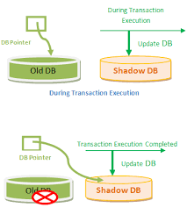
Types of Failure
SHADOW PAGING: (Cont…)

Slide 168
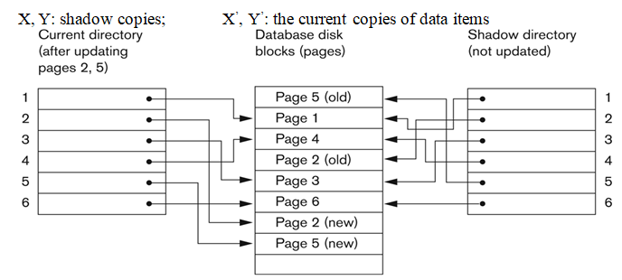
Types of Failure
SHADOW PAGING: (Cont…)

Slide 169
Types of Failure
SHADOW PAGING:
To recover from a failure, it is sufficient to free the modified pages and discard the current directory.
The state of the database before transaction execution is available through the shadow directory.
Database can be returned to its previous state that was executing when the crash occurred.
We can categorized as a NO-UNDO/NO-REDO technique for recovery Logs and checkpoints must be incorporated into the shadow paging technique.

Slide 170
Types of Failure
SHADOW PAGING:
Disadvantages:
Complex storage management strategies, the overhead of writing shadow directories to disk, garbage collection overhead (old pages referenced by the shadow directory).

