Slide 1
NoSQL Basics and MongoDB

Slide 2
Contents
NoSQL Basics
MongoDB
NoSQL Definition
Why NoSQL?
RDBMS vs NoSQL
Types of NoSQL
NoSQL pros and cons
MongoDB Features
MongoDB Nexus Architecture
MongoDB Data Model
MongoDB Query Model
Indexing
MongoDB Data ManageMent
Working Example

Slide 3
What is NoSQL?
NoSQL database, also called Not Only SQL, is an approach to data management and database design that's useful for very large sets of distributed data.
This database system is non-relational, distributed, open-source and horizontally scalable.
NoSQL, which encompasses a wide range of technologies and architectures, seeks to solve the scalability and big data performance issues that relational databases weren’t designed to address.
NoSQL does not prohibit structured query language (SQL). Some NoSQL systems are entirely non-relational, others simply avoid selected relational functionality such as fixed table schemas and join operations.
Popular NoSQL database is Apache Cassandra, SimpleDB, Google BigTable, Apache Hadoop, MapReduce, MemcacheDB, and Voldemort.

Slide 4
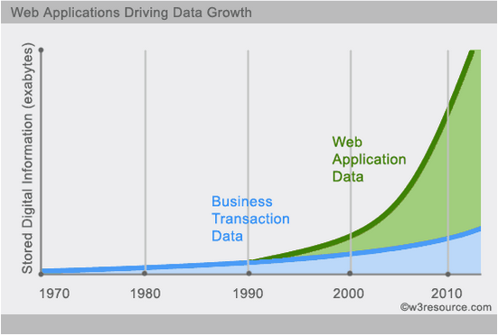
Why NoSQL ?
In today’s world the velocity and nature of data used/generated over the Internet is growing exponentially.
In areas like social media, the data has no specific structure boundary.
In order to handle unstructured data which is non-relational and schema-less in nature, it becomes a real challenge for RDBMS to provide the cost effective and fast CRUD operation as it has to deal with the overhead of joins and maintaining relationships amongst various data.
This is where NoSQL comes into the picture to handle unstructured BIG data in an efficient way to provide maximum business value and customer satisfaction.

Slide 5
Brief History of NoSQL
The name “NoSQL” was in fact first used by Carlo Strozzi in 1998 as the name of file-based database he was developing. Ironically it’s relational database just one without a SQL interface. As such it is not actually a part of the whole NoSQL movement we see today.
The term re-surfaced in 2009 when Eric Evans used it to name the current surge of covering a collection of open-source distributed databases in non-relational databases. It seems like the name has stuck for better or for worse.
Based on 2014 revenue, the NoSQL market leaders are MarkLogic, MongoDB, and Datastax.
Based on 2015 popularity rankings, the most popular NoSQL databases are MongoDB, Apache Cassandra, and Redis.

Slide 6
Distributed Systems
A distributed system consists of multiple computers and software components that communicate through a computer network (a local network or by a wide area network).
Advantages of Distributed Computing
  Reliability (fault tolerance)
  Scalability
  Sharing of Resources
  Flexibility
  Speed
  Open system
  Performance
Disadvantages of Distributed Computing
  Troubleshooting
  Software
  Networking
  Security
Notes:
Advantages of Distributed Computing
Reliability (fault tolerance) :
The important advantage of distributed computing system is reliability. If some of the machines within the system crash, the rest of the computers remain unaffected and work does not stop.
Scalability :
In distributed computing the system can easily be expanded by adding more machines as needed.
Sharing of Resources :
Shared data is essential to many applications such as banking, reservation system. As data or resources are shared in distributed system, other resources can be also shared (e.g. expensive printers).
Flexibility :
As the system is very flexible, it is very easy to install, implement and debug new services.
Speed :
A distributed computing system can have more computing power and it's speed makes it different than other systems.
Open system :
As it is open system, every service is equally accessible to every client i.e. local or remote.
Performance :
The collection of processors in the system can provide higher performance (and better price/performance ratio) than a centralized computer.
Disadvantages of Distributed Computing
Troubleshooting :
Troubleshooting and diagnosing problems.
Software :
Less software support is the main disadvantage of distributed computing system.
Networking :
The network infrastructure can create several problems such as transmission problem, overloading, loss of messages.
Security :
Easy access in distributed computing system increases the risk of security and sharing of data generates the problem of data security

Slide 7
RDBMS vs NoSQL
RDBMS
- Structured and organized data
- Structured query language (SQL)
- Data and its relationships are stored in separate tables.
- Data Manipulation Language, Data Definition Language
- Tight Consistency
- Follow the ACID property
NoSQL
- Stands for Not Only SQL
- No declarative query language
- No predefined schema
- Key-Value pair storage, Column Store, Document Store, Graph databases
- Eventual consistency rather ACID property
- Unstructured and unpredictable data
- CAP Theorem
- Prioritizes high performance, high availability and scalability

Slide 8
ACID Paradigm (RDBMS)
Atomic: All operations of a transaction are executed, or none is.
Consistent: At the end of the transaction, all data must be left in a consistent state.
Isolated: Modifications of data performed by a transaction must be independent of another transaction.
Durability: Durability refers to the guarantee that once the user has been notified of success, the transaction will persist and not be undone.
Notes:
Relational database systems offer the concept of referential integrity, mechanisms to add semantics to the model by using keys and foreign key relationships to ensure data consistency.
Concurrent access to a database is administered by using transactions. The famous ACID paradigm is part of (almost) all relational database systems and guarantees transaction to be

Slide 9
CAP Theorem (NoSQL)
Eric Brewer formulates the CAP theorem whose properties are used by BASE System.
The CAP theorem states that a distributed computer system cannot guarantee all of the following three properties at the same time:
  Consistency (C) – once data is written, all future read requests will contain that data
  Availability (A)– the database is always available and responsive
  Partition tolerance (P) – if one part of the database is unavailable, other parts are unaffected
Brewer originally described this impossibility result as forcing a choice of “two out of the three” CAP properties: CP, AP and CA
Notes:
CA – data should be consistent between all nodes. As long as all nodes are online, users can read/write from any node and be sure that the data is the same on all nodes.
CP – data is consistent between all nodes and maintains partition tolerance by becoming unavailable when a node goes down.
AP - nodes remain online even if they can’t communicate with each other and will re-sync data once the partition is resolved, but you aren’t guaranteed that all nodes will have the same data (either during or after the partition)

Slide 10
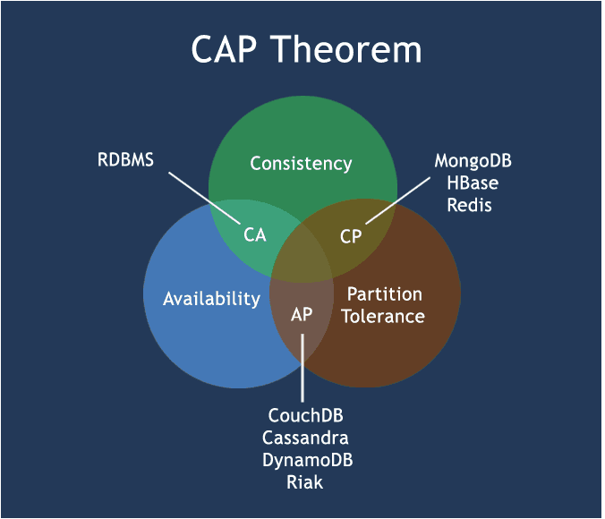
CAP Theorem

Slide 11
BASE System (NoSQL)
A BASE system gives up on consistency so as to have greater Availability and Partition tolerance. A BASE can be defined as following:
  Basically Available indicates that the system does guarantee availability.
  Soft state indicates that the state of the system may change over time, even without input. This is because of the eventual consistency model.
  Eventual consistency indicates that the system will become consistent over time, given that the system doesn’t receive input during that time.

Slide 12
NoSQL Database Types
Key-value stores
Column-oriented databases
Graph databases
Document Oriented databases

Slide 13
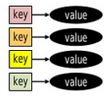
1. Key-value stores
The key-value model is the simplest and easiest to implement.
It is a schema-less construct.
This model contains a key along with a piece of associated data or object as value.
Key-Value stores follows the 'Availability' and 'Partition' aspects of CAP theorem.
Key-Value stores can be used as collections, dictionaries, associative arrays etc.
Pros: Scalable, Simple API (put, get, delete).
Cons: No way to query based on the content of the value.
Example Databases:
  Riak
  Redis
  Amazon’s DynamoDB

Slide 14
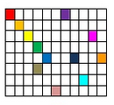
2. Column-oriented databases
These were created to store and process very large amounts of data distributed over many machines.
There are still keys but they point to multiple columns.
The columns are arranged by column family.
Pros: Good Scale out, Versioning.
Cons: Row and column designs are critical.
Example Databases:
  BigTable
  Hbase
  Cassandra

Slide 15
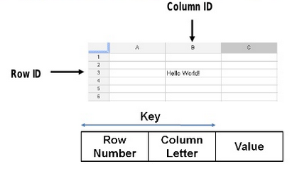

Key in Column-oriented databases
Spreadsheets
BigTable
Spreadsheets use a Row/Column as a key
Bigtable systems use a combination of row and column information as a part of their key.
Key also include timestamps, which allows multiple versions of data.
Values are just ordered bytes.

Slide 16
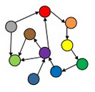
3. Graph databases
A graph database is a collection of nodes and edges.
Each node represents an entity (such as a student or business) and each edge represents a connection or relationship between two nodes.
Query are really graph traversal.
Ideal when relationships between data are keys: Social Networks.
Pros: First network search.
Cons: Poor scalability when graphs do not fit into RAM.
Example Databases:
  Neo4j
  OrientDB
  AllegroGraph
Notes:
Graph Databases:
Every node and edge is defined by a unique identifier.
Each node knows its adjacent nodes.
As the number of nodes increases, the cost of a local step (or hop) remains the same.
Index for lookups.

Slide 17
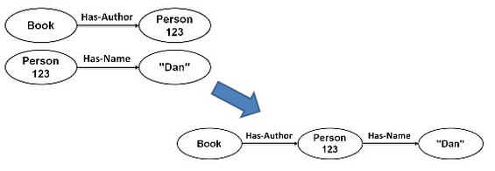
Graph Creation in Graph databases
Nodes are joined to create graph
Notes:
How do you know two items reference the same object?
- By Node identification (URI or similar structure)

Slide 18
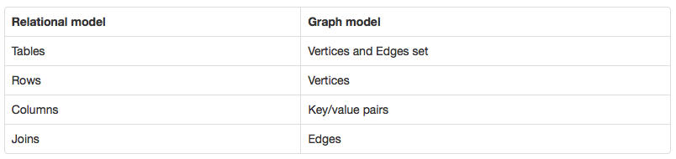
Terms Comparison between the classic relational model and the graph model

Slide 19
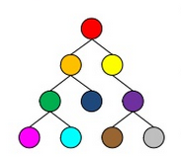
4. Document Oriented Databases
A collection of documents and data in this model is stored inside documents.
Document databases are essentially the next level of key-value, allowing nested values associated with each key.
The semi-structured documents are stored in formats like JSON or XML.
Document databases support querying more efficiently.
Documents are not typically forced to have a schema and therefore are flexible and easy to change.
Documents are stored into collections in order to group different kinds of data.
Pros: No object-relational mapping, ideal for research.
Cons: Complex to implement and incompatible with SQL.
Example Databases:
  MongoDB
  CouchDB
  MarkLogic

Slide 20
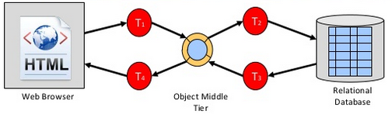
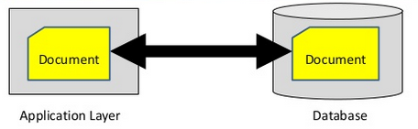
Object Relational Mapping or not
Object Relational Mapping
Document Store
T₁ – HTML into object
T₂ – Object into SQL table
T₃ – Table into object
T₄ – Object into HTML
Documents in the application
Documents in the database
No object middle tier
No “shredding”
Simple

Slide 21
NoSQL pros and cons
Pros
Cons
High scalability
Distributed Computing
Lower cost
Schema flexibility
Un/semi-structured data
No complex relationships
No join operations
No standardization
Limited query capabilities (so far)

Slide 22
What is MongoDB?
Document-oriented database
  Uses JSON (BSON actually)
Schema-free
Performant
  Written in C++
  Full index support
  No transactions (has atomic operation)
  Memory-mapped files(delayed writes)
Scalable
  Replication
  Auto Sharding
Commercially Supported

Slide 23
Other Features of MongoDB
Fast, Iterative Development: A flexible data model coupled with dynamic schema and idiomatic drivers make it fast for developers to build and evolve applications.
Flexible Data Model: MongoDB's document data model makes it easy for you to store and combine data of any structure, without giving up sophisticated data access and rich indexing functionality.
Pluggable Storage Architecture: Users can leverage the same MongoDB query language, data model, scaling, security and operational tooling across different applications, each powered by different pluggable MongoDB storage engines.
Multi-Datacenter Scalability: MongoDB can be scaled within and across multiple distributed data centers, providing new levels of availability and scalability.
Integrated Feature Set: Analytics, text search, geospatial, in-memory performance and global replication allow you to deliver a wide variety of real-time applications on one technology, reliably and securely.
Lower TCO: MongoDB runs on commodity hardware, dramatically lowering costs.
Long-Term Commitment: MongoDB Inc and the MongoDB ecosystem stand behind the world's fastest-growing database. 10M+ downloads. 2,000+ customers including more than 1/3rd of the Fortune 100. 1,000+ partners.
Notes:
Fast, Iterative Development Contrast this against static relational schemas and complex operations that have hindered you in the past.
Flexible Data Model: You can dynamically modify the schema without downtime. You spend less time prepping your data for the database, and more time putting your data to work.
Pluggable Storage Architecture With MongoDB, organizations can address diverse application needs with a single database technology. With it's pluggable storage architecture, M
ongoDB can be extended with new capabilities, and configured for optimal use of specific hardware architectures.
Integrated Feature Set: RDBMS systems require additional, complex technologies demanding separate integration overhead and expense to do this well.

Slide 24
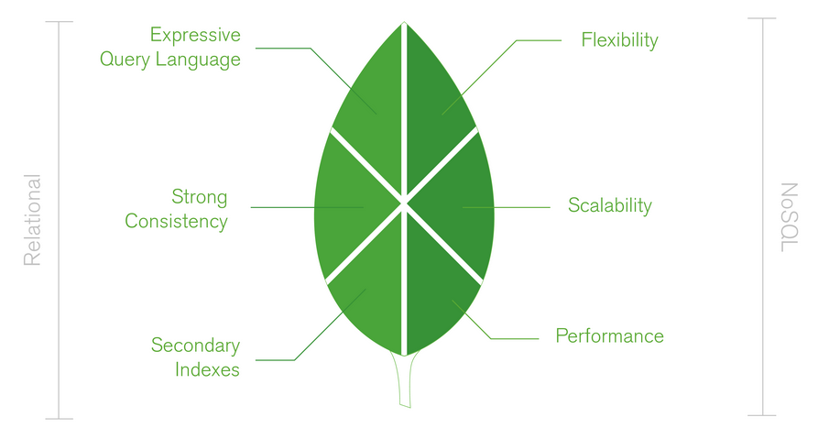
MongoDB Nexus Architecture
MongoDB’s design philosophy is focused on combining
  the critical capabilities of relational databases
  the innovations of NoSQL technologies

Slide 25
MongoDB Nexus Architecture
Relational Database
NoSQL
Expressive query language
Secondary indexes
Strong consistency
Flexible Data Model
Elastic Scalability
High Performance

Slide 26
MongoDB Data Model
Data As Documents
  MongoDB stores data as documents in a binary representation called BSON (Binary JSON).
  BSON documents contain one or more fields, and each field contains a value of a specific data type, including arrays, binary data and sub-documents.
  Documents that tend to share a similar structure are organized as collections.
Dynamic Schema
  Fields can vary from document to document.
  There is no need to declare the structure of documents to the system – documents are self describing.
  MongoDB continues to store the updated objects without the need for performing costly ALTER_TABLE operations
Schema Design
  Although MongoDB provides schema flexibility, schema design is still important
RDBMS | MongoDB
Table | Collection
Row | Document
Column | Field
Notes:
Data As Documents: MongoDB stores data as documents in a binary representation called BSON (Binary JSON). The BSON encoding extends the popular JSON (JavaScript Object
Notation) representation to include additional types such as int, long, and floating point. BSON documents contain one or more fields, and each field contains a value of a specific data type, including arrays, binary data and sub-documents.
Schema Design: Developers and DBAs should consider a number of topics, including the types of queries the application will need to perform, how objects are managed in the application code, and how documents will change over time.

Slide 27
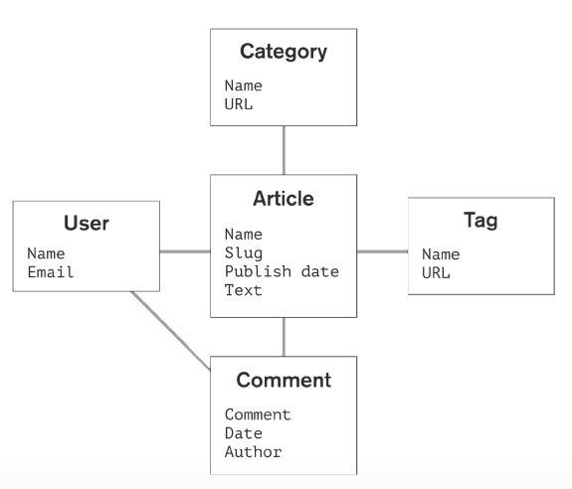
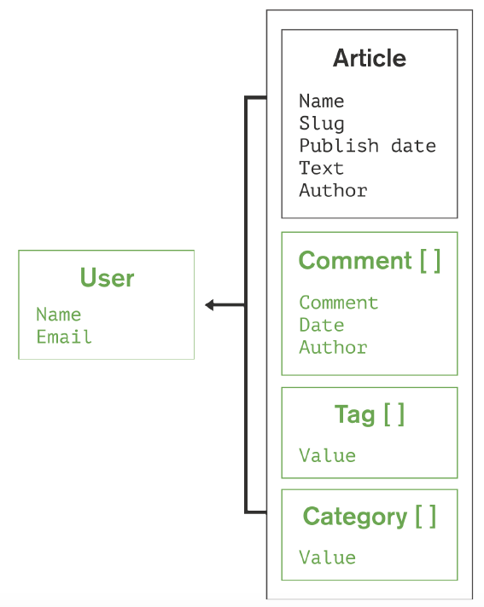
An Example Data Model for a Blogging Application
Relational Data Model
MongoDB Data Model
Notes:
As this example illustrates, MongoDB documents tend to have all data for a given record in a single document, whereas in a relational database information for a given
record is usually spread across many tables. With the MongoDB document model, data is more localized, which significantly reduces the need to JOIN separate tables. The result is dramatically higher performance and scalability across commodity hardware as a single read to the database can retrieve the entire document containingall related data.
In addition, MongoDB BSON documents are more closely aligned to the structure of objects in the programming language. This makes it simpler and faster for developers to model how data in the application will map to data stored in the database.

Slide 28
MongoDB Query Model
Idiomatic Drivers
Query types
Indexing

Slide 29
Idiomatic Drivers
MongoDB provides native drivers for all popular programming languages and frameworks to make development natural.
Supported drivers include
  Java
  .NET
  Ruby
  PHP
  JavaScript
  node.js
  Python
  Perl
  Scala and others.

Slide 30
Query Types
Key-value queries
Range queries
Geospatial queries
Text Search queries
Aggregation Framework queries
MapReduce queries
Notes:
Key-value queries return results based on any field in the document, often the primary key.
Range queries return results based on values defined as inequalities (e.g. greater than, less than or equal to, between).
Geospatial queries return results based on proximity criteria, intersection and inclusion as specified by a point, line, circle or polygon.
Text Search queries return results in relevance order based on text arguments using Boolean operators (e.g., AND, OR, NOT).
Aggregation Framework queries return aggregations of values returned by the query (e.g., count, min, max, average, similar to a SQL GROUP BY statement).
MapReduce queries execute complex data processing that is expressed in JavaScript and executed across data in the database.

Slide 31
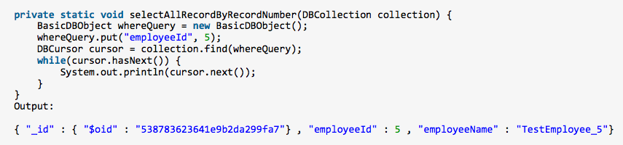
Query Types
Key-value queries

Slide 32
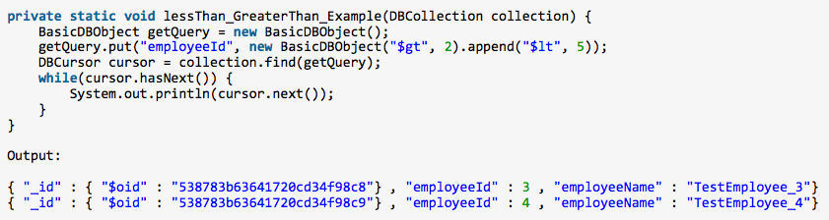
Query Types
Range queries

Slide 33
Indexing
Indexes are a crucial mechanism for optimizing system performance and scalability while providing flexible access to the data.
  Unique Indexes: By specifying an index as unique, MongoDB will reject inserts of new documents or the update of a document with an existing value.
  Compound Indexes: It can be useful to create compound indexes for queries that specify multiple predicates.
  Array Indexes: For fields that contain an array, each array value is stored as a separate index entry
  TTL Indexes: Time to Live (TTL) indexes allow the user to specify a period of time after which the data will automatically be deleted from the database.
  Geospatial Indexes: MongoDB provides geospatial indexes to optimize queries related to location within a two dimensional space, such as projection systems for the earth.
  Sparse Indexes: It only contain entries for documents that contain the specified field.
  Text Search Indexes: MongoDB provides a specialized index for text search that uses advanced, language-specific linguistic rules for stemming, tokenization and stop words.
Notes:
Compound Indexes: For example, consider an application that stores data about customers. The application may need to find customers based on last name, first name, and city of residence. With a compound index on last name, first name, and city of residence, queries could efficiently locate people with all three of these values specified.
TTL Indexes: A common use of TTL indexes is applications that maintain a rolling window of history (e.g., most recent 100 days) for user actions such as clickstreams.
Geospatial Indexes: These indexes allow MongoDB to optimize queries for documents that contain points or a polygon that are closest to a given point or line; that are within a circle, rectangle, or polygon; or that intersect with a circle, rectangle, or polygon.
Sparse Indexes: Because the document data model of MongoDB allows for flexibility in the data model from document to document, it is common for some fields to be present only in a subset of all documents. Sparse indexes allow for smaller, more efficient indexes when fields are not present in all documents.
Text Search Indexes: Queries that use the text search index will return documents in relevance order. One or more fields can be included in the text index.

Slide 34
MongoDB Data Management
Auto-sharding for linear scalability
Pluggable storage architecture for application flexibility
Storage efficiency witih compression

Slide 35
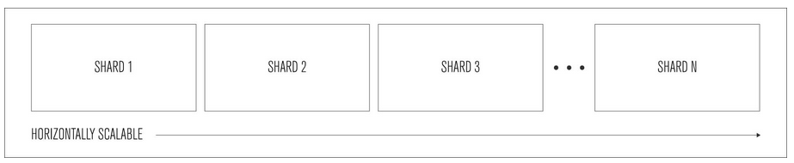
Auto-sharding for Linear Scalability
Sharding distributes data across multiple physical partitions called shards.
Sharding allows MongoDB deployments to address the hardware limitations of a single server, such as bottlenecks in RAM or disk I/O.
Unlike relational databases, sharding is automatic and built into the database.
Developers don't face the complexity of building sharding logic into their application code

Slide 36
Auto-sharding for Linear Scalability
Multiple sharding policies available – hash-based, range-based and location-based.
  Range-based Sharding. Documents with shard key values close to one another are likely to be co-located on the same shard. This approach is well suited for applications that need to optimize range based queries.
  Hash-based Sharding. Documents are distributed according to an MD5 hash of the shard key value. This approach guarantees a uniform distribution of writes across shards, but is less optimal for range-based queries.
  Location-based Sharding. Documents are partitioned according to a user-specified configuration that associates shard key ranges with specific shards and hardware.

Slide 37
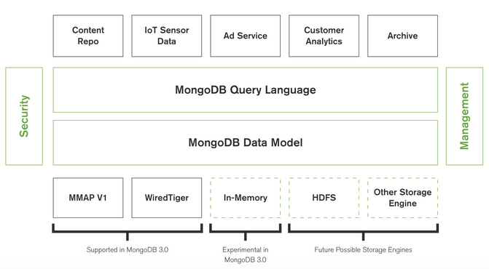
Pluggable storage architecture for application flexibility
Through the use of a pluggable storage architecture, MongoDB can be extended with new capabilities, and configured for optimal use of specific hardware architectures.
Notes:
MongoDB 3.0 ships with two supported storage engines:
MMAPv1 (Memory Mapped Version 1) engine – an improved version of the engine used in prior MongoDB releases;
and the new WiredTiger storage engine bringing higher concurrency and compression.
The Pluggable Storage Architecture (PSA) Framework package allows partners to deliver performance-enhancing, multi-pathing and load-balancing behaviors optimized per array.

Slide 38
Storage efficiency witih compression
MongoDB supports native compression when configured with the WiredTiger storage engine, reducing physical storage footprint by as much as 80%.
In addition to reduced storage space, compression enables much higher storage I/O scalability as fewer bits are read from disk.
Administrators have the flexibility to configure specific compression algorithms for collections, indexes.

Slide 39
MongoDB Consistency & Availability
Transaction model
  The ACID guarantees provided by MongoDB ensure complete isolation as a document is updated.
Replica sets
  MongoDB maintains multiple copies of data called replica sets using native replication. A replica set is a fully self-healing shard that helps prevent database downtime.
In-memory performance with on-disk capacity
  MongoDB makes extensive use of RAM to speed up database operations. In MongoDB, all data is read and manipulated through memory-mapped files.
Security
  Authentication, Authorization, Auditing and Encryption.
Notes:
Authentication. Simplifying access control to the database, MongoDB offers integration with external security mechanisms including LDAP, Windows Active Directory, Kerberos and x.509 PKI certificates.
Authorization. User-defined roles enable administrators to configure granular permissions for a user or application, based on the privileges they need to do their job. Additionally, field-level redaction can work with trusted middleware to manage access to individual fields within a document, allowing the co-location of data with multiple security levels for ease of development and operation.
Auditing. For regulatory compliance, security administrators can use MongoDB's native audit log to track access and operations performed against the database.
Encryption. MongoDB data can be encrypted on the network and on disk. Support for SSL allows clients to connect to MongoDB over an encrypted channel.

Slide 40
Working Example: Using MongDB Java Driver on Mac OS X
Instructions to install MongDB:
  Download mongodb-osx-x86_64-3.0.7.tgz file and extract it.
  Copy it into /usr/local/mongdb
  Go to terminal into this directory and command the followings
  export PATH=<mongodb-install-directory>/bin:$PATH
  sudo chown -R $USER /data/db
  Mongod
Coding in Java
  You need to download the jar from the path Download mongo.jar. https://oss.sonatype.org/content/repositories/releases/org/mongodb/mongo-java-driver/3.1.1/
  You need to include the mongo.jar into your classpath.

Slide 41
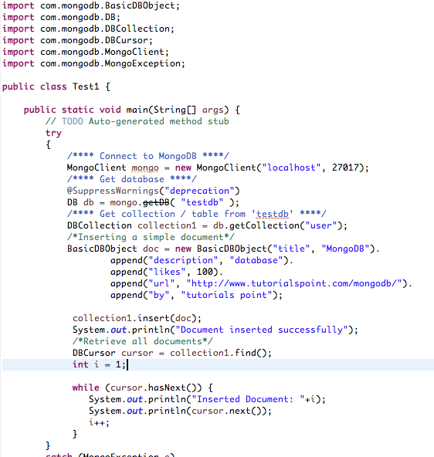
Java Code
Include these import statements.
Database Connectivity
Insertion

Slide 42
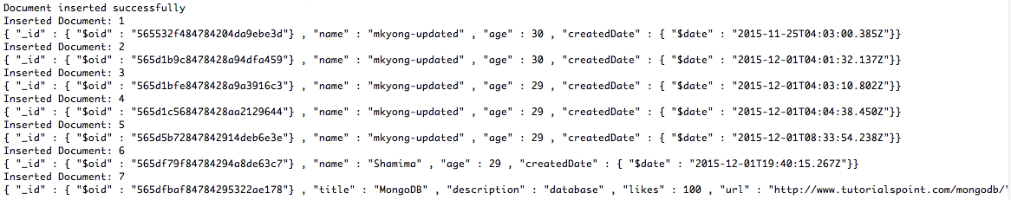
Output

Slide 43


Summary
NoSQL, its characteristics and its types.
MongoDB, its characteristics and working example with MongoDB java.

