Slide 1
Entity Relationship Model

Slide 2
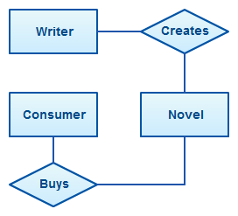
Entity Relationship Model
An Entity Relationship Diagram (ERD) is a visual representation of different data using conventions that describe how these data are related to each other.
For example, the elements writer, novel, and consumer may be described using ER diagrams this way:
The elements inside rectangles are called entities while the items inside diamonds denote the relationships between entities.

Slide 3
Entity
An entity can be a real-world object, either animate or inanimate, that can be easily identifiable.
  For example, in a school database, students, teachers, classes, and courses offered can be considered as entities.
  All these entities have some attributes or properties that give them their identity.
An entity set is a collection of similar types of entities.
  An entity set may contain entities with attribute sharing similar values.
  For example,
  a Students set may contain all the students of a school;
  likewise a Teachers set may contain all the teachers of a school from all faculties. Entity sets need not be disjoint.

Slide 4

Weak Entity
A weak entity is an entity that depends on the existence of another entity.
In more technical terms it can defined as an entity that cannot be identified by its own attributes.
It uses a foreign key combined with its attributed to form the primary key.
An entity like order item is a good example for this.
  The order item will be meaningless without an order so it depends on the existence of order.

Slide 5
Attributes
Entities are represented by means of their properties, called attributes.
All attributes have values.
For example, a student entity may have name, class, and age as attributes.
There exists a domain or range of values that can be assigned to attributes.
For example, a student's name cannot be a numeric value. It has to be alphabetic. A student's age cannot be negative, etc.

Slide 6
Types of Attributes
Simple attribute − Simple attributes are atomic values, which cannot be divided further. For example, a student's phone number is an atomic value of 10 digits.
Composite attribute − Composite attributes are made of more than one simple attribute. For example, a student's complete name may have first_name and last_name.

Slide 7
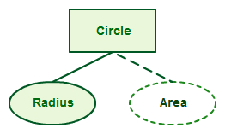
Types of Attributes (contd.,)
Derived attribute − Derived attributes are the attributes that do not exist in the physical database, but their values are derived from other attributes present in the database.
For example, average_salary in a department should not be saved directly in the database, instead it can be derived.
For another example, age can be derived from data_of_birth.
For example for a circle the area can be derived from the radius.

Slide 8

Types of Attributes (contd.,)
Single-value attribute − Single-value attributes contain single value. For example − Social_Security_Number.
Multi-value attribute − Multi-value attributes may contain more than one values. For example, a person can have more than one phone number, email_address, etc.
For example a teacher entity can have multiple subject values.

Slide 9
These attribute types can come together in a way like −
simple single-valued attributes
simple multi-valued attributes
composite single-valued attributes
composite multi-valued attributes

Slide 10
Entity-Set and Keys
Key is an attribute or collection of attributes that uniquely identifies an entity among entity set.
For example, the roll_number of a student makes him/her identifiable among students.
Super Key − A set of attributes (one or more) that collectively identifies an entity in an entity set.
Candidate Key − A minimal super key is called a candidate key. An entity set may have more than one candidate key.
Primary Key − A primary key is one of the candidate keys chosen by the database designer to uniquely identify the entity set.

Slide 11

Relationship
The association among entities is called a relationship.
For example, an employee works_at a department, a student enrolls in a course.
Here, Works_at and Enrolls are called relationships.
For example, the entity “carpenter” may be related to the entity “table” by the relationship “builds” or “makes”. Relationships are represented by diamond shapes and are labeled using verbs.

Slide 12
Degree of Relationship
The number of participating entities in a relationship defines the degree of the relationship.
Binary = degree 2
Ternary = degree 3
n-ary = degree

Slide 13
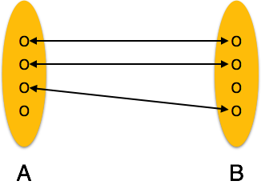
Mapping Cardinalities
Cardinality defines the number of entities in one entity set, which can be associated with the number of entities of other set via relationship set.
One-to-one − One entity from entity set A can be associated with at most one entity of entity set B and vice versa.

Slide 14
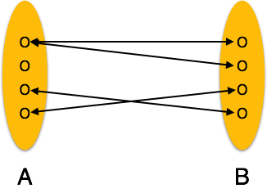
One-to-many − One entity from entity set A can be associated with more than one entities of entity set B however an entity from entity set B, can be associated with at most one entity.

Slide 15
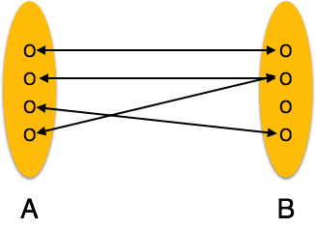
Many-to-one − More than one entities from entity set A can be associated with at most one entity of entity set B, however an entity from entity set B can be associated with more than one entity from entity set A.

Slide 16
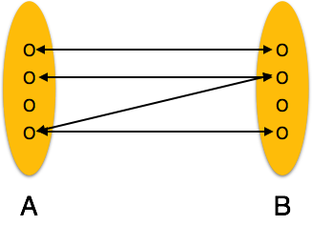
Many-to-many − One entity from A can be associated with more than one entity from B and vice versa.

Slide 17
ER Diagram Representation
Let us now learn how the ER Model is represented by means of an ER diagram.
Any object, for example, entities, attributes of an entity, relationship sets, and attributes of relationship sets, can be represented with the help of an ER diagram.

Slide 18
Entity
Entities are represented by means of rectangles. Rectangles are named with the entity set they represent.

Slide 19
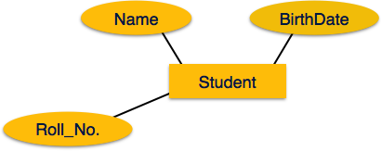
Attributes
Attributes are the properties of entities. Attributes are represented by means of ellipses.
Every ellipse represents one attribute and is directly connected to its entity (rectangle).

Slide 20
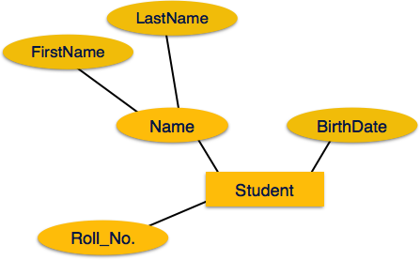
If the attributes are composite, they are further divided in a tree like structure. Every node is then connected to its attribute. That is, composite attributes are represented by ellipses that are connected with an ellipse.

Slide 21
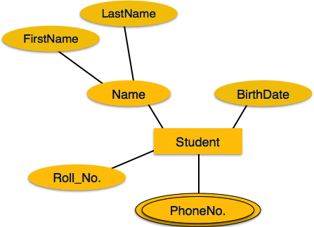
Multivalued attributes are depicted by double ellipse.

Slide 22
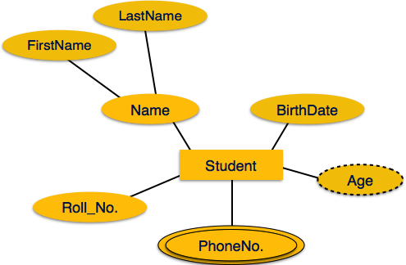
Derived attributes are depicted by dashed ellipse.

Slide 23
Relationship
Relationships are represented by diamond-shaped box.
Name of the relationship is written inside the diamond-box.
All the entities (rectangles) participating in a relationship, are connected to it by a line.
Binary Relationship and Cardinality
A relationship where two entities are participating is called a binary relationship. Cardinality is the number of instance of an entity from a relation that can be associated with the relation.

Slide 24
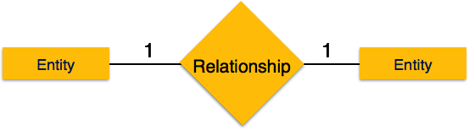
One-to-one − When only one instance of an entity is associated with the relationship, it is marked as '1:1'. The following image reflects that only one instance of each entity should be associated with the relationship. It depicts one-to-one relationship.

Slide 25
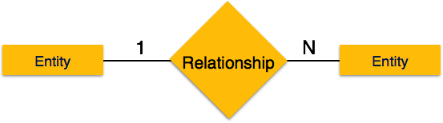
One-to-many − When more than one instance of an entity is associated with a relationship, it is marked as '1:N'. The following image reflects that only one instance of entity on the left and more than one instance of an entity on the right can be associated with the relationship. It depicts one-to-many relationship.

Slide 26
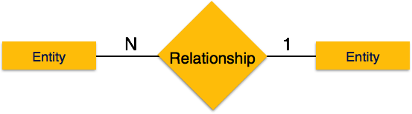
Many-to-one − When more than one instance of entity is associated with the relationship, it is marked as 'N:1'. The following image reflects that more than one instance of an entity on the left and only one instance of an entity on the right can be associated with the relationship. It depicts many-to-one relationship.

Slide 27

Many-to-many − The following image reflects that more than one instance of an entity on the left and more than one instance of an entity on the right can be associated with the relationship. It depicts many-to-many relationship.

Slide 28
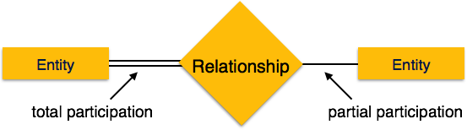
Participation Constraints
Total Participation − Each entity is involved in the relationship. Total participation is represented by double lines.
Partial participation − Not all entities are involved in the relationship. Partial participation is represented by single lines.

Slide 29
Generalization Aggregation
The ER Model has the power of expressing database entities in a conceptual hierarchical manner.
As the hierarchy goes up, it generalizes the view of entities, and as we go deep in the hierarchy, it gives us the detail of every entity included.
Going up in this structure is called generalization, where entities are clubbed together to represent a more generalized view.
For example, a particular student named Mira can be generalized along with all the students.
The entity shall be a student, and further, the student is a person. The reverse is called specialization where a person is a student, and that student is Mira.

Slide 30
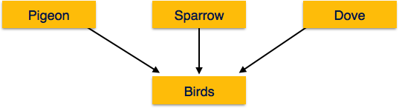
Generalization
The process of generalizing entities, where the generalized entities contain the properties of all the generalized entities, is called generalization.
In generalization, a number of entities are brought together into one generalized entity based on their similar characteristics. For example, pigeon, house sparrow, crow and dove can all be generalized as Birds.

Slide 31
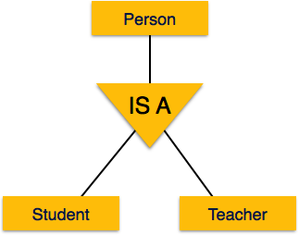
Specialization
Specialization is the opposite of generalization. In specialization, a group of entities is divided into sub-groups based on their characteristics.
Take a group ‘Person’ for example. A person has name, date of birth, gender, etc. These properties are common in all persons, human beings. But in a company, persons can be identified as employee, employer, customer, or vendor, based on what role they play in the company.
Similarly, in a school database, persons can be specialized as teacher, student, or a staff, based on what role they play in school as entities.

Slide 32
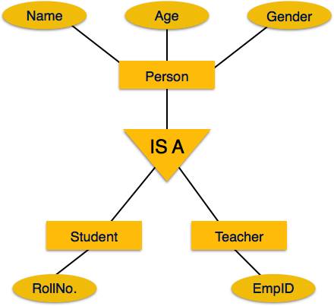
Inheritance
We use all the above features of ER-Model in order to create classes of objects in object-oriented programming.
The details of entities are generally hidden from the user; this process known as abstraction.
Inheritance is an important feature of Generalization and Specialization. It allows lower-level entities to inherit the attributes of higher-level entities.
For example, the attributes of a Person class such as name, age, and gender can be inherited by lower-level entities such as Student or Teacher.

Slide 33
ER Diagram Example
Suppose you are given the following requirements for a simple database for the National Hockey League (NHL):
the NHL has many teams,
each team has a name, a city, a coach, a captain, and a set of players,
each player belongs to only one team,
each player has a name, a position (such as left wing or goalie), a skill level, and a set of injury records,
a team captain is also a player,
a game is played between two teams (referred to as host_team and guest_team) and has a date (such as May 11th, 1999) and a score (such as 4 to 2).
Construct a clean and concise ER diagram for the NHL database.

Slide 34
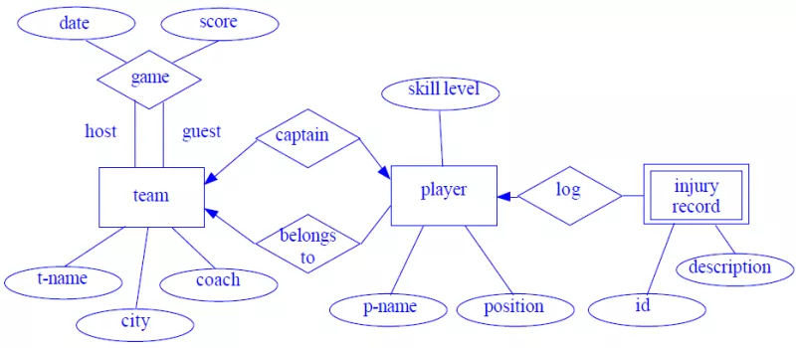

Slide 35
Question 2:
A university registrar’s office maintains data about the following entities:
courses, including number, title, credits, syllabus, and prerequisites;
course offerings, including course number, year, semester, section number, instructor(s), timings, and classroom;
students, including student-id, name, and program;
instructors, including identi‑cation number, name, department, and title.
Further, the enrollment of students in courses and grades awarded to students in each course they are enrolled for must be appropriately modeled. Construct an E-R diagram for the registrar’s of‑ce.Document all assumptions that you make about the mapping constraints.

Slide 36
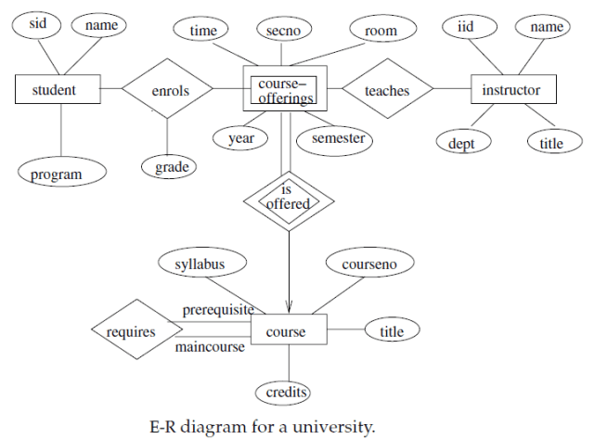

Slide 37
Question 3:
(a) Construct an E-R diagram for a car-insurance company whose customers own one or more cars each. Each car has associated with it zero to any number of recorded accidents.
(b) Construct appropriate tables for the above ER Diagram ?

Slide 38
Car insurance tables:
person (driver-id, name, address)
car (license, year,model)
accident (report-number, date, location)
participated(driver-id, license, report-number, damage-amount)

Slide 39
