Slide 1
UNIT IV IMPLEMENTATION TECHNIQUES
Overview of Physical Storage Media – RAID – File Organization – Organization of Records in Files – Indexing and Hashing –Ordered Indices – B+ tree Index Files – B tree Index Files – Static Hashing – Dynamic Hashing – Query Processing Overview – Catalog Information for Cost Estimation - Query Optimization

Slide 2
Classification of Physical Storage Media
Speed with which data can be accessed
Cost per unit of data
Reliability
  data loss on power failure or system crash
  physical failure of the storage device
Can differentiate storage into:
  volatile storage: loses contents when power is switched off
  non-volatile storage:
    Contents persist even when power is switched off.
    Includes secondary and tertiary storage, as well as battery-backed up main-memory.

Slide 3
Physical Storage Media
Cache – fastest and most costly form of storage; volatile; managed by the computer system hardware
  (Note: “Cache” is pronounced as “cash”)
Main memory:
  fast access (10s to 100s of nanoseconds; 1 nanosecond = 10^{–9} seconds)
  generally too small (or too expensive) to store the entire database
    capacities of up to a few Gigabytes widely used currently
    Capacities have gone up and per-byte costs have decreased steadily and rapidly (roughly factor of 2 every 2 to 3 years)
  Volatile — contents of main memory are usually lost if a power failure or system crash occurs.

Slide 4
Physical Storage Media (Cont.)
Flash memory
  Data survives power failure
  Data can be written at a location only once, but location can be erased and written to again
    Can support only a limited number (10K – 1M) of write/erase cycles.
    Erasing of memory has to be done to an entire bank of memory
  Reads are roughly as fast as main memory
  But writes are slow (few microseconds), erase is slower

Slide 5
Physical Storage Media (Cont.)
Flash memory
  NOR Flash
    Fast reads, very slow erase, lower capacity
    Used to store program code in many embedded devices
  NAND Flash
    Page-at-a-time read/write, multi-page erase
    High capacity (several GB)
    Widely used as data storage mechanism in portable devices

Slide 6
Physical Storage Media (Cont.)
Magnetic-disk
  Data is stored on spinning disk, and read/written magnetically
  Primary medium for the long-term storage of data; typically stores entire database.
  Data must be moved from disk to main memory for access, and written back for storage
  direct-access – possible to read data on disk in any order, unlike magnetic tape
  Survives power failures and system crashes
    disk failure can destroy data: is rare but does happen

Slide 7
Physical Storage Media (Cont.)
Optical storage
  non-volatile, data is read optically from a spinning disk using a laser
  CD-ROM (640 MB) and DVD (4.7 to 17 GB) most popular forms
  Write-one, read-many (WORM) optical disks used for archival storage (CD-R, DVD-R, DVD+R)
  Multiple write versions also available (CD-RW, DVD-RW, DVD+RW, and DVD-RAM)
  Reads and writes are slower than with magnetic disk
  Juke-box systems, with large numbers of removable disks, a few drives, and a mechanism for automatic loading/unloading of disks available for storing large volumes of data

Slide 8
Physical Storage Media (Cont.)
Tape storage
  non-volatile, used primarily for backup (to recover from disk failure), and for archival data
  sequential-access – much slower than disk
  very high capacity (40 to 300 GB tapes available)
  tape can be removed from drive ⇒ storage costs much cheaper than disk, but drives are expensive
  Tape jukeboxes available for storing massive amounts of data
    hundreds of terabytes (1 terabyte = 10⁹ bytes) to even a petabyte (1 petabyte = 10¹² bytes)

Slide 9
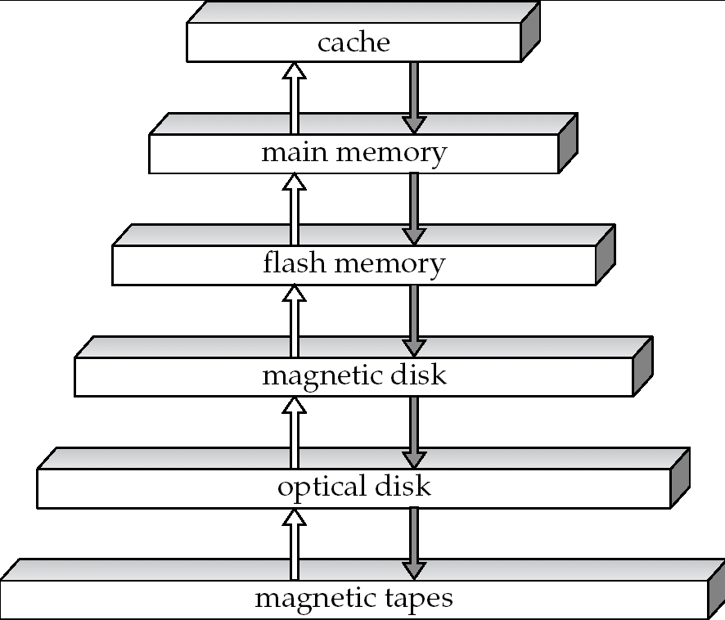
Storage Hierarchy

Slide 10
Storage Hierarchy (Cont.)
primary storage: Fastest media but volatile (cache, main memory).
secondary storage: next level in hierarchy, non-volatile, moderately fast access time
  also called on-line storage
  E.g. flash memory, magnetic disks
tertiary storage: lowest level in hierarchy, non-volatile, slow access time
  also called off-line storage
  E.g. magnetic tape, optical storage

Slide 11
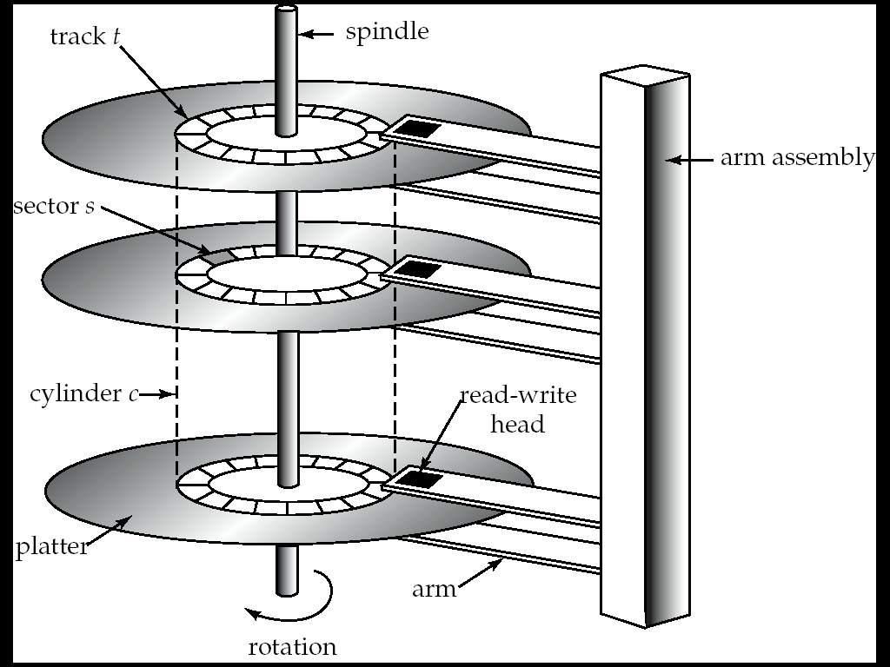
Magnetic Hard Disk Mechanism
NOTE: Diagram is schematic, and simplifies the structure of actual disk drives

Slide 12
Magnetic Disks
Read-write head
  Positioned very close to the platter surface (almost touching it)
  Reads or writes magnetically encoded information.
Surface of platter divided into circular tracks
  Over 50K-100K tracks per platter on typical hard disks
Each track is divided into sectors.
  Sector size typically 512 bytes
  Typical sectors per track: 500 (on inner tracks) to 1000 (on outer tracks)
To read/write a sector
  disk arm swings to position head on right track
  platter spins continually; data is read/written as sector passes under head

Slide 13
Magnetic Disks (Cont.)
Head-disk assemblies
  multiple disk platters on a single spindle (1 to 5 usually)
  one head per platter, mounted on a common arm.
Cylinder i consists of i^{th} track of all the platters
Earlier generation disks were susceptible to “head-crashes” leading to loss of all data on disk
  Current generation disks are less susceptible to such disastrous failures, but individual sectors may get corrupted

Slide 14
Disk Controller
Disk controller – interfaces between the computer system and the disk drive hardware.
  accepts high-level commands to read or write a sector
  initiates actions such as moving the disk arm to the right track and actually reading or writing the data
  Computes and attaches checksums to each sector to verify that data is read back correctly
    If data is corrupted, with very high probability stored checksum won’t match recomputed checksum
  Ensures successful writing by reading back sector after writing it
  Performs remapping of bad sectors

Slide 15
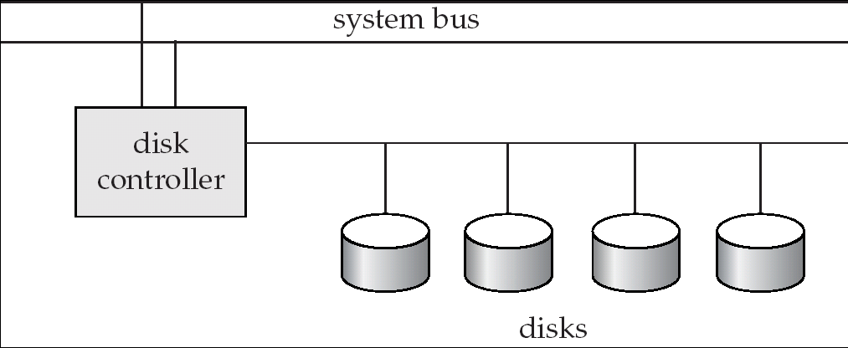
Disk Subsystem
Disk interface standards families
  ATA (AT adaptor) range of standards
  SATA (Serial ATA)
  SCSI (Small Computer System Interconnect) range of standards
  Several variants of each standard (different speeds and capabilities)

Slide 16
Performance Measures of Disks
Access time – the time it takes from when a read or write request is issued to when data transfer begins. Consists of:
  Seek time – time it takes to reposition the arm over the correct track.
    Average seek time is 1/2 the worst case seek time.
      Would be 1/3 if all tracks had the same number of sectors, and we ignore the time to start and stop arm movement
    4 to 10 milliseconds on typical disks
  Rotational latency – time it takes for the sector to be accessed to appear under the head.
    Average latency is 1/2 of the worst case latency.
    4 to 11 milliseconds on typical disks (5400 to 15000 r.p.m.)

Slide 17
Performance Measures (Cont.)
Data-transfer rate – the rate at which data can be retrieved from or stored to the disk.
  25 to 100 MB per second max rate, lower for inner tracks
  Multiple disks may share a controller, so rate that controller can handle is also important
    E.g. ATA-5: 66 MB/sec, SATA: 150 MB/sec, Ultra 320 SCSI: 320 MB/s
    Fiber Channel (FC2Gb): 256 MB/s

Slide 18
Performance Measures (Cont.)
Mean time to failure (MTTF) – the average time the disk is expected to run continuously without any failure.
  Typically 3 to 5 years
  Probability of failure of new disks is quite low, corresponding to a theoretical MTTF of 500,000 to 1,200,000 hours for a new disk
    E.g., an MTTF of 1,200,000 hours for a new disk means that given 1000 relatively new disks, on an average one will fail every 1200 hours
  MTTF decreases as disk ages

Slide 19
Optimization of Disk-Block Access
Block – a contiguous sequence of sectors from a single track
  data is transferred between disk and main memory in blocks
  Typical block sizes today range from 4 to 16 kilobytes
Disk-arm-scheduling algorithms order pending accesses to tracks so that disk arm movement is minimized
  elevator algorithm : move disk arm in one direction (from outer to inner tracks or vice versa), processing next request in that direction, till no more requests in that direction, then reverse direction and repeat

Slide 20
Optimization of Disk Block Access (Cont.)
File organization – optimize block access time by organizing the blocks to correspond to how data will be accessed
  E.g. Store related information on the same or nearby blocks/cylinders.
    File systems attempt to allocate contiguous chunks of blocks (e.g. 8 or 16 blocks) to a file
  Files may get fragmented over time
    E.g. if data is inserted to/deleted from the file
    Or free blocks on disk are scattered, and newly created file has its blocks scattered over the disk
    Sequential access to a fragmented file results in increased disk arm movement
  Some systems have utilities to defragment the file system, in order to speed up file access

Slide 21
Optimization of Disk Block Access (Cont.)
Nonvolatile write buffers speed up disk writes by writing blocks to a non-volatile RAM buffer immediately
  Non-volatile RAM: battery backed up RAM or flash memory
    Even if power fails, the data is safe and will be written to disk when power returns
  Controller then writes to disk whenever the disk has no other requests or request has been pending for some time
  Database operations that require data to be safely stored before continuing can continue without waiting for data to be written to disk
  Writes can be reordered to minimize disk arm movement

Slide 22
Optimization of Disk Block Access (Cont.)
Log disk – a disk devoted to writing a sequential log of block updates
  Used exactly like nonvolatile RAM
    Write to log disk is very fast since no seeks are required
    No need for special hardware (NV-RAM)
File systems typically reorder writes to disk to improve performance
  Journaling file systems write data in safe order to NV-RAM or log disk
  Reordering without journaling: risk of corruption of file system data

Slide 23
RAID
RAID: Redundant Arrays of Independent Disks
  disk organization techniques that manage a large numbers of disks, providing a view of a single disk of
    high capacity and high speed by using multiple disks in parallel, and
    high reliability by storing data redundantly, so that data can be recovered even if a disk fails
The chance that some disk out of a set of N disks will fail is much higher than the chance that a specific single disk will fail.
  E.g., a system with 100 disks, each with MTTF of 100,000 hours (approx. 11 years), will have a system MTTF of 1000 hours (approx. 41 days)

Slide 24
Improvement of Reliability via Redundancy
Redundancy – store extra information that can be used to rebuild information lost in a disk failure
E.g., Mirroring (or shadowing)
  Duplicate every disk. Logical disk consists of two physical disks.
  Every write is carried out on both disks
    Reads can take place from either disk
  If one disk in a pair fails, data still available in the other
    Data loss would occur only if a disk fails, and its mirror disk also fails before the system is repaired
      Probability of combined event is very small
        Except for dependent failure modes such as fire or building collapse or electrical power surges

Slide 25
Improvement of Reliability via Redundancy
Mean time to data loss depends on mean time to failure,
and mean time to repair
  E.g. MTTF of 100,000 hours, mean time to repair of 10 hours gives mean time to data loss of 500*10⁶ hours (or 57,000 years) for a mirrored pair of disks (ignoring dependent failure modes)

Slide 26
Improvement in Performance via Parallelism
Two main goals of parallelism in a disk system:
  1. Load balance multiple small accesses to increase throughput
  2. Parallelize large accesses to reduce response time.
Improve transfer rate by striping data across multiple disks.
Bit-level striping – split the bits of each byte across multiple disks
  But seek/access time worse than for a single disk
    Bit level striping is not used much any more
Block-level striping – with n disks, block i of a file goes to disk (i mod n) + 1
  Requests for different blocks can run in parallel if the blocks reside on different disks
  A request for a long sequence of blocks can utilize all disks in parallel

Slide 27

RAID Levels
RAID organizations, or RAID levels, have differing cost, performance and reliability characteristics
RAID Level 0: Block striping; non-redundant.
  Used in high-performance applications where data lost is not critical.
RAID Level 1: Mirrored disks with block striping
  Offers best write performance.
  Popular for applications such as storing log files in a database system.

Slide 28
RAID Levels (Cont.)
RAID Level 2: Memory-Style Error-Correcting-Codes (ECC) with bit striping.
RAID Level 3: Bit-Interleaved Parity
  a single parity bit is enough for error correction, not just detection
    When writing data, corresponding parity bits must also be computed and written to a parity bit disk
    To recover data in a damaged disk, compute XOR of bits from other disks (including parity bit disk)

Slide 29
RAID Levels (Cont.)
RAID Level 3 (Cont.)
  Faster data transfer than with a single disk, but fewer I/Os per second since every disk has to participate in every I/O.
RAID Level 4: Block-Interleaved Parity; uses block-level striping, and keeps a parity block on a separate disk for corresponding blocks from N other disks.
  When writing data block, corresponding block of parity bits must also be computed and written to parity disk
  To find value of a damaged block, compute XOR of bits from corresponding blocks (including parity block) from other disks.

Slide 30
RAID Levels (Cont.)
RAID Level 4 (Cont.)
  Provides higher I/O rates for independent block reads than Level 3
    block read goes to a single disk, so blocks stored on different disks can be read in parallel
  Before writing a block, parity data must be computed
    Can be done by using old parity block, old value of current block and new value of current block (2 block reads + 2 block writes)
    Or by recomputing the parity value using the new values of blocks corresponding to the parity block
      More efficient for writing large amounts of data sequentially
  Parity block becomes a bottleneck for independent block writes since every block write also writes to parity disk

Slide 31
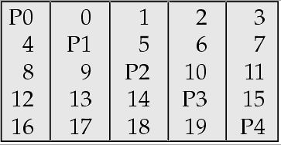
RAID Levels (Cont.)
RAID Level 5: Block-Interleaved Distributed Parity; partitions data and parity among all N + 1 disks, rather than storing data in N disks and parity in 1 disk.
  E.g., with 5 disks, parity block for nth set of blocks is stored on disk (n mod 5) + 1, with the data blocks stored on the other 4 disks.

Slide 32
RAID Levels (Cont.)
RAID Level 5 (Cont.)
  Higher I/O rates than Level 4.
    Block writes occur in parallel if the blocks and their parity blocks are on different disks.
  Subsumes Level 4: provides same benefits, but avoids bottleneck of parity disk.
RAID Level 6: P+Q Redundancy scheme; similar to Level 5, but stores extra redundant information to guard against multiple disk failures.
  Better reliability than Level 5 at a higher cost; not used as widely.

Slide 33
Choice of RAID Level
Factors in choosing RAID level
  Monetary cost
  Performance: Number of I/O operations per second, and bandwidth during normal operation
  Performance during failure
  Performance during rebuild of failed disk
    Including time taken to rebuild failed disk
RAID 0 is used only when data safety is not important
  E.g. data can be recovered quickly from other sources
Level 2 and 4 never used since they are subsumed by 3 and 5
Level 3 is not used since bit-striping forces single block reads to access all disks, wasting disk arm movement
Level 6 is rarely used since levels 1 and 5 offer adequate safety for most applications
So competition is mainly between 1 and 5

Slide 34
Choice of RAID Level (Cont.)
Level 1 provides much better write performance than level 5
  Level 5 requires at least 2 block reads and 2 block writes to write a single block, whereas Level 1 only requires 2 block writes
  Level 1 preferred for high update environments such as log disks
Level 1 had higher storage cost than level 5
  disk drive capacities increasing rapidly (50%/year) whereas disk access times have decreased much less (x 3 in 10 years)
  I/O requirements have increased greatly, e.g. for Web servers
  When enough disks have been bought to satisfy required rate of I/O, they often have spare storage capacity
    so there is often no extra monetary cost for Level 1!
Level 5 is preferred for applications with low update rate,
and large amounts of data
Level 1 is preferred for all other applications

Slide 35
Hardware Issues
Software RAID: RAID implementations done entirely in software, with no special hardware support
Hardware RAID: RAID implementations with special hardware
  Use non-volatile RAM to record writes that are being executed
  Beware: power failure during write can result in corrupted disk
    E.g. failure after writing one block but before writing the second in a mirrored system
    Such corrupted data must be detected when power is restored
      Recovery from corruption is similar to recovery from failed disk
      NV-RAM helps to efficiently detected potentially corrupted blocks
        Otherwise all blocks of disk must be read and compared with mirror/parity block

Slide 36
Hardware Issues (Cont.)
Hot swapping: replacement of disk while system is running, without power down
  Supported by some hardware RAID systems,
  reduces time to recovery, and improves availability greatly
Many systems maintain spare disks which are kept online, and used as replacements for failed disks immediately on detection of failure
  Reduces time to recovery greatly
Many hardware RAID systems ensure that a single point of failure will not stop the functioning of the system by using
  Redundant power supplies with battery backup
  Multiple controllers and multiple interconnections to guard against controller/interconnection failures

Slide 37
RAID Terminology in the Industry
RAID terminology not very standard in the industry
  E.g. Many vendors use
    RAID 1: for mirroring without striping
    RAID 10 or RAID 1+0: for mirroring with striping
  “Hardware RAID” implementations often just offload RAID processing onto a separate subsystem, but don’t offer NVRAM.
    Read the specs carefully!
Software RAID supported directly in most operating systems today

Slide 38
Storage Access
A database file is partitioned into fixed-length storage units called blocks. Blocks are units of both storage allocation and data transfer.
Database system seeks to minimize the number of block transfers between the disk and memory. We can reduce the number of disk accesses by keeping as many blocks as possible in main memory.
Buffer – portion of main memory available to store copies of disk blocks.
Buffer manager – subsystem responsible for allocating buffer space in main memory.

Slide 39
Buffer Manager
Programs call on the buffer manager when they need a block from disk.
Buffer manager does the following:
  If the block is already in the buffer, return the address of the block in main memory
  If the block is not in the buffer
    Allocate space in the buffer for the block
      Replacing (throwing out) some other block, if required, to make space for the new block.
      Replaced block written back to disk only if it was modified since the most recent time that it was written to/fetched from the disk.
    Read the block from the disk to the buffer, and return the address of the block in main memory to requester.

Slide 40
Buffer-Replacement Policies
Most operating systems replace the block least recently used (LRU strategy)
Idea behind LRU – use past pattern of block references as a predictor of future references
Queries have well-defined access patterns (such as sequential scans), and a database system can use the information in a user’s query to predict future references
  LRU can be a bad strategy for certain access patterns involving repeated scans of data
    e.g. when computing the join of 2 relations r and s by a nested loops
    for each tuple tr of r do
    for each tuple ts of s do
    if the tuples tr and ts match …
  Mixed strategy with hints on replacement strategy provided
  by the query optimizer is preferable

Slide 41
Buffer-Replacement Policies (Cont.)
Pinned block – memory block that is not allowed to be written back to disk.
Toss-immediate strategy – frees the space occupied by a block as soon as the final tuple of that block has been processed
Most recently used (MRU) strategy – system must pin the block currently being processed. After the final tuple of that block has been processed, the block is unpinned, and it becomes the most recently used block.
Buffer manager can use statistical information regarding the probability that a request will reference a particular relation
  E.g., the data dictionary is frequently accessed. Heuristic: keep data-dictionary blocks in main memory buffer
Buffer managers also support forced output of blocks for the purpose of recovery (more in Chapter 17)

Slide 42
File Organization
The database is stored as a collection of files. Each file is a sequence of records. A record is a sequence of fields.
One approach:
  assume record size is fixed
  each file has records of one particular type only
  different files are used for different relations
  This case is easiest to implement; will consider variable length records later.

Slide 43
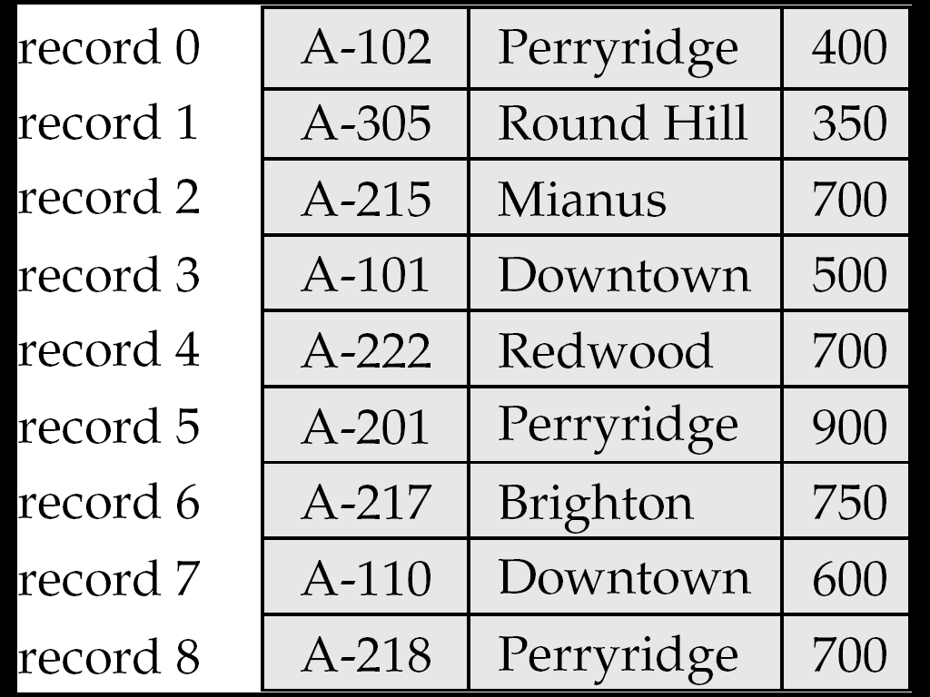
Fixed-Length Records
Simple approach:
  Store record i starting from byte n ∗ (i – 1), where n is the size of each record.
  Record access is simple but records may cross blocks
    Modification: do not allow records to cross block boundaries
Deletion of record i:
alternatives:
  move records i + 1, . . ., n
  to i, . . . , n – 1
  move record n to i
  do not move records, but
  link all free records on a
  free list

Slide 44
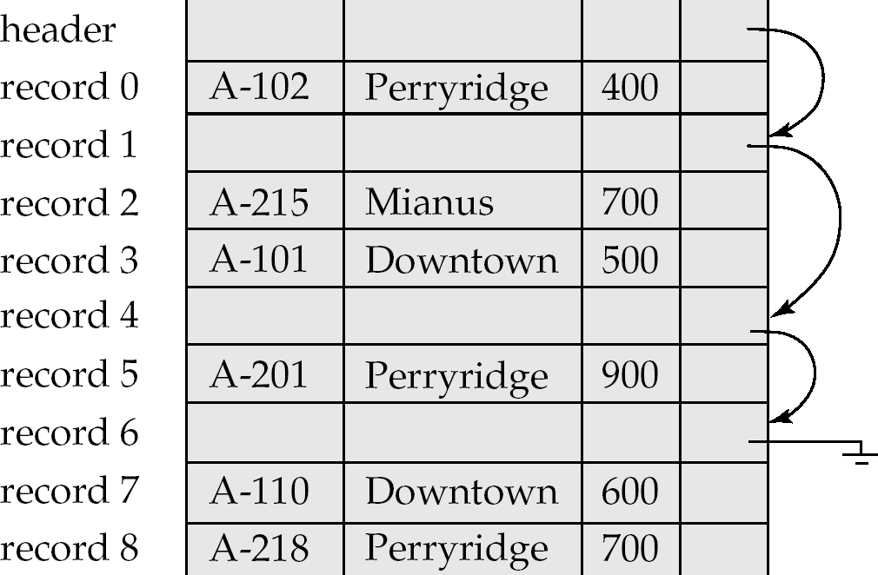
Free Lists
Store the address of the first deleted record in the file header.
Use this first record to store the address of the second deleted record, and so on
Can think of these stored addresses as pointers since they “point” to the location of a record.
More space efficient representation: reuse space for normal attributes of free records to store pointers. (No pointers stored in in-use records.)

Slide 45
Variable-Length Records
Variable-length records arise in database systems in several ways:
  Storage of multiple record types in a file.
  Record types that allow variable lengths for one or more fields.
  Record types that allow repeating fields (used in some older data models).

Slide 46
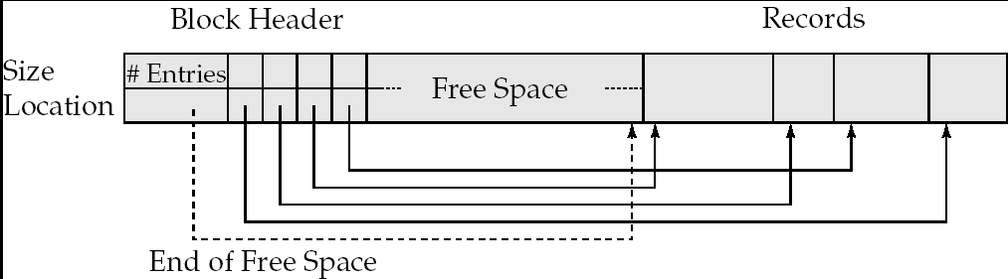
Variable-Length Records: Slotted Page Structure
Slotted page header contains:
  number of record entries
  end of free space in the block
  location and size of each record
Records can be moved around within a page to keep them contiguous with no empty space between them; entry in the header must be updated.
Pointers should not point directly to record — instead they should point to the entry for the record in header.

Slide 47
Organization of Records in Files
Heap – a record can be placed anywhere in the file where there is space
Sequential – store records in sequential order, based on the value of the search key of each record
Hashing – a hash function computed on some attribute of each record; the result specifies in which block of the file the record should be placed
Records of each relation may be stored in a separate file. In a multitable clustering file organization records of several different relations can be stored in the same file
  Motivation: store related records on the same block to minimize I/O

Slide 48
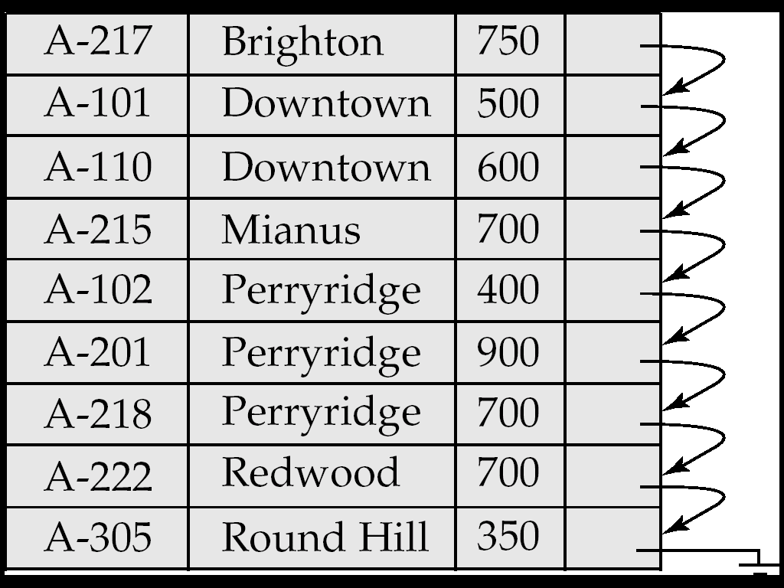
Sequential File Organization
Suitable for applications that require sequential processing of the entire file
The records in the file are ordered by a search-key

Slide 49
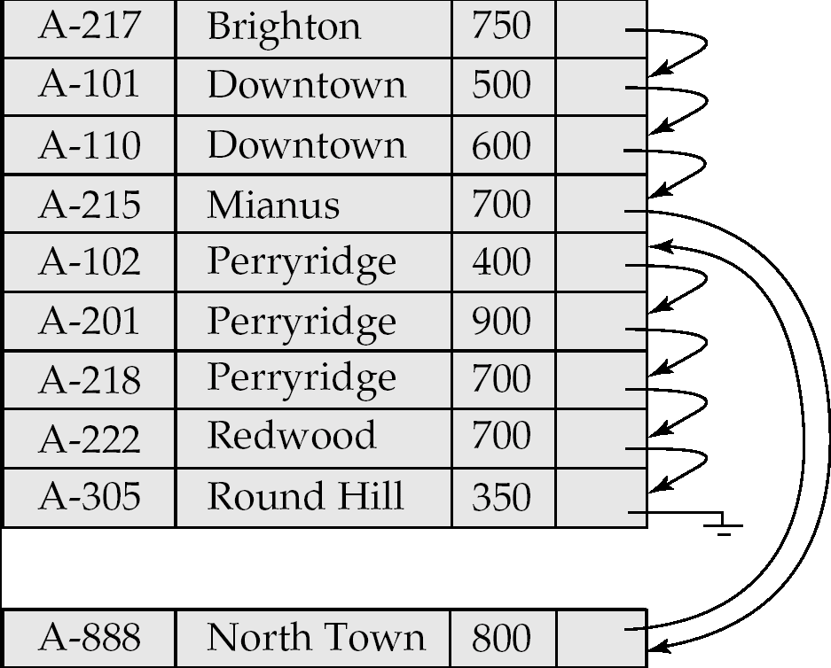
Sequential File Organization (Cont.)
Deletion – use pointer chains
Insertion –locate the position where the record is to be inserted
  if there is free space insert there
  if no free space, insert the record in an overflow block
  In either case, pointer chain must be updated
Need to reorganize the file
from time to time to restore
sequential order

Slide 50
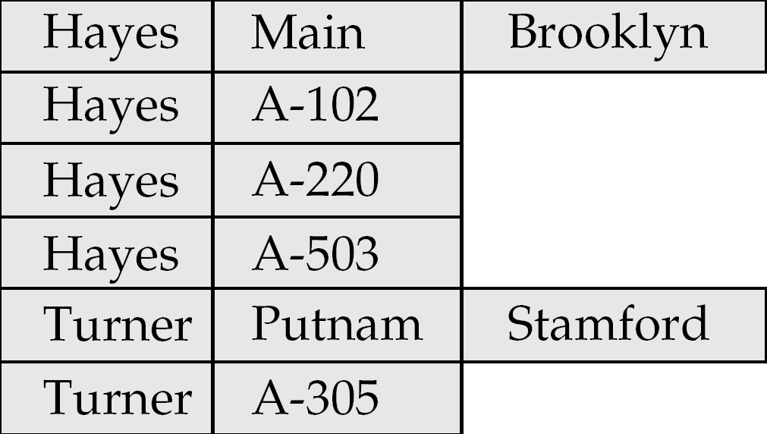
Multitable Clustering File Organization (cont.)
Store several relations in one file using a multitable clustering file organization
Multitable clustering organization of customer and depositor:
  good for queries involving depositor customer, and for queries involving one single customer and his accounts
  bad for queries involving only customer

Slide 51
Data Dictionary Storage
Data dictionary (also called system catalog) stores metadata: that is, data about data, such as
Information about relations
  names of relations
  names and types of attributes of each relation
  names and definitions of views
  integrity constraints
User and accounting information, including passwords
Statistical and descriptive data
  number of tuples in each relation
Physical file organization information
  How relation is stored (sequential/hash/…)
  Physical location of relation
Information about indices (Chapter 12)

Slide 52
Data Dictionary Storage (Cont.)
Catalog structure
  Relational representation on disk
  specialized data structures designed for efficient access, in memory
A possible catalog representation:
Relation_metadata = (relation_name, number_of_attributes,
storage_organization, location)
Attribute_metadata = (relation_name, attribute_name, domain_type,
position, length)
User_metadata = (user_name, encrypted_password, group)
Index_metadata = (relation_name, index_name, index_type,
index_attributes)
View_metadata = (view_name, definition)

Slide 53
Indexing and Hashing

Slide 54
Basic Concepts
Indexing mechanisms used to speed up access to desired data.
  E.g., author catalog in library
Search Key - attribute to set of attributes used to look up records in a file.
An index file consists of records (called index entries) of the form
Index files are typically much smaller than the original file
Two basic kinds of indices:
  Ordered indices: search keys are stored in sorted order
  Hash indices: search keys are distributed uniformly across “buckets” using a “hash function”.
search-key
pointer

Slide 55
Index Evaluation Metrics
Access types supported efficiently. E.g.,
  records with a specified value in the attribute
  or records with an attribute value falling in a specified range of values (e.g. 10000 < salary < 40000)
Access time
Insertion time
Deletion time
Space overhead

Slide 56
Ordered Indices
In an ordered index, index entries are stored sorted on the search key value. E.g., author catalog in library.
Primary index: in a sequentially ordered file, the index whose search key specifies the sequential order of the file.
  Also called clustering index
  The search key of a primary index is usually but not necessarily the primary key.
Secondary index: an index whose search key specifies an order different from the sequential order of the file. Also called
non-clustering index.
Index-sequential file: ordered sequential file with a primary index.

Slide 57
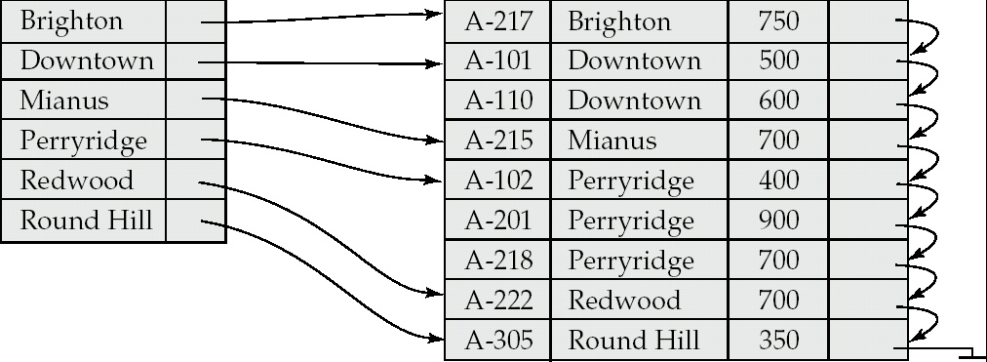
Dense Index Files
Dense index — Index record appears for every search-key value in the file.

Slide 58
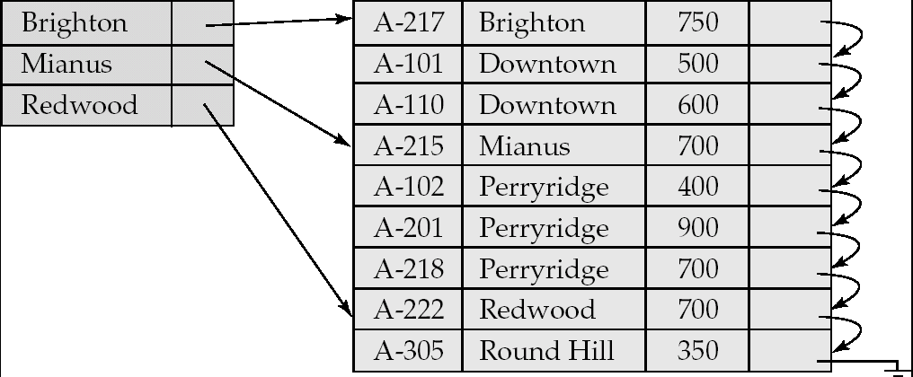
Sparse Index Files
Sparse Index: contains index records for only some search-key values.
  Applicable when records are sequentially ordered on search-key
To locate a record with search-key value K we:
  Find index record with largest search-key value < K
  Search file sequentially starting at the record to which the index record points

Slide 59
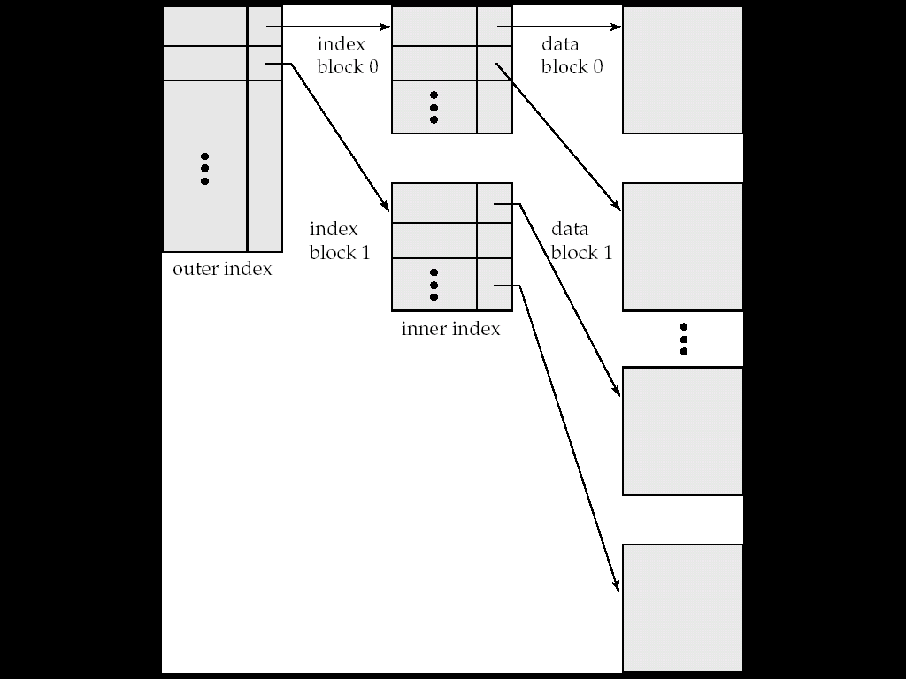
Sparse Index Files (Cont.)
Compared to dense indices:
  Less space and less maintenance overhead for insertions and deletions.
  Generally slower than dense index for locating records.
Good tradeoff: sparse index with an index entry for every block in file, corresponding to least search-key value in the block.

Slide 60
Multilevel Index
If primary index does not fit in memory, access becomes expensive.
Solution: treat primary index kept on disk as a sequential file and construct a sparse index on it.
  outer index – a sparse index of primary index
  inner index – the primary index file
If even outer index is too large to fit in main memory, yet another level of index can be created, and so on.
Indices at all levels must be updated on insertion or deletion from the file.

Slide 61
Multilevel Index (Cont.)

Slide 62
Index Update: Record Deletion
If deleted record was the only record in the file with its particular search-key value, the search-key is deleted from the index also.
Single-level index deletion:
  Dense indices – deletion of search-key: similar to file record deletion.
  Sparse indices –
    if deleted key value exists in the index, the value is replaced by the next search-key value in the file (in search-key order).
    If the next search-key value already has an index entry, the entry is deleted instead of being replaced.

Slide 63
Index Update: Record Insertion
Single-level index insertion:
  Perform a lookup using the key value from inserted record
  Dense indices – if the search-key value does not appear in the index, insert it.
  Sparse indices – if index stores an entry for each block of the file, no change needs to be made to the index unless a new block is created.
    If a new block is created, the first search-key value appearing in the new block is inserted into the index.
Multilevel insertion (as well as deletion) algorithms are simple extensions of the single-level algorithms

Slide 64
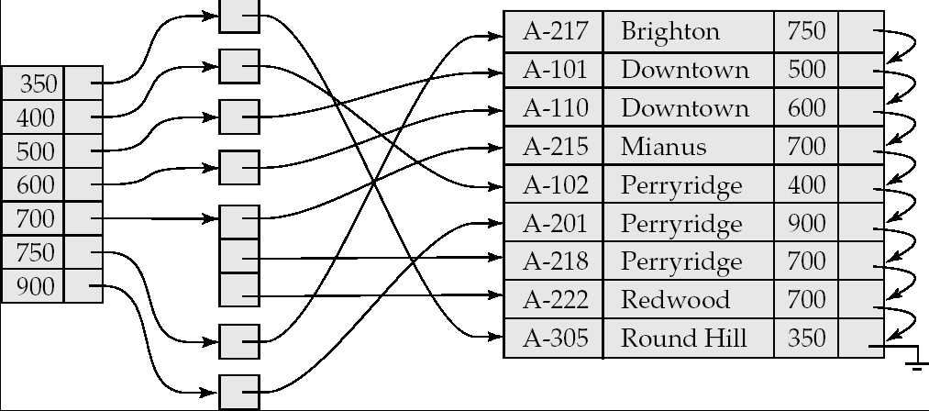
Secondary Indices Example
Secondary index on balance field of account
Index record points to a bucket that contains pointers to all the actual records with that particular search-key value.
Secondary indices have to be dense

Slide 65
Primary and Secondary Indices
Indices offer substantial benefits when searching for records.
BUT: Updating indices imposes overhead on database modification --when a file is modified, every index on the file must be updated,
Sequential scan using primary index is efficient, but a sequential scan using a secondary index is expensive
  Each record access may fetch a new block from disk
  Block fetch requires about 5 to 10 micro seconds, versus about 100 nanoseconds for memory access

Slide 66
B⁺-Tree Index Files
B⁺-tree indices are an alternative to indexed-sequential files.
Disadvantage of indexed-sequential files
  performance degrades as file grows, since many overflow blocks get created.
  Periodic reorganization of entire file is required.
Advantage of B⁺-tree index files:
  automatically reorganizes itself with small, local, changes, in the face of insertions and deletions.
  Reorganization of entire file is not required to maintain performance.
(Minor) disadvantage of B⁺-trees:
  extra insertion and deletion overhead, space overhead.
Advantages of B⁺-trees outweigh disadvantages
  B⁺-trees are used extensively

Slide 67
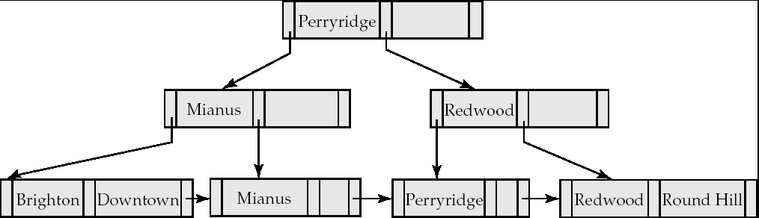
B⁺-Tree Index Files (Cont.)
A B⁺-tree is a rooted tree satisfying the following properties:
All paths from root to leaf are of the same length
Each node that is not a root or a leaf has between ⎡n/2⎤ and n children.
A leaf node has between ⎡(n–1)/2⎤ and n–1 values
Special cases:
  If the root is not a leaf, it has at least 2 children.
  If the root is a leaf (that is, there are no other nodes in the tree), it can have between 0 and (n–1) values.

Slide 68
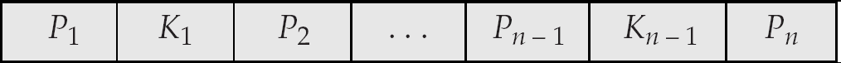
B⁺-Tree Node Structure
Typical node
  K_{i} are the search-key values
  P_{i} are pointers to children (for non-leaf nodes) or pointers to records or buckets of records (for leaf nodes).
The search-keys in a node are ordered
K₁ < K₂ < K₃ < . . . < K_{n–1}

Slide 69
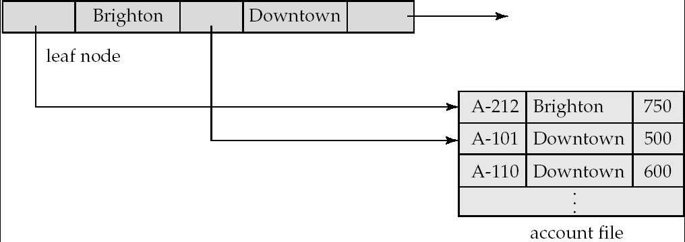
Leaf Nodes in B⁺-Trees
Properties of a leaf node:
For i = 1, 2, . . ., n–1, pointer P_{i} either points to a file record with search-key value K_{i}, or to a bucket of pointers to file records, each record having search-key value K_{i}. Only need bucket structure if search-key does not form a primary key.
If L_{i}, L_{j} are leaf nodes and i < j, L_{i}’s search-key values are less than L_{j}’s search-key values
P_{n} points to next leaf node in search-key order

Slide 70
Non-Leaf Nodes in B⁺-Trees
Non leaf nodes form a multi-level sparse index on the leaf nodes. For a non-leaf node with m pointers:
  All the search-keys in the subtree to which P₁ points are less than K₁
  For 2 ≤ i ≤ n – 1, all the search-keys in the subtree to which P_{i} points have values greater than or equal to K_{i–1} and less than K_{i}
  All the search-keys in the subtree to which P_{n} points have values greater than or equal to K_{n–1}

Slide 71
Example of a B⁺-tree
B⁺-tree for account file (n = 3)

Slide 72
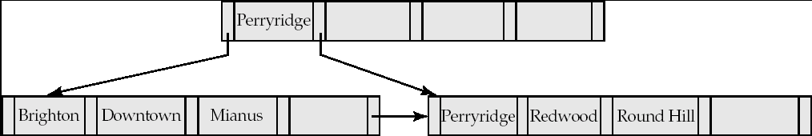
Example of B⁺-tree
B⁺-tree for account file (n = 5)
Leaf nodes must have between 2 and 4 values
(⎡(n–1)/2⎤ and n –1, with n = 5).
Non-leaf nodes other than root must have between 3 and 5 children (⎡(n/2⎤ and n with n =5).
Root must have at least 2 children.

Slide 73
Observations about B⁺-trees
Since the inter-node connections are done by pointers, “logically” close blocks need not be “physically” close.
The non-leaf levels of the B⁺-tree form a hierarchy of sparse indices.
The B⁺-tree contains a relatively small number of levels
    Level below root has at least 2* ⎡n/2⎤ values
    Next level has at least 2* ⎡n/2⎤ * ⎡n/2⎤ values
    .. etc.
  If there are K search-key values in the file, the tree height is no more than ⎡ log_{⎡n/2⎤}(K)⎤
  thus searches can be conducted efficiently.
Insertions and deletions to the main file can be handled efficiently, as the index can be restructured in logarithmic time (as we shall see).

Slide 74
Queries on B⁺-Trees
Find all records with a search-key value of k.
  N=root
  Repeat
    Examine N for the smallest search-key value > k.
    If such a value exists, assume it is K_{i}. Then set N = P_{i}
    Otherwise k ≥ K_{n–1}. Set N = P_{n}
    Until N is a leaf node
  If for some i, key K_{i} = k follow pointer P_{i} to the desired record or bucket.
  Else no record with search-key value k exists.

Slide 75
Queries on B⁺⁻Trees (Cont.)
If there are K search-key values in the file, the height of the tree is no more than ⎡log_{⎡n/2⎤}(K)⎤.
A node is generally the same size as a disk block, typically 4 kilobytes
  and n is typically around 100 (40 bytes per index entry).
With 1 million search key values and n = 100
  at most log₅₀(1,000,000) = 4 nodes are accessed in a lookup.
Contrast this with a balanced binary tree with 1 million search key values — around 20 nodes are accessed in a lookup
  above difference is significant since every node access may need a disk I/O, costing around 20 milliseconds

Slide 76
Updates on B⁺-Trees: Insertion
Find the leaf node in which the search-key value would appear
If the search-key value is already present in the leaf node
  Add record to the file
If the search-key value is not present, then
  add the record to the main file (and create a bucket if necessary)
  If there is room in the leaf node, insert (key-value, pointer) pair in the leaf node
  Otherwise, split the node (along with the new (key-value, pointer) entry) as discussed in the next slide.

Slide 77
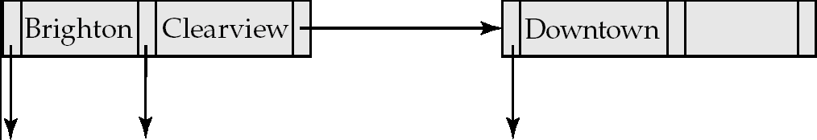
Updates on B⁺-Trees: Insertion (Cont.)
Splitting a leaf node:
  take the n (search-key value, pointer) pairs (including the one being inserted) in sorted order. Place the first ⎡n/2⎤ in the original node, and the rest in a new node.
  let the new node be p, and let k be the least key value in p. Insert (k,p) in the parent of the node being split.
  If the parent is full, split it and propagate the split further up.
Splitting of nodes proceeds upwards till a node that is not full is found.
  In the worst case the root node may be split increasing the height of the tree by 1.
Result of splitting node containing Brighton and Downtown on inserting Clearview
Next step: insert entry with (Downtown,pointer-to-new-node) into parent

Slide 78

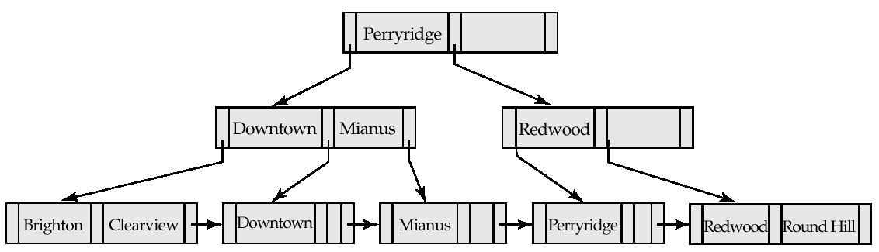
Updates on B⁺-Trees: Insertion (Cont.)
B⁺-Tree before and after insertion of “Clearview”

Slide 79
Insertion in B⁺-Trees (Cont.)
Splitting a non-leaf node: when inserting (k,p) into an already full internal node N
  Copy N to an in-memory area M with space for n+1 pointers and n keys
  Insert (k,p) into M
  Copy P₁,K₁, …, K _{⎡n/2⎤-1},P _{⎡n/2⎤} from M back into node N
  Copy P_{⎡n/2⎤+1},K _{⎡n/2⎤+1},…,K_{n},P_{n+1} from M into newly allocated node N’
  Insert (K _{⎡n/2⎤},N’) into parent N
Read pseudocode in book!
Mianus
Downtown Mianus Perryridge
Downtown
Redwood

Slide 80
Updates on B⁺-Trees: Deletion
Find the record to be deleted, and remove it from the main file and from the bucket (if present)
Remove (search-key value, pointer) from the leaf node if there is no bucket or if the bucket has become empty
If the node has too few entries due to the removal, and the entries in the node and a sibling fit into a single node, then merge siblings:
  Insert all the search-key values in the two nodes into a single node (the one on the left), and delete the other node.
  Delete the pair (K_{i–1}, P_{i}), where P_{i} is the pointer to the deleted node, from its parent, recursively using the above procedure.

Slide 81
Updates on B⁺-Trees: Deletion
Otherwise, if the node has too few entries due to the removal, but the entries in the node and a sibling do not fit into a single node, then redistribute pointers:
  Redistribute the pointers between the node and a sibling such that both have more than the minimum number of entries.
  Update the corresponding search-key value in the parent of the node.
The node deletions may cascade upwards till a node which has ⎡n/2⎤ or more pointers is found.
If the root node has only one pointer after deletion, it is deleted and the sole child becomes the root.

Slide 82

Examples of B⁺-Tree Deletion
Before and after deleting “Downtown”
Deleting “Downtown” causes merging of under-full leaves
  leaf node can become empty only for n=3!

Slide 83
B⁺-Tree File Organization
Index file degradation problem is solved by using B⁺-Tree indices.
Data file degradation problem is solved by using B⁺-Tree File Organization.
The leaf nodes in a B⁺-tree file organization store records, instead of pointers.
Leaf nodes are still required to be half full
  Since records are larger than pointers, the maximum number of records that can be stored in a leaf node is less than the number of pointers in a nonleaf node.
Insertion and deletion are handled in the same way as insertion and deletion of entries in a B⁺-tree index.

Slide 84
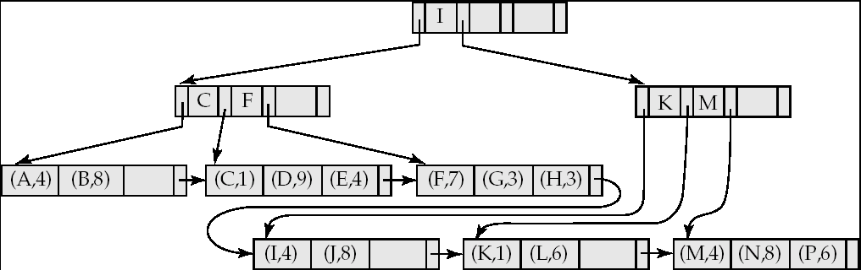

B⁺-Tree File Organization (Cont.)
Example of B⁺-tree File Organization
Good space utilization important since records use more space than pointers.
To improve space utilization, involve more sibling nodes in redistribution during splits and merges
  Involving 2 siblings in redistribution (to avoid split / merge where possible) results in each node having at least entries

Slide 85
Indexing Strings
Variable length strings as keys
  Variable fanout
  Use space utilization as criterion for splitting, not number of pointers
Prefix compression
  Key values at internal nodes can be prefixes of full key
    Keep enough characters to distinguish entries in the subtrees separated by the key value
      E.g. “Silas” and “Silberschatz” can be separated by “Silb”
  Keys in leaf node can be compressed by sharing common prefixes

Slide 86
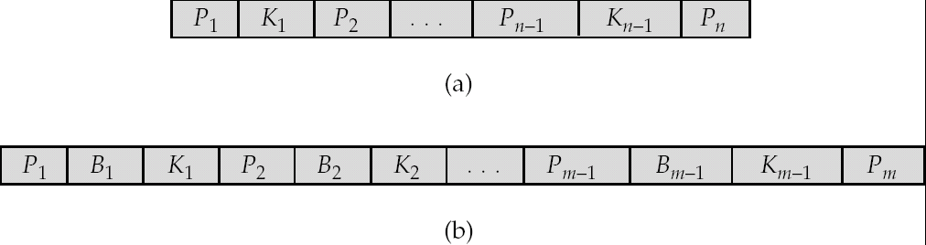
B-Tree Index Files
Similar to B+-tree, but B-tree allows search-key values to appear only once; eliminates redundant storage of search keys.
Search keys in nonleaf nodes appear nowhere else in the B-tree; an additional pointer field for each search key in a nonleaf node must be included.
Generalized B-tree leaf node
Nonleaf node – pointers Bi are the bucket or file record pointers.

Slide 87
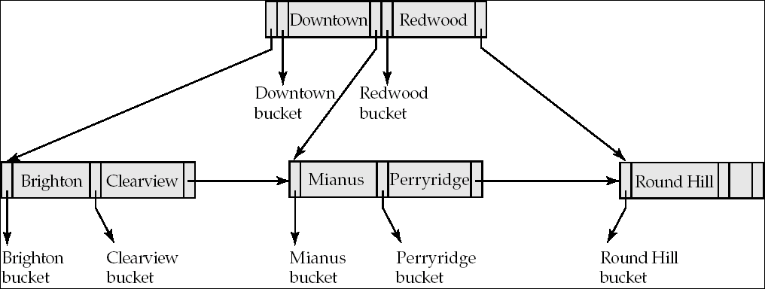
B-Tree Index File Example
B-tree (above) and B+-tree (below) on same data

Slide 88
B-Tree Index Files (Cont.)
Advantages of B-Tree indices:
  May use less tree nodes than a corresponding B⁺-Tree.
  Sometimes possible to find search-key value before reaching leaf node.
Disadvantages of B-Tree indices:
  Only small fraction of all search-key values are found early
  Non-leaf nodes are larger, so fan-out is reduced. Thus, B-Trees typically have greater depth than corresponding B⁺-Tree
  Insertion and deletion more complicated than in B⁺-Trees
  Implementation is harder than B⁺-Trees.
Typically, advantages of B-Trees do not out weigh disadvantages.

Slide 89
Multiple-Key Access
Use multiple indices for certain types of queries.
Example:
  select account_number
  from account
  where branch_name = “Perryridge” and balance = 1000
Possible strategies for processing query using indices on single attributes:
  1. Use index on branch_name to find accounts with branch name Perryridge; test balance = 1000
  2. Use index on balance to find accounts with balances of $1000; test branch_name = “Perryridge”.
  3. Use branch_name index to find pointers to all records pertaining to the Perryridge branch. Similarly use index on balance. Take intersection of both sets of pointers obtained.

Slide 90
Indices on Multiple Keys
Composite search keys are search keys containing more than one attribute
  E.g. (branch_name, balance)
Lexicographic ordering: (a₁, a₂) < (b₁, b₂) if either
  a₁ < b₁, or
  a₁=b₁ and a₂ < b₂

Slide 91
Indices on Multiple Attributes
Suppose we have an index on combined search-key
(branch_name, balance).
For
where branch_name = “Perryridge” and balance = 1000
the index on (branch_name, balance) can be used to fetch only records that satisfy both conditions.
  Using separate indices in less efficient — we may fetch many records (or pointers) that satisfy only one of the conditions.
Can also efficiently handle
where branch_name = “Perryridge” and balance < 1000
But cannot efficiently handle
where branch_name < “Perryridge” and balance = 1000
  May fetch many records that satisfy the first but not the second condition

Slide 92
Non-Unique Search Keys
Alternatives:
  Buckets on separate block (bad idea)
  List of tuple pointers with each key
    Low space overhead, no extra cost for queries
    Extra code to handle read/update of long lists
    Deletion of a tuple can be expensive if there are many duplicates on search key (why?)
  Make search key unique by adding a record-identifier
    Extra storage overhead for keys
    Simpler code for insertion/deletion
    Widely used

Slide 93
Other Issues in Indexing
Covering indices
  Add extra attributes to index so (some) queries can avoid fetching the actual records
    Particularly useful for secondary indices
      Why?
  Can store extra attributes only at leaf
Record relocation and secondary indices
  If a record moves, all secondary indices that store record pointers have to be updated
  Node splits in B⁺-tree file organizations become very expensive
  Solution: use primary-index search key instead of record pointer in secondary index
    Extra traversal of primary index to locate record
      Higher cost for queries, but node splits are cheap
    Add record-id if primary-index search key is non-unique

Slide 94
Hashing

Slide 95
Static Hashing
A bucket is a unit of storage containing one or more records (a bucket is typically a disk block).
In a hash file organization we obtain the bucket of a record directly from its search-key value using a hash function.
Hash function h is a function from the set of all search-key values K to the set of all bucket addresses B.
Hash function is used to locate records for access, insertion as well as deletion.
Records with different search-key values may be mapped to the same bucket; thus entire bucket has to be searched sequentially to locate a record.

Slide 96
Example of Hash File Organization
Hash file organization of account file, using branch_name as key
(See figure in next slide.)
There are 10 buckets,
The binary representation of the ith character is assumed to be the integer i.
The hash function returns the sum of the binary representations of the characters modulo 10
  E.g. h(Perryridge) = 5 h(Round Hill) = 3 h(Brighton) = 3

Slide 97
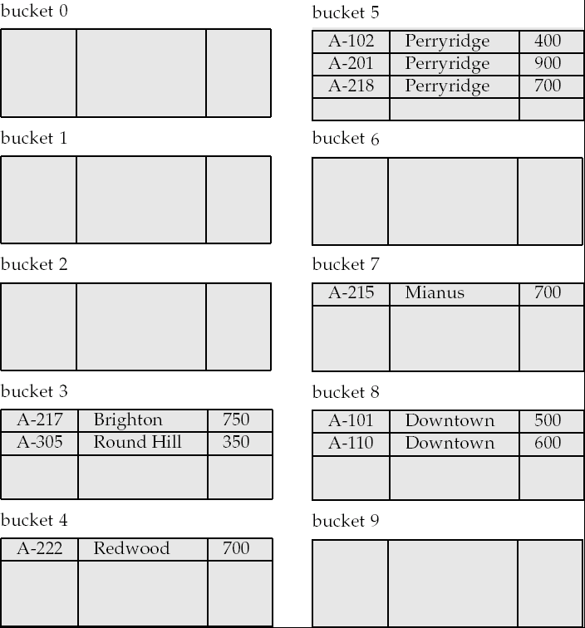
Example of Hash File Organization
Hash file organization of account file, using branch_name as key
(see previous slide for details).

Slide 98
Hash Functions
Worst hash function maps all search-key values to the same bucket; this makes access time proportional to the number of search-key values in the file.
An ideal hash function is uniform, i.e., each bucket is assigned the same number of search-key values from the set of all possible values.
Ideal hash function is random, so each bucket will have the same number of records assigned to it irrespective of the actual distribution of search-key values in the file.
Typical hash functions perform computation on the internal binary representation of the search-key.
  For example, for a string search-key, the binary representations of all the characters in the string could be added and the sum modulo the number of buckets could be returned. .

Slide 99
Handling of Bucket Overflows
Bucket overflow can occur because of
  Insufficient buckets
  Skew in distribution of records. This can occur due to two reasons:
    multiple records have same search-key value
    chosen hash function produces non-uniform distribution of key values
Although the probability of bucket overflow can be reduced, it cannot be eliminated; it is handled by using overflow buckets.

Slide 100
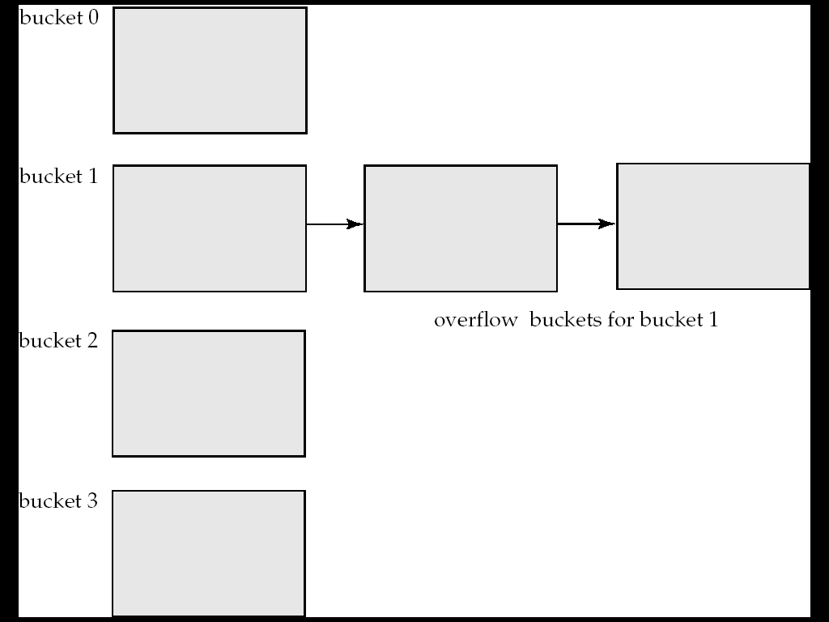
Handling of Bucket Overflows (Cont.)
Overflow chaining – the overflow buckets of a given bucket are chained together in a linked list.
Above scheme is called closed hashing.
  An alternative, called open hashing, which does not use overflow buckets, is not suitable for database applications.

Slide 101
Hash Indices
Hashing can be used not only for file organization, but also for index-structure creation.
A hash index organizes the search keys, with their associated record pointers, into a hash file structure.
Strictly speaking, hash indices are always secondary indices
  if the file itself is organized using hashing, a separate primary hash index on it using the same search-key is unnecessary.
  However, we use the term hash index to refer to both secondary index structures and hash organized files.

Slide 102
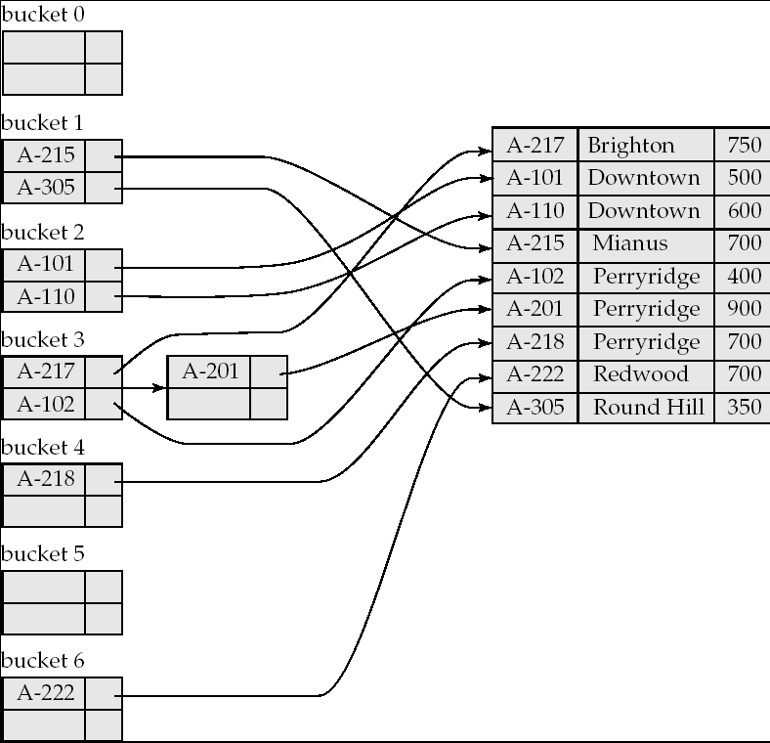
Example of Hash Index

Slide 103
Deficiencies of Static Hashing
In static hashing, function h maps search-key values to a fixed set of B of bucket addresses. Databases grow or shrink with time.
  If initial number of buckets is too small, and file grows, performance will degrade due to too much overflows.
  If space is allocated for anticipated growth, a significant amount of space will be wasted initially (and buckets will be underfull).
  If database shrinks, again space will be wasted.
One solution: periodic re-organization of the file with a new hash function
  Expensive, disrupts normal operations
Better solution: allow the number of buckets to be modified dynamically.

Slide 104
Dynamic Hashing
Good for database that grows and shrinks in size
Allows the hash function to be modified dynamically
Extendable hashing – one form of dynamic hashing
  Hash function generates values over a large range — typically b-bit integers, with b = 32.
  At any time use only a prefix of the hash function to index into a table of bucket addresses.
  Let the length of the prefix be i bits, 0 ≤ i ≤ 32.
    Bucket address table size = 2^{i.} Initially i = 0
    Value of i grows and shrinks as the size of the database grows and shrinks.
  Multiple entries in the bucket address table may point to a bucket (why?)
  Thus, actual number of buckets is < 2^{i}
    The number of buckets also changes dynamically due to coalescing and splitting of buckets.

Slide 105
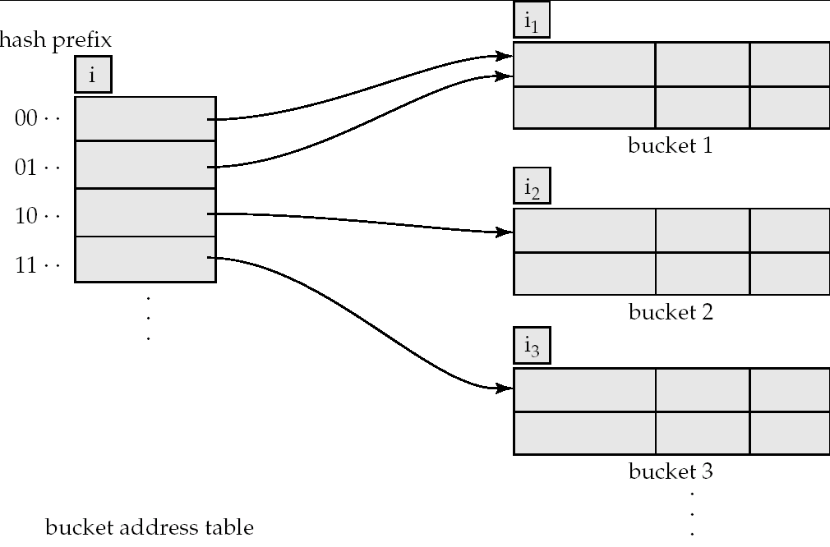
General Extendable Hash Structure
In this structure, i₂ = i₃ = i, whereas i₁ = i – 1 (see next slide for details)

Slide 106
Use of Extendable Hash Structure
Each bucket j stores a value i_{j}
  All the entries that point to the same bucket have the same values on the first i_{j} bits.
To locate the bucket containing search-key K_{j}:
  1. Compute h(K_{j}) = X
  2. Use the first i high order bits of X as a displacement into bucket address table, and follow the pointer to appropriate bucket
To insert a record with search-key value K_{j}
  follow same procedure as look-up and locate the bucket, say j.
  If there is room in the bucket j insert record in the bucket.
  Else the bucket must be split and insertion re-attempted (next slide.)
    Overflow buckets used instead in some cases (will see shortly)

Slide 107
Insertion in Extendable Hash Structure (Cont)
To split a bucket j when inserting record with search-key value K_{j}:
If i > i_{j} (more than one pointer to bucket j)
  allocate a new bucket z, and set i_{j} = i_{z} = (i_{j} + 1)
  Update the second half of the bucket address table entries originally pointing to j, to point to z
  remove each record in bucket j and reinsert (in j or z)
  recompute new bucket for K_{j} and insert record in the bucket (further splitting is required if the bucket is still full)
If i = i_{j} (only one pointer to bucket j)
  If i reaches some limit b, or too many splits have happened in this insertion, create an overflow bucket
  Else
    increment i and double the size of the bucket address table.
    replace each entry in the table by two entries that point to the same bucket.
    recompute new bucket address table entry for K_{j}
    Now i > i_{j} so use the first case above.

Slide 108
Deletion in Extendable Hash Structure
To delete a key value,
  locate it in its bucket and remove it.
  The bucket itself can be removed if it becomes empty (with appropriate updates to the bucket address table).
  Coalescing of buckets can be done (can coalesce only with a “buddy” bucket having same value of i_{j} and same i_{j} –1 prefix, if it is present)
  Decreasing bucket address table size is also possible
    Note: decreasing bucket address table size is an expensive operation and should be done only if number of buckets becomes much smaller than the size of the table

Slide 109
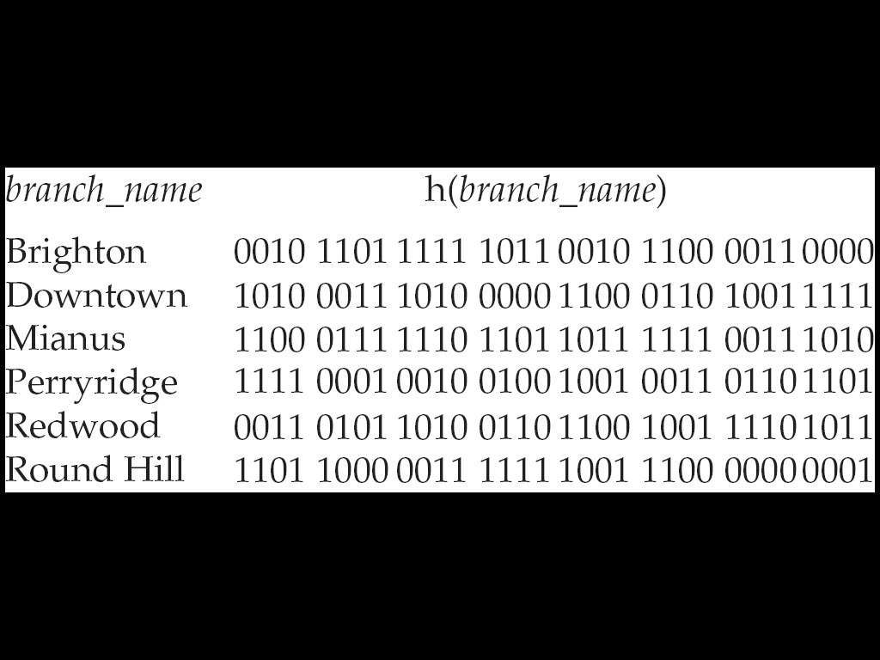
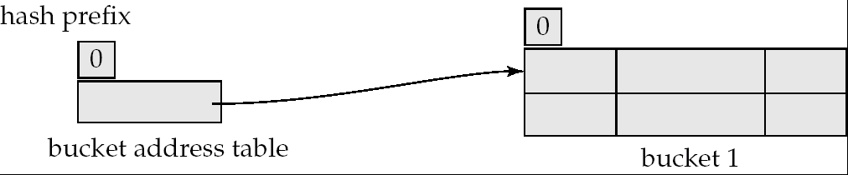
Use of Extendable Hash Structure: Example
Initial Hash structure, bucket size = 2

Slide 110
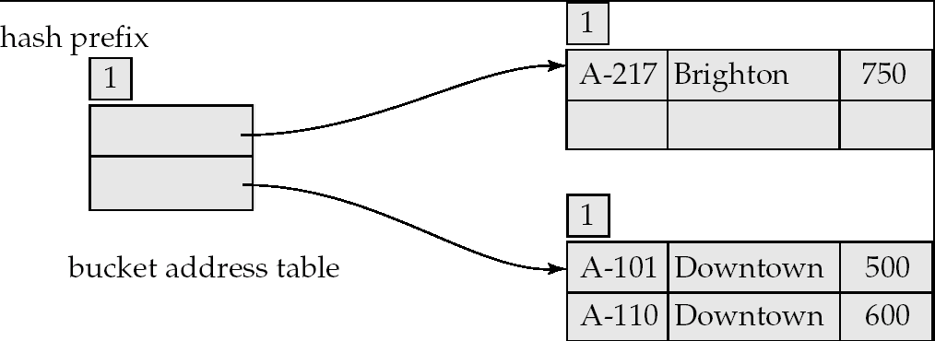
Example (Cont.)
Hash structure after insertion of one Brighton and two Downtown records

Slide 111
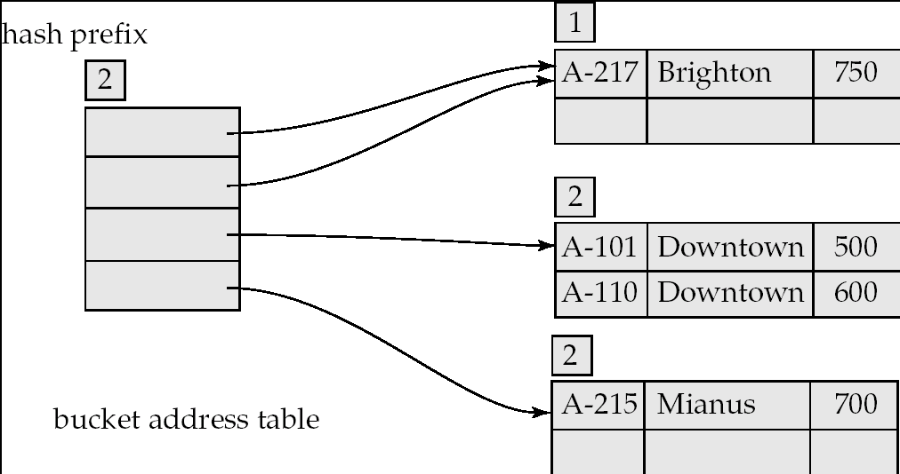
Example (Cont.)
Hash structure after insertion of Mianus record

Slide 112
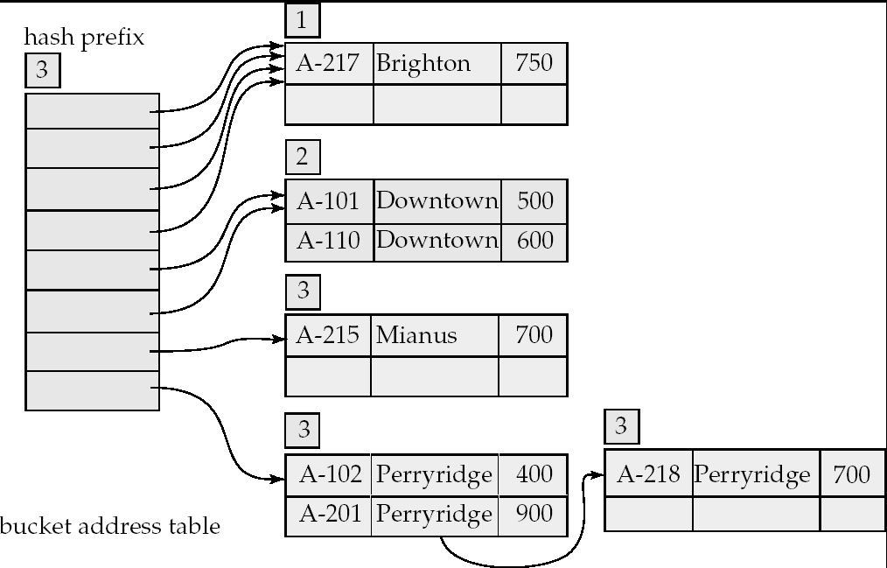
Example (Cont.)
Hash structure after insertion of three Perryridge records

Slide 113
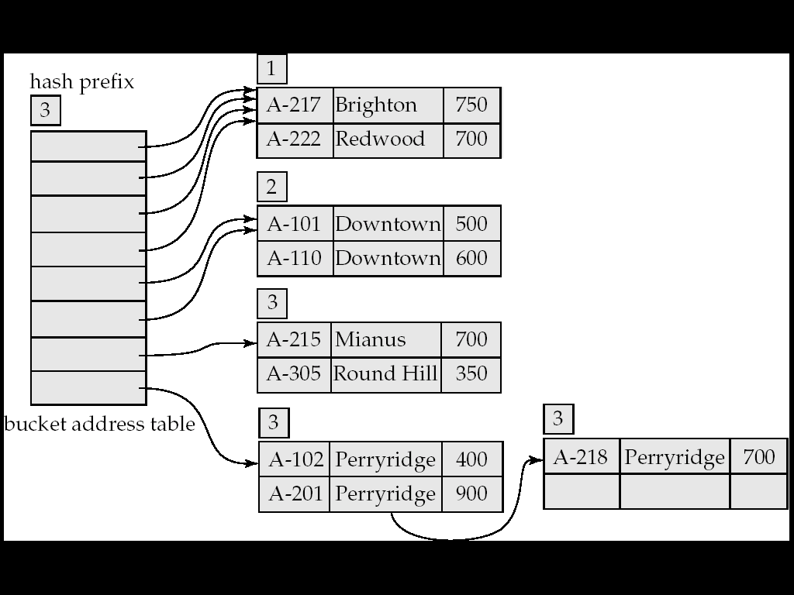
Example (Cont.)
Hash structure after insertion of Redwood and Round Hill records

Slide 114
Extendable Hashing vs. Other Schemes
Benefits of extendable hashing:
  Hash performance does not degrade with growth of file
  Minimal space overhead
Disadvantages of extendable hashing
  Extra level of indirection to find desired record
  Bucket address table may itself become very big (larger than memory)
    Cannot allocate very large contiguous areas on disk either
    Solution: B⁺-tree file organization to store bucket address table
  Changing size of bucket address table is an expensive operation
Linear hashing is an alternative mechanism
  Allows incremental growth of its directory (equivalent to bucket address table)
  At the cost of more bucket overflows

Slide 115
Comparison of Ordered Indexing and Hashing
Cost of periodic re-organization
Relative frequency of insertions and deletions
Is it desirable to optimize average access time at the expense of worst-case access time?
Expected type of queries:
  Hashing is generally better at retrieving records having a specified value of the key.
  If range queries are common, ordered indices are to be preferred
In practice:
  PostgreSQL supports hash indices, but discourages use due to poor performance
  Oracle supports static hash organization, but not hash indices
  SQLServer supports only B⁺-trees

Slide 116
Bitmap Indices
Bitmap indices are a special type of index designed for efficient querying on multiple keys
Records in a relation are assumed to be numbered sequentially from, say, 0
  Given a number n it must be easy to retrieve record n
    Particularly easy if records are of fixed size
Applicable on attributes that take on a relatively small number of distinct values
  E.g. gender, country, state, …
  E.g. income-level (income broken up into a small number of levels such as 0-9999, 10000-19999, 20000-50000, 50000- infinity)
A bitmap is simply an array of bits

Slide 117
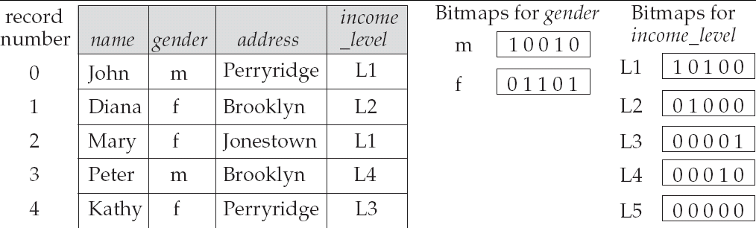
Bitmap Indices (Cont.)
In its simplest form a bitmap index on an attribute has a bitmap for each value of the attribute
  Bitmap has as many bits as records
  In a bitmap for value v, the bit for a record is 1 if the record has the value v for the attribute, and is 0 otherwise

Slide 118
Bitmap Indices (Cont.)
Bitmap indices are useful for queries on multiple attributes
  not particularly useful for single attribute queries
Queries are answered using bitmap operations
  Intersection (and)
  Union (or)
  Complementation (not)
Each operation takes two bitmaps of the same size and applies the operation on corresponding bits to get the result bitmap
  E.g. 100110 AND 110011 = 100010
  100110 OR 110011 = 110111
  NOT 100110 = 011001
  Males with income level L1: 10010 AND 10100 = 10000
    Can then retrieve required tuples.
    Counting number of matching tuples is even faster

Slide 119
Bitmap Indices (Cont.)
Bitmap indices generally very small compared with relation size
  E.g. if record is 100 bytes, space for a single bitmap is 1/800 of space used by relation.
    If number of distinct attribute values is 8, bitmap is only 1% of relation size
Deletion needs to be handled properly
  Existence bitmap to note if there is a valid record at a record location
  Needed for complementation
    not(A=v): (NOT bitmap-A-v) AND ExistenceBitmap
Should keep bitmaps for all values, even null value
  To correctly handle SQL null semantics for NOT(A=v):
    intersect above result with (NOT bitmap-A-Null)

Slide 120
Efficient Implementation of Bitmap Operations
Bitmaps are packed into words; a single word and (a basic CPU instruction) computes and of 32 or 64 bits at once
  E.g. 1-million-bit maps can be and-ed with just 31,250 instruction
Counting number of 1s can be done fast by a trick:
  Use each byte to index into a precomputed array of 256 elements each storing the count of 1s in the binary representation
    Can use pairs of bytes to speed up further at a higher memory cost
  Add up the retrieved counts
Bitmaps can be used instead of Tuple-ID lists at leaf levels of
B⁺-trees, for values that have a large number of matching records
  Worthwhile if > 1/64 of the records have that value, assuming a tuple-id is 64 bits
  Above technique merges benefits of bitmap and B⁺-tree indices

Slide 121
Index Definition in SQL
Create an index
  create index <index-name> on <relation-name>
  (<attribute-list>)
  E.g.: create index b-index on branch(branch_name)
Use create unique index to indirectly specify and enforce the condition that the search key is a candidate key is a candidate key.
  Not really required if SQL unique integrity constraint is supported
To drop an index
  drop index <index-name>
Most database systems allow specification of type of index, and clustering.

Slide 122
Query Processing

Slide 123
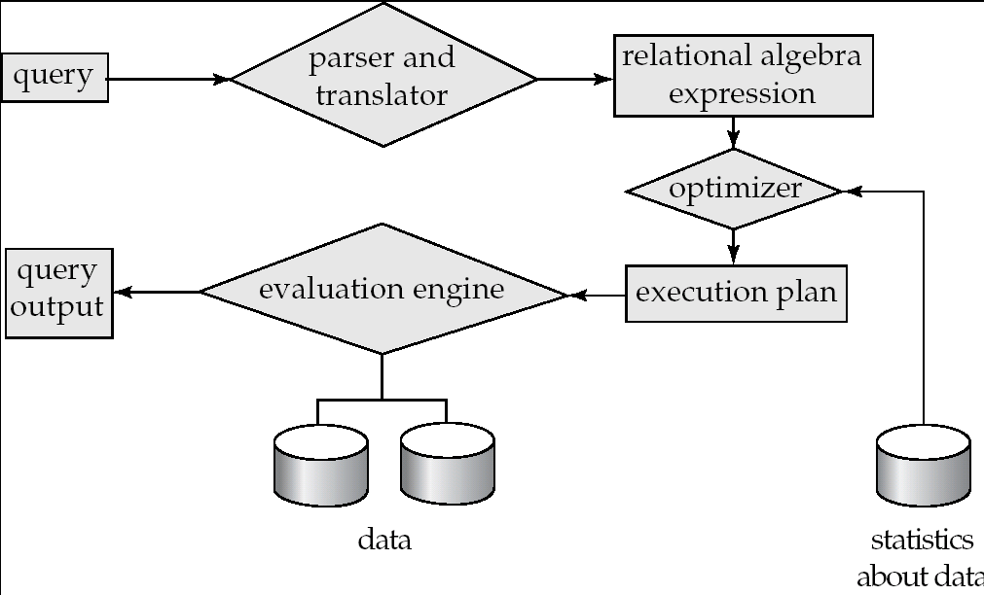
Basic Steps in Query Processing
1. Parsing and translation
2. Optimization
3. Evaluation

Slide 124
Basic Steps in Query Processing (Cont.)
Parsing and translation
  translate the query into its internal form. This is then translated into relational algebra.
  Parser checks syntax, verifies relations
Evaluation
  The query-execution engine takes a query-evaluation plan, executes that plan, and returns the answers to the query.

Slide 125
Basic Steps in Query Processing : Optimization
A relational algebra expression may have many equivalent expressions
  E.g., σ_{balance<2500}(∏_{balance}(account)) is equivalent to
  ∏_{balance}(σ_{balance<2500}(account))
Each relational algebra operation can be evaluated using one of several different algorithms
  Correspondingly, a relational-algebra expression can be evaluated in many ways.
Annotated expression specifying detailed evaluation strategy is called an evaluation-plan.
  E.g., can use an index on balance to find accounts with balance < 2500,
  or can perform complete relation scan and discard accounts with balance ≥ 2500

Slide 126
Basic Steps: Optimization (Cont.)
Query Optimization: Amongst all equivalent evaluation plans choose the one with lowest cost.
  Cost is estimated using statistical information from the
  database catalog
    e.g. number of tuples in each relation, size of tuples, etc.

Slide 127
Measures of Query Cost
Cost is generally measured as total elapsed time for answering query
  Many factors contribute to time cost
    disk accesses, CPU, or even network communication
Typically disk access is the predominant cost, and is also relatively easy to estimate. Measured by taking into account
  Number of seeks * average-seek-cost
  + Number of blocks read * average-block-read-cost
  + Number of blocks written * average-block-write-cost
    Cost to write a block is greater than cost to read a block
      data is read back after being written to ensure that the write was successful
  Assumption: single disk
    Can modify formulae for multiple disks/RAID arrays
    Or just use single-disk formulae, but interpret them as measuring resource consumption instead of time

Slide 128
Measures of Query Cost (Cont.)
For simplicity we just use the number of block transfers from disk and the number of seeks as the cost measures
  t_{T} – time to transfer one block
  t_{S} – time for one seek
  Cost for b block transfers plus S seeks
  b * t_{T} + S * t_{S}
We ignore CPU costs for simplicity
  Real systems do take CPU cost into account
We do not include cost to writing output to disk in our cost formulae
Several algorithms can reduce disk IO by using extra buffer space
  Amount of real memory available to buffer depends on other concurrent queries and OS processes, known only during execution
    We often use worst case estimates, assuming only the minimum amount of memory needed for the operation is available
Required data may be buffer resident already, avoiding disk I/O
  But hard to take into account for cost estimation

Slide 129
Selection Operation
File scan – search algorithms that locate and retrieve records that fulfill a selection condition.
Algorithm A1 (linear search). Scan each file block and test all records to see whether they satisfy the selection condition.
  Cost estimate = b_{r} block transfers + 1 seek
    b_{r} denotes number of blocks containing records from relation r
  If selection is on a key attribute, can stop on finding record
    cost = (b_{r} /2) block transfers + 1 seek
  Linear search can be applied regardless of
    selection condition or
    ordering of records in the file, or
    availability of indices

Slide 130
Selection Operation (Cont.)
A2 (binary search). Applicable if selection is an equality comparison on the attribute on which file is ordered.
  Assume that the blocks of a relation are stored contiguously
  Cost estimate (number of disk blocks to be scanned):
    cost of locating the first tuple by a binary search on the blocks
      ⎡log₂(b_{r})⎤ * (t_{T} + t_{S})
    If there are multiple records satisfying selection
      Add transfer cost of the number of blocks containing records that satisfy selection condition
      Will see how to estimate this cost in Chapter 14

Slide 131
Selections Using Indices
Index scan – search algorithms that use an index
  selection condition must be on search-key of index.
A3 (primary index on candidate key, equality). Retrieve a single record that satisfies the corresponding equality condition
  Cost = (h_{i} + 1) * (t_{T} + t_{S})
A4 (primary index on nonkey, equality) Retrieve multiple records.
  Records will be on consecutive blocks
    Let b = number of blocks containing matching records
  Cost = h_{i} * (t_{T} + t_{S}) + t_{S} + t_{T} * b
A5 (equality on search-key of secondary index).
  Retrieve a single record if the search-key is a candidate key
    Cost = (h_{i} + 1) * (t_{T} + t_{S})
  Retrieve multiple records if search-key is not a candidate key
    each of n matching records may be on a different block
    Cost = (h_{i} + n) * (t_{T} + t_{S})
      Can be very expensive!

Slide 132
Selections Involving Comparisons
Can implement selections of the form σ_{A≤V} (r) or σ_{A ≥ V}(r) by using
  a linear file scan or binary search,
  or by using indices in the following ways:
A6 (primary index, comparison). (Relation is sorted on A)
    For σ_{A ≥ V}(r) use index to find first tuple ≥ v and scan relation sequentially from there
    For σ_{A≤V} (r) just scan relation sequentially till first tuple > v; do not use index
A7 (secondary index, comparison).
    For σ_{A ≥ V}(r) use index to find first index entry ≥ v and scan index sequentially from there, to find pointers to records.
    For σ_{A≤V} (r) just scan leaf pages of index finding pointers to records, till first entry > v
    In either case, retrieve records that are pointed to
      requires an I/O for each record
      Linear file scan may be cheaper

Slide 133
Implementation of Complex Selections
Conjunction: σ_{θ1}∧ _{θ2}∧. . . _{θn}(r)
A8 (conjunctive selection using one index).
  Select a combination of θ_{i} and algorithms A1 through A7 that results in the least cost for σ_{θi} (r).
  Test other conditions on tuple after fetching it into memory buffer.
A9 (conjunctive selection using multiple-key index).
  Use appropriate composite (multiple-key) index if available.
A10 (conjunctive selection by intersection of identifiers).
  Requires indices with record pointers.
  Use corresponding index for each condition, and take intersection of all the obtained sets of record pointers.
  Then fetch records from file
  If some conditions do not have appropriate indices, apply test in memory.

Slide 134
Algorithms for Complex Selections
Disjunction:σ_{θ1}∨ _{θ2} ∨. . . _{θn} (r).
A11 (disjunctive selection by union of identifiers).
  Applicable if all conditions have available indices.
    Otherwise use linear scan.
  Use corresponding index for each condition, and take union of all the obtained sets of record pointers.
  Then fetch records from file
Negation: σ_{¬θ}(r)
  Use linear scan on file
  If very few records satisfy ¬θ, and an index is applicable to θ
    Find satisfying records using index and fetch from file

Slide 135

Pipelining
Pipelined evaluation : evaluate several operations simultaneously, passing the results of one operation on to the next.
E.g., in previous expression tree, don’t store result of
  instead, pass tuples directly to the join.. Similarly, don’t store result of join, pass tuples directly to projection.
Much cheaper than materialization: no need to store a temporary relation to disk.
Pipelining may not always be possible – e.g., sort, hash-join.
For pipelining to be effective, use evaluation algorithms that generate output tuples even as tuples are received for inputs to the operation.
Pipelines can be executed in two ways: demand driven and producer driven

Slide 136
Pipelining (Cont.)
In demand driven or lazy evaluation
  system repeatedly requests next tuple from top level operation
  Each operation requests next tuple from children operations as required, in order to output its next tuple
  In between calls, operation has to maintain “state” so it knows what to return next
In producer-driven or eager pipelining
  Operators produce tuples eagerly and pass them up to their parents
    Buffer maintained between operators, child puts tuples in buffer, parent removes tuples from buffer
    if buffer is full, child waits till there is space in the buffer, and then generates more tuples
  System schedules operations that have space in output buffer and can process more input tuples
Alternative name: pull and push models of pipelining

Slide 137
Pipelining (Cont.)
Implementation of demand-driven pipelining
  Each operation is implemented as an iterator implementing the following operations
    open()
      E.g. file scan: initialize file scan
        state: pointer to beginning of file
      E.g.merge join: sort relations;
        state: pointers to beginning of sorted relations
    next()
      E.g. for file scan: Output next tuple, and advance and store file pointer
      E.g. for merge join: continue with merge from earlier state till
      next output tuple is found. Save pointers as iterator state.
    close()

Slide 138
Evaluation Algorithms for Pipelining
Some algorithms are not able to output results even as they get input tuples
  E.g. merge join, or hash join
  intermediate results written to disk and then read back
Algorithm variants to generate (at least some) results on the fly, as input tuples are read in
  E.g. hybrid hash join generates output tuples even as probe relation tuples in the in-memory partition (partition 0) are read in
  Pipelined join technique: Hybrid hash join, modified to buffer partition 0 tuples of both relations in-memory, reading them as they become available, and output results of any matches between partition 0 tuples
    When a new r₀ tuple is found, match it with existing s₀ tuples, output matches, and save it in r₀
    Symmetrically for s₀ tuples

Slide 139
End of Chapter

