Slide 1
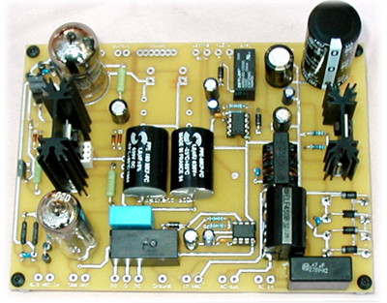
Electronics Overview
diode bridge
Basic Circuits, Power Supplies,
Transistors, Cable Impedance

Slide 2
Basic Circuit Analysis
What we won’t do:
common electronics-class things: RLC, filters, detailed analysis
What we will do:
set out basic relations
look at a few examples of fundamental importance (mostly resistive circuits)
look at diodes, voltage regulation, transistors
discuss impedances (cable, output, etc.)

Slide 3
The Basic Relations
V is voltage (volts: V); I is current (amps: A); R is resistance (ohms: Ω); C is capacitance (farads: F); L is inductance (henrys: H)
Ohm’s Law: V = IR; V = ; V = L(dI/dt)
Power: P = IV = V²/R = I²R
Resistors and inductors in series add
Capacitors in parallel add
Resistors and inductors in parallel, and capacitors in series add according to:

Slide 4
Example: Voltage divider
Voltage dividers are a classic way to set a voltage
Works on the principle that all charge flowing through the first resistor goes through the second
so ΔV ∝ R-value
provided any load at output is negligible: otherwise some current goes there too
So V_{out} = V(R₂/(R₁ + R₂))
R₂ here is a variable resistor, or potentiometer, or “pot”
typically three terminals: R₁₂ is fixed, tap slides along to vary R₁₃ and R₂₃, though R₁₃ + R₂₃ = R₁₂ always
R₁
V
V_{out}
1
R₂
3
2

Slide 5
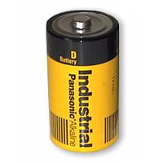
Real Batteries: Output Impedance
A power supply (battery) is characterized by a voltage (V) and an output impedance (R)
sometimes called source impedance
Hooking up to load: R_{load}, we form a voltage divider, so that the voltage applied by the battery terminal is actually V_{out} = V(R_{load}/(R+R_{load}))
thus the smaller R is, the “stiffer” the power supply
when V_{out} sags with higher load current, we call this “droop”
Example: If 10.0 V power supply droops by 1% (0.1 V) when loaded to 1 Amp (10 Ω load):
internal resistance is 0.1 Ω
called output impedance or source impedance
may vary with load, though (not a real resistor)
R
V
D-cell example: 6A
out of 1.5 V battery
indicates 0.25 Ω output
impedance

Slide 6
Power Supplies and Regulation
A power supply typically starts with a transformer
to knock down the 340 V peak-to-peak (120 V AC) to something reasonable/manageable
We will be using a center-tap transformer
(A’ − B’) = (winding ratio)×(A − B)
when A > B, so is A’ > B’
geometry of center tap (CT) guarantees it is midway between A’ and B’ (frequently tie this to ground so that A’ = −B’)
note that secondary side floats: no ground reference built-in
A
A’
AC input
CT
AC output
B
B’

Slide 7
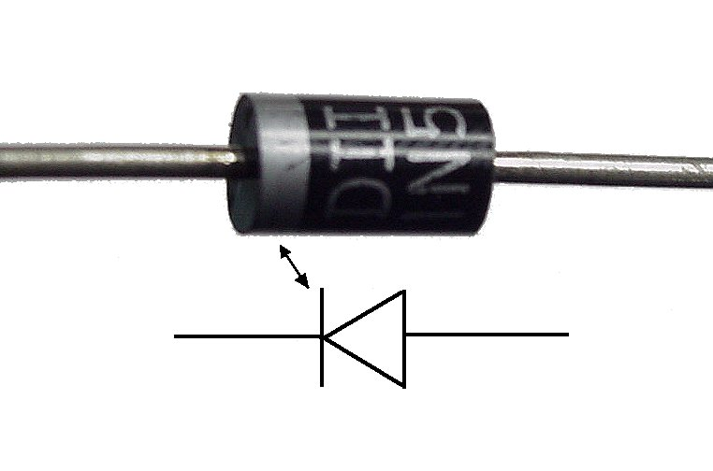
Diodes
Diodes are essentially one-way current gates
Symbolized by:
Current vs. voltage graphs:
acts just like a wire
(will support arbitrary
current) provided that
voltage is positive
I
I
I
I
V
V
0.6 V
V
V
plain resistor
diode
idealized diode
WAY idealized diode
the direction the
arrow points in the
diode symbol is the
direction that current
will flow
no current flows
current flows

Slide 8
Diode Makeup
Diodes are made of semiconductors (usually silicon)
Essentially a stack of p-doped and n-doped silicon to form a p-n junction
doping means deliberate impurities that contribute extra electrons (n-doped) or “holes” for electrons (p-doped)
Transistors are n-p-n or p-n-p arrangements of semiconductors
p-type
n-type

Slide 9
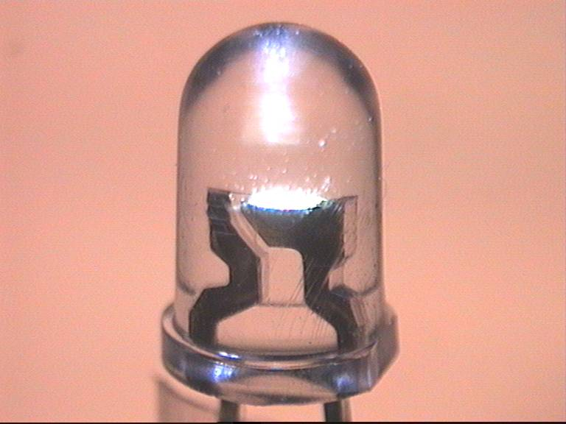
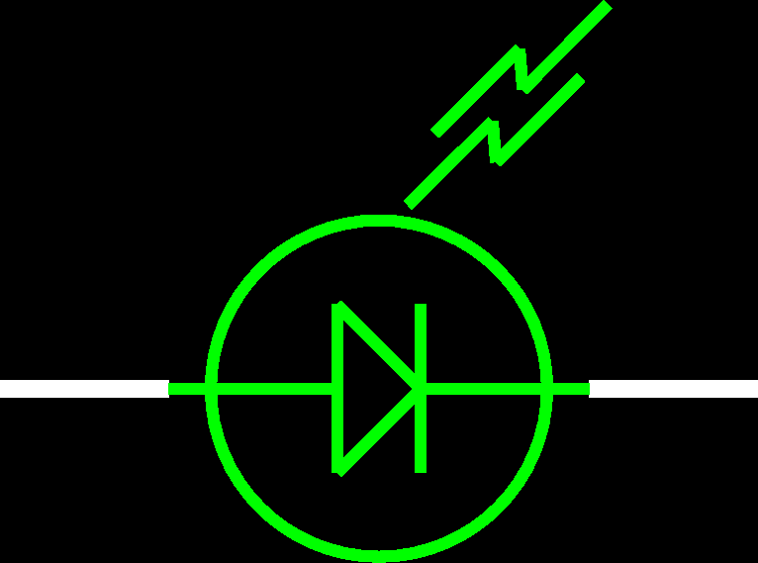
LEDs: Light-Emitting Diodes
Main difference is material is more exotic than silicon used in ordinary diodes/transistors
typically 2-volt drop instead of 0.6 V drop
When electron flows through LED, loses energy by emitting a photon of light rather than vibrating lattice (heat)
LED efficiency is 30% (compare to incandescent bulb at 10%)
Must supply current-limiting resistor in series:
figure on 2 V drop across LED; aim for 1–10 mA of current

Slide 10
Getting DC back out of AC
AC provides a means for us to distribute electrical power, but most devices actually want DC
bulbs, toasters, heaters, fans don’t care: plug straight in
sophisticated devices care because they have diodes and transistors that require a certain polarity
rather than oscillating polarity derived from AC
this is why battery orientation matters in most electronics
Use diodes to “rectify” AC signal
Simplest (half-wave) rectifier uses one diode:
input voltage
AC source
load
diode only conducts
when input voltage is positive
voltage seen by load

Slide 11
Doing Better: Full-wave Diode Bridge
The diode in the rectifying circuit simply prevented the negative swing of voltage from conducting
but this wastes half the available cycle
also very irregular (bumpy): far from a “good” DC source
By using four diodes, you can recover the negative swing:
B & C conduct
input voltage
A
B
AC source
A & D conduct
C
load
D
voltage seen by load

Slide 12
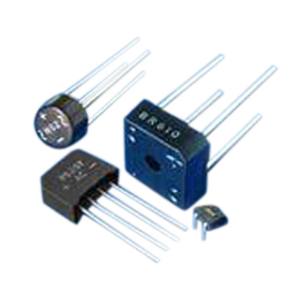
Full-Wave Dual-Supply
By grounding the center tap, we have two opposite AC sources
the diode bridge now presents + and − voltages relative to ground
each can be separately smoothed/regulated
cutting out diodes A and D makes a half-wave rectifier
AC source
A
B
voltages seen by loads
C
+ load
D
− load
can buy pre-packaged diode bridges

Slide 13
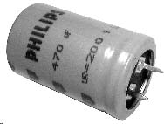
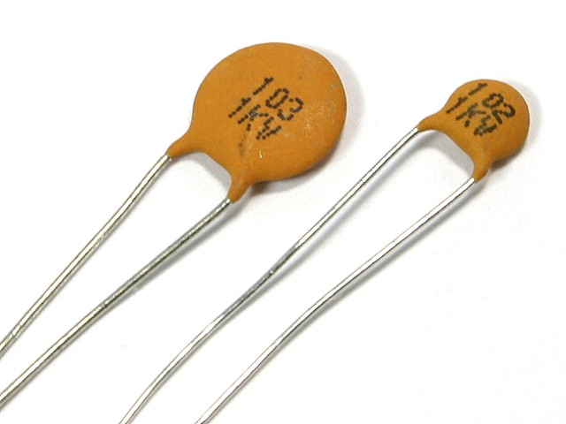
Smoothing out the Bumps
Still a bumpy ride, but we can smooth this out with a capacitor
capacitors have capacity for storing charge
acts like a reservoir to supply current during low spots
voltage regulator smoothes out remaining ripple
A
B
capacitor
AC source
C
load
D

Slide 14
How smooth is smooth?
V
An RC circuit has a time constant τ = RC
because dV/dt = I/C, and I = V/R → dV/dt = V/RC
so V is V₀exp(±t/τ)
Any exponential function starts out with slope = Amplitude/τ
So if you want < 10% ripple over 120 Hz (8.3 ms) timescale…
must have τ = RC > 83 ms
if R = 100 Ω, C > 830 μF
C
R
τ

Slide 15
Regulating the Voltage
The unregulated, ripply voltage may not be at the value you want
depends on transformer, etc.
suppose you want 15.0 V
You could use a voltage divider to set the voltage
But it would droop under load
output impedance → R₁ || R₂
need to have very small R₁, R₂ to make “stiff”
the divider will draw a lot of current
perhaps straining the source
power expended in divider >> power in load
Not a “real” solution
Important note: a “big load” means a small resistor value: 1 Ω demands more current than 1 MΩ
V_{in}
R₁
V_{out}
1
R_{load}
R₂
3
2

Slide 16
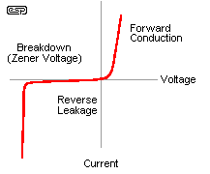
The Zener Regulator
Zener diodes break down at some reverse voltage
can buy at specific breakdown voltages
as long as some current goes through zener, it’ll work
good for rough regulation
Conditions for working:
let’s maintain some minimal current, I_{z} through zener (say a few mA)
then (V_{in} − V_{out})/R₁ = I_{z} + V_{out}/R_{load} sets the requirement on R₁
because presumably all else is known
if load current increases too much, zener shuts off (node drops below breakdown) and you just have a voltage divider with the load
zener voltage
high slope is what makes the
zener a decent voltage regulator
V_{in}
R₁
V_{out} = V_{z}
R_{load}
Z

Slide 17
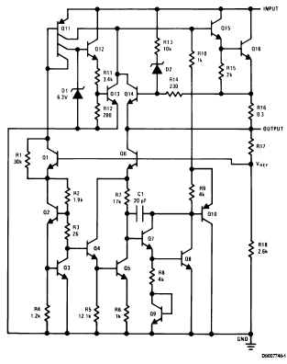
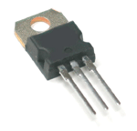
Voltage Regulator IC
Can trim down ripply voltage to precise, rock-steady value
Now things get complicated!
We are now in the realm of integrated circuits (ICs)
ICs are whole circuits in small packages
ICs contain resistors, capacitors, diodes, transistors, etc.
note zeners

Slide 18
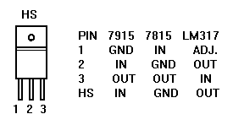
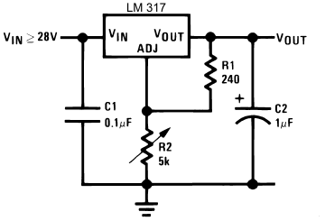
Voltage Regulators
The most common voltage regulators are the LM78XX (+ voltages) and LM79XX (− voltages)
XX represents the voltage
7815 is +15; 7915 is −15; 7805 is +5, etc
typically needs input > 3 volts above output (reg.) voltage
A versatile regulator is the LM317 (+) or LM337 (−)
1.2–37 V output
V_{out} = 1.25(1+R₂/R₁) + I_{adj}R₂
Up to 1.5 A
picture at right can go to 25 V
datasheetcatalog.com for details
beware that housing is not always ground

Slide 19
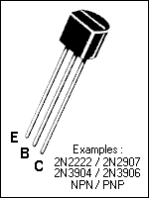
Transistors
Transistors are versatile, highly non-linear devices
Two frequent modes of operation:
amplifiers/buffers
switches
Two main flavors:
npn (more common) or pnp, describing doping structure
Also many varieties:
bipolar junction transistors (BJTs) such as npn, pnp
field effect transistors (FETs): n-channel and p-channel
metal-oxide-semiconductor FETs (MOSFETs)
We’ll just hit the essentials of the BJT here
MOSFET in later lecture
C
E
B
B
E
C
npn
pnp

Slide 20
BJT Amplifier Mode
Central idea is that when in the right regime, the BJT collector-emitter current is proportional to the base current:
namely, I_{ce} = βI_{b}, where β (sometimes h_{fe}) is typically ~100
In this regime, the base-emitter voltage is ~0.6 V
below, I_{b} = (V_{in} − 0.6)/R_{b}; I_{ce} = βI_{b} = β(V_{in} − 0.6)/R_{b}
so that V_{out} = V_{cc} − I_{ce}R_{c} = V_{cc} − β(V_{in} − 0.6)(R_{c}/R_{b})
ignoring DC biases, wiggles on V_{in} become β (R_{c}/R_{b}) bigger (and inverted): thus amplified
V_{cc}
R_{c}
R_{b}
out
C
in
B
E

Slide 21
Switching: Driving to Saturation
What would happen if the base current is so big that the collector current got so big that the voltage drop across R_{c} wants to exceed V_{cc}?
we call this saturated: V_{c} − V_{e} cannot dip below ~0.2 V
even if I_{b} is increased, I_{c} won’t budge any more
The example below is a good logic inverter
if V_{cc} = 5 V; R_{c} = 1 kΩ; I_{c}(sat) ≈ 5 mA; need I_{b} > 0.05 mA
so R_{b} < 20 kΩ would put us safely into saturation if V_{in} = 5V
now 5 V in → ~0.2 V out; < 0.6 V in → 5 V out
V_{cc}
R_{c}
R_{b}
out
in

Slide 22
Transistor Buffer
V_{cc}
in
out
R
In the hookup above (emitter follower), V_{out} = V_{in} − 0.6
sounds useless, right?
there is no voltage “gain,” but there is current gain
Imagine we wiggle V_{in} by ΔV: V_{out} wiggles by the same ΔV
so the transistor current changes by ΔI_{e} = ΔV/R
but the base current changes 1/β times this (much less)
so the “wiggler” thinks the load is ΔV/ΔI_{b} = β·ΔV/ΔI_{e} = βR
the load therefore is less formidable
The “buffer” is a way to drive a load without the driver feeling the pain (as much): it’s impedance isolation

Slide 23
Improved Zener Regulator
By adding a transistor to the zener regulator from before, we no longer have to worry as much about the current being pulled away from the zener to the load
the base current is small
R_{load} effectively looks β times bigger
real current supplied through transistor
Can often find zeners at 5.6 V, 9.6 V, 12.6 V, 15.6 V, etc. because drop from base to emitter is about 0.6 V
so transistor-buffered V_{reg} comes out to 5.0, 9.0, etc.
I_{z} varies less in this arrangement, so the regulated voltage is steadier
V_{in}
V_{in}
R_{z}
V_{z}
V_{reg}
Z
R_{load}

Slide 24
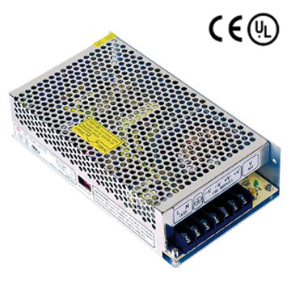
Switching Power Supplies
Power supplies without transformers
lightweight; low cost
can be electromagnetically noisy
Use a DC-to-DC conversion process that relies on flipping a switch on and off, storing energy in an inductor and capacitor
regulators were DC-to-DC converters too, but lossy: lose ΔP = IΔV of power for voltage drop of ΔV at current I
regulators only down-convert, but switchers can also up-convert
switchers are reasonably efficient at conversion

Slide 25
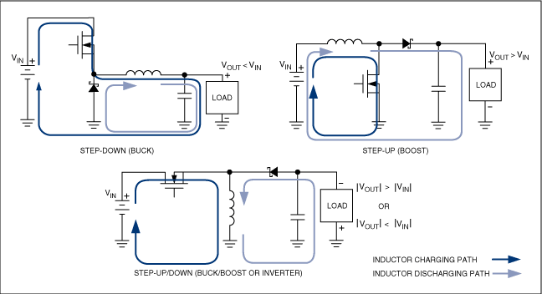
Switcher topologies
The FET switch is turned off or on in a pulse-width-modulation (PWM) scheme,
the duty cycle of which determines the ratio of V_{out} to V_{in}
from: http://www.maxim-ic.com/appnotes.cfm/appnote_number/4087

Slide 26
Step-Down Calculations
If the FET is on for duty cycle, D (fraction of time on), and the period is T:
the average output voltage is V_{out} = DV_{in}
the average current through the capacitor is zero, the average current through the load (and inductor) is 1/D times the input current
under these idealizations, power in = power out

Slide 27
Step-down waveforms
Shown here is an example of the step-down with the FET duty cycle around 75%
The average inductor current (dashed) is the current delivered to the load
the balance goes to the capacitor
The ripple (parabolic sections) has peak-to-peak fractional amplitude of T²(1−D)/(8LC)
so win by small T, large L & C
10 kHz at 1 mH, 1000 μF yields ~0.1% ripple
means 10 mV on 10 V
FET
Inductor
Current
Supply
Current
Capacitor
Current
Output
Voltage
(ripple exag.)

Slide 28
Cable Impedances
RG58 cable is characterized as 50 Ω cable
RG59 is 75 Ω
some antenna cable is 300 Ω
Isn’t the cable nearly zero resistance? And shouldn’t the length come into play, somehow?
There is a distinction between resistance and impedance
though same units
Impedances can be real, imaginary, or complex
resistors are real: Z = R
capacitors and inductors are imaginary: Z = −i/ωC; Z = iωL
mixtures are complex: Z = R − i/ωC + iωL

Slide 29
Impedances, cont.
Note that:
capacitors become less “resistive” at high frequency
inductors become more “resistive” at high frequency
bigger capacitors are more transparent
bigger inductors are less transparent
i (√−1) indicates 90° phase shift between voltage and current
after all, V = IZ, so Z = V/I
thus if V is sine wave, I is ±cosine for inductor/capacitor
and given that one is derivative, one is integral, this makes sense (slide # 3)
adding impedances automatically takes care of summation rules: add Z in series
capacitance adds as inverse, resistors, inductors straight-up

Slide 30
Impedance Phasor Diagram
Impedances can be drawn on a complex plane, with pure resistive, inductive, and capacitive impedances represented by the three cardinal arrows
An arbitrary combination of components may have a complex impedance, which can be broken into real and imaginary parts
Note that a system’s impedance is frequency-dependent
imag. axis
Z_{i}
Z
ωL
Z_{r}
real axis
R
1/ωC

Slide 31
Transmission Line Model
input
L
C
output
The cable has a finite capacitance per unit length
property of geometry and dielectric separating conductors
C/l = 2πε/ln(b/a), where b and a are radii of cylinders
Also has an inductance per unit length
L/l = (μ/2π)ln(b/a)
When a voltage is applied, capacitors charge up
thus draw current; propagates down the line near speed of light
Question: what is the ratio of voltage to current?
because this is the characteristic impedance
Answer: Z₀ = sqrt(ωL/ωC) = sqrt(L/C) = (1/2π)sqrt(μ/ε)ln(b/a)
note that Z₀ is frequency-independent

Slide 32
Typical Transmission Lines
RG58 coax is abundant
30 pF per foot; 75 nH per foot; 50 Ω; v = 0.695c; ~5 ns/m
RG174 is the thin version
same parameters as above, but scaled-down geometry
RG59
used for video, cable TV
21 pF/ft; 118 nH per foot; 75 Ω; v = 0.695c; ~5 ns/m
twisted pair
110 Ω at 30 turns/ft, AWG 24–28
PCB (PC-board) trace
get 50 Ω if the trace width is 1.84 times the separation from the ground plane (assuming fiberglass PCB with ε = 4.5)

Slide 33
Why impedance matters
For fast signals, get bounces (reflections) at every impedance mismatch
reflection amplitude is (Z_{t} − Z_{s})/(Z_{t} + Z_{s})
s and t subscripts represent source and termination impedances
sources intending to drive a Z₀ cable have Z_{s} = Z₀
Consider a long cable shorted at end: insert pulse
driving electronics can’t know about the termination immediately: must charge up cable as the pulse propagates forward, looking like Z₀ of the cable at first
surprise at far end: it’s a short! retreat!
in effect, negative pulse propagates back, nulling out capacitors (reflection is −1)
one round-trip later (10 ns per meter, typically), the driving electronics feels the pain of the short

Slide 34
Impedance matters, continued
Now other extreme: cable un-terminated: open
pulse travels merrily along at first, the driving electronics seeing a Z₀ cable load
at the end, the current has nowhere to go, but driver can’t know this yet, so keeps loading cable as if it’s still Z₀
effectively, a positive pulse reflects back, double-charging capacitors (reflection is +1)
driver gets word of this one round-trip later (10 ns/m, typically), then must cease to deliver current (cable fully charged)
The goldilocks case (reflection = 0)
if the end of the cable is terminated with resistor with R = Z₀, then current is slurped up perfectly with no reflections
the driver is not being lied to, and hears no complaints

Slide 35
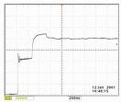
So Beware!
If looking at fast (tens of ns domain) signals on scope, be sure to route signal to scope via 50 Ω coax and terminate the scope in 50 Ω
if the signal can’t drive 50 Ω, then use active probes
Note that scope probes terminate to 1 MΩ, even though the cables are NOT 1 MΩ cables (no such thing)
so scope probes can be very misleading about shapes of fast signals

Slide 36
References and Assignment
References:
The canonical electronics reference is Horowitz and Hill: The Art of Electronics
Also the accompanying lab manual by Hayes and Horowitz is highly valuable (far more practically-oriented)
And of course: Electronics for Dogs (just ask Gromit)
Reading
Sections 6.1.1, 6.1.2
Skim 6.2.2, 6.2.3, 6.2.4
Sections 6.3.1, 6.5.1, 6.5.2
Skim 6.3.2

