Slide 1


END

Slide 2

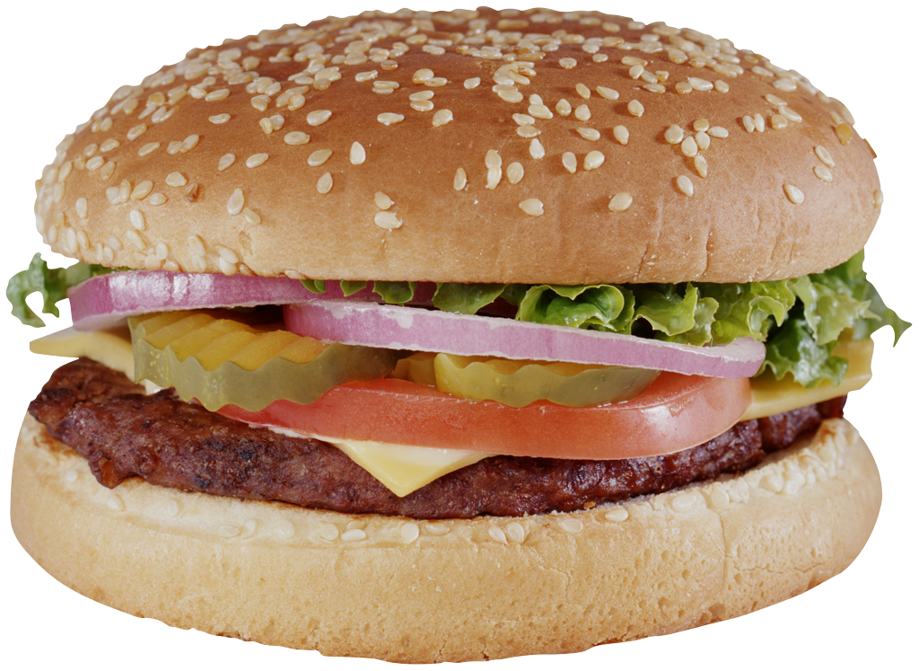
start
Choose path
To next island

Slide 3
END

Slide 4
You must eat something
green.
To teleport to ice cream island you must put ice on your under ware for 30 seconds
To teleport to burger island you must eat salt
You must pass
through a window
Eat a tiny spoon of vinegar
Play again
You must spend 60 seconds in a dark closet
Miss a turn.
Spend 60 seconds in the car with very loud sound
Kiss princess poppy
In the mouth
Select another player to throw dice. If you get less, miss a turn
Choose another player that will try to make you laugh for 30 seconds. If you laugh, miss a turn, if you don’t he misses a turn
Lie down on a chaise long in the porch
You must make mammy say the word ice cream to go to ice cream island, or burger to go to burger island

