Slide 1

Ant colony optimization (ACO)
Richard Babjak, Kristián Durak, Maroš Hliboký

Slide 2
Problém a jeho riešenie
ACOpy
NetworkX
TSP

Slide 3
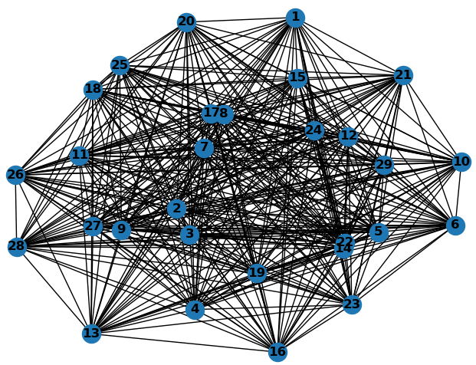

Travelling Salesman Problem

Slide 4
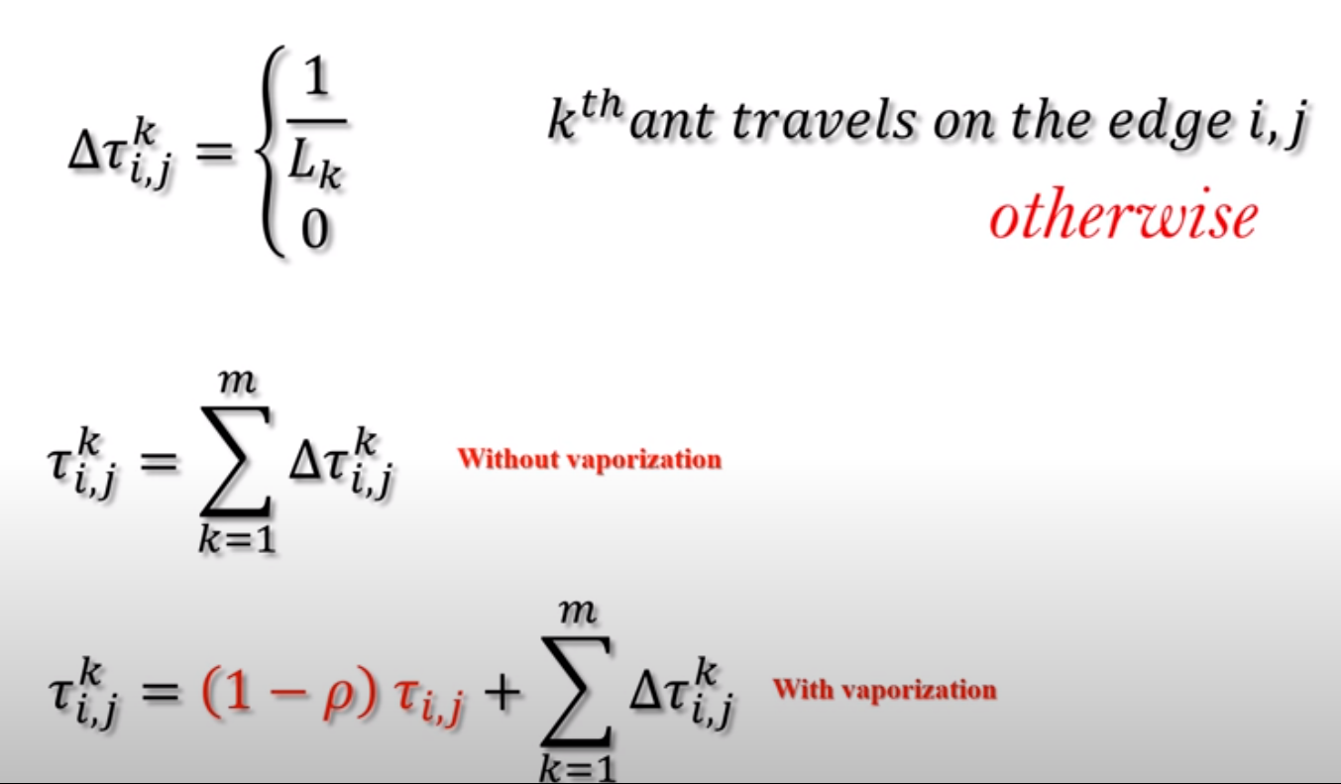
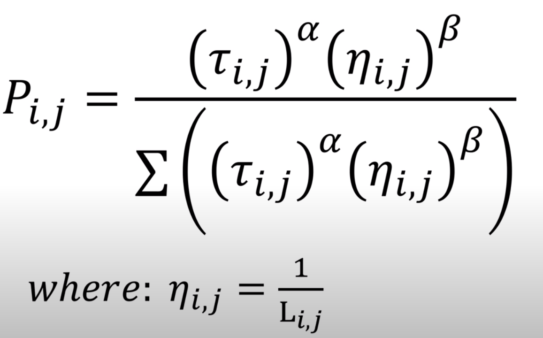
Ant Colony Optimization
Pheromone (model and vaporization)
Cost matrix (distance)
Pheromone matrix
Decision making
Rullete wheel

Slide 5
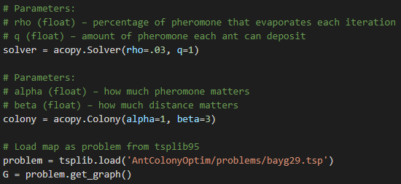
ACOpy

Slide 6

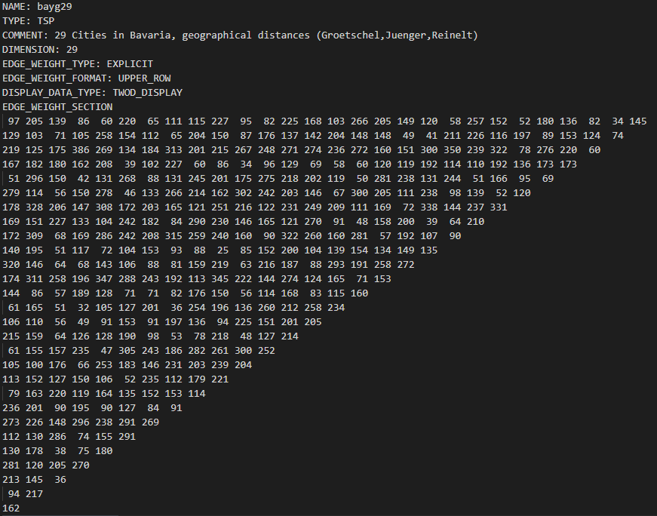
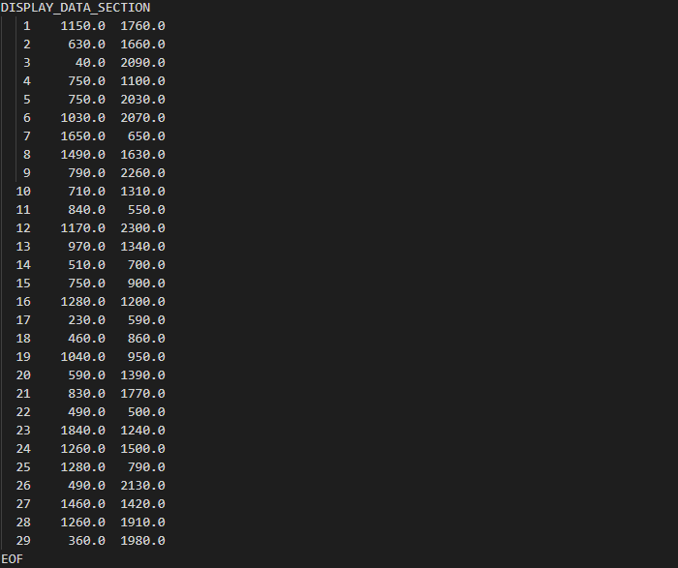
TSPlib

Slide 7
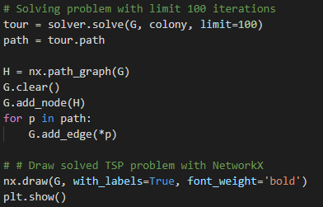
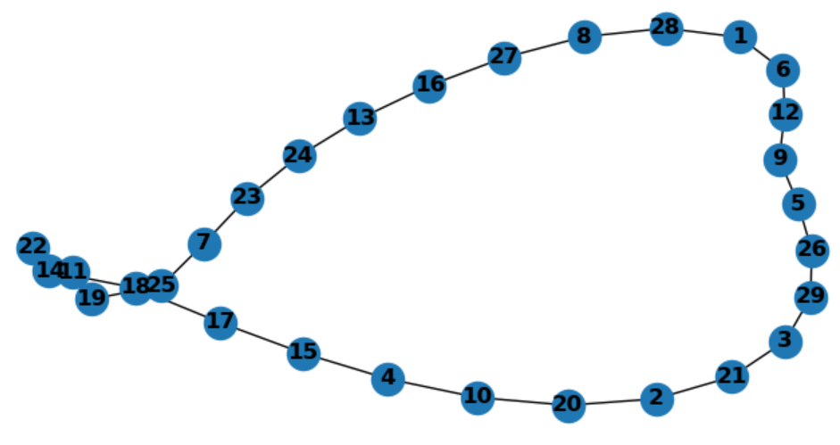
NetworkX

Slide 8


Consultation Questions Answers
Thank you!

