Slide 2









Orange Cyberdefense
  Certificates & Accreditations
Worldwide
Security Revenue 2024
approx. 1.2 billion €
Part of Orange S.A.
approx. €44 billion
17 SOC’s
11 CERT’s
4 Scrubbing Centers
ISO 27001
ISO 9001
ISO 14001
CERT Competencies
24/7/365
MSS Services
Continuous monitoring of
safety-relevant systems
Incident response with on-site support
50,000
Customers worldwide
40,000
Suspicious websites closed every year
~500
Sources for our
Threat Intelligence Datalake
3.100+
Highly qualified cybersecurity experts
1.000
Security Consultants
SOC2 Type II
audited
Qualified APT response service provider at the BSI

Slide 3
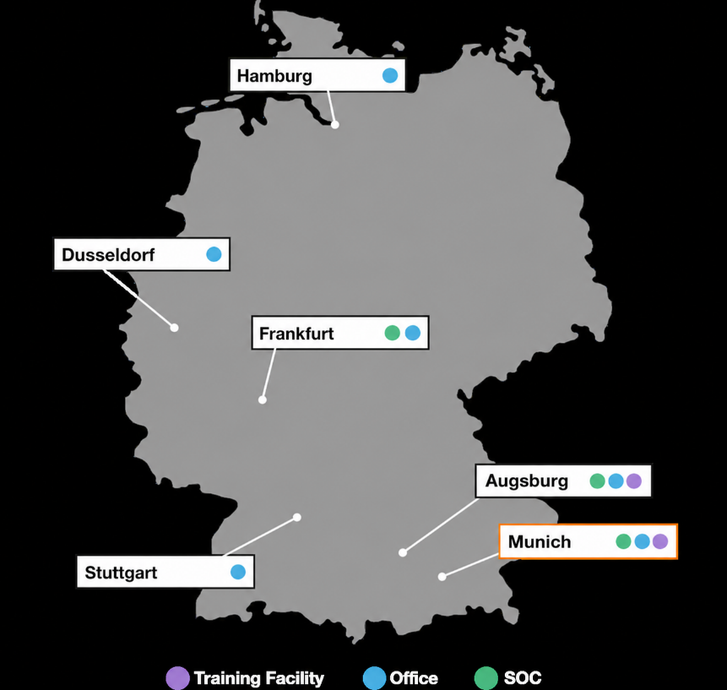




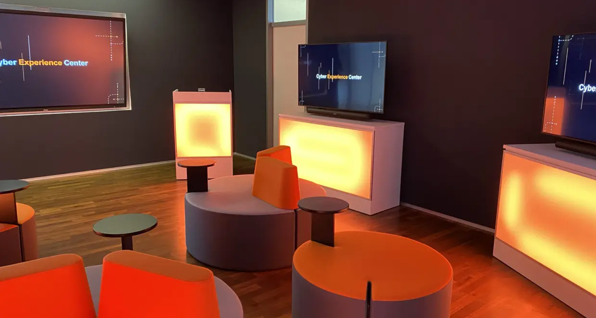
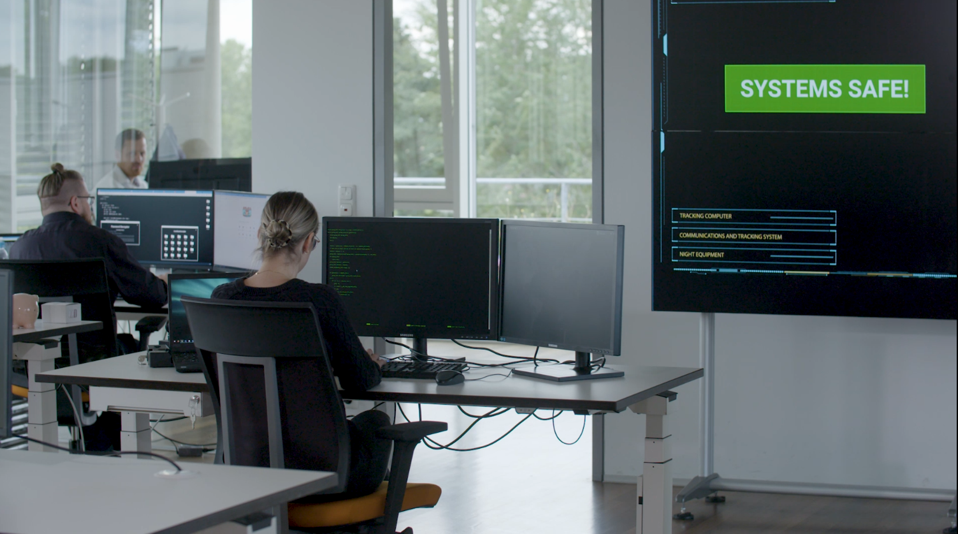
Orange Cyberdefense in Germany
Your consulting and service partner with AI and compliance know-how
50 Security Consultants
AI-optimized managed detection and response for IT and OT
Vulnerability, Threat and Exposure Management
Infrastructure Transformation
Data Loss Prevention
80 regional MSS experts
in German-speaking 24x7 SOC
New in Augsburg
  Cyber Crisis Management & Analysts Training

Slide 4
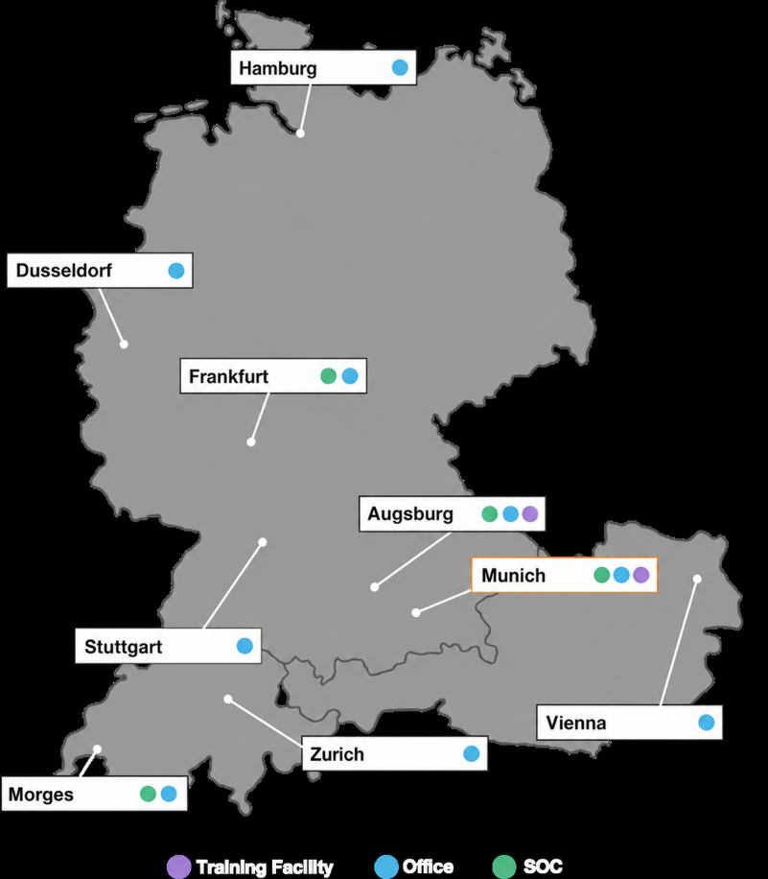
Orange Cyberdefense in D/A/CH
Your consulting and service partner with AI and compliance know-how
50 Security Consultants
AI-optimized managed detection and response for IT and OT
Vulnerability, Threat and Exposure Management
Infrastructure Transformation
Data Loss Prevention
80 regional MSS experts
in German-speaking 24x7 SOC
NEU in Augsburg
  Cyber Crisis Management & Analysts Training

Slide 5
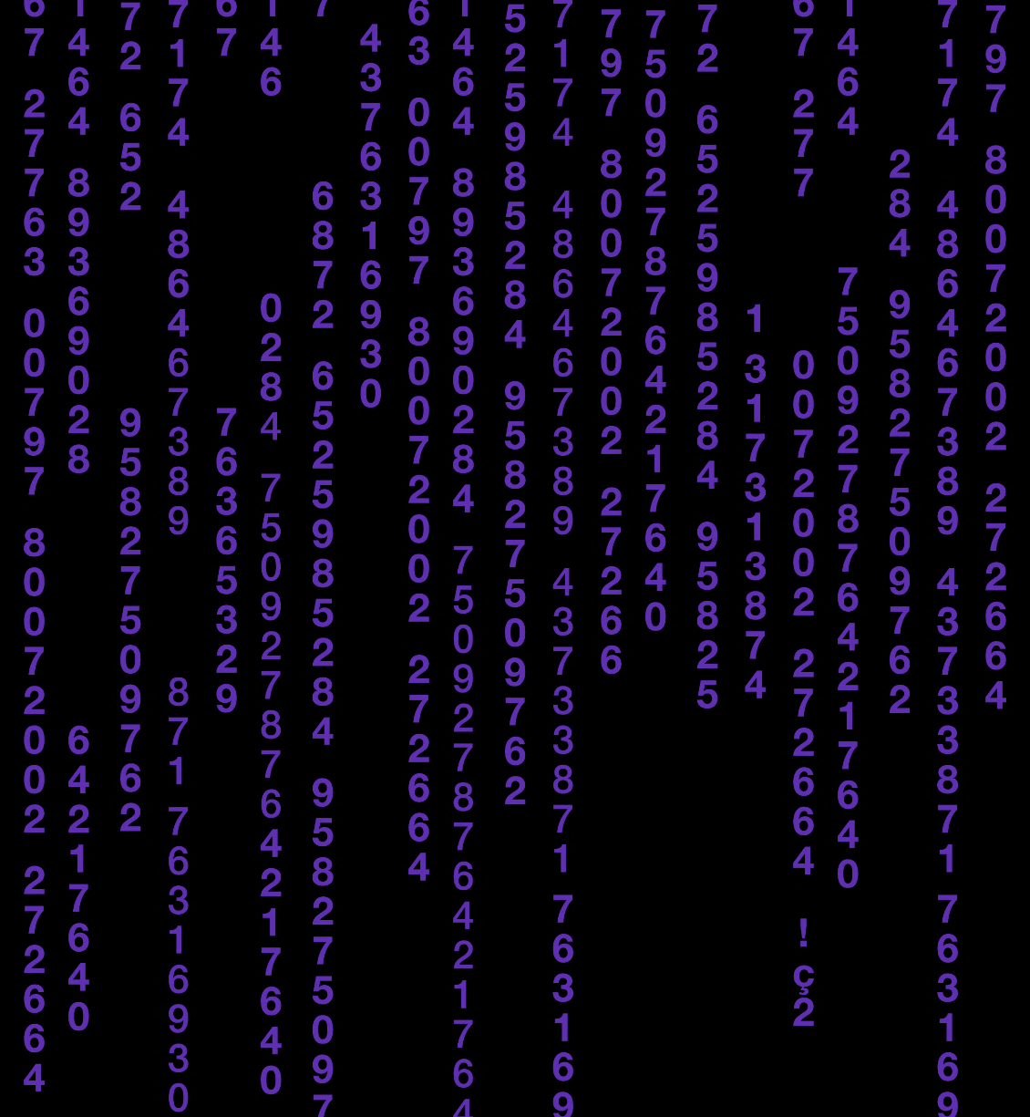
Why Orange Cyberdefense?
Our strengths and unique capabilities.
Global presence with European roots.
Threat Research & Intelligence is part of our DNA.
3,000+ cybersecurity experts work together.
You're protected and compliant no matter where you are.
You can concentrate on what matters and achieve better results.
You can focus on your business and create a trusted digital space.
Notes:
Why us? How we do it?
We are a European anchorage with a global footprint: you are protected and compliant no matter where you are located.
Threat research & intelligence is part of our DNA: so you can focus on what matters, achieving better security outcomes.
2,500+ cybersecurity experts working together: so you can focus on your business, enabling a trusted digital space.

Slide 6
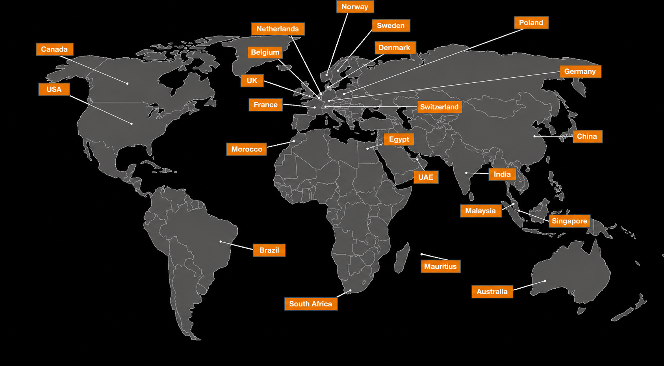
We speak your language.
Notes:
Global protection with local expertise. We offer you 24/7/365 local operations in 19 locations with 18 Security Operations Centres (SOCs) worldwide, 11 CyberSOCs, 4 CERTS and sales and services support in 160 countries. This means we thoroughly understand local regulations, context and speak your language while protecting your business globally.
Our SOCs and CyberSOCs track malicious actors’ campaigns across regions and time zones, helping your business be constantly aware of emerging threats and quickly support remediation in case of an incident.

Slide 7
Cybersecurity Intelligence
Internal and external data are collected, validated, aggregated, correlated and analyzed.
Risks and threat actors are identified, attacks are detected and the motivations, methods and actions of the attackers are understood.
Limited security resources can be invested where they have the greatest impact.

Slide 8
How can we help you?

Slide 9





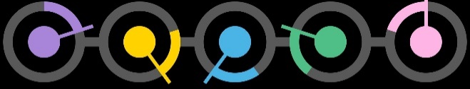
We support you throughout the entire threat lifecycle.
Anticipate
Anticipate the latest cyber threats and prevent digital risks.
Identify
Identify your critical assets, data, and vulnerabilities to define your security strategy and actions.
Industry expertise
Protect
Protect your business with the right technology and expertise.
Tailor-made services
Detect
Detect cyber attacks by analyzing alarms and behaviors.
Technology
Consulting
Management
& Support
Respond
Respond to cyber attacks with appropriate mitigation and remediation plans.
Notes:
So let me try and explain why this report is important for our managed services sales and how also how our managed services can help our customers.
If we start with the customer. Customer decision-making is done in the same part of the brain as where they have their feelings. So feelings will control decitions.
The most important feeling for us is “TRUST”, and this report really help to buld trust for us and our abilities with our customers.
So how can we help our customers where they may fall short? Lets look at this within the context of our five different services areas.
ANTICIPATE: If you do not understand the threat, how can understand how to identify, detect or protect against the threat?
Do you have resources and skils to monitor for new vulnerabilities, threats (like fake domains, mobile apps) or attackvectors like java-scripr card skimming…) If not, buy a service
IDENTIFY: Always a good idea to have an external thirdparty to verify your attack surface. We know of customers that have excluded vuln data to look better in their internal KPI:s..
PROTECT: A big part of incidents could have been avoided, or the impact could have been reduced if the equipment where configured in an optimal way. Do customer have time and deep expertise across all the
complex cybersecurity technologies to be able to configure and monitor them in an optimal way
DETECT: Detection has three challenges:
1.) There is no silver bullet (log vs endpoint vs network) You need to understand how to best invest your money to get ROI
2.) Analyzing detections are more complex today than 10 years ago. Then it was black/white. Hit/miss based on signatures and static correlation rules Now it is all about detecting behavior anomalies in files, endpoint, application or network activities. You need to be an expert to be able to sort out the FP from the TP.
3.). This is not a daytime job. You need this 24x7
RESPOND:
The toughest job in the cybersecurity industry. If you do it 99.999% correct you have failed and the attacker is still in your infrastructure.
Threat Disruption requires 24x7 eyes-on-screen, and IR requires deep expertise and experience..

Slide 10

A holistic portfolio and experience to enable your business.
Threat Advisory Service
Managed Threat Detection - Intelligence
  Data Leakage Detection
  Brand Protection
  Attack Surface Reduction
Cyberwatch
Assessment Services
Advisory Services
Security Awareness Training
Penetration testing
Red and purple teaming
DevSecOps
Data-centric Security
Infrastructure Security
Network Security
Security Intelligence
Endpoint Security
Identity & Access Management
Managed Vulnerability Scanning
Managed Threat Detection
  Log based (SIEM)
  Network based
  Endpoint based
Incident response
  Retainer
  Emergency Response
  Incident Response Consulting
Digital forensics
Malware Analysis
Endpoint Quarantine

Slide 11
Cybersecurity Intelligence
Anticipate
World Watch Threat Advisory
Managed Cybercrime Monitoring
Cyber Threats
Identify
Assessment and Advisory Services
Managed Vulnerability Intelligence
Ethical Hacking
Risks before hackers do
Protect
Your business with the right technology
Managed Security Services – Endpoint, Network, Gateway, Identity Access, Vulnerability
Intelligence Backbone
Detect
Cyberattacks through the analysis of alarms
Managed Threat Detection – Endpoint, Network, Log based
Respond
with targeted investigation and response
Onsite Incident Response & Consulting
Compromise Assessment
Digital Forensics
Endpoint Quarantine
Notes:
Übersetzen
Siehe Email
With our operational and tactical focus, you have access to real-time intelligence to fend-of threats and mitigate vulnerabilities. Our services feed from our intelligence backbone, so you can adopt timely preventative measures, improve threat detection and targeted remediation.
<Highlight any service category or solution that fits for this customer>

Slide 12





Intelligence-led Managed Services
Threat & Vulnerability Intelligence
Orange
Global Threat Research Team
Managed Vulnerability Intelligence
[watch]
Anticipate
World Watch
Attack Surface Discovery
Threat Detection
Managed Vulnerability Intelligence
[identify]
Managed Cloud Security [infrastructure]
Ethical Hacking
Managed Cybercrime Monitoring
Malware Cleaner
Managed Threat Detection
[endpoint]
[log]
[network]
Identify
Detect
Attack Surface Reduction
Secure Infrastructure
Endpoint & Mobile Security
Identity & Access Management
Cloud & Application Security
OT / ICS Security
Protect
Incident Response
Respond

Slide 13
Attack Surface Reduction
Secure Infrastructure
Endpoint & Mobile Security
Identity & Access Management
Managed Firewall
(FSP)
Managed Secure Web Gateway
(WPS)
Managed Remote Access
(Flexible Application Access)
Managed WAF
(WAGO)
Cloud & Application Security
Managed Mobile Protection
(Mobile Threat Protection)
OT / IoT Security
Managed IAM
(Flexible Identity Authentication)
Managed Email Protection
(EPS)
Managed Endpoint Security
(SecurePrevent Endpoint)
Managed OT Firewall
Managed Cloud Firewall
(Secure Gateway)
Managed IDPS
(Active Prevention)
Managed OT Security
Managed DDoS Protection
Managed Firewall
(Secure Gateway)
Managed Cloud Security – Infrastructure
Protect

Slide 14
Intelligence-led Managed Services
Threat & Vulnerability Intelligence
Orange
Global Threat Research Team
Observations
Managed Vulnerability Intelligence
[watch]
Anticipate
World Watch
Managed
Vulnerability
Services
Attack Surface Discovery
Threat Detection
Managed Vulnerability Intelligence
[identify]
Managed Cloud Security [infrastructure]
Ethical Hacking
Managed Cybercrime Monitoring
Malware Cleaner
Managed Threat Detection
[endpoint]
[log]
[network]
Identify
Detect
Attack Surface Reduction
Managed
Detection &
Response
Services
Secure Infrastructure
Endpoint & Mobile Security
Identity & Access Management
Cloud & Application Security
OT / ICS Security
Protect
Incident Response
Incident Response Retainer / Emergency
Compromise Assessment
IR Consulting & Digital Forensics
Managed Threat Response
[isolation]
[takedown]
Respond

Slide 15
Service & Solution Domains
Security Intelligence
Secure Infrastructure & Endpoint Security
Cloud & Data-centric Security
OT/ICS Security
Consulting Germany
Strategy
Advise & Architect
Professional Services
Design & Implement
Operate, Test & Support
Near SOC
Detect & Respond
Managed Detection & Response Services

Slide 16
Service & Solution Domains
Security Intelligence
Secure Infrastructure & Endpoint Security
Cloud & Data-centric Security
OT/ICS Security
Consulting Germany
Strategy
Consulting & Conception
CISO as a Service
Cloud Security Maturity Assessment
Advise & Architect
Advisory Services
Assessment Services
Security Maturity Assessment
Professional Services
Solution Design
Review & Optimization
Threat Intelligence
Design & Implement
SIEM
SOC Toolstack
EDR
Cloud Security Posture Management
SOAR
Cloud Workload Protection Management
Use Case Design &
Implementation
Pentesting
DevSecOps
Operate, Test & Support
Operate SOC Toolstack
Vulnerablility Assessment
Code Review
Near SOC
SOC & Cyberdefense Center Consulting
Analyst Trainings
Cloud Monitoring
Industrial SOC
Detect & Respond
SOC Validation &
Optimization
Analyst as a Service
Cloud Workload Protection
Managed Detection & Response Services

Slide 17





Portfolio dedicated to Security Intelligence
Security
Consulting
Professional Services
Operate SOC Toolstack
SI
Security Solutions
SOC & SIEM Development
SIEM Architecture Planning
SOC Maturity Assessments
Cloud Security Monitoring Strategy
Use Case Consulting
Training / Workshops
Implementation – SIEM / SOAR
SIEM Migration
SIEM Cloud Integration
Copilot Service for Customers for Know How Transfer
Integrating SOC Toolstack
Operations
  Update & Maintain
  Data Onboarding
  Support & Troubleshoot
SIEM & SOAR
  Use Case Engineering
  Playbook Development
Develop Operation Concepts
SIEM
SOAR
Vulnerability Management
Threat Intelligence
Big Data Solutions
User Behavior Analytics
Machine Learning & Analytics

Slide 18

Portfolio dedicated to Infrastructure Security
Security
Consulting
Security
Solutions
Security
Solutions
Operate SOC Toolstack
Security Architecture & Design
Zoning Concepts
Cloud Integrations & Interoperability
Configuration Review
Analysis
Next Generation Firewalls
Secure Access Service Edge
Data Protection
Threat Prevention
Security Intelligence
Access Control
Secure Remote Access
Application Control
Endpoint Detection & Response
SD-WAN, Software Defined Network
Microsegmenation
Zoning Concepts
Pentests
Analysis
Integrating Infrastructure Security to SOC Toolstack
Operations
  Update & Maintain
  Data Onboarding
  Support & Troubleshoot
Use Case Engineering
Playbook Development

Slide 19
Portfolio dedicated to Endpoint Security
Security
Consulting
Endpoint
Security Solutions
Security
Solutions
Operate SOC Toolstack
Security Architecture & Design
Zoning Concepts
Configuration Review
Requirement Analysis
Incident Response
Endpoint Forensics
Next Generation Endpoint Detection & Response
Data Protection
Threat Prevention
Security Intelligence
Access Control
Secure Remote Access
Remote Forensics
Application Control
Microsegmentation
Authentication
NAC
Integrating EDR to SOC Toolstack
Operations
  Update & Maintain
  Data Onboarding
  Support & Troubleshoot
Use Case Engineering
Playbook Development

Slide 20
Portfolio dedicated to Cloud Security
Cloud Security
Consulting
Cloud SaaS
Security Solutions
Cloud Native
Security Solutions
Cloud Application Security Solutions
Hybrid SIEM Concepts
Cloud Transition
Cloud Configuration Review
Cloud Architecture Assessment
DevSecOps Consulting Services
Secure Access Service Edge
Access and Authentication
Data Protection
Threat Protection
Security Intelligence
Cloud Provider Security Adoption
Cloud Network Security
Cloud Security Posture Management
Cloud Access Security Broker
Cloud Workload Protection Platform
Container Pentesting
CI/CD Security

Slide 21
Portfolio dedicated to OT Security
OT/ICS
Consulting
OT/ICS
Security Solutions
Operate SOC Toolstack
OT/ICS
Security Solutions
Zoning Concepts
Pentests
Requirement Analysis
Proof of Concepts
Market Analysis
IT/OT Segmentation
Vulnerability Patching
OT/ICS Mock-Up
Network Protection
Access Concepts
Threat Detection & Protection
Integrating OT/ICS to SOC Toolstack
Operations
  Update & Maintain
  Data Onboarding
  Support & Troubleshoot
Use Case Engineering
Playbook Development
Industrial Firewalls
Remote Access Solutions for ICS environments
Privileged User Control
Authentication & User Management
Vulnerability Management

Slide 22
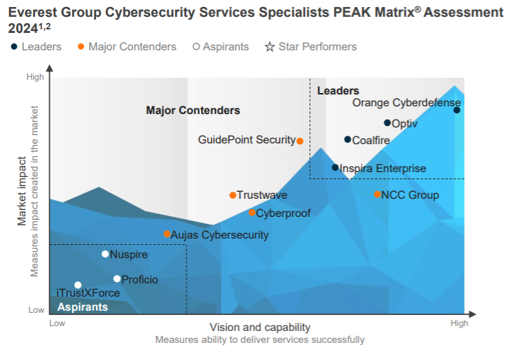

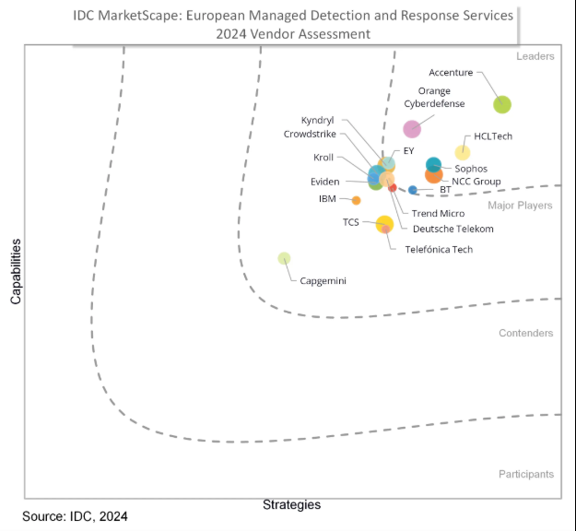
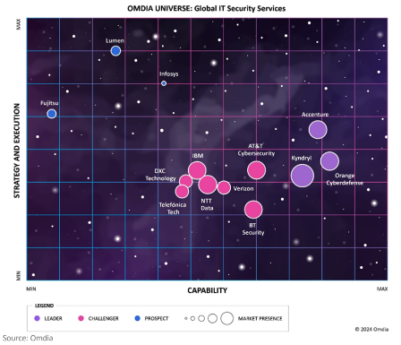

Change of perspective: an outside view
Omdia sees Orange Cyberdefense as one of the leading provider of global IT security services
IDC Positioned Orange Cyberdefense as leading provider of Managed Detection and Response in Europe
The Everest Group has recognized Orange Cyberdefense in its 2024 PEAK Matrix Assessment as leading provider of cybersecurity services

Slide 23





We strive for the highest standards of excellence. But it is not only our word that can be relied upon.
Gartner lists Orange Cyberdefense as a representative vendor in the Market Guide for Managed Detection and Response, Managed Security Services, Digital Forensics & Incident Response, Threat Intelligence and Operational Technology Security.
Omdia sees Orange Cyberdefense as one of the leading providers of global IT security services: "The provider has demonstrated considerable commitment, strategic vision and solution expertise in various end-to-end security service categories such as cloud, endpoint, OT, SASE, infrastructure and security intelligence."
Forrester ranks Orange Cyberdefense as a leader. According to the Forrester report, "Orange Cyberdefense delights its customers with high-quality technical services. Orange Cyberdefense is building its capabilities in cloud security and managed detection and response."
IDC positions Orange Cyberdefense in the "Leaders" category in the IDC Marketscape: European Managed Detection and Response Services 2024 Vendor Assessment. "Orange Cyberdefense offers a comprehensive range of managed and professional security services and can help companies to comprehensively mitigate cybersecurity risks."
Everest Group has recognized Orange Cyberdefense as a leader in managed threat detection. In the study, Everest Group evaluates 27 MDR service providers worldwide that are listed in the MDR Services PEAK Matrix® Assessment.

Slide 24
















Product partners for our services
Security platforms
Elite Partner
Premier Partner
Innovator MSSP
Elite Partner
Vulnerability, Threat & Exposure Management
Detection & Response
SASE & ZTNA
OT Security
Data Security

Slide 25









These companies trust us

Slide 26



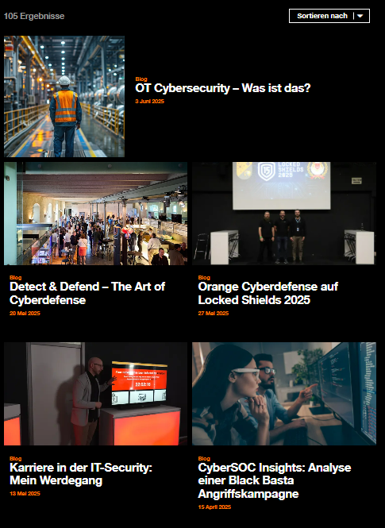
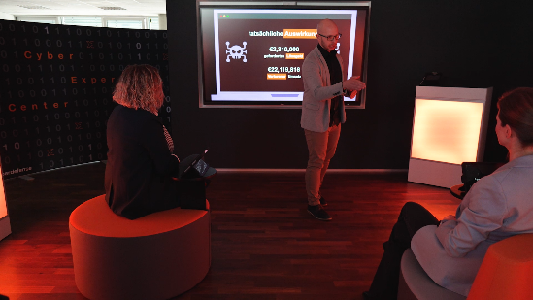
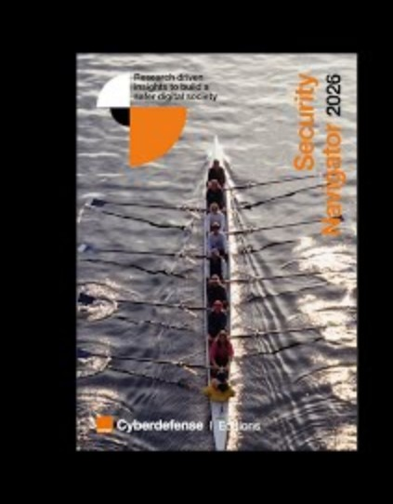
More Orange Cyberdefense
Security
Navigator 2026
Available now!
orangecyberdefense.com/de/security-navigator

Slide 27
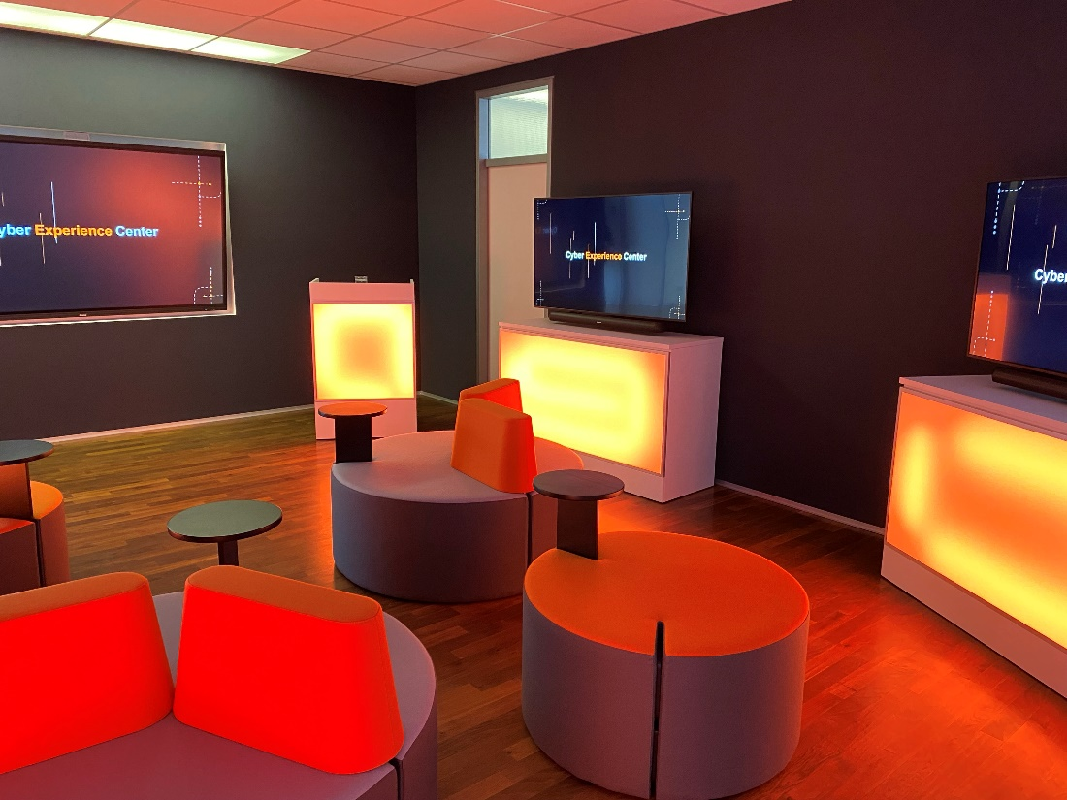


Global partner – local presence
Why Orange Cyberdefense?
3,000+ Security Experts
including 100+ experts in Germany
Highest partner accreditation
and more...
  Worldwide Services
CERT Services,
Threat Intelligence,
Incident Response,
Forensic, Deception
Leading provider of security services
17 SOC's, one SOC in Germany
(7x24x365)
Notes:
Anmerkung E-Mail

Slide 28




Managed Vulnerability Intelligence [watch]
Identify your weaknesses before the attacker do!
Managed Vulnerability Intelligence [watch] is a vulnerability monitoring service.
It allows you to be informed of the vulnerabilities impacting your
information system and the patches to be applied.
16.000 security vulnerabilities discovered in 2018
80% of attacks exploit a known vulnerability
Needs
New vulnerabilities are discovered every day!
Unpatched vulnerabilities in exposed services are an easy way in for attackers
How can you keep track on all relevant vulnerabilities for your company?
Solution
Customer creates a profile of what vulnerability information they need
Vulnerability information is monitored, analyzed and enriched with useful content
Relevant vulnerability information are forward via email to customers
Benefits
Early warnings enables customers to mitigate risk of vulnerabilities before exploits becomes commodity
Reduces the risk and cost of a breach
Why Orange?
1st private CERT in Europe
Managed Service
Threat intelligence capabilities

Slide 29
World Watch
Know what to do after hearing the news
World Watch aims to provide Security Managers and CISOs with a real-time view of current cybersecurity events that may impact their security operations and provide guidance regarding the optimal response to those events.
1/3 people working in a small company is now directly targeted by a cyber threat
The global cost of cybercrime is estimated to be $600 billion
Needs
Difficult to take tactical decisions based on cyber attack news
How to delegate the watch for major events in the cybersecurity space and receive tactical information with actionable guidance?
Solution
We collect, analyse, prioritise, contextualise and summarise global, geographical and vertical threats
We provide actionable security intelligence relevant to the business, its infrastructure, processes and applications
Benefits
Real-time view of current events that may impact your security operations
Guidance regarding the optimal response to these events
Why Orange?
Orange Global Threat Research Team
Managed Service
Threat intelligence capabilities

Slide 30

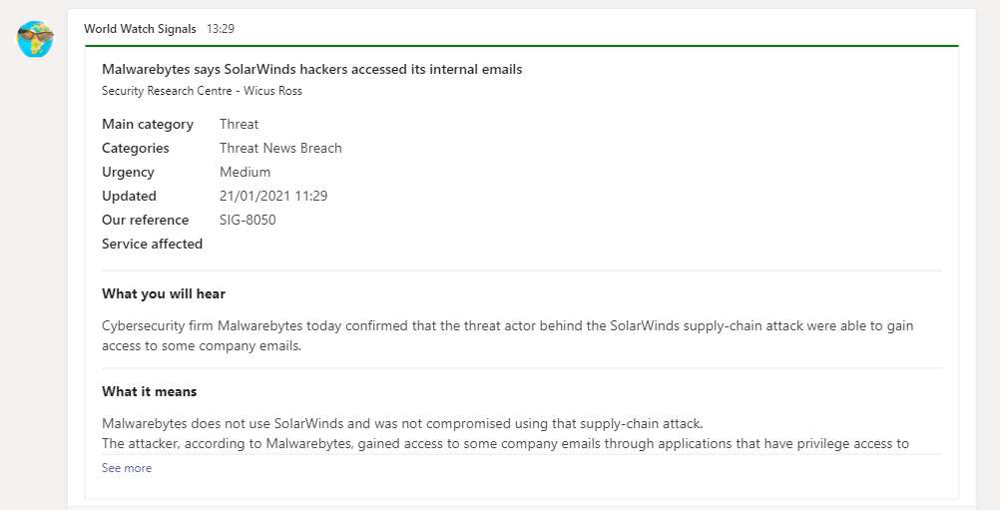
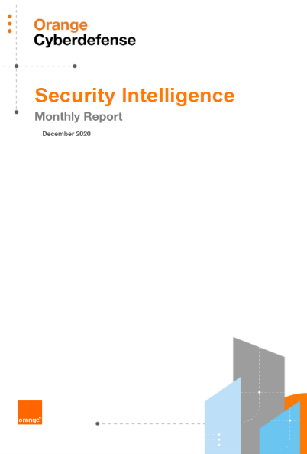
Know what to do after hearing the news.
World Watch Threat Advisory:
Complimentary service for our customers, at no extra cost.
Real-time alerts on current cybersecurity events and guidance on response actions.
Monthly report with further in-depth analysis and recommendations.
Powered by our proprietary intelligence and analysis from the Orange Cyberdefense Global Security Research team.
Notes:
Do you know what to do after watching the news? Our World Watch Threat Advisory is a complimentary service, free to our customers and gives real-time alerts and guidance when cybersecurity events happen. Our global Security Research team works with our in house intelligence and analysis to write an additional monthly report with further in-depth analysis and recommendations.

Slide 31

Managed Vulnerability Intelligence [identify]
Have an accurate view of your attack surface
Managed Vulnerability Intelligence [identify] is a vulnerability monitoring service. Our experts identify your vulnerable assets with a scanner and provide you with a complete report including the guidance on remediation.
16.000 security vulnerabilities discovered in 2018
80% of attacks exploit a known vulnerability
Needs
Unpatched vulnerabilities in exposed services are an easy way in for attackers
How can you have an accurate view of your attack surface, vulnerabilities and weaknesses together with proactive guidance on remediation ?
Solution
Identify and catalogue your internal / external assets
Collect & monitor vulnerability data
Enrich vulnerability data with threat intelligence
Proactively alert on global threats and vulnerabilities
Benefits
A complete asset view and associated risk data
Enriched reports with threat intelligence and guided remediation
Why Orange?
Cybersecurity expertise
Managed service
Threat intelligence capabilities

Slide 32
Managed Vulnerability Intelligence
Better understand your vulnerabilities to mitigate threats.
Benefits:
Stay ahead of exploitable vulnerabilities ​
Real-time alerts on the vulnerabilities impacting your information system and the patches to be applied via Managed Vulnerability Intelligence [watch].
Contextualize the threat in your environment
Scanning your assets to identify and catalogue, pin-point vulnerable ones, gain guidance on remediation and monitor vulnerability mitigation performance via Managed Vulnerability Intelligence [identify].
Modular managed services to help you reduce risks on your business your exposure
+5.000 products monitored, with vulnerabilities analysed and recommendations provided by our in-house CERT
Notes:
With managed vulnerability intelligence you can understand your vulnerabilities. You can benefit from real time alerts and scanning the vulnerabilities in order to identify them

Slide 33
Managed Cloud Security [infrastructure]
Comprehensive Cloud Native Security
Get visibility of your cloud assets and reduce your attack surface by
reducing the risk of configuration mistakes and known vulnerabilities.
Expand your detection capabilities to Public Cloud
Needs
Visibility of cloud assets in hybrid cloud environments
Identify and mitigate vulnerabilities in public cloud
Detect and respond to threats in public clouds
Solution
Provide real-time visibility into hybrid public cloud environments
Provide alerts about important vulnerabilities
Detect and report on cloud behaviours that could be a threat to the company
Benefits
Understand your cloud environment
Reduce the risk of breaches in the cloud
Detect existing threats in your cloud
Why Orange?
Cloud and Cybersecurity experts
Strong portfolio
including Cloud Advisory services & 24/7 Detection & Response Services
Proximity
Local teams close to you

Slide 34







Ethical Hacking
Identify and fix your security vulnerabilities before they are exploited.
SensePost, an ethical hacking team of Orange
Cyberdefense:
Penetration tests
Red
Team
Providing you with vital decision-making information to ensure that your business, applications and networks are secure.
A senior team with 20+ years of experience
Technical & application audits
Comprehensive and flexible approaches specific to your goals
Phishing simulations
Research-led approach with regular contributions to public research
Notes:
With Ethical Hacking you can test your system and know your weaknesses. Identify and fix your security vulnerabilities before they are exploited. How ? through different services like for example penetration tests, application audits, phishing simulations.

Slide 35

Managed Firewall
Protect your environment with the First Line of defense
Managed firewall provides customers with a complete solution of designing & building the first line of defense, with a team to manage & maintain and tune the solution following business and security requirement.
Needs
Expensive and difficult to staff a complete SOC to perform
Outdated firewall ruleset allows unauthorized access
Firewalls are the first line of defence
Difficult to keep track of all vulnerabilities associated with firewall model & operating system
Solution
Different vendor technologies and different platform types (physical , virtual or on public cloud)
We manage in different flavours (support only , Co-managed or Fully managed)
We maintain the life cycle/support and Product license for the customer
Cyber SOC services based on integration with threat intelligence and threat protection policy management services
Benefits
Complete firewall / policy management and review
Complete risk assessment for current policy
Integration of Firewall logs with threat intelligence for better security and awareness of current risks / attacks
Time/Cost Saving
Why Orange?
Security Partnership by working closely with customer
Threat intelligence , vulnerability and risk assessment capabilities
Different SOC teams to cover 24*7 Management all over the world
Notes:
Different SOC teams to cover 24*7 all over the world

Slide 36
Web Protection Suite (WPS)
Protect Users & Control Access to Applications
WPS is a cloud-based security platform which allows companies to consistently enforce their security policies, and secure their employees internet access at all times, on all devices, and in any location.
WPS provides as well a Zero-Trust Network Access (ZTNA) to corporate applications for employees
& 3rd parties while leveraging a single unified agent.
Trusted by 350+ customers, 2.4M end-users protected
OPEX model for Licenses + Services
Needs
NextGen architecture that provides protection for users & corporate applications.
Manage risks associated with localized Internet access in every location (e.g. SD-WAN)
Consistent policy enforcement irrespective of user location & device
Visibility & reporting
Maximize ROI
Solution
150+ Datacentres worldwide
Solution includes SSL Inspection, URL Filtering, Anti-Xware, Advanced Threat Protection, DLP, CASB, Cloud Sandbox, NG Cloud Firewall, etc.
Zero Trust model for accessing corporate applications using a unified agent.
Live reporting with dashboards
Benefits
Cloud based solution with no additional on-site appliances
Policy enforcement at all times, on any device
99.999% availability SLA
OPEX model helping CISOs/CIOs accelerate their cybersecurity plans
Why Orange?
One of the largest global Zscaler partners and the largest for managed services
300+ Certified Zscaler Experts

Slide 37
Email Protection Suite
Protect your messaging servers against all threats
Controls inbound and outbound messaging flows.
Manage all threats and suspicious emails outside your network.
Let experts manage your email security.
Spam catch rate 99%
Known virus blocked 100%
Antimalware solution and Graymail solution
Needs
How to reduce the risk of attacks and infections by targeted spam campaigns and malwares?
How to receive only messages related to your business?
How to limit the load on your servers and your internet access?
How to protect hybrid architecture, on premises servers and O365?
Solution
Cloud services solution
Availability : 99,99 %
Multilingual quarantine
Management by Orange
Scalability of the solution
Benefits
Scalable solution, compatible with all messaging systems, including cloud email solutions
Benefit from monthly billing, at fixed cost, without infrastructure to buy
Entrust the management of your security to experts and free your teams from the fight against spam
Why Orange?
Cybersecurity Experts
Managed Services
Strong Partnership

Slide 38

DDoS Protection
Prevent volumetric and low slow attack against critical assets
DDoS protection is monitoring inbound internet traffic.
It allows to clean-up non legitimate traffic targeting customer critical asset accessible from
public @IP before it reach a specific resource.
158% increase of DDoS attack in S1/2020 (YoY)
1,5 Gbps is the average volume of a DDoS attack
Needs
New DDoS every day
More and more critical services are exposed on Internet
How could I be sure my critical asset will be available 100% ?
Solution
Manage a customer review to list critical Assets
Configure detection rules and adapt threshold to real incoming traffic
Continuously monitor incoming traffic from Internet
Activate and manage mitigation and clean up in case of DDoS attack
Benefits
Early detection to mitigate risk of DDoS attack before it impact critical assets
Reduces time to mitigate on every internet access (Single point of contact)
Service available 24 x 7
Why Orange?
Cyber Security Expertise
DDoS protection is done in our Backbone
Solution for Orange and 3rd party connections

Slide 39
DDoS Protection
Prevent volumetric and low slow attack against critical assets
DDoS protection is monitoring inbound internet traffic.
It allows to clean-up non legitimate traffic targeting customer critical asset accessible from
public @IP before it reach a specific resource.
158% increase of DDoS attack in S1/2020 (YoY)
1,5 Gbps is the average volume of a DDoS attack
Needs
New DDoS every day
More and more critical services are exposed on Internet
How could I be sure my critical asset will be available 100% ?
Solution
Manage a customer review to list critical Assets
Configure detection rules and adapt threshold to real incoming traffic
Continuously monitor incoming traffic from Internet
Activate and manage mitigation and clean up in case of DDoS attack
Benefits
Early detection to mitigate risk of DDoS attack before it impact critical assets
Reduces time to mitigate on every internet access (Single point of contact)
Service available 24 x 7
Why Orange?
Cyber Security Expertise
DDoS protection is done in our Backbone
Solution for Orange and 3rd party connections

Slide 40
Flexible Applications Access
Remote access on demand
Flexible Applications Access is our managed remote access solution. You can provide remote access to your network or to your applications with granular access. Your end-users can connect from anywhere with any kind of device. The number of remote users is flexible and can be adjusted according to your needs.
6/10 people working remotely would like to continue homeworking after the Covid crisis
74% of CFOs consider permanent teleworking for some employees
Needs
Hybrid networks
Crisis situation requiring more remote users for a limited period of time
How can you have one single solution answering remote access but also security together?
Solution
Multi networks solution and hosting capabilities
Granular access to applications according to the end-user profile
Simplified end-user experience
Scalable solution: increase and decrease number of remote users
Benefits
One single point of contact to manage the global solution (support, release management…)
Co-management capabilities: configuration, licenses management, reporting
Why Orange?
Cybersecurity and network expertise
Managed Service
Strong SASE story and SDWAN strategy

Slide 41
Flexible Identity Authentication
Ease and secure your application accesses
Secure all connections to applications in hybrid environments, whether in the Cloud or on-premise, with intelligent contextual and multi-factor authentication.
99.9% efficiency against unwanted login attempts
81% of data thief involve the use of password
Needs
  Strengthen the security of access to corporate resources through security policies
  Improve browsing on business applications through Single Sign-On
  Access to corporate resources from tablets and smartphones
  Adapt authentication mechanisms according to the risks
Solution
Cloud-based turnkey access management solution, easy to use and manage
Makes browsing your business applications smoother and protects your corporate resources
Reducing your operating costs
Benefits
  Protect corporate resources
  Simplified monitoring
  Reduce your IT/Security budget: pay-per-use monthly billing and reduction of password requests to the helpdesk
  Respond to regulatory constraints
Why Orange?
Scalable and flexible offer with busness guarantee
Custom support & change management
Expertize at any time of your project

Slide 42
Flexible Security Platform Cloud
Protect against internet threats
Flexible Security Platform, a solution that perfectly controls the uses of your users and in particular: access to applications in the cloud, email, websites...
This ensures that all these uses are free of threats thanks to advanced protection services.
Needs
Custom security level to protect against internet threats
Manage the security level & policy
Ask for expert help
Solution
Next gen virtual firewall and internet access in OBS data center (up to 400Mbps)
Helpdesk 24/7/365
Digital customer journey and pay as you use model
Benefits
Modular, scalable service that can be activated online on a pay-per-use basis
Complete protection of your internet, site and nomadic flows
Complete reporting on the level of security of your company
Internet access included
Why Orange?
Cyber security expertise
world class telecom operator
Innovation & technology

Slide 43
Flexible Security Platform Local
Protect against internet threats
Flexible Security Platform, a solution that perfectly controls the uses of your users and in particular: access to applications in the cloud, email, websites...
This ensures that all these uses are free of threats thanks to advanced protection services.
Needs
Custom security level to protect against internet threats
Manage the security level & policy
Ask for expert help
Solution
Next gen firewall on customer premise (or OBS data center) up to 4Gbps
Helpdesk 24/7/365
Digital customer journey and pay as you use model
Benefits
Modular service that can be activated online on a pay-per-use basis
Complete protection of your internet, site and nomadic flows
Complete reporting on the level of security of your company
Why Orange?
Cyber security expertise
world class telecom operator
Innovation & technology

Slide 44
Web Application Guardian by Orange (Wago)
Protect your web servers against all threats
Web Application Guardian by Orange protects Internet applications or client websites
against HTTP or HTTPS attacks such as cross site scripting, SQL injections,
traffic generated by malicious bots etc.
40% of data leaks suffered by companies have passed through the website
10 Major OWASP &
DDoS layer 7 protection included
Needs
New vulnerabilities are discovered every day!
How to preserve the activity and image of my company?
How to ensure the availability and compliance of my Internet service or application?
Solution
Cloud services solution
Web Application Firewall offer
Scalability of the solution
Possible integration with your SIEM
24/7 Support
Benefits
Block attacks before they impact your Web Service
Benefit from monthly invoicing, at a fixed cost, with no infrastructure to buy
Entrust the management of your security to experts
Why Orange?
Cybersecurity Experts
Managed services
Strong Partnership

Slide 45
Active Prevention
Intrusion detection and Prevention System
Active prevention is a service based on McAfee NSP that act as a dedicated IPS with full resources to stop and mitigate attacks that matches on signatures or anomalies
Needs
Need for a dedicated intrusion prevention System
Identify unfamiliar hosts and networks that trigger malicious activity or anomalies
Need for immediate enforcement solution on network level
Solution
Dedicated IPS based
Policy can be basic or customized following your needs
Integration with CyberSOC SIEM to identify more attacks
Benefit
Policy implementation and continuous tuning
Immediate automated response action for attacks
Further detection with integration in our Cyber SOC SIEM
Save Money & cost for stafffing a CyberSOC team for accurate analysis of all identified attacks
Why Orange?
Continues analysis, response and reporting by (Cyber)SOC
Integration with Cyber SOC shared SIEM
150+ analysts delivering CyberSOC activities over 10 years

Slide 46

Managed Cybercrime Monitoring
Extend Managed Detection and Response capabilities outside of your infrastructure
Managed Cybercrime Monitoring provides a broad range of digital risk management capabilities. Processing large amounts of unstructured data, across millions of sources, the service enables visibility into Operational Threat Intelligence incidents in areas such as Data Leakage, Brand and Reputation, Phishing (web pages as well as phishing email analysis), and Social Media.
Needs
Monitor the open, deep and dark web for data breaches orl data loss
Prevent brand exploitation or brand misuse
Monitor the online attack surface and increasing issues with Shadow IT
Solution
Delivered by an experienced CERT team / carefully selected 3rd party threat intelligence providers
Fully managed service that is delivered as a hosted monitoring infrastructure
Benefits
Huge data gathering capability across millions of sources, with machine learning and language processing techniques
Human analysis of potential incidents including classification and prioritization
Strategic reporting delivered by a multi-lingual cybercrime monitoring team
Why Orange?
20+ cybercrime analysts delivering intelligence services for over 17 years
Member of TF-CSIRT and FIRST, strong partnership with vendors

Slide 47



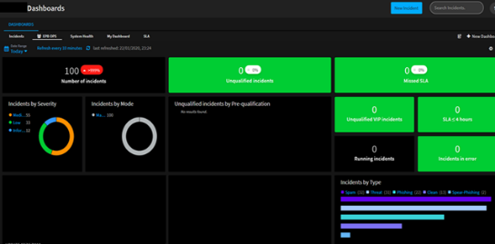
Managed Cybercrime Monitoring
Monitor your assets outside your corporate perimeter.
Benefits:
Managed Cybercrime Monitoring – Email
Managed Cybercrime Monitoring Fraud – Domain
Managed Cybercrime Monitoring Fraud – Phishing
Preserve your brand reputation.
Cybercrime Monitoring tools
Monitoring, qualification and remediation security events outside of your network.
20 years of expertise in the fight against cybercrime.
Get access to multi-skilled, multi-language cybercrime experts who work hard to understand your business context and apply it to deliver relevant, targeted and actionable intelligence back to you.​
Phishing Analytics
Takedown Management
Data Leakage Monitoring
Notes:
It is essential as well to monitor your assets outside your corporate perimeter to protect you against Fraud : email; domain, phishing
We have 18 years of expertise in the fight against cybercrime. Get access to multi-skilled, multi-language cybercrime experts who work hard to understand your business context and apply it to deliver relevant, targeted and actionable intelligence back to you.​

Slide 48





Threats on the USB vector can have
far-reaching consequences.
Critical Industrial Infrastructure
An employee downloaded the film La la land on a USB key during his break. As a result, the operational system of a nuclear power plant was infected.
Source : Kaspersky 2019
International
events
Gift-given USB fans suspected of carrying spyware
Source : Le Monde 2018
Leading player in the industry
USB Flash Drives delivered to its customers and infected by malware.
Source : Data security breach 2018
Industrialsabotage
Intellectual property theft
Data destruction
Ransomware

Slide 49
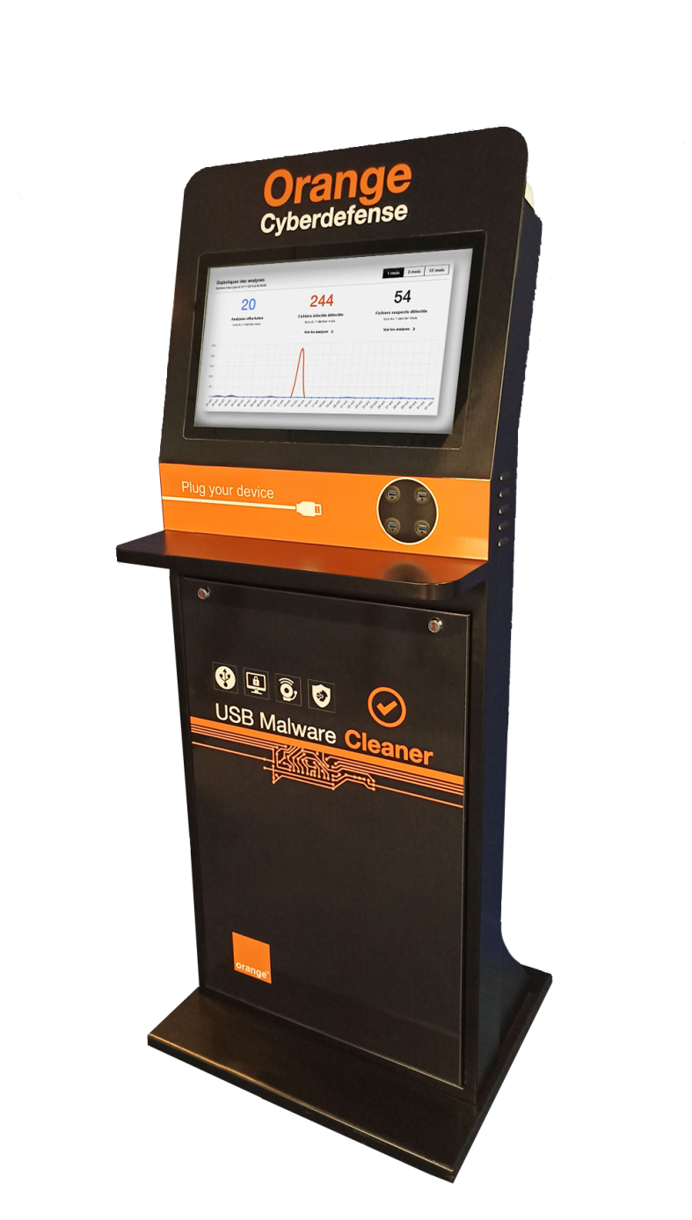
It's hard to do without USB devices, so how do you protect yourself?
There are decontamination solutions that allow you to analyze the contents of a USB device.
But Malware Cleaner goes further!

Slide 50
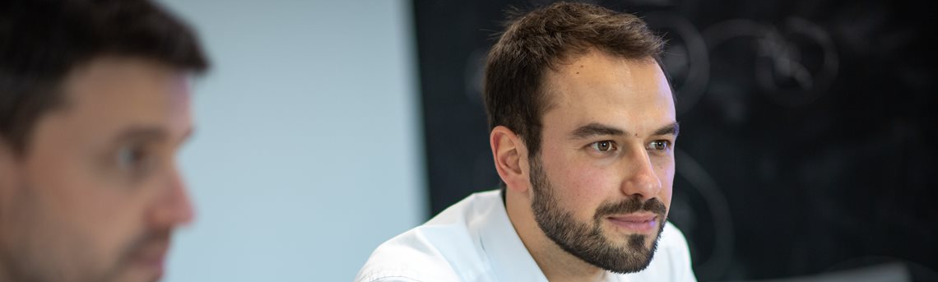
Protection against viral infections adapted to your business needs
1
2
3
A comprehensive protection
8 anti-viruses integrated in the solution
Protection of workstations via the Malware Cleaner agent
Remote analysis of suspicious files
BAD USB detection
A highly configurable solution
Configuration of the solution according to your security policy
On-line or off-line updates, depending on your needs
Local or remote monitoring and configuration via your administration console
An offer available under
4 formats
Customizable kiosk
Mini-kiosk
Nomadic Key
System version

Slide 51
Managed Threat Detection [endpoint]
Detect, Correlate & Respond to advanced Endpoint Attacks
Managed Threat Detection [endpoint] is a managed detection and response service used to detect and correlate events from all endpoints across the enterprise (including office environments, remote workers and servers) as well as providing active threat response capabilities.
Needs
Endpoint is a focal point for attackers and requires dedicated monitoring
Users may be connecting from systems and environments that are insecure or poorly
A balance of visibility and data vs. management of the noise
Requirement to correlate endpoint data across the Enterprise
Solution
Agent package that can be deployed quickly to deliver full context of all endpoint activities
Scheduled / ad-hoc threat hunting through Orange
Platform is continuously tuned based on customer case feedback
Malicious Operations are forwarded to the Security Analysts 24x7 and triaged, analysed, prioritised and escalated
Benefits
Comprehensive Endpoint Visibility with Endpoint detection based on cross-machine correlation
Advanced Analysis capabilities & Threat Hunting techniques
Rapid 24x7 analysis and managed threat response
Quick time-to-value
Why Orange?
Detection Coverage (Log, Endpoint & Network)
Broad range of Incident Response options
150+ analysts delivering CyberSOC activities for over 10 years

Slide 52
Managed Threat Detection [network]
Identify Hidden Attacks within Network Traffic
Managed Threat Detection [network] is a managed detection and response service that primarily supervises, analyzes, and detects security anomalies on a Customer’s network – including inside encrypted traffic and in public cloud environments - and optionally enables response actions via the addition of Managed Threat Response.
Needs
Better visibility inside the Network
Need for a solution that identifies hidden attacks that have already evaded signature-based solutions
requirement for an automated solution to identify and detect potential attacks
24x7 analysis & response activities
Solution
Network detection and response platform designed and implemented in customer network
You will receive incident notifications
Optional services of threat hunting and account based Managed Threat Response
Benefits
Complete Network Visibility
World class security analysis
24x7 Monitoring & Response
Time & Cost Savings compared to internally resourcing
Why Orange?
Detection Coverage (Log, Endpoint & Network)
Broad range of Incident Response options
150+ analysts delivering CyberSOC activities for over 10 years

Slide 53

Managed Threat Detection [log]
Security Event Intelligence
Detect and investigate suspicious behaviour on customer infrastructure
Security Event Intelligence detects the most complex threats in the customer's IT infrastructure.
Default Content package with more than 200 security rules
Scalable solution Ingesting more than 1 million of EPS per day
Needs
Investigaton to detect external intrusion is very expensive
How could I check every suspicious event on my network ?
How to continuously improve my security sanity?
Solution
Based on SIEM that ensures the continuous good functioning of your Information System (IS) by aggregating, co-relating and analyzing logs
Easy to change:
Scope covered by detection
Monitoring strategy
Alert management
Benefits
We qualify the alerts to guarantee that your team don’t waste time on false positives
We provide actionable recommendations to neutralize cyber attacks
Detection strategy suited to your business
Alerts reported in real-time (24x7)
Proactive Threat Hunting
Why Orange?
Cyber security expertise
End-to-end attack analysis
Relevant information extracted from the massive amount of data received

Slide 54
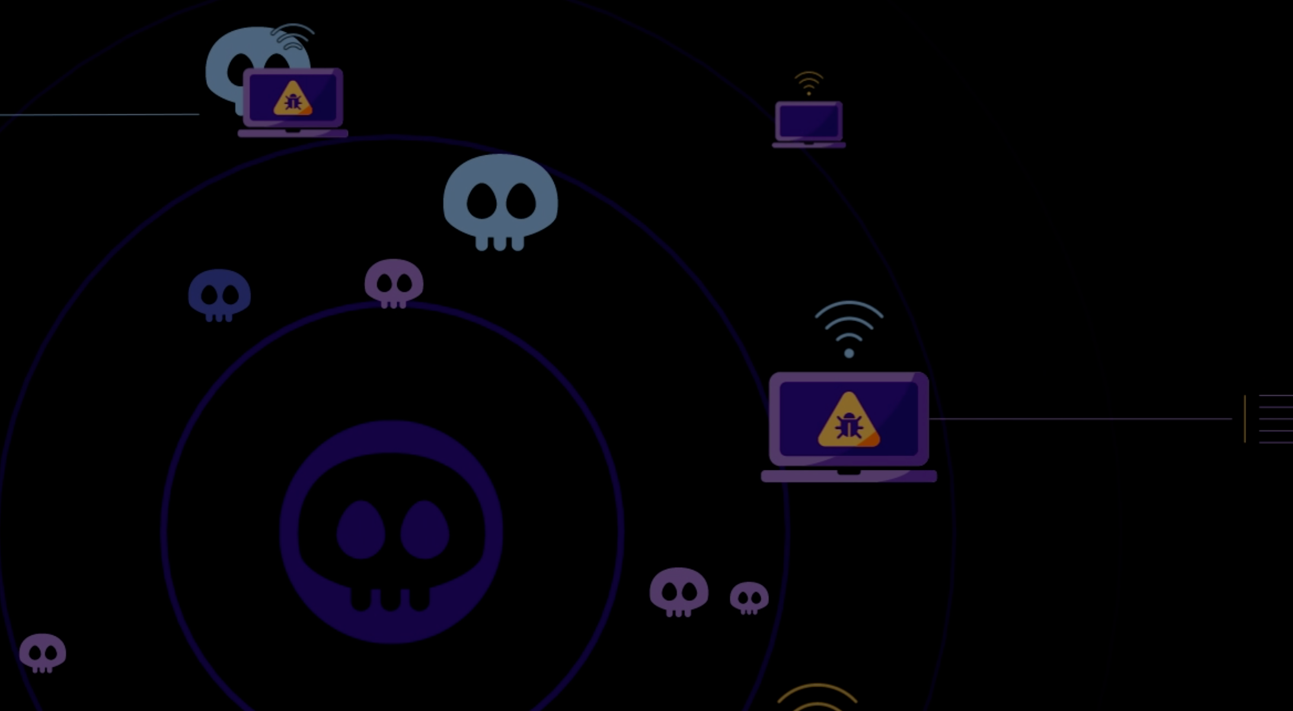

Managed Threat Detection:
Detecting breaches in real time
Benefits:
Complete detection visibility
Gain insight inside and outside of your organisation to detect cyber security threats.
The SOC Triad, supported by our
Threat Detection Framework
Intelligence-led security
We invest heavily in Research and Development to detect and respond to the latest tactics, techniques and procedures.​
Endpoint Detection and Response
Network Detection and Response
Log based / SIEM
Active response
A broad range of active response options are available 24x7x365 to suit your security operations needs .​
“Orange Cyberdefense is a Representative Vendor of Managed Detection and Response Services.”
Save time and costs
We use innovative techniques to ensure that incidents are investigated in context and noise is reduced as much as possible. ​
Notes:
The challenge with detection is that there is not one type of technology that solves the complete set of detection requirements. There is a need for conducting detection across multiple sources including log data, network data and endpoint data. There are also threat activities that happen outside of your infrastructure that may cause a risk to your business that needs to be detected.
You can probably not solve all these problems at the same time, but you can choose a security partner with a complete MDR portfolio that can guide you to your best investments.
Orange Cyberdefense offers a complete Managed Threat Detection portfolio that covers not only the SOC triad of log, network and endpoint but also detection of threats to your business on the Open, Deep and Dark Web. We help you to start with the most relevant monitoring for your current need, and then expand as your business requires.

Slide 55

Incident Response Services
Retainer, Emergency Response, Digital Forensics and Compromise Assessment
Subscribe to expert Incident Response capabilities
Conduct in-depth investigations to understand potential or already identified security breaches
Incident Response Retainer services provide access to a highly experienced and multi-skilled CSIRT (Computer Security Incident Response Team) on-demand, 24x7, 365 days a year. The CSIRT also deliver one-off engagement focused on Emergency Response scenarios, Digital Forensics investigations and Compromise Assessments to attempt to discover signs of a breach.
Needs
Reduce the time between discovery of a breach and remediation, in order to limit financial losses and brand/reputation damage
Be prepared for cyber security incidents and to handle them in a consistent way
GDPR and other regulations or compliance requirements
Solution
Incident Response hours purchased on retainer subscription,
Emergency Response services available even to you without a contract
Digital Forensics capabilities
Compromise Assessment
Benefits
Be prepared to face the ever-growing threat of cyber attacks
Expertise available to cover the entire incident response lifecycle
One of the largest CSIRT teams in Europe
Why Orange?
20+ responders across Europe, backed up by a broader CERT team of 80+
Member of TF-CSIRT and FIRST, as well as CREST accreditation
Analyst recognition for Digital Forensics and Incident Response from Gartner, Forrester and others

Slide 56
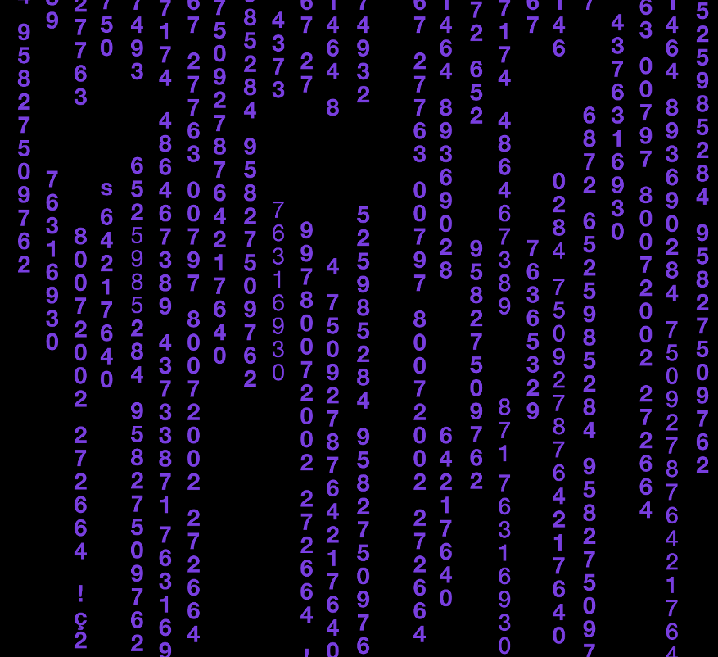
Incident Response Services
Be better prepared to face the ever-growing threat of cyber attacks.
Benefits:
Fill the resource gap in a modular fashion.
Preparation
We ensure that our customers are better prepared to face the ever-growing threat of cyber attacks.​
Incident Response
Incident Response Consulting
Compromise Assessment
Digital Forensics
End-to-end response
Expertise to cover the entire incident response lifecycle and to fill resource gaps in a modular fashion.
Access to skilled resources
Specialist skills across many different disciplines, with one of the largest CSIRT teams in Europe as well as access to the wider CERT team.​
“Orange Cyberdefense is a Representative Vendor of Digital Forensics and Incident Response services.”
Easy to work with
Access to an adaptable, customer-centric team that passionately believe in what they do.​. ​
Notes:
The key to mitigating the impact of any cybersecurity incident is the reaction time between detection and response. Don’t wait for an incident to happen. Discover our solutions to be better prepared to face the ever-growing threat of cyber attacks.

Slide 57
End-to-end Incident Response
Incident Response Retainer
Incident Response Consulting
Compromise Assessment
Emergency Response
Managed Detection
and Response
Digital Forensics
Preparation
Identification
Containment
Eradication
Recovery
How will we handle incidents if they occur?
What is the event, is it classed as an incident?
Working to your IR goals to achieve the right results.
Safely removing the highlighted issues.
Restoring your network to a safe operating state.
Notes:
And we deliver a set of services within incident response that really cover the end to end lifecycle. So what you see in front of you along the bottom
here is a typical incident response Lifecycle and the phases of incident response
Preparation. Understanding how you will handle incidents if they occur.
Through to identification. What is the event that has caused an incident? Is it even classed as an incident? Sometimes we may
get involved at this stage to help understand if something is even an incident. Or not.
Once you've identified the incident and its severity and a number of other factors, we then are looking at containment - working
to our customers incident response goals to achieve the right results for them.
Eradication is the next step and that’s the stage where we are looking at safely removing the highlighted issues, making sure that once we've
contained the incident we then start to get rid of anything (for example malware) – any kind of residual effects of the incident
Finally, Recovery - getting the customer back to a safe operating state. Also taking lessons that we’ve learned from any incident that we've handled and feeding that back into Preparation. So this is an ongoing lifecycle, not an end to end process and then it is done. It very much carries on continuously.
So what do we do in each of these stages?
Preparation is very focused on incident response consulting. Our assessment and advisory consultants, working very closely with our CSIRT teams, deliver a lot of preparation services. Looking at things like reviewing the customers’ incident response readiness; looking at incident response plans; delivering training exercises etc.
Next we have our compromise assessment. This is really focused on whether our customers have an existing breach. Identifying if there are incidents happening that the customer doesn't know about.
Then we have our managed detection and response services. These are delivered by our CyberSOCs who work very closely with our Incident
Response team. It’s worth showing this within the slide because it is part of the incident response process and whenever you have our managed detection and response services then certainly the identification and containment phases are delivered within the orange cyberdefense operational scope. We have 24/7
eyes on these areas for our customers, so we deliver a part of that initial incident response phase, particularly those early phases.
The next thing we deliver is emergency response, so any customer can call us with a request for incident response, and typically that happens once they've identified an incident themselves. We will handle such cases if we have the capacity, (and that's a key thing - this isn't a service that can be purchased in advance. It's a service that is delivered entirely at our discretion. Often though, we can help and will look to quickly let you know if we cannot.
As we move Later in the lifecycle, if a customer has their own incident response team internally, or if they have got cyber insurance for example, and the
insurance companies come in and have had someone handle those initial stages of identification and containment, there's still often the requirement for digital forensics. This can also be the case if there is going to be legal action taken as part of, for example a policy breach, something that is perhaps more focused around the insider threat or delicate situations.
Our incident response retainer really stretches across this entire lifecycle. It gives the customer the assurance that we can handle any of these things and in a very flexible way. They can buy a set of hours from us to use on retainer and with the comfort that if they do call us we will be there to respond within a set of SLAs (as opposed to emergency response).

Slide 58
Managed Threat Response
Extend Managed Threat Detection / Managed Cybercrime Monitoring capabilities to include containment / remediation activities
Managed Threat Response services enable Customers to further transfer responsibility to Orange Cyberdefense to deliver initial active response actions, through adding endpoint isolation to Managed Threat Detection services, or adding takedown capabilities to the Managed Cybercrime Monitoring.
Needs
Close the gap between initial detection of security incidents and custom actioning of such incidents
To reduce the risk of not having people available to respond to identified incidents 24x7
Solution
Managed Threat Response [Isolation] is an add-on service that attaches to the Managed Threat Detection service family
Managed Threat Response [Takedown] attaches to Managed Cybercrime Monitoring services
Benefits
Managed Threat Response [Isolation]
rapidly isolate infected endpoints and reduce time between initial detection and threat disruption
Managed Threat Response [Takedown]
Efficient takedown of fraudulent, malicious or sensitive content, to minimize impact of Cybercrime incidents
Why Orange?
Experience & Expertise in delivering active response services for many years
Experience and active cooperation with internet hosting and service providers

Slide 59




Combine MSS + MDR for the best intelligence value
Benefits:
Simplification & cost efficiency
A single trusted partner to support security management, monitoring and incident response
Risk reduction
Effective preventative and response measures, minimizing risk and potential impact of breaches
Agility
Fast and coordinated detection, preventative and response measures
Collective Intelligence
Benefit from our threat intelligence backbone, enriched by real-time observations from our SOC, CyberSOC and CERT
Constantly monitored and tuned to provide the best protection
Detection across multiple sources, inside and outside the corporate perimeter
Containment and remediation according to agreed governance
Secure Infrastructure:
network, applications, data
Endpoint & Mobile Security
Identity & Access Management
Cloud & Application Security
OT / ICS Security
Incident Response Services
Managed Threat Detection
Managed Security Services
Notes:
The most suitable way, to get the best intelligence value is to combine our managed security services and managed detection and response capabilities.
Our managed security services to constantly monitor and tune to get the best protection
Managed Threat Detection to detect across multiple sources, both inside and outside the corporate perimeter
And our Incident Response Services to contain and remediate according to the agreed governance
A single trusted partner will simplify the process, and be cost efficient. It will minimize the risk and potential impact of breaches, because of the fast and coordinated detection, preventative and response measures. While in parallel you will be benefiting from our threat intelligence backbone, for collective intelligence.

Slide 60
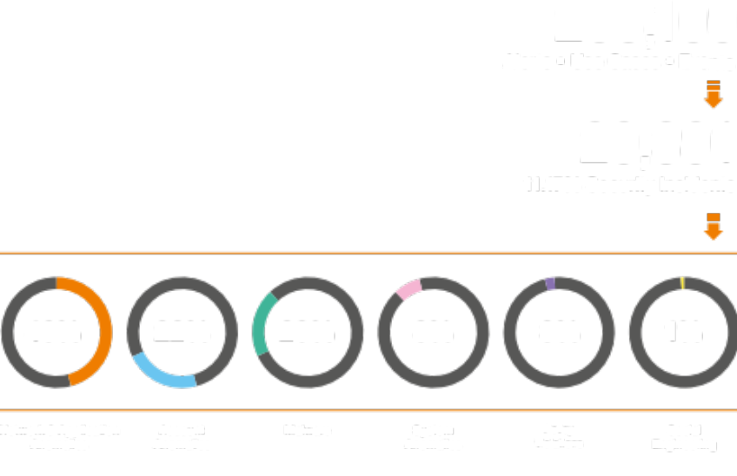
Decrease wasted time on false alerts, improve response to real incidents.
X 10 productivity
< 5% false positives
Proprietary threat use-cases, response playbooks and embedded threat intelligence.
In-house CSIRT / CERT, malware analysis, proprietary 3rd-gen sandbox and Signal Intelligence lab.
Threat alliances with key vendors, governments and international organizations.
Monitoring of IT, OT, Cloud environments
Notes:
Managed threat detection and response allows you to reduce alert fatigue, improving your team’s productivity and improving response to real incidents.
Our service is much more than deploying turnkey technologies such as SIEM, EDR (Endpoint Detection and Response) or NTA (Network Traffic Analysis). Our engineers fine-tune platforms with exclusive use cases, and triage and qualify alerts on a continuous basis thanks to our embedded proprietary threat intelligence. In addition, our cutting-edge research and tools means you can focus on what really matters.
This can include extending monitoring and response beyond on-premise IT to Cloud and OT environments, for complete threat management across the organizational digital environments.
If a real incident is identified, we are right by your side to help contain and remediate it via our in-house CSIRT/CERT teams.
[Notes:
1. on productivity increase. The 10x calculation is based on the ratio of alerts to incidents. We can also assume the alerts management would take an equivalent 65 FTE, 29K+ security incidents are 7FTE and the saving from our value-add is 58 FTE in total. As these total number of alerts correspond to a significant part of our customer base, it is not applicable to single customers. Hence, a ratio of circa x10 between 7->65
2.The total number of alerts and incident represent a sample of the total that the CyberSOC and CSIRT teams oversee on an annual basis. Source: Orange Cyberdefense Security Navigator 2020 Guide]

Slide 61






Streamline your security with other IT services Outsource your IT and connectivity, we secure your data journey together with Orange Business Services.
Collect
data respecting privacy and regulation
Transport
data around the world
Store & Process
safely, according to your needs
Analyze
data to turn into useful information
Collaborate & Create
value for your teams, your clients and your projects
Consulting
Integration
Security across the data journey
Notes:
For multinationals seeking to outsource IT and connectivity, Orange Business Services offers solutions across the data journey. As the Orange Group’s specialist cyber security division, we power the security services for OBS embedding security across connectivity, cloud and mobility solutions.
This approach allows you to streamline security with other outsourced IT services and easily orchestrate across multiple vendors with a single point of contact and full visibility. This is especially critical in case of a security incident.
What you gain: greater efficiency, better supplier value and security effectiveness.
[Note on the full data journey framework]
[COLLECT]
The first step of the journey is to locate and collect the data. Orange already manages 15 million connected objects and is skilled at combining IoT and external data to generate new insights.
[TRANSPORT]
Thanks to our expertise in business, mobile, virtualized and subsea networks, we get our customers’ data in the right place at the right time for analysis so that the cloud and IT user experience remains optimal, all around the world, at the office or in mobility. It’s our network operator core business with WAN, voice enterprise, or SD WAN solutions
[STORE & PROCESS]
We develop cloud platforms and software solutions to facilitate the exploitation of the data by AI tools. We manage our own data centers in accordance with the data privacy governance rules in Europe and other jurisdictions around the world.
[ANALYSE]
Our data analysts are skilled in using AI to extract and decipher insights from considerable volumes of data to help enterprises with decision making.
[SHARE & CREATE]
We also enable our customers to share AI data insights and create new value with them through customer-facing applications. Our "collaborative workspace" solutions – including social enterprise network platforms - facilitate the exchange and sharing of insights between teams. While our expertise in contact centre management and Customer Relationship Management systems to drive personalized web experiences allows the optimization of multichannel customer touchpoints.

Slide 62

Protect industrial environments from cyber threats.
Visibility
Compliance
Segmentation
Secure access
Notes:
OT, ICS and office IT are increasingly sharing networks. Production, sensors, health and medical equipment are now increasingly interconnected with IT and cloud. Often, these devices aren’t designed with security in mind, and they don’t play nice with your processes.
Keep control of proprietary protocols
A large part of industrial control systems uses proprietary protocols and software. We provide solutions that enable non-intrusive network visibility and analysis for OT networks, supporting such proprietary protocols.
Well-designed segmentation with next-generation firewalls, separating production environments and equipment reduces the risk of unauthorized access. In addition, remote management solutions leveraging isolation provide the highest levels of security.
In addition to the technical solutions, we provide managed detection and response services specifically designed for OT and industrial networks, with 24×7 capabilities

Slide 63
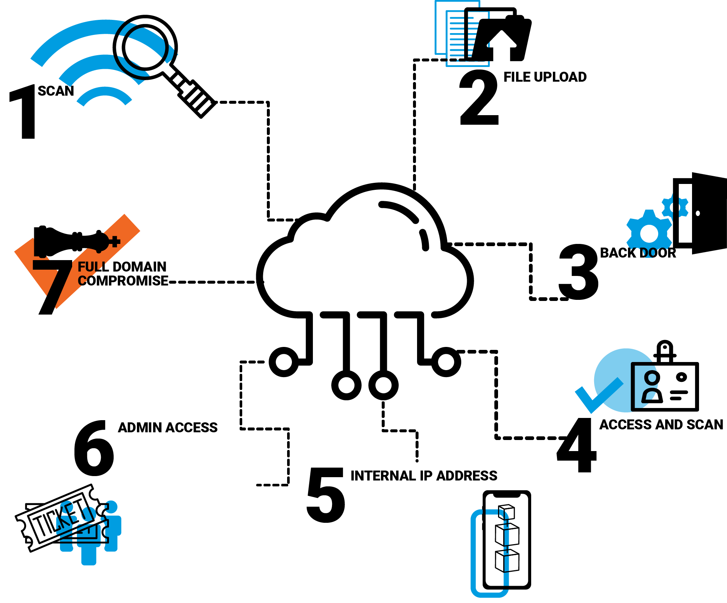
Find out your real security weaknesses to invest effectively.
Powered by SensePost, our elite pentesting arm.
Notes:
In order to invest effectively in protection and detection technologies and services, you need to find out your real security weaknesses are.
Our 150+ penetration testers and specialist consultants can help with a range of ethical hacking and consulting services.
You can be assured you are supported by the best: our experts regularly provide training for aspiring pen-testers, publish research and actively participate in the cyber community and events including BlackHat, DEFCON and others.

Slide 64
Secure your digital assets and your brand image.
45K rogue sites blocked per year
100 rogue app stores monitored
Notes:
We help you stay one step ahead by continuously looking out for threats to your brand, crawling the web, deep and dark web for any sigs of website fraud, phishing data leakage, early indications of a targeted attack, rogue mobile apps, amongst others.
Our memberships into global alliances such as the Phishing Initiative and the European Cyber Security group ensure we are constantly informed of nascent threats for your benefit.
We monitor over 100 rogue app stores, and take down over 45k rogue websites that can damage our customers reputation per month.

Slide 65
Manage the complexity of multi-cloud security
Simply using cloud integrated security capabilities is not enough.
Security needs across multiple clouds and on-premise needs to be strengthened.
Compliance
Intrusion detection
Ransomware protection
Encryption
Privileged access
Log management
Notes:
Cloud gives you flexibility, scalability and agility. But how do you secure it, especially with multi-cloud and a hybrid on-premise and cloud environment?
Only 10 % of security needs of MNC are covered by CSPs, this number is slightly higher at 30s % for SMBs (source: Bain)
We help you:
- ensure consistent security and compliance across multi-cloud and hybrid cloud environments and simplify security operations by gaining deep, cross-cloud security visibility.
enforce security policy management across multi and hybrid cloud deployments and perform incident investigations
deploy additional security solutions and services to strengthen CSP capabilities
Our services can be delivered consistently regardless of the Cloud services & providers:
Targeted threat intelligence
Regulatory & compliance Shadow IT
Infrastructure security
Data protection
Container security
Detect and manage security alerts across multiple clouds
Incident Response
Cyber resilience
[Note: Common questions about CSPs security tools:
Is it compliant with my security policy?
How to protect against generic malware?
How to detect intrusions?
How to protect against ransomware?
Do you have more than one encryption solution or encryption vendor in your organization?
How do you provide key lifecycle management for your existing encryption solutions?
Who controls and access the keys?
Is a simple bastion enough ? How do I protect my privileged user ?
How to use log management in a global security operation center? ]

Slide 66

Organizations of all sizes already rely on our expertise.
Focus on safety, partnership on duty: Our SOC services for Blanc & Fischer
"As a CISO, I am happy to have Orange as a professional partner for defending against cyber threats.“
Marc-Andre Pantea // CISO
Notes:
And you would not be the first one to rely on our intelligence-led expertise.
In March 2020, LUCA School of Arts was hit by a cyberattack. As a result, the IT systems were not available. A rapid intervention was required to get rid of the ransomware on the IT systems. To avoid such attacks in the future, LUCA School of Arts wanted a solution that had to meet two important criteria.
- A fast and secure system restart was needed in the short term.
- And the solution also had to detect and shut down any suspicious activities on the IT systems. Preferably 24/7.

Slide 67

Organizations of all sizes already rely on our expertise.
Managed Threat Detection [XDR] with MS Defender
for FlüWo
"As a CISO, I am happy to have Orange as a professional partner for defending against cyber threats.“
XXX // CISO
Notes:
And you would not be the first one to rely on our intelligence-led expertise.
In March 2020, LUCA School of Arts was hit by a cyberattack. As a result, the IT systems were not available. A rapid intervention was required to get rid of the ransomware on the IT systems. To avoid such attacks in the future, LUCA School of Arts wanted a solution that had to meet two important criteria.
- A fast and secure system restart was needed in the short term.
- And the solution also had to detect and shut down any suspicious activities on the IT systems. Preferably 24/7.

Slide 68

Organizations of all sizes already rely on our expertise.
Breach & Attack Simulation for BESTSECRET
"It helps us to stay close on the attackers' heels, quickly improve security controls, and stay at our best.“
Amine Abed // Team Lead Cyber Defense
Notes:
And you would not be the first one to rely on our intelligence-led expertise.
In March 2020, LUCA School of Arts was hit by a cyberattack. As a result, the IT systems were not available. A rapid intervention was required to get rid of the ransomware on the IT systems. To avoid such attacks in the future, LUCA School of Arts wanted a solution that had to meet two important criteria.
- A fast and secure system restart was needed in the short term.
- And the solution also had to detect and shut down any suspicious activities on the IT systems. Preferably 24/7.

Slide 69
Organizations of all sizes already rely on our expertise.
Cyberdefense for TAL, by
the development of a strategic
Security infrastructure.
"What we appreciate about the cooperation with Orange Cyberdefense is the efficient way of working and the excellent know-how. The implementation was a great success.“
Günther Baumann // Security Responsible at Deutsche Oelleitung GmbH
Notes:
And you would not be the first one to rely on our intelligence-led expertise.
In March 2020, LUCA School of Arts was hit by a cyberattack. As a result, the IT systems were not available. A rapid intervention was required to get rid of the ransomware on the IT systems. To avoid such attacks in the future, LUCA School of Arts wanted a solution that had to meet two important criteria.
- A fast and secure system restart was needed in the short term.
- And the solution also had to detect and shut down any suspicious activities on the IT systems. Preferably 24/7.

Slide 70

Organizations of all sizes already rely on our expertise.
Firefighting at
Metabo
“I was impressed with how quickly and accurately the incident response team was able to identify the attack vector and implement appropriate sustainable preparedness measures."
Thomas Rinas // Head IT Metabowerke GmbH
Notes:
And you would not be the first one to rely on our intelligence-led expertise.
In March 2020, LUCA School of Arts was hit by a cyberattack. As a result, the IT systems were not available. A rapid intervention was required to get rid of the ransomware on the IT systems. To avoid such attacks in the future, LUCA School of Arts wanted a solution that had to meet two important criteria.
- A fast and secure system restart was needed in the short term.
- And the solution also had to detect and shut down any suspicious activities on the IT systems. Preferably 24/7.

Slide 71

Organizations of all sizes already rely on our expertise.
Grenzebach relies on the Managed Threat Detection Services from Orange Cyberdefense.
"Together with Orange Cyberdefense, we are able to check our network 24/7 for attacks and our provider can directly prevent/isolate attacks in an emergency. As a result, we have been able to increase our security maturity level many times over.“
Benjamin Eckert, Manager Global IT Infrastructure
Notes:
And you would not be the first one to rely on our intelligence-led expertise.
In March 2020, LUCA School of Arts was hit by a cyberattack. As a result, the IT systems were not available. A rapid intervention was required to get rid of the ransomware on the IT systems. To avoid such attacks in the future, LUCA School of Arts wanted a solution that had to meet two important criteria.
- A fast and secure system restart was needed in the short term.
- And the solution also had to detect and shut down any suspicious activities on the IT systems. Preferably 24/7.

Slide 72

Organizations of all sizes already rely on our expertise.
Orange Cyberdefense's 24/7 services protect T.CON around the clock
“Working with Orange Cyberdefense has proven to be an ideal decision. Their outstanding CyberSOC enables smooth 24/7 service for our endpoints. Orange Cyberdefense's expertise combined with products from Palo Alto Networks has taken our cybersecurity to a new level."
Roland Kühnel // Information Security & Compliance Officer
Notes:
And you would not be the first one to rely on our intelligence-led expertise.
In March 2020, LUCA School of Arts was hit by a cyberattack. As a result, the IT systems were not available. A rapid intervention was required to get rid of the ransomware on the IT systems. To avoid such attacks in the future, LUCA School of Arts wanted a solution that had to meet two important criteria.
- A fast and secure system restart was needed in the short term.
- And the solution also had to detect and shut down any suspicious activities on the IT systems. Preferably 24/7.

Slide 73

Organizations of all sizes already rely on our expertise.
IMS Gear: Worldwide drive technology at the highest level
"After moving to the new XDR solution, we have excellent visibility and are better equipped than ever against modern cyber threats. With Orange Cyberdefense, we have a competent partner at our side – both in strengthening our security architecture and in the rapid detection and handling of security incidents.“
Manuel Furtwängler // Director IT-Operations
Notes:
And you would not be the first one to rely on our intelligence-led expertise.
In March 2020, LUCA School of Arts was hit by a cyberattack. As a result, the IT systems were not available. A rapid intervention was required to get rid of the ransomware on the IT systems. To avoid such attacks in the future, LUCA School of Arts wanted a solution that had to meet two important criteria.
- A fast and secure system restart was needed in the short term.
- And the solution also had to detect and shut down any suspicious activities on the IT systems. Preferably 24/7.

Slide 74
Managed Threat Detection [XDR] with Microsoft Defender for FLÜWO
"The cooperation with Orange Cyberdefense was characterized by fast, uncomplicated onboarding and a close, trusting exchange. We were particularly impressed by the flexibility in adapting the security measures and the professional support.“
Lasse Förster // Project Manager IT Security
Notes:
And you would not be the first one to rely on our intelligence-led expertise.
In March 2020, LUCA School of Arts was hit by a cyberattack. As a result, the IT systems were not available. A rapid intervention was required to get rid of the ransomware on the IT systems. To avoid such attacks in the future, LUCA School of Arts wanted a solution that had to meet two important criteria.
- A fast and secure system restart was needed in the short term.
- And the solution also had to detect and shut down any suspicious activities on the IT systems. Preferably 24/7.

Slide 75

Full visibility thanks to
Microsoft and Orange Cyberdefense
"By choosing Orange Cyberdefense as MSSP and consistently using Microsoft's security platform, we have taken a decisive step towards future-proofing.
The close cooperation and holistic solutions give us the confidence to be optimally protected even in an ever-changing threat environment.
This allows us to concentrate fully on our core business and know that our sensitive data is in the best hands.“
Matthias Pfeffer // Director Professional Services
Notes:
And you would not be the first one to rely on our intelligence-led expertise.
In March 2020, LUCA School of Arts was hit by a cyberattack. As a result, the IT systems were not available. A rapid intervention was required to get rid of the ransomware on the IT systems. To avoid such attacks in the future, LUCA School of Arts wanted a solution that had to meet two important criteria.
- A fast and secure system restart was needed in the short term.
- And the solution also had to detect and shut down any suspicious activities on the IT systems. Preferably 24/7.

