Slide 1

White Wine Quality
Kriesnawan handy s

Slide 2
Introduction
Today, varied consumers enjoy wine more and more.
Wine industry is researching new technologies for both wine making and selling processes in order to back up this growth.
Determination of wines is not an easy process remembering to the complexity and heterogeneity of its compenents.
The classification of wines is very important because of economic value of wine products, A bottle of wine is priced based on its quality.

Slide 3
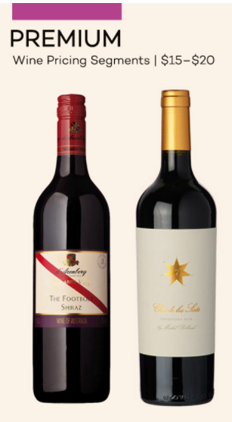
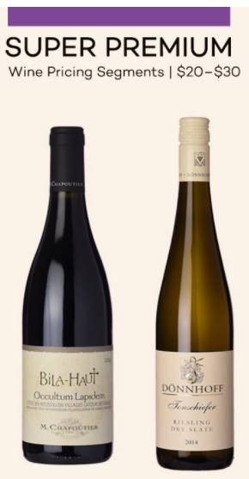
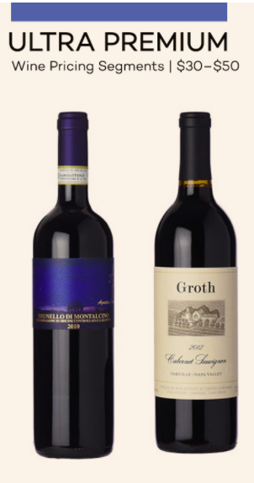
Introduction
We can use machine learning model that can predict the quality of wine and help the wine maker setting the go to market price.

Slide 4
Purpose
Determine the correlation between quality of wine and its components
Predict the quality of wine, according to its components
Determine the components that has the greatest impact on quality

Slide 5
Features

Slide 6
Features

Slide 7
Data
 | fixed_ acidity | volatile_ acidity | citric_acid | residual_sugar | chlorides | free_sulfur _dioxide | density | pH | sulphates | alcohol | quality | bound_sulfur _dioxide
count | 4898 | 4898 | 4898 | 4898 | 4898 | 4898 | 4898 | 4898 | 4898 | 4898 | 4898 | 4898
mean | 6.854788 | 0.278241 | 0.334192 | 6.391415 | 0.04577 | 35.308085 | 0.99403 | 3.18827 | 0.489847 | 10.51427 | 5.87791 | 103.052572
std | 0.843868 | 0.100795 | 0.12102 | 5.072058 | 0.02185 | 17.007137 | 0.00299 | 0.151 | 0.114126 | 1.230621 | 0.88564 | 34.7217
min | 3.8 | 0.08 | 0 | 0.6 | 0.009 | 2 | 0.98711 | 2.72 | 0.22 | 8 | 3 | 4
max | 14.2 | 1.1 | 1.66 | 65.8 | 0.346 | 289 | 1.03898 | 3.82 | 1.08 | 14.2 | 9 | 331

Slide 8
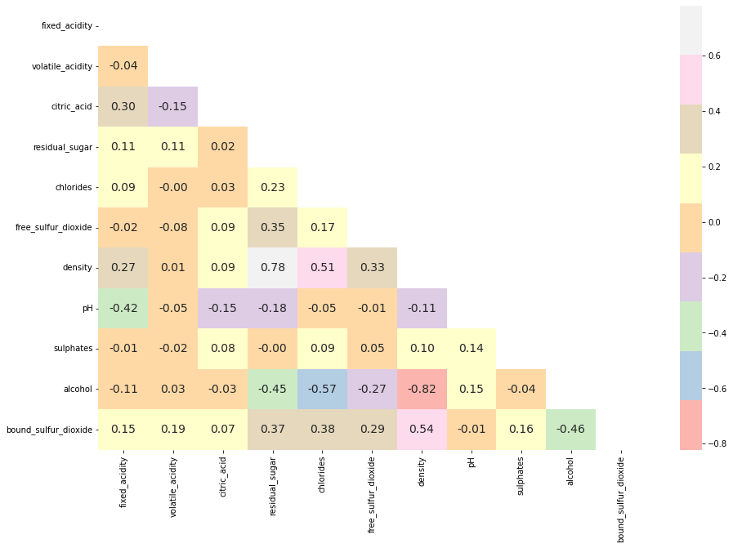
Correlation

Slide 9
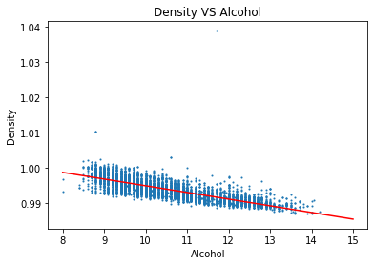
Alcohol VS Density (r = -0.82)
Density of Alcohol (ethanol) = 0.789
The mixture density will be decreasing because the ethanol density

Slide 10
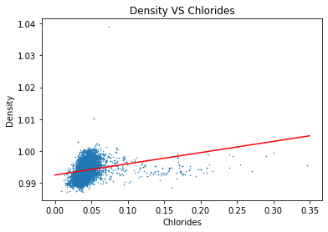
Density VS Chlorides
Density of Alcohol chlorides > 1

Slide 11
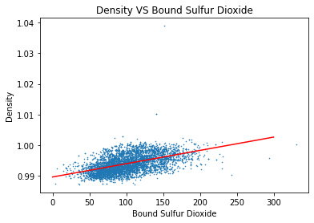
Density VS Bound Sulfur Dioxide
Density of Alcohol chlorides = 1.377

Slide 12
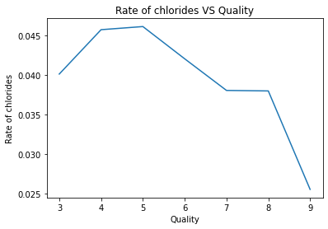

Slide 13
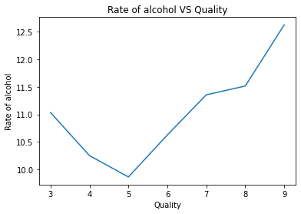
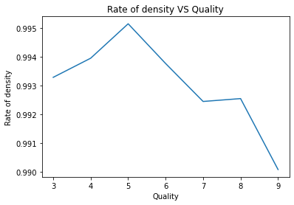

Slide 14
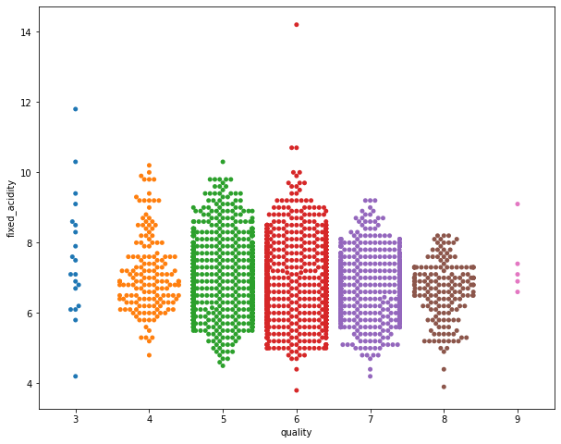
Outliers

Slide 15
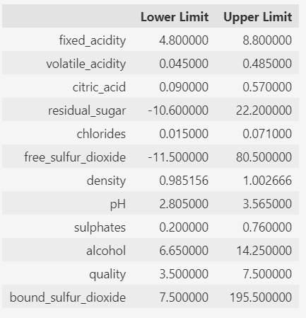
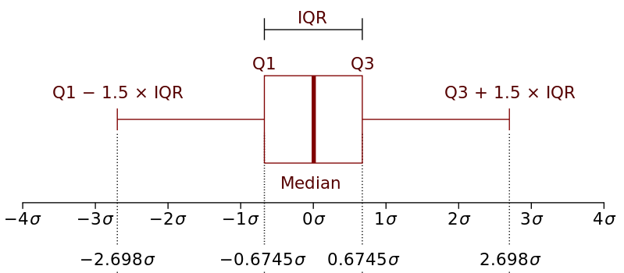
Remove Outliers
Remove outliers based on statistical method :
  lower limit : Q1 – (1.5 * IQR)
  upper limit : Q3 + (1.5 * IQR)
    Where,
      IQR = Q3 - Q1
      IQR = Interquartile
      Q1 = first / lower quartile
      Q2 = third / upper quartile

Slide 16
Data Information
Amount of Original data = 4898
Amount of Clean data = 3989

Slide 17
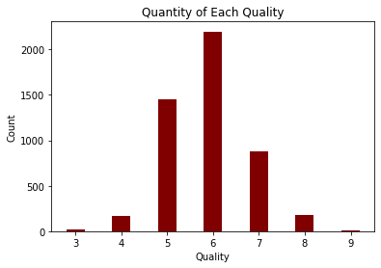
Low
Medium
High

Slide 18
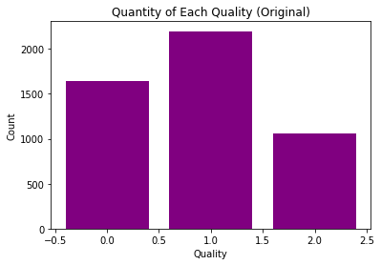
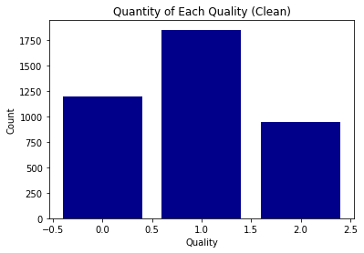
Quantity of Classes

Slide 19
Split Training and Test data
Data
20 %
80 %
Training Data
Testing Data
20 %
80 %
Training Data
Validation Data

Slide 20
Model ML (Ori Data)
KNN
N_neighbors = 3
 | KNN | Random Forest | XGBoost
Precision | 50.38 | 67.48 | 69.23
Recall | 50.68 | 64.35 | 70.14
F1 | 50.29 | 65.52 | 69.61
Accuracy | 52.42 | 65.34 | 70.15
Random Forest
Max_depth = 14
N_estimators = 500
XGBoost
Learning_rate = 0.7
Max_depth = 26
N_estimators = 300

Slide 21
Model ML (Clean Data)
 | KNN | Random Forest | XGBoost
Precision | 48.02 | 72.86 | 69.9
Recall | 47.03 | 68.61 | 68.39
F1 | 47.28 | 70.29 | 69.08
Accuracy | 50.49 | 71.36 | 70.11
KNN
N_neighbors = 4
Random Forest
Max_depth = 16
N_estimators = 100
XGBoost
Learning_rate = 0.7
Max_depth = 12
N_estimators = 800

Slide 22
Predict Test Data
 | XGBoost
Precision | 69.53
Recall | 68.81
F1 | 69.14
Accuracy | 69.29

Slide 23
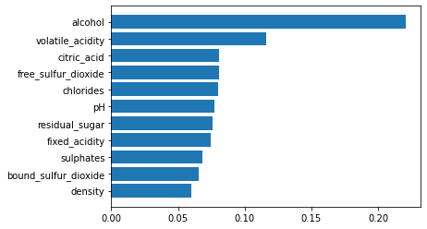
Features Importance

Slide 24
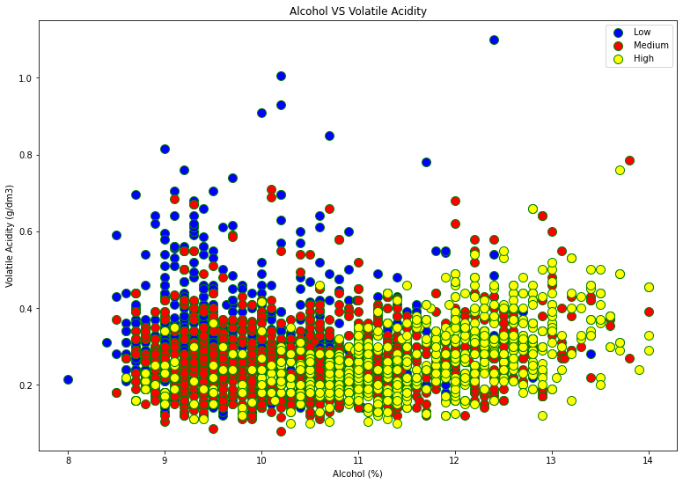
Alcohol VS Volatile Acidity

Slide 25
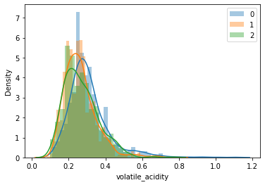
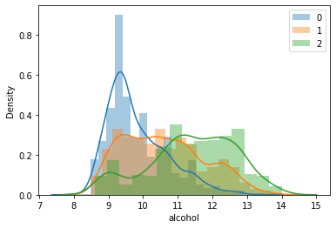
Dist of Volatile Acid and Alcohol

Slide 26
Dist of Alcohol
Quality | Mean | Median | Std
Low (0) | 9.83 | 9.5 | 0.86
Medium (1) | 10.59 | 10.5 | 1.16
High (2) | 11.41 | 11.5 | 1.24

Slide 27

Thank you

Slide 31
3w 1H
- Why : Supaya dapat memiliki racikan wine yang bersaing.
- What : Mengetahui korelasi antara quality berdasarkan variasi komponen pada wine
- Who : Wine makers (Manufacture)
- How : dengan model machine learning supervised (Klasifikasi)
Kita akan mengklasifikasi wine berdasarkan komposisi yang ada terhadap nilai quality yang memiliki rentang 1 – 10. (klasifikasi)
Goal : Mengetahui korelasi antara quality berdasarkan variasi komponen pada wine

Slide 33
Features (pengaruh masing2)
Fixed Acidity : Amount of Tartaric Acid in wine, measured in (g(tartaric acid)/dm³)
  The main organic acid in wine (the characteristic of grapes)
Volatile Acidity : Amount of Acetic Acid in wine, measured in (g(acetic acid)/dm³)
  Affected the aroma of the grape (placed in skin of grape), the molecule become the aroma of wine during fermentation
Citric Acid : Amount of citric acid in wine in (g/dm³).
  Contributes to crispness of wine.

Slide 34
Features
Residual Sugar : amonunt of sugar left in wine after fermentation. Measured in in (g/dm³)
  Fermentation is stopped before its end to keep some sugar (Mutage / Fortification)
Chlorides : amount of Sodium Choloride (salt) in wine. Measured in (g/dm³)
  Chlorides being a major contributor to saltiness
Free Sulfur Dioxide : Amount of SO2 in free form. Measured in (mg/dm³)
  The FSO2 and the pH of wine determine how much SO2 is available in the active
  Contributing a sharp/bitter/metallic/chemical flavour

Slide 35
Features
Total Sulfur Dioxide : Total Amount of SO2. (mg/dm³)
  Too much SO2 can lead to a pungent smell. SO2 acts as antioxidant and antimicrobial agent. (bound and free form). Bound to aldehydes, pigments, sugar
  Sulfur Dioxide can shift to free state
Density : Density of Wine in (g/cm³)
  The density of wine
pH : pH of Wine on a scale of 0-14
  0 means highly Acidic, while 14 means highly basic.

Slide 36
Feature
Sulphates : Amount of Potassium Sulphate in wine, measured in (g/dm³).
  Contributes to the formation of SO2. Acting as an antioxidant. Removing all the oxygen suspended in the wine which slows down aging.
Alcohol : alcohol content in wine (% volume)
  If alcohol is too high in a wine, it can taste “hot” or “burning”. Very difficult to pair with many foods.
  If a wine is too low in alcohol, the wine will taste “thin” or “watery”.
Quality : Wine Quality graded on a scale of 1 - 10 (Higher is better)

Slide 37
Data (Transpose, replace %)
 | fixed_acidity | volatile_acidity | citric_acid | residual_sugar
count | 4898 | 4898 | 4898 | 4898
mean | 6.854788 | 0.278241 | 0.334192 | 6.391415
std | 0.843868 | 0.100795 | 0.12102 | 5.072058
min | 3.8 | 0.08 | 0 | 0.6
25% | 6.3 | 0.21 | 0.27 | 1.7
50% | 6.8 | 0.26 | 0.32 | 5.2
75% | 7.3 | 0.32 | 0.39 | 9.9
max | 14.2 | 1.1 | 1.66 | 65.8

Slide 38
Data
 | chlorides | free_sulfur_dioxide | total_sulfur_dioxide
count | 4898 | 4898 | 4898
mean | 0.04577 | 35.308085 | 138.360657
std | 0.02185 | 17.007137 | 42.498065
min | 0.009 | 2 | 9
25% | 0.036 | 23 | 108
50% | 0.043 | 34 | 134
75% | 0.05 | 46 | 167
max | 0.346 | 289 | 440

Slide 39
Data
 | density | pH | sulphates | alcohol | quality
count | 4898 | 4898 | 4898 | 4898 | 4898
mean | 0.99403 | 3.18827 | 0.489847 | 10.51427 | 5.87791
std | 0.00299 | 0.151 | 0.114126 | 1.230621 | 0.88564
min | 0.98711 | 2.72 | 0.22 | 8 | 3
25% | 0.99172 | 3.09 | 0.41 | 9.5 | 5
50% | 0.99374 | 3.18 | 0.47 | 10.4 | 6
75% | 0.9961 | 3.28 | 0.55 | 11.4 | 6
max | 1.03898 | 3.82 | 1.08 | 14.2 | 9

