Slide 1

Reticent

Slide 2
Problem Statement
Nowadays, most people face social anxiety and are too scared to approach another person. Hence we miss out on the opportunity to create an experience for ourselves, make a connection, or even express what we are thinking.
We could lead much more fulfilling lives by conquering this little problem that exists only in our heads.

Slide 3
Background of the problem
We realize that the fundamental need for us humans is to talk, communicate and express ourselves. However, as we grew up, we became more conscious about how people would perceive us and what they would think about us; hence, this thought process holds us back from progressing and being ourselves.
The main background of the problem is to help people socialize and provide a safe environment.(in general and currently around the campus). We have seen many students not talking to each other, sitting alone on campus, and playing alone. We come across many people on campus who hesitate to speak or even say hi.

Slide 4
Requirements
Networking: The app should allow students to connect with other students in their college or university.
Academic and extracurricular sharing: The app should enable students to share information about their academic and extracurricular activities
User-friendly interface: The app should have a simple and intuitive user interface that is easy to navigate and use.
Support for multimedia: The app should support multimedia, such as photos, videos, and audio, to allow students to share their experiences more effectively.

Slide 5
Scope
Through this project, we aim to make a contribution towards this significant problem by helping people connect with another person in a safer environment. We are also considering creating a feature that helps like-minded individuals connect at that moment
For now, we are considering starting from our college IIITD, but later on, we could expand outside. There's no upper limit, as we could cover different colleges and the general public.

Slide 6
Scalability: The app should be able to handle a large number of users and be easily scalable to accommodate future growth.
Push notifications: The app should have push notifications to inform the students of important events, announcements, and other relevant information.
Interaction with Institution: The app should have a feature that allows students to interact with their institution, such as accessing their academic records, class schedules, and other official information.

Slide 7
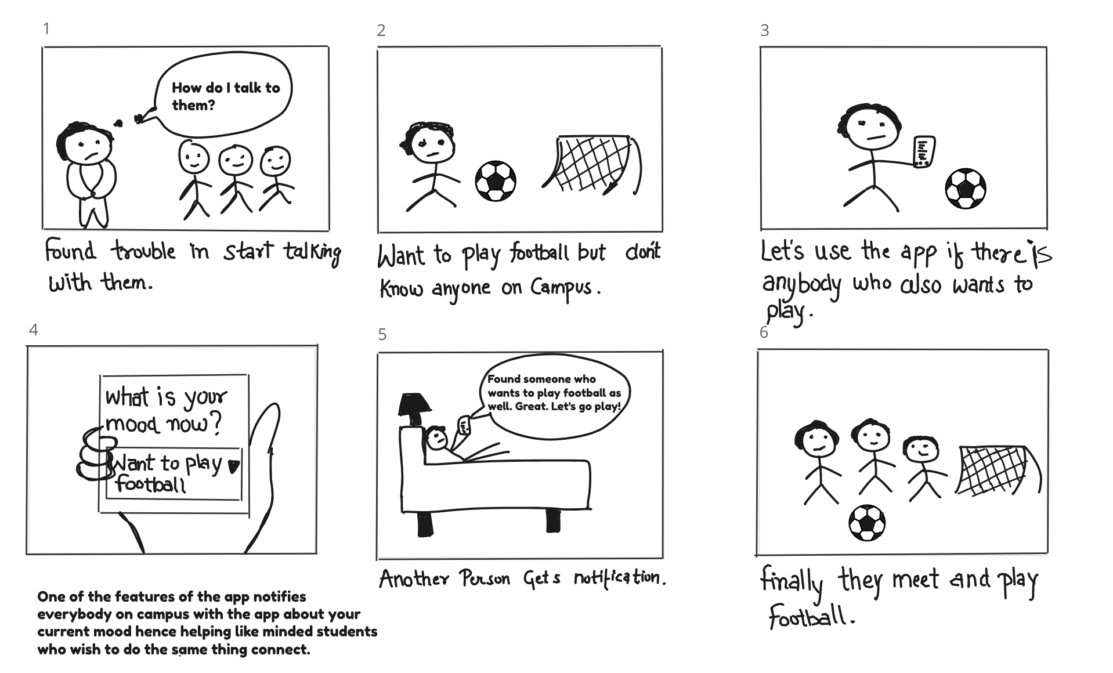
Storyboard

Slide 8
Research
To investigate the need for an excellent social media platform in college to socialize introverts, we will conduct a series of research methods, including:
Surveys and interviews: To gather information about introverted college students' socializing habits, preferences, and experiences with social media.
Focus groups: To gather feedback from introverted college students on their experiences with existing social media platforms and their needs for an ideal social media platform.
Usability testing: To evaluate the user experience and functionality of existing social media platforms for introverted college students.

Slide 9
This research has investigated the need for an excellent social media platform in college to socialize introverts. Through surveys, interviews, focus groups, and usability testing, we found that introverted college students prefer to use social media for socializing and that existing social media platforms may not fully meet their needs.
Therefore, there is a need for an excellent social media platform that provides a comfortable and safe space for introverted college students to connect with others. This would greatly improve the social media experience of introverted college students.
Research insights

Slide 10
Task Flow
Main Features
Profile creation
Posting updates (text, photos, videos, etc.)
Messaging and direct messaging
Networking
Connecting with friends and classmates
Joining groups and communities
Privacy and Safety
Account security (password, two-factor authentication)
Block and report feature
Interaction with Institution
Access to academic records
Class schedules and announcements
Library and study resource

Slide 11
Personalization
Customizable profile and settings
Themes and backgrounds
Push notifications
Multimedia Support
Photos and videos
Live streaming
Audio features
Integration
Integration with other apps (calendar, to-do list)
External sharing (Facebook, Twitter, etc.)
Analytics
User engagement
Content metrics
User demographics

Slide 12
Miro links
https://miro.com/app/board/uXjVP3bKp4I=/
https://miro.com/app/board/uXjVP3ICRlw=/?share_link_id=88685428600
https://miro.com/app/board/uXjVP3bKp4I=/?share_link_id=27409345097
https://miro.com/app/board/uXjVP9IFW80=/?share_link_id=268667715199
https://miro.com/app/board/uXjVP270qU0=/?share_link_id=625988866167

Slide 13
https://miro.com/app/board/uXjVP3bKp4I=/?share_link_id=27409345097
https://miro.com/app/board/uXjVP3bKp4I=/?share_link_id=27409345092
https://miro.com/app/board/uXjVP270qU0=/?share_link_id=359380766856
https://miro.com/app/board/uXjVP9IFW80=/?share_link_id=268667715199

Slide 14
Survey Links
https://docs.google.com/spreadsheets/d/1K1i7P8XIJEHPgTM1MtGWGH5VrpOCzaIpkcbxhMWucSc/edit?resourcekey#gid=649063324
https://docs.google.com/spreadsheets/d/1K1i7P8XIJEHPgTM1MtGWGH5VrpOCzaIpkcbxhMWucSc/edit?resourcekey#gid=649063324
https://docs.google.com/spreadsheets/d/1uXwPJj_9yV8QHyIBBA-G2zHAwJOew9-fRRoPP2E2uVI/edit?usp=sharing
https://docs.google.com/spreadsheets/d/1uXwPJj_9yV8QHyIBBA-G2zHAwJOew9-fRRoPP2E2uVI/edit?usp=sharing

Slide 15
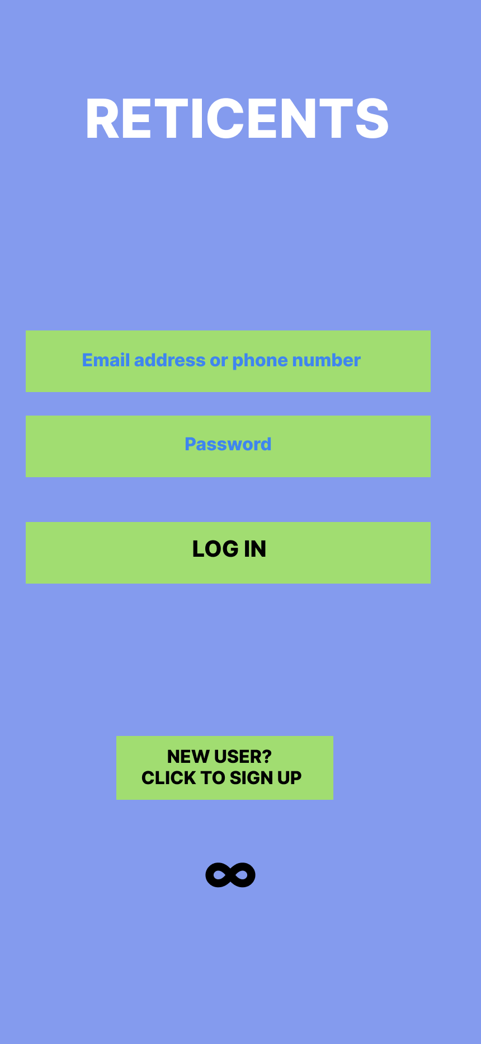
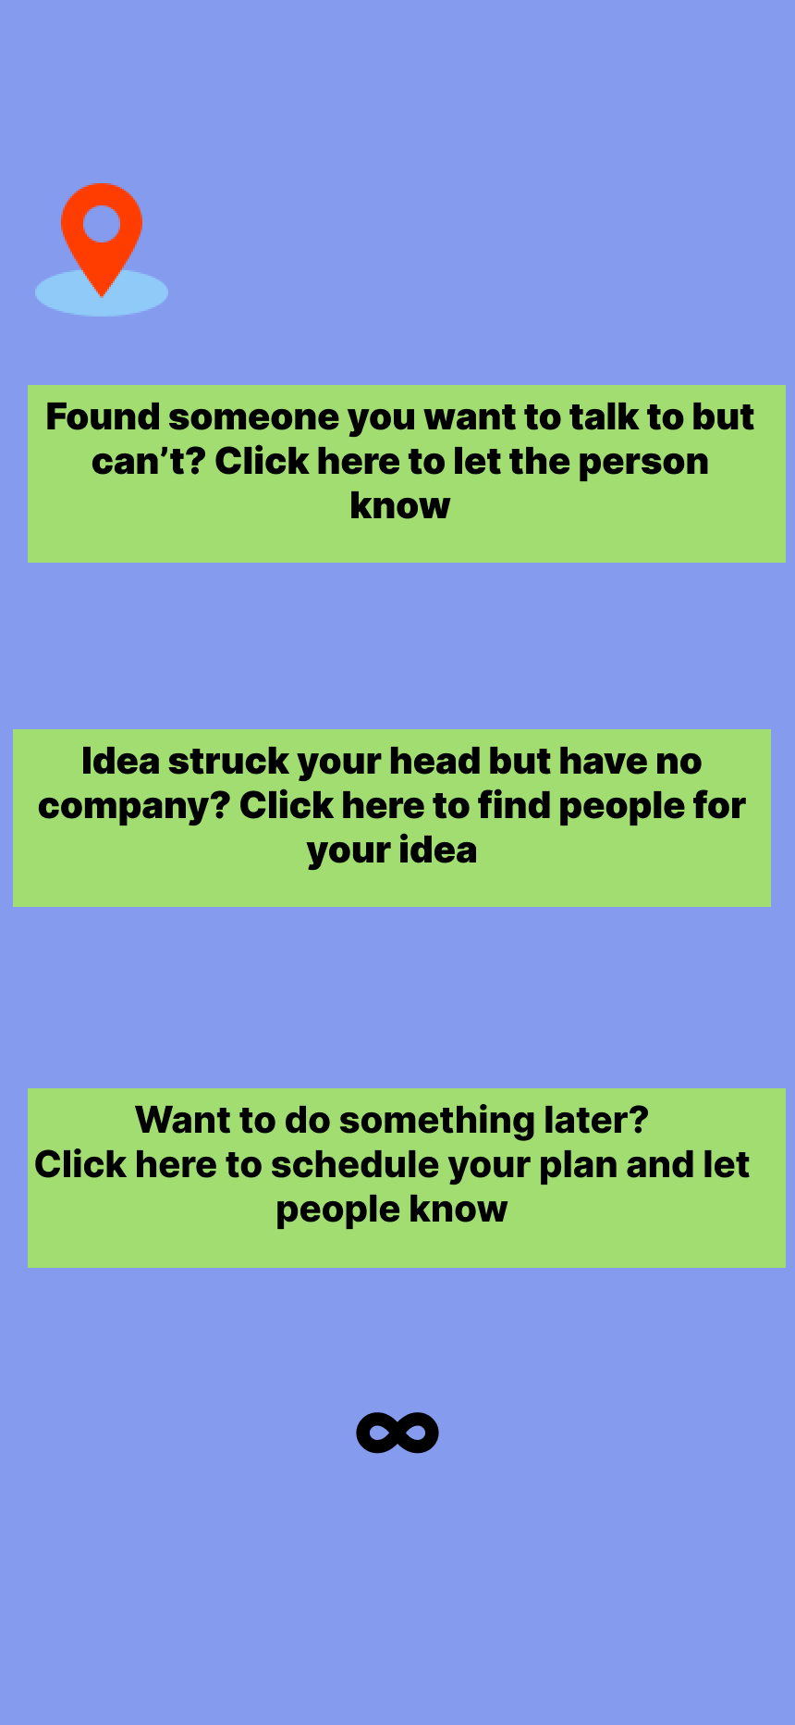
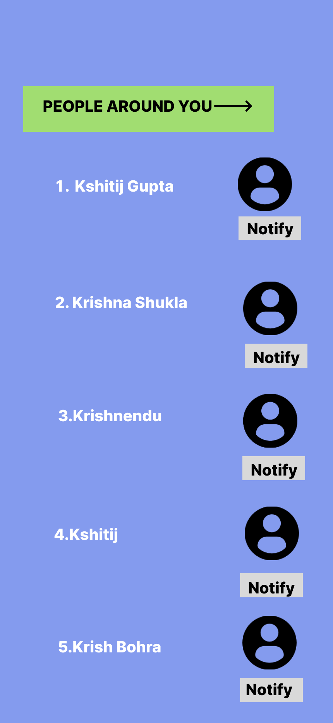
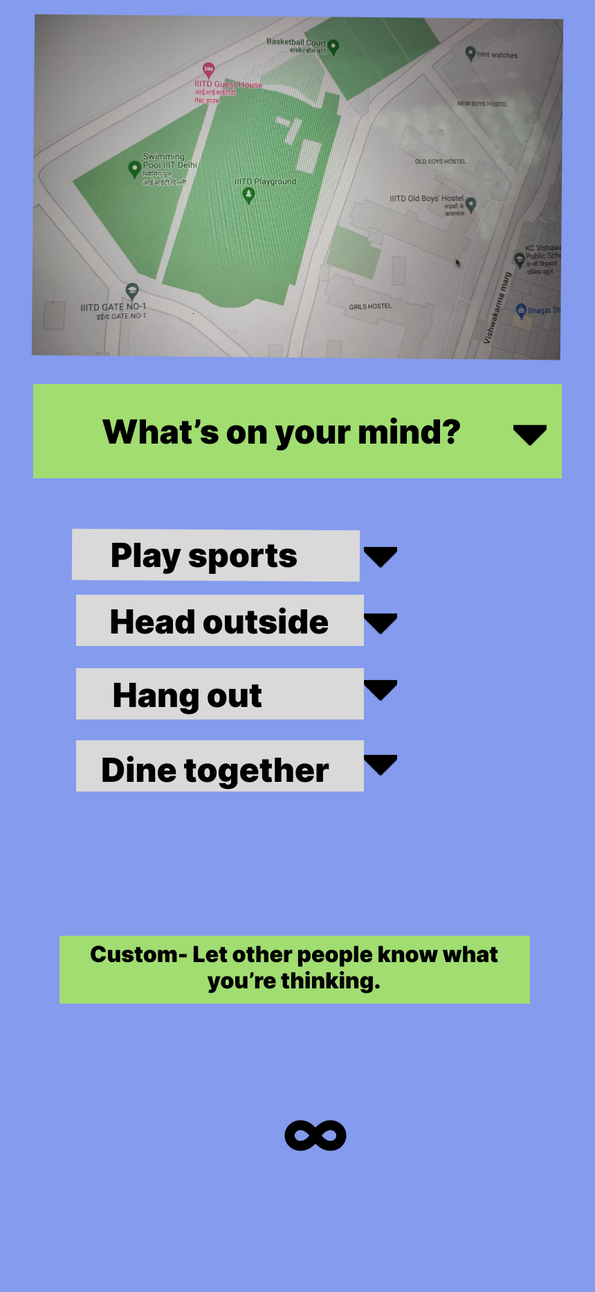
Lofi Initial Design

Slide 16
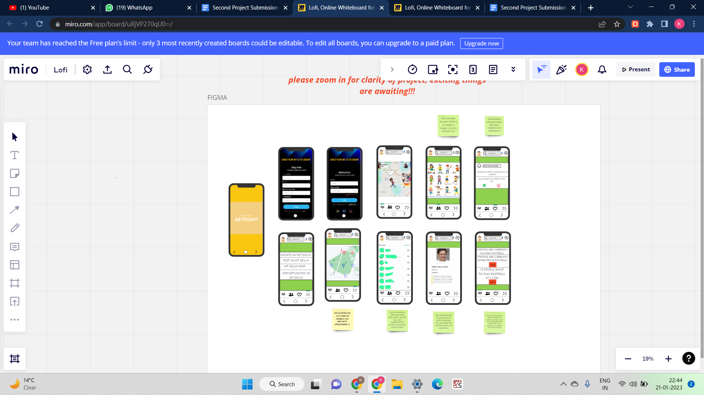
Alternative Lofi Designs
https://miro.com/app/board/uXjVP270qU0=/?share_link_id=359380766856

Slide 17
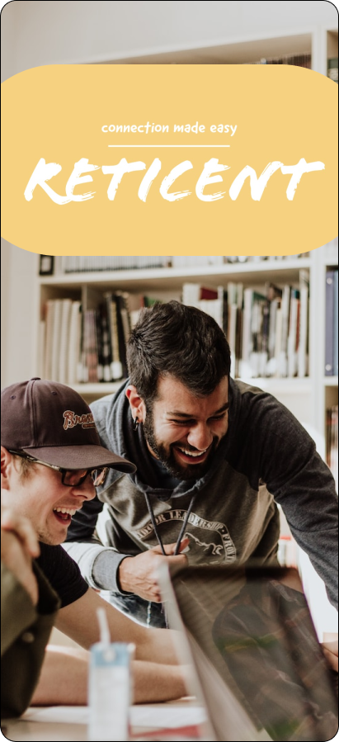
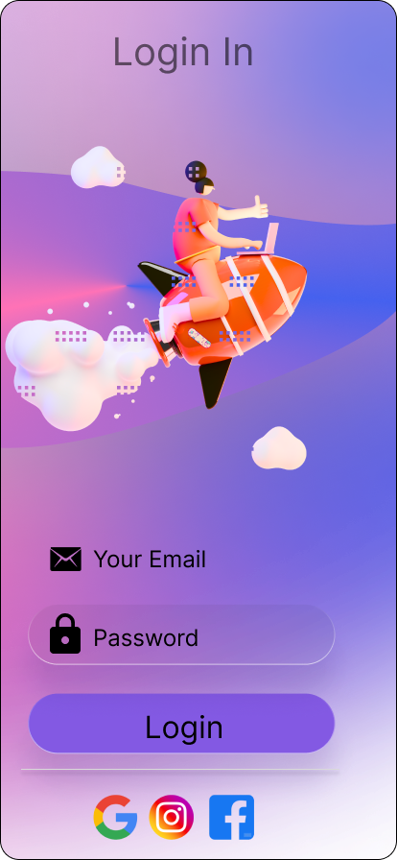
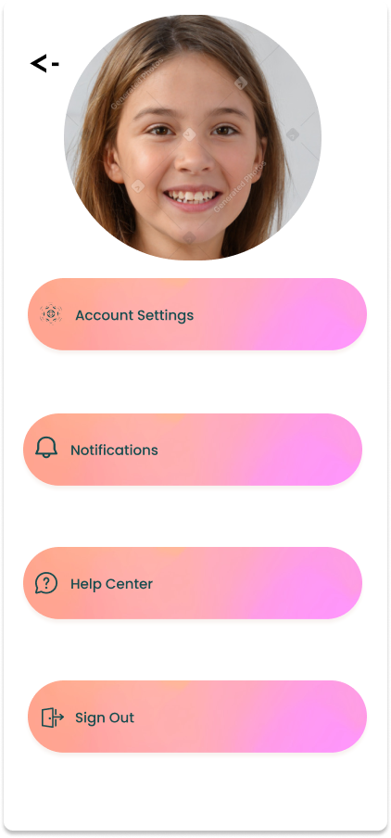
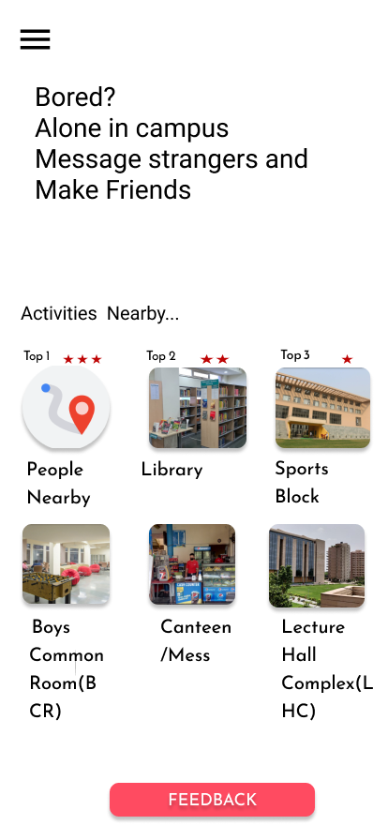
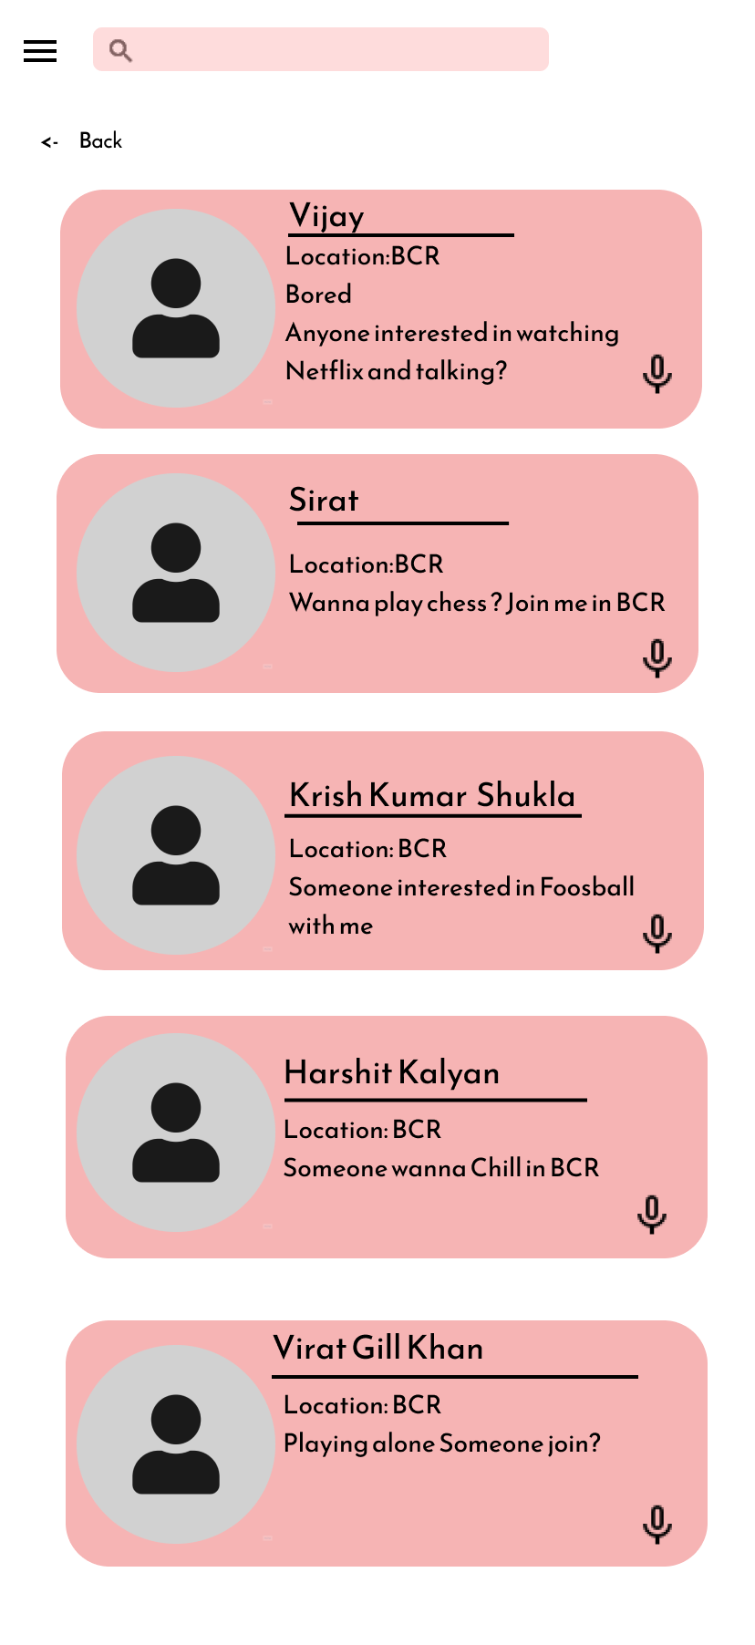
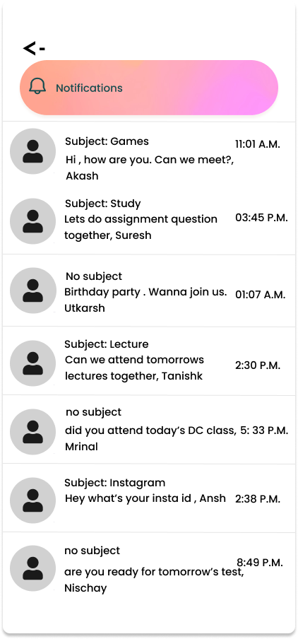
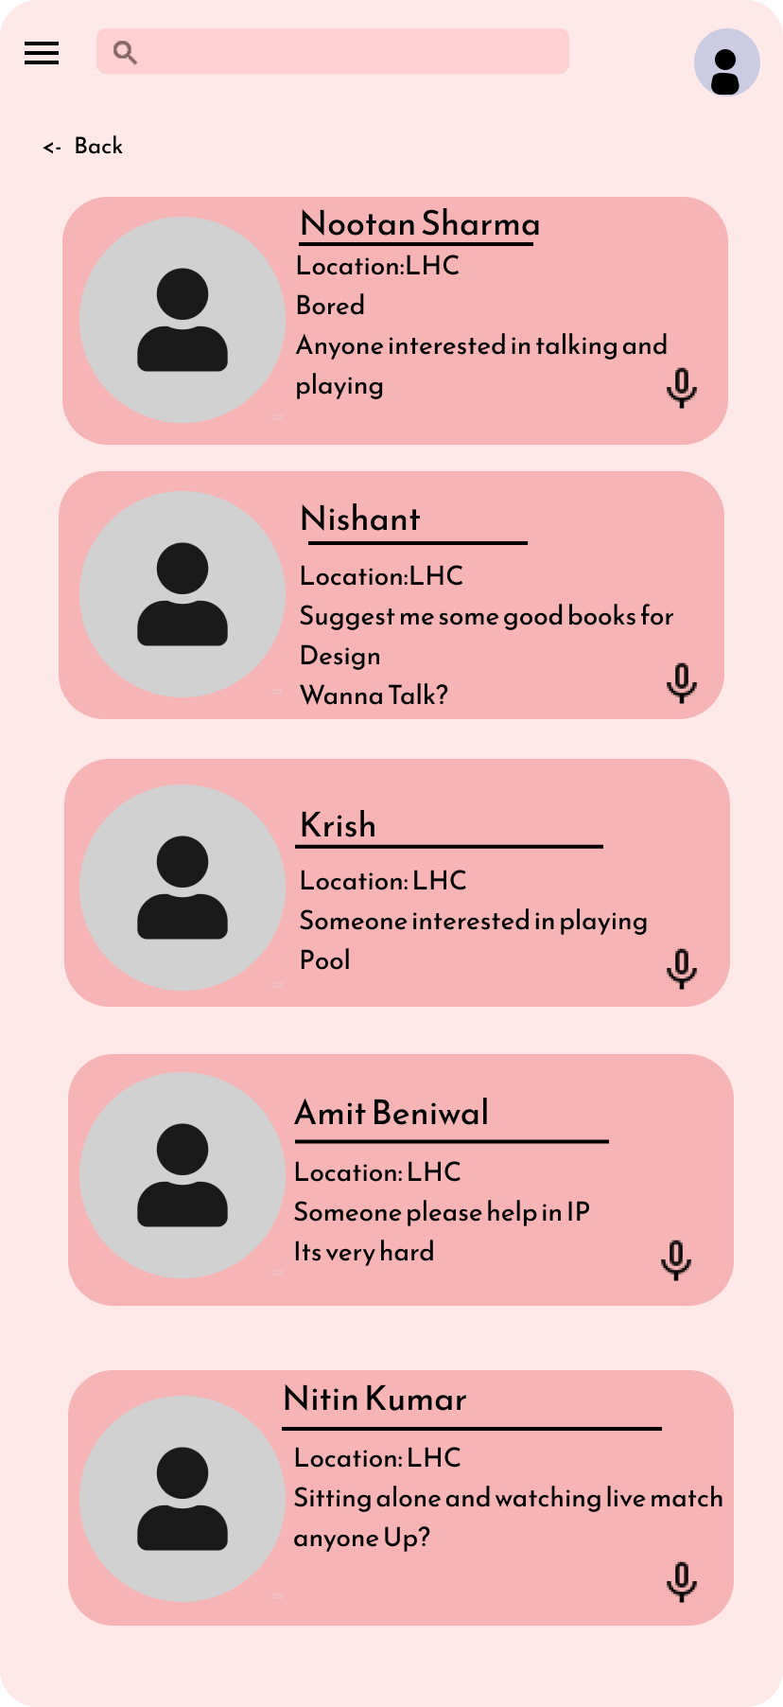
Lo Fi Alternate Design /LoFi Final Design

Slide 18
Lofi Review
"The Lo-Fi app is perfect for basic socializing needs. I can post updates, message with classmates, and join groups without any problems."
"The Lo-Fi version of the social media app is great for the basic needs of college students. I can access my class schedules and academic records, as well as join groups and events on campus."
"The Lo-Fi version of the app is a good option for those who don't need all the extra features. The basic functionalities are there, and it's easy to use."
"The Lo-Fi version of the app is a good option for those who want a simple and straightforward social media experience. The messaging feature is basic, but it gets the job done."

Slide 19
Overall, the Lo-Fi version of the social media app has received positive feedback for its simplicity and ease of use. It has been noted that it is a good option for those who only need basic socializing features and don't require advanced features. The messaging feature is basic but it is enough for the basic needs of college students.

Slide 20
Mid-fi Design
https://www.figma.com/proto/PyZyHq1eqlTecQkHi7k5qO/Mid-Fi?scaling=scale-down&page-id=0%3A1&starting-point-node-id=411%3A4058&node-id=411%3A4058

Slide 21
Mid Fi reviews
"The Mid-Fi version of the app is easy to navigate and has a clean interface. I was able to create my profile and connect with my classmates without any previous issues. The search and discovery feature is also great for finding groups and events on campus."
"The Mid-Fi version of the social media app is a great improvement from the one. I was able to find and connect with my classmates easily. The multimedia support is also great, I can share my photos and videos easily"
“Overall the app was good but there is a lack of feedback option in the app”

Slide 22
4. "The Mid-Fi version of the app has a great user interface and navigation. I was able to find and join groups, as well as access my academic records and class schedules with ease. The messaging feature could be improved, but overall, it's a great app."
5. “There is also a lack of memories in the app”
PS:These surveys are based on review of more than 30 people of different age and background

Slide 23
Hi Fi Design
The link for the same:
https://www.figma.com/file/1vpFQtFSBtARYMQJ2HjBcJ/high-fidelity-prototype-(Community)?node-id=0%3A1&t=G6G8zSRCfwNnvqvy-1
More in the link

Slide 24
Hi fi Reviews
"The Hi-Fi version of the app is impressive. The user interface is sleek and easy to navigate. The messaging feature is also great, it's easy to connect and communicate with my classmates."
"I'm impressed with the Hi-Fi version of the social media app. The graphics and animation are top-notch, and the multimedia support is fantastic. I can easily share my photos and videos with my classmates."
"The Hi-Fi version of the app is amazing. The personalization options are endless, and I can customize my profile and settings to suit my preferences. The search and discovery feature is also fantastic, I can find and connect with classmates easily."
Overall, the Hi-Fi version of the social media app has received positive feedback for its user-friendly interface, top-notch privacy and safety features, and multimedia support. The integration with other apps and analytics feature have been well received by the users.

Slide 25
User Testing and Evaluation
As a part of the user evaluation process, we have taken feedback in the form of surveys(through google forms) and questionnaires from several of our batchmates, seniors and acquaintances.
This application is having so many colors and also many bright colors. We have considered this into account and have done some modifications to the colours(applied some darker shades to some of the pages) and are continuing to work on this.
We also tried to keep it minimalistic by keeping the cognitive load as low as possible and keeping only the essential features in the design.
For the most part, the response to this hi-fi prototype that we have created finally after modifying the lo-fi and mid-fi designs has been very positive.
The users are finding our product to have a unique concept which would be helpful to the masses as well as being easy to use and efficient at the same time.

Slide 26
A few users have also appreciated the fact that we have kept a feedback page in our prototype by which we can regularly keep up with the demands of users based on the user feedback.
We also got positive feedback on one of the central themes of the project which is a radar based notification system which helps people connect.
Another common feedback was that the onboarding process was smooth and simple.
Based on the feedback and user evaluation we have gone ahead with this final prototype for our project.

Slide 27
Credits
Professor-Rajiv Ratn Shah
TA- Sneh Suman-2019337
TA-Kirti Gautam-2018291
TA-K Sibin-2020307
Krishna Shukla-2022254
Kshitij Gupta-202257
Krishnendu- 2022255
Kshitij - 2022256
Krish Kumar Bhoruka-2022253

Slide 28
Credits
We all thank our TAs and Professor towards our project submission and we all appreciate their efforts and time they have invested in us.

Slide 29
THANK
YOU
TEAM RETICENT SIGNING OFF

