Slide 1
Phishing URL detection
Made By Group ज्ञानवर्धन परिषद:
Abhirup Das
Himanshu Singh
Krishna Shukla
Shaurya Parashar

Slide 2
Problem Statement
Our work aims to develop a classification algorithm that accurately distinguishes phishing URLs from legitimate URLs.
We aim to analyse the features and identify patterns which act as a first line of defence against malicious web URLs.
Significance
With the rise in online threats, the web has become hazardous, with phishing attacks seeing a 47.2%^{[1]} increase in 2022 and an additional 40%^{[2]} in 2023. In 2023, consumers reported nearly $8.8 billion^{[3]} in losses from scams, with phishing as a major contributor. This has driven the Security as a Service (SECaaS) market to $20.1 billion^{[4]}, highlighting the demand for robust protection solutions.

Slide 3
Dataset
URL-Specific:
URL: The web address.
URLLength, DomainLength, TLDLength: Length-related metrics.
CharContinuationRate, URLCharProb: Character analysis.
NoOfSubDomain, TLD: URL structure details.
IsDomainIP: Indicates if the domain is an IP.
IsHTTPS: Presence of HTTPS (security check).
URLTitleMatchScore, DomainTitleMatchScore: URL and page title correlation.
Page Content Features:
HasTitle, Title: Title existence and content.
NoOfImage, NoOfCSS, NoOfJS: Page element counts.
HasExternalFormSubmit, HasHiddenFields, HasPasswordField: Security-related checks.
Bank, Pay, Crypto: Keywords indicating financial or sensitive themes.
Dataset Overview
Total Instances: 235,795 (134,850 legitimate & 100,945 phishing URLs)
Associated Task: Classification
Feature Types: Real, Categorical, Integer
Missing Values: None
Target Feature: label (indicates if a URL is phishing: 1 or legitimate: 0)
54 features that analyze the URL and web page structure
Technical Features:
LineOfCode, LargestLineLength: Code structure details.
NoOfURLRedirect, NoOfSelfRedirect: Redirect behaviors.
Robots, IsResponsive: Web compliance and adaptability.

Slide 4
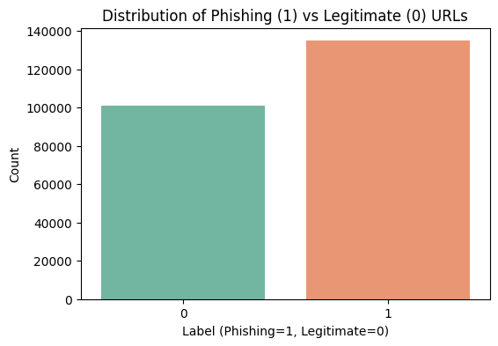
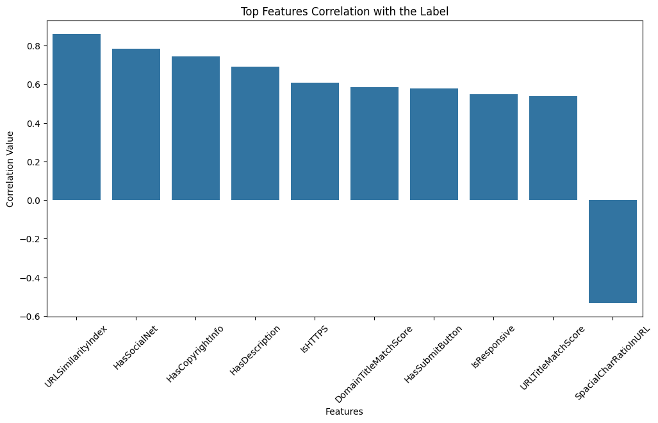
Exploratory Data Analysis
Class Balance Top features(correlation with label)

Slide 5
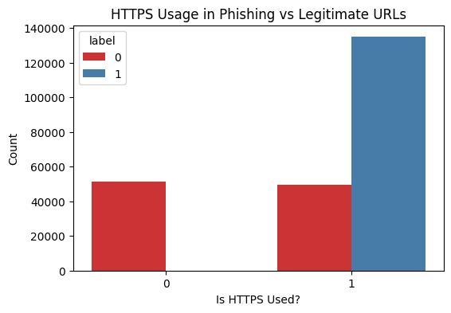
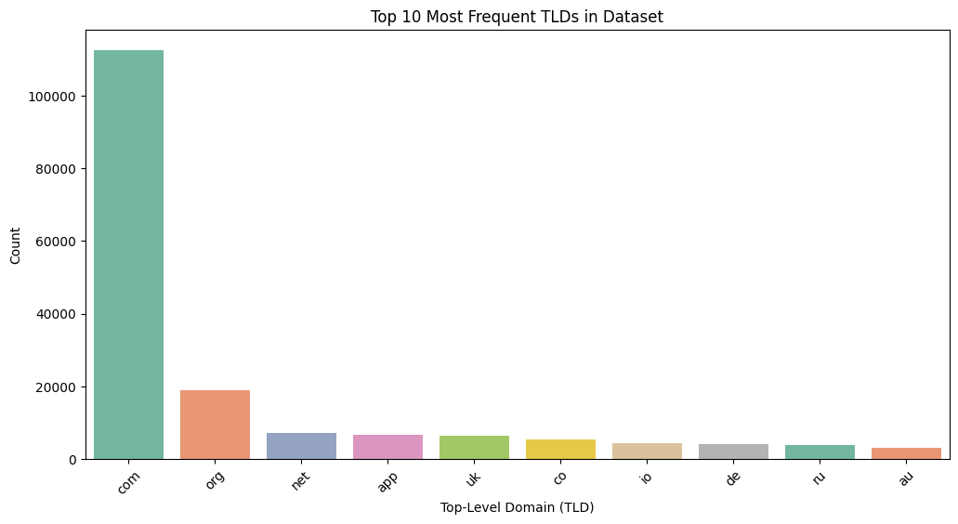
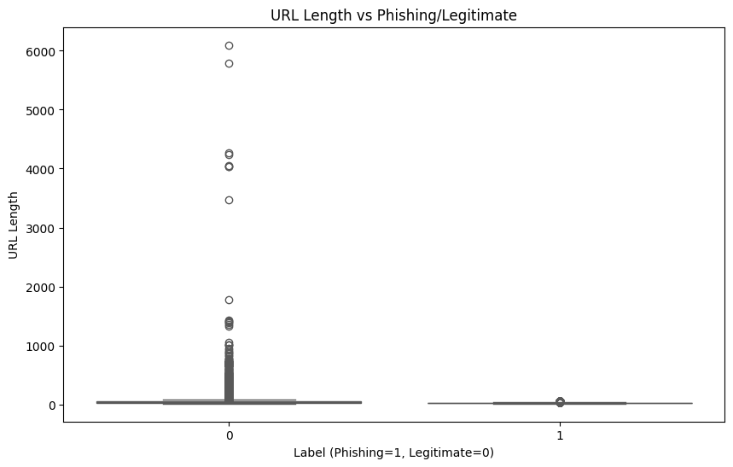

Slide 6
Key Insights
Feature Relevance: Identified strong correlations between certain URL and webpage features (e.g., URLLength, HasObfuscation, CharContinuationRate) and the likelihood of phishing.
Data Distribution: Phishing URLs displayed distinct patterns in metrics such as NoOfSubDomain and SpacialCharRatioInURL, aiding differentiation.
Balanced Data: The dataset was well-balanced between legitimate and phishing URLs, ensuring reliable model training without bias.
Outliers and Anomalies: Addressed minimal outliers, confirming data quality and consistency.
Conclusion
The EDA confirms that the dataset is rich in informative features suitable for building a robust phishing URL detection model. Feature analysis validated their significance, providing a strong foundation for hypothesis testing and classification model development.

Slide 7
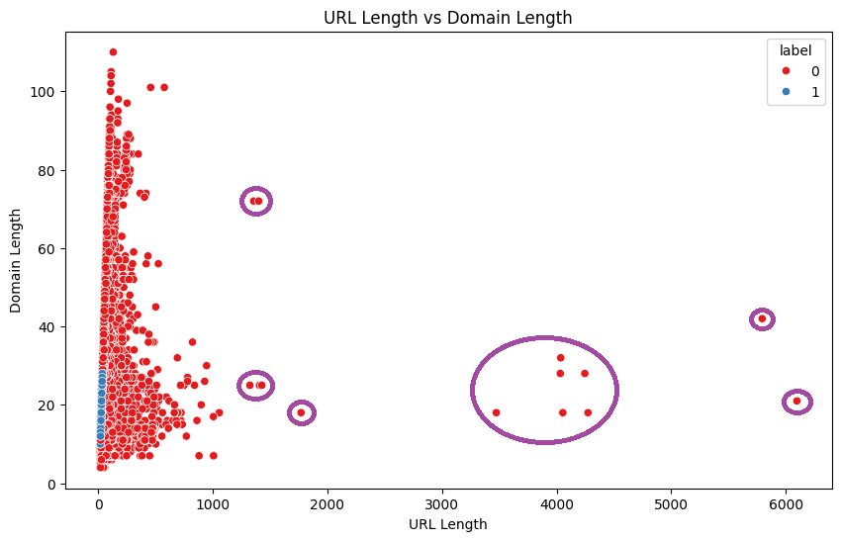
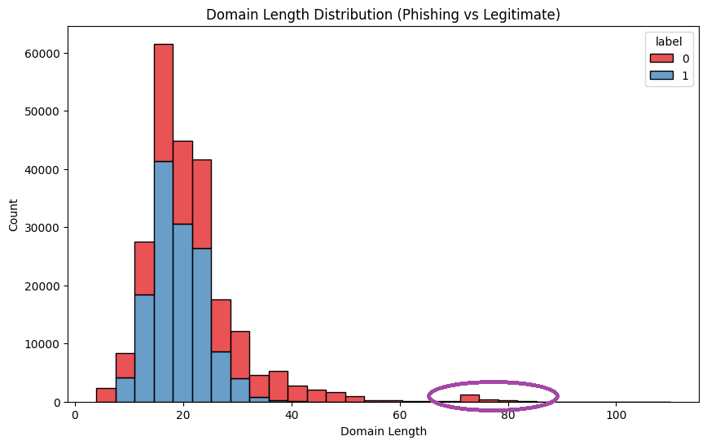
Pre-Processing
Outlier Detection

Slide 8
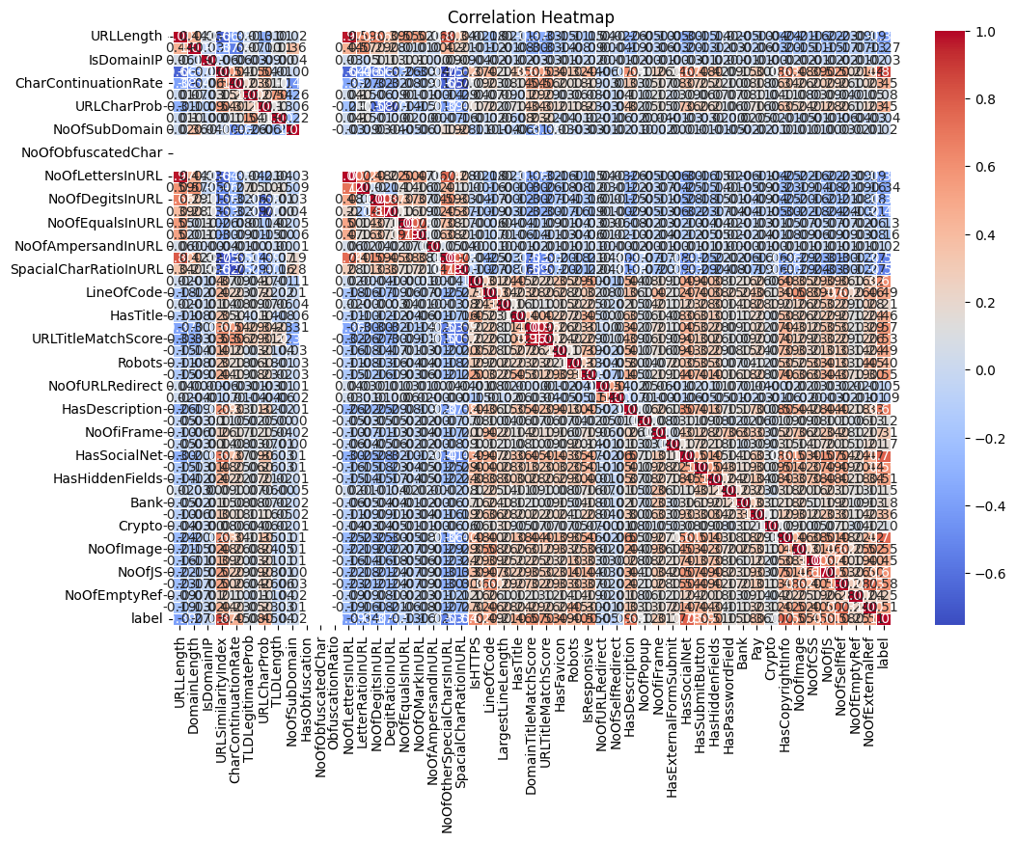
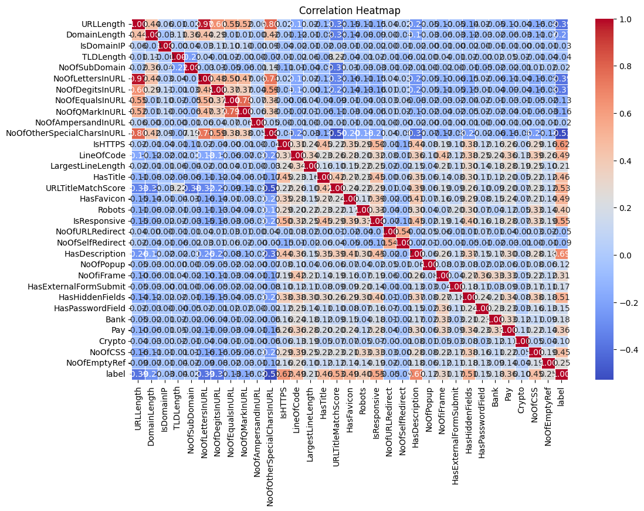
Pre-Processing
2. Removing Redundant Features (those that are heavily correlated with some other feature)

Slide 9
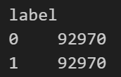
Pre-Processing
3. Normalizing Continuous Data and Label Encoding Discrete Features
4. Balancing the Counts of Each Label in the Dataset.
Normalization and class balancing will be required later on, when we fit our data into a machine learning model.

Slide 10
Hypothesis Tests
Comparing Whether the Distribution of URL Lengths is same across Phishing and non-Phishing URLs.
Examining if there is a linear relationship between number of digits and letters in a URL.
Examining if there is a linear relationship between URL length and Domain Length.
Examining if the URL being a Phishing URL depends on it having a title.
Examining if the URL being a Phishing URL depends on it being an HTTPS link.
Broader Hypothesis

Slide 11
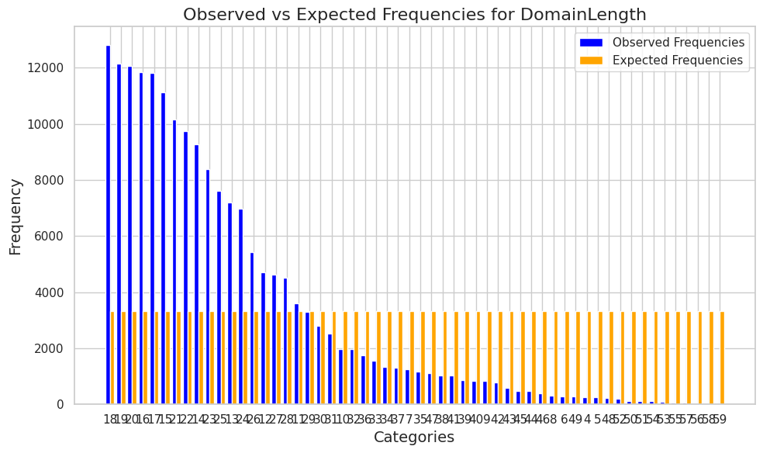
Experiments Conducted
For Test 1 in the previous slide, 5000 samples of each class were randomly sampled. Then, we performed a paired t-test to compare the distributions of URL lengths across both classes, with 5% significance level.
Conclusion: Phishing URLs have significantly larger URL lengths.
For Tests 2 and 3, 10000 samples randomly sampled. Then, we performed a t-test for correlation coefficient to find the Pearson-r value, to see if our features were linearly correlated. Again, 5% significance level used.
Conclusions:
Similar Observation with two-tail chi squared test
1) Positive correlation between no. of digits and letter in a URL.
2) Positive correlation between URL length and Domain Length.

Slide 12
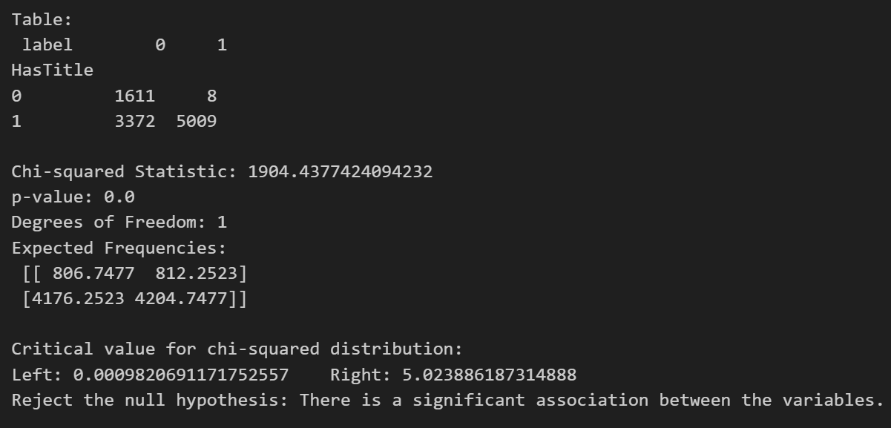
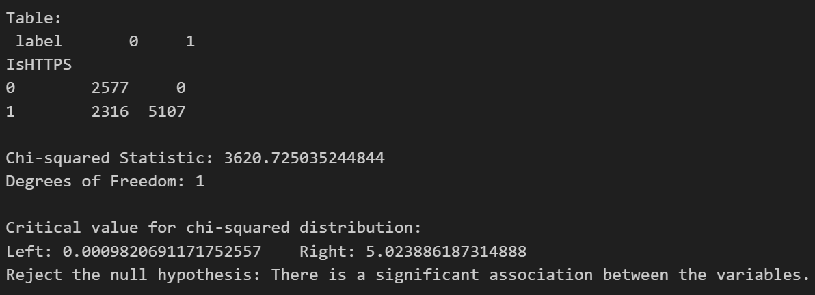
Experiments Conducted
3.
Performed a Chi-Squared Test for Independence with a 5% level of significance. Sampled 10000 data points at random from the dataset and performed the test.
Conclusions:
1) A URL being a phishing URL depends on whether it has a title.
2) A URL being a phishing URL depends on whether it it is an HTTPS link.

Slide 13
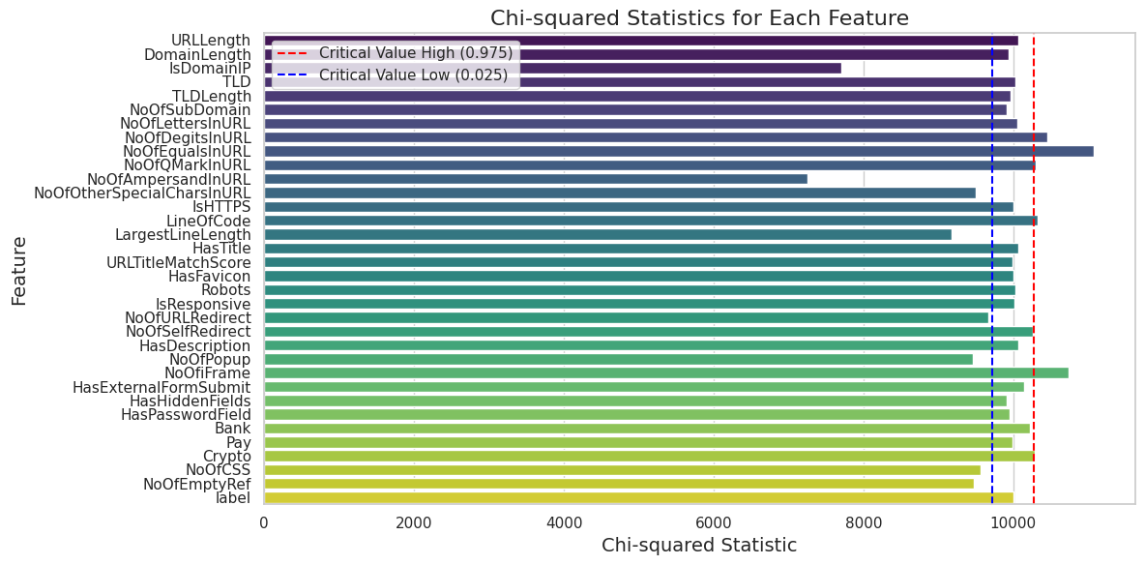
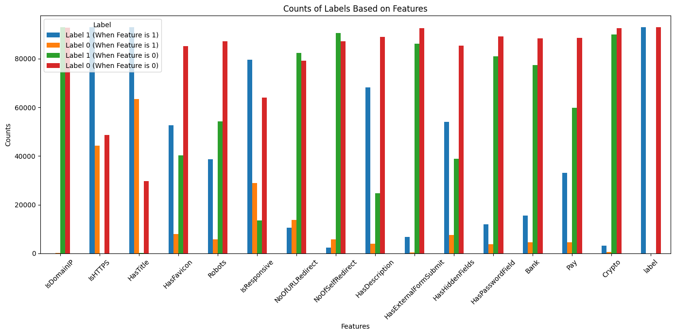
Broader Hypothesis
Aims to assess the relevance of each integer and float feature in predicting the label using various hypothesis tests learned in the course, as well as conduct a gain analysis on binary features.
Two Tail Chi square Graphical Visualization
Label vs binary feature relevance

Slide 14
ML Models Used
Random Forests → Many smaller decision trees are created on a subset of the data and a subset of the features. Then, on any input, the mode of the output of each tree is the final prediction.
Train Accuracy: 100%
Test Accuracy: 99.975%
Running Time: 6.4s

Slide 15
ML Models Used
2. Gradient Boosting → Gradient Boosting combines several weak learners into strong learners, in which each new model is trained to minimize the loss function of the previous model. The predictions of the new model are then added to the ensemble, and the process is repeated until a stopping criterion is met.
Train Accuracy: 100%
Test Accuracy: 99.978%
Running Time: 35.7s

Slide 16
ML Models Used
3. Logistic Regression → It is a statistical model used for binary classification. It predicts the probability of an outcome (0 or 1) by applying the logistic (sigmoid) function to a linear combination of input features. The model is trained to minimize the log-likelihood (or cross-entropy) loss using optimization techniques like gradient descent. The output is a probability, and a threshold (usually 0.5) is applied to classify the result.
Train Accuracy: 99.93 %
Test Accuracy: 99.935 %
Running Time: 3.4s

Slide 17
Scaling Techniques
Coreset → A coreset is a smaller, weighted subset of the data that approximates the original dataset in terms of a specific task, like classification or clustering. In our approach, we first experiment with various coreset sizes, and after iterating, we determine that the best coreset size and it is 160 for Random Forest and 270 for Logistic Regression . This coreset was created by randomly sampling the data points, ensuring that the selected subset retains the key information needed for the task. Using the coreset helps improve efficiency without sacrificing the quality of the model’s performance.
Test Accuracy (Running Time):
 | Random Forests | Logistic Regression
Coreset | 99.64% (6s) | 99.477% (0.6s)
Size | 160 | 270
Train Accuracy: 100% for RF and 99.924 for LR

Slide 18
Scaling Techniques
2. JL → We transform the data into a lower dimension with the help of a JL matrix (whose entries are sampled from N(0, 1/k), where k is the size of the reduced number of dimensions, in our case, k = 10). The JL lemma ensures that distance between points is maintained even after transformation, a useful property that maintains structure. Thus, we utilize this technique for our case, since the classification could rely on these patterns in the data. We also try out a sparse JL matrix to reduce computation time.
Test Accuracy (Running Time):
 | Random Forests | Gradient Boosting
Regular JL | 99.075% (20.1s) | 99.308% (6m 11.6s)
Sparse JL | 99.875% (7.8s) | 99.957% (1m 5.9s)
Train Accuracy: 100% for all

Slide 19
Scaling Techniques
3. Singular value decomposition → We transform the data into a lower dimension using SVD by reducing it to its top k singular components, where k = 10 is the reduced number of dimensions. This transformation preserves the most significant structure in the data, as SVD captures the principal directions of variation. This dimensionality reduction technique is particularly useful in maintaining the relationships and patterns within the data, which are crucial for classification tasks.
 | Random Forests | Gradient Boosting
Train | 100% | 100%
Test | 99.59% | 99.67%
Run Time | 17.4s | 4m 53.2s
Accuracy:

Slide 20
Scaling Techniques
4. CUR → reduces the size of the feature space by selecting a subset of important columns (features) based on statistical leverage scores. This reduces the size of the dataset which improves performance. We sample the most important columns and rows to perform the decomposition. Keeping the actual features in the dataset, we maintain the meaning the features had in the original dataset. This is in contrast to SVD-based techniques like PCA, where interpretability can be lost as the features are a combination of the original columns.
 | Random Forest | Gradient Boosting
Test | 99.695% | 99.747%
Train | 99.999% | 99.999%
Run Time | 5.4s | 1m 20.9s
Accuracy:

Slide 21
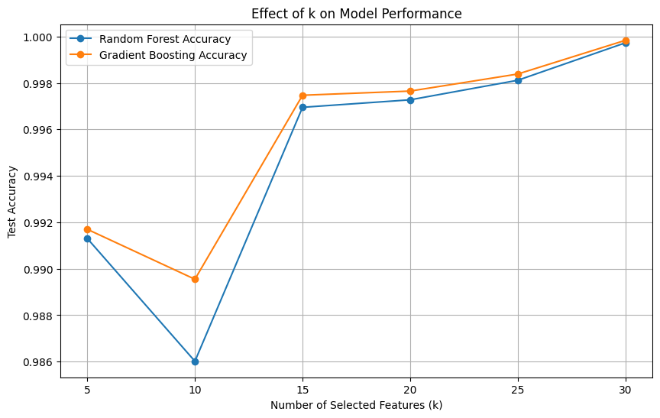
How to Choose k ?
CUR decomposition
The accuracy seems to grow steeply till k = 15.
After 20 the accuracy plateaus.
Accuracy plateaus as added features contribute minimal new information

Slide 22
Conclusion and Future Work
The best parameters for the dataset were found to be :
Random Forests: {'criterion': 'log_loss', 'max_depth': 30, 'max_features': 'sqrt', 'min_samples_leaf': 1, 'min_samples_split': 2}
Gradient Boosting: {'criterion': 'squared_error', 'learning_rate': 0.1, 'loss': 'log_loss', 'max_depth': 10, 'max_features': 'sqrt', 'min_samples_split': 10}
CUR has higher interpretability(maintains datasets intrinsic structure) than SVD. Sparse JL matrix provided the best accuracy when paired with the Random Forest as the ML model. Coresets also provided good accuracy and also reduced the computational time by a bit, which is useful for even larger datasets.
Future Work: Experimenting with more advanced ML models, DL based methods for scaling (autoencoders and more).

Slide 23
THANK
YOU

