Slide 1
Presentation
2022254, 2022488 Krishna Shukla , Shubham

Slide 2
UDP Client code UDP ping client, which sends a series of 10 ping messages to a server. It uses the socket module for instantiating the UDP socket and the time module, providing management over timestamps. In every iteration, client constructs a ping message, combining sequence number and current timestamp, and sends it to the server. It records the time immediately after that and waits for response. It calculates round-trip time if the response is acquired. If the response times out after 1 second, the client increases its loss counter and prints the timeout message. Then gives statistics: minimum, maximum, and average RTT with a packet loss rate. The program catches exceptions when no responses were received to avoid making arithmetic errors in these statistics calculations. This is an easy way of understanding measurements of the latency of the network with UDP pings. The UDP Heartbeat client creates a UDP socket designed to track the presence of a server through periodic heartbeat messages. It declares a UDP socket that communicates with a server running on localhost on port 12000, with a timeout of 1 second for responses. The loop is in an infinite loop: it sends heartbeat messages containing the timestamp and a sequence number. It does find the round-trip time for each of the responses received by storing all good responses in a list. If no response is received within the time-out, it increments the counter for missed responses and prints a message about the time out. In case of three consecutive timeouts, it concludes that the server is down and leaves the loop. At the end of the test, it also calculates and prints the following statistics: total heartbeats sent, responses received, timeouts, packet loss percent, and RTT in averages, min, and max metrics. Thus, the results tell what's going on with the server health and how things go in the network

Slide 3
UDP Server Code Explanation
The code will set up a UDP Heartbeat server to listen on port 12000 for incoming heartbeat messages. On receiving of the message it simulates some packet loss at random from 30%. It has some random number so if that is less than 3 the server assumes the packet lost and doesn't send an acknowledgement. Assuming the packet is received, the server processes the heartbeat message with the timestamp along with the sequence number. It also calculates how much time has passed from the time it arrived to the current time by computing a difference between the time elapsed and the received timestamp, and it will return the information to the client along with the sequence number. The server keeps running with multiple heartbeat messages.

Slide 4
Calculations
1. Packet Loss Rate: With a 30% packet loss rate, there is a 70% chance that any single packet will be received. 2. Consecutive Losses: To see 3 consecutive missing responses, you need to experience three failures in a row. 3. Probability of 3 Consecutive Losses: ○ The probability of missing a single heartbeat is 0.3 (30%). ○ The probability of missing three consecutive heartbeats is (0.3)^3=0.027 (2.7%). Expected Trials To find out how many heartbeats you need to send to expect 3 consecutive losses: 1. Average Trials Until 3 Consecutive Losses: ○ As this is a Geometric Random Variable, The average number of trials needed can be calculated as 1/P , where P is the probability of the event happening. In this case, it would be: 2. Expected trials=1/0.027 =37 trial This means you might expect to send around 37 heartbeats before observing 3 consecutive lost packets. Conclusion ● Sending 10 Heartbeat Packets: Unlikely to see 3 consecutive losses (probability too low) appx(25%) ● Sending 100 Heartbeat Packets: More likely to see 3 consecutive losses appx (75%) ● Sending 1000 Heartbeat Packets: Almost certain to see 3 consecutive losses. appx(99%) Based on the calculations, sending around 37 to 100 packets could lead you to experience 3 consecutive missing responses, depending on the random occurrences of packet loss.

Slide 5
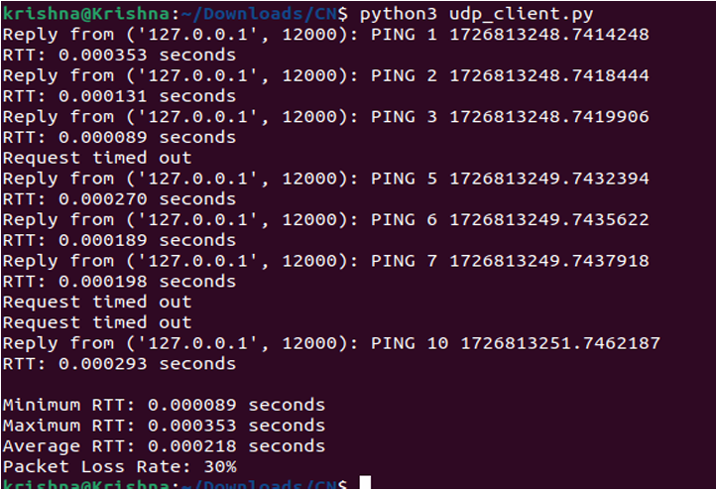

Slide 6
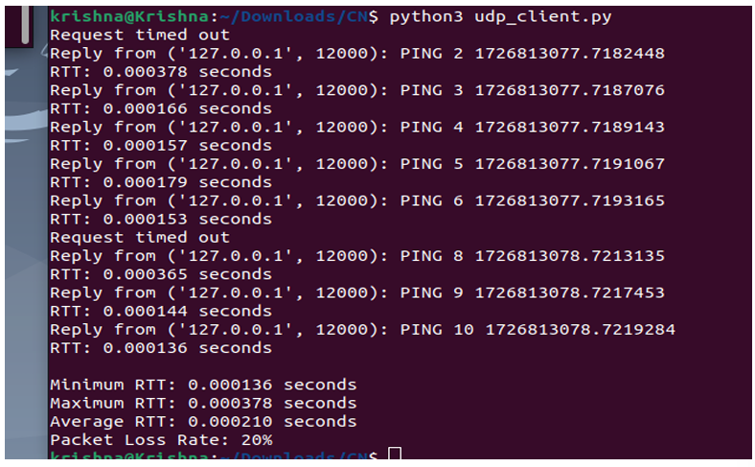

Slide 7
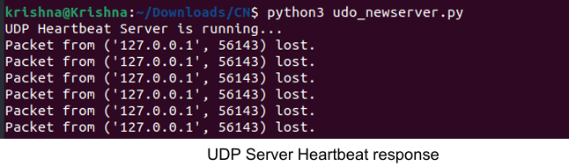
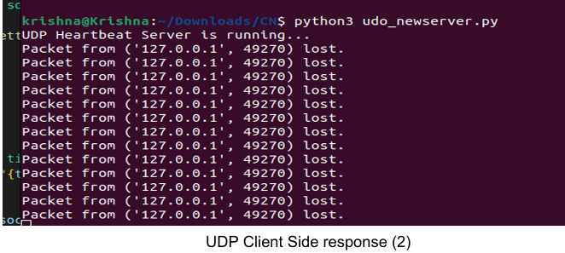

Slide 8
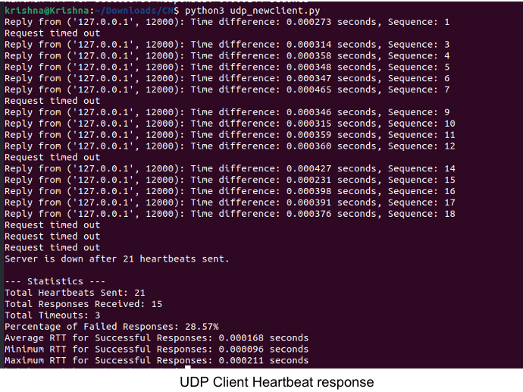

Slide 9
