Slide 1
Assignment -2
Krishna Shukla (2022254) &
Shubham (2022488)

Slide 2

Building a Simple HTTP Server with Python
Introduction to Socket Programming
What is it?
Communication between computers over networks.
Uses protocols like TCP/IP for reliable connections.
Code Overview
Objective: Create a simple HTTP server.
Key Components:
Socket Creation: serverSocket = socket(AF_INET, SOCK_STREAM)
Binding: serverSocket.bind(('', 6789))
Listening: serverSocket.listen(1)
Core Functionality
Accept Connections:
connectionSocket, addr = serverSocket.accept()
Process Requests:
Receive and decode the request.
Extract the requested file name.
Reference: Python Socket Programming Documentation

Slide 3
Handling Requests and Responses
Sending HTTP Responses
Successful File Request:
Send 200 OK header:
connectionSocket.send("HTTP/1.1 200 OK\r\n\r\n".encode())
connectionSocket.send(outputdata.encode())
Error Handling:
If file not found, send 404 Not Found: connectionSocket.send("HTTP/1.1 404 Not Found\r\n\r\n".encode())
Closing Connections
Importance of Closing:
Use connectionSocket.close() to free resources.
Summary
Takeaways:
Basic HTTP server functionality.
Foundation for more complex server applications.
Reference: https://docs.python.org/3/tutorial/errors.html

Slide 4
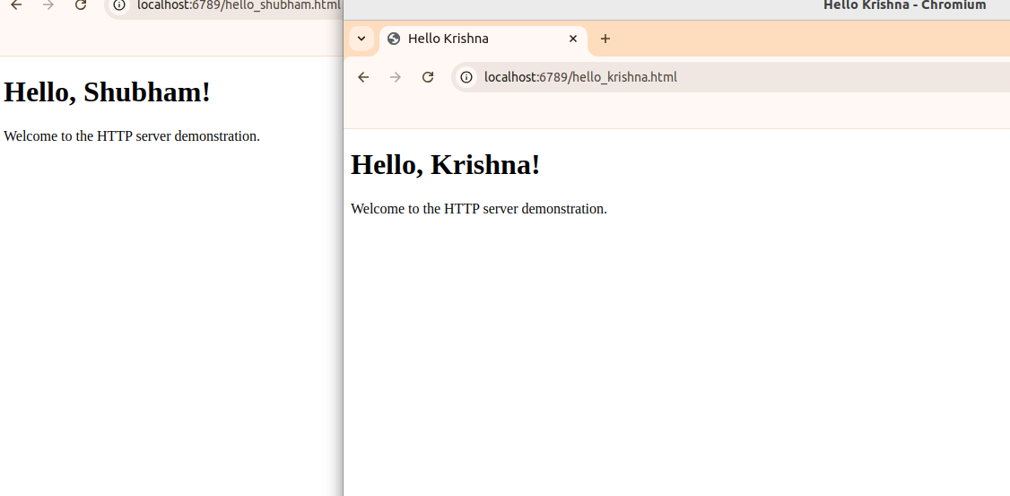

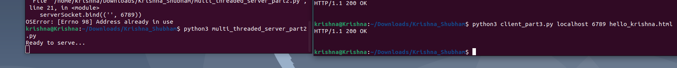
Building a Multithreaded HTTP Server with Python
Introduction to Socket Programming
What is it?
Communication between computers over networks.
Utilizes protocols like TCP/IP for reliable connections.
Code Overview
Objective: Create a multithreaded HTTP server.
Key Components:
Socket Creation: Initialize a socket for communication.
Binding and Listening: Bind to a port and listen for incoming connections.
Multithreading
Handling Multiple Clients:
Use threading to manage concurrent connections.
Each client request is processed in a separate thread.

Slide 5
Handling Client Requests
Core Functionality
Accepting Connections:
Wait for client connections and establish communication.
Processing Requests:
Each request is handled by a dedicated thread.
The server responds with file content or an error message if the file is not found.
Client Handler Function
Key Responsibilities:
Receive and decode the client's request.
Open the requested file and send the appropriate response.
Handle errors gracefully, sending a 404 response when necessary.

Slide 6
Summary and References
Summary
Key Takeaways:
A multithreaded HTTP server allows handling multiple client requests simultaneously.
Basic request processing and error handling are implemented to manage file access.
References:
Python Socket Programming Documentation
Python Threading Documentation
HTTP/1.1 Specification

Slide 7
HTTP Client Implementation in Python
Overview
Objective: Create a simple HTTP client to send requests to a server.
Key Components:
Command Line Arguments:
server_host: The server's hostname or IP address.
server_port: The port number to connect to.
filename: The resource to request from the server.
Establishing Connection
Socket Creation:
Create a TCP socket for communication.
Connecting to Server:
Use the provided host and port to establish a connection.

Slide 8
Sending Requests and Receiving Responses
Sending HTTP Requests
HTTP GET Request:
Construct and send a GET request for the specified filename.
Include the Host header for proper routing.
Receiving and Printing Response
Response Handling:
Receive the server's response and decode it.
Print the response to the console for the user to see.
Conclusion
Closing the Connection:
Properly close the client socket after the request is complete.
References:
Python Socket Programming Documentation

