Slide 2
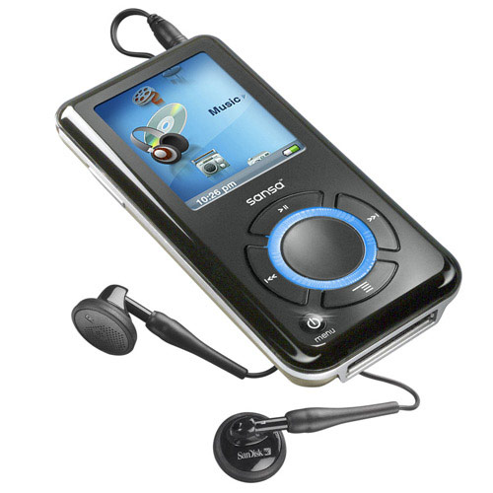
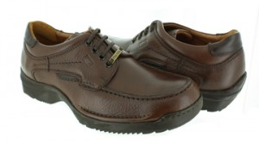

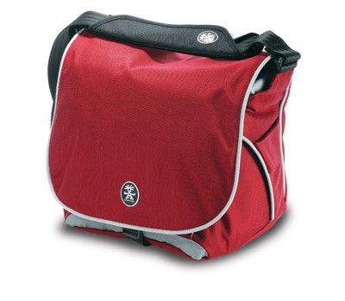
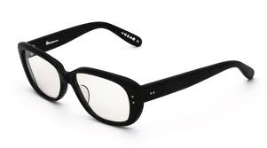
Notes:
Alex: "Hey Sam! I've got a nasty problem lately: I lose my stuff all the time and I can't find them back!"

Slide 3


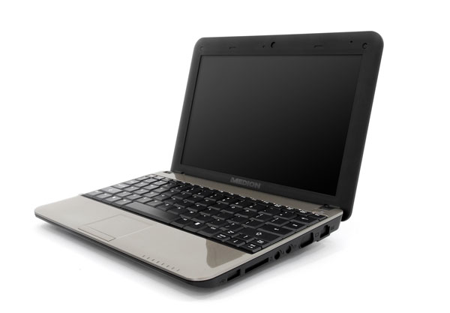
Notes:
Sam: "Hey Alex! Then I've got the right solution for your problem! If you tag your stuff with for example RFID tags from now on, then you should find them back with your computer when you lose them again!"

Slide 4


Notes:
Alex: "How would the computer know where all the stuff is located?"

Slide 5

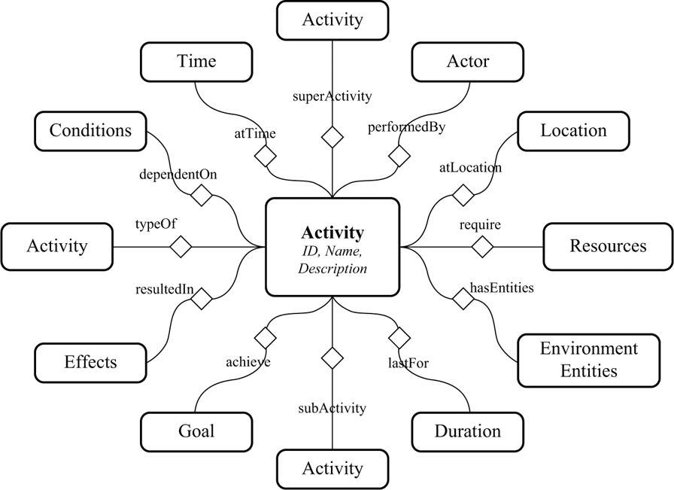
“Context Ontology Model”
Notes:
Sam: "The computer will know where the stuff is located, because it keeps track of them with a Context Model!"

Slide 6
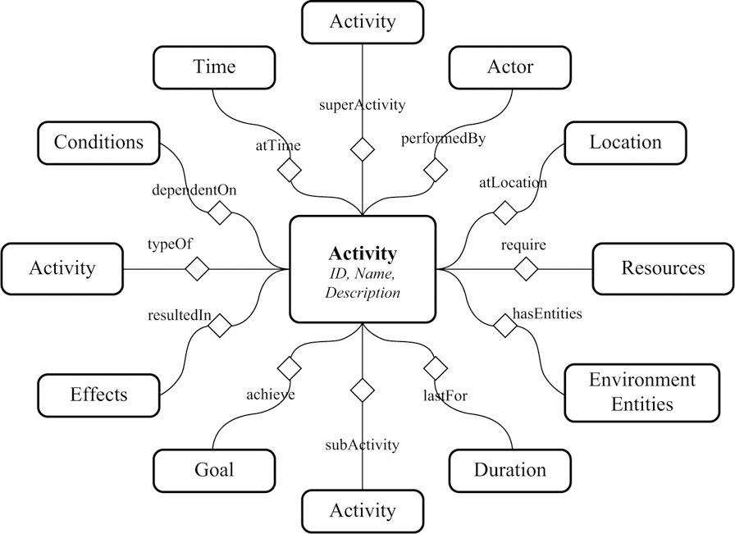
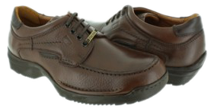
Notes:
Alex: "WOW! Wouldn't the computer give the wrong place for time to time?" (Context inconsistencies)

Slide 7
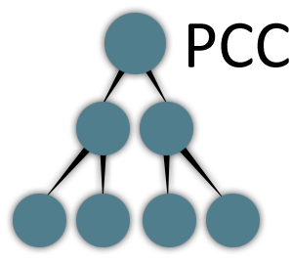
“Partial Constraint Checking (PCC)”
Notes:
Sam: "Oh no! Thanks to a special feature called Partial Constraint Checking the computer will always know where your stuff is located!"

Slide 8
Presentation April 21st:
Context Inconsistency Management
in Pervasive Systems
Notes:
Find more about this incredible solution on April 21st!

