Slide 1









Context Inconsistency Management in Pervasive Computing
Samuel Esposito
Alexander Jurjens

Slide 2
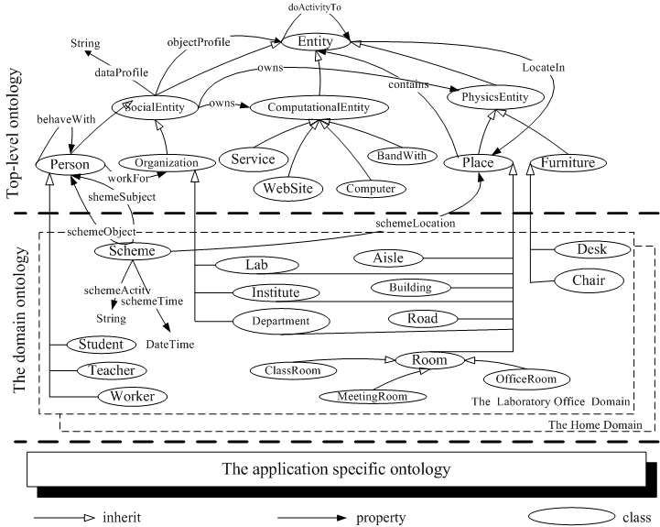
Ontology-based Model

Slide 3
Constraint Checking
Non-Incremental Checking
Incremental Checking
  Entire Constraint Checking
  Partial Constraint Checking

Slide 4
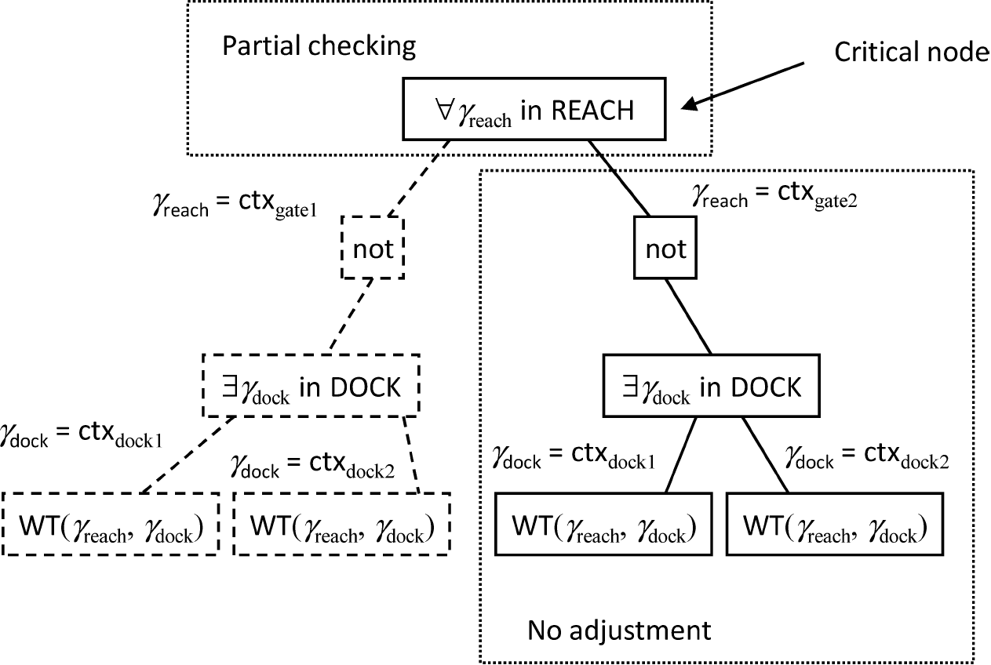
Consistency Computation Tree

Slide 5
Context Inconsistency Resolution
Extend Ontology-based Model with status- and temporal properties about a context
Use relative frequency
Runs in polynomial time (worst case)

Slide 6
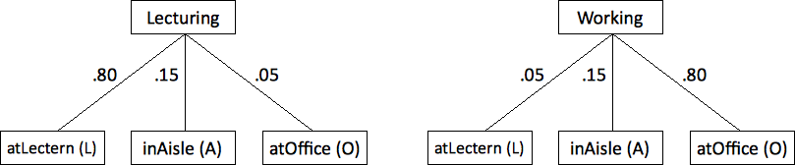
Fuzzy Ontologies
Hidden Markov Models

Slide 7
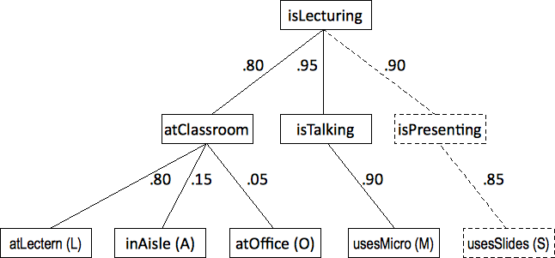
Partial Probability Calculation

Slide 8
Results: PPC Advantages and
Disadvantages
Possible inconsistencies incorporated in the model.
Always yields most probable high-level contexts.
Requires training

Slide 9

Discussion

