Slide 1


Slide 2


Slide 3
S@nté.Dz An Intelligent Platform For The Remote Diagnosis And Monitoring Of Radiological Abnormalities.

Slide 4
Revenue streams
Introduction
Business Model Canvas
Problem
Prototype
CONTENTS
Solution
Production plan
Proposed values
Team work
Experimental prototype
Target market

Slide 5
INTRODUCTION
Healthcare is a critical field that holds immense importance in people’s lives, and Algeria like many other countries around the world, faces significant challenges in providing timely and appropriate healthcare to its citizens across the nation.
With the advancement of technology and the widespread availability of fast communication, digitization has become an essential part of enhancing the healthcare system in Algeria. This realization has led us to propose our innovative solution in this field.

Slide 6
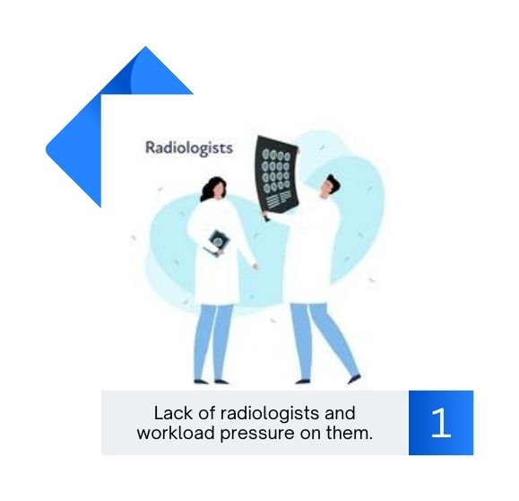

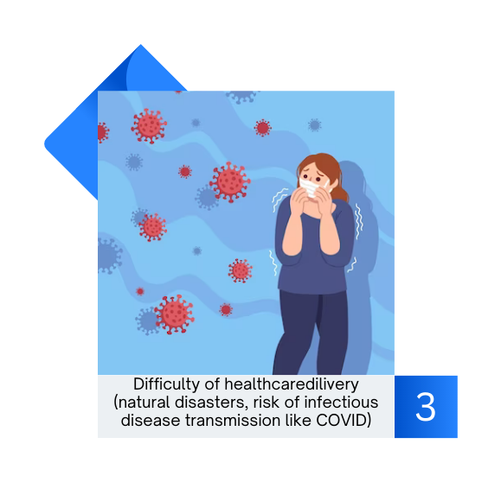
PROBLEM

Slide 7
PROBLEM
Algeria has faced difficulties in providing an adequate number of speciallized doctors, particularly radiologists. With the increasing statistics of cancer cases in the country, the pressure on these doctors has intensified, potentially leading to medical errors.
Accessing healthcare, especially in remote areas, is difficult due to the concentration of medical professionals and facilities in major cities. This imbalance raises the demand on them and complicates the appointment scheduling process.
Providing healthcare becomes even more challenging during epidemics and natural disasters.

Slide 8
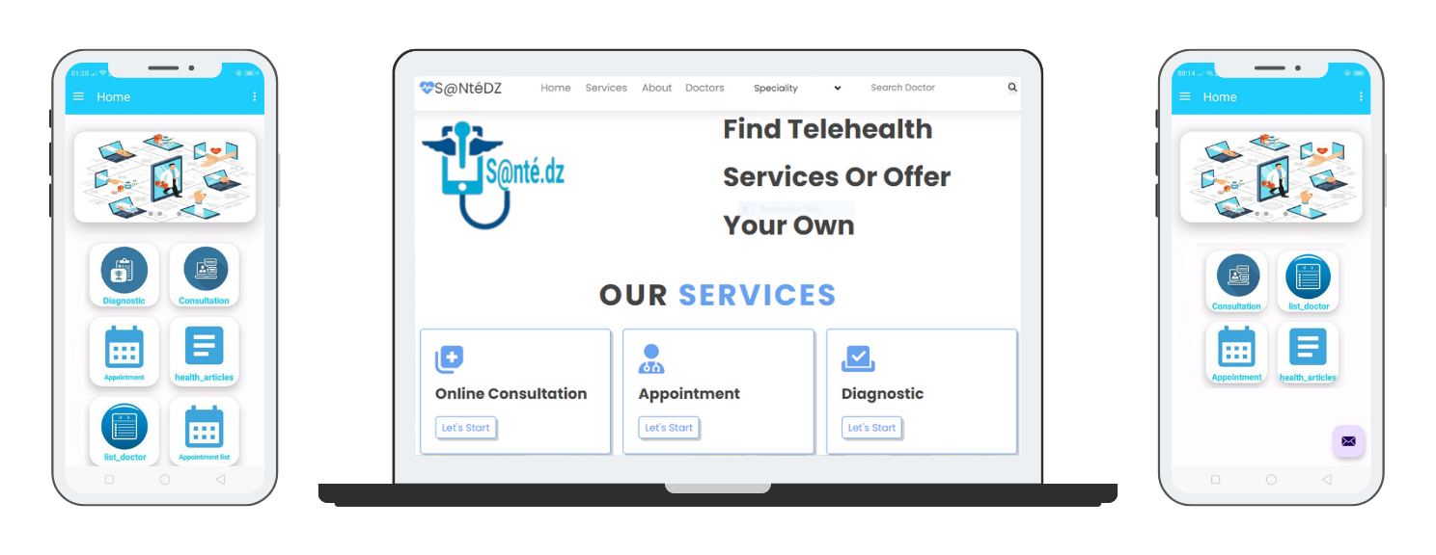
SOLUTION

Slide 9

An Intelligent digital platform called S@nté.dz for the Remote Diagnosis and Monitoring of Radiological Abnormalities.
Our platform aims to manages doctor-patient relationships and interactions between doctors. It offers remote medical services through an integrated app, allowing patients to consult, get diagnosed, book appointments, and access medical reports remotely.
Doctors can use the platform's diagnostic services, which rely on intelligent patterns that uses artificial intelligence and modern algorithms. They can send medical images of their patients for instant and accurate diagnoses of radiological abnormalities. The diagnoses are provided as comprehensive reports.
SOLUTION

Slide 10
PROPOSED VALUES
Improve hospitals' ability to diagnose radiological abnormalities in medical images faster and more accurately.
Digitize public health.
Manage and organize the relationship between doctors and their patients (facilitating communication between them) as well as the interaction among doctors themselves.
Health aspect
Improve the quality of healthcare and facilitate access to it, applying the principle of "pervasive health".

Slide 11
Targeting a new market (Marche Vierge).
PROPOSED VALUES
Increasing profitability and scientific research through the creation of large databases and selling them to researchers.
Save costs, time and effort for both patients and radiologists/doctors.
Economic aspect
Targeting a new market (Marche Vierge).

Slide 12
Quick and accurate diagnosis of radiological abnormalities means faster medical management and treatment selection, increasing patients' chances of survival.
PROPOSED VALUES
Protect the privacy and confidentiality of clients' medical information.
Providing high-quality, reliable, and affordable healthcare services and Applicability for updates and development to meet user requirements through the development of new services.
Social aspect
Provide 24/7 customer service to respond to user inquiries and provide necessary technical support.

Slide 13
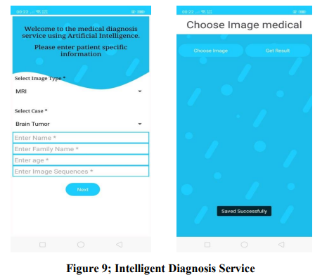
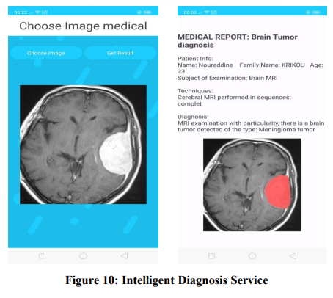
Experimental prototype
PROPOSED VALUES

Slide 14
Prototype ANDROID Application
Mobile app
https://drive.google.com/drive/folders/1WJ9G2Hup6aTNLpmQucJ6xb5plQSzEiPu?usp=sharing

Slide 15

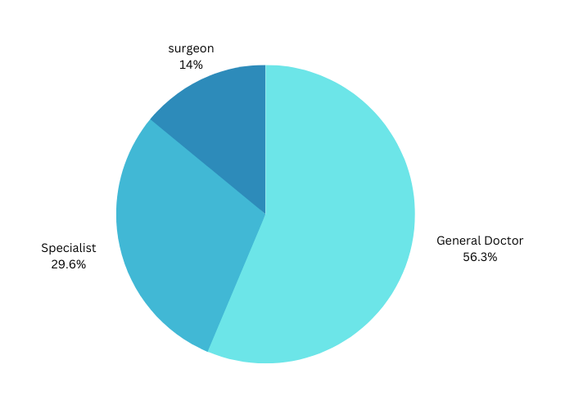
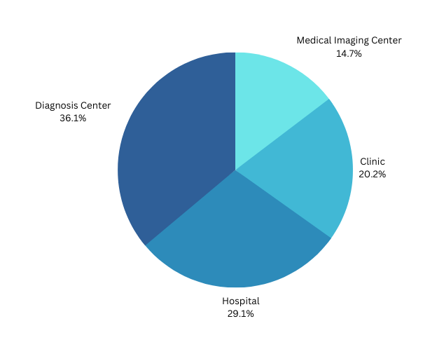
Target Market
- Radiology imaging centers experiencing workload pressure and desiring to expedite the diagnosis process.
Hospitals and doctors without radiology specialists who need initial diagnosis for prompt patient care.
- Patients in remote areas seeking medical diagnosis without the hassle of travel or those seeking a second opinion for confirmation.

Slide 16
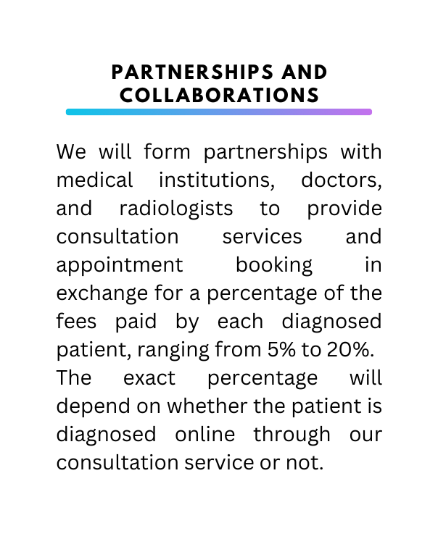
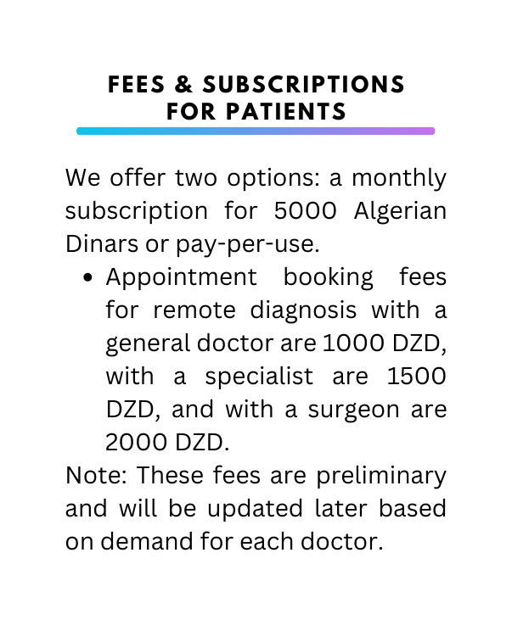
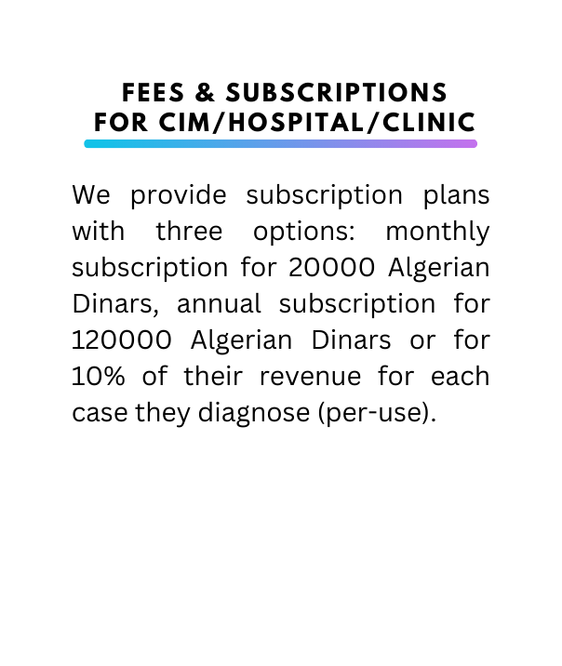

Revenue Streams

Slide 17









BUSINESS MODEL CANVAS
KEY PARTNERS
• Radiological imaging centers
• Anti-Cancer centers
• Radiologist
• Doctors
• Business incubator of Oum El Bouaghi University
KEY ACTIVITIES
• Collecting medical data
• Building artificial intelligence models
• Designing, developing, and deploying the application
• Providing consultation service • Providing intelligent diagnosis service
• Managing patient appointments
• Offering technical support
• Ensuring data security and privacy
• Marketing the application
PROPOSED VALUES
• Enhance diagnosis speed and accuracy.
• Provide intelligent diagnostic services.
• Provide doctor consultation service.
• Reduce costs, efforts and time.
• Pervasive health.
• Deliver high-quality, reliable, and affordable healthcare services. Ensure privacy and confidentiality.
• Manage doctor-patient relationships and facilitate communication.
• Digitize public health services.
• Utilize AI and machine learning for accurate medical image analysis.
• Offer user-friendly remote diagnostic interfaces.
• Meet user needs.
• Provide 24/7 customer service and technical support.
• Increase patient survival chances.
CUSTOMER RELATIONSHIPS
• Customer service and technical support 24/24
• Contact us directly
CUSTOMERS
• Radiologist.
• Doctors
• Medical imaging centers.
• Private clinics.
• Hospitals
• Patients
KEY RESOURCES
• Application developers, artificial intelligence experts, and medical data analysts
• Radiologists and doctors
• Databases and medical information
• Infrastructure for storage and cloud processing
• Capital
CHANNELS
• Online application store
• social media sites
• Advertising and marketing
COST STRUCTURE
• Workers' salaries: 300000 to 700000 DA monthly.
• Equipment and software: 5000000 to 6000000 DA\4 years
• Server and hosting: 500000 - 1000000 DZD annually.
• Database management: 200000 - 500000 DA annually.
• Security measures: 100000 - 500000 DZD annually.
• Networks and Internet connection: 50000 - 200000 DZD annually.
• Backup and disaster recovery: 100000 - 300000 DA annually.
• Trial and testing of the application: starting from 20000 DZD annually
• Marketing: ranging from 10000 to 50000 DA annually
• API from Algeria Post: for 40000000 DZD.
• Project local and furnishing from 80000 DZD annually
• Legal requirements: It can be estimated at 5% of the total cost of the project
REVENUE STREAMS
• Service fees for booking an appointment with a doctor and consultation, ranging from 5% to 20%
• Intelligent diagnostic fees, 20000 DZD monthly, annually for 120000 DZD or per-use by paying 10% of their revenue for each case they diagnose.
• Advertising fees range from 5000 to 20000 DA
• Contracting with medical institutions: agreeing on a 10% commission for each diagnosed case
• Downloading the application by customers: It has special estimates, according to Google

Slide 18
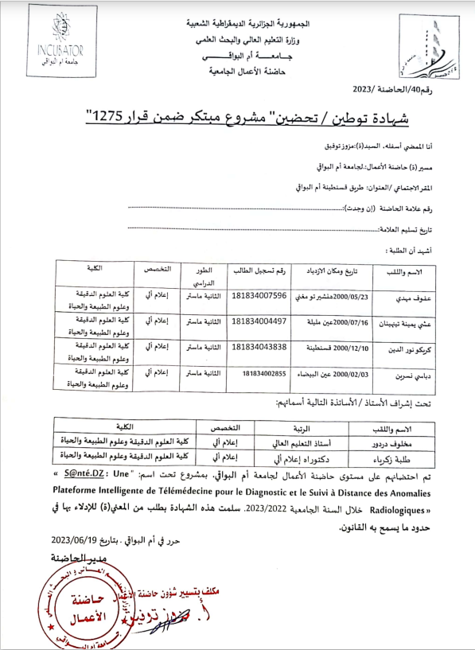
Certificate of incubation of an innovative project

Slide 19
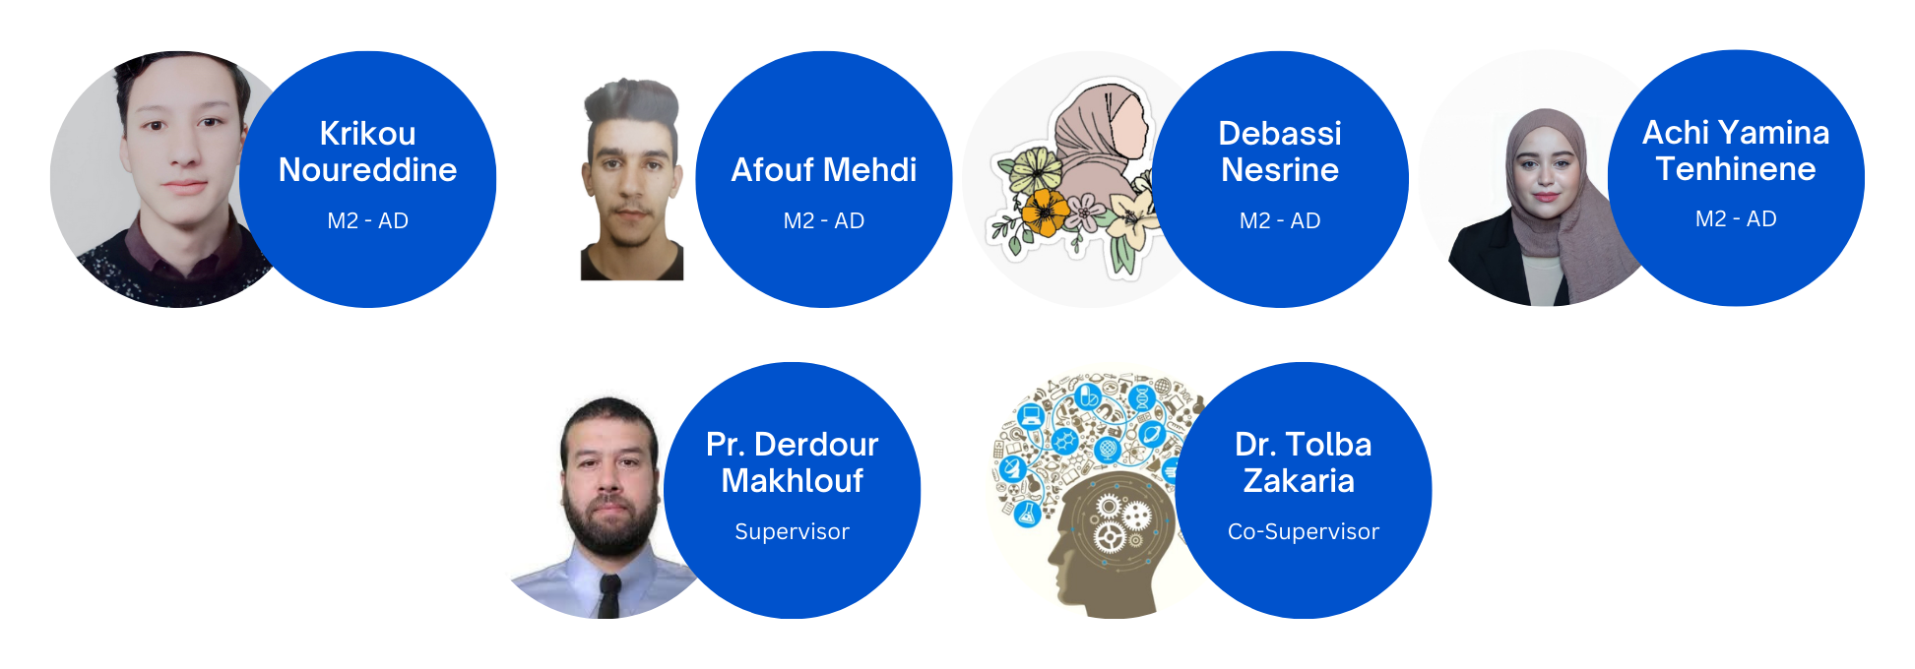
Team

