Slide 1

PROJECT TITLE
FUREVERHOME – A PET ADOPTION WEBSITE
MARWADI UNIVERSITY
FACULTY OF DIPLOMA STUDIES
COMPUTER ENGINEERING DEPARTMENT
Prepared by:
PARTHRAJSINH JADEJA : 92300938082
YUG SAMANI : 92300938110
RAJDEEP SISODIYA : 92300938113
MANTHAN MEHTA : 92300938114
KRINAL KARIYA : 92300938122
SEMESTER : 6
Project Review - 4
Guided by:
PROF.TWINKAL CHAVDA

Slide 2
CONTENT
Acknowledgement
Aim / Objectives
Problems
Methods
Results
System Design(Diagrams)
Conclusion

Slide 3
Acknowledgment
We would like to extend our sincere gratitude to Prof. Twinkal Chavda, our project guide, for her constant support, valuable insights, and expert guidance throughout the development of our project, FurEverHome – A Pet Adoption Website. Her encouragement and constructive feedback played a vital role in shaping our ideas and bringing this project to life.
We are also deeply thankful to Marwadi University for providing us with an excellent learning environment, technical resources, and continuous motivation that helped us explore a real-world problem and work toward a meaningful solution. This opportunity has enhanced our understanding of community-driven platforms and the importance of animal welfare in society.

Slide 4
OBJECTIVES
To integrate multiple features including pet listings, NGO coordination, lost & found pet tracking, and service provider directories (especially in Rajkot).
To enable role-based access and interactions through User, NGO, and Admin panels with secure login and control.
To develop an intuitive and responsive web platform named FurEver Home to facilitate pet adoption in a structured and humane manner.
To raise awareness about animal health issues and promote responsible pet ownership through informative and interactive content.
To create a scalable and maintainable system that can be used by local communities, shelters, and individuals.

Slide 5
Pet adoption in Rajkot is mostly offline and time-consuming.
Users cannot easily find pets or get complete details.
NGOs face difficulty managing pet records manually.
No proper system for tracking adoption requests.
Communication between users, NGOs, and admin is unorganized.
Lack of a centralized platform reduces transparency.
PROBLEMS

Slide 6
METHODS
Developed a web-based adoption system with User, NGO, and Admin panels.
Used HTML, CSS, Bootstrap for a clean and responsive interface.
Implemented PHP and MySQL for backend logic and database handling.
Added OTP-based email verification for secure user registration.
Provided pet listings with filters for species, breed, age, and city.
Enabled NGOs to manage pet data and Admin to control approvals and activities.

Slide 7
RESULTS
Adoption process becomes simple, quick, and fully digital.
Users can easily search pets and track their adoption requests.
NGOs can smoothly manage pet listings and updates.
Admin gets a clear view of all system activities.
Transparency and communication among all parties improves.
Encourages responsible and organized pet adoption in Rajkot.

Slide 8
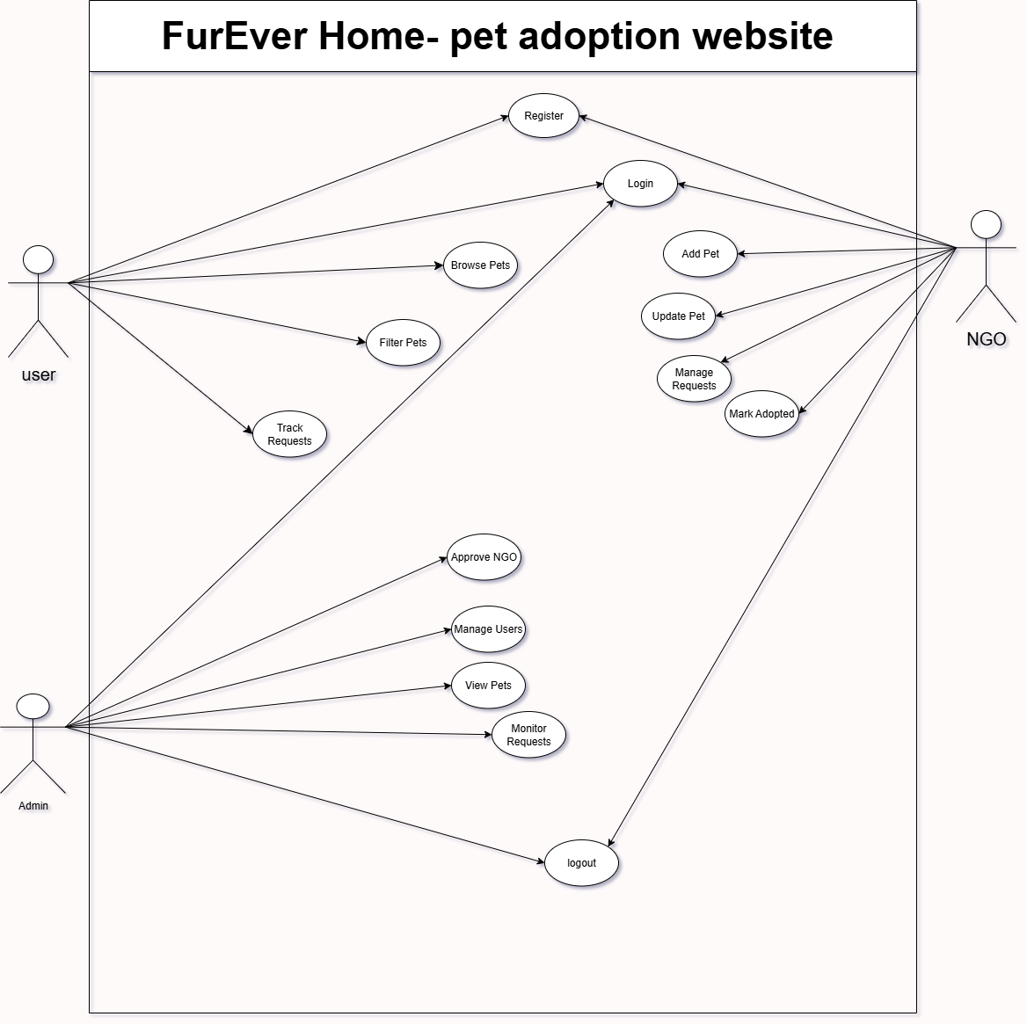
SYSTEM DESIGN(DIAGRAMS)
Figure 1.1 Use Case Diagram

Slide 9
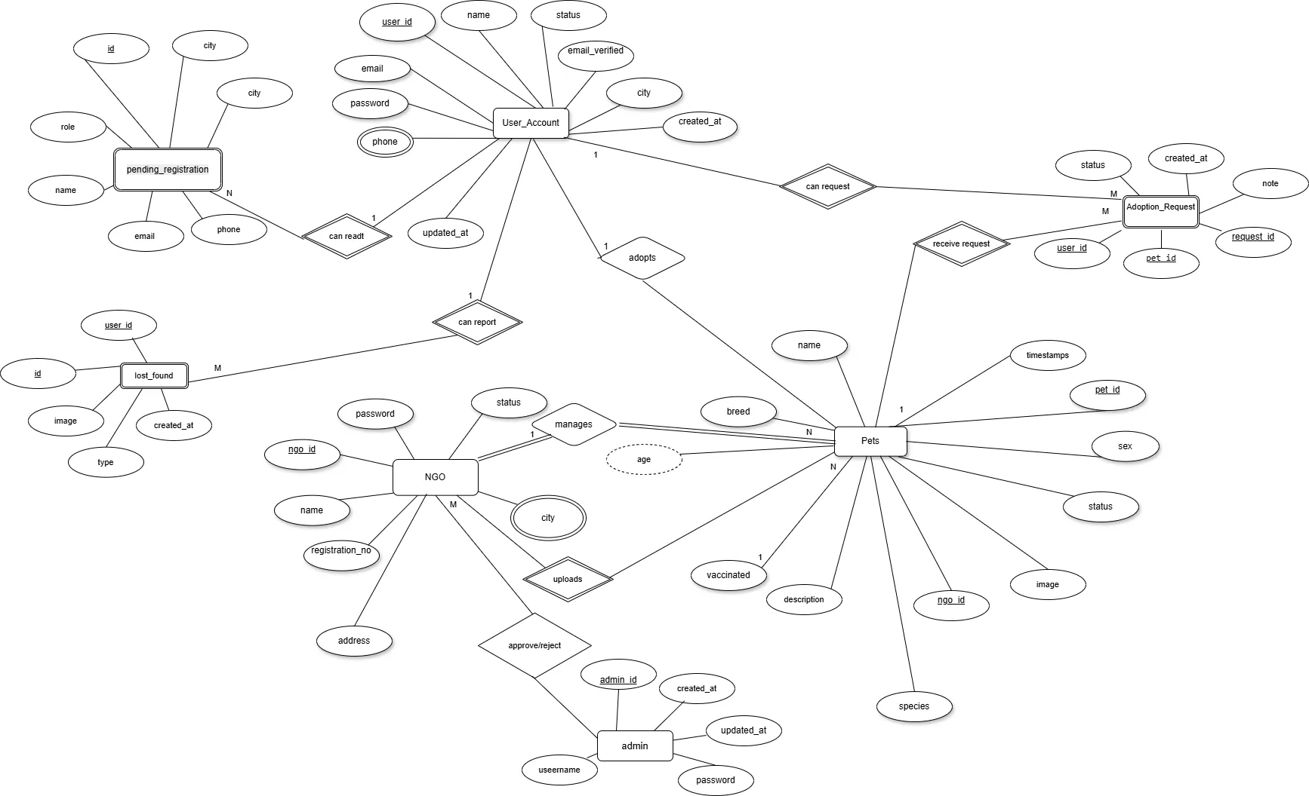
Figure 1.2 E.R. Diagram

Slide 10
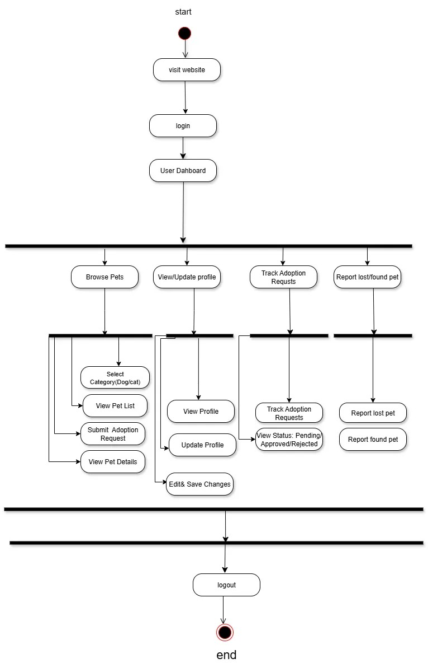
Figure 1.3.1 user Activity Diagram

Slide 11
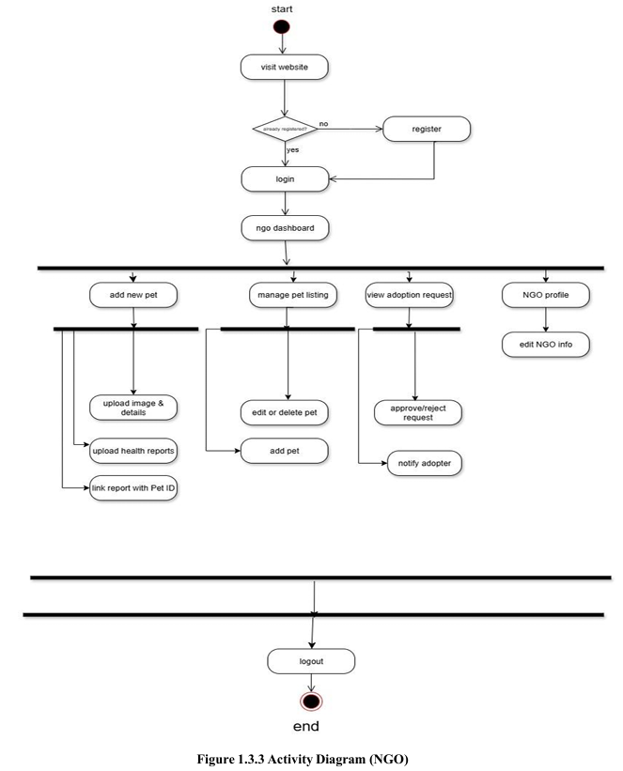
Figure 1.3.2 Ngo Activity Diagram

Slide 12
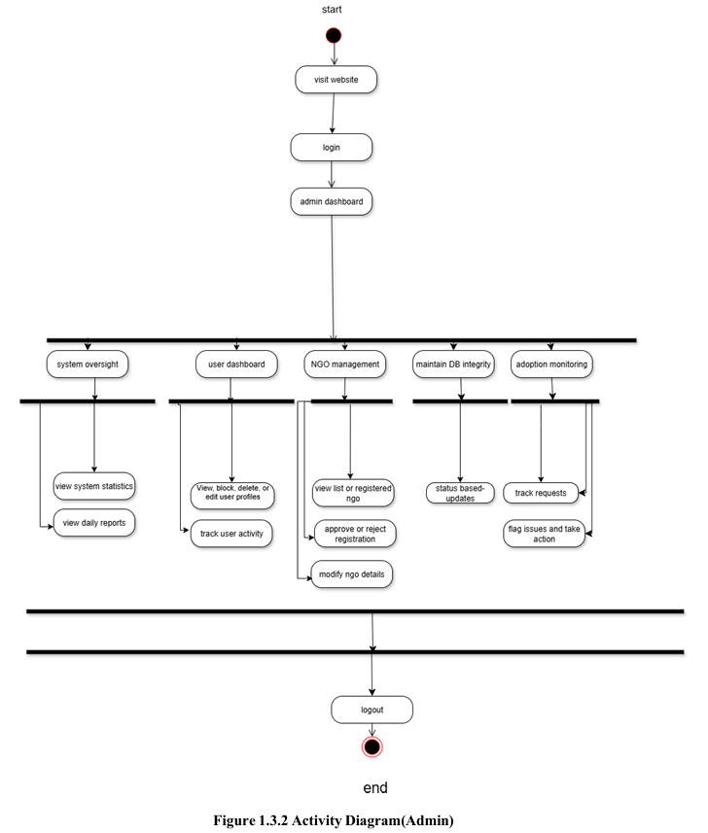
Figure 1.3.3 Admin Activity Diagram

Slide 13
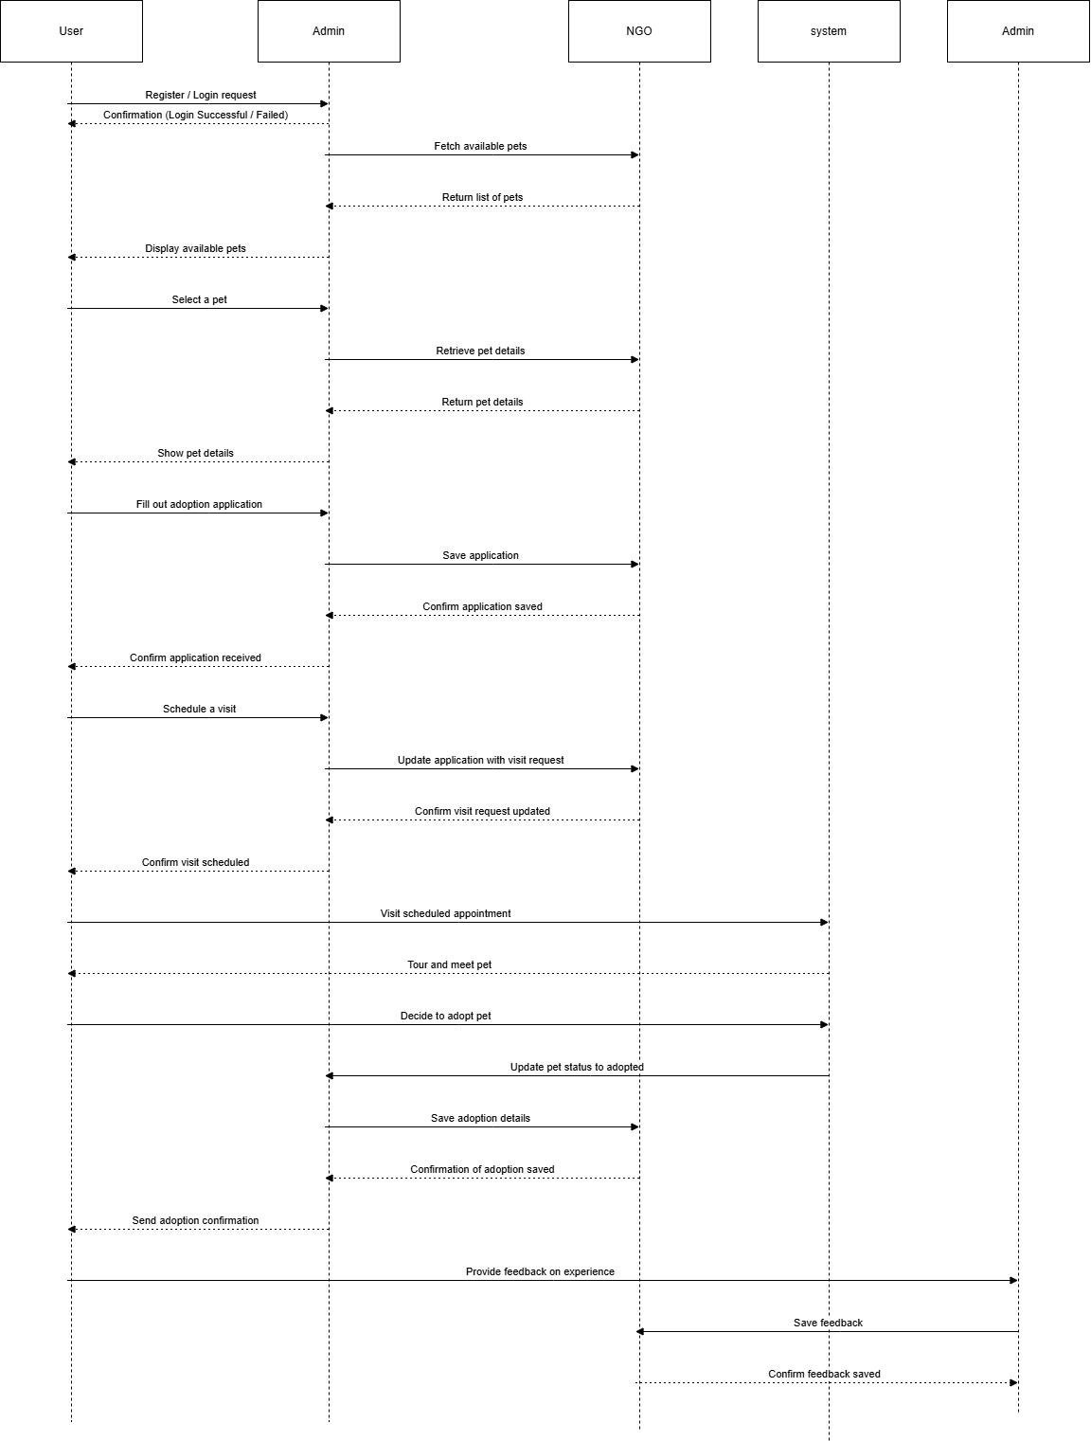
Figure 1.4 Sequence Diagram

Slide 14
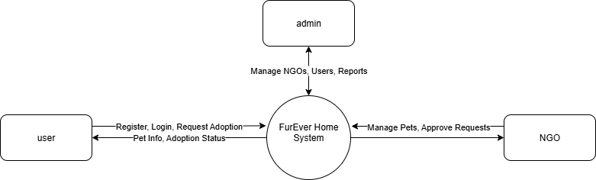
Figure 1.5 DFD Diagram (Level 0)

Slide 15
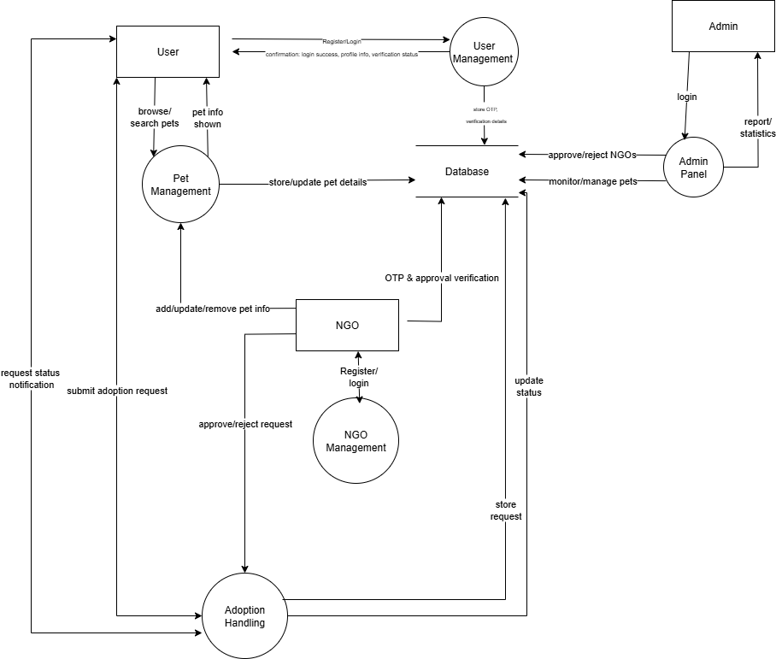
Figure 1.6 DFD Diagram (Level 1)

Slide 16
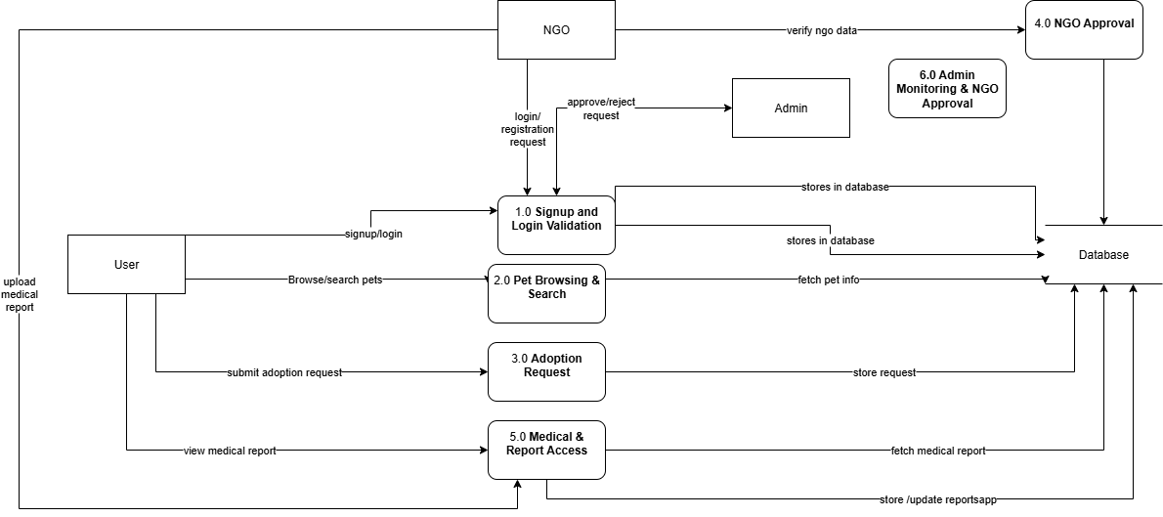
Figure 1.7 Admin Panel Dfd (Level 2)

Slide 17
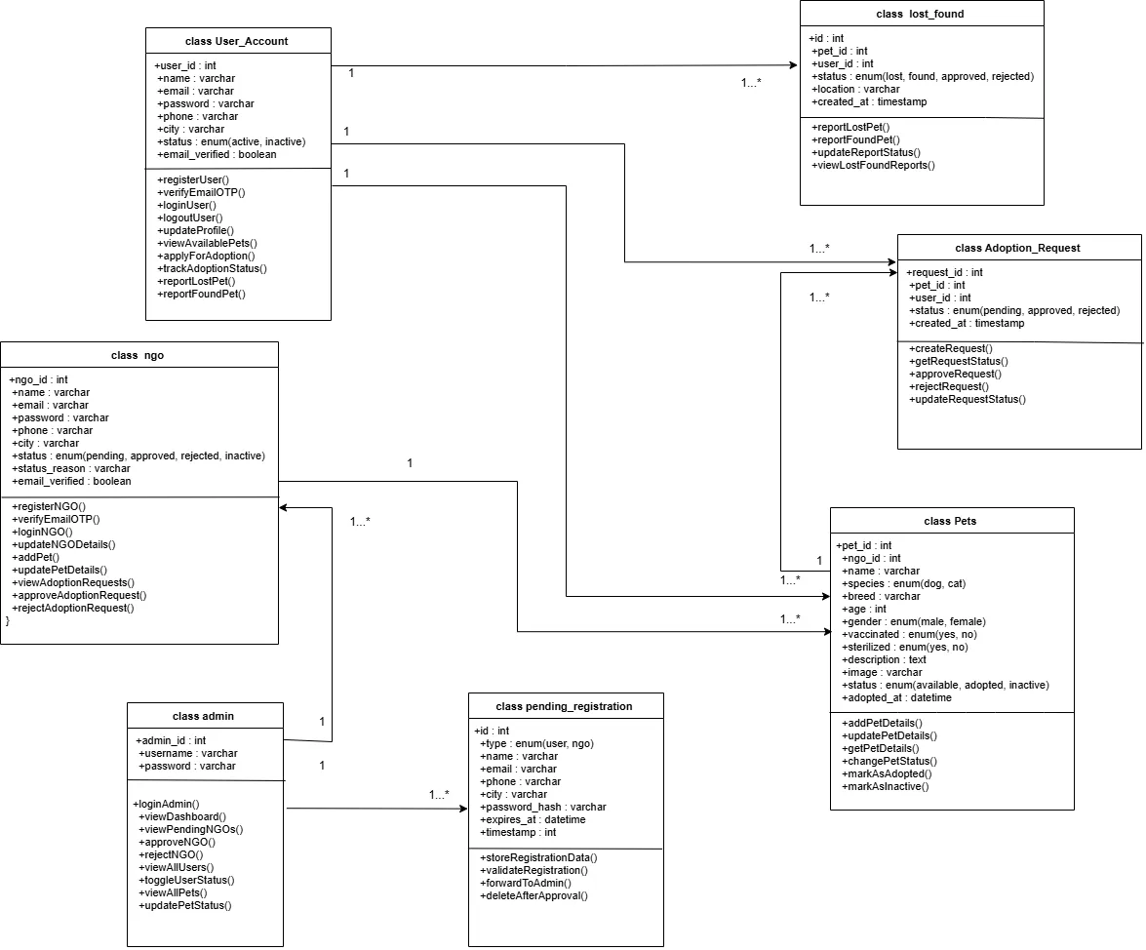
Figure 1.8 Class Diagram

Slide 18
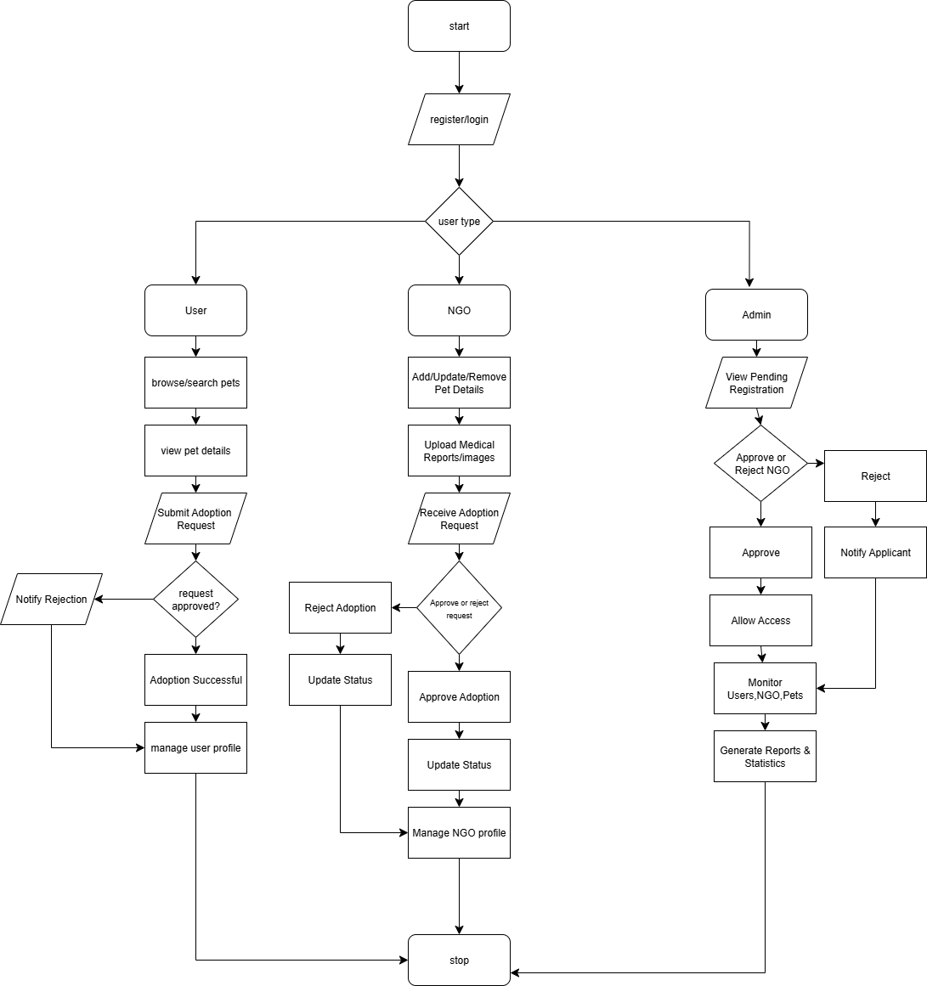
Figure 1.9 Flowchart

Slide 19
CONCLUSION
FurEver (Rajkot) successfully transforms the traditional pet adoption process into a digital, organized, and user-friendly system. By bringing users, NGOs, and administrators onto one platform, the website improves communication, transparency, and efficiency. The system makes pet browsing and adoption easier for users, helps NGOs manage pets more effectively, and allows the admin to maintain full control of operations. Overall, FurEver promotes responsible pet adoption, supports animal welfare, and provides a reliable solution for the community of Rajkot.

