Slide 1

WEEK-01
PRESENTATION
Summer Internship presentation
Topic :Health-Aware and Explainable Food Recommendation Systems Using Retrieval-Augmented LLMs
Foundational Week 1 Deliverables for the GroundedNutriRec system architecture

Slide 2

ABOUT OUR
PROJECT
Food Recommendation System
This project focuses on building a smart recommendation system that suggests recipes based on user preferences and historical data. Our team — Ishan, Kush, and Krina — worked collaboratively to analyze a real dataset Food.com containing recipe details and user reviews.
The objective is to extract meaningful insights and design a system that can provide personalized recipe suggestions. This project combines data analysis, preprocessing, and machine learning concepts to solve a practical problem. I
t also helps us understand how real-world recommendation systems (like Netflix or Amazon) work.

Slide 3
ABOUT OUR
DATASET
The dataset consists of two main files:
recipes.csv – Contains recipe-related information
reviews.csv – Contains user interaction data
The recipes dataset includes attributes such as recipe name, ingredients, cooking time, nutritional values, and ratings. The reviews dataset includes user IDs, ratings, and textual reviews. Both datasets are linked using a common key called RecipeId, which allows us to combine them for deeper analysis.
This structure makes the dataset suitable for building recommendation systems.

Slide 4
DATASET EXPLANTION
The dataset is a structured and relational dataset consisting of two interconnected tables: recipes and reviews.
The recipes dataset contains detailed information about each recipe, including attributes like recipeid, name, ingredients, preparation time, cooking time, nutritional values (calories, protein, fat, etc.), and aggregated ratings. These features help in understanding the characteristics of each recipe.
The reviews dataset contains user-generated data such as reviewid, authorid, rating, review text, and timestamps. This dataset captures user preferences and feedback, which is crucial for recommendation systems.
Both datasets are linked through the recipeid column, forming a one-to-many relationship (one recipe can have multiple reviews). This relationship allows us to merge datasets and analyze how users interact with recipes. The dataset is ideal for both content-based filtering (using recipe features) and collaborative filtering (using user ratings).

Slide 5
IDEA
We are building a hybrid recommendation system that combines collaborative filtering (based on user ratings and behavior) with content-based filtering (based on recipe features like ingredients and nutrition).
This combination helps overcome individual limitations—collaborative filtering handles personalization but struggles with new users, while content-based filtering works without user data but may lack variety.
By analyzing user preferences and matching them with similar recipes using techniques like cosine similarity, the system delivers more accurate, diverse, and personalized recommendations

Slide 6
APPROACH & TECH-STACK
Our approach follows a structured pipeline:
Data Cleaning – Handling missing values, fixing column names, and removing duplicates
Exploratory Data Analysis (EDA) – Understanding patterns, distributions, and relationships
Data Merging – Combining recipes and reviews using recipeid
Feature Engineering – Creating useful features such as average rating, popularity, and ingredient vectors
Model Building – Applying recommendation algorithms
Data is cleaned, analyzed, and merged, then key features are created. Finally, models like cosine similarity and matrix factorization generate accurate recommendations.
Jupyter Notebook
Python & Libraries :
Pandas → Data handling and manipulation
NumPy → Numerical computations
Matplotlib → Basic visualization
Seaborn → Advanced visualization
Scikit-learn → Machine learning models

Slide 7
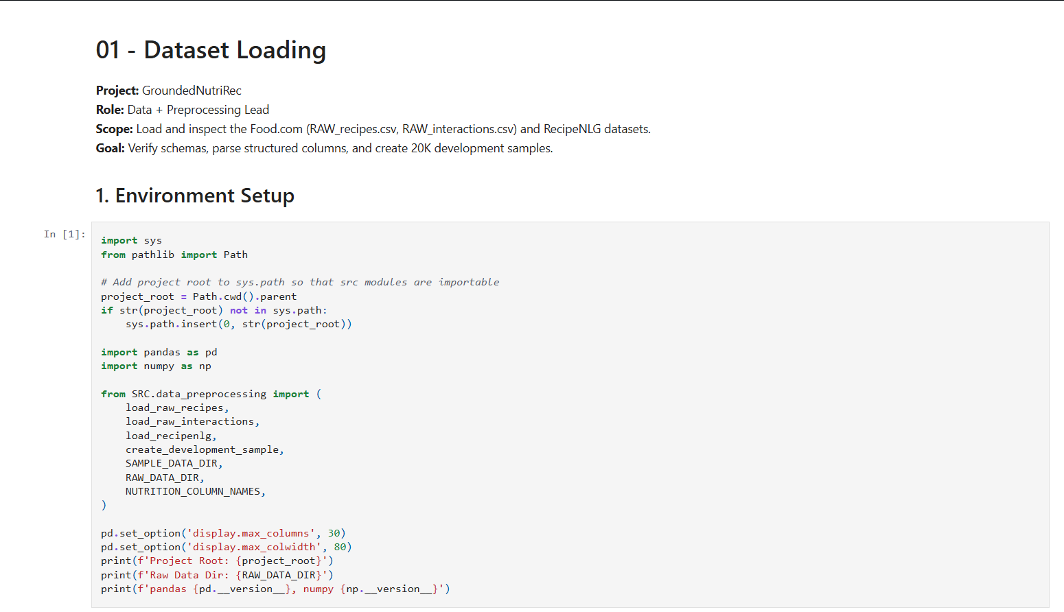
OUTPUT & SCREENSHOTS
Two Files:
01_data_loading.ipynb
02_dataset_eda.ipynb
SCREENSHOT OF FILE ONE

Slide 8
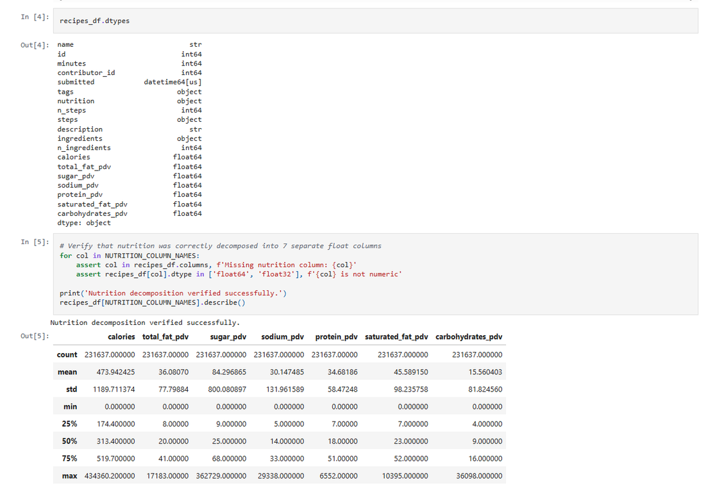
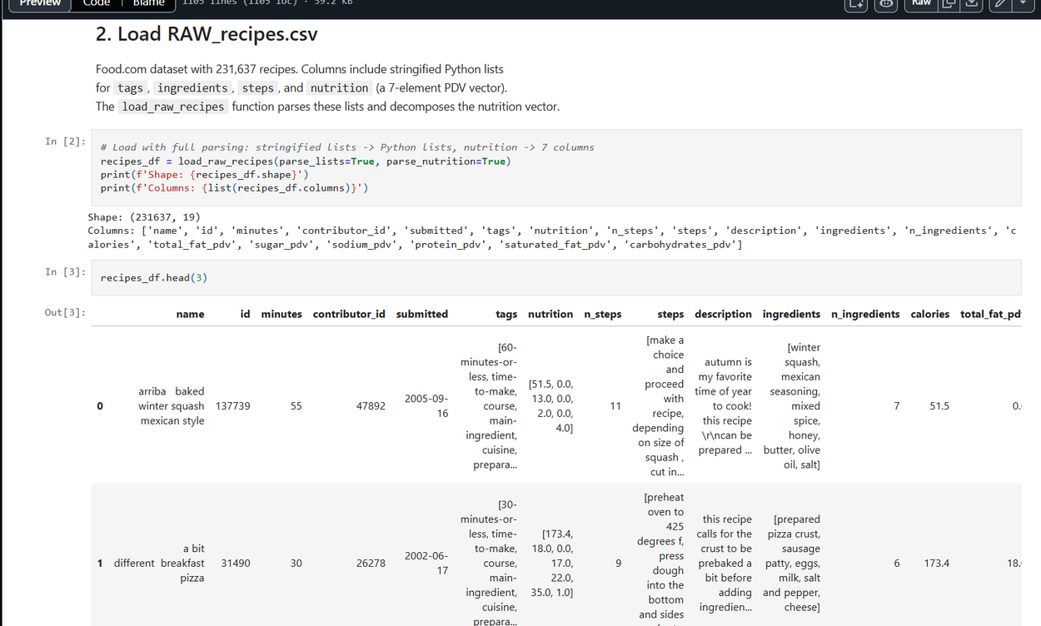
CONTINUES .....

Slide 9
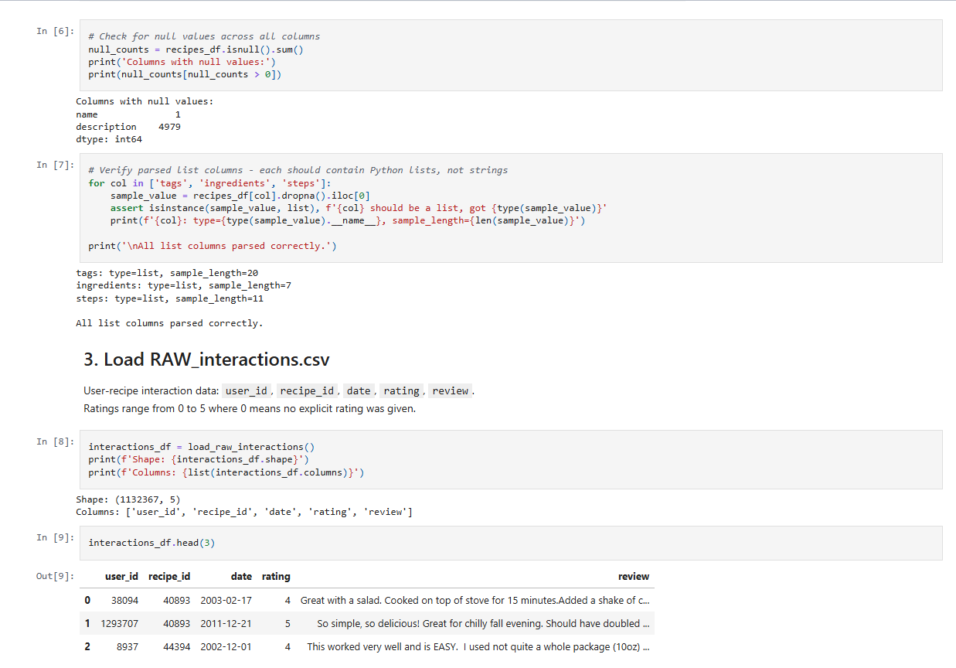
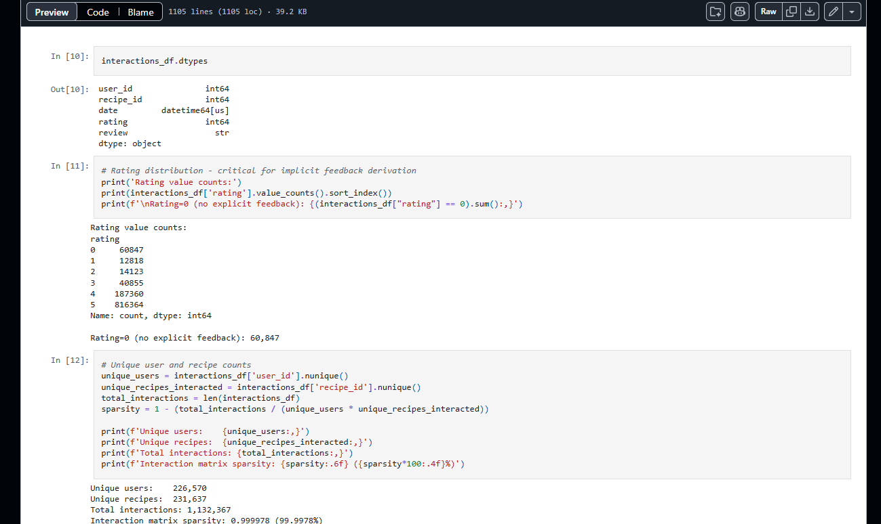
CONTINUES .....

Slide 10
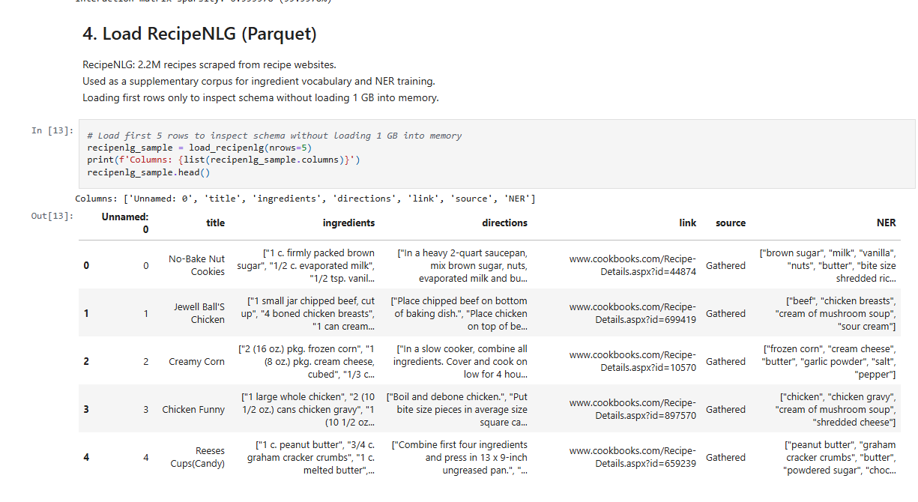
CONTINUES .....

Slide 11
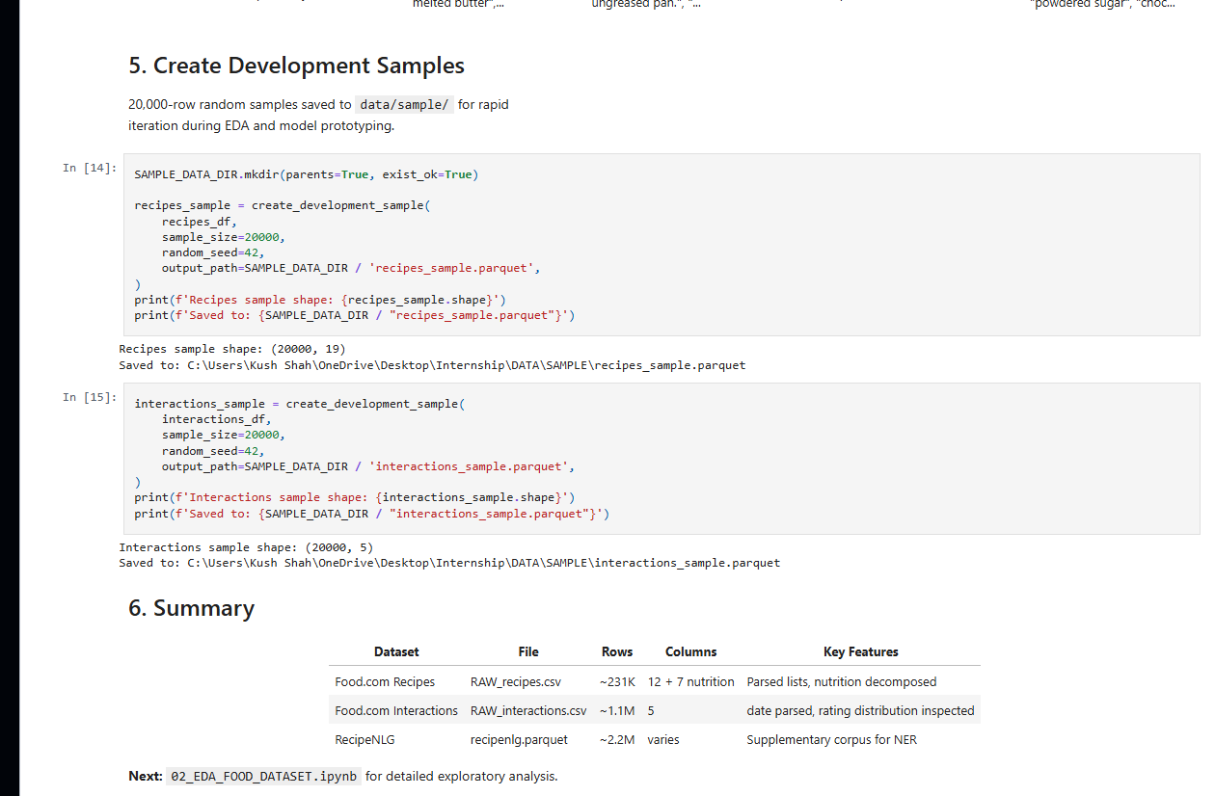
CONTINUES .....

Slide 12
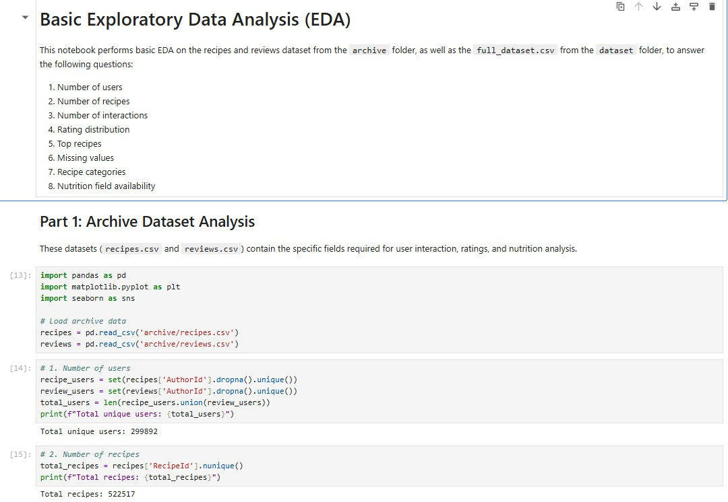
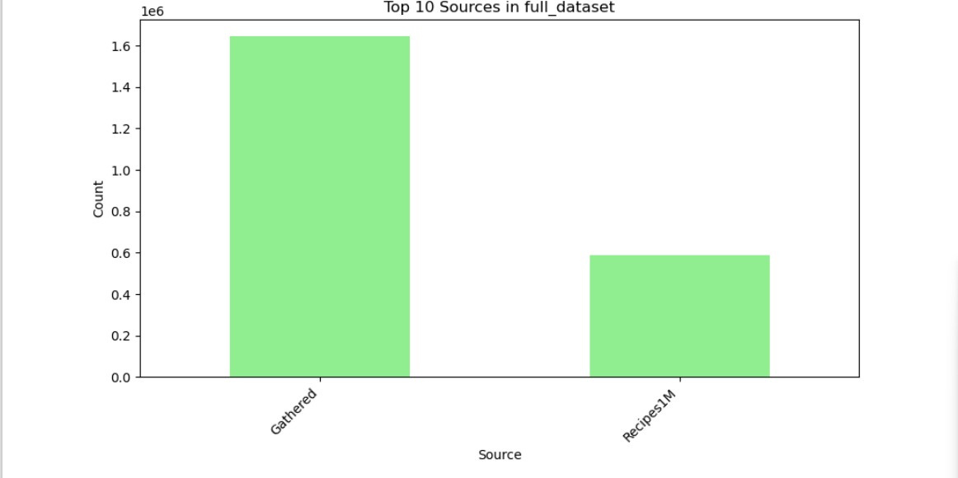
FILE 2 : 02_DATASET_EDA

Slide 13
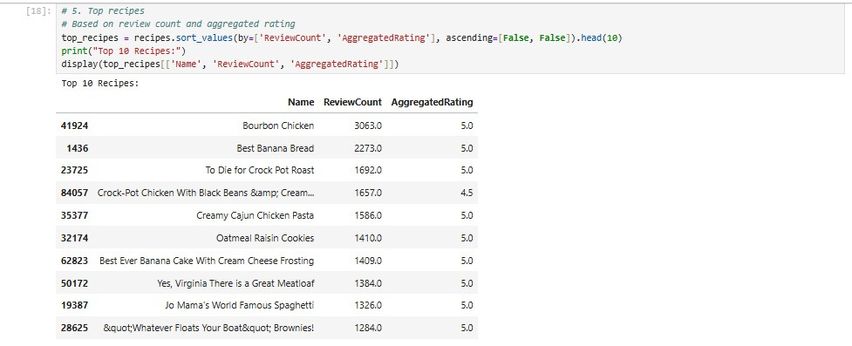
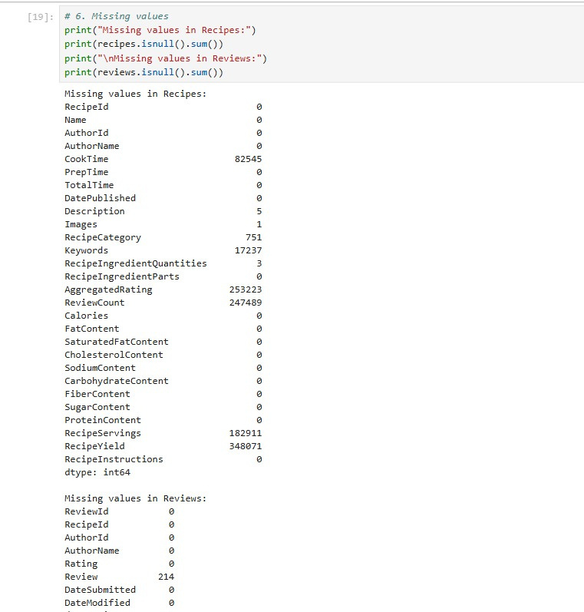
CONTINUES .....

Slide 14
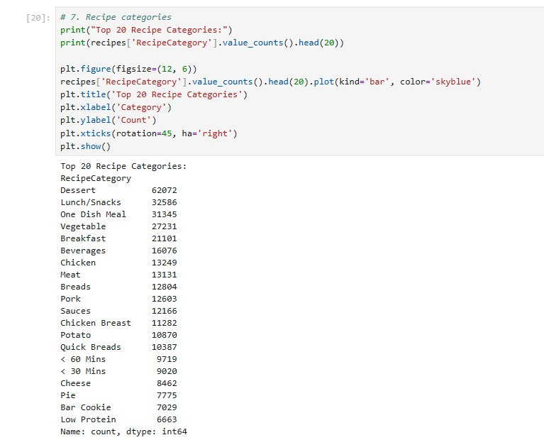
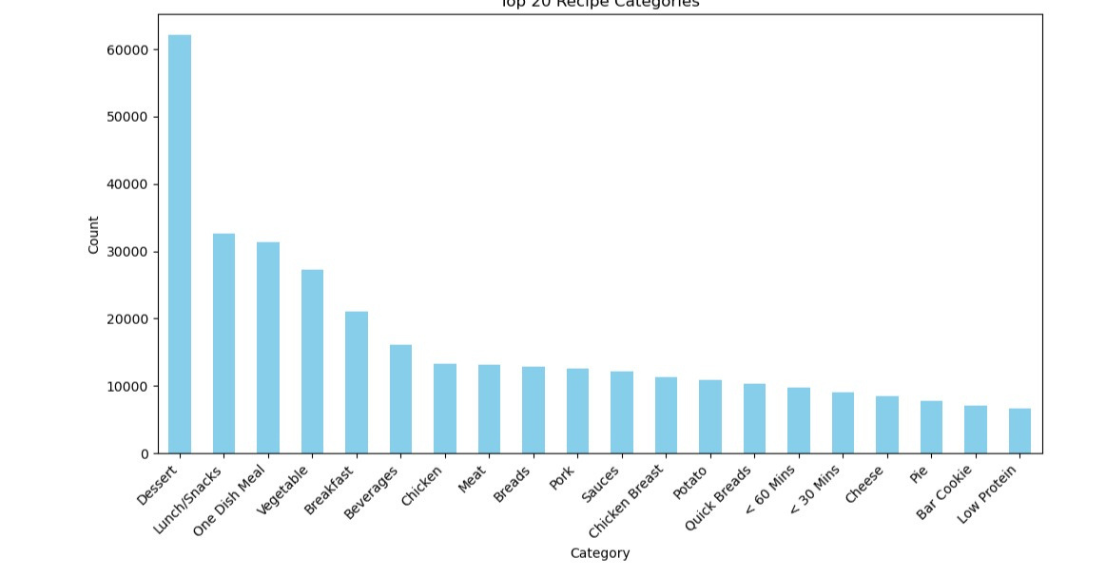
CONTINUES .....

Slide 15
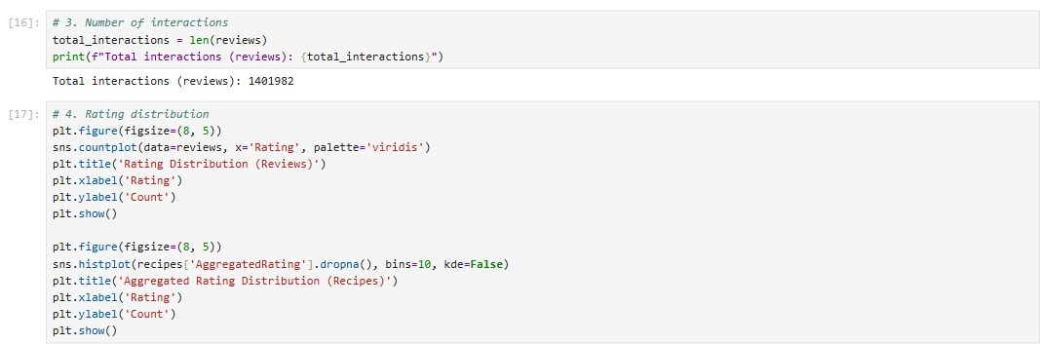
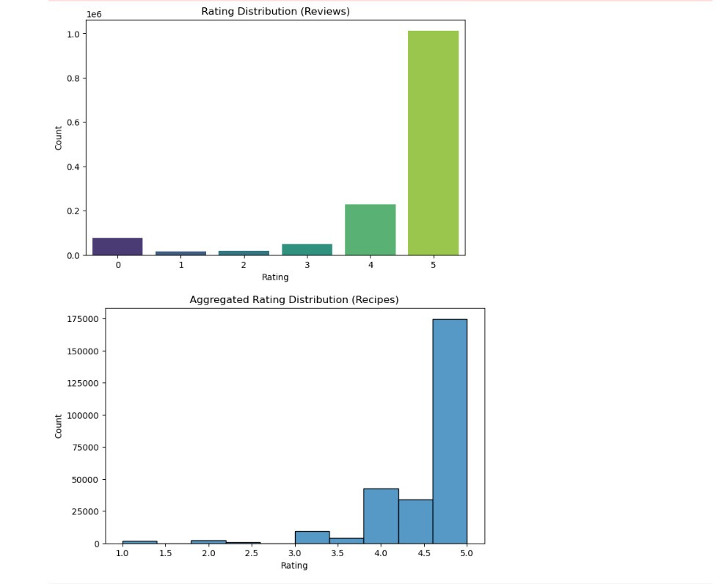
CONTINUES .....

Slide 16
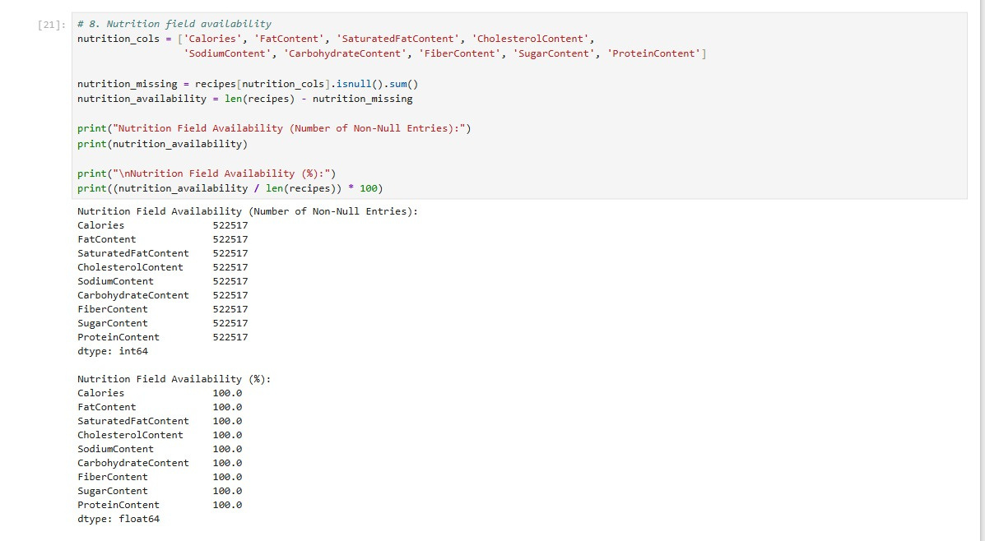
CONTINUES .....

Slide 17
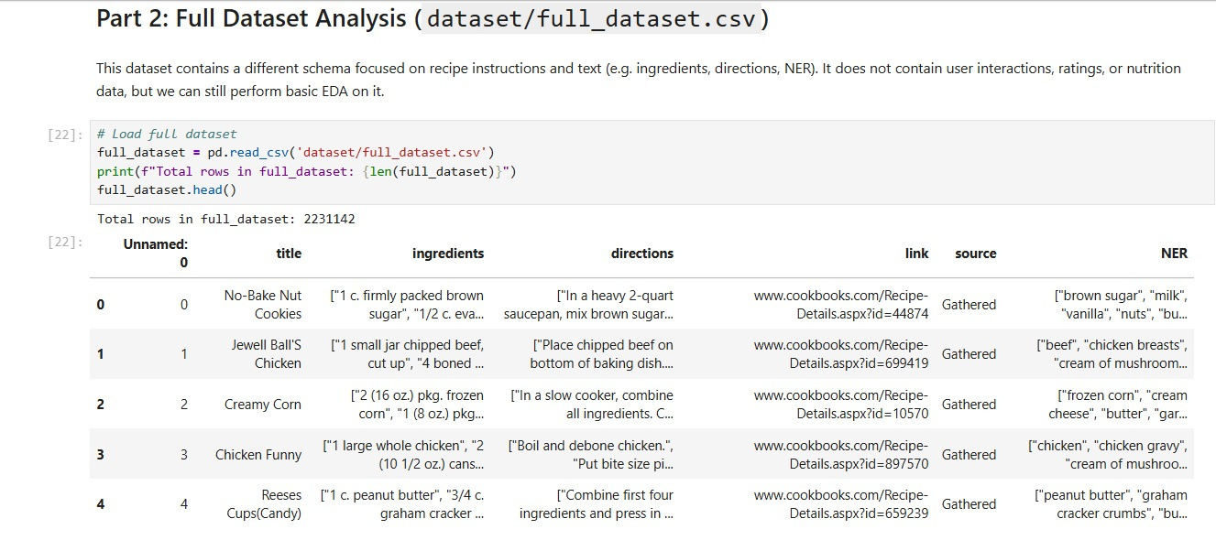
CONTINUES .....

Slide 18
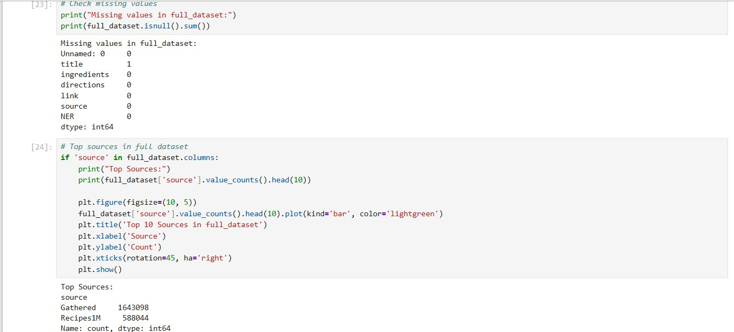
CONTINUES .....

Slide 19
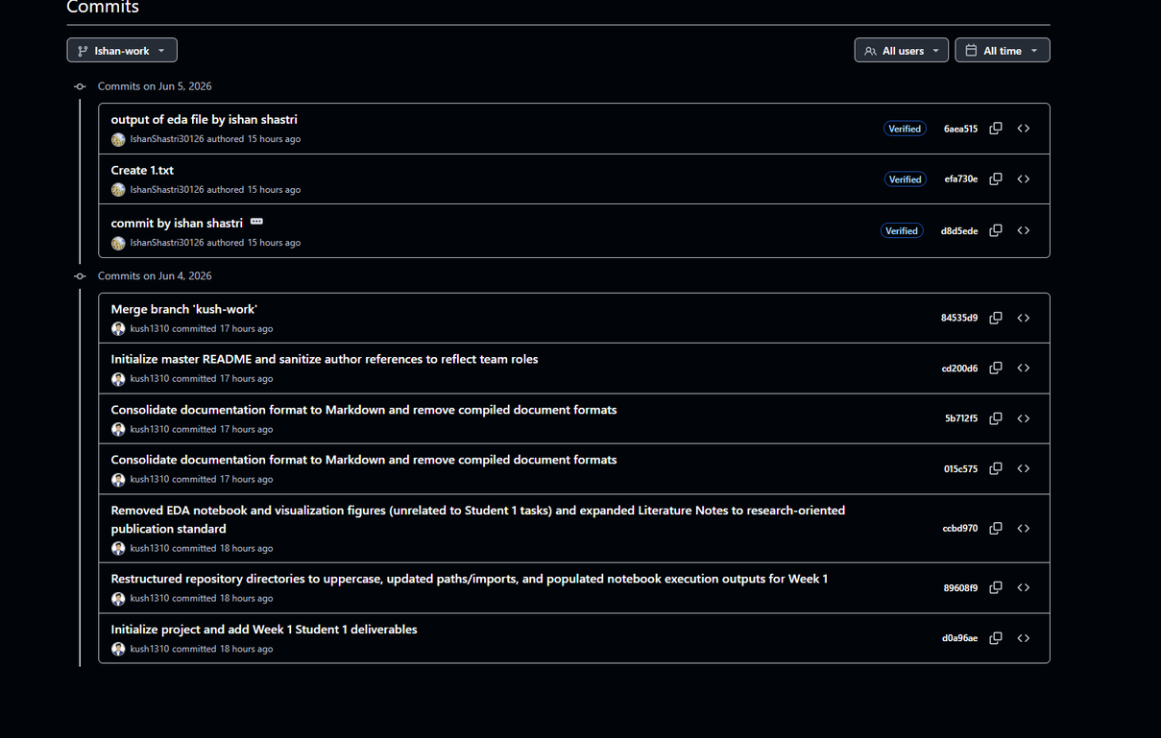
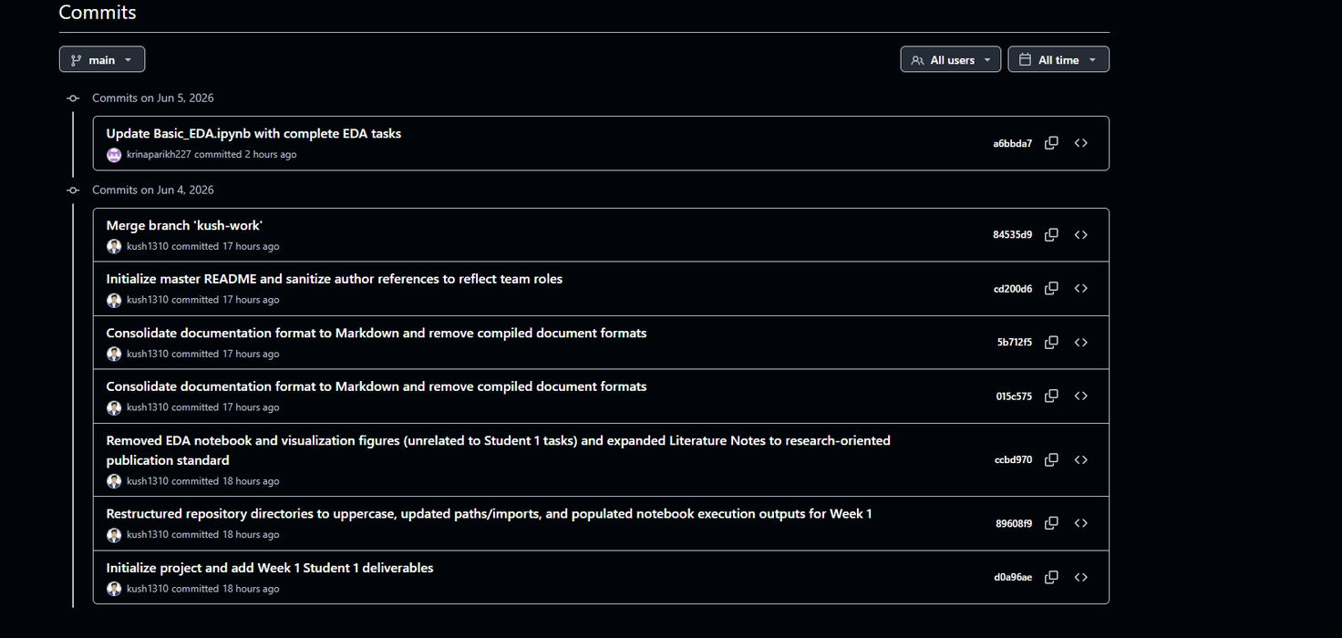
GITHUB COMMITS:

Slide 20
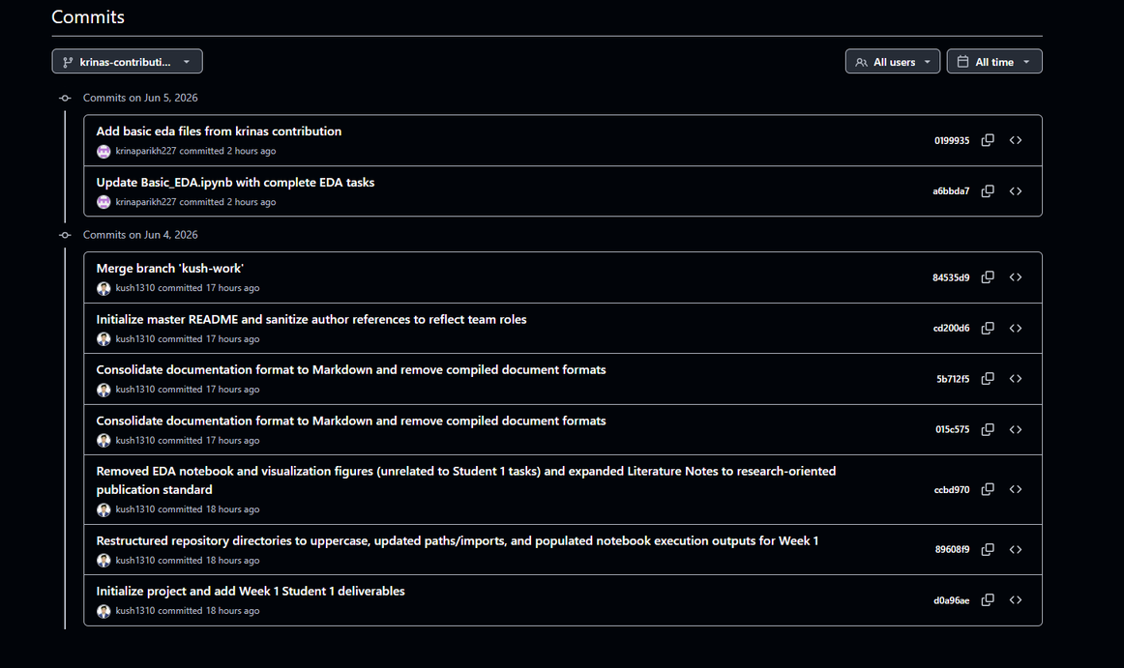
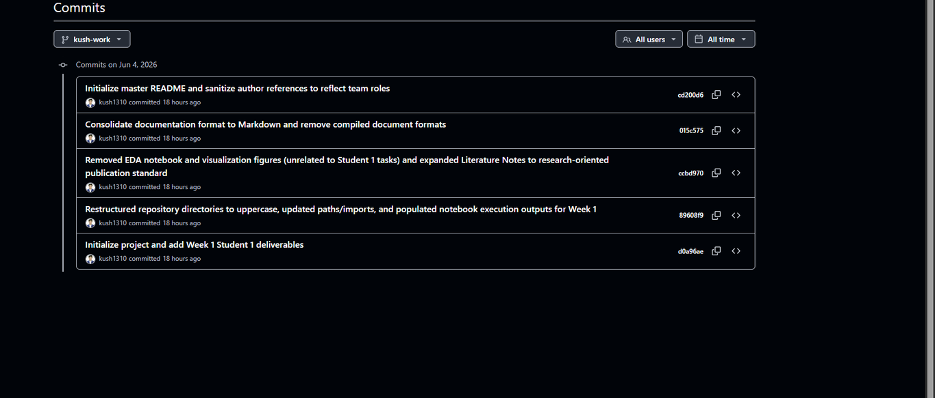
GITHUB COMMITS:

Slide 21
OUR INTERNSHIP
TEAM MATE
Ishan Shastri :- 24CE115
Kush Shah :- D25CE145
Krina Parikh :- D25CE146

Slide 22

THANK YOU

