Slide 1
Tesla Stock Price Forecasting

Slide 2
Project Overview
Goal: Forecast Tesla stock prices using historical data.
Approach:
- ARIMA
- Prophet
- LSTM

Slide 3
Dataset Description
Source: Tesla stock price dataset(2010-2017)
Columns: Date, Open, Close, High, Low, Volume
Preprocessing:
- Converted date column
- Removed missing values
- Set Date as index

Slide 4
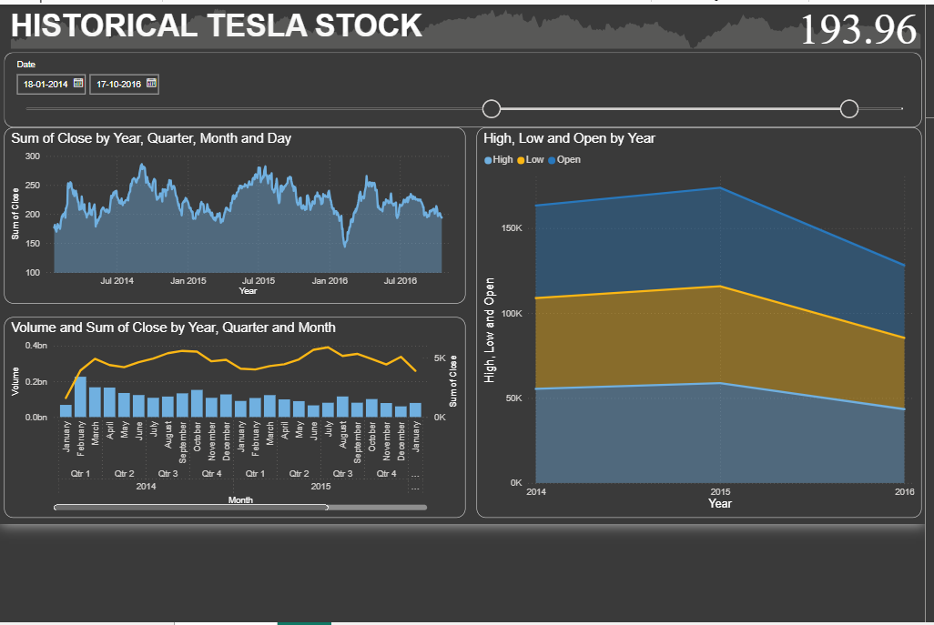
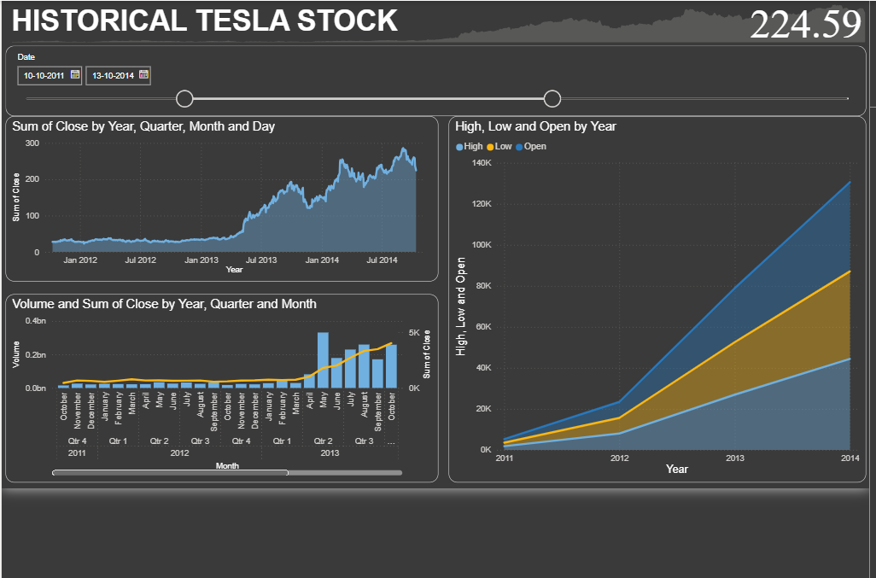
Data Visualization
Observed trends, fluctuations, and stock growth.

Slide 5
Time Series Decomposition
Used seasonal_decompose to split:
- Trend
- Seasonality
- Residuals

Slide 6
ARIMA Model
ARIMA stands for autoregressive integrated moving average model and is specified by three order parameters:(p, d, q).
Steps:
- Checked stationarity using ADF test
- Fitted ARIMA(5,1,0)
Forecast: Next 30 days
Plotted Actual vs Predicted prices

Slide 7
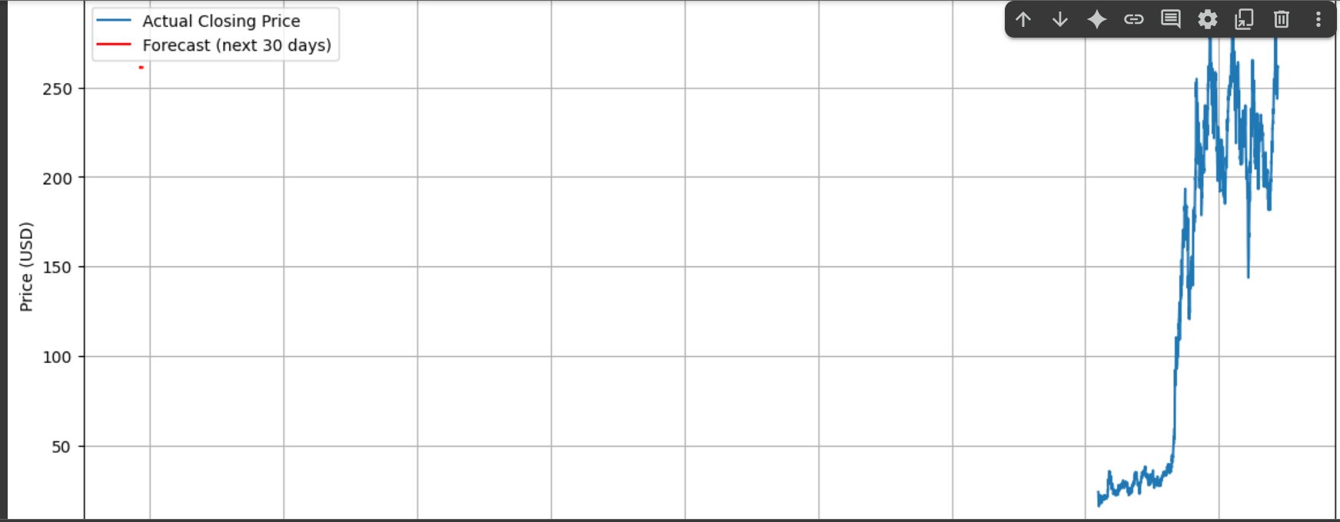

Slide 8
Prophet Model
- Handled seasonality automatically
- Data: Date (ds), Close (y)
Forecasted 30 days with confidence intervals

Slide 9
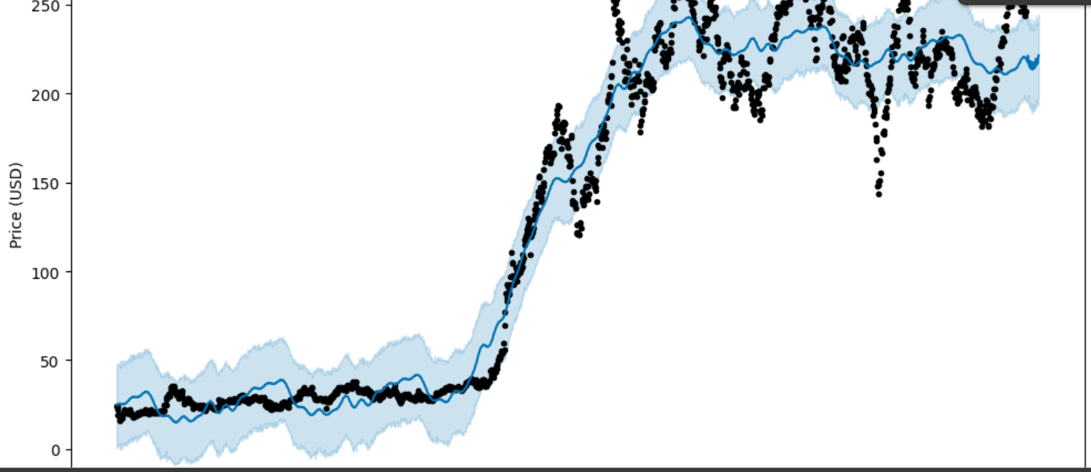

Slide 10
LSTM Model
Deep learning approach
- Normalized data
- Sequence format (60 days)
Model: 2 LSTM layers + Dense
Plotted Actual vs Predicted

Slide 11
Model Evaluation
Evaluation Metric: RMSE (Root Mean Squared Error)
Comparison: ARIMA vs Prophet vs LSTM
Visual: Bar Chart of RMSE
Best model highlighted

Slide 12
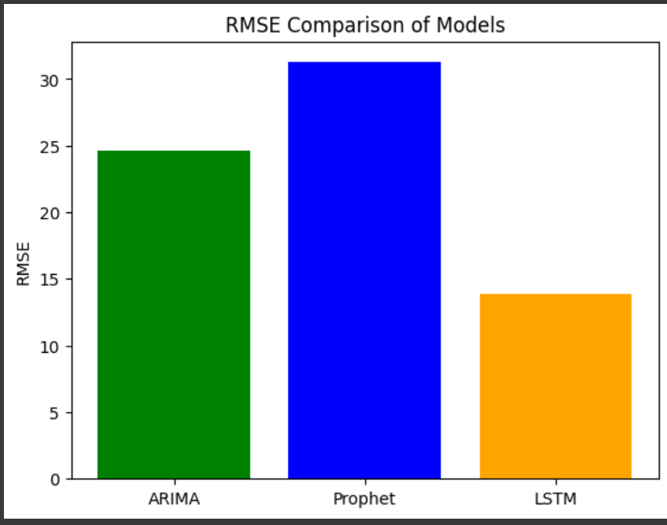

Slide 13
Final Conclusion
All models were implemented and compared
Best-performing model identified
Key Learnings:
- ML vs DL models
- Importance of preprocessing

Slide 14
THANK YOU!!

