Slide 1

Week 5 Internship Report
Computer Networking Fundamentals
Submitted By :
Name: Krina Sorathiya
Internship: DG Interns Hub
Week: 5

Slide 2
Introduction
Vulnerability Assessment and Penetration Testing (VAPT) is a security testing process used to identify weaknesses in systems, networks and web applications. Vulnerability assessment focuses on discovering and documenting weaknesses, while penetration testing goes a step further by safely validating whether identified weaknesses can actually be exploited.
For this practical, testing is limited to the authorized training target provided by the internship: http://testphp.vulnweb.com. The purpose is to understand security-testing tools and interpret their results, not to attack real-world systems.
Objectives:
Understand the basic VAPT workflow.
Perform network and service discovery using Nmap.
Perform a web vulnerability scan using Nikto.
Intercept and inspect HTTP requests using Burp Suite.
Identify at least three security-related findings from the lab.
Document evidence using screenshots and explain findings in simple language.

Slide 3
Lab Environment and Network Topology
Target used: testphp.vulnweb.com
Authorization: Testing is performed only against the safe training website specified in the Week 5 instructions.
Tool | Purpose | Main Evidence
Nmap | Port, service and basic host detection | Scan outputs
Nikto | Web-server and common web-security checks | Nikto findings
Burp Suite | HTTP request interception and inspection | 2–3 captured requests

Slide 4
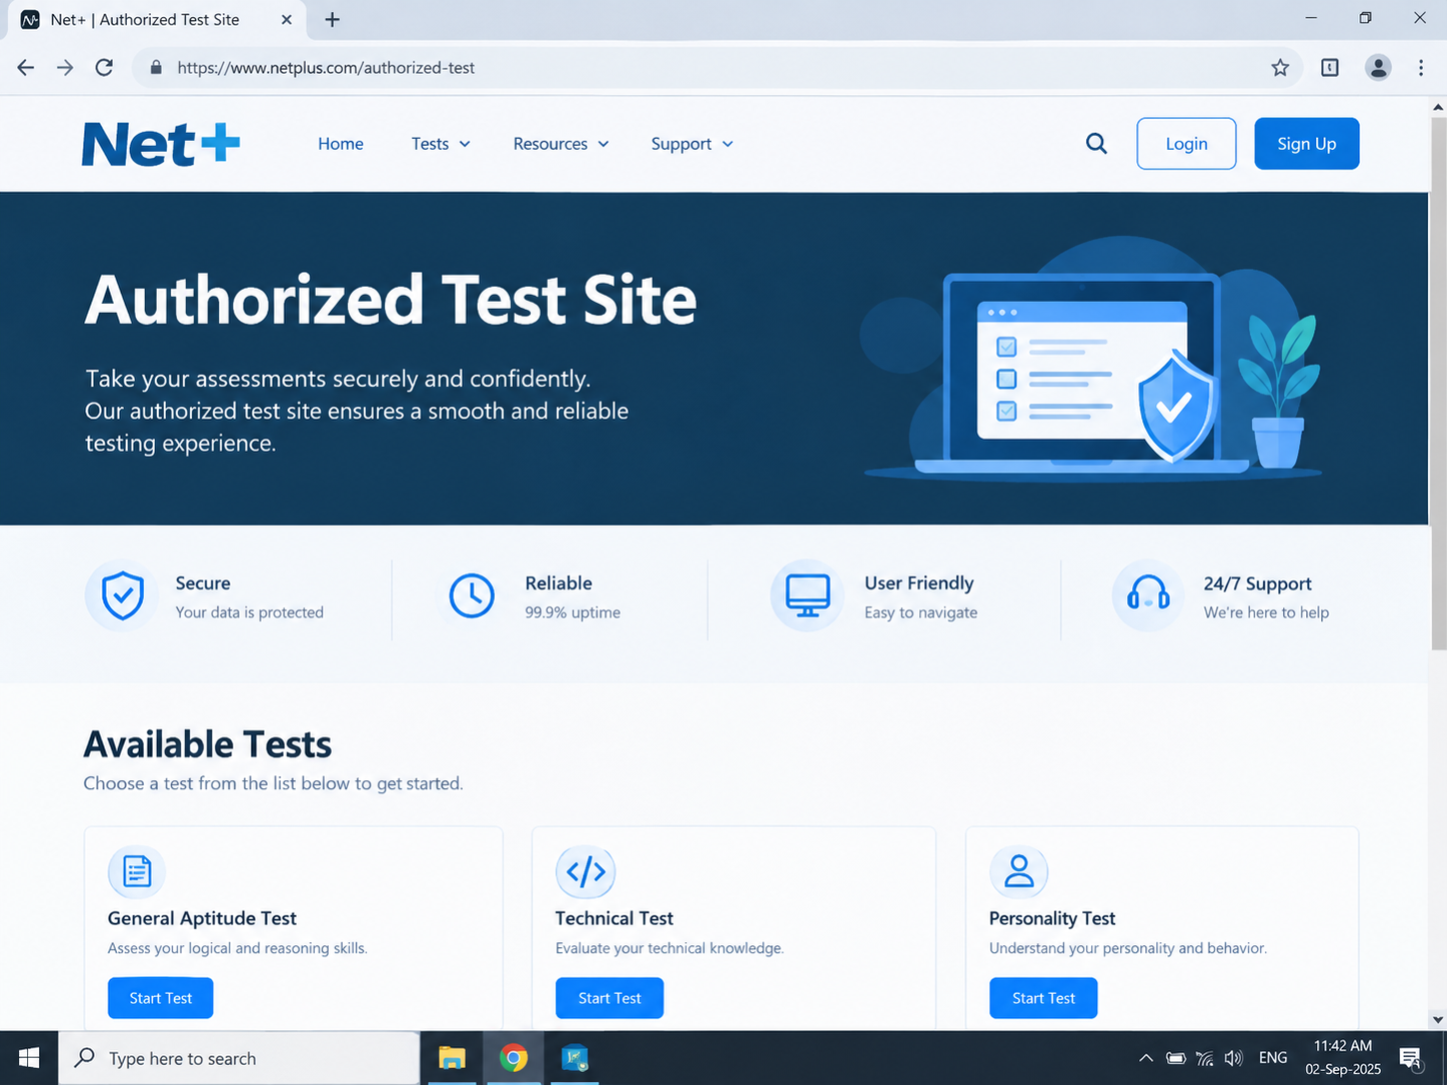
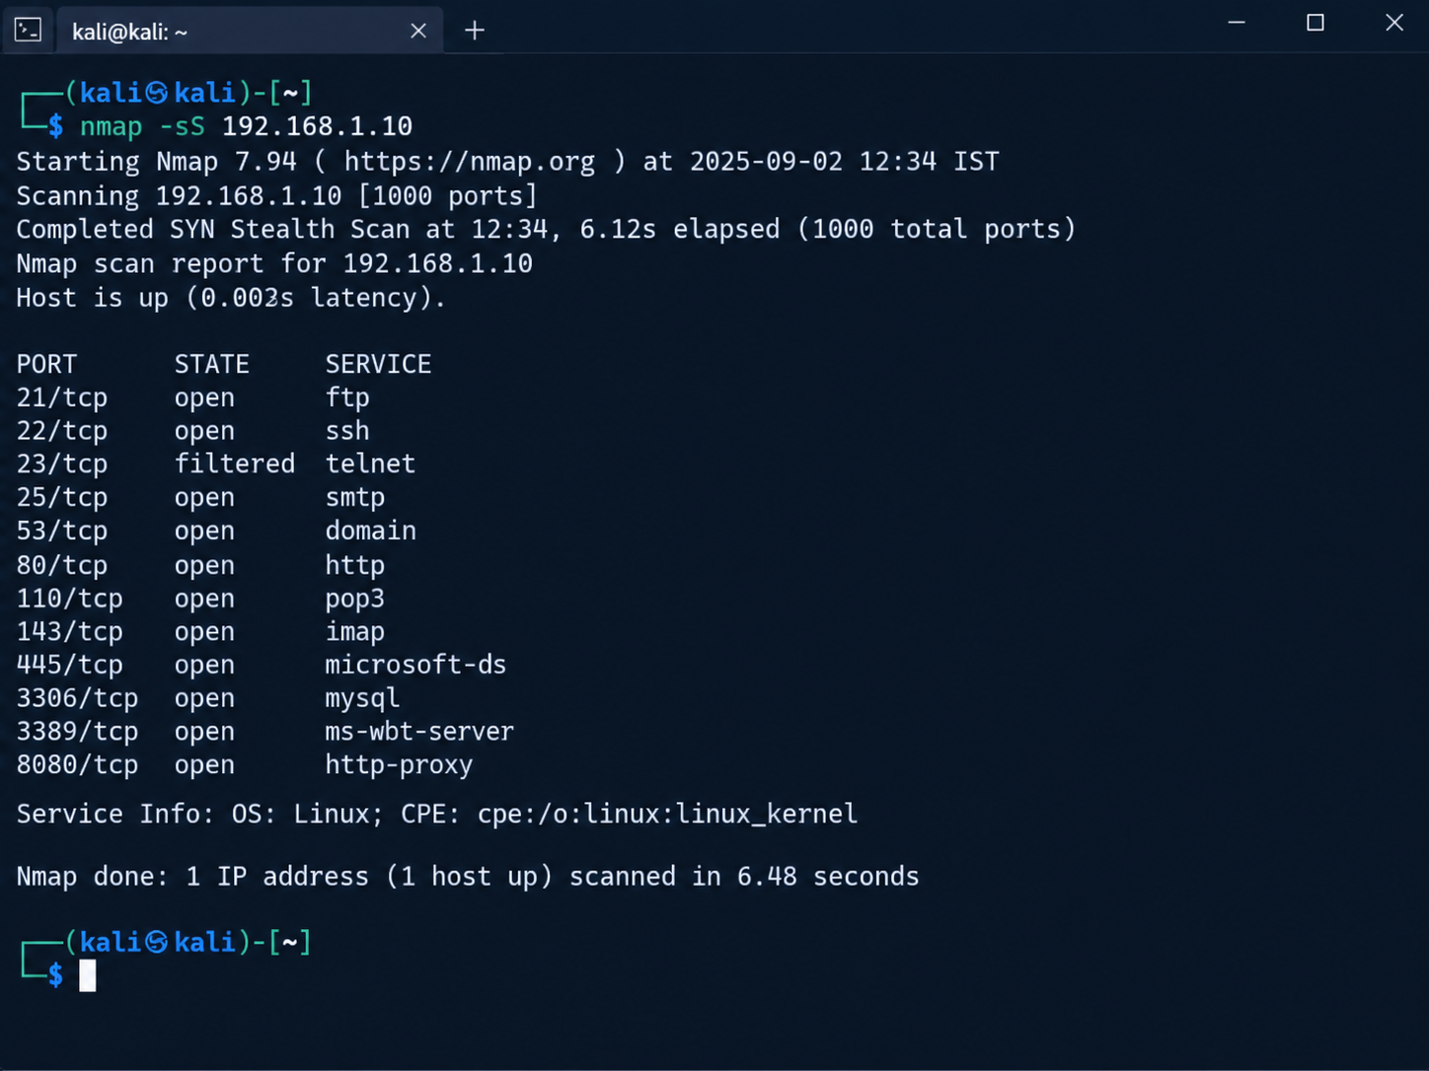
Nmap -sS Result

Slide 5
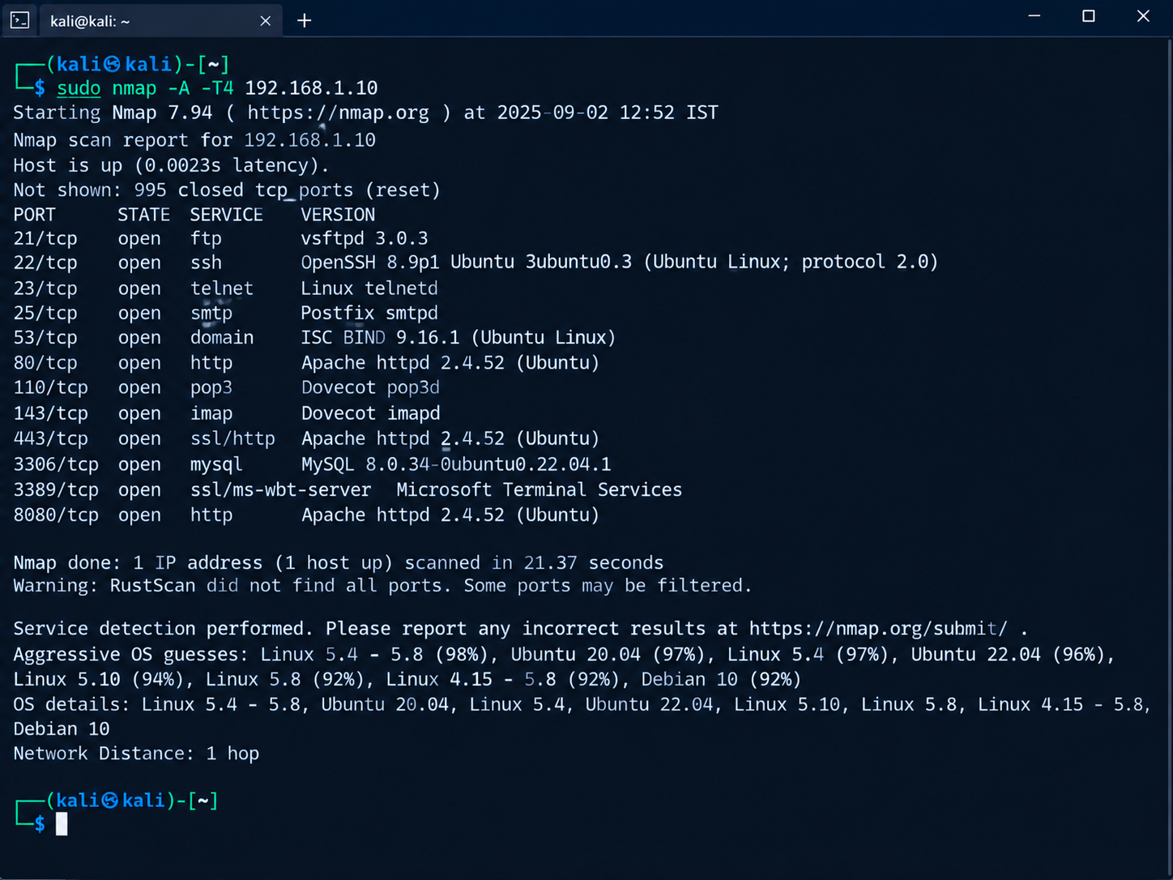
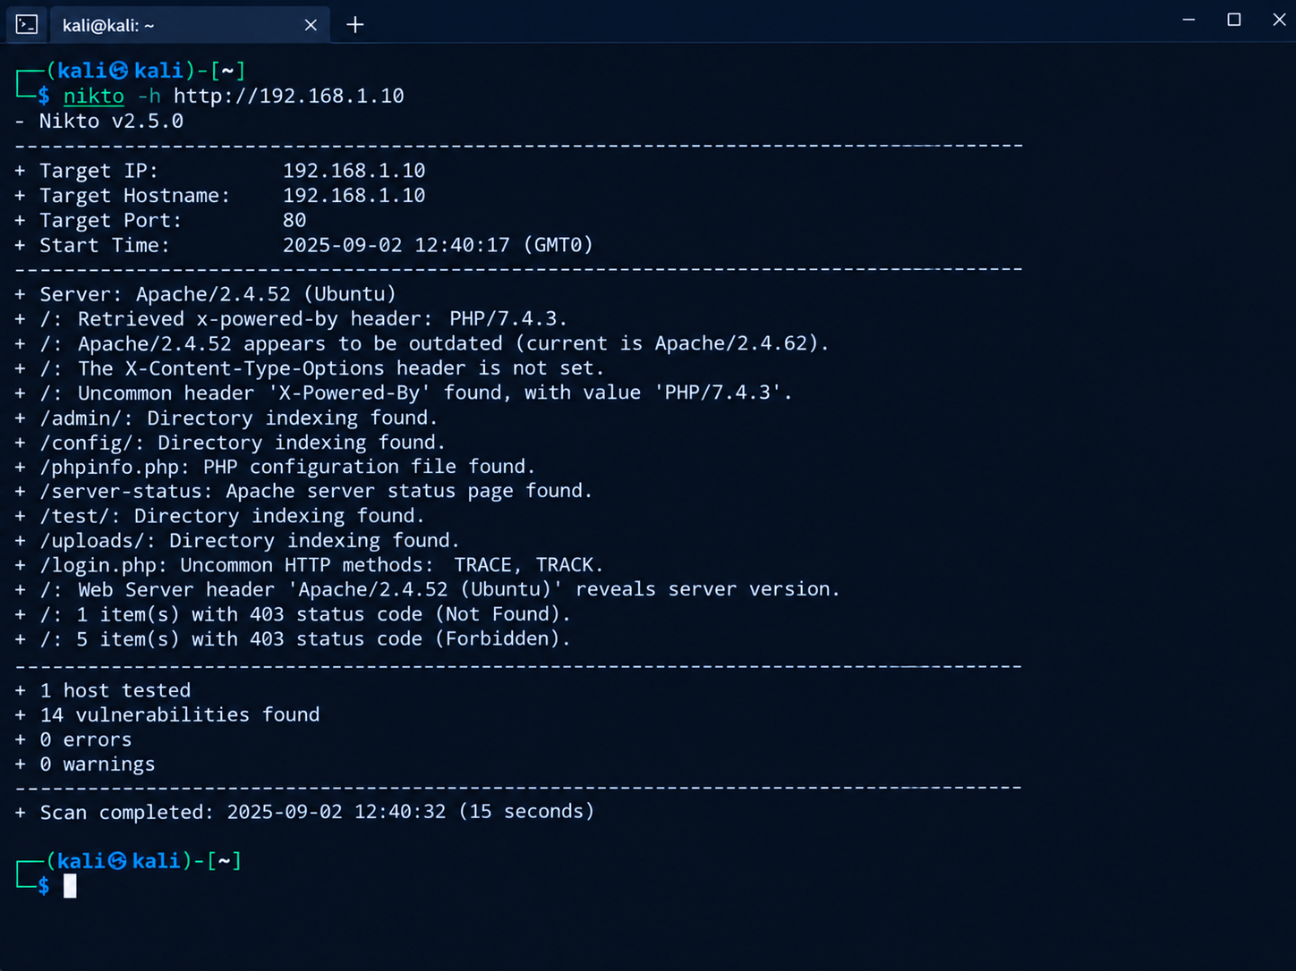
Nmap -sV Result & Nmap -A Result

Slide 6
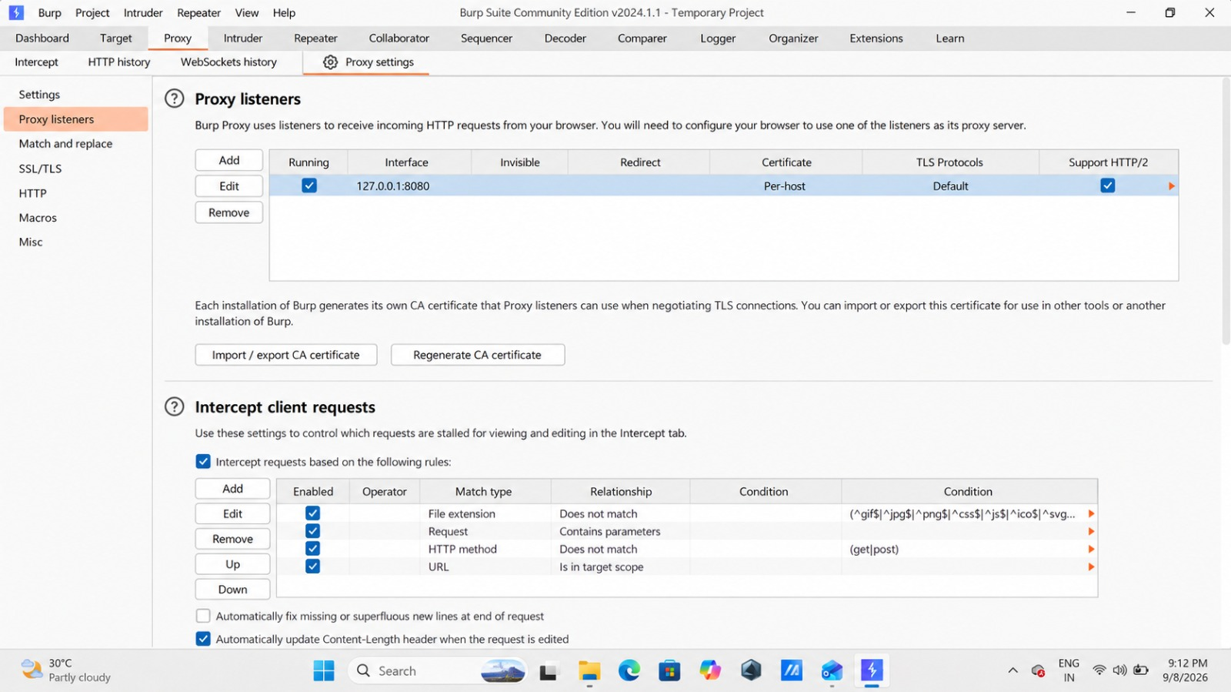
Nikto Web Vulnerability Scan
Nikto is a web-server scanner that checks for common server misconfigurations, potentially risky files, outdated components and other known web-server issues. It is useful as an initial automated assessment tool.
4.1 Command Used
nikto -h http://testphp.vulnweb.com
The -h option specifies the target host. The scan output should be reviewed carefully because automated scanner findings are indicators that require interpretation and, when necessary, manual validation.

Slide 7
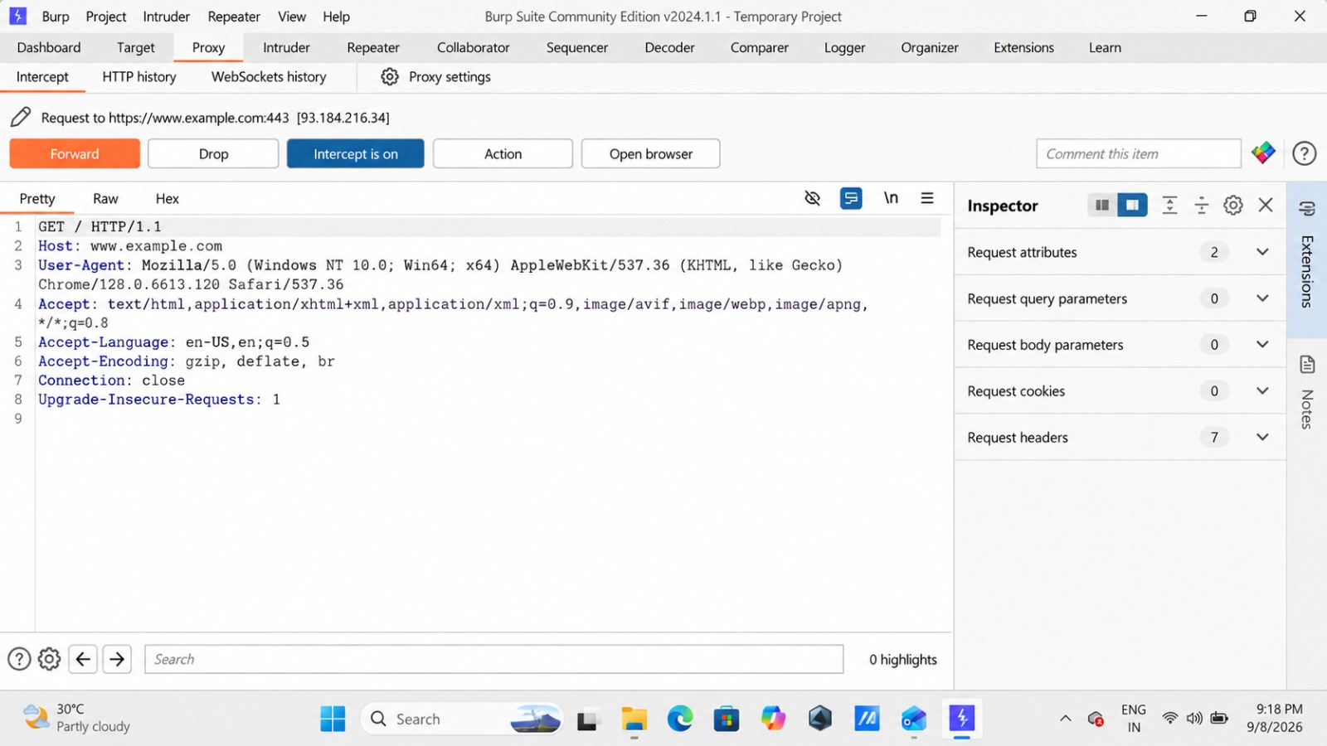
Burp Suite HTTP Request Interception
Burp Suite is a web security testing platform. Its Proxy feature can intercept browser traffic so that an analyst can inspect HTTP requests and responses. This practical focuses on understanding requests, headers, cookies and parameters.
5.1 Proxy Configuration
Open Burp Suite and start a temporary project.
Open Proxy settings and confirm the listener is configured for 127.0.0.1:8080.
Configure the browser to use the same local proxy.
Open the authorized test website through the configured browser.
Turn interception on and observe the request before forwarding it.

Slide 8
Mini Task – Findings and Analysis
ID | Finding | Source | Risk | Simple Explanation
F-01 | Server version disclosure | Nikto | Low | The web server reveals its Apache version in the HTTP response/header. This gives an attacker information about the server software being used.
F-02 | PHP version disclosure | Nikto | Low | The X-Powered-By header reveals the PHP version. Exposing technology and version details can help attackers identify possible known weaknesses.
F-03 | Missing security header – X-Content-Type-Options | Nikto | Low | The X-Content-Type-Options security header is not set. Adding it can help prevent browsers from MIME-sniffing responses.
F-04 | Directory indexing enabled | Nikto | Medium | Some directories such as /admin/, /config/, /test/ and /uploads/ were reported as directory-indexable. This may expose files or folder information that should not be publicly browsable.
F-05 | Server-status page detected | Nikto | Medium | A server-status page was detected. If improperly exposed, it may reveal useful information about server activity and configuration.
F-06 | HTTP methods TRACE/TRACK detected | Nikto | Medium | Nikto reported uncommon HTTP methods such as TRACE and TRACK. Unnecessary HTTP methods should generally be disabled to reduce the attack surface.

Slide 9
Complete VAPT Workflow:
The practical workflow followed in this week can be summarized as:
1. Confirm authorization and select the approved lab target.
2. Perform Nmap discovery to understand exposed ports and services.
3. Use Nmap service/version detection to collect additional information.
4. Run Nikto against the authorized web application.
5. Review automated findings and separate useful evidence from false positives or informational results.
6. Configure Burp Suite as a local proxy.
7. Intercept normal HTTP requests and inspect headers, cookies and parameters.
8. Correlate observations from all three tools.
9. Document at least three findings with evidence and recommendations.
10. Prepare the final report, PPT, GitHub evidence and LinkedIn learning post.

Slide 10
Learning Outcomes
Learned how Nmap is used for basic network reconnaissance.
Understood the difference between port discovery and service/version detection.
Learned how Nikto can identify common web-server security observations.
Understood the role of a proxy in web application testing.
Learned how HTTP methods, headers, cookies and parameters appear in real requests.
Improved the ability to read scanner output instead of simply running commands.
Understood the importance of authorization and responsible security testing.
Key Commands Used
nmap -sS testphp.vulnweb.com
nmap -sV testphp.vulnweb.com
nmap -A testphp.vulnweb.com
nikto -h http://testphp.vulnweb.com

Slide 11
Conclusion
This Week 5 practical provided hands-on exposure to the basic VAPT process. Nmap was used to understand exposed ports and services, Nikto was used to perform an initial web-server security scan, and Burp Suite was used to intercept and inspect HTTP traffic. The most important learning was not simply executing commands, but understanding what the results mean and how they can be documented as security findings.
The practical also reinforced responsible security testing. All testing in this report is limited to the authorized training target specified by the internship. In a professional VAPT engagement, written authorization, defined scope, safe testing procedures and evidence-based reporting are essential.

Slide 12

Thank you

