Slide 1
CYBER SECURITY INTERNSHIP
WEEK 10
SOC Monitoring with Wazuh SIEM
Endpoint telemetry • Alert triage • Investigation • Snort context
PRIMARY PLATFORM
LAB CONTEXT
Wazuh 4.8.1 dashboard
Ubuntu server + Windows agent
Technical internship presentation | October 2026

Slide 2
Executive Summary
OVERVIEW
Week 10 validates the analyst workflow: collect telemetry, review detections, investigate evidence, and recommend a proportionate response.
01 MONITOR
02 INVESTIGATE
03 RESPOND
Confirm the Wazuh dashboard and endpoint agent are available.
Review alert time, rule, agent, source/destination and severity.
Validate context before containment; document recovery and lessons.
Key principle
An alert is a signal to investigate—not automatic proof of compromise.
Scope: authorized virtual lab; event interpretation remains evidence-led.
WEEK 10 • SOC MONITORING 02 / 15

Slide 3
Objectives & Learning Outcomes
LEARNING GOALS
• Understand Wazuh components and the role of centralized security monitoring.
• Verify the Linux server, dashboard access and agent-to-manager communication.
• Generate controlled authentication, file and network activity in the lab.
• Record real alerts and investigate one high-interest event.
• Explain how network IDS evidence from Snort can complement endpoint telemetry.
TECHNICAL
Logs, rules, agents, dashboards
ANALYTICAL
Triage, timelines, evidence
COMMUNICATION
Clear findings and response notes
WEEK 10 • SOC MONITORING 03 / 15

Slide 4
Wazuh Architecture & Event Flow
ARCHITECTURE
01 TEST ENDPOINT
02 WAZUH AGENT
03 WAZUH MANAGER
04 DASHBOARD
05 SOC ANALYST
Generates system and security activity
→
Collects configured host telemetry
→
Decodes events and applies rules
→
Searches, filters and visualizes alerts
→
Validates, prioritizes and responds
Troubleshooting follows the same chain: endpoint activity → collection → manager processing → dashboard visibility.
If an event is missing, verify each stage rather than assuming detection is broken.
WEEK 10 • SOC MONITORING 04 / 15

Slide 5
Wazuh SIEM vs Snort IDS
DETECTION ROLES
WAZUH | ENDPOINT + CENTRAL VIEW
SNORT | NETWORK VIEW
• Endpoint logs and authentication activity
• File integrity monitoring (when configured)
• Agent, rule and alert context
• Centralized investigation workspace
• Network packets and traffic patterns
• Signature/rule-based detection
• Source, destination, port and protocol context
• Network-focused security alerts
Together, these perspectives can strengthen a timeline—but only when event details genuinely match.
WEEK 10 • SOC MONITORING 05 / 15

Slide 6
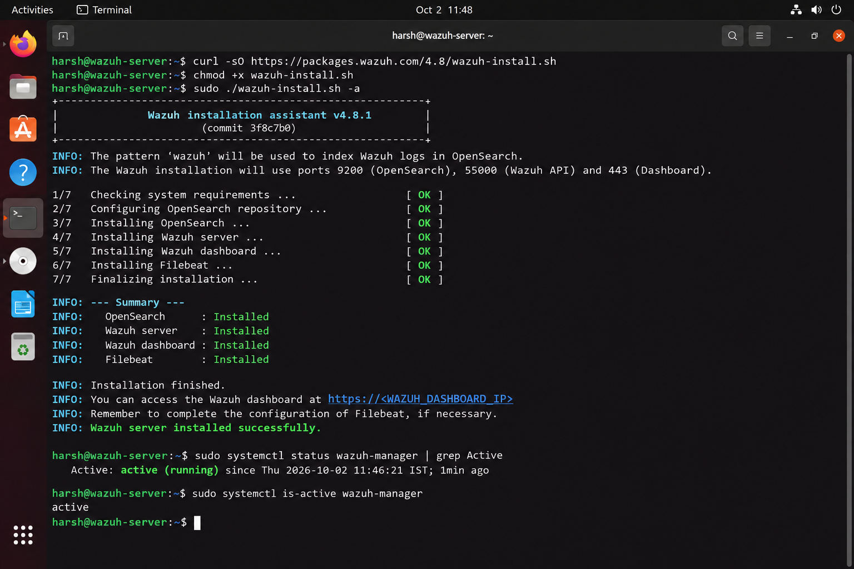
Lab Environment & Setup Verification
ENVIRONMENT
WAZUH SERVER
RESOURCES
VALIDATION
Ubuntu 22.04.5 LTS
Hostname: wazuh-server
Wazuh version: 4.8.1 (dashboard)
4 CPU threads
7.7 GiB RAM
50 GB disk
Dashboard reachable
Services checked
Agent status visible
Evidence note: use the actual lab screenshot for final submission; do not substitute a mockup for live evidence.
WEEK 10 • SOC MONITORING 06 / 15

Slide 7
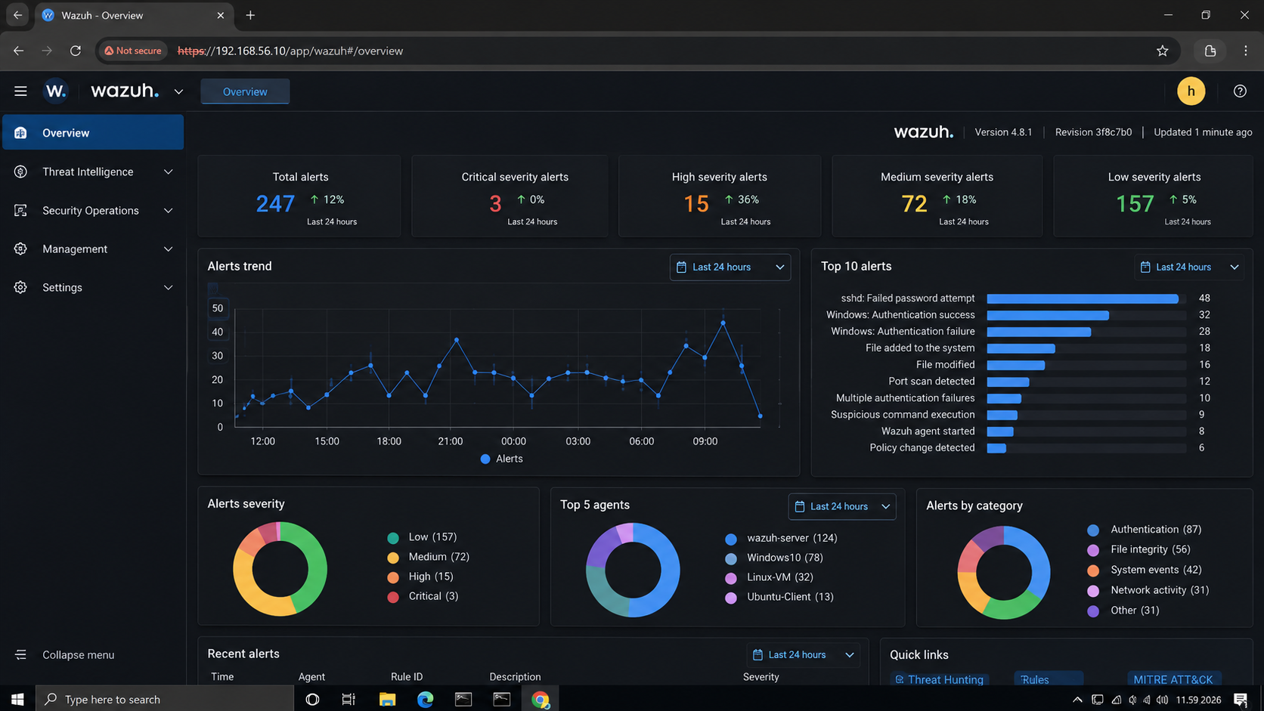
Final SOC Dashboard — Summary Metrics
DASHBOARD
1,842
156
78
1
TOTAL EVENTS
ALERTS
RULES FIRED
ACTIVE AGENT
Snapshot values must be tied to the selected dashboard time range (Last 24 hours).
WEEK 10 • SOC MONITORING 07 / 15

Slide 8
Alert Severity & Prioritization
TRIAGE
CRITICAL
HIGH
MEDIUM
LOW
12 alerts
34 alerts
67 alerts
43 alerts
What the distribution suggests
ANALYST CHECK
• Medium alerts form the largest group in this snapshot.
• Critical and high alerts should be reviewed promptly, with asset and event context.
• Severity is a triage signal; it does not independently prove compromise.
Confirm event details, repetition, affected asset, and whether the activity was expected.
WEEK 10 • SOC MONITORING 08 / 15

Slide 9
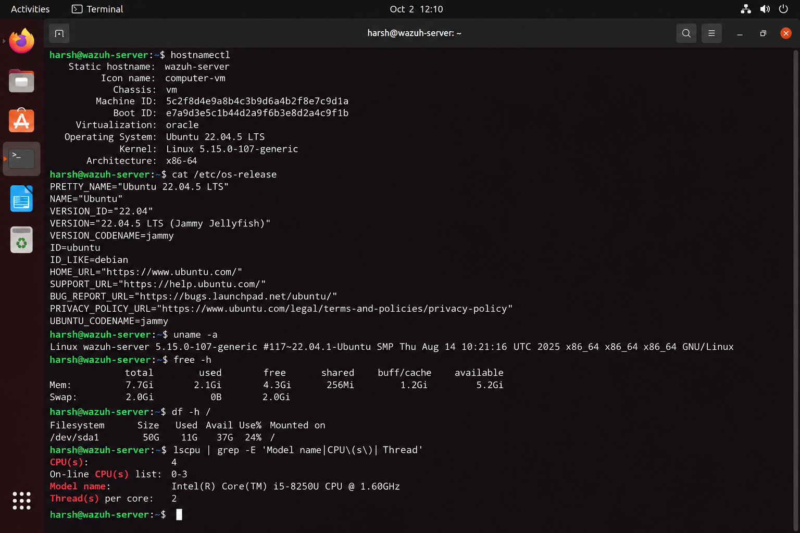
Endpoint Onboarding & Connectivity
ENDPOINT
• Install the compatible Wazuh Agent on an authorized Windows/Linux endpoint.
• Configure the Wazuh Manager address and start the agent service.
• Confirm the agent appears as Active in the Dashboard.
• Validate event visibility; a running service alone does not prove end-to-end delivery.
TROUBLESHOOTING CHECKLIST
Manager IP • VM network • agent service • enrollment • firewall • configuration
WEEK 10 • SOC MONITORING 09 / 15

Slide 10
Controlled Security Event Validation
TELEMETRY
Failed login
Limited incorrect attempts on a test account
→
Authentication failure telemetry
Successful login
Normal test-account login
→
Expected baseline event
File change
Create/edit a harmless test file
→
FIM event, if configured
Network activity
Authorized lab traffic
→
Available network/security telemetry
Controlled events create a known baseline and help distinguish missing telemetry from an absence of activity.
WEEK 10 • SOC MONITORING 10 / 15

Slide 11
SOC Alert Investigation Method
WORKFLOW
1
IDENTIFY
Alert ID, agent, rule
2
TIMELINE
Exact timestamp and nearby events
3
EXAMINE
Source, destination, user, process, file
4
ASSESS
Expected, suspicious, or confirmed malicious
5
ACT
Escalate, contain, recover, document
Good triage is evidence-led: explain why an alert matters and what should happen next.
WEEK 10 • SOC MONITORING 11 / 15

Slide 12
Case Study: Nmap Scripting Engine Detection
CASE STUDY
ET SCAN Nmap Scripting Engine User-Agent Detected
RULE ID
SEVERITY
ENDPOINT
2100498
Level 4 • Medium
windows-agent • ID 001
NETWORK EVIDENCE
INITIAL ASSESSMENT
Source: 192.168.56.1
Destination: 192.168.56.11:80/TCP
Consistent with possible network reconnaissance; alert alone does not prove compromise.
Timestamp shown in alert: Oct 2, 2026 • 12:32:18.441
First confirm whether the scan was authorized, then correlate with related events and logs.
WEEK 10 • SOC MONITORING 12 / 15

Slide 13
Snort + Wazuh: Evidence Correlation
CORRELATION
SNORT / NETWORK VIEW
WAZUH / ENDPOINT VIEW
Signature: ET SCAN Nmap Scripting Engine User-Agent Detected
Source → destination: 192.168.56.1 → 192.168.56.11:80/TCP
Agent: windows-agent (001)
Review timestamp, rule, host, and nearby endpoint events.
Correlation confidence requires
CURRENT CONCLUSION
• Matching timestamps within a justified time window
• Consistent source/destination or affected host
• Compatible event context and original log evidence
Evidence is consistent with possible Nmap reconnaissance. Confirm exact Wazuh event timestamp before claiming verified correlation.
WEEK 10 • SOC MONITORING 13 / 15

Slide 14
Response Recommendations & Lessons Learned
RESPONSE
CONTAIN
RECOVER
IMPROVE
Verify authorization. If unauthorized, follow lab policy to isolate the source or block suspicious traffic.
Confirm the scan stopped; review affected services and related alerts; restore normal operations if impacted.
Monitor repeated scans, reduce unnecessary exposure, maintain detection rules, and document decisions.
Lessons for a junior SOC analyst
• Do not treat every alert as an incident.
• Use timestamps and supporting fields to validate findings.
• Keep live evidence separate from conceptual architecture and generated mockups.
WEEK 10 • SOC MONITORING 14 / 15

Slide 15
Conclusion & Key Takeaways
WRAP-UP
A practical SOC workflow turns raw events into defensible decisions.
VISIBILITY
INVESTIGATION
INTEGRITY
Agent and dashboard health are prerequisites for trustworthy monitoring.
Timestamps, rule IDs, hosts and network fields establish context.
Accurate reporting distinguishes observed evidence from assumptions.
Final message
Detect → Validate → Investigate → Respond → Learn
Week 10 | SOC — Wazuh SIEM Setup & Alert Monitoring
WEEK 10 • SOC MONITORING 15 / 15

