Slide 1
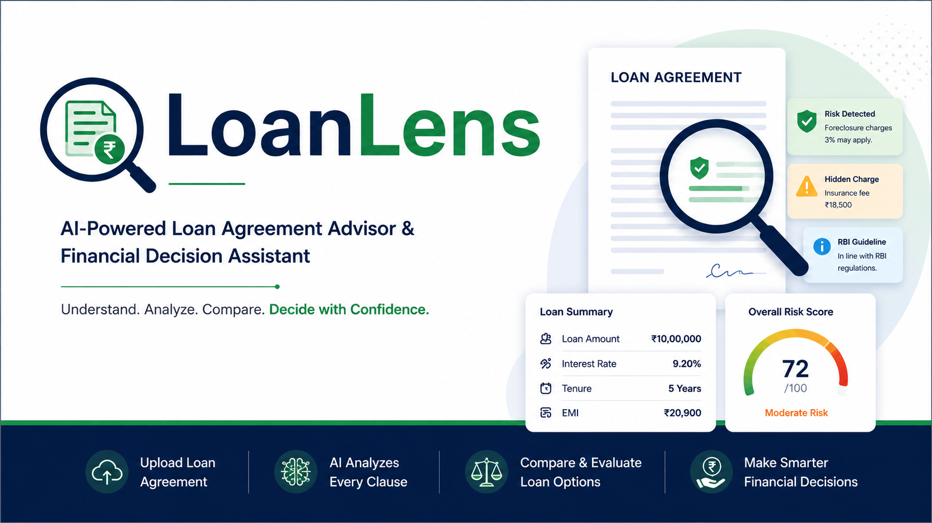
Name 1: Anandpara Krinna-202302626010006
Name2: Doshi Arya- 202302626010019

Slide 2
01 • THE PROBLEM
Loan agreements are legally dense —
and borrowers sign them blind
!
Dense legal language
?
No easy way to check compliance
Clauses on interest reset, penal charges, and foreclosure are written for lawyers, not borrowers.
Borrowers can't tell whether a clause actually matches current RBI rules — or a rule that's since been withdrawn.
⇄
Hard to compare offers
⚠
Risk hides in the fine print
Comparing two loan offers means manually cross-reading two long PDFs, clause by clause.
Costly clauses (penal interest, reset frequency, prepayment charges) are easy to miss until it's too late.
2

Slide 3
02 • The Solutions
LoanLens — final core features
Not just a chatbot — a smart, explorable version of the agreement: summarized, explained clause by clause, compared, costed, and turned into a prepayment decision engine.
Σ
¶
?
⇄
Complete Loan Summary
Clause-by-Clause Explain
AI Chat
Compare Loans
Every key figure — EMI, fees, insurance, foreclosure — extracted the moment you upload.
Any clause explained in plain language, with financial impact, RBI source, and risk level.
Ask anything; answers are grounded in your agreement and the RBI knowledge base, with sources.
Two agreements side by side, with an AI verdict on which is actually cheaper overall.
₹
»
⚑
True Cost of Loan
What If I Pay Early
Withdrawn-Rule Awareness
The real all-in cost beyond the principal — interest, fees, insurance, add-ons combined.
Simulates a prepayment: interest saved, prepayment charge, and net benefit — instantly.
If a cited RBI circular is withdrawn or superseded, the assistant says so explicitly.
4

Slide 4
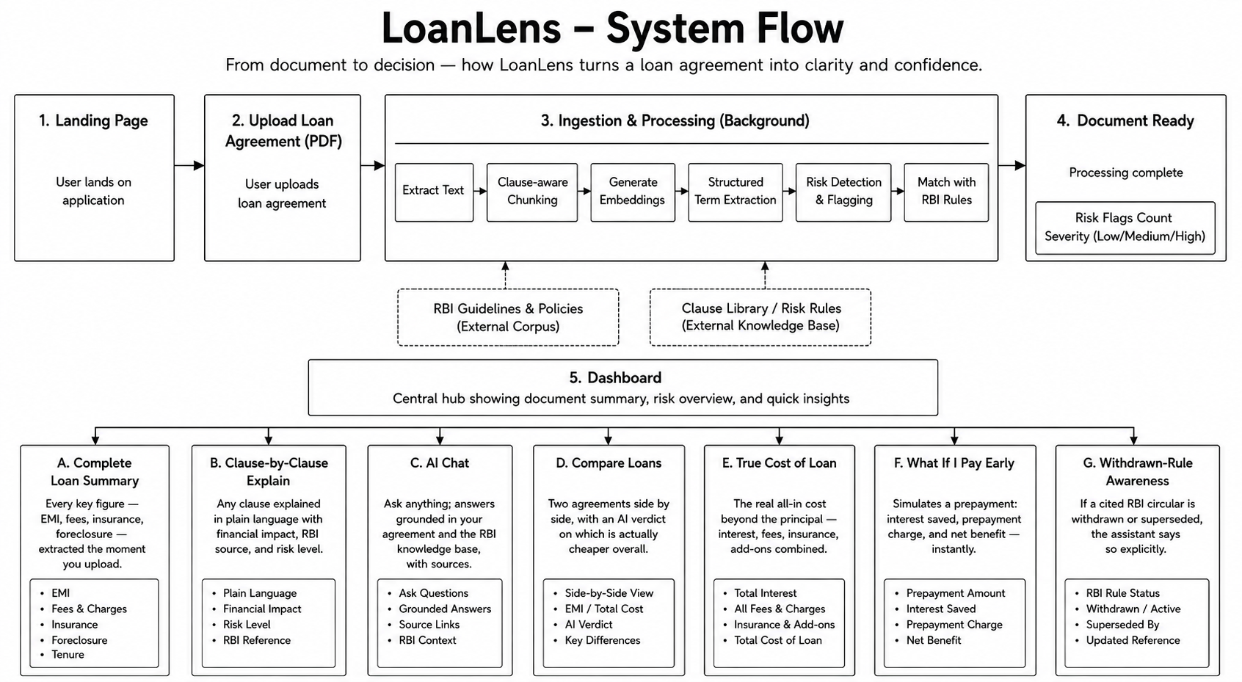
Thank You

Slide 5
04 • TECH STACK
Technologies planned to be used
API & Backend
Data & Storage
FastAPI — REST + SSE streaming endpoints
Uvicorn — ASGI server
Alembic — versioned DB migrations
MySQL — documents, profiles, risk flags, comparisons
ChromaDB — vector store (per-user + shared RBI collection)
SQLAlchemy (String columns only, no Enum types)
AI / RAG Layer
Document Parsing
Local embedding model — on-device, no external calls
Groq LLM API — fast inference for comparison & reasoning
Dual retrieval + independent reranking pipeline
pdfplumber — PDF loan agreements & RBI circulars
python-docx — Word agreement uploads
Plain-text ingestion for RBI .txt circulars
5

Slide 6
05 • CORE ALGORITHM
Dual-retrieval comparison algorithm
Why dual retrieval?
def retrieve_agreement_and_rbi_context(
session_id: str, agreement_label: str,
query: str, top_k: int = 5):
query_embedding = embed_query(query)
raw = dual_retrieve(
session_id, agreement_label,
query_embedding, n_results=20)
agreement_top = (
rerank_chunks(query, raw["agreement_chunks"], top_k=top_k)
if raw["agreement_chunks"] else [])
rbi_top = (
rerank_chunks(query, raw["rbi_chunks"], top_k=top_k)
if raw["rbi_chunks"] else [])
agreement_top = normalize_scores(agreement_top) if agreement_top else []
rbi_top = normalize_scores(rbi_top) if rbi_top else []
return {
"agreement_chunks": agreement_top,
"rbi_chunks": rbi_top
}
Searching both collections in one pass keeps the agreement clause and the matching RBI rule from the same query moment — no stale context.
Independent reranking means a strong RBI match doesn't get pushed out by a stronger (but irrelevant) agreement match, or vice versa.
Separate score normalization keeps the agreement and RBI result sets independently calibrated before they are passed to the next stage.
Both result sets are returned separately, so downstream prompt construction can preserve the distinction between agreement-specific context and RBI regulatory context.
6

Slide 7
06 • OPEN ITEMS
Assumptions, challenges & open queries
Assumptions
Challenges
Open Queries
Users upload genuine, unedited loan agreements in PDF, DOCX, or TXT.
session_id alone is sufficient identity for this prototype (no login yet).
Locally embedded vectors are adequate for clause-level semantic matching.
RBI's Oct-2025 consolidation folded ~9,000 circulars into 238 new Master Directions — our seeded status tags need re-verification.
Correctly reconciling a withdrawn source with an active one in the same answer, without confusing the user.
Keeping the RBI knowledge base current as circulars are added, amended, or withdrawn over time.
RBI Circular Validity: How should superseded or partially applicable RBI circulars be handled?
Risk Thresholds: Should LOW/MED/HIGH risk criteria vary by loan type?
Authentication: What secure authentication model is appropriate beyond the prototype?
7

Slide 8
Thank You

