Slide 1
The Step Command: A Closer Look
By: Kripa Varma

Slide 2
(gdb)step ---> DHCSR.C_STEP
RSP packet from gdb to pyOCD
$s#73
DAP Command from pyOCD to cmsis dap interface firmware
0x5, 0x0, 0x2, 0x5,0xE000EDF0, 0xD, 0xA05F000B
Serial Wire Debug Protocol between cmsis dap interface chip and ARM Cortex M3 target.

Slide 3
The System
arm-none-eabi-gdb
Host PC
GDB
cli
inf
pyOCD
gdb_server
target
Mbed module
remote
Target cortex_m
CMSIS DAP I/F firmware
RSP
Transport cmsis_dap
DAP
serial
DAP Cmds
Interface pyUSB_backend
Dbg Port
Mem Acc Port
ser-tcp
gdb_socket
USBD_ HID
SW_DP
SW_DP
S/M bus
TCP
USB HID
USBD
IP
LPC11U24
LPC1768
Beagle 5000 USB Protocol Analyzer

Slide 4
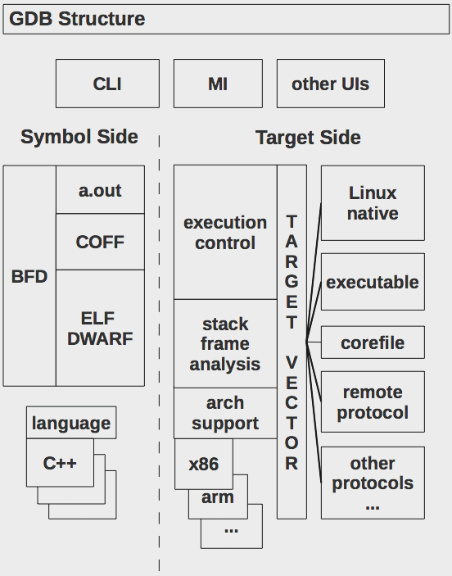
GDB Internals

Slide 5
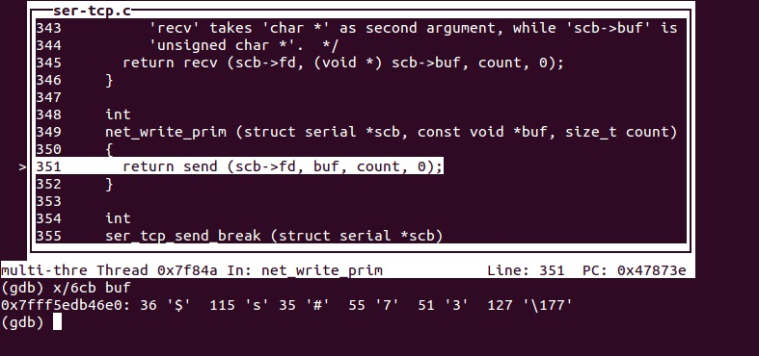
GDB- RSP Packet Screenshot

Slide 6
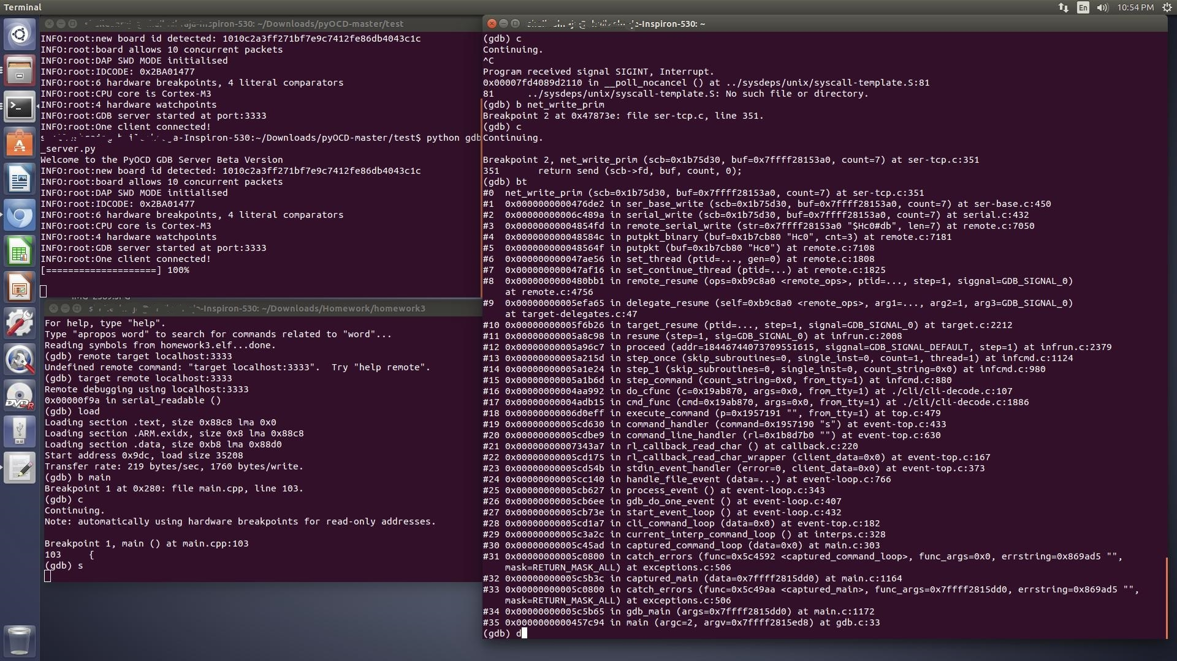
GDB - Step Command backtrace

Slide 7
pyOCD Internals
board (mbed_board)
flash (flash_lpc1768)
target (cortex_m)
transport (cmsis_dap)
interface (pyOCD_backend)
gdb_server

Slide 8
DAP Command Format
DAP Command Format:
CmdId(8), DAPIdx(8), count(8), { { req1 (8), data1 (32) }, { req2 (8), data2 (32) }, …. }
CmdId = 0x5 // DAP Transfer
Count = 2
Req = RegAddr[3:2], RnW(1), APnDP(1)
Reg Addr 0 = CSW 1 = TAR // Target Address 2 = DRW // Data Read Write

Slide 9
C_STEP -> DHCSR
The DAP command that sets C_STEP, C_MASKINTS, C_DEBUGEN Flags in Debug Halt Ctrl Sstatus Register (DHCSR):
0x5, 0x0, 0x2,{ 0x5,0xE000EDF0, 0xD, 0xA05F000B}
1st Req: Write 0xE000EDF0 to AP Reg TAR
2nd Req: Write 0xA05F000B to AP Reg DRW

Slide 10
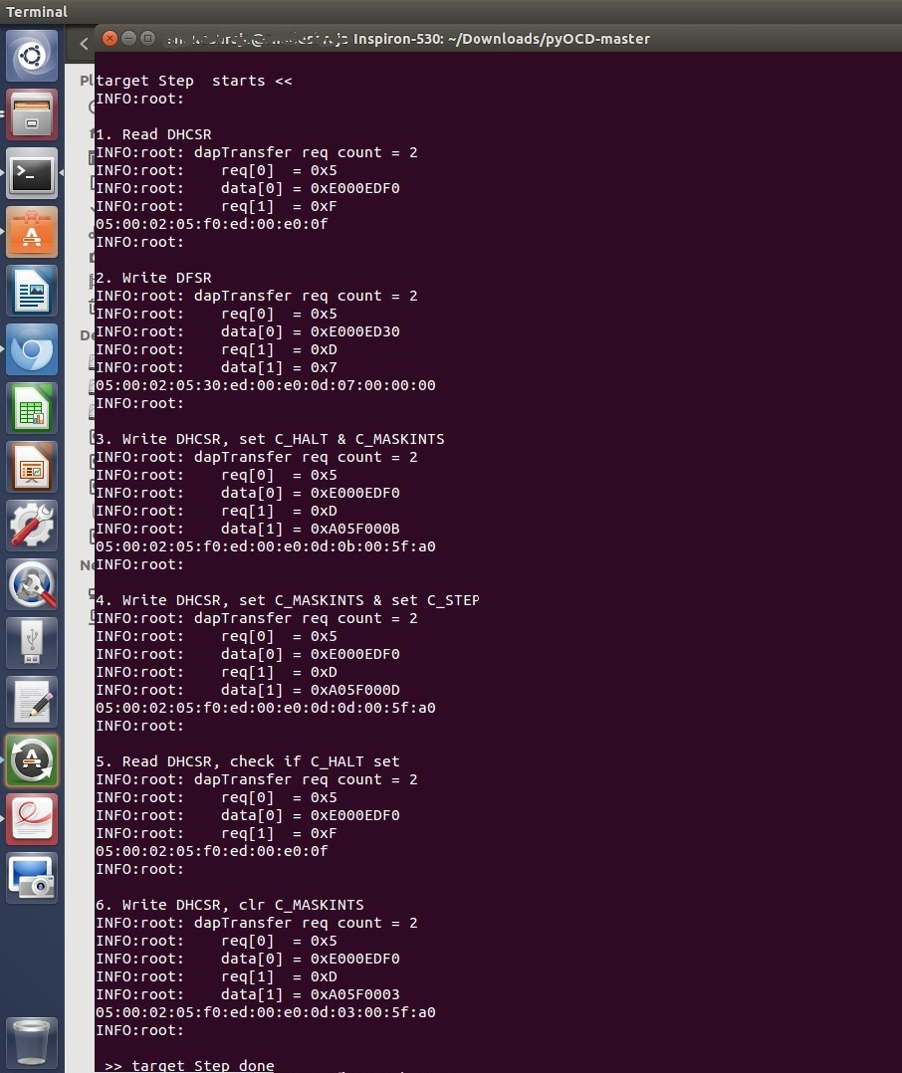
pyOCD – DAP Commands

Slide 11
pyOCD - backtrace
gdbserver/gdbserver.py: run() handleMsg() step() target/cortex_m.py: step() writeMemory(DHCSR, value) transport/cmsis_dap.py: writeMem() // called twice , 1st TAR, 2nd DRW dapTransfer() // imported from cmsis_dap_core.py interface/pyUSB_backend.py: write() ep_out.write() // call pyUSB

Slide 12
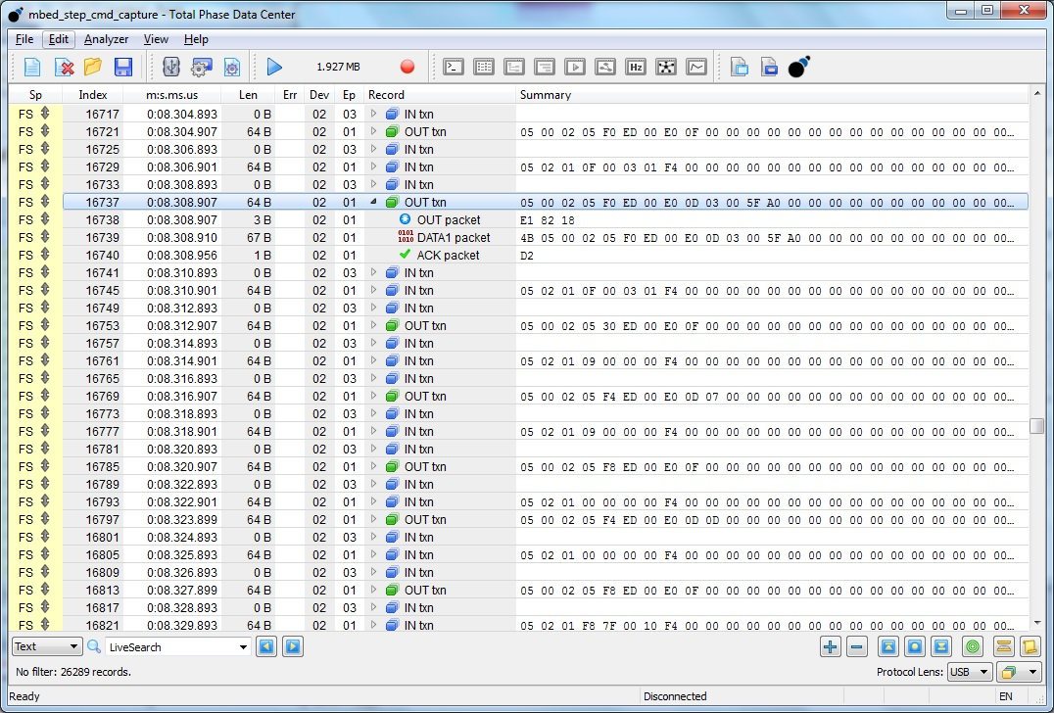
USB Analyzer Capture

Slide 13
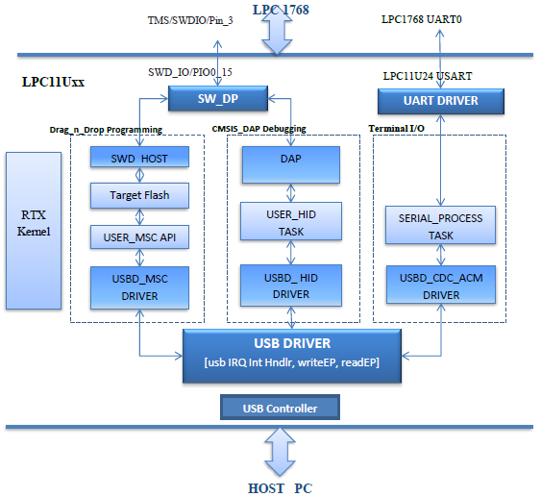
CMSIS_DAP I/F Firmware

Slide 14
CMSIS_DAP Backtrace
USBD_LPC11Uxx.c : USB_IRQHandler() isr_evt_set(USBD_EVT_OUT , USBD_RTX_EPTask[2/2] ) USBD_HID.c : __task USBD_RTX_HID_EP_INT_Event() // wakes up USBD_HID_EP_INT_Event() USBD_HID_EP_INTOUT_Event() USB_USER_HID.c : usbd_hid_set_report() // call back invoked memcpy() // copy to intermediate buffer os_evt_set(DAP_PAQUET_RECEIVED, dapTask); __task hid_process() // wakes up usbd_hid_process() DAP.c : DAP_ProcessCommand(request, response) DAP_SWD_Transfer(request, response) SW_DP.C SWD_Transfer(request, response) // called once for each request in DAP Cmd SW_WRITE_BIT() PIN_SWDIO_OUT() PIN_DELAY()

Slide 15
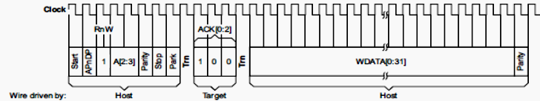
Serial Wire Debug Protocol
The transactions over Serial Wire for writing DHCSR address (0xE000EDF0) to TAR register of Mem AP
1 | 1 | 0 | 1 | 0 | 0 | 0 | - |  | 1 | 0 | 0 |  | 0 | 0 | 0 | 0 | 1 | 1 | 1 | 1 | 1 | 0 |  | 0 | 0 | 0 | 0 | 0 | 0 | 0 | 0 | 1 | 1 | 1

Slide 16
DP to AP to Debug Components

Slide 17
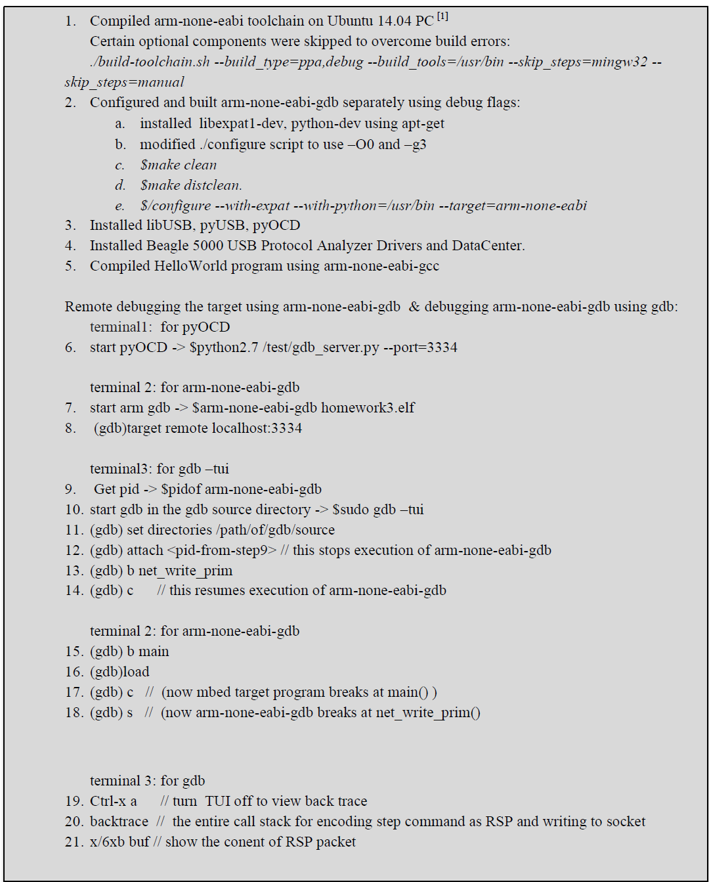
Procedure

