Slide 1
The Step Command: A Closer Look
By: Kripa Varma

Slide 2
Debugging setup
arm-none-eabi-gdb
Host PC
GDB
cli
inf
pyOCD
gdb_server
target
Mbed module
remote
Target cortex_m
CMSIS DAP I/F firmware
RSP
Transport cmsis_dap
DAP
serial
DAP Cmds
Interface pyUSB_backend
Dbg Port
Mem Acc Port
ser-tcp
gdb_socket
USBD_ HID
SW_DP
SW_DP
S/M bus
TCP
USB HID
USBD
IP
LPC11U24
LPC1768
Beagle 5000 USB Protocol Analyzer

Slide 3
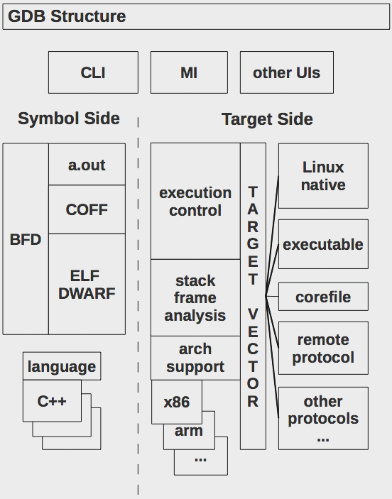
GDB Internals

Slide 4
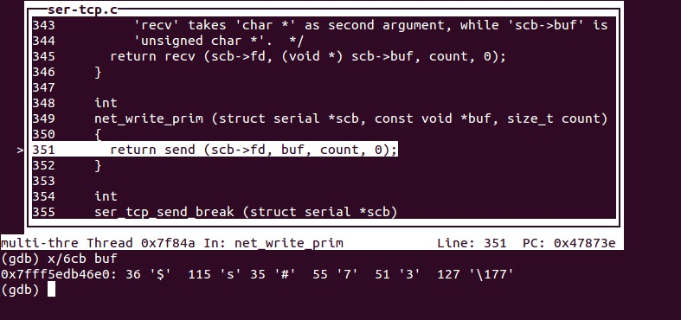
GDB- RSP Packet Screenshot

Slide 5
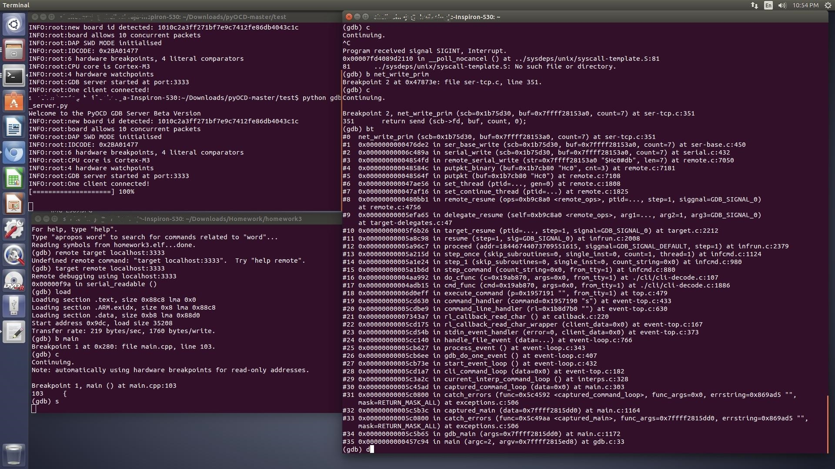
GDB - Step Command backtrace

Slide 6
pyOCD Internals
board (mbed_board)
flash (flash_lpc1768)
target (cortex_m)
transport (cmsis_dap)
interface (pyOCD_backend)
gdb_server

Slide 7
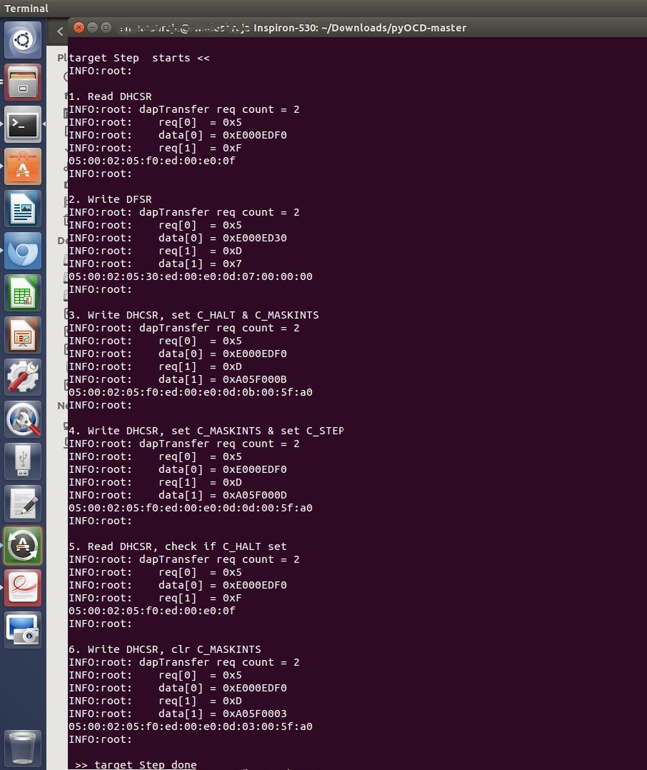
pyOCD – DAP Commands

Slide 8
pyOCD - backtrace
gdbserver/gdbserver.py: run() handleMsg() step() target/cortex_m.py: step() writeMemory(DHCSR, value) transport/cmsis_dap.py: writeMem() // called twice , 1st TAR, 2nd DRW dapTransfer() // imported from cmsis_dap_core.py interface/pyUSB_backend.py: write() ep_out.write() // call pyUSB

Slide 9
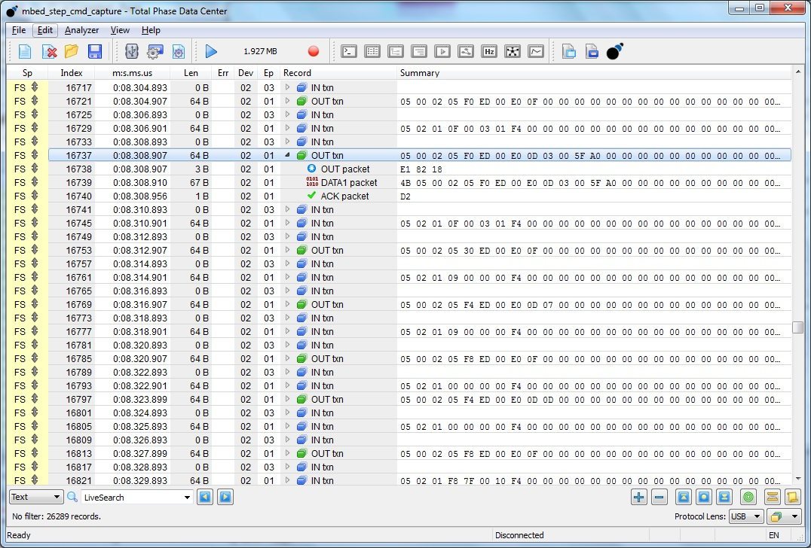
USB Analyzer Capture

Slide 10
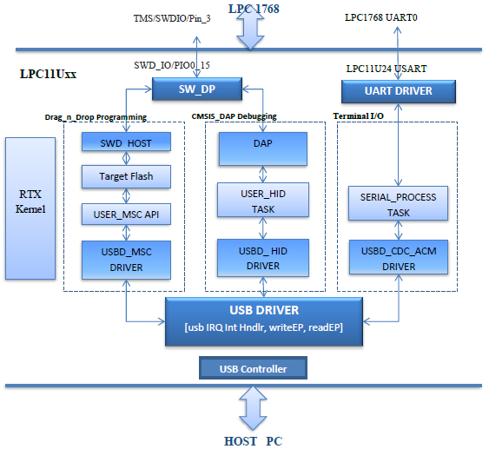
CMSIS_DAP I/F Firmware

Slide 11
CMSIS_DAP Backtrace
USBD_LPC11Uxx.c : USB_IRQHandler() isr_evt_set(USBD_EVT_OUT , USBD_RTX_EPTask[2/2] ) USBD_HID.c : __task USBD_RTX_HID_EP_INT_Event() // wakes up USBD_HID_EP_INT_Event() USBD_HID_EP_INTOUT_Event() USB_USER_HID.c : usbd_hid_set_report() // call back invoked memcpy() // copy to intermediate buffer os_evt_set(DAP_PAQUET_RECEIVED, dapTask); __task hid_process() // wakes up usbd_hid_process() DAP.c : DAP_ProcessCommand(request, response) DAP_SWD_Transfer(request, response) SW_DP.C SWD_Transfer(request, response) // called once for each request in DAP Cmd SW_WRITE_BIT() PIN_SWDIO_OUT() PIN_DELAY()

Slide 12
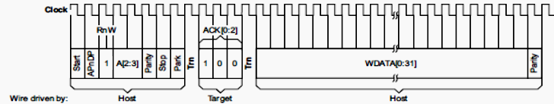
Serial Wire Debug Protocol
The transactions over Serial Wire for writing DHCSR address (0xE000EDF0) to TAR register of Mem AP
1 | 1 | 0 | 1 | 0 | 0 | 0 | - |  | 1 | 0 | 0 |  | 0 | 0 | 0 | 0 | 1 | 1 | 1 | 1 | 1 | 0 |  | 0 | 0 | 0 | 0 | 0 | 0 | 0 | 0 | 1 | 1 | 1

Slide 13
DP to AP to Debug Components

Slide 14
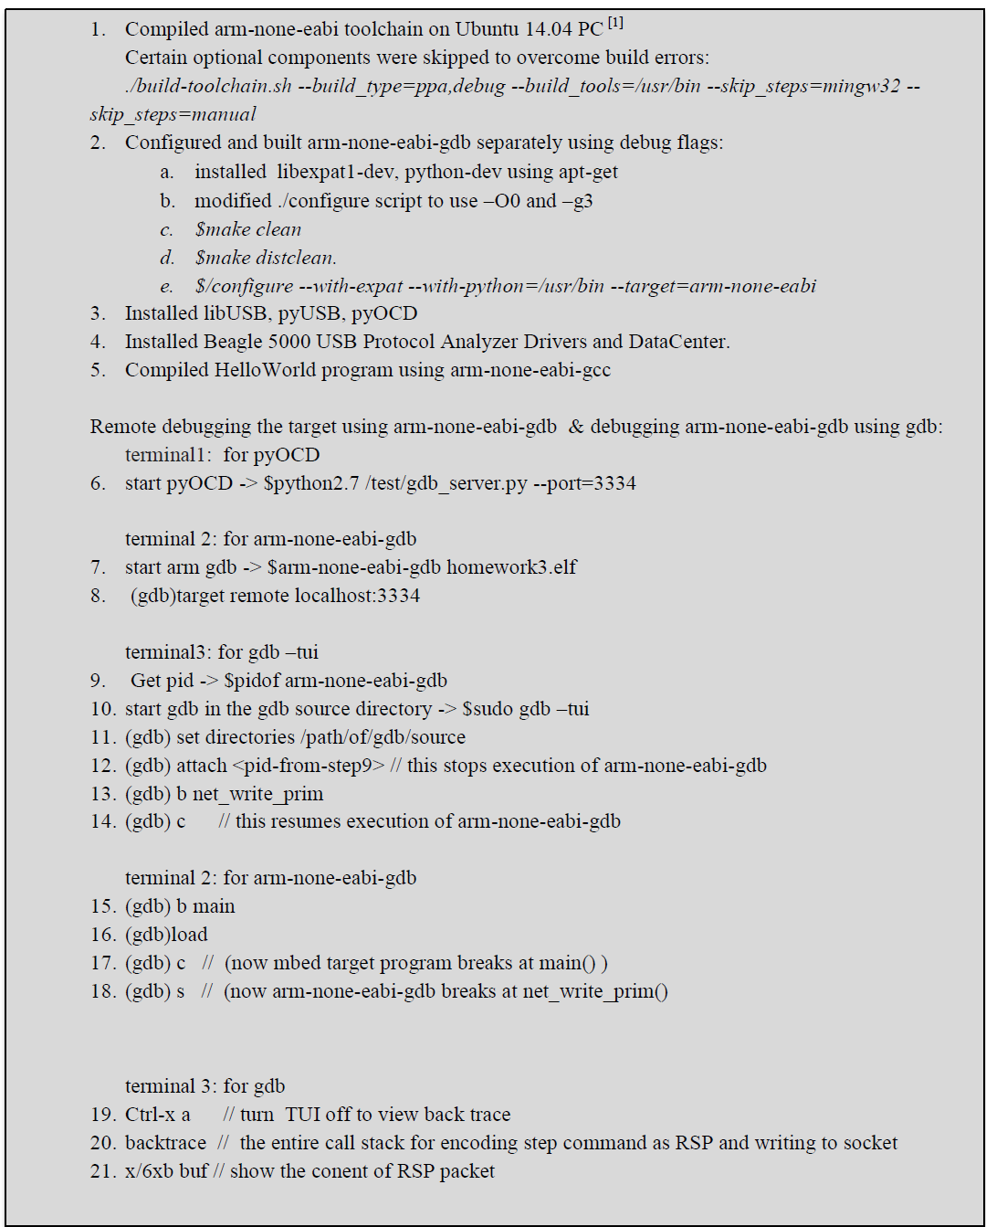
Procedure

