Slide 1
The Step Command: A Closer Look
By: Kripa Varma

Slide 2
Contents
Introduction
GDB Internals
pyOCD Internals
cmsis_DAP Interface Internals
Serial Wire Debug Protocol
Conclusion

Slide 3
Introduction
(gdb) step
- tells a halted target to execute one instruction and then halt
gdb repeats this in a loop, if one line of code involves multiple instructions

Slide 4
(gdb)step ---> DHCSR.C_STEP
gdb <-> pyOCD
RSP Packet
pyOCD <-> cmsis dap I/F firmware
DAP Command
cmsis dap i/f <->ARM Cortex M3
Serial Wire Debug Protocol

Slide 5
The System
arm-none-eabi-gdb
Host PC
GDB
cli
inf
pyOCD
gdb_server
target
Mbed module
remote
Target cortex_m
CMSIS DAP I/F firmware
RSP
Transport cmsis_dap
DAP
serial
DAP Cmds
Interface pyUSB_backend
Dbg Port
Mem Acc Port
ser-tcp
gdb_socket
USBD_ HID
SW_DP
SW_DP
S/M bus
TCP
USB HID
USBD
IP
LPC11U24
LPC1768
Beagle 5000 USB Protocol Analyzer

Slide 6
Contents
Introduction
GDB Internals
pyOCD Internals
cmsis_DAP Interface Internals
Serial Wire Debug Protocol
Conclusion

Slide 7
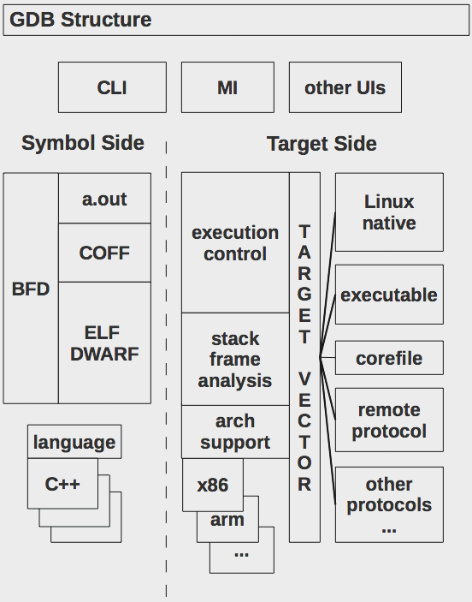
GDB Internals
CLI : Command Line Interface
MI : Machine Interface
BFD : Binary File Descriptor
ELF DWARF : Debug format for ELF file
INF : Inferior execution control

Slide 8
GDB- RSP Packet
gdb -> pyOCD
step command RSP packet :
$s#73

Slide 9
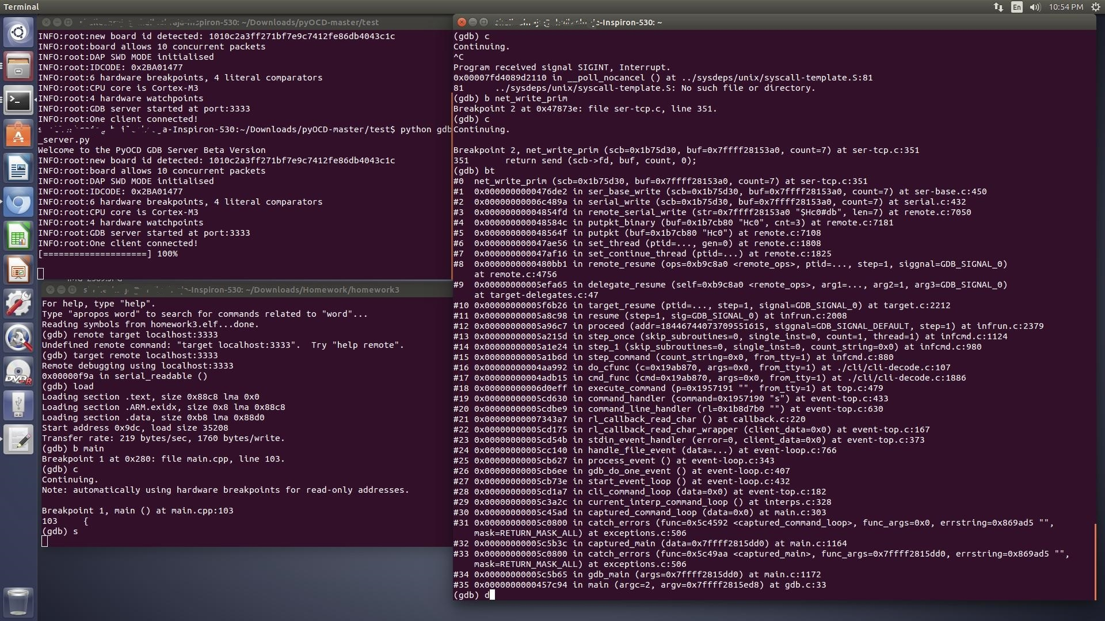
GDB - Step Command backtrace

Slide 10
pyOCD Internals
board (mbed_board)
flash (flash_lpc1768)
target (cortex_m)
transport (cmsis_dap)
interface (pyOCD_backend)
gdb_server

Slide 11
Contents
Introduction
GDB Internals
pyOCD Internals
cmsis_DAP Interface Internals
Serial Wire Debug Protocol
Conclusion

Slide 12
pyOCD - backtrace
gdbserver/gdbserver.py: run() handleMsg() step() target/cortex_m.py: step() writeMemory(DHCSR, value) transport/cmsis_dap.py: writeMem() // called twice , 1st TAR, 2nd DRW dapTransfer() // imported from cmsis_dap_core.py interface/pyUSB_backend.py: write() ep_out.write() // call pyUSB

Slide 13
DAP Command Format
DAP Command Format:
CmdId(8), DAPIdx(8), count(8), { { req1 (8), data1 (32) }, { req2 (8), data2 (32) }, …. }
Where Req = RegAddr[3:2], RnW(1), APnDP(1)
Reg Addr Values :
b00 = CSW
b01 = TAR // Target Address
b11 = DRW // Data Read Write
{C_STEP, C_MASKINTS, C_DEBUGEN } -> DHCSR
0x5, 0x0, 0x2,{ 0x5,0xE000EDF0, 0xD, 0xA05F000B}
1st Req: Write 0xE000EDF0 to AccessPort Reg TAR
2nd Req: Write 0xA05F000B to AccessPort Reg DRW

Slide 14
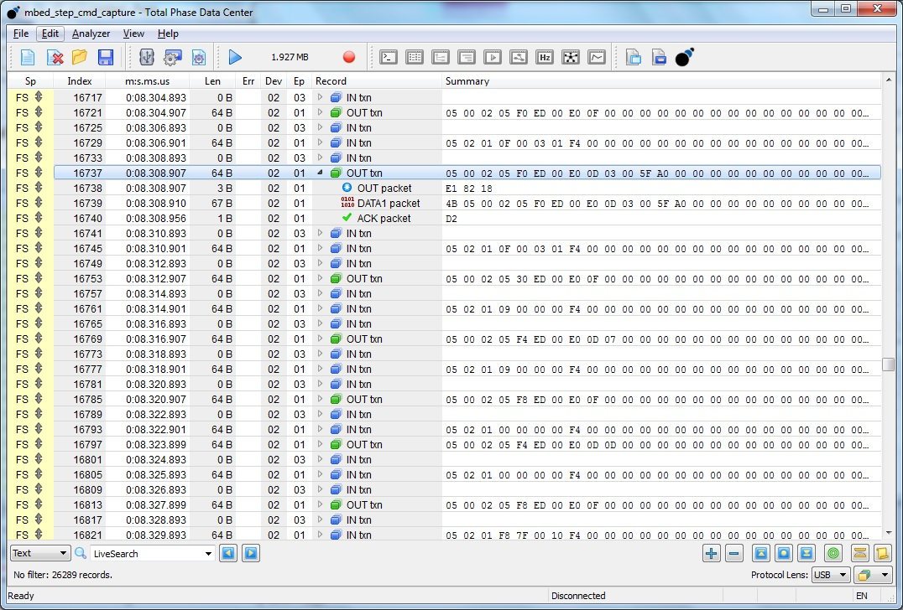
USB Analyzer Capture

Slide 15
Contents
Introduction
GDB Internals
pyOCD Internals
cmsis_DAP Interface Internals
Serial Wire Debug Protocol
Conclusion

Slide 16
Overview
3 Interfaces / Function
Mass Storage Device ( for Drag n Drop F/W upgrade)
* Bulk EP #2
Human Interface Device (for CMSIS_DAP Debugging )
*INT End points #1
Communication Device Class ( for serial comm,
USB-UART bridge)
*Bulk EP #4
*INT IN EP #3 for keep alive messages

Slide 17
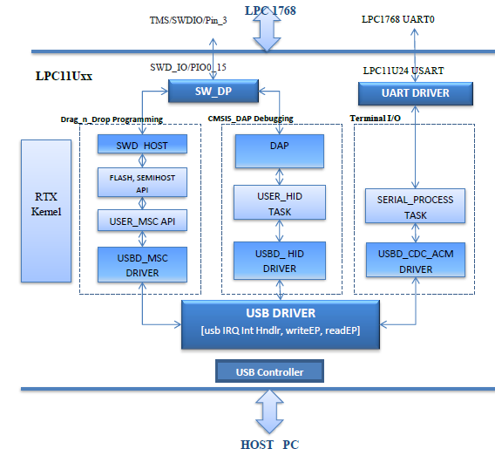
CMSIS_DAP I/F Firmware

Slide 18
CMSIS_DAP Backtrace
USBD_LPC11Uxx.c : USB Driver Interrupt handler sets EP OUT Event USBD_HID.c : HID_EP_INT_Event () task wakes up Invokes USER_HID Callback.
USB_USER_HID.c : Sets DAP_PAQUET_RECEIVED event hid_process() task wakes up DAP.c : DAP_ProcessCommand(request, response) DAP_SWD_Transfer(request, response) SW_DP.C : SWD_Transfer(request, response) SW_WRITE_BIT()

Slide 19
Contents
Introduction
GDB Internals
pyOCD Internals
cmsis_DAP Interface Internals
Serial Wire Debug Protocol
Conclusion

Slide 20
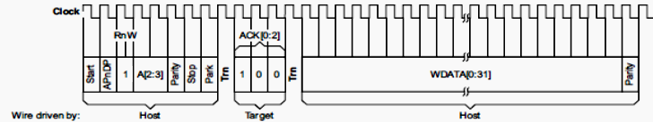
Serial Wire Debug Protocol
The transactions over Serial Wire for writing DHCSR address (0xE000EDF0) to TAR register of Mem AP
1 | 1 | 0 | 1 | 0 | 0 | 0 | - |  | 1 | 0 | 0 |  | 0 | 0 | 0 | 0 | 1 | 1 | 1 | 1 | 1 | 0 |  | 0 | 0 | 0 | 0 | 0 | 0 | 0 | 0 | 1 | 1 | 1

Slide 21
Debug Access Port
Data [32] | A[3:2] | RnW | APnDP
DAP Request
Debug Port
 |  |  | SELECT | CSR | IDCODE | ABORT
0
?
1
AHB AP
APB AP
Bank0
DRW |  | TAR | CSW
Bank1
Bank0
DRW |  | TAR | CSW
Bank1
Upto 256 Access Ports
AHB BUS
System Memory Space
DBG Reg
DEMCR | DCRDR | DCRSR | DHCSR | DFSR

Slide 22
Thank you

