Slide 1
OmniHealth Insights : An Integrated Hospital Management System
Problem Statement : Streamlining OPD Queuing, Bed Availability, Patient Admission,
and Inventory Tracking
KRIPANSH PANDEY (13000223072)
MADHUPARNA ADHIKHARY (13000223073)
MAHI AGRAWAL (13000223074)
MANTU KUMAR (13000223075)
MOHAMMAD IMRAN (13000223076)
SAYANDEEP BANIK (13000224201)
Group Number :- 13

Slide 2
Omnihealth Insights : A Comprehensive Web-Based Hospital Management System
OPD Queuing : Real-time tracking and management of outpatient queues to reduce wait times and enhance patient experience.
Bed Availability : Dynamic monitoring of bed occupancy to facilitate efficient patient admissions and resource utilization.
Patient Admission : Streamlined admission processes with integrated patient information management.
Inventory Tracking : Automated tracking of medical supplies and equipment to ensure optimal stock levels and reduce wastage
Innovation and Uniqueness :
Integration of multiple hospital operations into a single platform.
User-friendly interfaces for different stakeholders (doctors, nurses, administrative staff).
Real-time data analytics for informed decision-making.

Slide 3
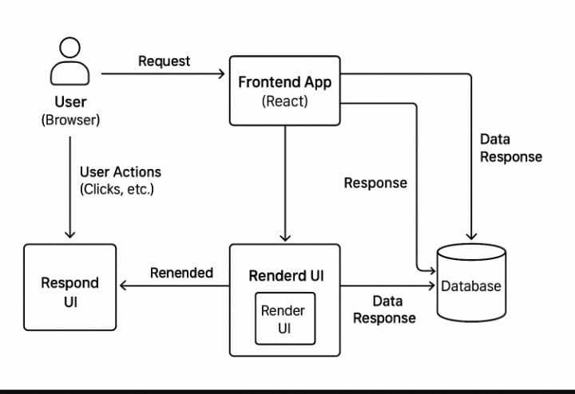
Technologies Used :
Frontend: React.js (for building interactive user interfaces).
Backend: Node.js with Express.js (for handling APIs and server-side logic).
Database: MongoDB (for storing patient, bed, inventory, and queue data).
Implementation Approach
The application was designed using a modular architecture, where each core functionality such as OPD queuing, bed management, patient admission, and inventory tracking was developed as a separate module and then integrated into a unified platform.
RESTful APIs were employed to ensure seamless communication between the frontend (built with React.js) and the backend (developed using Node.js and Express.js).
MongoDB was used as the database to handle dynamic and scalable data storage.

Slide 4
RESULTS
OPD Queuing Module: Successfully reduced average patient wait time through digital token generation, real-time queue status, and doctor-specific scheduling for better crowd control.
Bed Management Module: Achieved accuracy in tracking bed occupancy using live updates, automated bed allocation, and visual availability dashboards for faster patient assignment.
Patient Admission Module: Streamlined admission reduced manual entry through auto-filled forms, linked patient records, and instant departmental notifications.
Inventory Tracking Module: Automated stock monitoring improved inventory turnover with low-stock alerts, real-time status updates, and categorized supply tracking.

Slide 5
Real-World Application & Influence
Hospitals: The system enhances operational efficiency by centralizing patient data, automating tasks, and providing real-time insights to support quicker and more informed decisions.
Patients: Patients experience shorter wait times, faster admissions, and better communication with hospital staff, leading to improved satisfaction and trust in healthcare services.
Healthcare Staff: Reduces the burden of manual tasks, improves workflow coordination, and allows staff to focus more on patient care rather than paperwork and logistics.
Benefits
Social: Promotes a patient-first approach by minimizing chaos in hospitals, improving transparency, and ensuring better healthcare delivery across departments.
Economic: Optimizes hospital resource usage, reduces redundant purchases, and lowers administrative costs through automation and efficient stock and bed management.
Environmental: Digital records reduce paper consumption significantly, supporting sustainable practices and lowering the hospital’s overall environmental footprint.

Slide 6
RESEARCH AND REFERENCES
MongoDB Official Documentation – https://www.mongodb.com/docs/manual/
ReactJS – https://reactjs.org/docs/getting-started.html
Node.js – https://nodejs.org/en/docs
Express JS – https://expressjs.com/en/starter/installing.html
GitHub Repository – https://github.com/kripansh8981/Omnihealth--Insights
"Hospital Management System" Research Paper – https://doi.org/10.1109/ICACCS.2017.8014672

