Slide 1
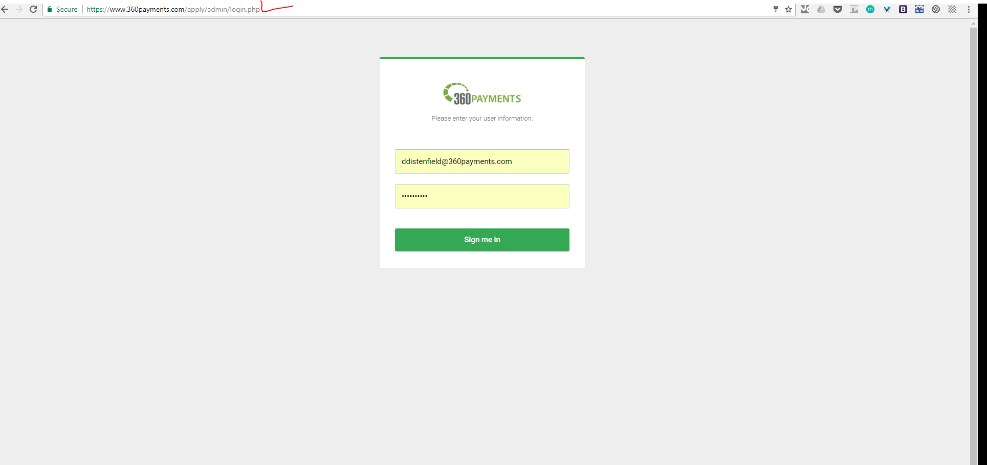
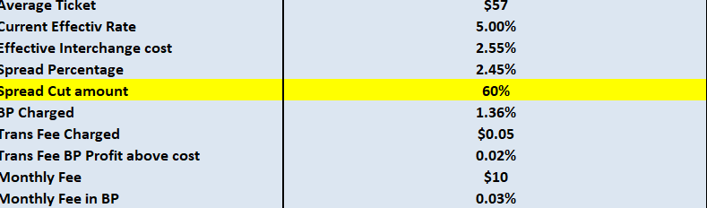
Remove PHP on aadmin page and others
Need to be able to edit

Slide 2
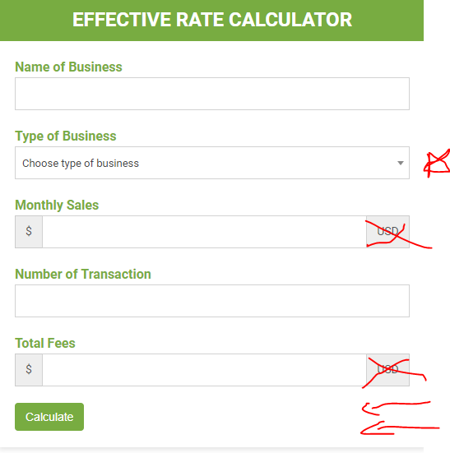



https://www.360payments.com/360partnercalculator/
Remove the “USD”
Under total fees ask “Who is your current credit card processor?”
Under type of business remove the numbers before the name
? Add a question Mark that has a pop out that says
Please check your credit card processing statements for the “total fees” or the amount deducted”.
Who is your current credit card processor?

Slide 3
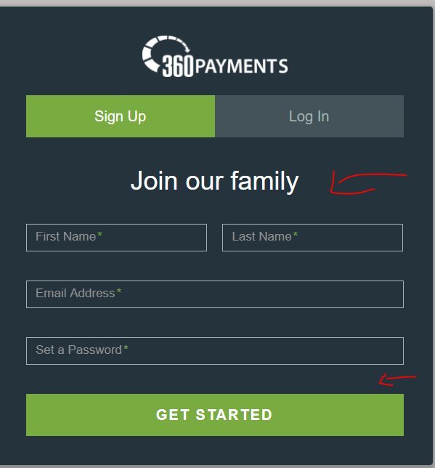
Change “Join our family” to “Get Your Free Credit Card Free Quote”
Ask for their phone number
See quote

Slide 4
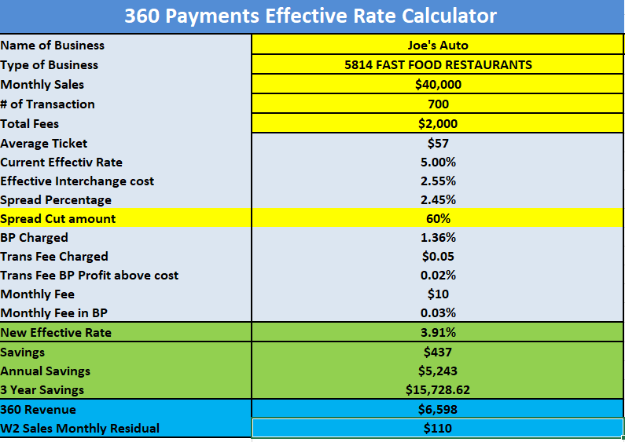
Email tickets@360-payments.com
Also need user full name and pw.
Phone number and email

Slide 5
Current Rate 360 Rate
Saving you $140/month
$15,000 over three years
Start Now
Need info
About 360 Payments

Slide 6
Takes him to applicaion no login

Slide 7
Current Rate 360 Rate
Saving you $140/month
$15,000 over three years
Start Now
Need info
About 360 Payments

Slide 8
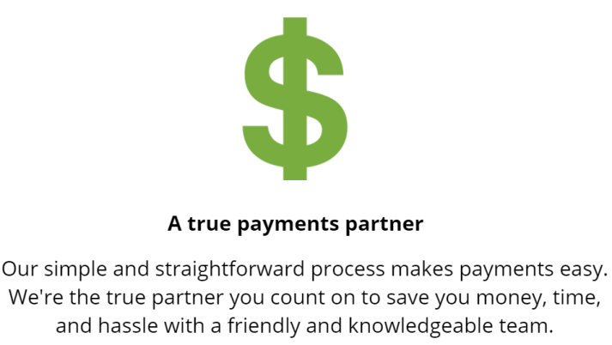



No problem! Someone from our team will call you shortly.
Don’t want to wait? Call us now at 408-295-8360

Slide 9
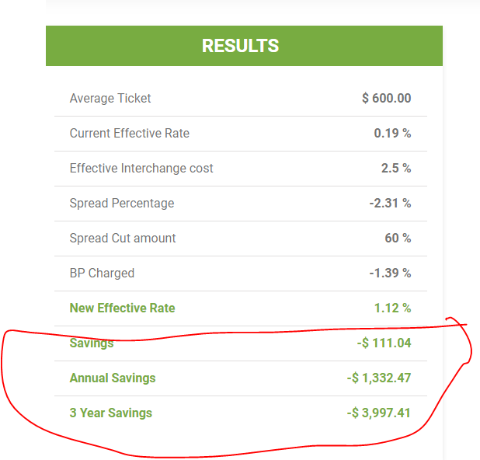
If the amount is negative on the formula
On 360 letter head designed by Katie!
We are looking forward to working with you. We have a couple more questions to provide you the most update quote. 408-295-8360
Also should send the user an email
Also send an email to the rep that we setup on the backend.

Slide 10
Change “Join our family” to “Get Your Free Credit Card Free Quote”
Ask for their phone number
Rep needs to be able login

Slide 11
https://www.360payments.com/repcalculator /
Remove the “USD”
Under total fees ask “Who is your current credit card processor?”
Under type of business remove the numbers before the name
Who is your current credit card processor?

Slide 12
Email: sales person and user
Also need user full name and pw.
Phone number and email

Slide 13
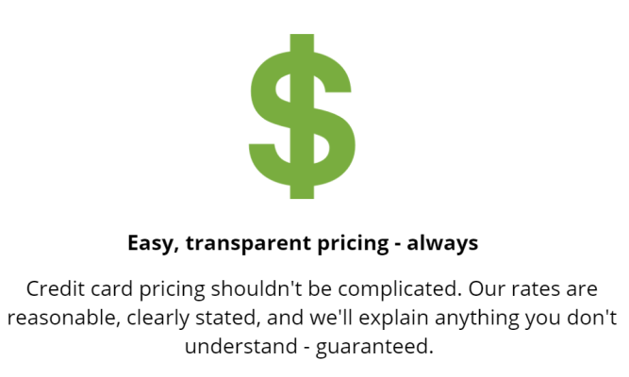



Your Current Rate:
Your New 360 Rate:
$1,200
$300
Saving you $900/month and…
$32,400 over three years
Start Now
Need More Info
Email quote_________________________________________

Slide 14
With Pipe Drive Id pull the data into software

Slide 15
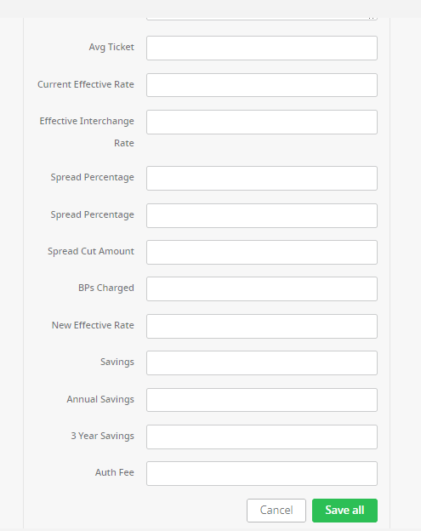
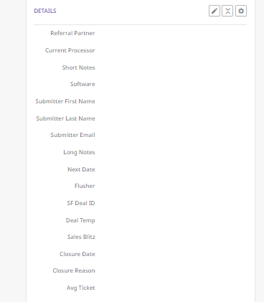
Pipe Drive manual entry

Slide 16
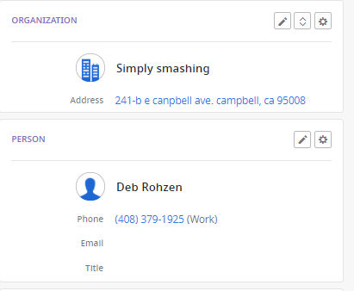
More PipeDrive Map

Slide 17
Questions that we need to add For PDF
Derek needs to send!

